Slide 1
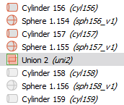
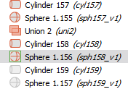
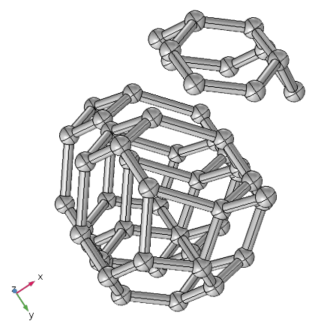
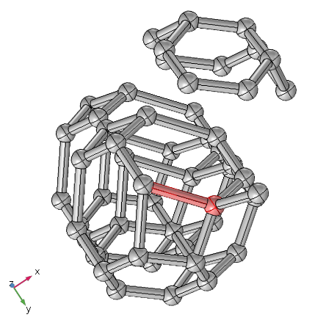
Union of all object before Cylinder 158
Cylinder 158 and Sphere 158 are on the top of already existing objects

Slide 2
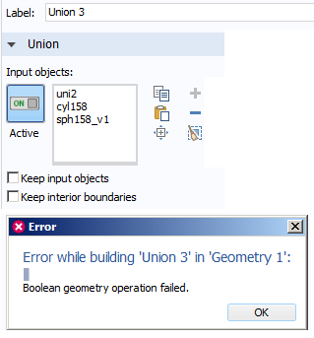
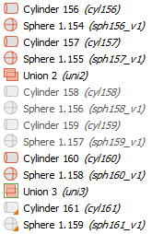
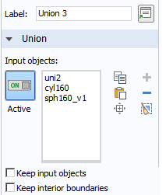
Attempt to Union Cylinder 158 and Sphere 158 with previous geometry fails
Cylinder 159 and Sphere 159 are also on the top of already existing objects
Disable those duplicate objects, then you will be able to create Union:

