Slide 1
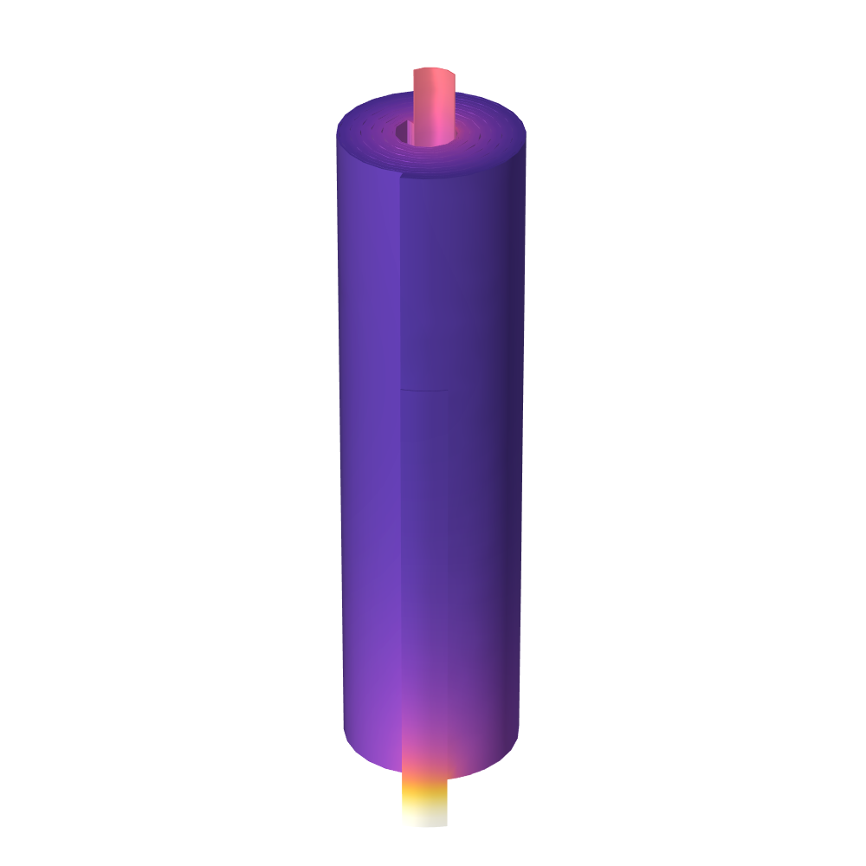
Jelly Roll
Notes:
You can use the heading from the application documentation for the title.

Slide 2
Background
In a cylindrical or prismatic battery cell, the active layers, current collector metal foils and separators are wound into a “jelly roll”
Additional tabs (metal strips) are welded to the current collector foils in order to conduct the current to the exterior of the cell can
The interplay of the various dimensions of the layers and the tabs, in combination with the magnitude of the cell current, governs the temperature and current distribution in the battery cell
This tutorial models the ohmic and activation losses, and the resulting temperature distribution, in a jelly roll for a pseudo-stationary case at a constant cell current

Slide 3
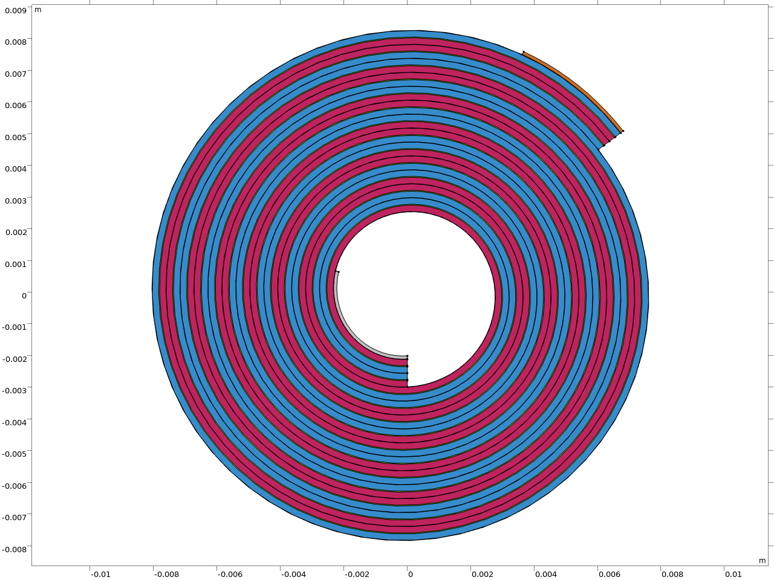
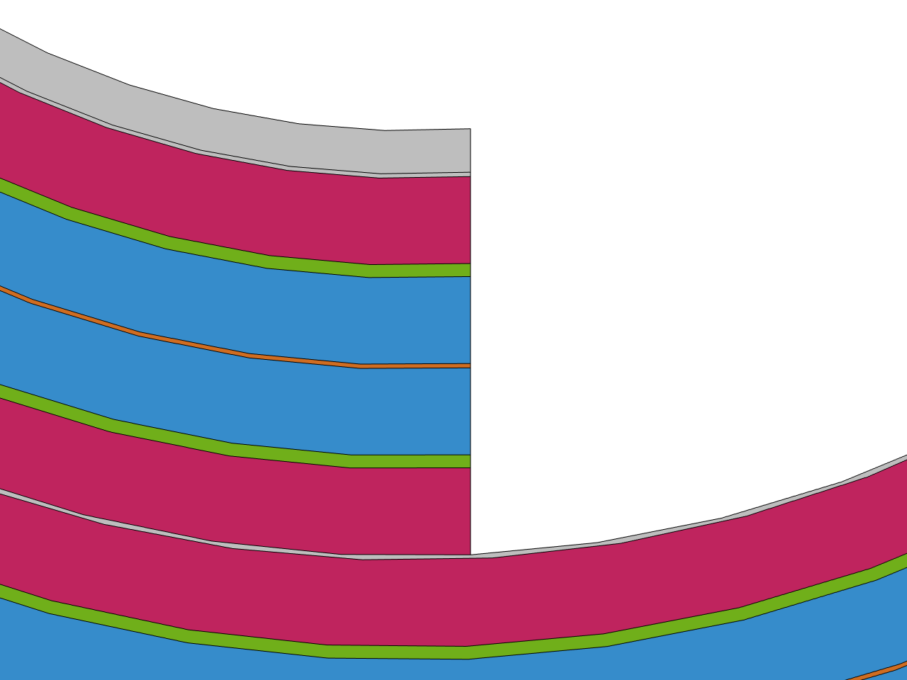
Jelly Roll Configuration
Negative Tab
Positive Tab
Positive Current Collector
Positive Electrode Layer
Separator
Negative Electrode Layer
Positive Tab
Negative Current Collector
Negative Electrode Layer
Separator
Positive Electrode Layer

Slide 4
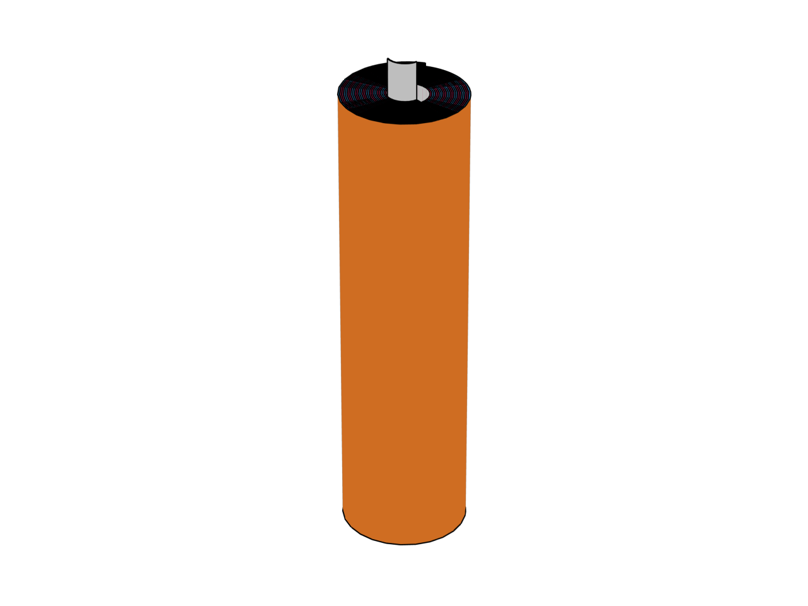
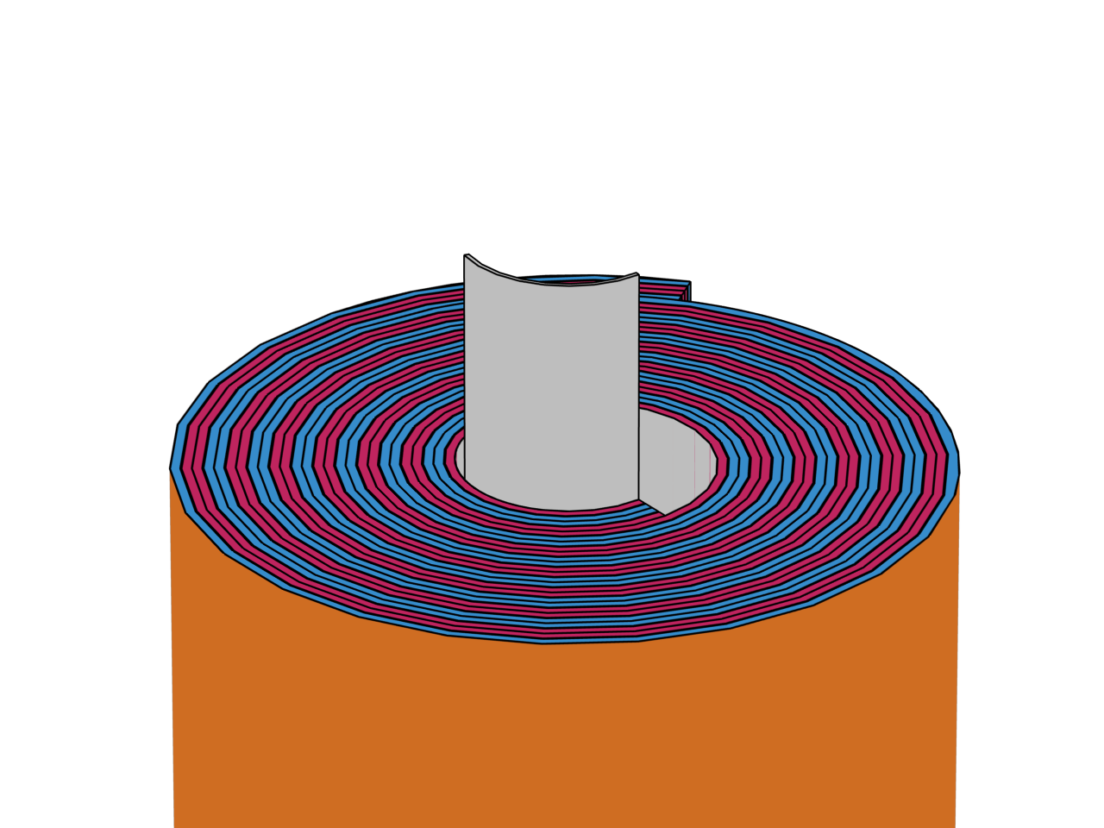
Model Geometry
The model is defined in 3D
The roll is designed to fit a 18650 can
60 mm high
8.5 mm outer spiral radius, including negative tab
2 mm inner radius, including positive tab
Parametric curves, based on archimedal spiral functions are used to define the winding
A constant cell thickness is assumed
The geometry is finalized as an assembly of two parts
Assembly boundaries are placed in the middle of the separators
This allows for sweeping the meshes in the thru-plane direction
Positive Tab

Slide 5
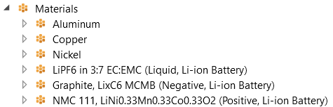
Materials
Positive Tab
Aluminum, 100 μm thick, 4 mm wide
Positive Current Collector
Aluminum, 10 μm thick
Positive Electrode
NMC 111, 200 μm thick
Separator
30 μm thick
Negative Electrode
Graphite, 200 μm thick
Negative Current Collector
Copper, 10 μm thick
Negative Tab
Nickel, 100 μm thick, 4 mm wide
Material nodes in the model builder

Slide 6
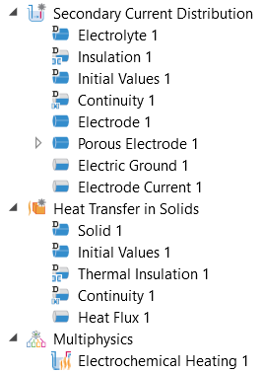
Physics Definition
Secondary Current Distribution
Defines the pseudo-stationary operation point for a constant current
Includes ohmic resistances and activation polarization (no concentration effects included)
Cell current of 3 A applied at the positive terminal
Negative terminal is grounded
Heat Transfer in Solids
Convective heat flux condition on the outer jelly roll boundary facing the can
Electrochemical Heating
Heat sources added due to ohmic resistances (Joule heating) and activation overpotentials
Physics setup in the model builder

Slide 7
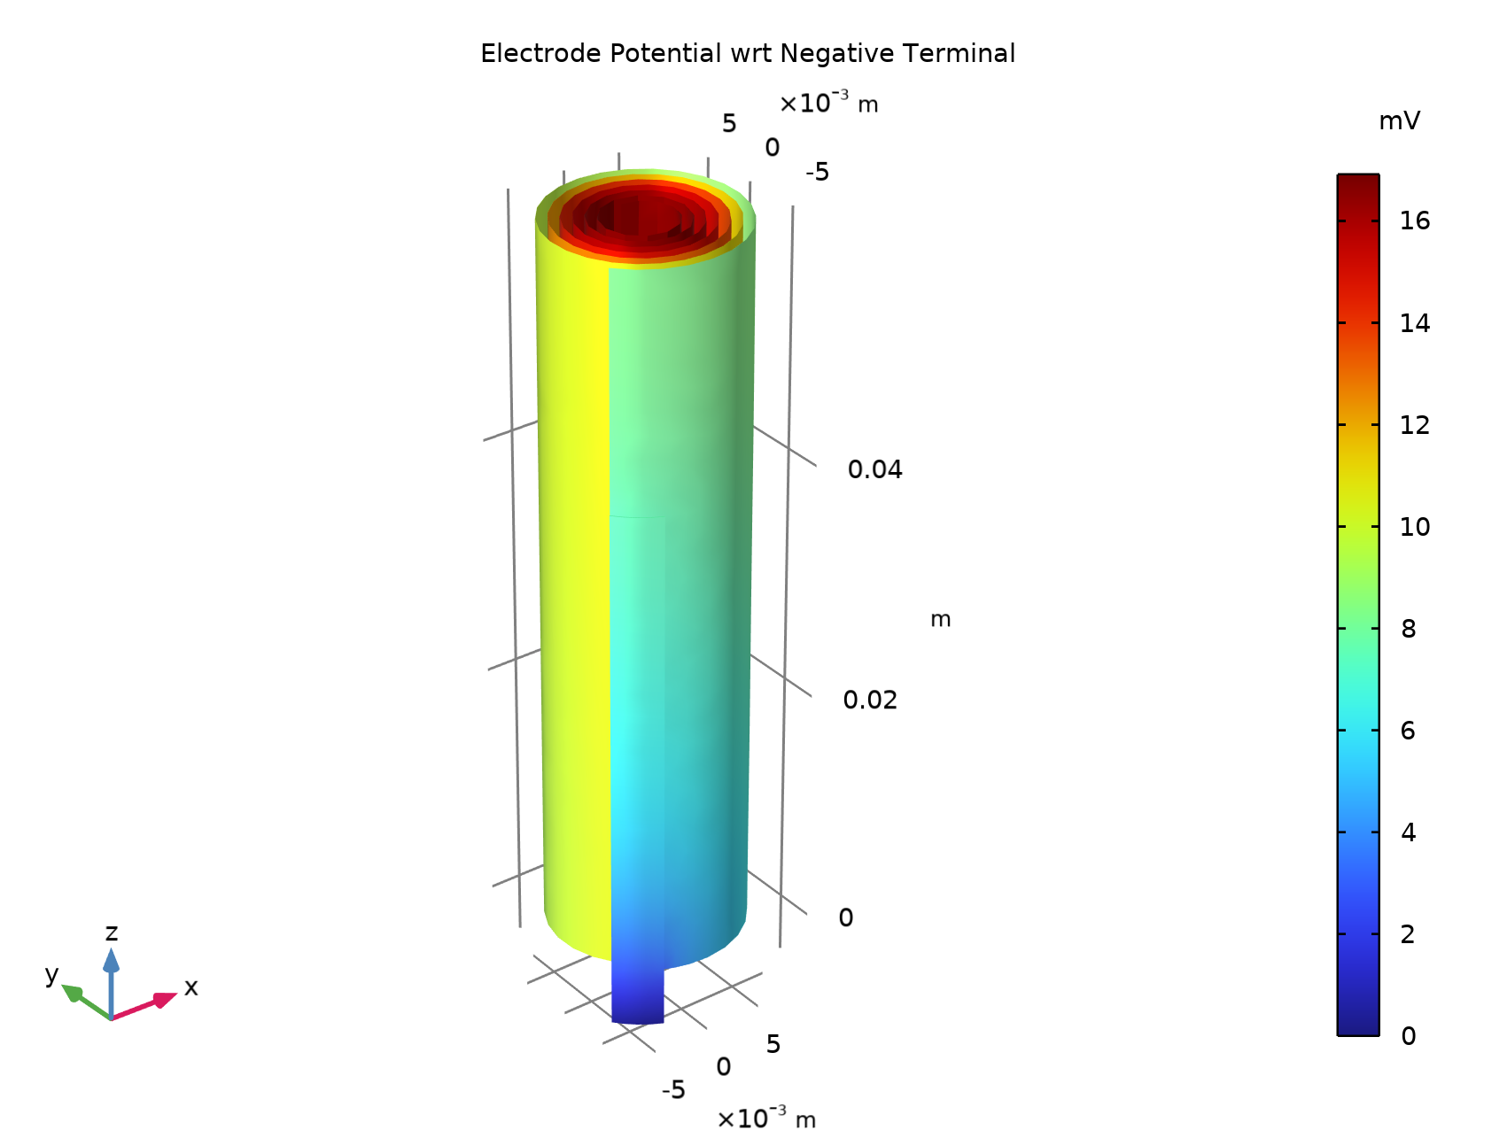
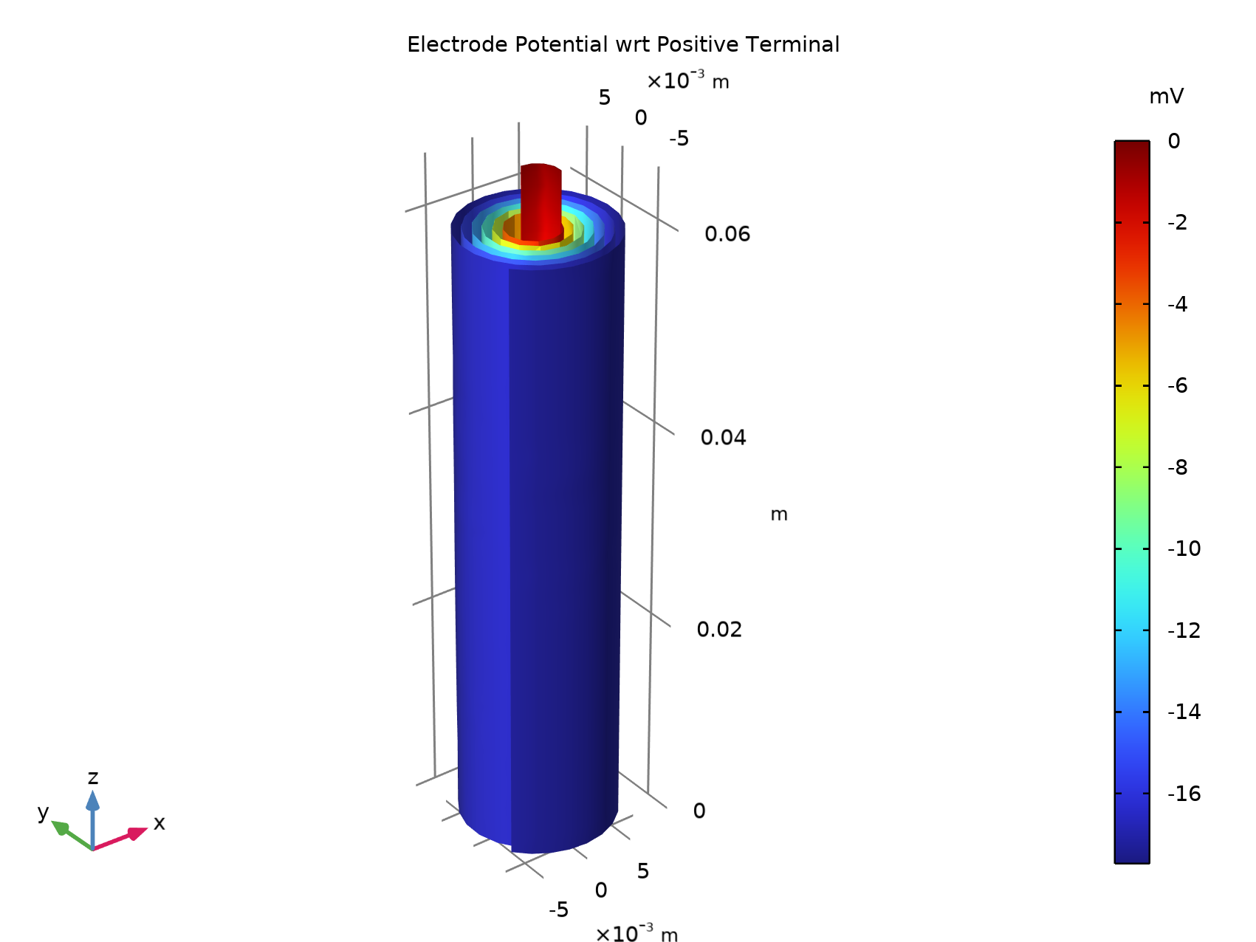
Electrode Phase Polarization
Negative Side
Positive Side

Slide 8
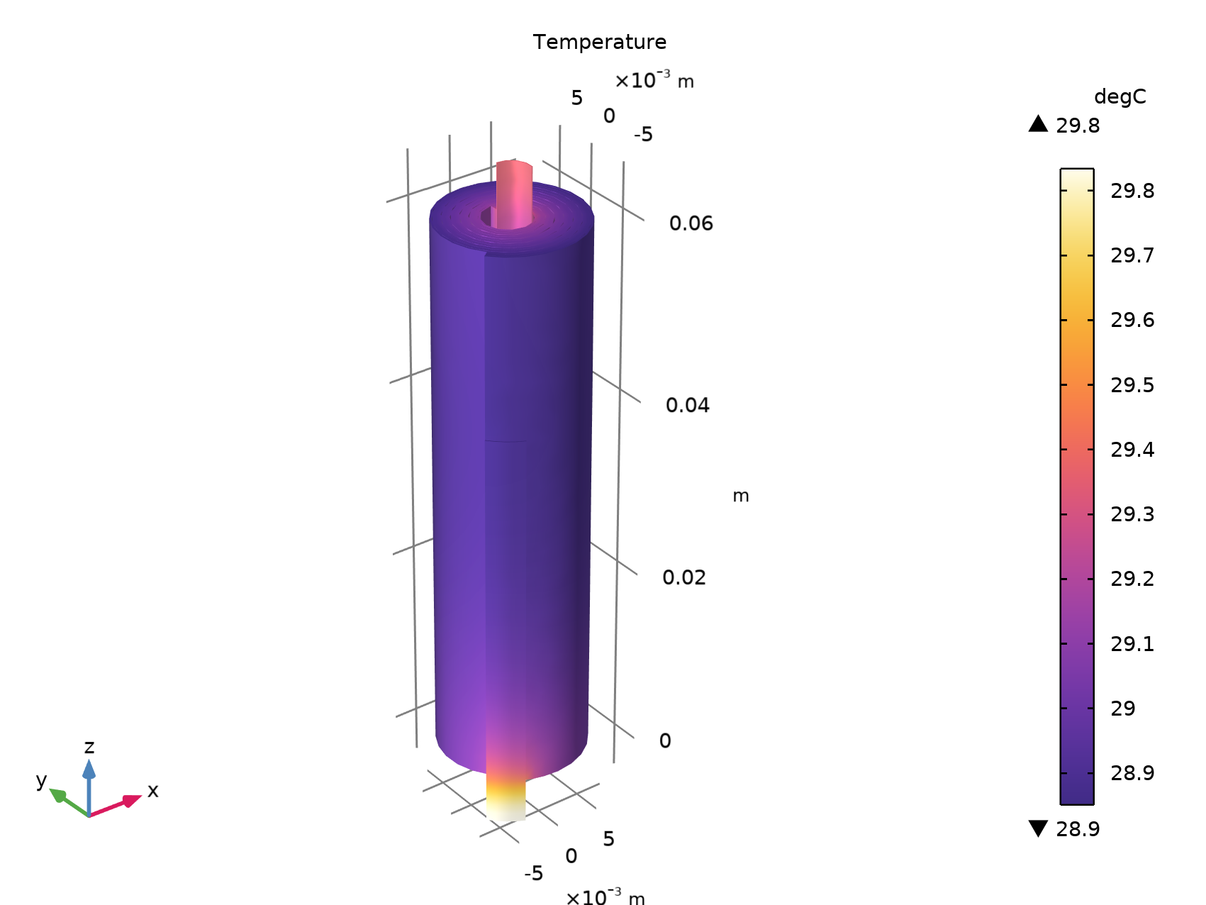
Temperature

