Slide 1
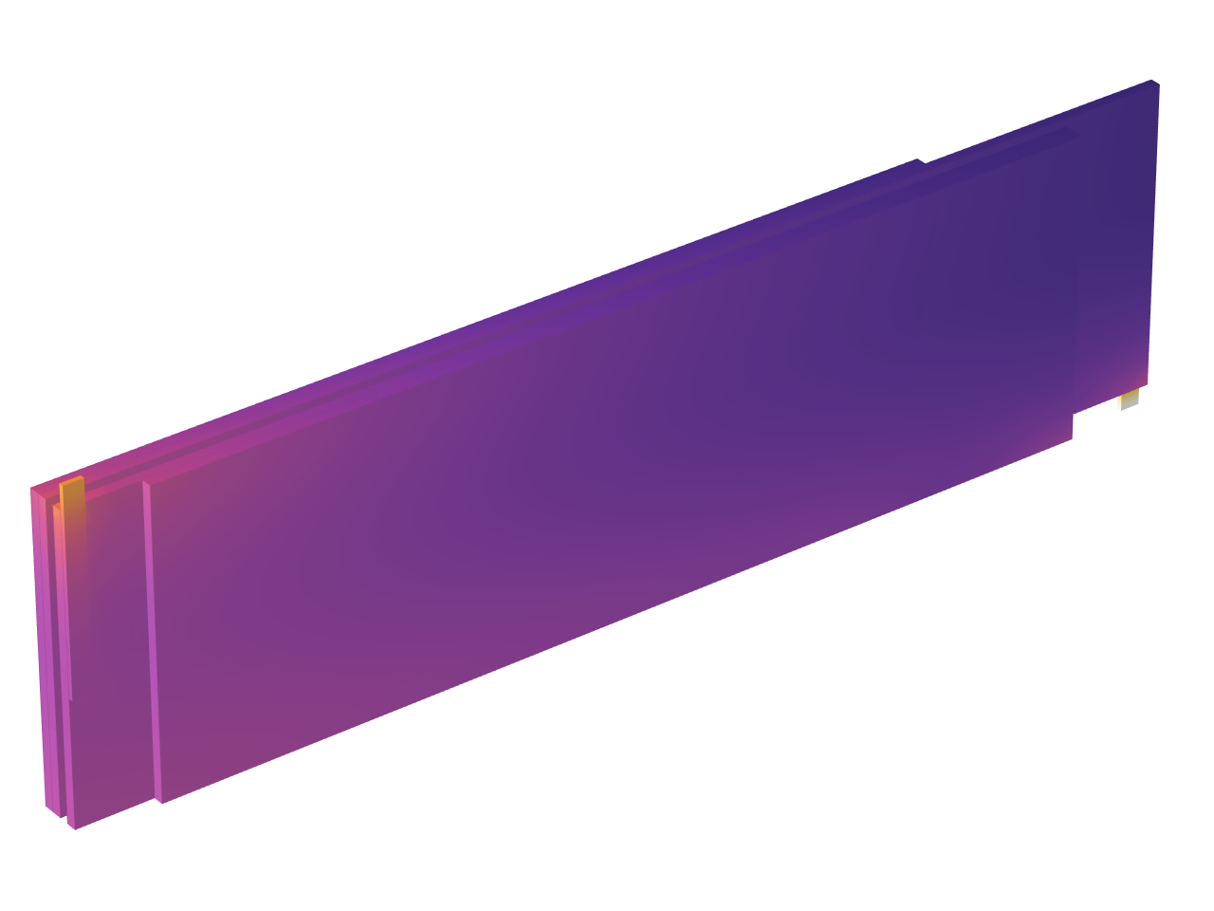
Jelly Roll Using a Flattened Geometry
Notes:
You can use the heading from the application documentation for the title.

Slide 2
Background
This example replicates the results of the Jelly Roll tutorial example using a flattened representation of the wound spiral-based geometry
  See the above model for details on the background, original geometry, materials, and the general physics setup
Mapping the original problem to a flattened 3d geometry, with flat surfaces, brings several advantages
  The curvature of the wound layers does not need to be resolved in the mesh. That is: the flattened geometry allows for a coarser mesh which results in a smaller problem size
  Results visualization along the spiral direction becomes simplified
  Introducing multiple tabs in the geometry sequence becomes easier
Transport equations on the flattened geometry neglect the effect of the local curvature of the layers
  This effect will however be shown to have a very limited impact on the results

Slide 3
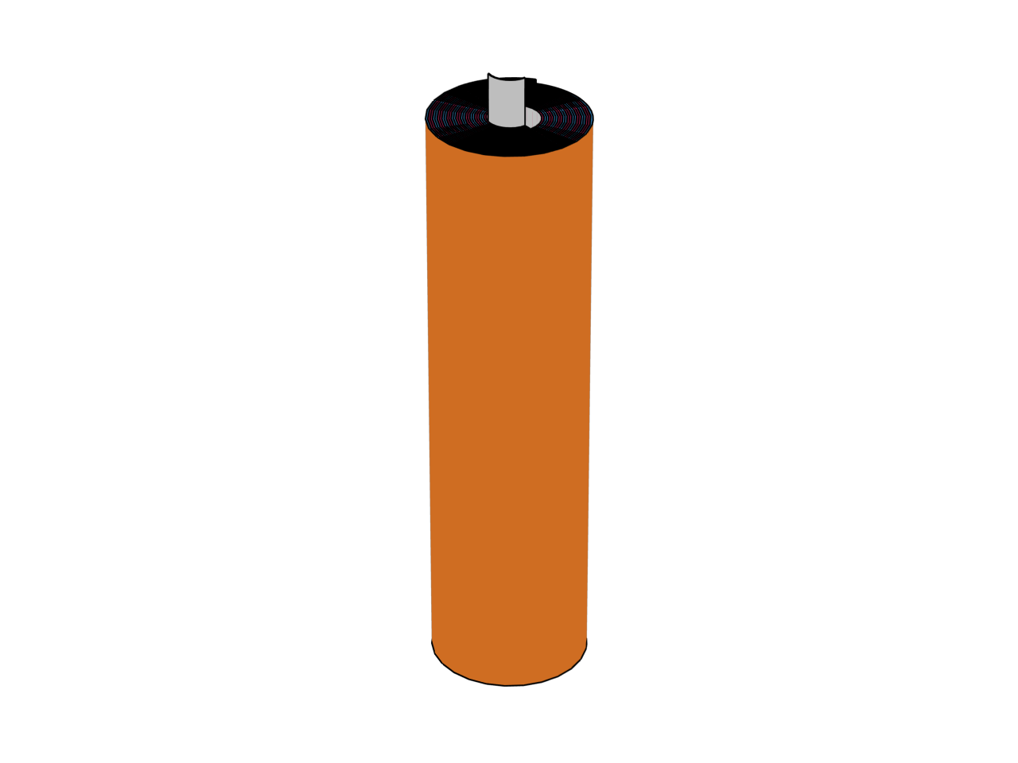
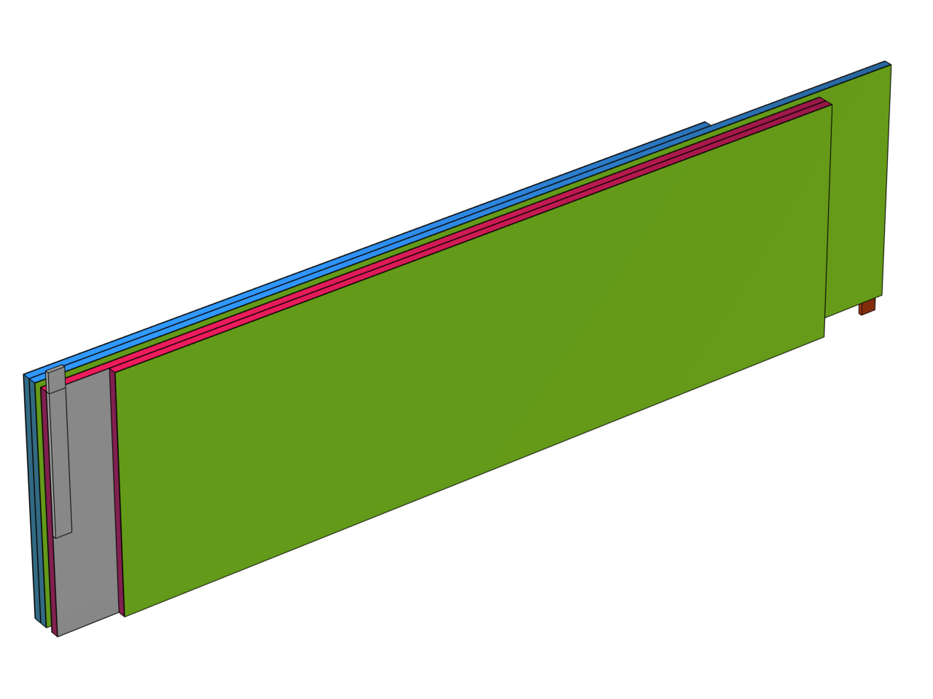
Model Geometry
Original Geometry
Flattened Model Geometry
Positive
Tab
Outer boundary
facing cell can
Positive
Tab
Negative
Tab
Spiral winding direction
Inner boundary
facing center of spiral

Slide 4
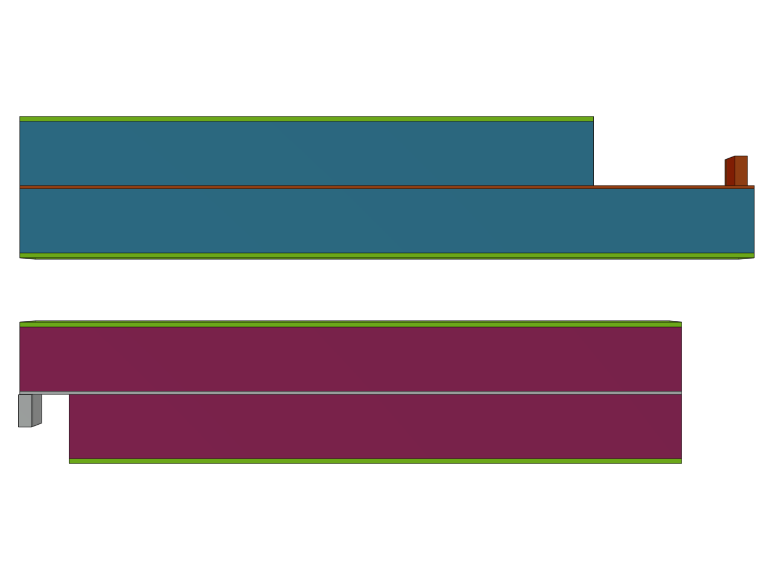
Layers
Positive Part
As a result of the spiral winding in the original geometry, the positive and negative current collectors differ in length
The geometry is split into two parts, based on different the lengths of the current collectors
  A virtual offset is added between the two parts
  The separators are split in half and divided between the two parts
Tab
Electrode Layer
Current Collector
Electrode Layer
Electrode Layer
Current Collector
Electrode Layer
Tab
Negative Part
Model geometry, seen from above. Scaled 100 times in the thru-plane direction.

Slide 5
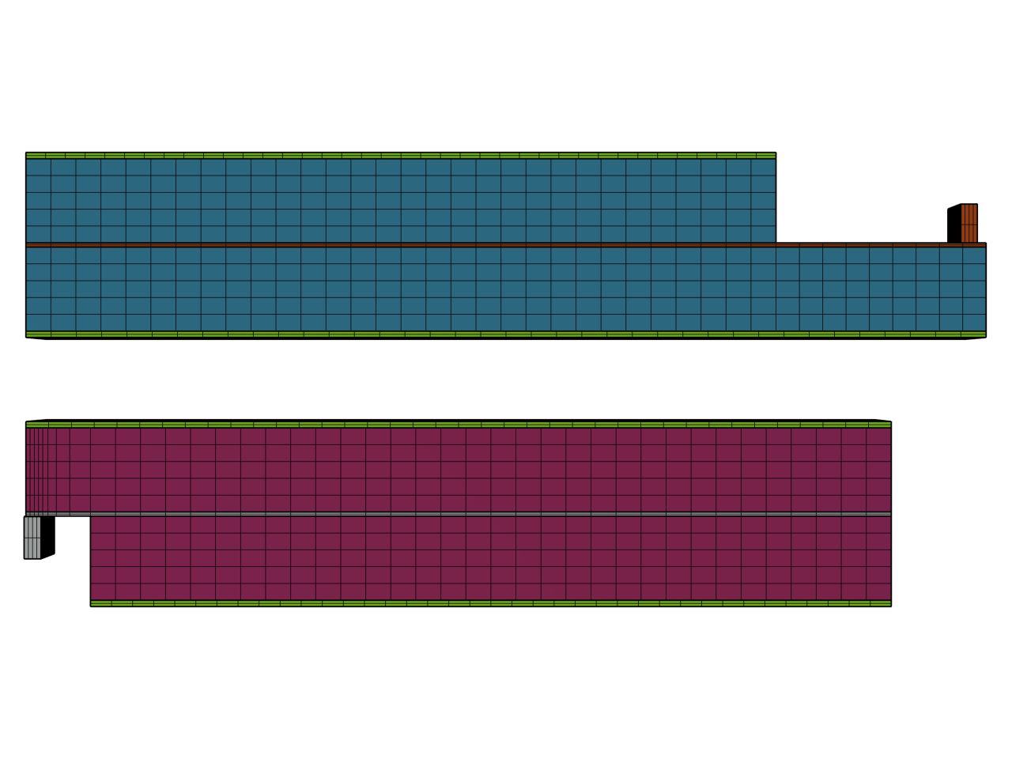
Meshing
The geometry is finalized as an assembly, with pair boundaries located between the separators and the electrodes
This allows for sweeping the mesh in the thru-plane direction, with non-matching meshes at the separator-electrode pair boundaries
Meshed model geometry, seen from above. Scaled 100 times in the thru-plane direction.

Slide 6
Coupling Between the Positive and Negative Parts
Potential and Temperature conditions and Linear Extrusion operators are defined at the shared separator boundaries between the two parts
The resulting coupling prescribes continuity in
  Temperature/Potential
  Total Heat Flux/Current
Note: Local Heat flux/Current density will be discontinuous due to the different lengths of the two parts
Equidistributed mapped surface meshes with an equal amount of elements (node points) are used at the coupling/extrusion separator boundaries in order to avoid spurious oscillations in the numerical solution
The arrows indicate the source/destination mapping of the linear extrusion operators.

Slide 7
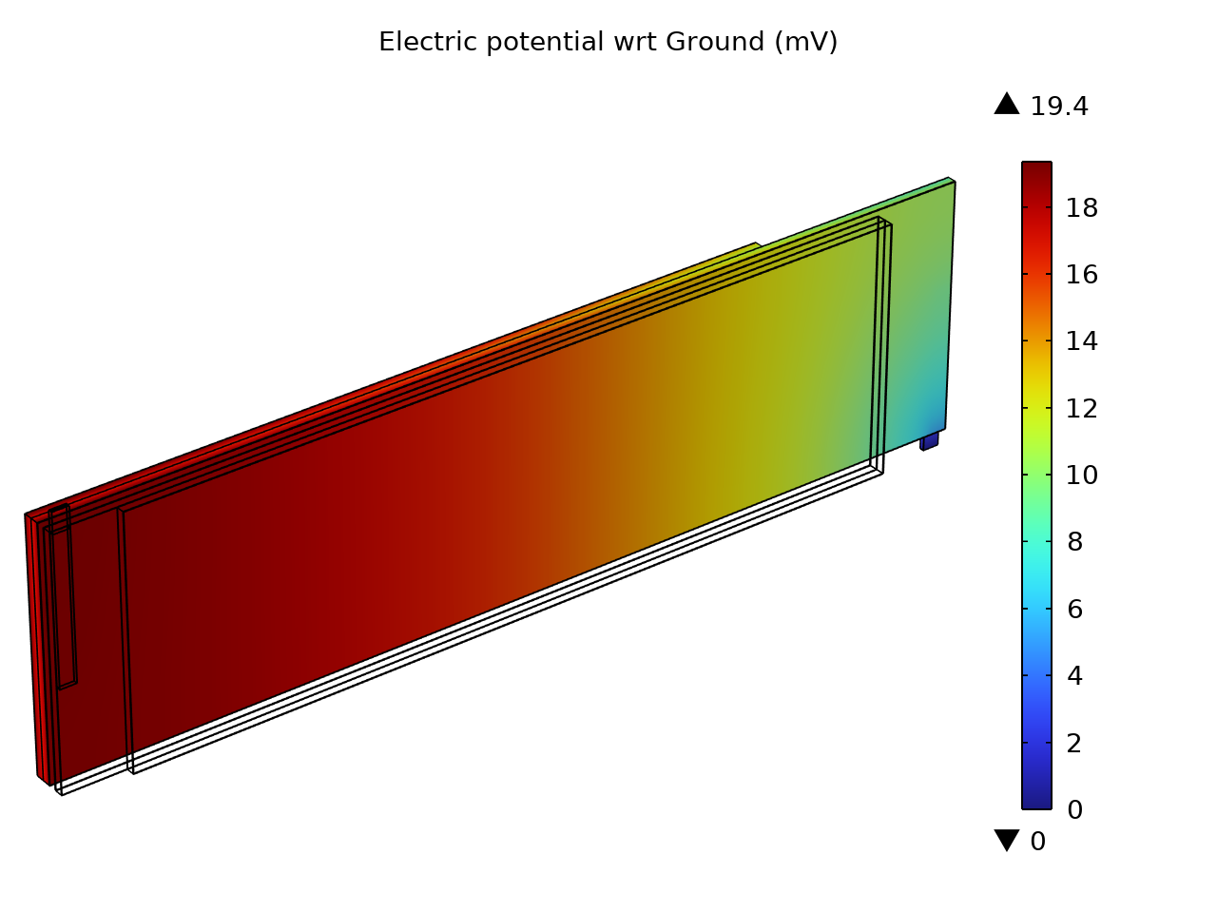
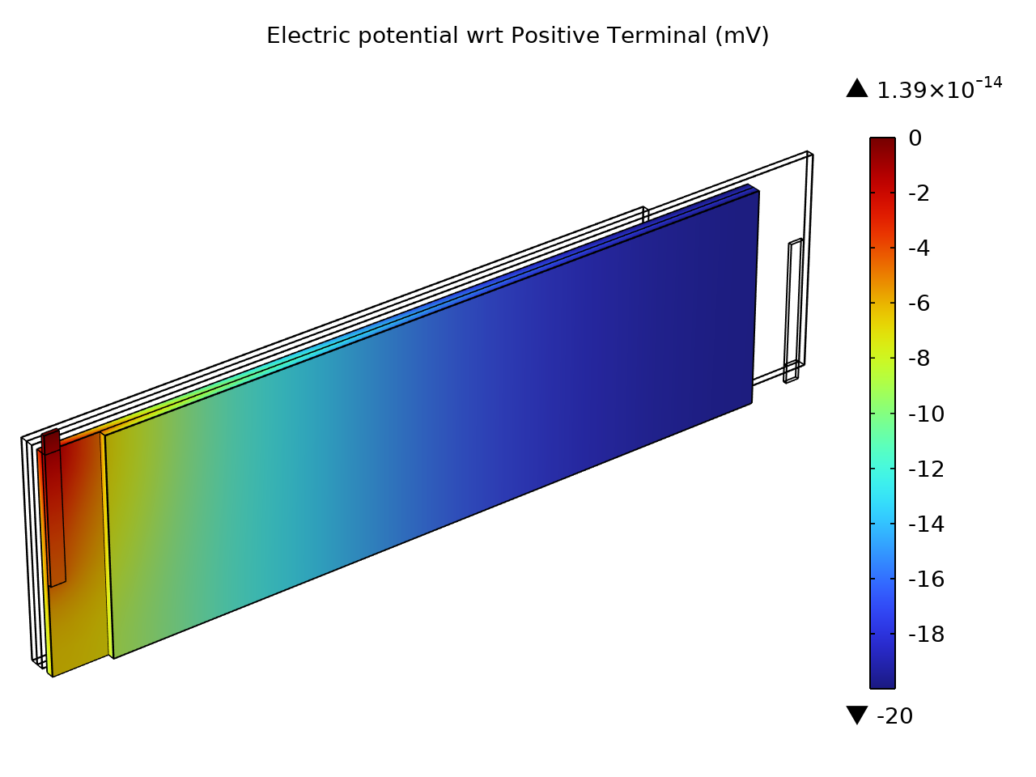
Electrode Phase Polarization
Negative Side
Positive Side

Slide 8
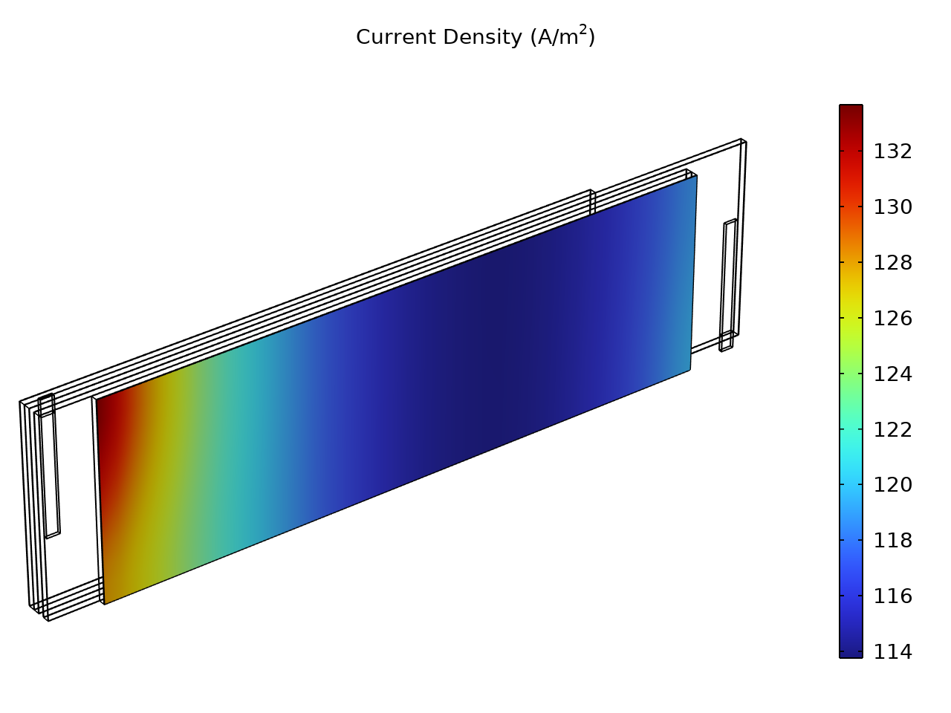
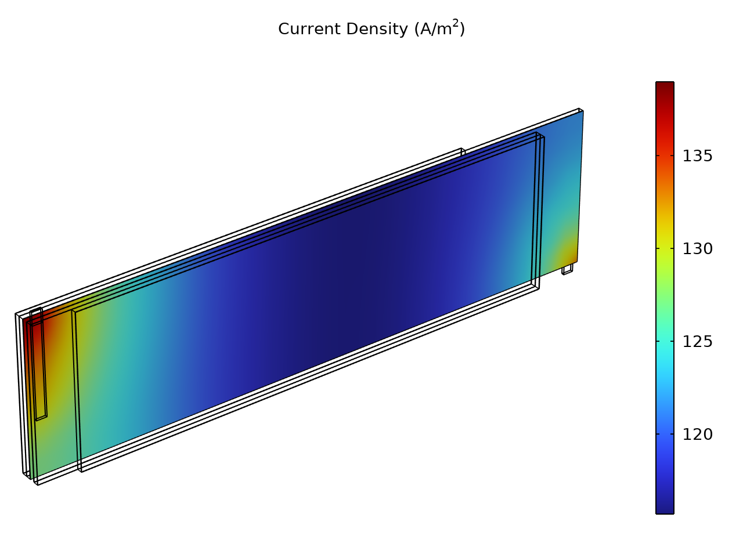
Thru-Plane Current Densities
Separator 1
Separator 2

Slide 9
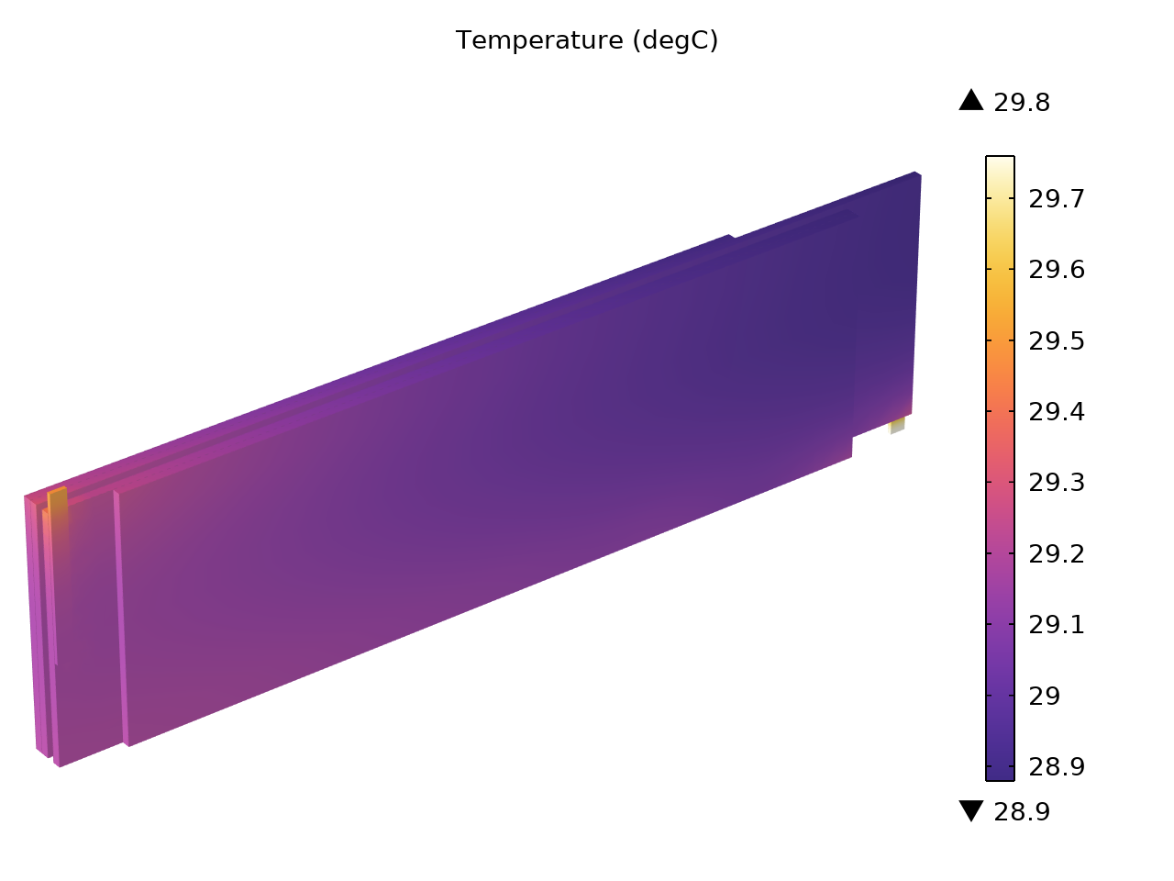
Temperature

Slide 10
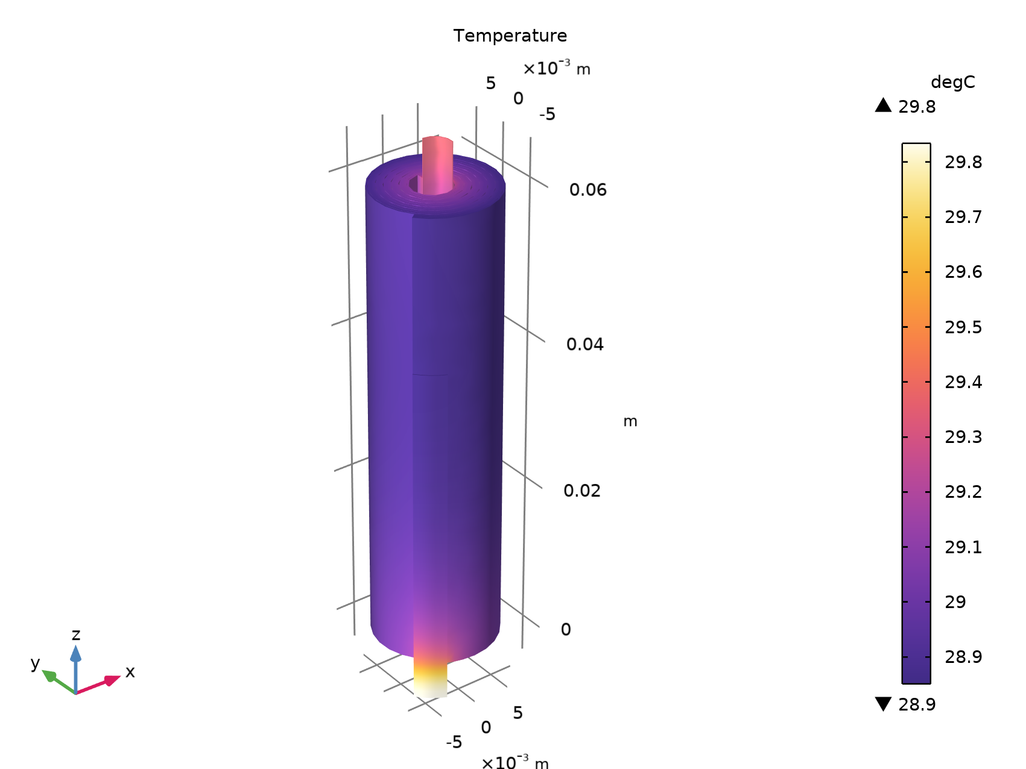
Comparison with Original Geometry

