Slide 1
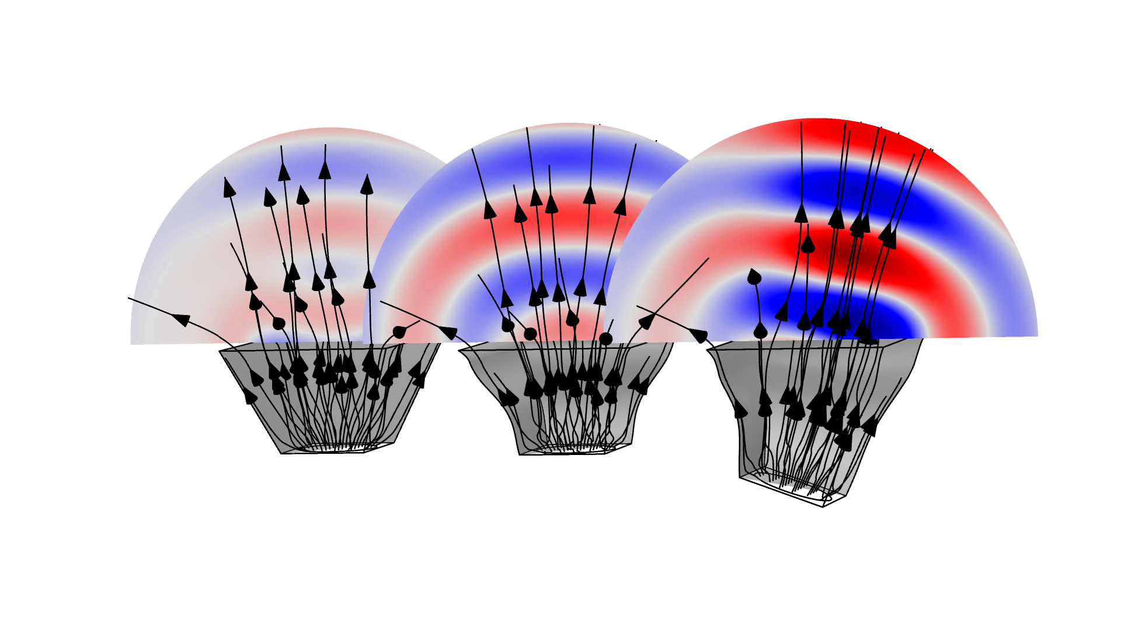
Shape Optimization of a Rectangular Loudspeaker Horn in 3D

Slide 2
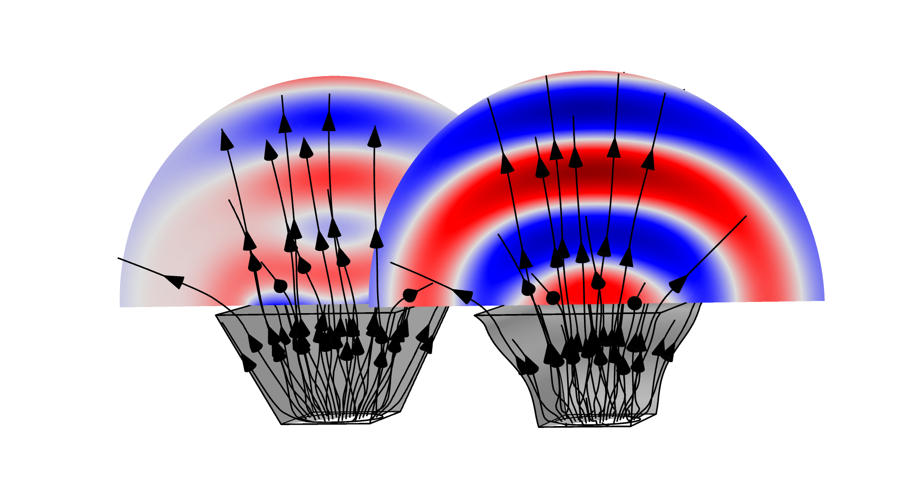
3D Speaker Shape Optimization – On Axis
On Axis Optimization Setup
Define a Control Function based on a Bernstein polynomial, cfunc1().
Use the function with an argument depending on the z-coordinate such that horn symmetry and rectangular cross sections is preserved.
Use a Electrical Circuit to limit the input power.
Use the built-in far field variable to maximize the on-axis pressure.
Use a Filter dataset to transfer the optimized shape to a Mesh part for import in a new component.
Shape Optimization of a Rectangular Loudspeaker Horn in 3D

Slide 3
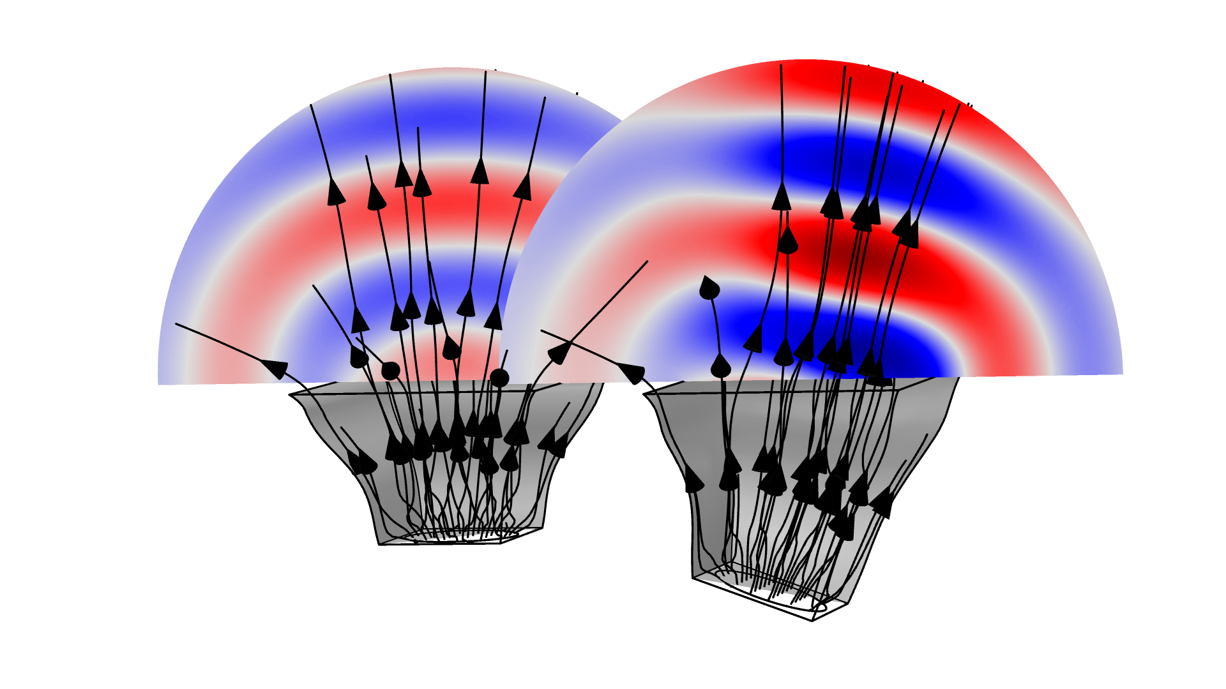
3D Speaker Shape Optimization – Off Axis
Off Axis Optimization Setup
Use Free Shape Domain, Free Shape Boundary, and Transformation shape optimization features to allow the rotation and translation of the speaker, while also varying the speaker shape.
Copy past the physics and objective from the 1st component to the new component.
Use a segregated solver
Shape Optimization of a Rectangular Loudspeaker Horn in 3D

Slide 4
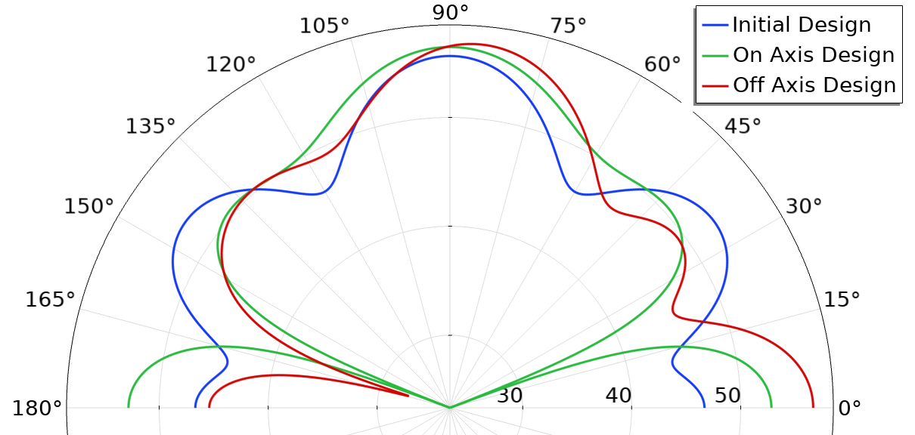
3D Speaker Shape Optimization – Radiation Pattern
Shape Optimization of a Rectangular Loudspeaker Horn in 3D

