Slide 1
General Parameter Estimation

Slide 2
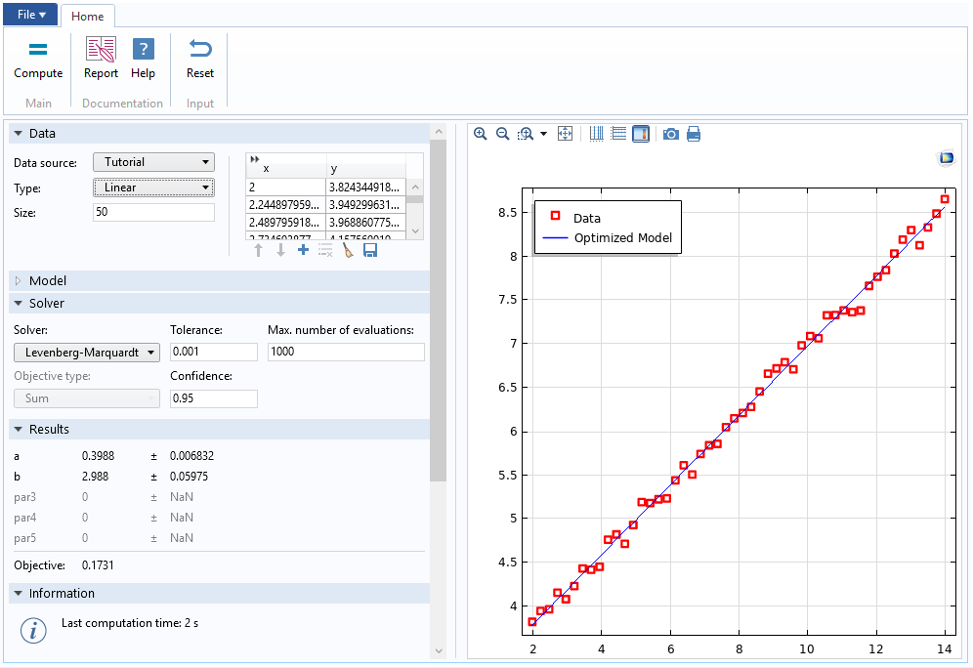
Linear Data and Model
App supports
Import of data from file
Generation of tutorial data (with noise)
Levenberg-Marquardt solver provides
Fast convergence
Confidence intervals
General Parameter Estimation

Slide 3
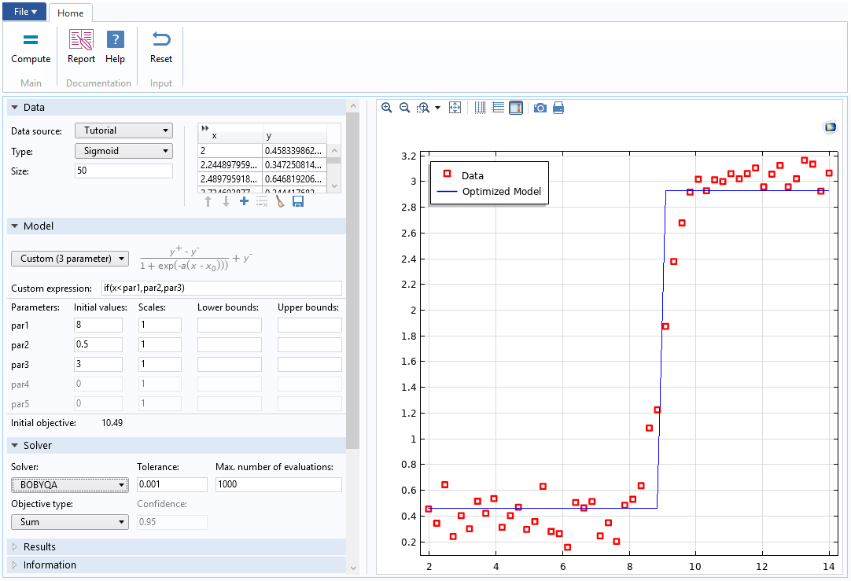
Sigmoid Data and Custom Model
App supports
Custom models
Lower and upper parameter bounds
(except for Levenberg-Marquardt solver)
BOBYQA solver provides
Optimization of non-differentiable models
Support for minimization of maximum square
(instead of sum)
General Parameter Estimation

