Slide 1
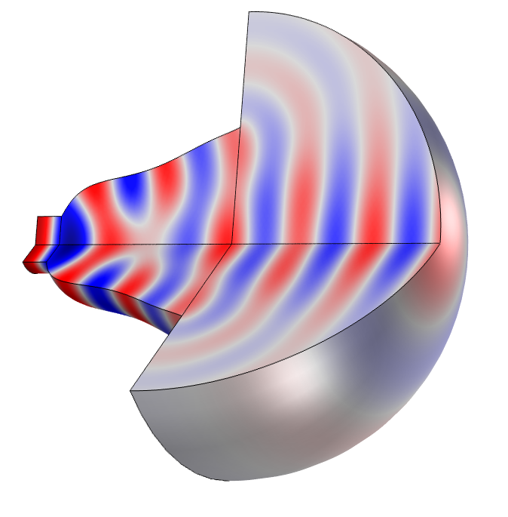
Optimizing the Shape of a Horn

Slide 2
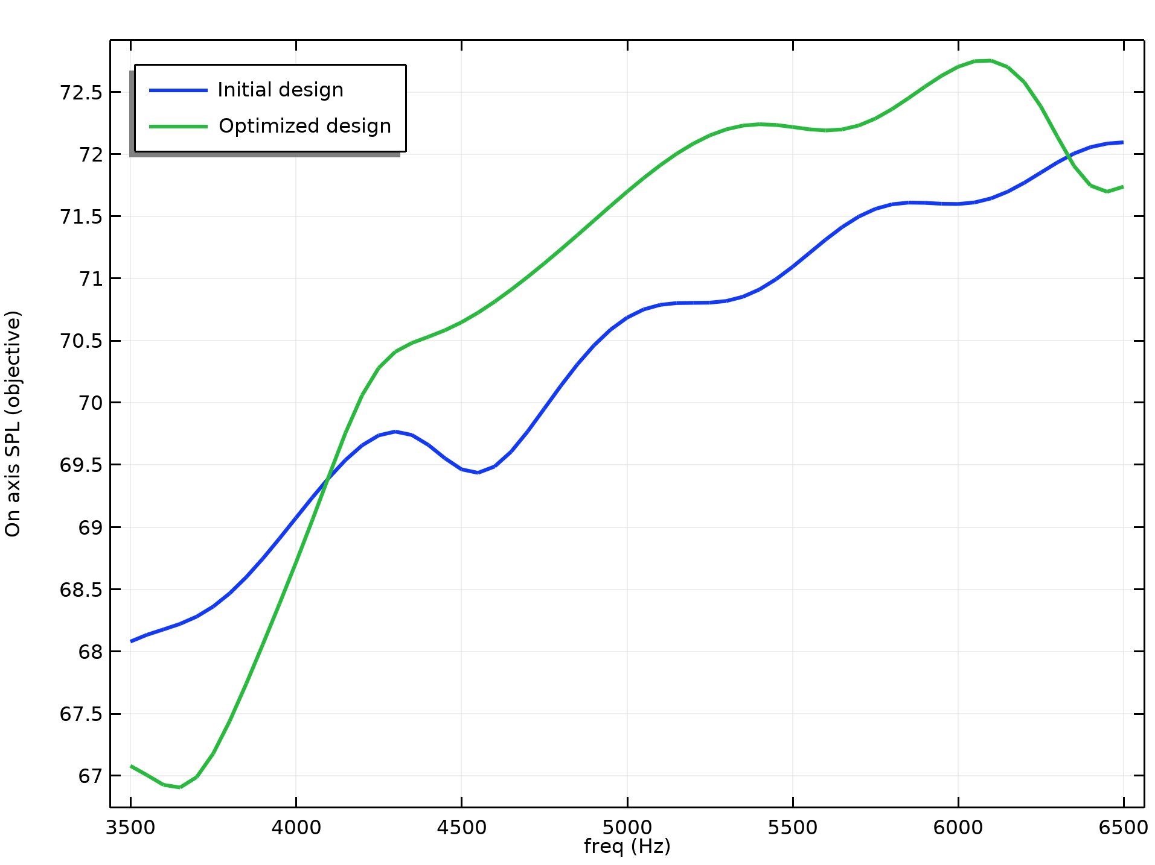
Optimizing the Shape of a Horn
Introduction
The shape optimization features in COMSOL can used in 2D, 2Daxi and 3D.
This model considers the shape optimization of a acoustic horn.
The objective is to maximize the far field pressure in narrow a frequency band.
Three frequencies are considered, 5 kHz ± 50 Hz.
The MMA optimization solver is setup to maximize the minimum of the three.
The optimization results in an improvement of 1 for the on axis SPL.
Optimizing the Shape of a Horn

