Slide 1
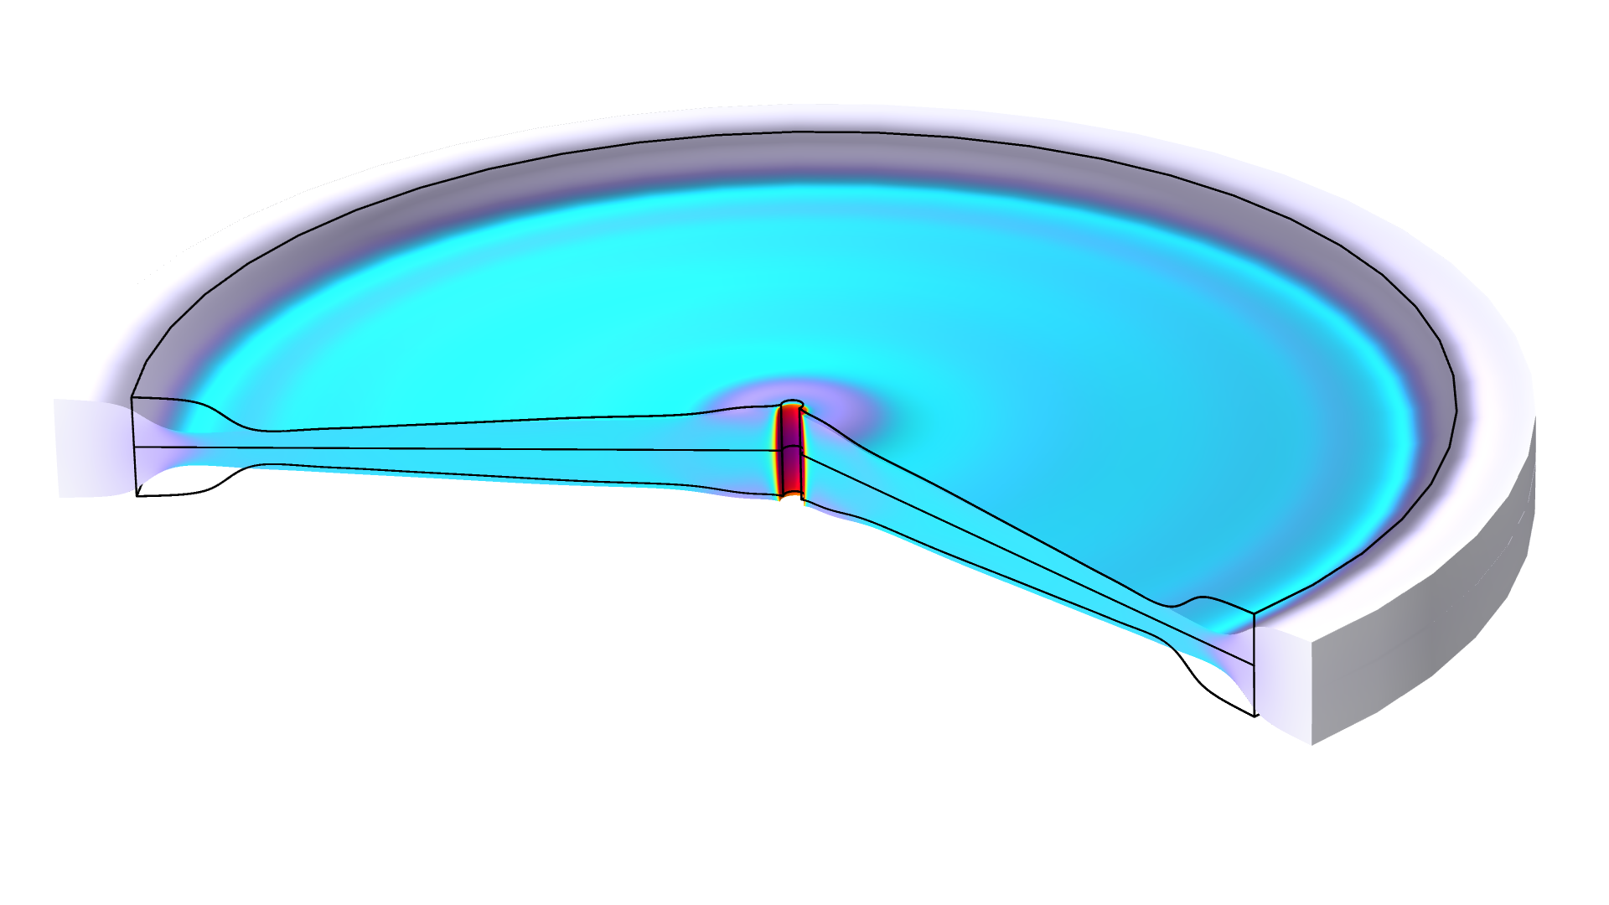
Optimizing a
Flywheel Profile

Slide 2
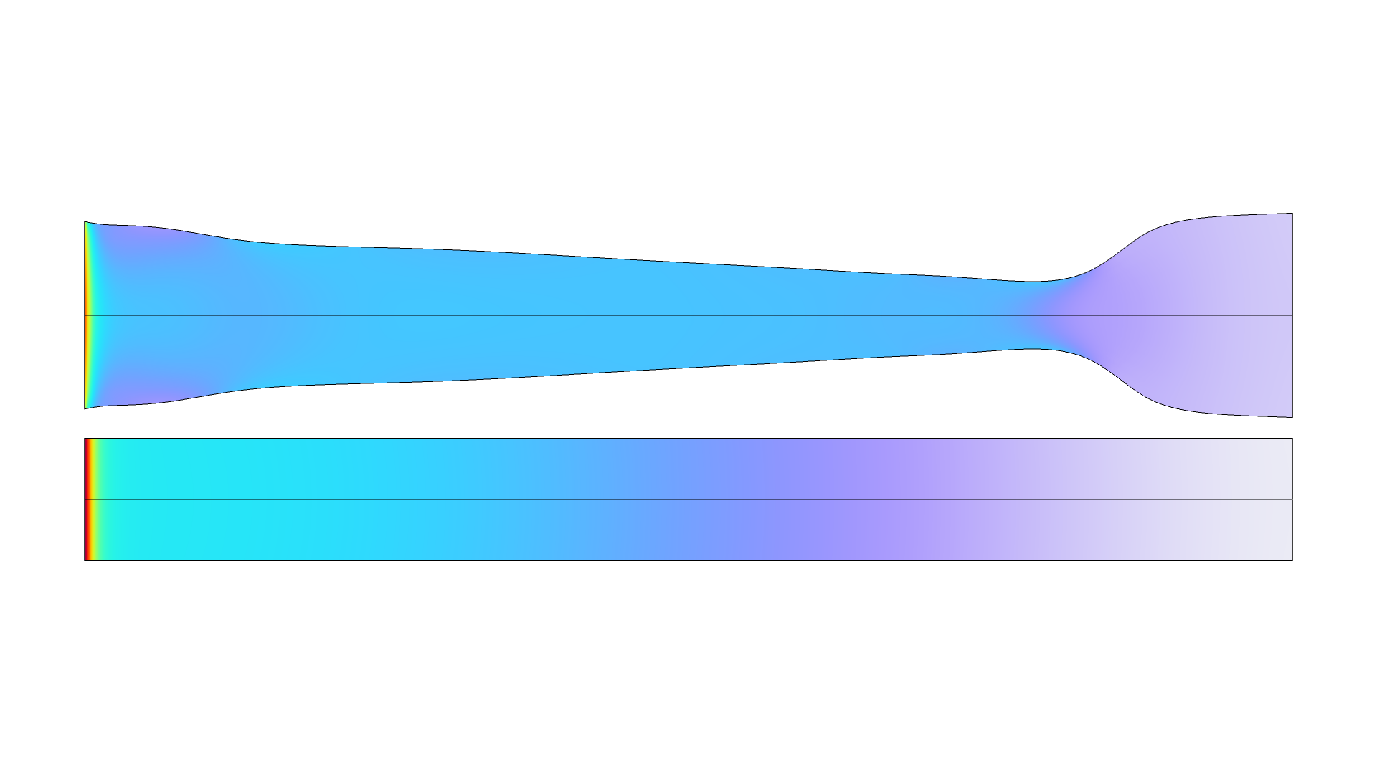
Optimizing a Flywheel Profile
Introduction
The shape optimization features in COMSOL can be used in 2D, 2Daxi and 3D components.
This model considers the shape optimization of a flywheel.
The objective is to maximize the moment of inertia.
The mass and maximum von Mises stress is constrained.
  The maximum von Mises stress is approximated
  with a p-norm (p=10)
The moment of inertia is increased by 9 %, while the maximum von Mises stress is reduced by 36 %. The mass is the same.
Optimizing a Flywheel Profile

