Slide 1
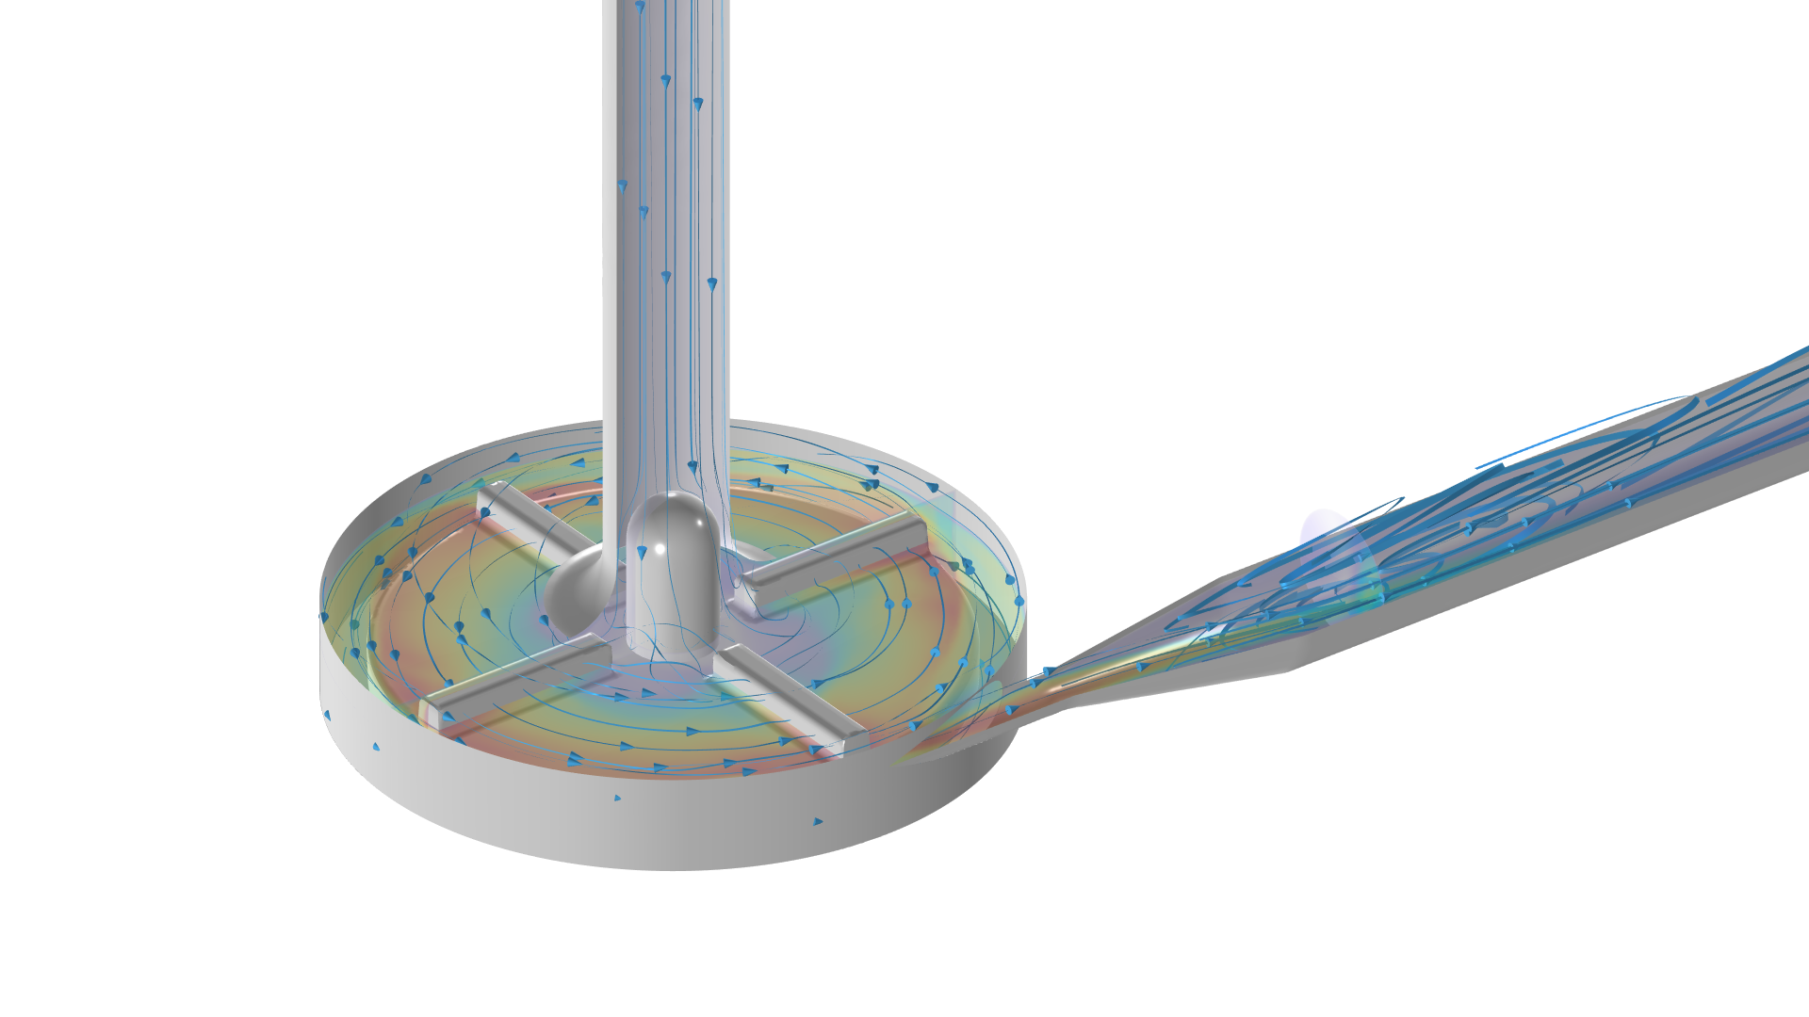
Centrifugal Blood Pump
Notes:
You can use the heading from the application documentation for the title.

Slide 2
Background
Fluid-structure interaction is a vital aspect in a variety of medical devices. Centrifugal blood pump is one such device which involves a rotating impeller to pump blood.
Centrifugal pumps have been found to lead to less trauma to red blood cells and lower systemic inflammatory response when compared with roller pumps¹. One of the important indicators of this is shear stress and numerical modeling can provide these values in the flow at all locations, which are hard to obtain through experiments.
So, effectively modeling such medical devices will aid in the process of improving their design, testing new device concepts, and understanding the behavior of existing designs in various operating conditions.
The geometry used in this model is taken from FDA’s Computational Round Robin #2.² FDA devised a model centrifugal blood pump and asked the CFD community to run a set of simulations under given flow rates and pump speeds. Experimental validations of flow in the pump were also performed for comparison.

Slide 3
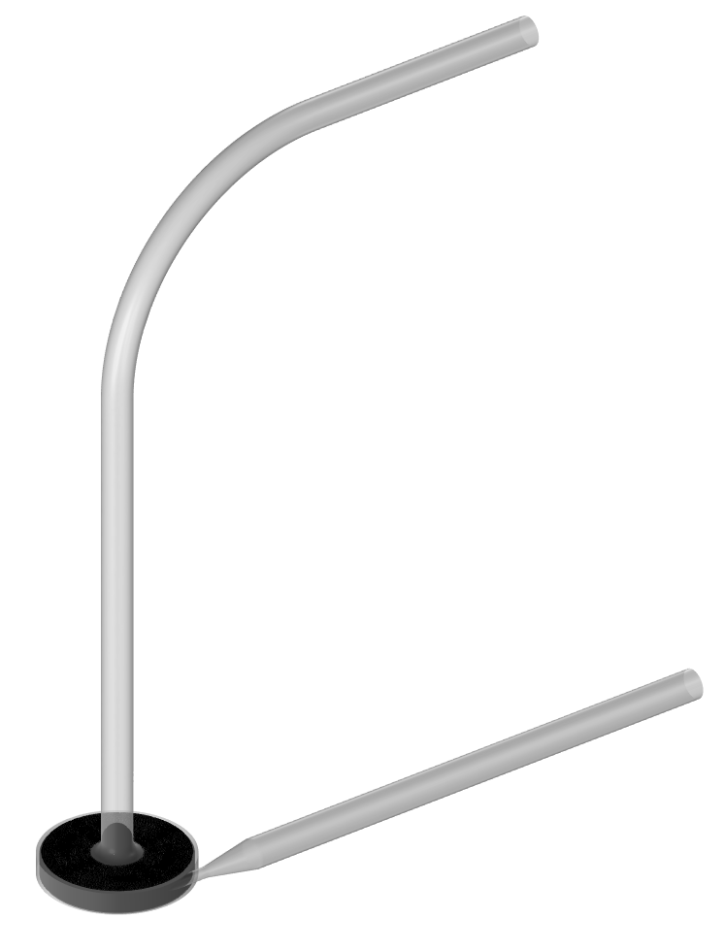
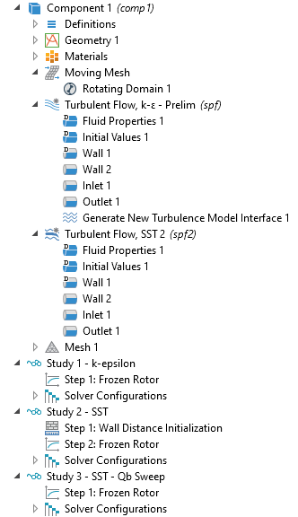
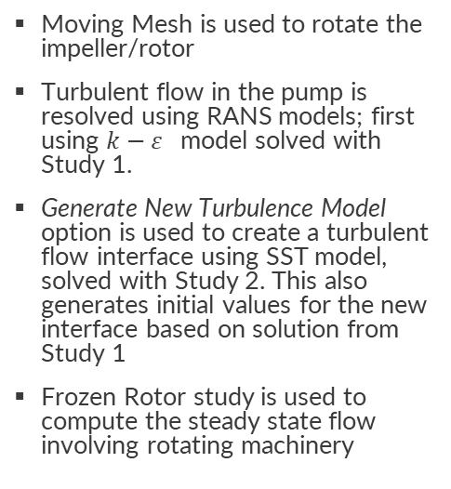
Model Definition & Implementation
Blood Inlet
Moving Mesh is used to rotate the impeller/rotor
Turbulent flow in the pump is resolved using RANS models; first using $k−ε$ model solved with Study 1.
Generate New Turbulence Model option is used to create a turbulent flow interface using SST model, solved with Study 2. This also generates initial values for the new interface based on solution from Study 1
Frozen Rotor study is used to compute the steady state flow involving rotating machinery
Blood Outlet
Moving mesh
for domain deformation

Slide 4
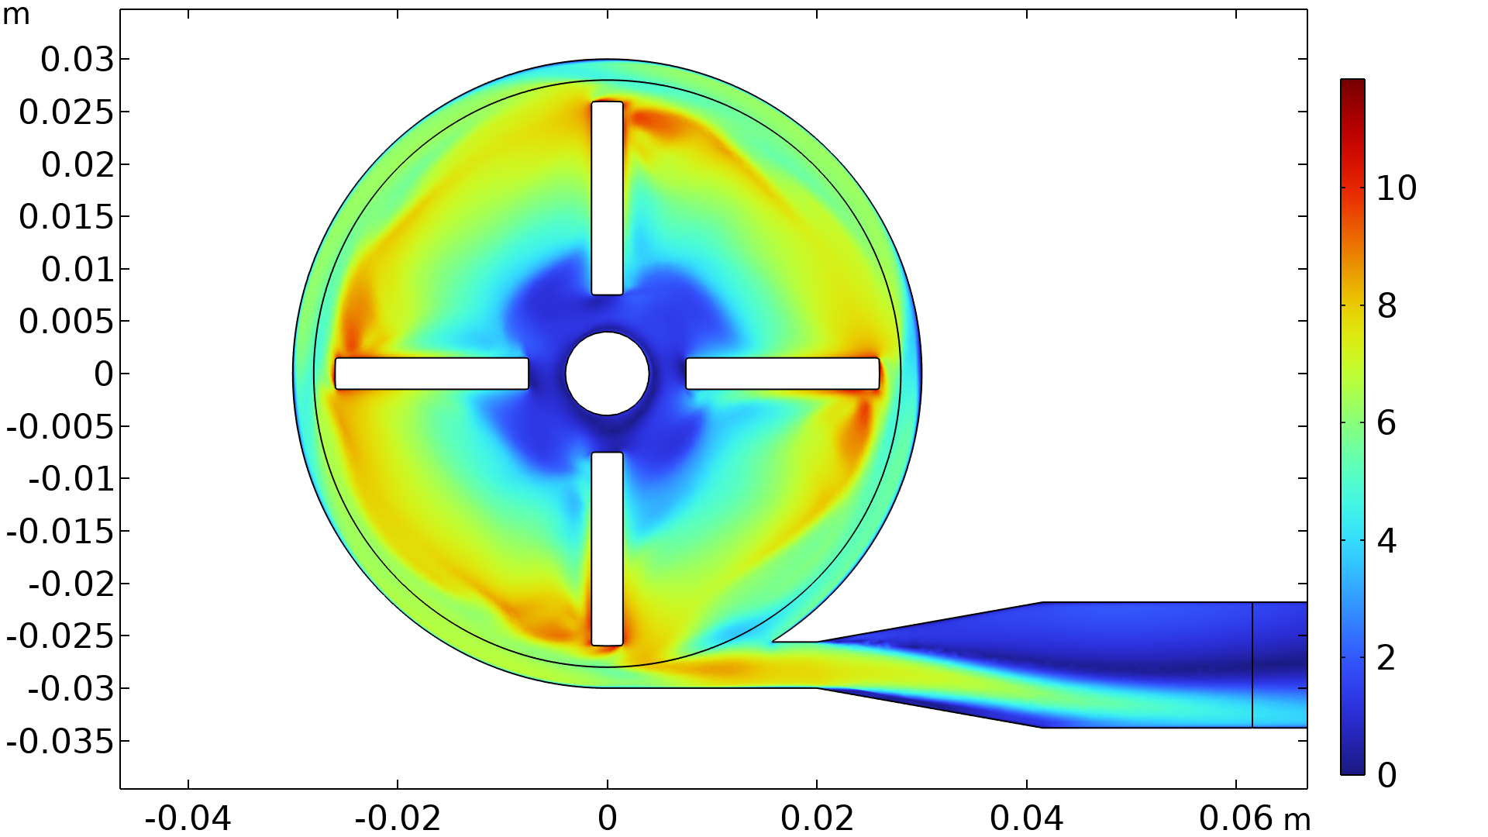
Results
The velocity magnitude surface plot in the blade passage plane shows good qualitative agreement with the PIV surface velocity plot from Malinauskas et. al. ³
Velocity magnitude at the blade passage plane under operating conditions of 3500[rpm] and an inlet flow rate of 6 [L/min]

Slide 5
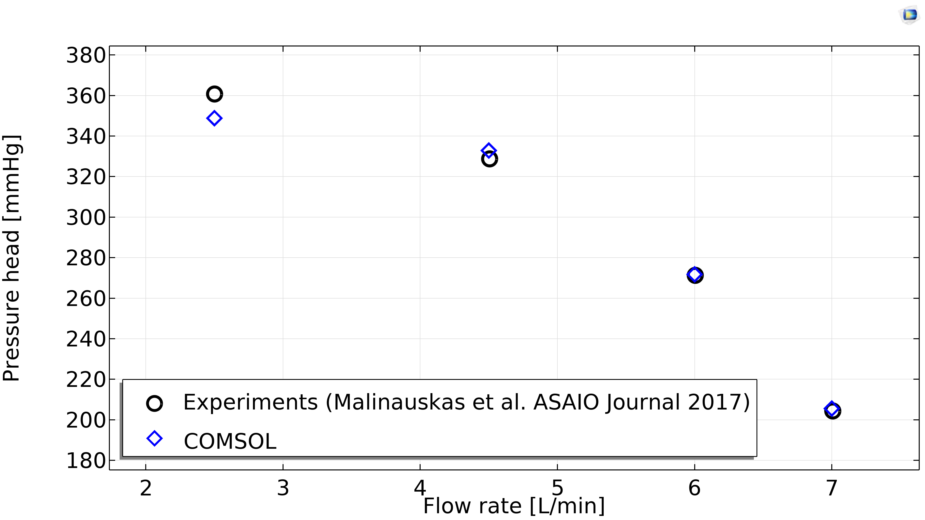
Results
The pressure head of the pump from the model shows good agreement with the experimental results from Malinauskas et. al. ³
Pressure head at different inlet flow rates for the centrifugal pump operating at 3500 [rpm]

Slide 6
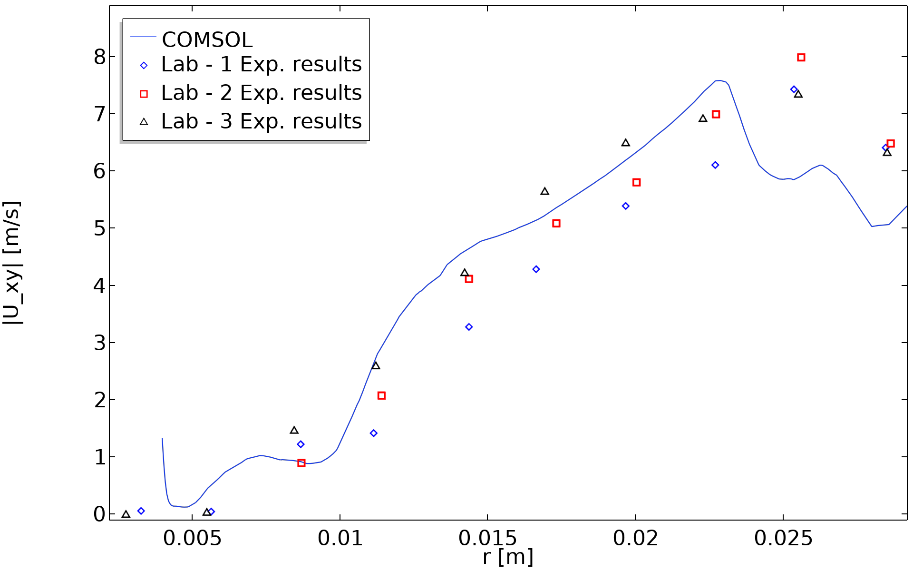
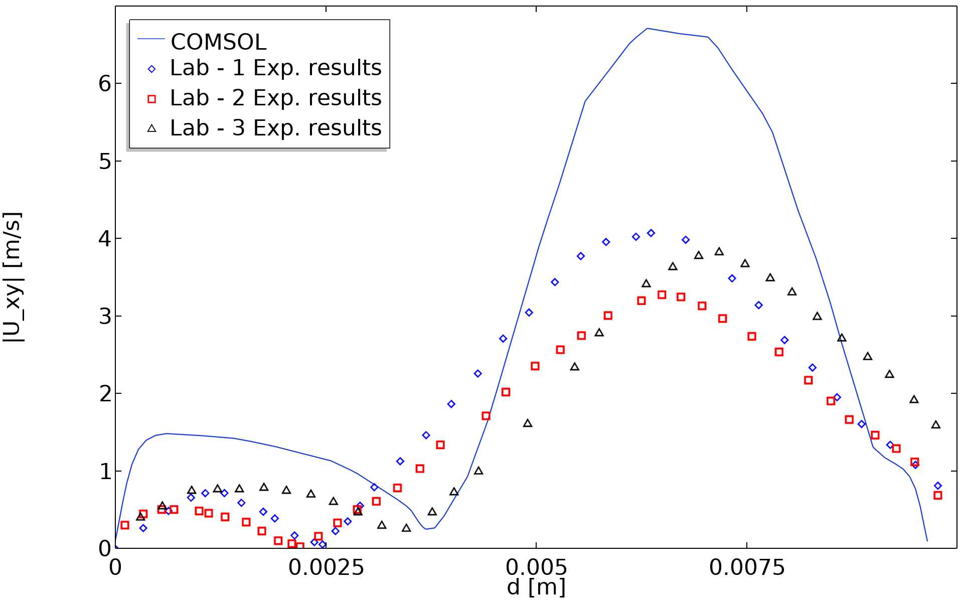
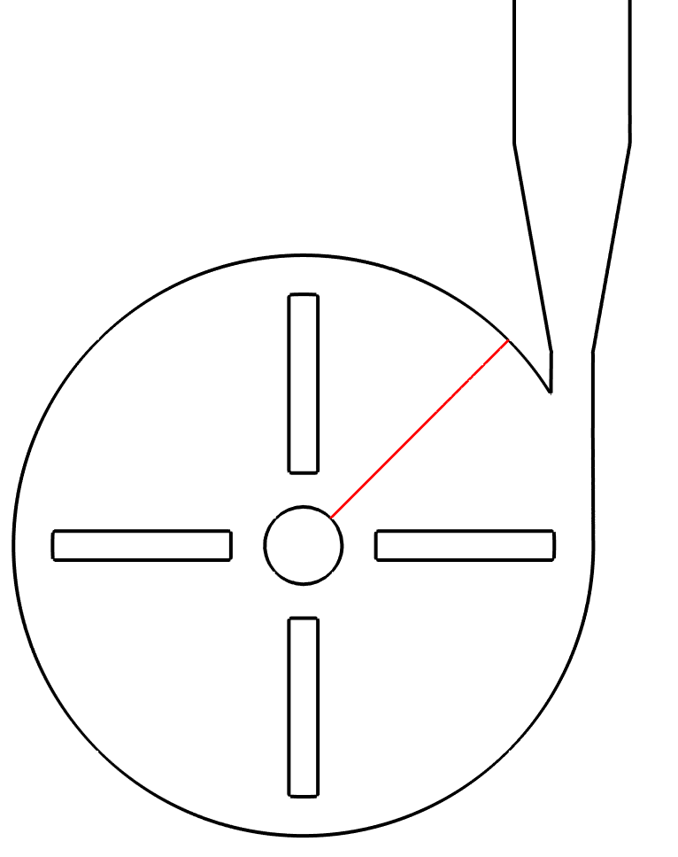
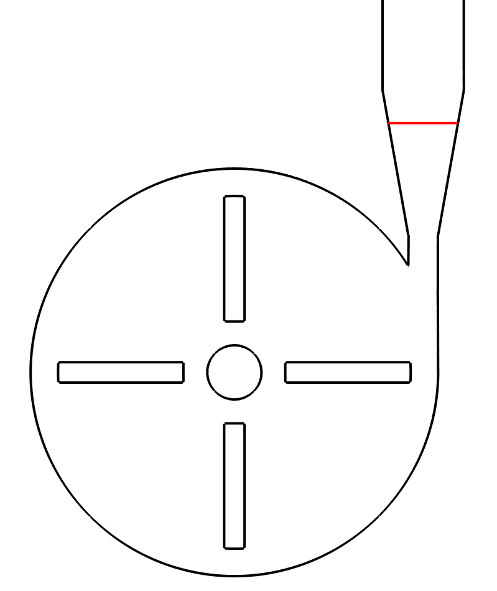
Results
d
r
Velocity magnitude based on the x & y velocity components along the radial cut line compared with experimental results from Malinauskas et. al. ³
Velocity magnitude based on the x & y velocity components along the diffuser cut line compared with experimental results from Malinauskas et. al. ³

Slide 7
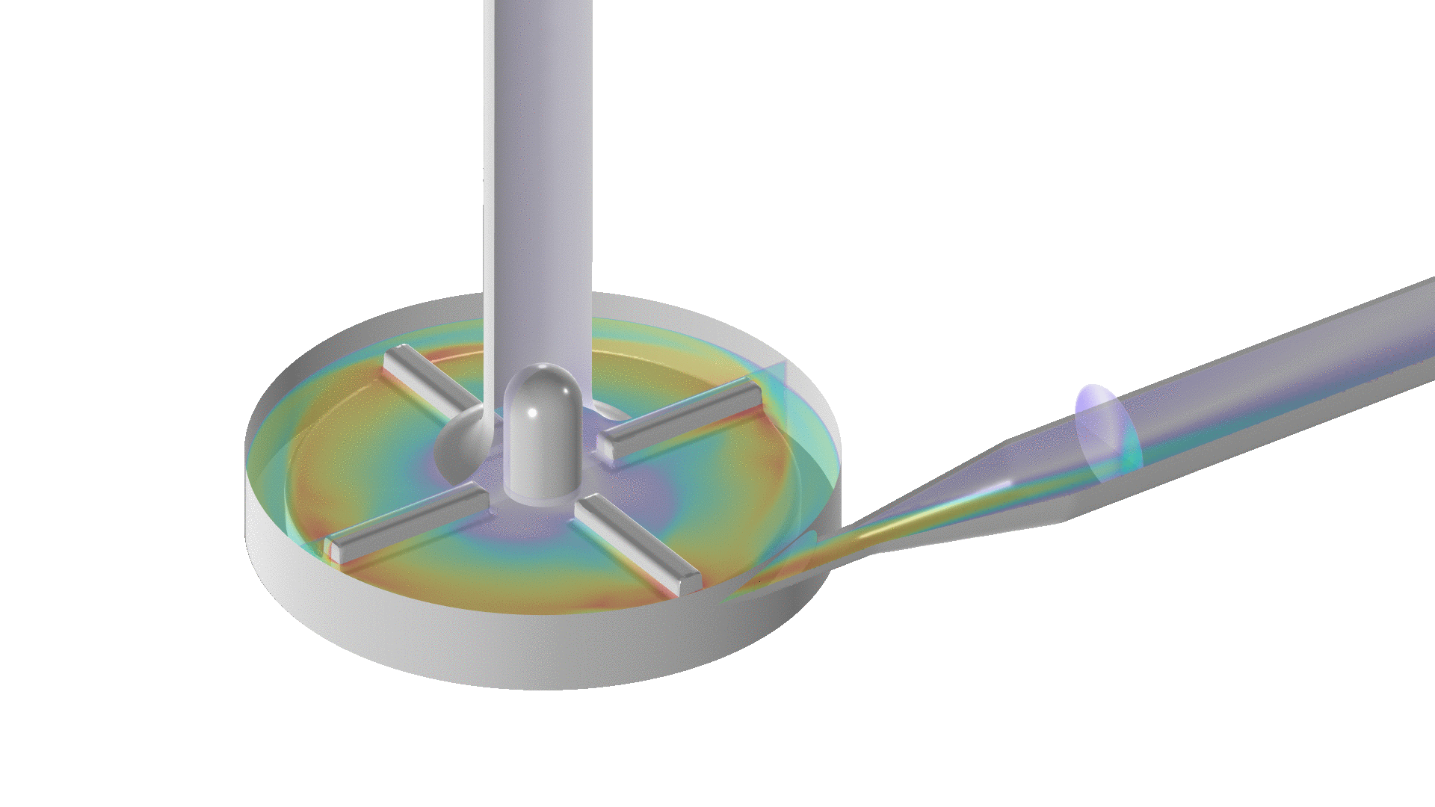
Conclusions
Computational fluid dynamics (CFD) can be effectively used to characterize fluid flow in medical devices.
COMSOL’s CFD Module and Mixer Module offer an effective CFD solution for fluid flow in rotating machinery, common in centrifugal blood pumps.
Results are consistent with previously reported studies by other CFD groups. ³
Velocity magnitude multi-slice plot animation created using the Transformation dataset operation

Slide 8
References
[1] Laura K. Diaz, Anthony Chang, CHAPTER 19 - Cardiac Assist Devices, Editor(s): Charles J. Coté, Jerrold Lerman, I. David Todres, A Practice of Anesthesia for Infants and Children (Fourth Edition), W.B. Saunders, 2009, Pages 439-451, ISBN 9781416031345, https://doi.org/10.1016/B978-141603134-5.50023-8
[2] Computational Fluid Dynamics Round Robin Study: https://ncihub.org/wiki/FDA_CFD
[3] Malinauskas, R. A., Hariharan, P., Day, S. W., Herbertson, L. H., Buesen, M., Steinseifer, U., ... & Craven, B. A. (2017). FDA benchmark medical device flow models for CFD validation. Asaio Journal, 63(2), 150-160.

