Slide 1
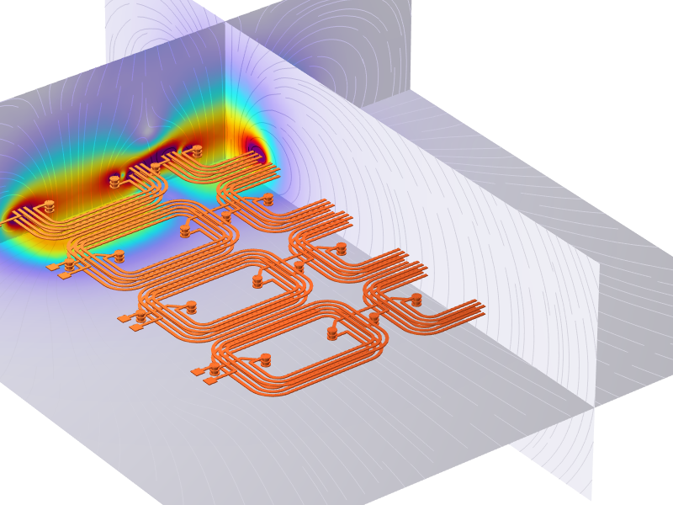
Extracting Electrical Circuits from Electromagnetic Simulations

Slide 2
Highlights
Circuit Extractor add-in
  Basics and preliminary steps
  Primer on Circuit Extractor, introductory case
  RL square wave response verification, case 1
  Resistors network stationary current verification, case 2
  RLC frequency domain extraction for PCB coil model, case 3
More information in blog Extracting Electrical Circuits from Electromagnetic Simulations
Models available here

Slide 3
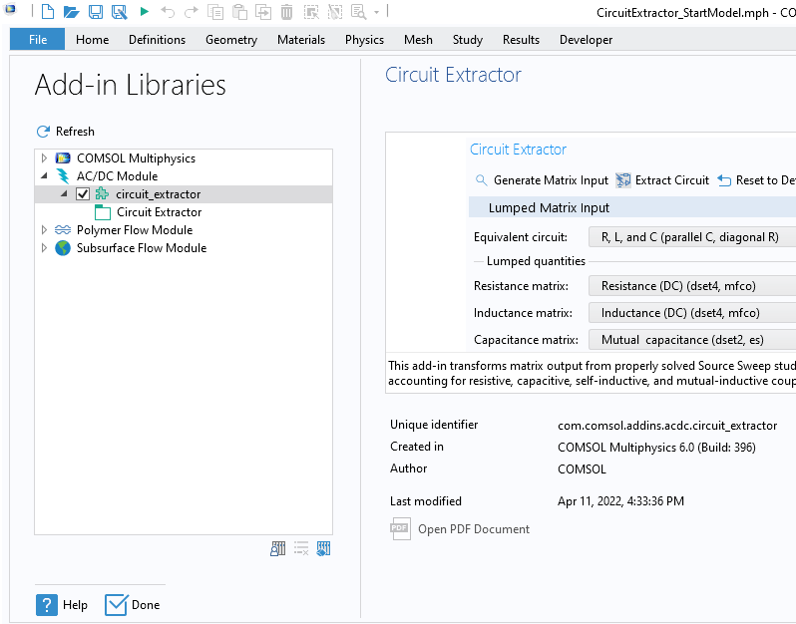
Circuit Extractor Add-in, Basic & Preliminary Steps
Convert Source Sweep studies into Electrical Circuits
Click on "Developer" in top ribbon
Select "Add-in Libraries“
Expand the AC/DC Module
Check "circuit_extractor"

Slide 4
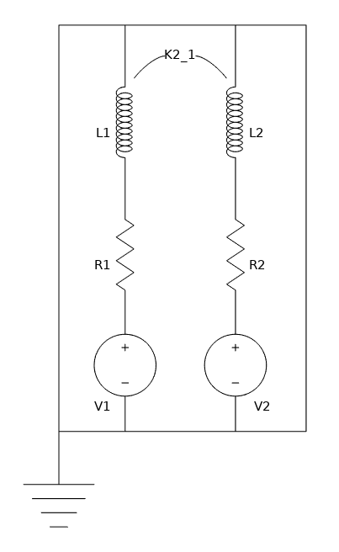
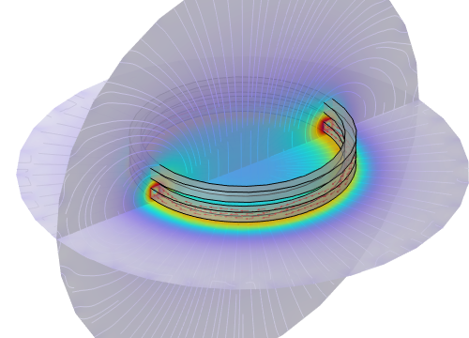
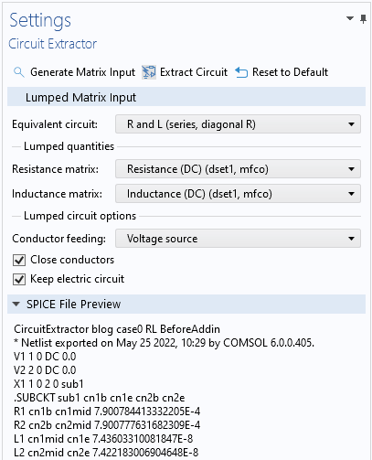
Primer on Circuit Extractor
Open model for introductory case with suffix “BeforeAddin”
Solve Source Sweep, getting lumped matrices
From Developer menu, Add-ins, select “Circuit Extractor”
Set Circuit Extractor as in image and press “Extract Circuit”
Output
SPICE File Preview
Electrical Circuit Interface
.cir file

Slide 5
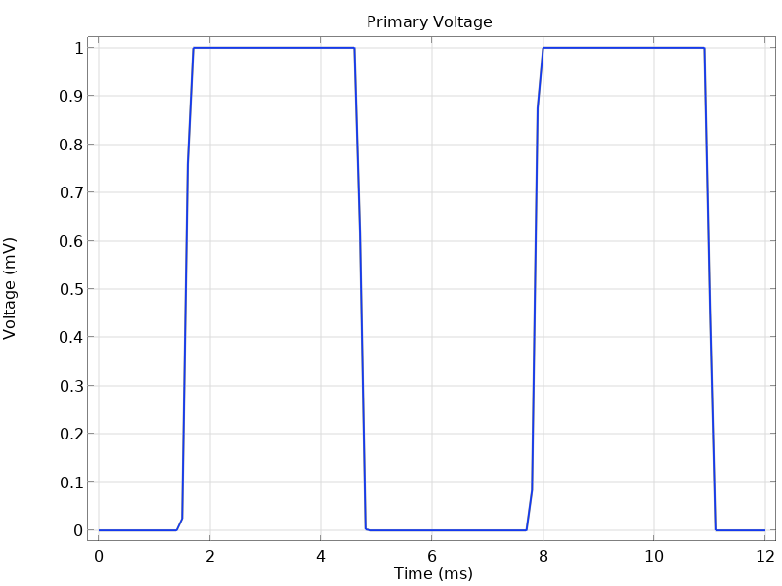
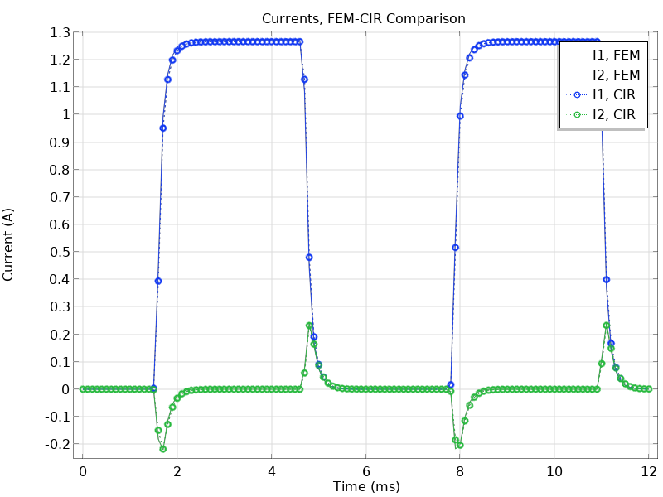
CASE 1: RL Square Wave Response Verification
Input square voltage signal on previous example
Comparison of FEM and CIR
Self inductance smooths resulting current as because of as self inductance RL response
Mutual inductive effects will generate currents on secondary coil
Solid line: full FEM transient approach, solved by means of "Magnetic Fields" physics
Open circles: solving the extracted Electrical Circuit

Slide 6
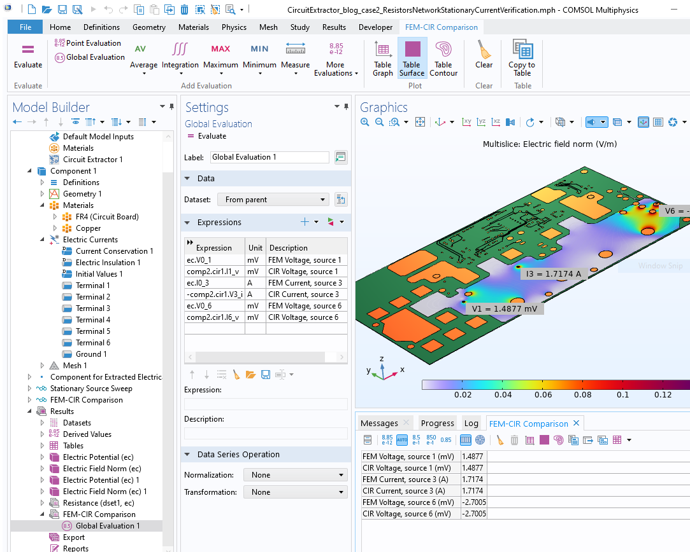
CASE 2: Resistors Network Stationary Current Verification
Geometry from ECAD Import Module Library. The ODB++ file is provided courtesy of Hypertherm, Inc., Hanover, NH, USA
Extract circuit of a 6 pin resistive mix feeding network

Slide 7
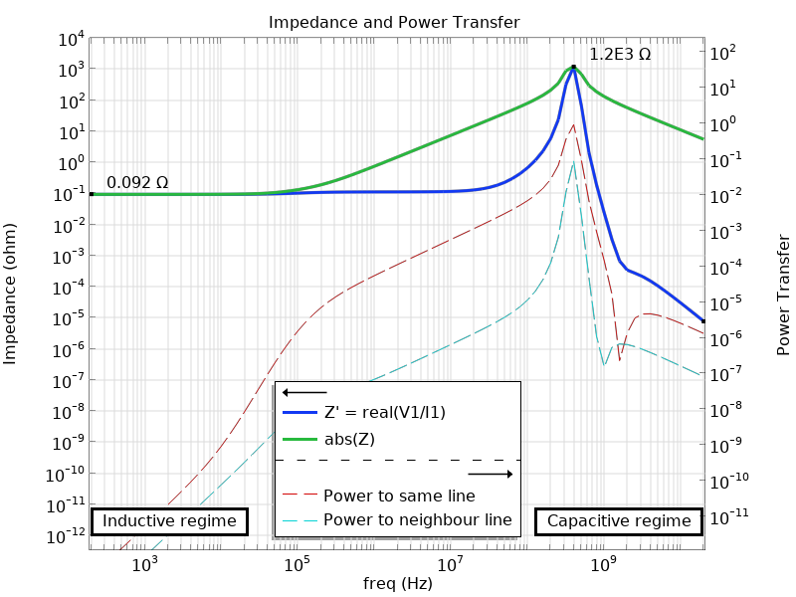
CASE 3: RLC Frequency Domain Extraction for PCB Coil Model
Model computing separately RL and C
Frequency sweep of extracted circuit
Matrices from different physics
Extracting single RLC and sweeping regimes from inductive to capacitive
Impedance showing LC resonance
Power transfer for different lines

