Slide 1
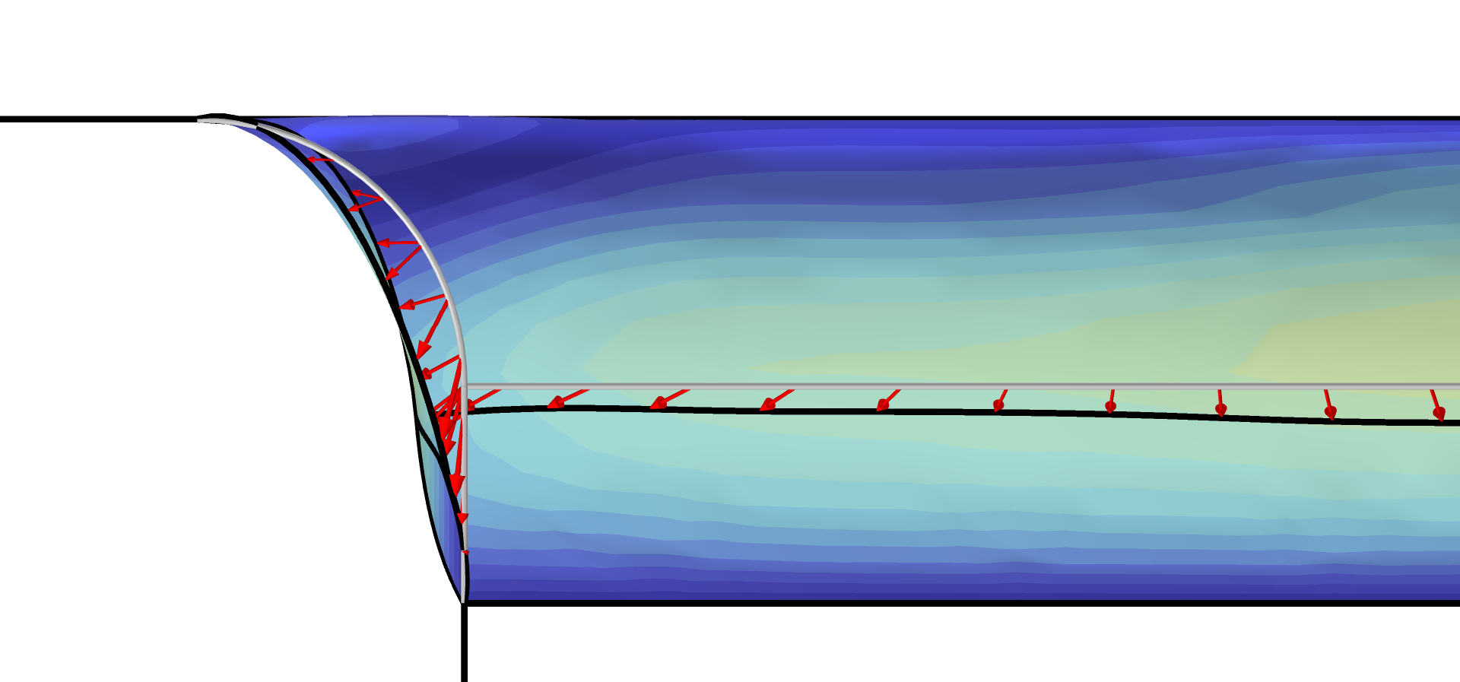
Wheel Rim — Stress Optimization with Fatigue Evaluation

Slide 2
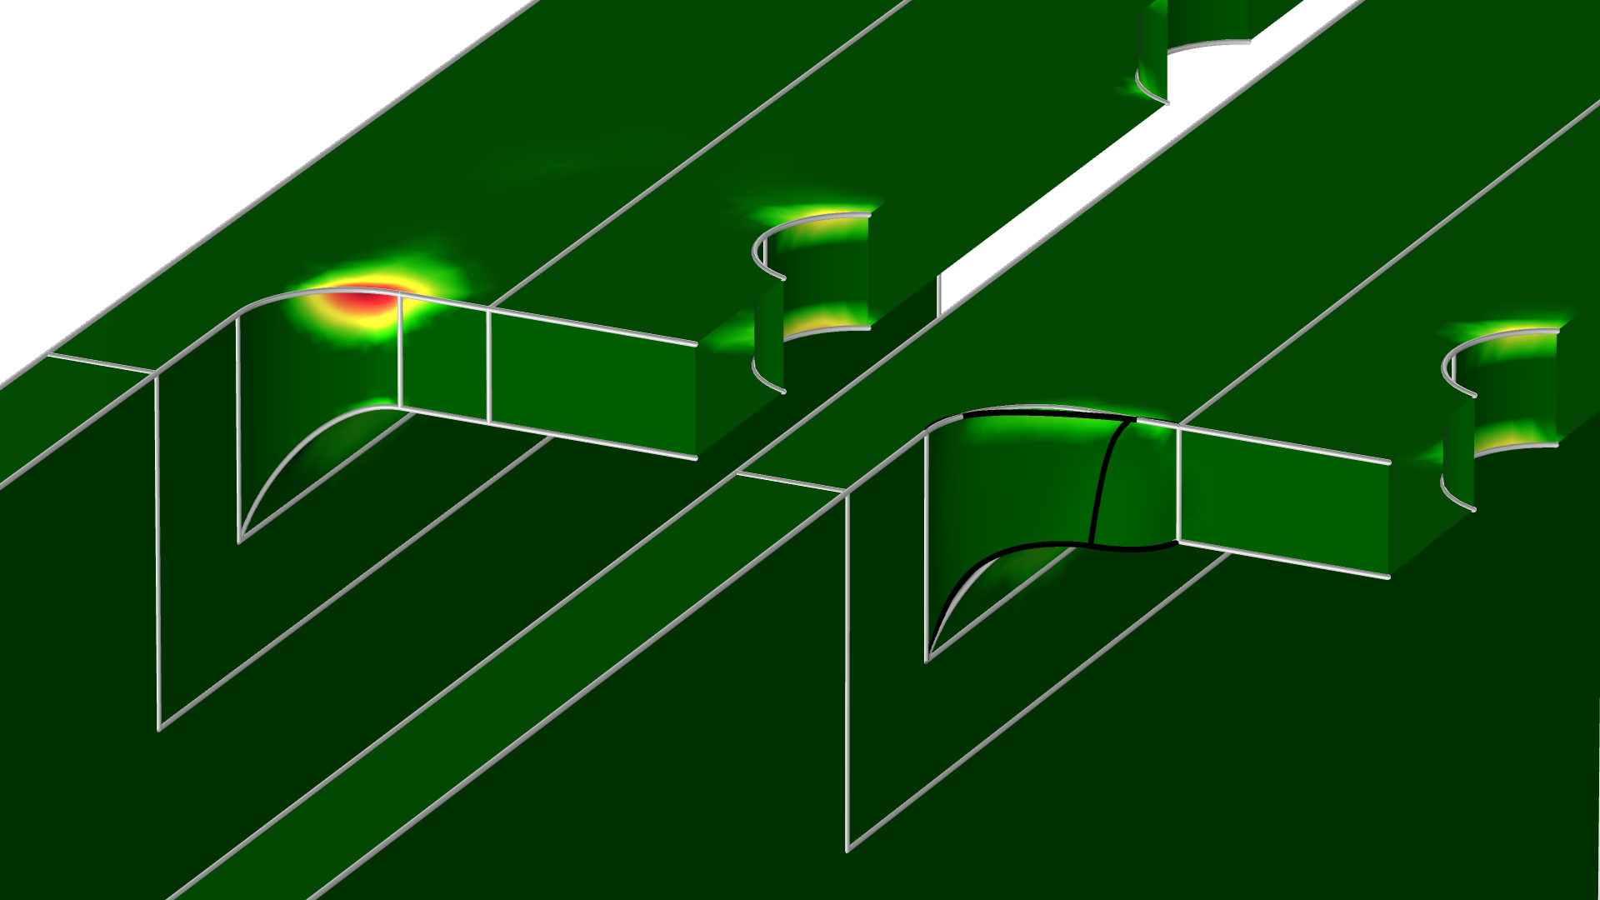
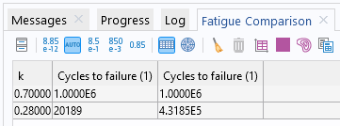
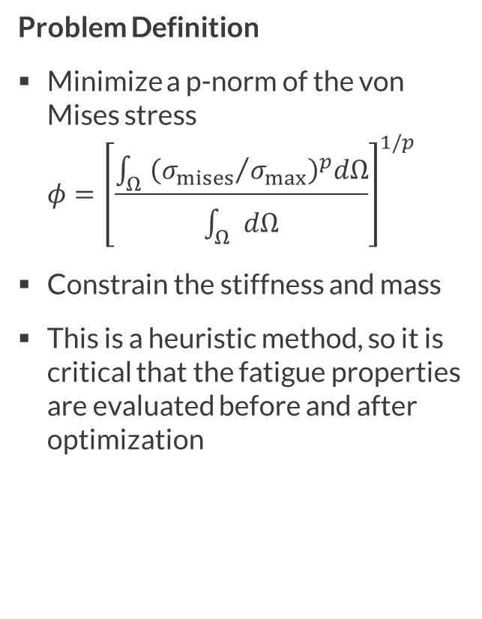
Shape Optimization
Problem Definition
Minimize a p-norm of the von Mises stress
$φ={\left[\frac{\int_{Ω}{{\left({σ_{mises}}/{σ_{max}}\right)}^{p}dΩ}}{\int_{Ω}{dΩ}}\right]}^{1/p}$
Constrain the stiffness and mass
This is a heuristic method, so it is critical that the fatigue properties are evaluated before and after optimization
The shape optimization increases the filter radius at the point of large stress, which improves the fatigue properties of the bracket.
Bracket — Stress Optimization with Fatigue Evaluation

