Slide 1
Topology Optimization and Verification of an Acoustic Mode in a 2D Room

Slide 2
Topology Optimization
Goal of the optimization is to distribute solid material in the design domain in order to minimize the sound pressure level in the objective domain (at a single given frequency).
Design domain: Ω_{d}
Acoustic domain
Point source
Objective domain: Ω_{ob}
Topology Optimization and Verification
of an Acoustic Mode in a 2D Room

Slide 3

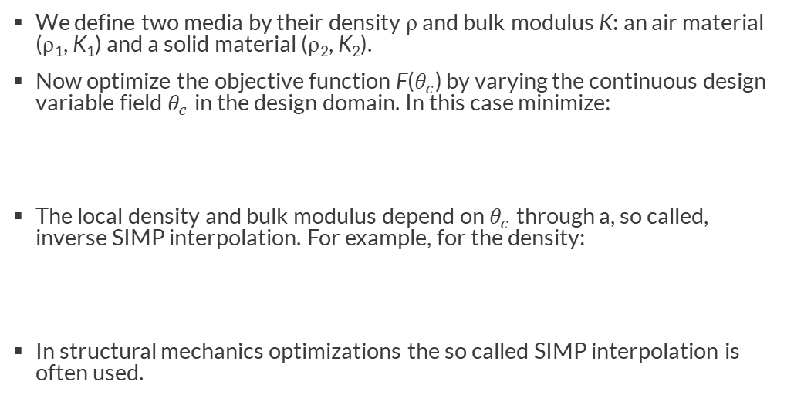

Topology Optimization
We define two media by their density ρ and bulk modulus K: an air material (ρ₁, K₁) and a solid material (ρ₂, K₂).
Now optimize the objective function F($θ_{c}$) by varying the continuous design variable field $θ_{c}$ in the design domain. In this case minimize:
The local density and bulk modulus depend on $θ_{c}$ through a, so called, inverse SIMP interpolation. For example, for the density:
In structural mechanics optimizations the so called SIMP interpolation is often used.
$$\min_{η}{F\left(θ_{c}\right) with 0<θ_{c}≤1 ∀ (x,y)∈Ω_{d}}$$
$ρ\left(θ_{p}\right)={\left(\frac{1}{ρ_{2}}+θ_{p}\left(\frac{1}{ρ_{1}}−\frac{1}{ρ_{2}}\right)\right)}^{−1} such that \left\{\begin{matrix}ρ\left(0\right)=ρ_{2} \\ ρ\left(1\right)=ρ_{1}\end{matrix}\right.$
Topology Optimization and Verification
of an Acoustic Mode in a 2D Room

Slide 4

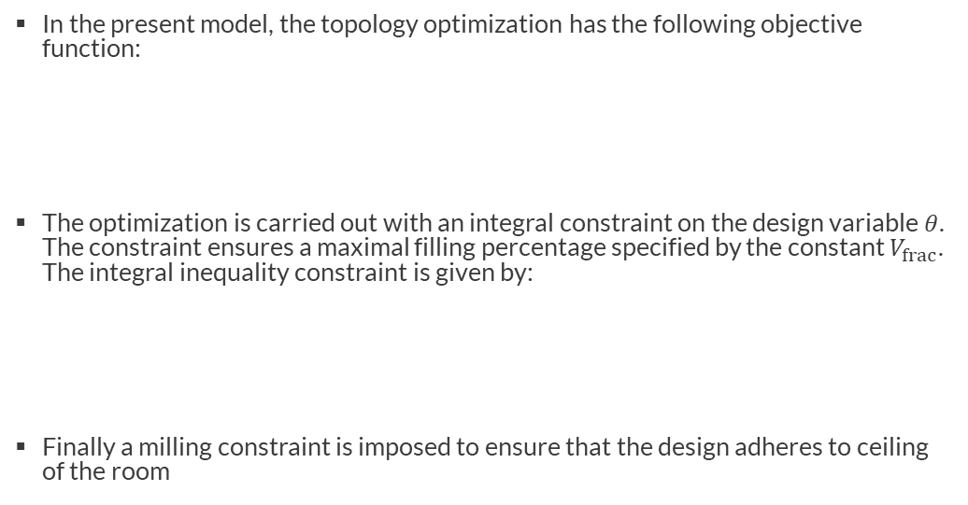

Topology Optimization
In the present model, the topology optimization has the following objective function:
The optimization is carried out with an integral constraint on the design variable$θ$. The constraint ensures a maximal filling percentage specified by the constant $V_{frac}$. The integral inequality constraint is given by:
Finally a milling constraint is imposed to ensure that the design adheres to ceiling of the room
$$F\left(η\right)=\log_{10}\left(\frac{\int_{Ω_{obj}}{{|p|}^{2}}}{\int_{Ω_{obj}}{1}}\right)$$
$$\int_{Ω_{obj}}{θ}≤V_{frac}\int_{Ω_{obj}}{1}$$
Topology Optimization and Verification
of an Acoustic Mode in a 2D Room

Slide 5
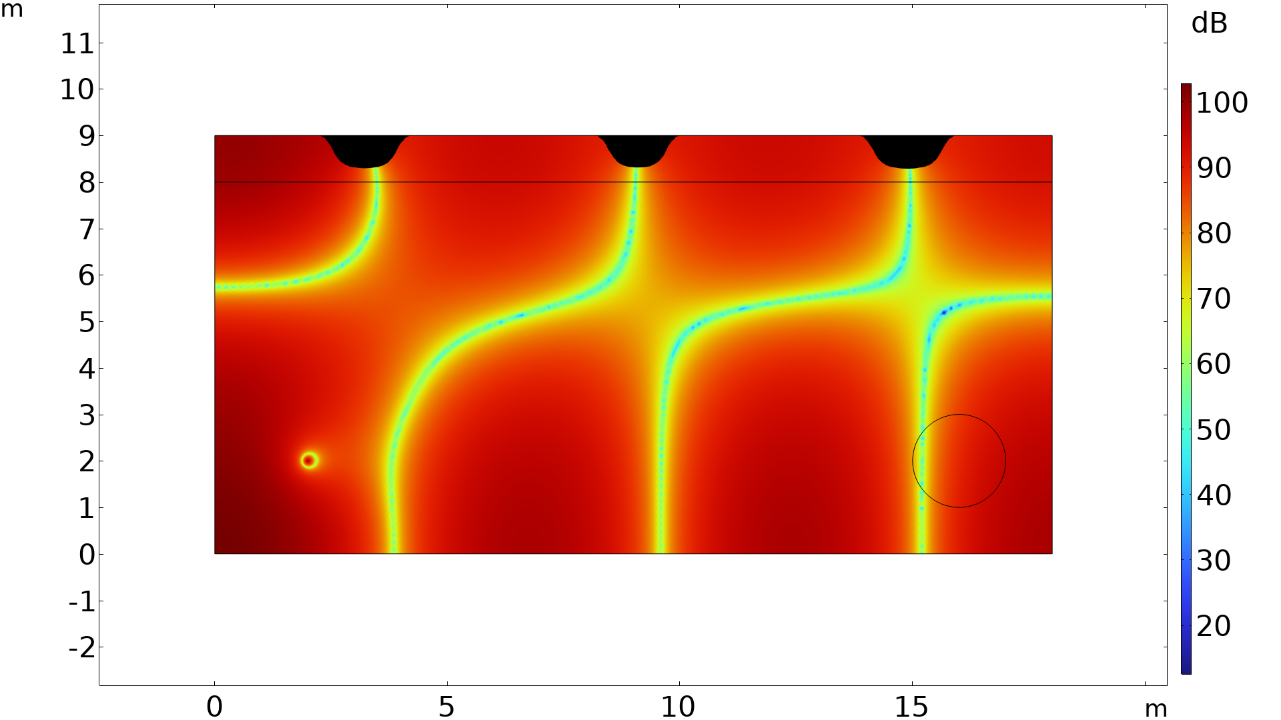
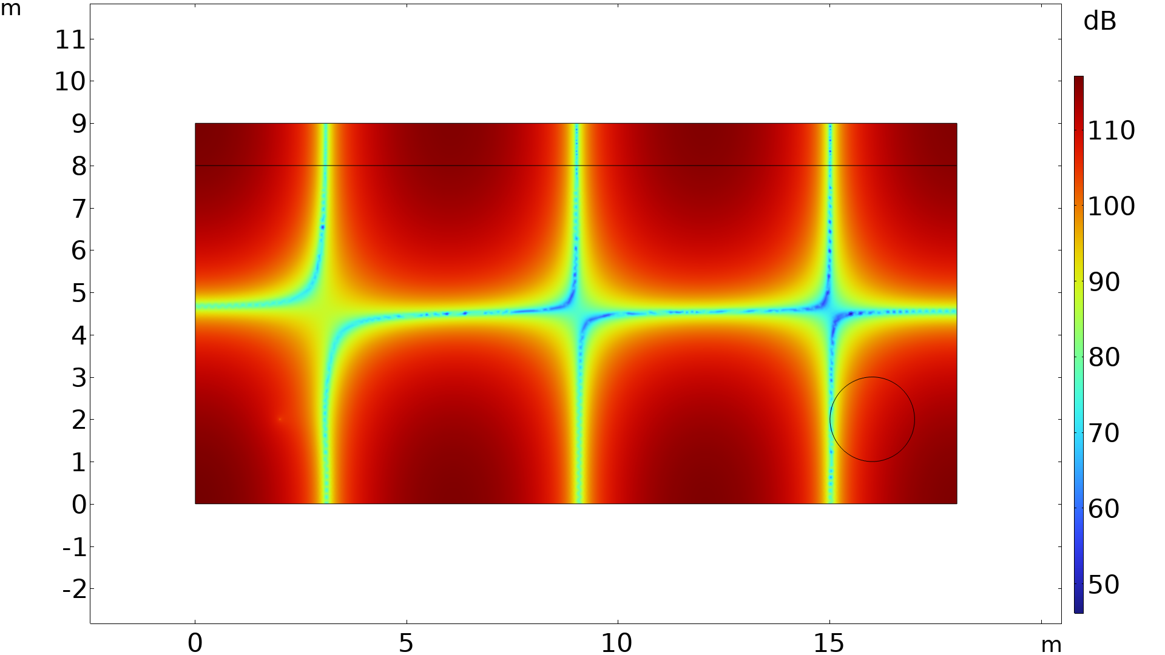
Results of Topology Optimization
Optimized Design
Material distribution inside the design domain. Black is solid.
Initial Design
Topology Optimization and Verification
of an Acoustic Mode in a 2D Room

Slide 6
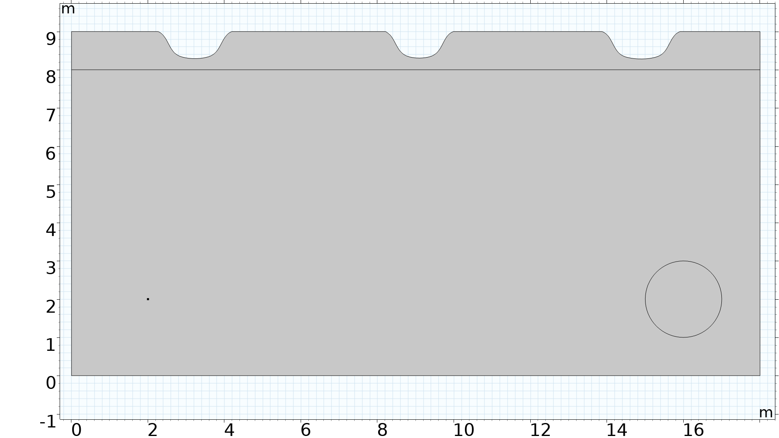
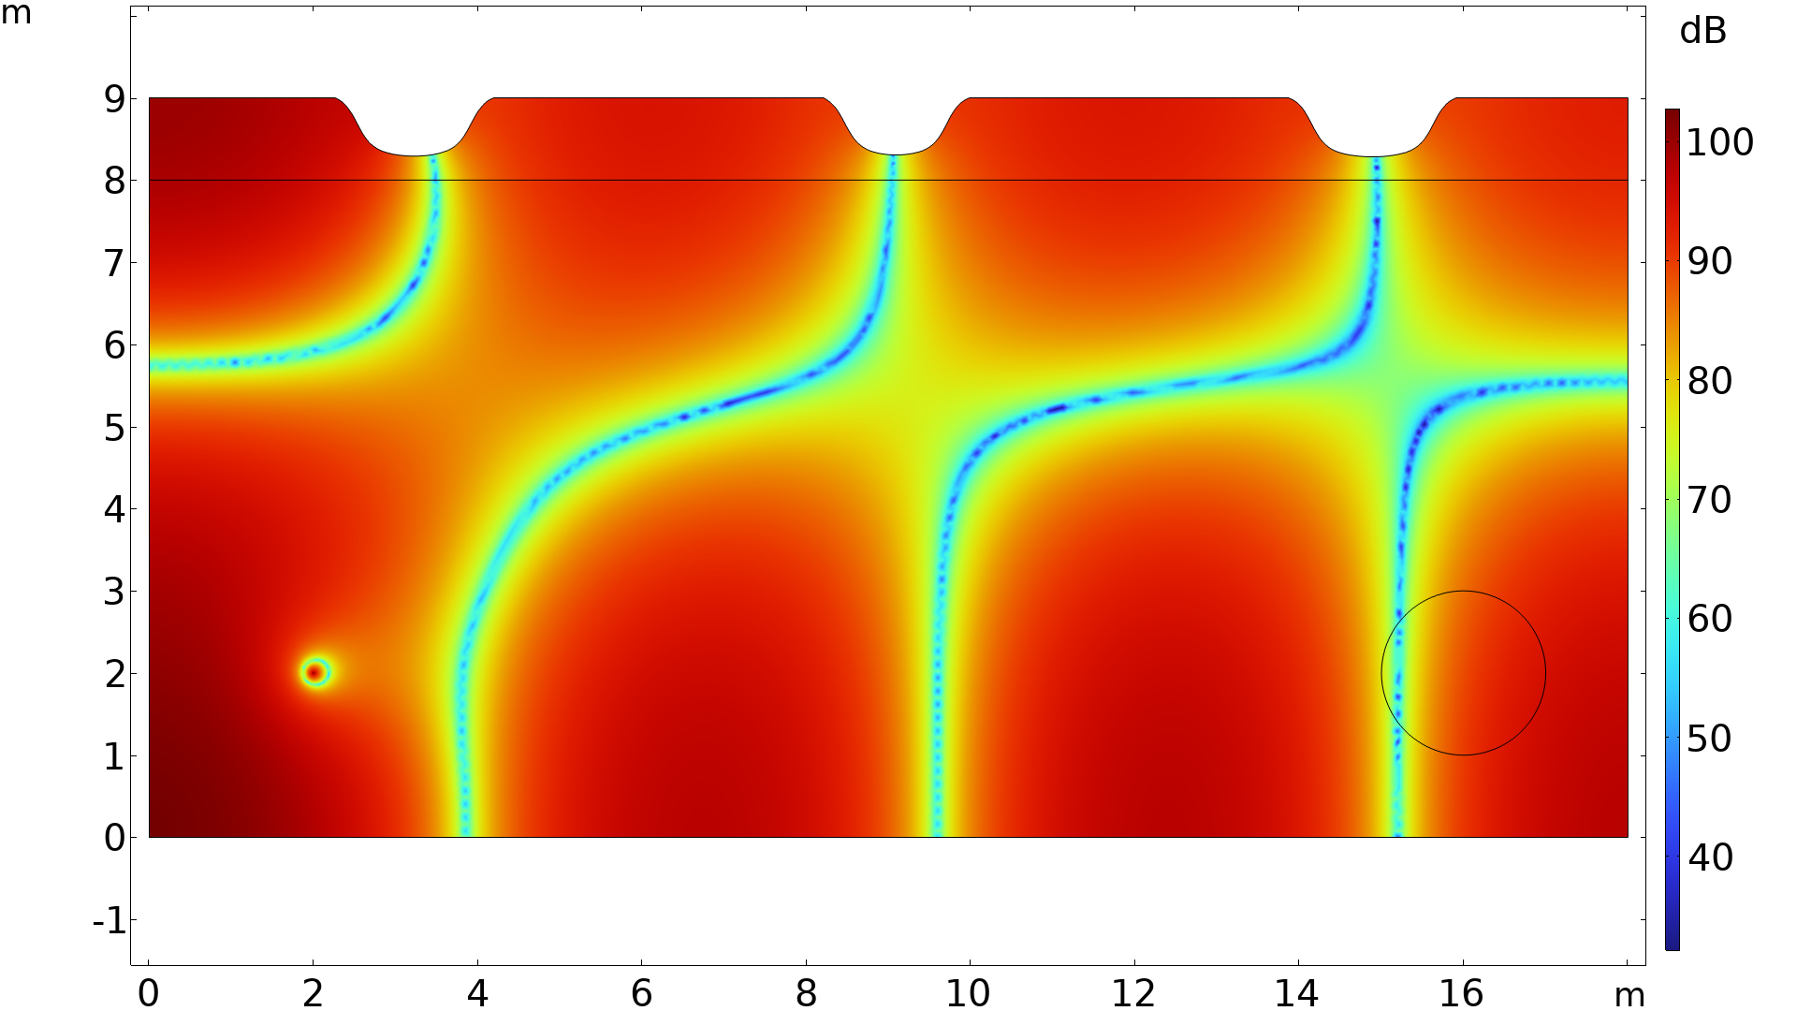
Verification
A geometry is created from the contour of the topology optimized results. The geometry is used to verify the design using actual Sound Hard Boundary conditions at the surface if the solid. The analysis is carried out in Component 2 of the model.
Geometry
Simulation on solid geometry
Topology Optimization and Verification
of an Acoustic Mode in a 2D Room

Slide 7
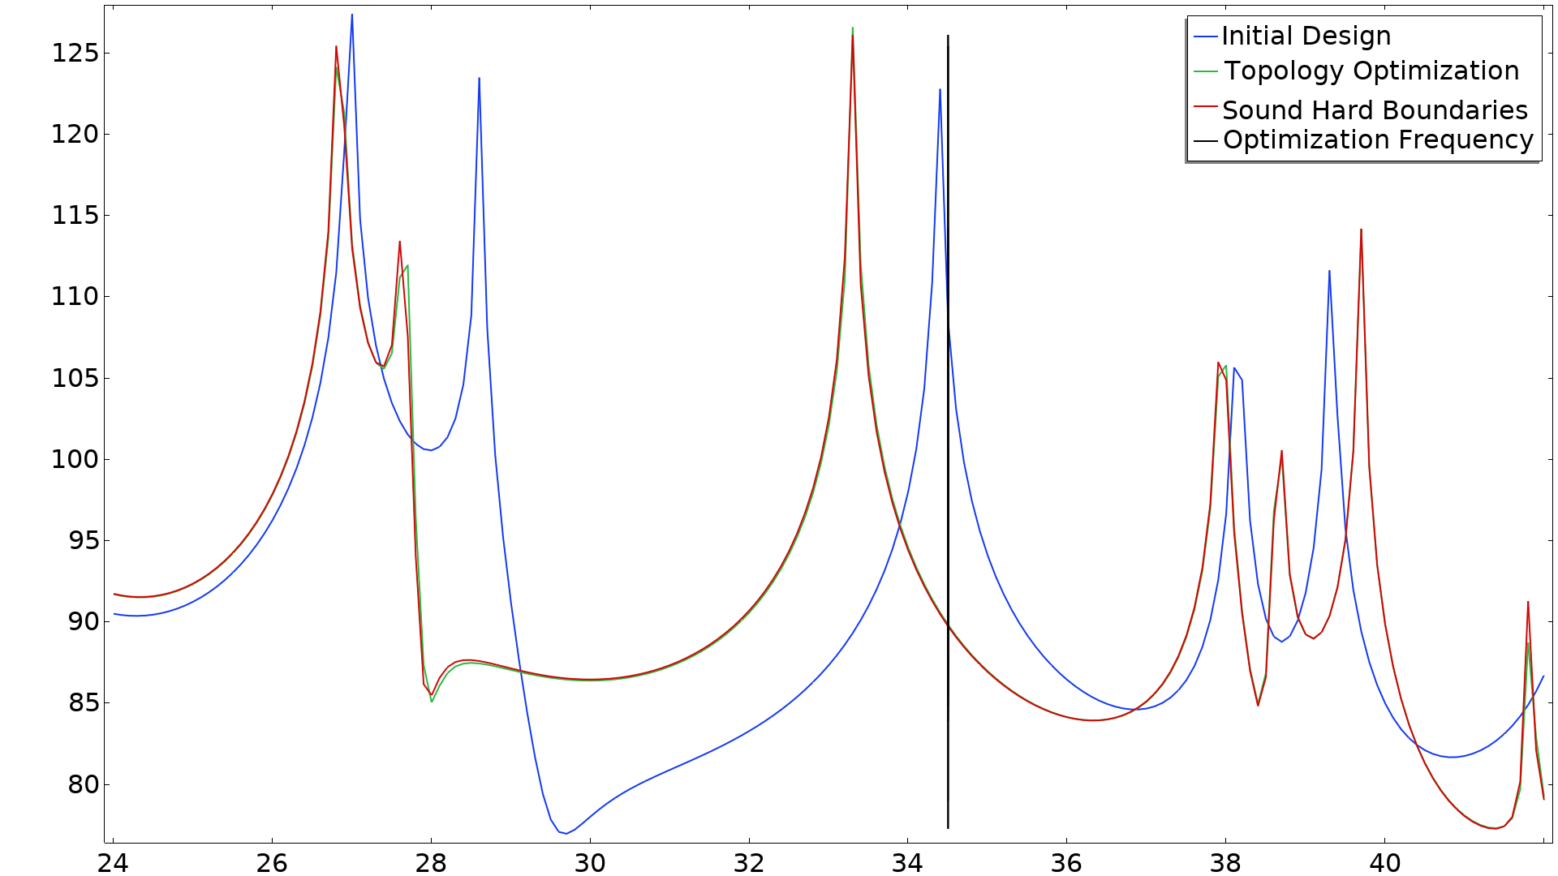
Results
Optimization frequency
Topology Optimization and Verification
of an Acoustic Mode in a 2D Room

Slide 8
Some References
The example studied here is often used in literature, see for example:
  J. M. Taglass, “Acoustic Design with Topology Optimization,” Master Thesis, Technical University of Denmark (2015).
  M. B. Dühring, J. S. Jensen, and O. Sigmund, “Acoustic design by topology optimization,” J. Sound Vib., 317 (2008).
  R. Ellebæk Christiansen, “Topology Optimization for Wave Propagation Problems with Experimental Validation,” Ph.D. Thesis, Technical University of Denmark (2016).
Examples in COMSOL:
  Topology Optimization of a Loaded Knee Structure (www.comsol.com/model/topology-optimization-of-a-loaded-knee-structure-4374)
  Topology Optimization of an MBB Beam (www.comsol.com/model/topology-optimization-of-an-mbb-beam-7428)
  Optimization of a Tesla Microvalve (www.comsol.com/model/optimization-of-a-tesla-microvalve-14513)
Blog posts on comsol.com:
  www.comsol.com/blogs/category/all/optimization/

