Slide 1
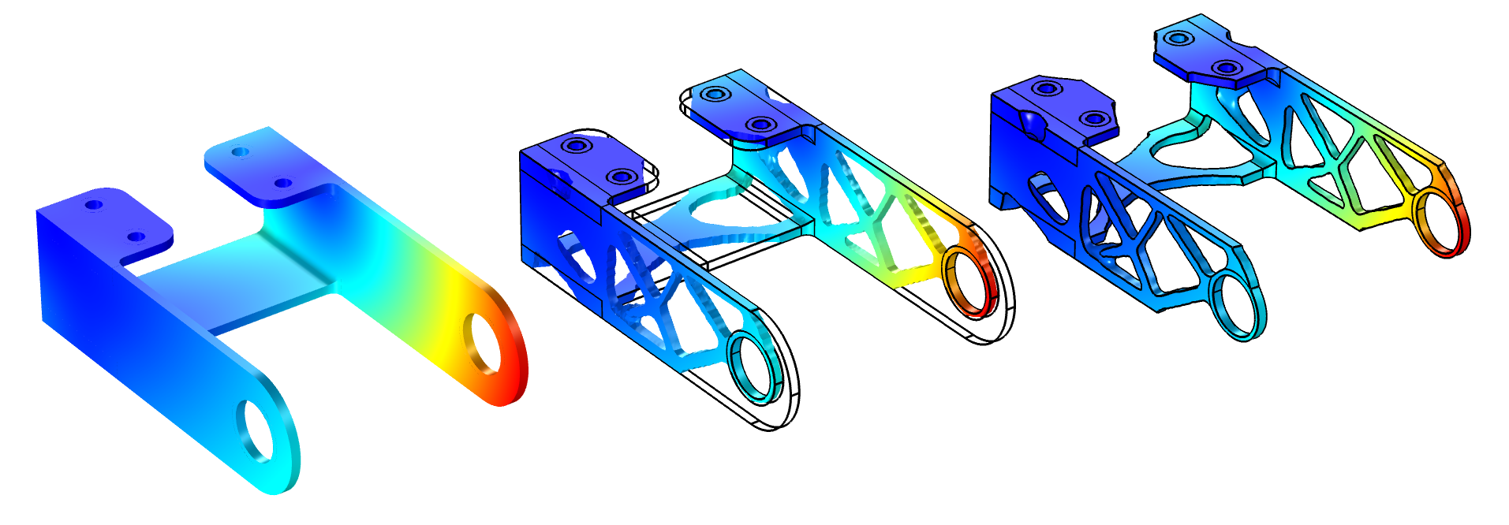
Bracket — Topology Optimization

Slide 2
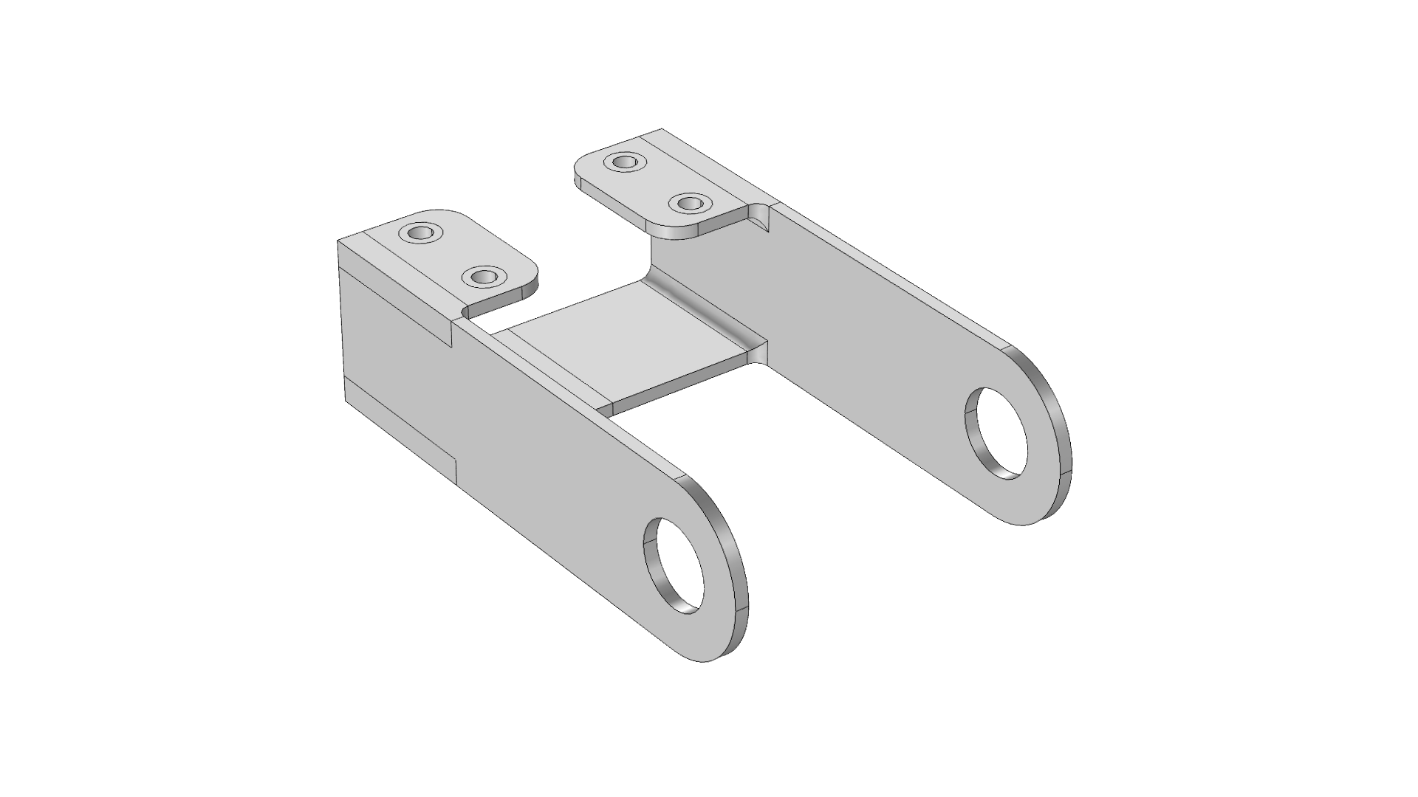
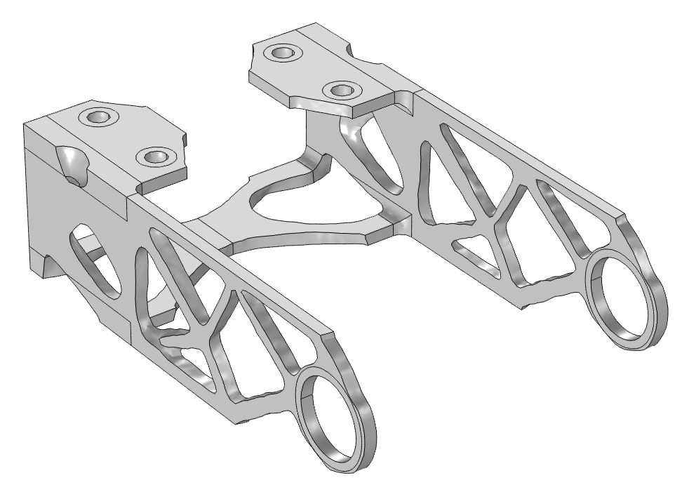
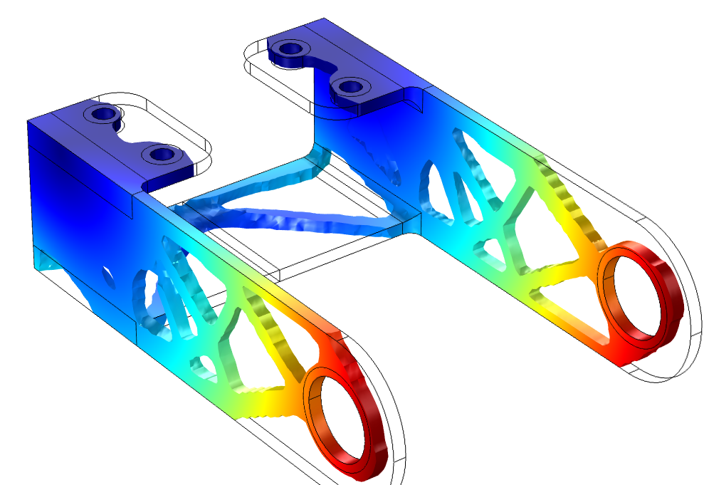
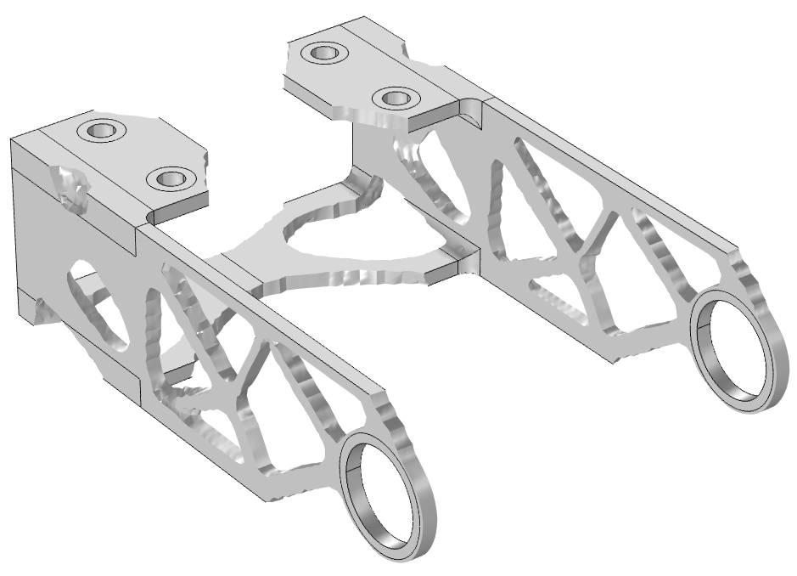
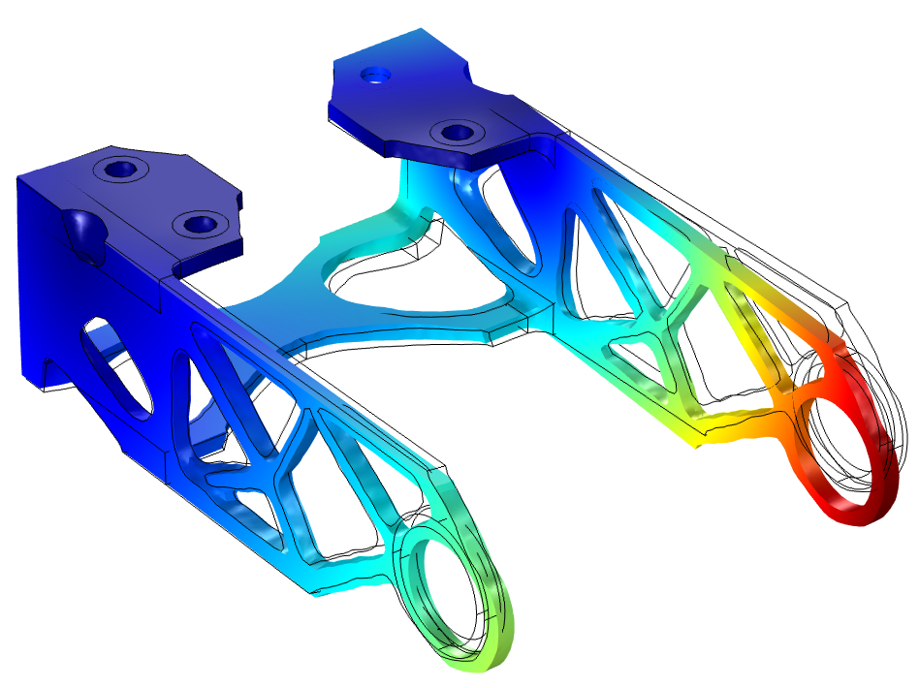
Bracket — Topology Optimization
Introduction
Definition
Continuation
Results
Verification
Topology optimization is a method that generates designs without a particular initial geometry
Remove 50 % of the material from a bracket
Maximize stiffness
Four value of SIMP exponent and projection slope
Increase the likelihood of finding a good minimum
1 load case
4 load cases
Threshold with Filter dataset
Import in new component
Perform verification analysis

Slide 3
Bracket — Topology Optimization
Topology optimization is a method that generates designs without a particular initial geometry.
In this model the method will be used to remove 50 % of the material from a bracket geometry, while maximizing the stiffness.
The model uses continuation in an interpolation parameter to increase the likelihood of finding a good minimum.
The case of one as well as 4 load cases is investigated.
Finally, the design is thresholded with a filter dataset and imported as a mesh, so that a verification analysis can be performed.
Bracket — Topology Optimization

