Slide 1
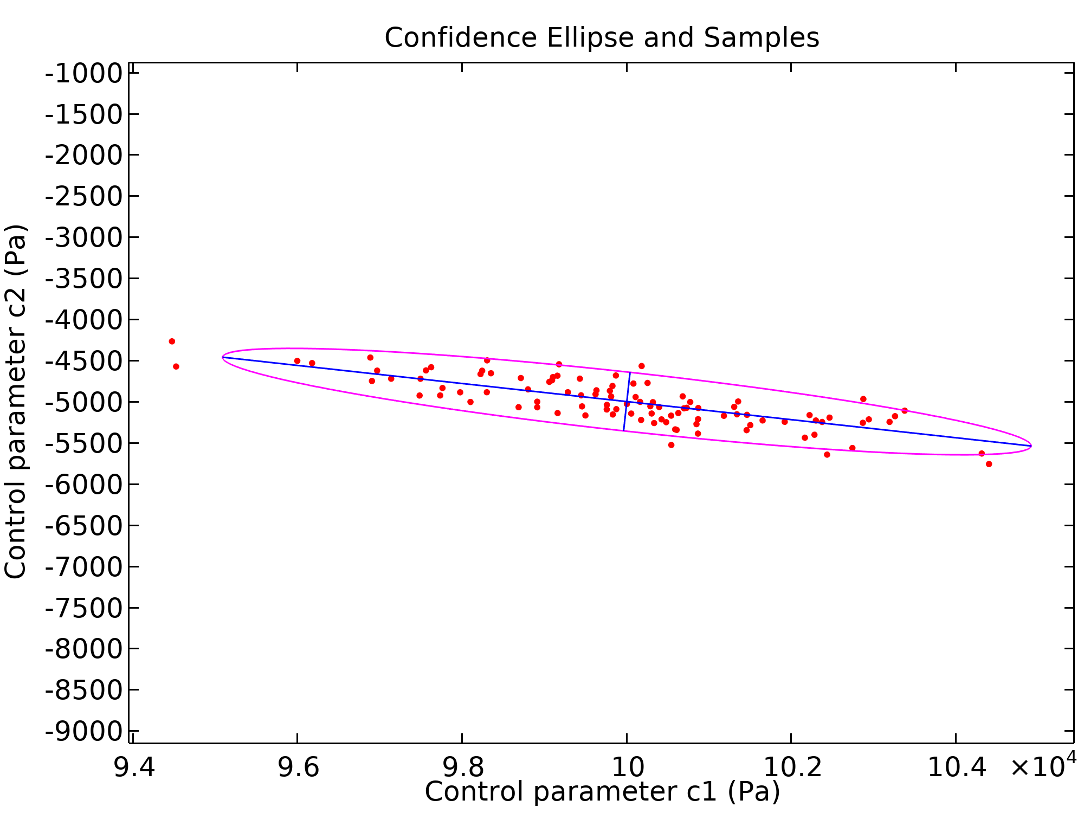
Parameter Estimation with Covariance Analysis

Slide 2
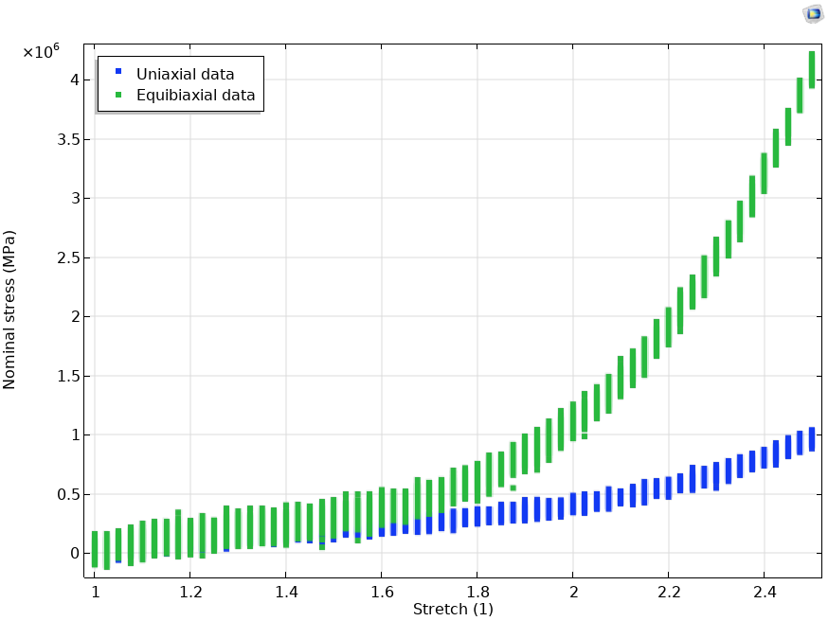
Introduction
When estimating model parameters in order to fit experimental data, data noise and modeling uncertainties will propagate to uncertainties in the estimated parameters
In particular for nonlinear models, small parameter variations can lead to large and unexpected changes in the model predictions
You can export the parameter confidence intervals as well as the full covariance matrix, when using a Parameter Estimation/Optimization study step with the Levenberg-Marquardt solver,
  This allows for uncertainty quantification in real-life components as a direct result of experimental noise
Spread in data
Spread in estimated parameters

Slide 3
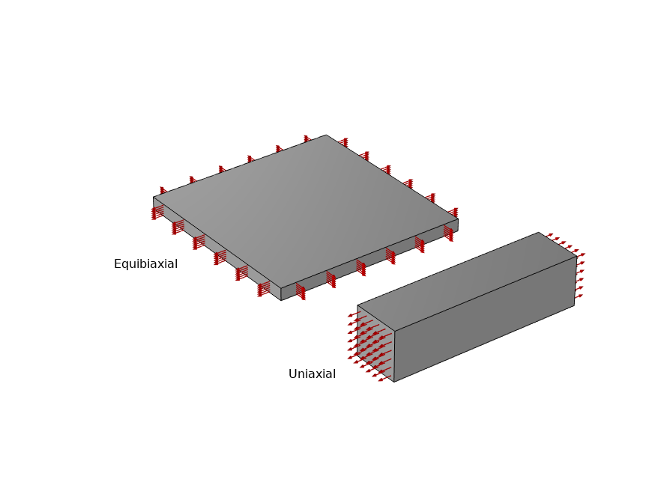
Illustrative Example (Solid Mechanics)
The functionality is illustrated by fitting two parameters of a Yeoh hyperelastic model given noisy uniaxial and equibiaxial data:
Multiple noisy datasets are generated (nOpt = 100)
The Yeoh parameters c₁ and c₂ are estimated for each individual dataset, resulting in corresponding samples in parameter space
The average and variance from the datasets are computed, and the parameter covariance matrix is computed by estimating the Yeoh parameters from the averaged data using variance as (inverse) weights
The resulting distribution of estimated parameters is compared with the covariance matrix

Slide 4
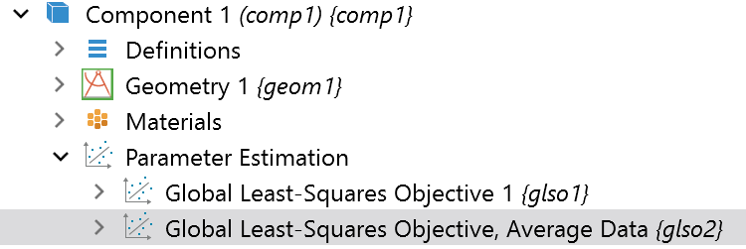
COMSOL Implementation Details (1/2)
For step-by-step instructions on how to set up a parameter estimation problem for an hyperelastic material model, see the model “Parameter Estimation of Hyperelastic Materials” in the Application Library of the Nonlinear Structural Materials Module
The Global Least-Squares Objective node under Parameter Estimation is used to define the objective function

Slide 5
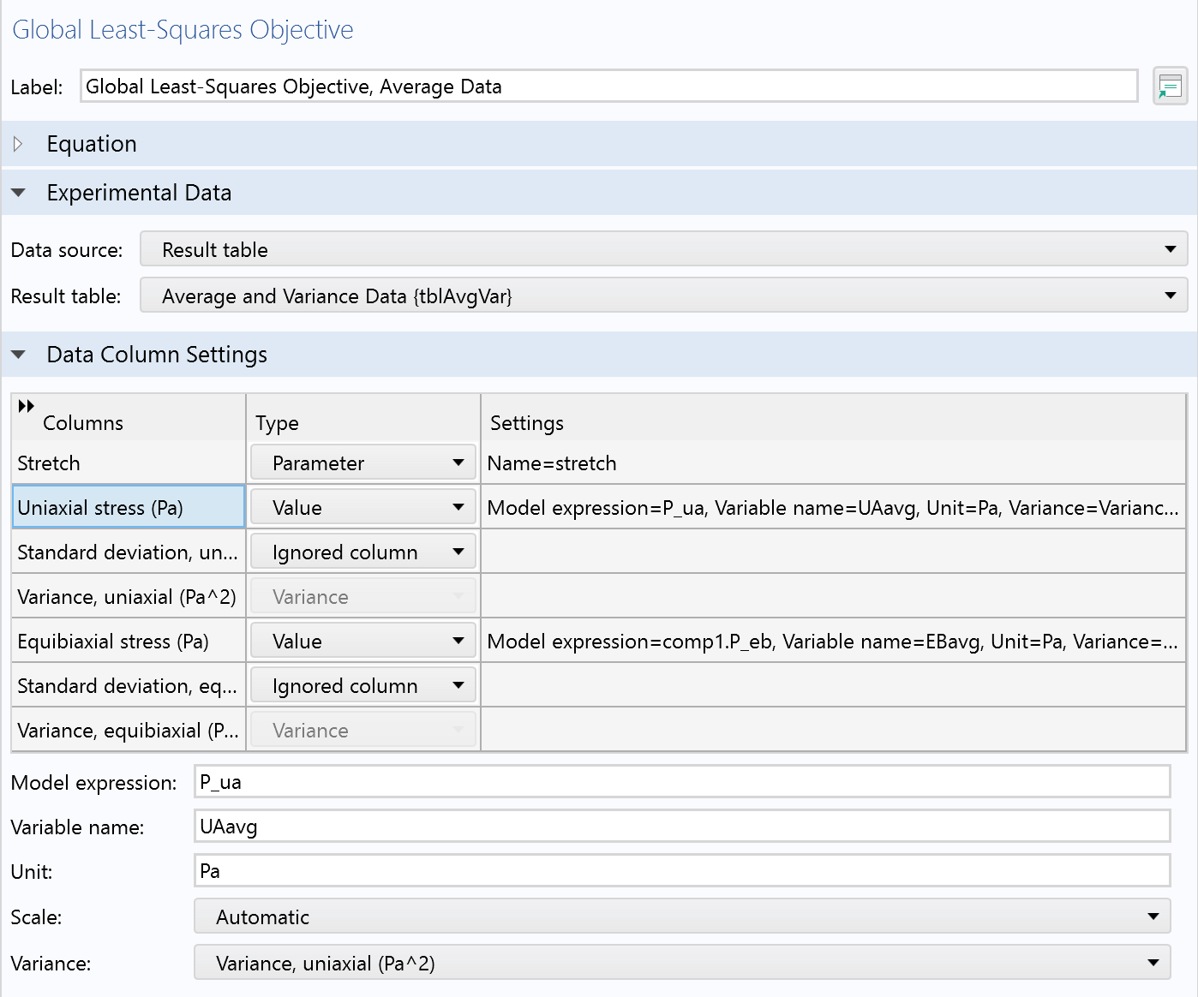
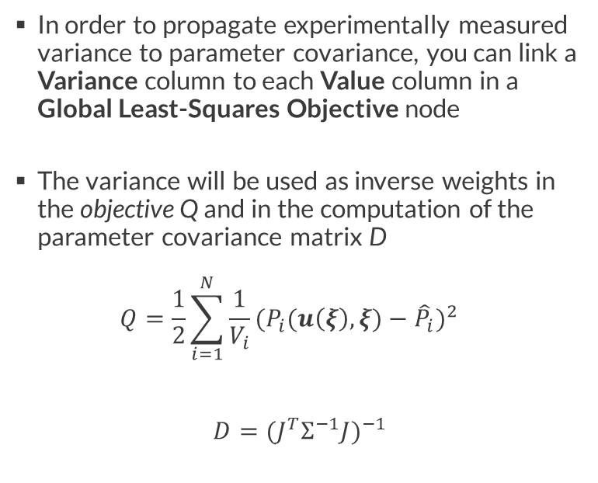
COMSOL Implementation Details (2/2)
In order to propagate experimentally measured variance to parameter covariance, you can link a Variance column to each Value column in a Global Least-Squares Objective node
The variance will be used as inverse weights in the objective Q and in the computation of the parameter covariance matrix D
$Q=\frac{1}{2}\sum_{i=1}^{N}{\frac{1}{V_{i}}{(P_{i}(u\left(ξ\right),ξ)−{\hat{P}}_{i})}^{2}}$
$$D={(J^{T}Σ^{−1}J)}^{−1}$$

Slide 6
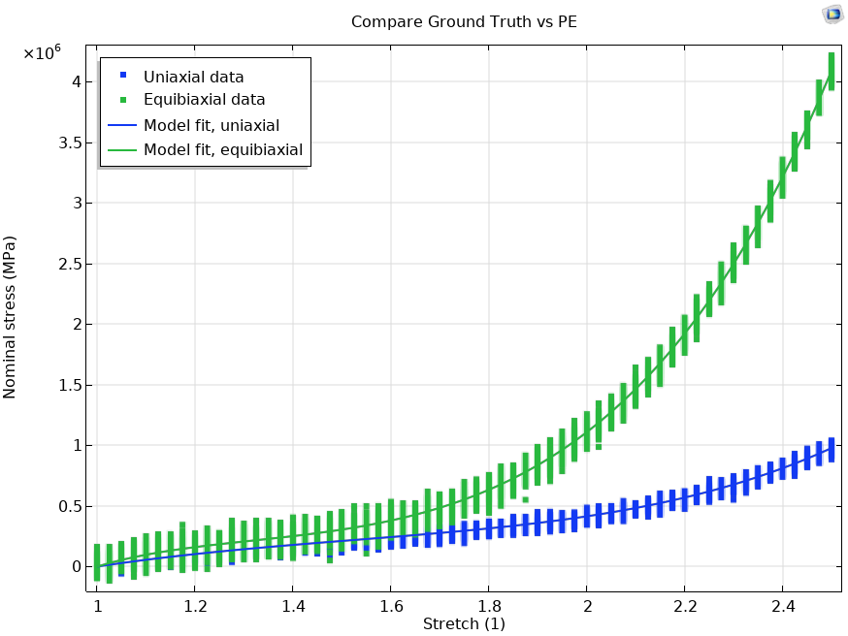
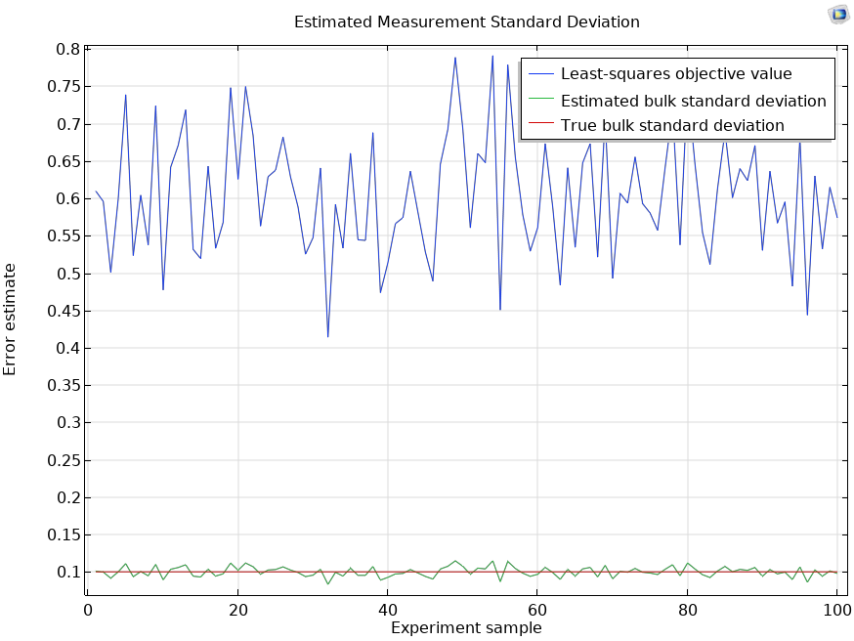
Parameter Estimation Results
Accurate model fit for both uniaxial and equibiaxial data as well as the estimated error

Slide 7
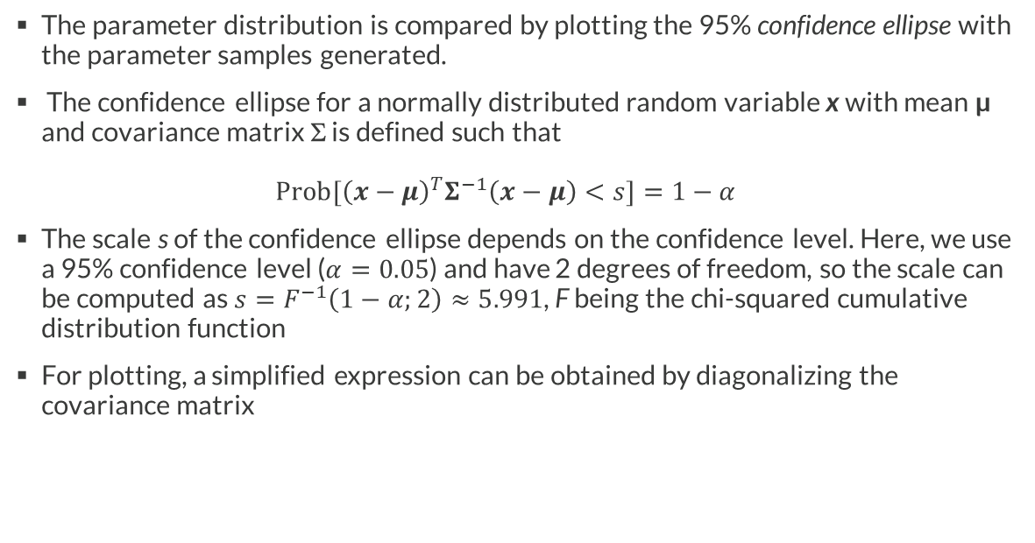
Confidence Ellipse
The parameter distribution is compared by plotting the 95% confidence ellipse with the parameter samples generated.
The confidence ellipse for a normally distributed random variable x with mean µ and covariance matrix Σ is defined such that
${Prob[\left(x−μ\right)}^{T}Σ^{−1}\left(x−μ\right)<s]=1−α$
The scale s of the confidence ellipse depends on the confidence level. Here, we use a 95% confidence level ($α=0.05$) and have 2 degrees of freedom, so the scale can be computed as$s=F^{−1}\left(1−α;2\right)≈5.991$, F being the chi-squared cumulative distribution function
For plotting, a simplified expression can be obtained by diagonalizing the covariance matrix

Slide 8

Confidence Ellipse
The plot contains
The estimated parameters for different data sets as red dots
The magenta confidence ellipse is shown for the estimated parameters centered in the true parameter values*
Similarly, the black confidence ellipse is drawn based on the confidence interval, disregarding parameter correlation
Of the 100 samples, 92 fall within the covariance ellipse. For larger sample sizes, this will approach 95%
*For the confidence ellipse from a single sample, there is a 95 % probability that an ellipse centered around the estimated parameters contain the true values.

Slide 9
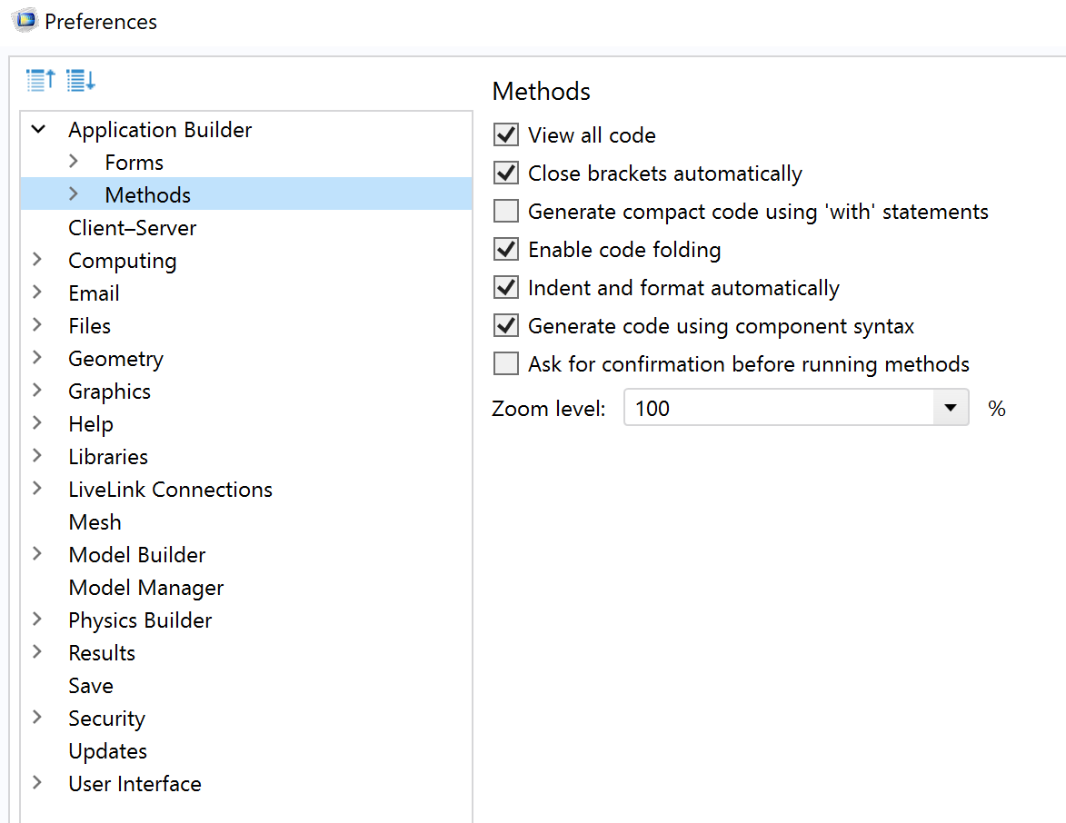
Appendix: Working with Model Methods
When working with model methods and the Application Builder, you can control the code preferences in the Application Builder section in the Preferences
  Select “View all code” to be able to see the utility methods computeEigenDecomposition and invertMatrix that are used in the calculation of the confidence ellipse

