Slide 1
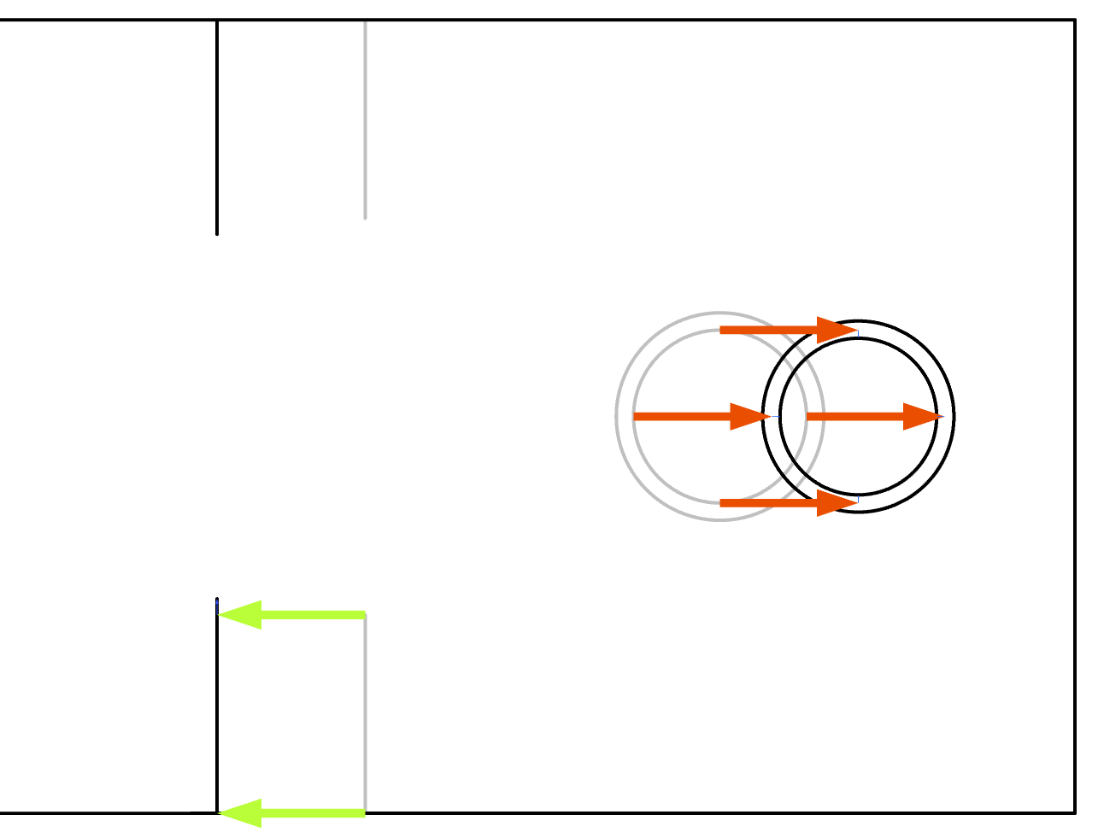
Shape Optimization of a Water Heater

Slide 2
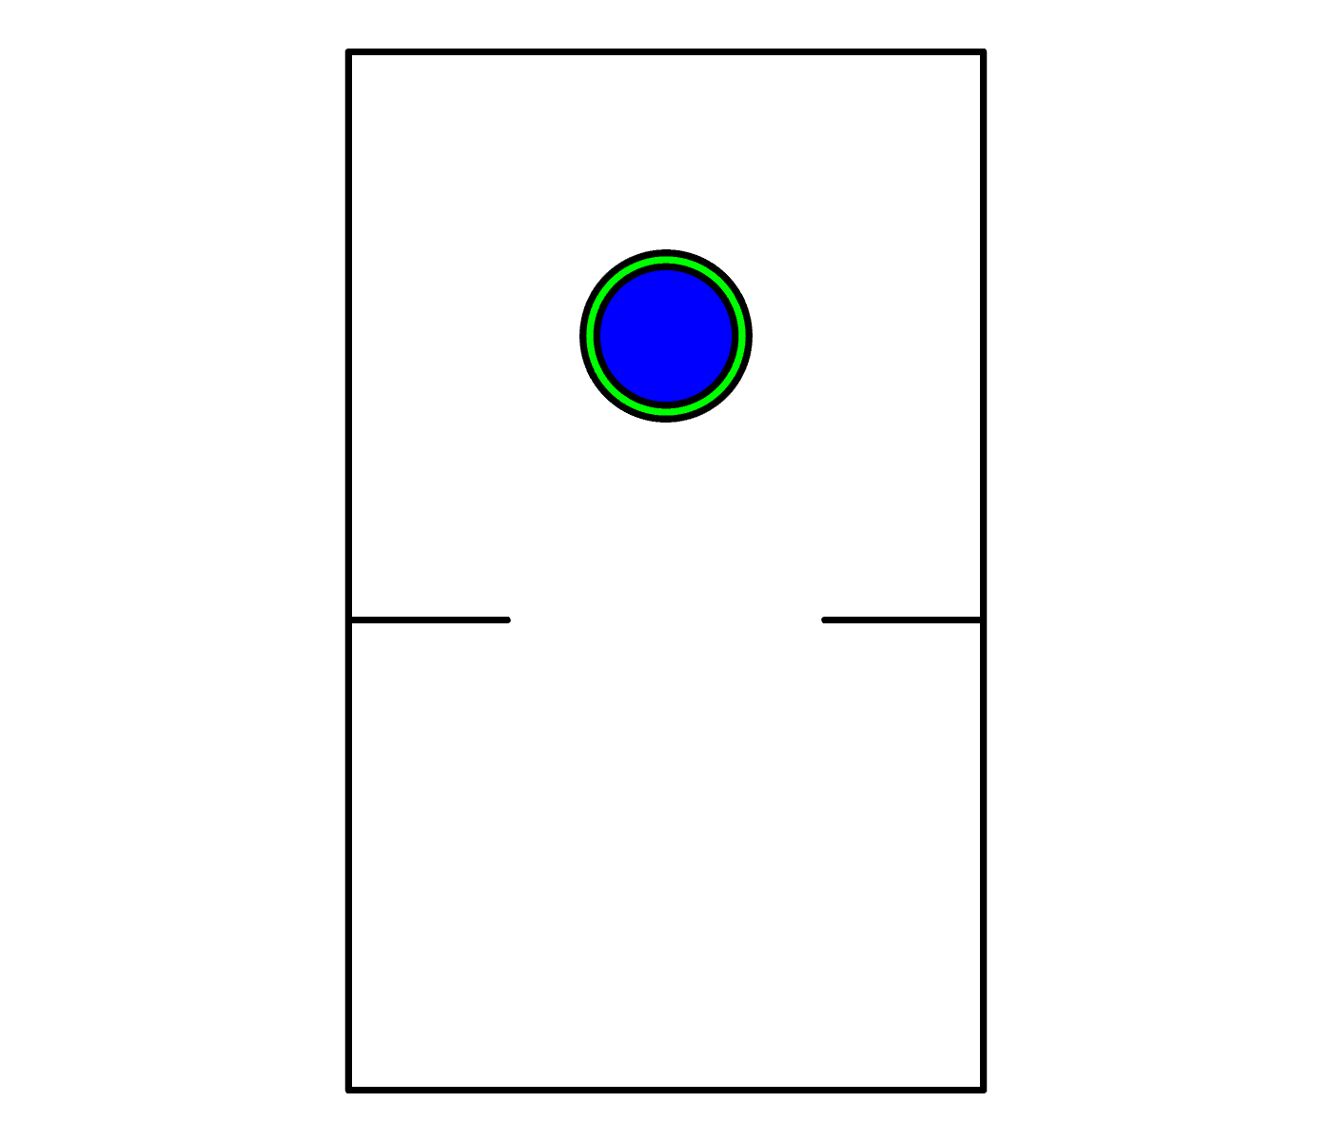
Shape Optimization of a Water Heater
Controls
Pipe diameter and position is controlled by Transformation 1
Chamber size (top) is controlled by Transformation 2.
A General Extrusion operator maintains the wall thickness of the pipe.
The heating in the water domain is used as objective.
Implemented as a constraint to trigger termination for satisfying performance.
Water
Pipe
Air
Port
Shape Optimization of a Water Heater

Slide 3
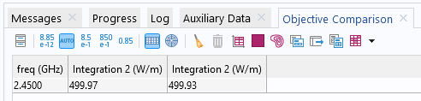
Shape Optimization of a Water Heater
Verification
The optimization produces distorted mesh elements, which can decrease the solution accuracy, so we perform a verification.
A Filter dataset is used to transfer the optimized design to a new component.
The use of material links and coordinate based selections in the optimization component simplifies the setup of the verification.
The objective in the verification component is almost identical.
Shape Optimization of a Water Heater

