Slide 1
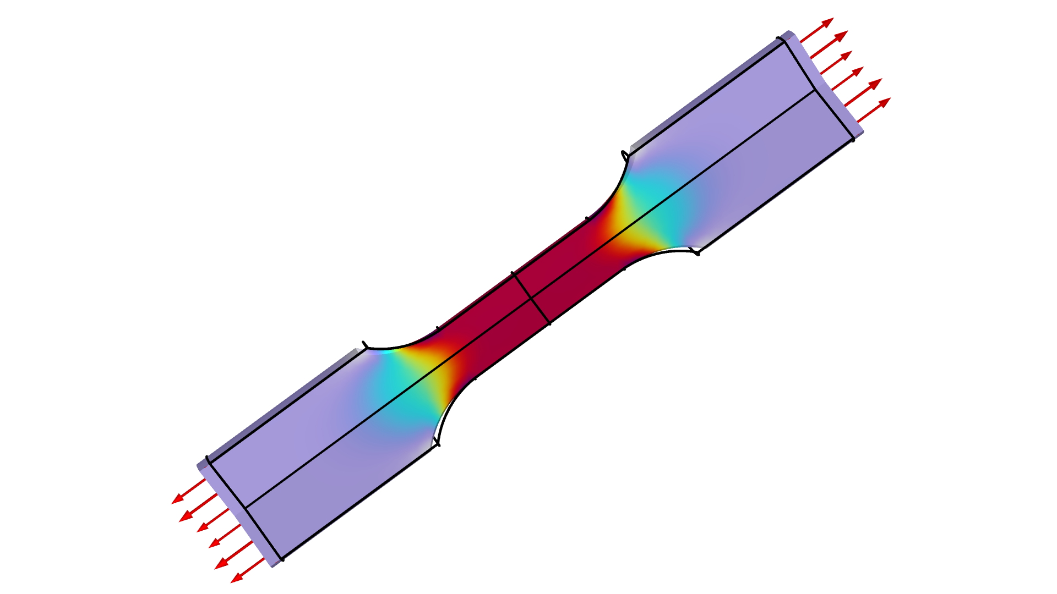
Parameter Estimation for a Tensile Test using
Maximum Likelihood

Slide 2

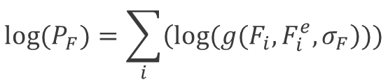
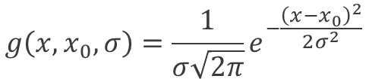
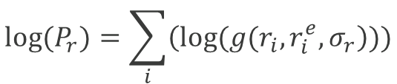
Maximum Likelihood Theory
Likelihood estimation
Output noise is expected to be normally distributed.
Probabilities are multiplied, but for numerical reasons, we estimate the logarithm of the likelihood.
Separate control variables are added for the force and radial displacement noise.
The negative logarithm of the probability is used as objective function.
$$g\left(x,x_{0},σ\right)=\frac{1}{σ\sqrt{2π}}e^{−\frac{{\left(x−x_{0}\right)}^{2}}{2σ^{2}}}$$
$$P=P_{F}P_{r}⇔\log\left(P\right)=\log\left(P_{F}\right)+log⁡(P_{r})$$
$${log⁡(P}_{F})=\sum_{i}{\left(log⁡(g(F_{i},F_{i}^{e},σ_{F}\right)))}$$
$${log⁡(P}_{r})=\sum_{i}{\left(log⁡(g(r_{i},r_{i}^{e},σ_{r}\right)))}$$
$$φ=−log⁡(P)$$
Parameter Estimation for a Tensile Test using Maximum Likelihood

Slide 3
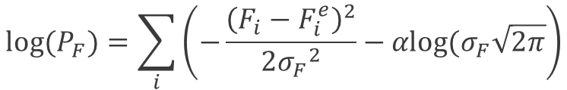
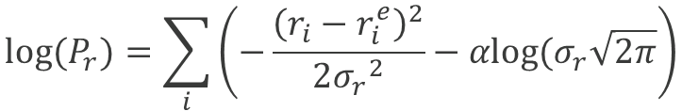


Parameter Estimation
Continuation – avoiding bad local minima
The objective consists of four terms
  Least-squares for force
  Least-squares for displacement
  Log term for force error
  Log term for displacement error
The optimization consists of two steps
  First the log terms are disregarded .
  Then the optimization is continued with the log terms .
$$g\left(x,x_{0},σ\right)=\frac{1}{σ\sqrt{2π}}e^{−\frac{{\left(x−x_{0}\right)}^{2}}{2σ^{2}}}$$
$$P=P_{F}P_{r}⇔\log\left(P\right)=\log\left(P_{F}\right)+log⁡(P_{r})$$
$${log⁡(P}_{F})=\sum_{i}{\left(−\frac{{\left(F_{i}−F_{i}^{e}\right)}^{2}}{2{σ_{F}}^{2}}−αlog⁡(σ_{F}\sqrt{2π}\right)}$$
$$(α=0)$$
$$(α=1)$$
$${log⁡(P}_{r})=\sum_{i}{\left(−\frac{{\left(r_{i}−r_{i}^{e}\right)}^{2}}{2{σ_{r}}^{2}}−αlog⁡(σ_{r}\sqrt{2π}\right)}$$
$$φ=−log⁡(P)$$
Parameter Estimation for a Tensile Test using Maximum Likelihood

Slide 4
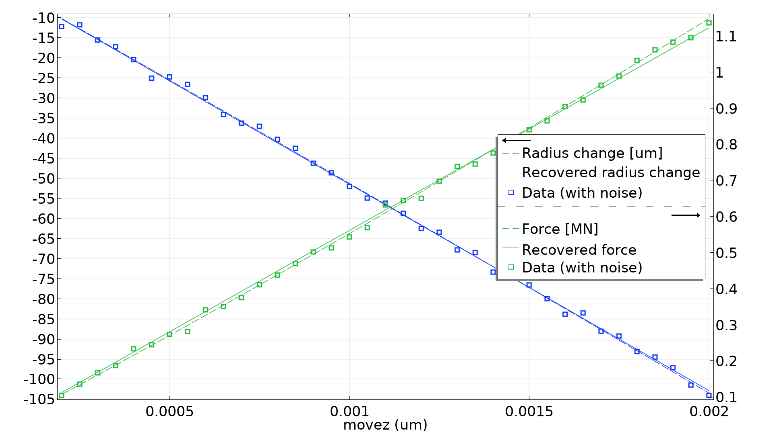
Results
The model has two studies
The 1st study generates synthetic data for the
  Tensile force
  Radial displacement
The 2nd study recovers two material parameters
  The Young’s Modulus
  The Poisson ratio
The synthetic noise is normally distributed
  10 kN standard deviation for the force
  1 µm standard deviation for the displacement
This results in 6 % error for the parameters and 25 % error for the noise.
Maximum likelihood avoids scaling issues and allows recovery of synthetic noise, but requires initial estimates of noise.
Parameter Estimation for a Tensile Test using Maximum Likelihood

