Slide 1
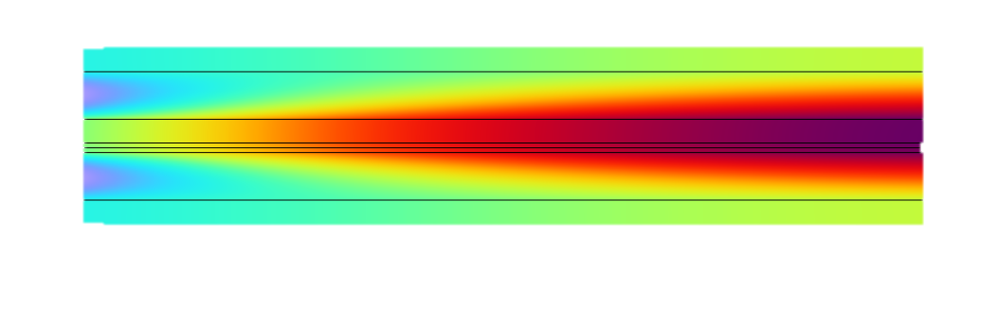
Water and Carbon Dioxide Co-Electrolysis in a Solid Oxide Electrolyzer Cell
COMSOL

Slide 2
Overview
A solid oxide electrolyzer cell model is presented here for co-electrolysis of H₂O and CO₂
The model includes the full coupling between the mass balances and gas flow in the H₂ and O₂ gas diffusion electrodes, the momentum balances in the H2 and O2 gas flow channels, the energy balance across the cell, the balance of the ionic current carried by the oxide ion, and an electronic-current balance
A reversible water gas shift reaction is included in the H₂ gas diffusion electrode and H₂ gas flow channel
The model computes the spatial distributions of the various species across the gas diffusion electrodes and gas flow channels
The spatial distribution of the total current density along the electrode length is also evaluated in the model using the general projection operator

Slide 3

Model Geometry
Interconnect
Gas Flow Channel
Gas Diffusion Electrode
Membrane
Gas Diffusion Electrode
Gas Flow Channel
Interconnect
Geometry defined in 2D
  Includes gas diffusion electrode, gas flow channel and interconnect for the anode and cathode in addition to membrane
The modeled species in H2 Gas Mixture (Cathode): H₂, H₂O, CO₂ and CO
The modeled species in O2 Gas Mixture (Anode): O₂ and N₂

Slide 4
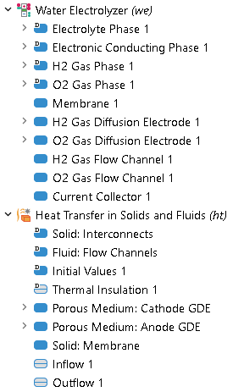
Model Definition
H₂O electrolysis reaction occurs at the H₂ gas diffusion electrode
  2H₂O(g) + 4e⁻ → 2H₂(g) + 2O²⁻
CO₂ electrolysis reaction occurs at the H₂ gas diffusion electrode
  CO₂(g) + 2e⁻ → CO (g) + O²⁻
Oxygen ions are oxidized to form oxygen gas at the O₂ gas diffusion electrode
  2O²⁻ → O₂(g) + 4e⁻
A reversible water gas shift reaction occurs at the H₂ gas diffusion electrode and H₂ gas flow channel
  CO(g) + H₂O(g) CO₂(g) + H₂(g)

Slide 5
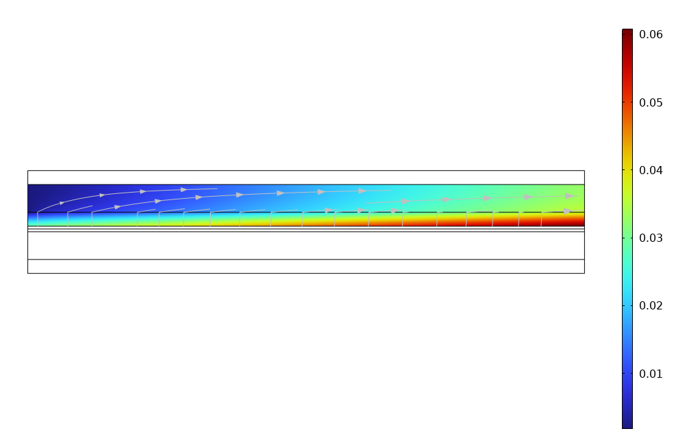
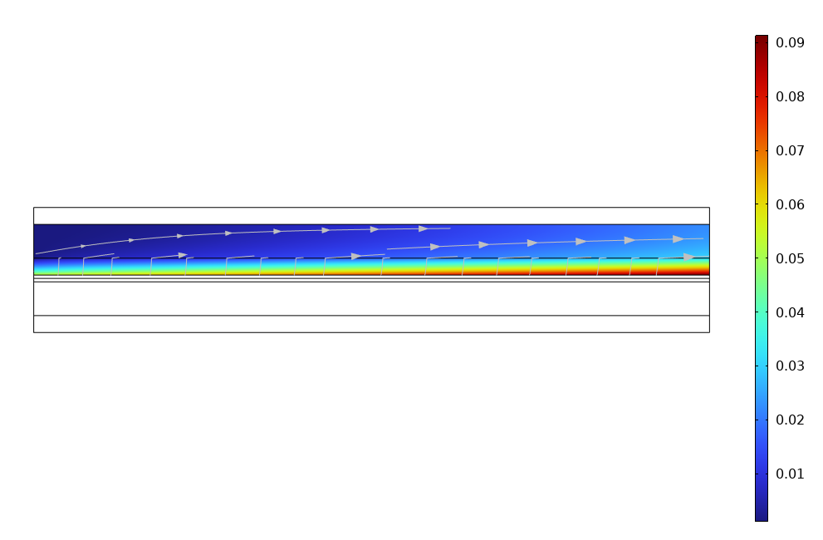
H₂ and CO Concentrations
H₂ concentration at applied potential = 1.5 V
CO concentration at applied potential = 1.5 V
H₂ and CO concentrations are found to increase along the electrode length due to H₂O and CO₂ electrolysis reactions, respectively, for applied potential of 1.5 V
Difference in concentration between the H₂ gas diffusion electrode and H₂ gas flow channel is considerably higher for CO when compared to H₂, which is attributed to slower diffusion of CO than H₂

Slide 6
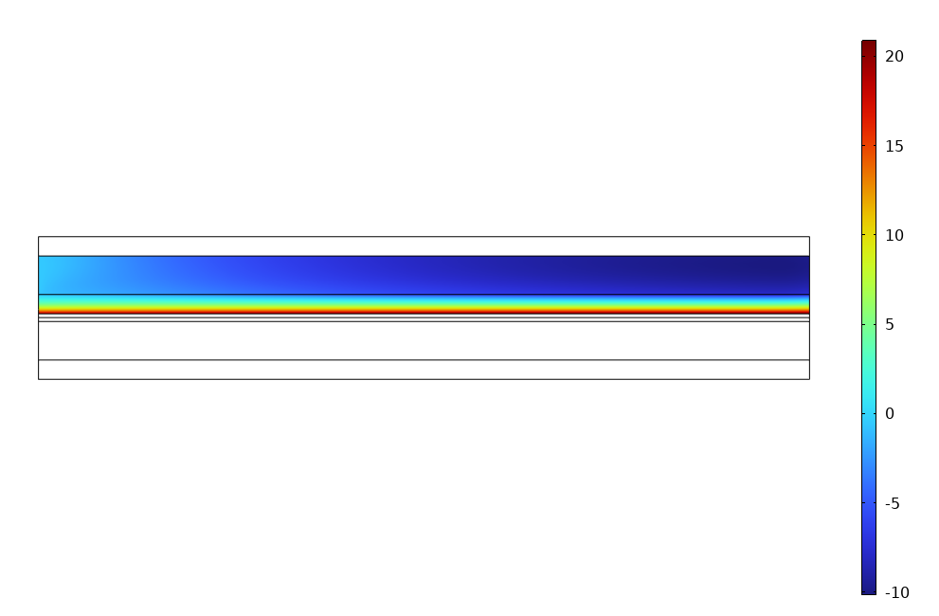
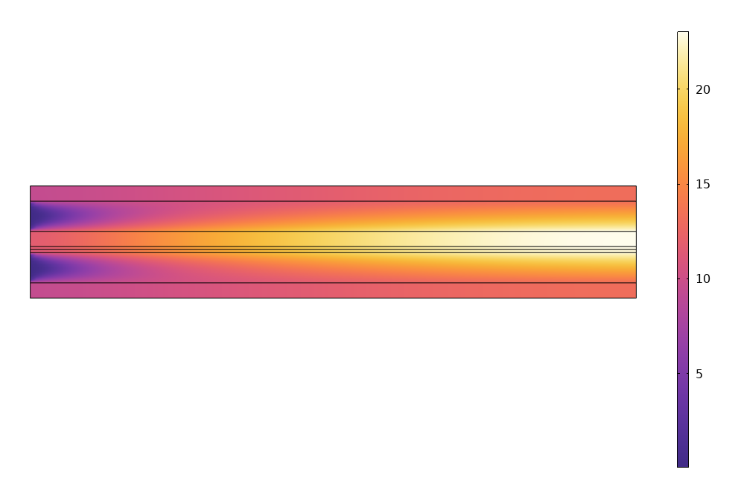
Water Gas Shift Reaction Rate and Temperature
Water gas shift reaction rate at applied potential = 1.5 V
Change in temperature at applied potential = 1.5 V
The rate of water gas shift reaction is found to be higher closer to the H₂ gas diffusion electrode-membrane interface for applied potential of 1.5 V, which is attributed to the high CO concentration in the region
Although both H₂O and CO₂ electrolysis reactions are endothermic, the cell temperature is increased by about 25 K from inlet to outlet for applied potential of 1.5 V. As this applied potential is higher than the thermoneutral potential for both H₂O and CO₂ electrolysis reactions, the heat generated from overpotential losses is more than the heat required for electrolysis reactions.

Slide 7
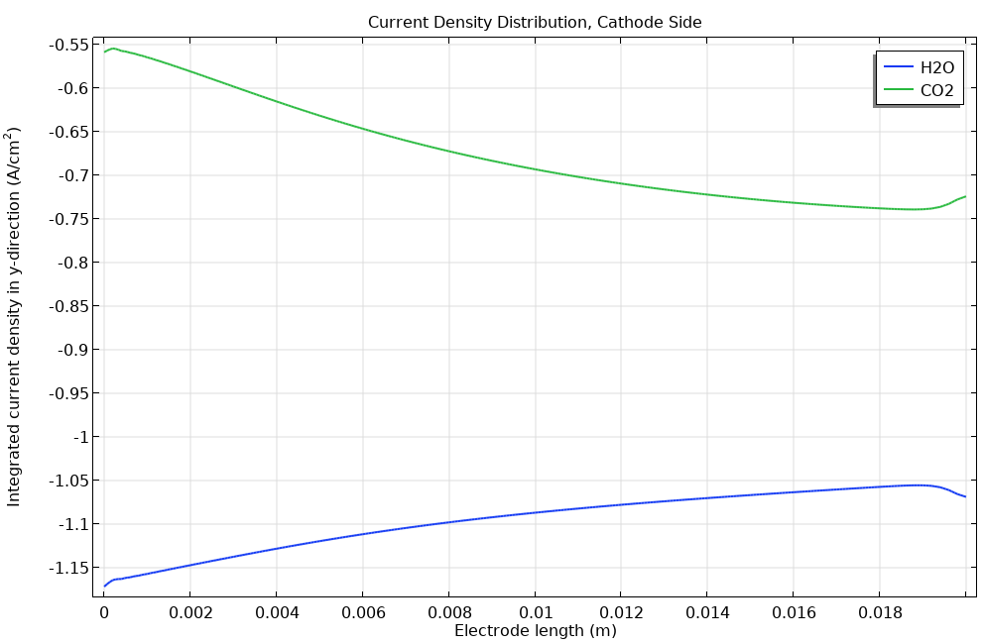
Total Current Density
Total current density at applied potential = 1.5 V
The total cathodic (negative) current density, which is integrated along the y-direction for each grid point along the x-direction using the general projection operator, is found to decrease for H₂O electrolysis and to increase for CO₂ electrolysis, along the electrode length

Slide 8
References
M. Ni, “2D thermal modeling of a solid oxide electrolyzer cell (SOEC) for syngas production by H2O/CO2 co-electrolysis”, International Journal of Hydrogen Energy, Vol. 32, pp. 6389-6399 (2012)

