Slide 1
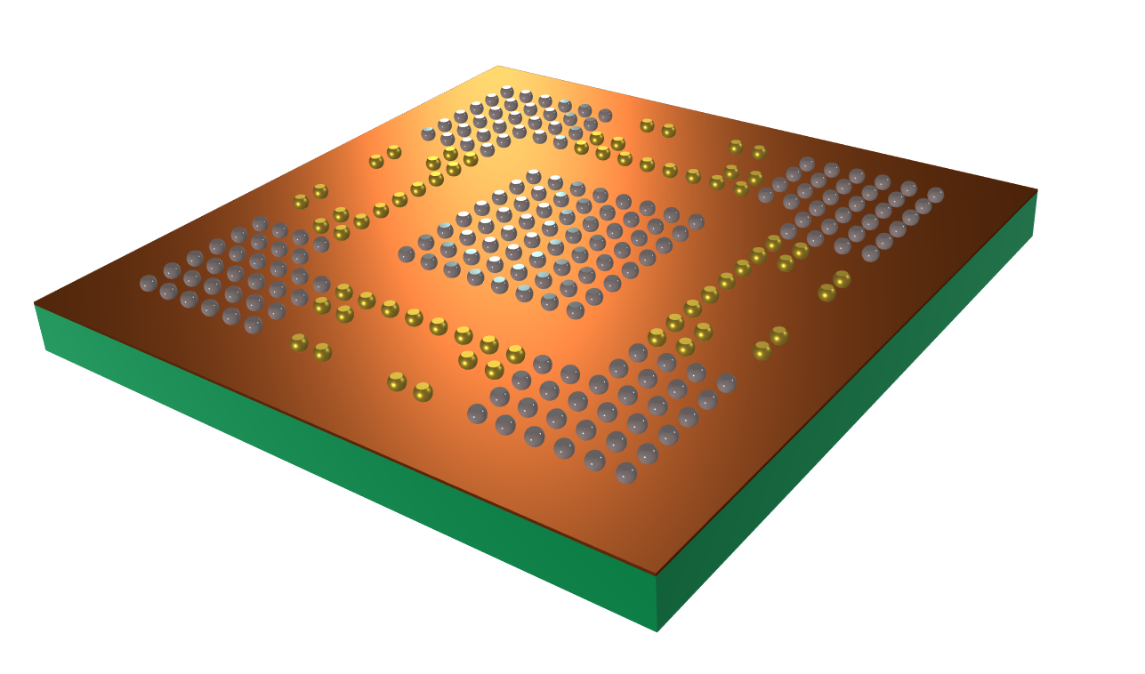
Optimization of the Solder Ball Array to Minimize Chip Warpage
COMSOL

Slide 2
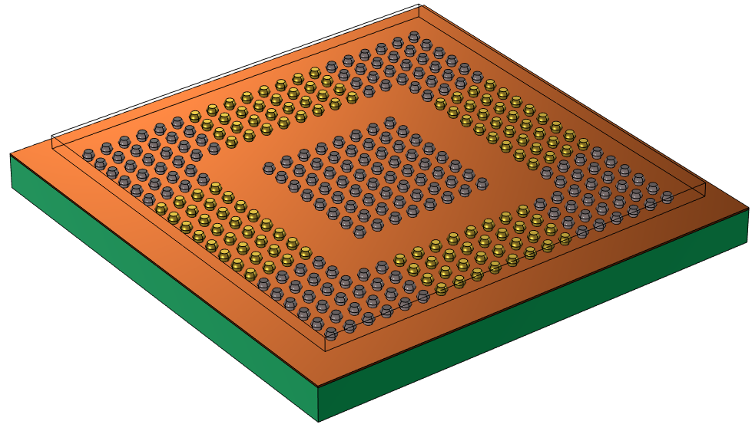
Introduction
BGA (Ball Grid Array) technology is a surface-mount packaging technology used in electronic packaging.
This model demonstrates the optimization of the arrangement of the support solder balls to minimize the warpage during operation.
The target of the optimization is to minimize the warpage of chip as the temperature is changed from room temperature to the operating temperature (70 ˚C).

Slide 3
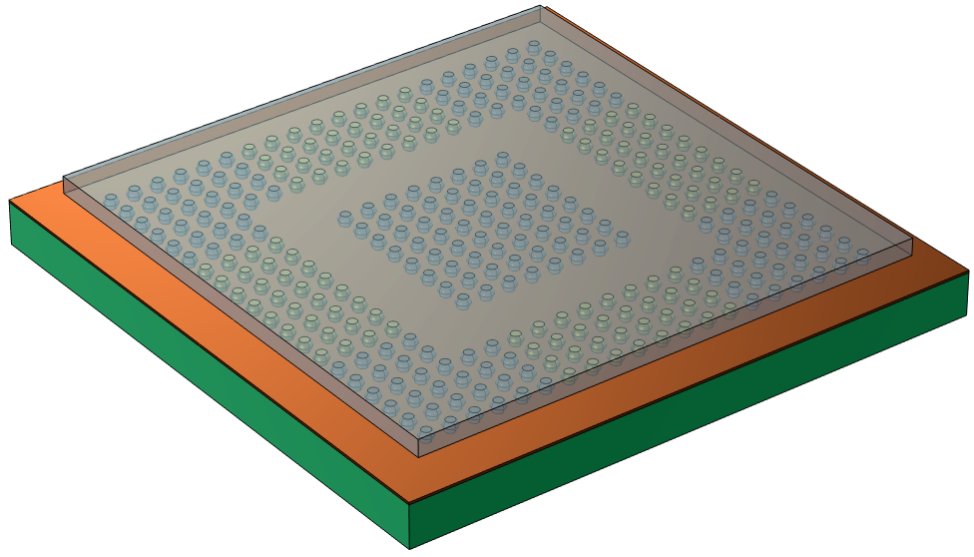
Model Definition
Chip
BGAs
Copper Layer
Two types of solder balls are considered in the layout.
Functional solder balls (grey): they are required to achieve electric connection. Usually the position of the functional solder balls are fixed.
Support solder balls (gold): they are used for mechanical connection reinforcement.
To minimize the warpage, whether the support solder balls should be placed in its grid is studied based on the optimization methods.
PCB
Functional solder balls
Support solder balls (Optimized area)

Slide 4
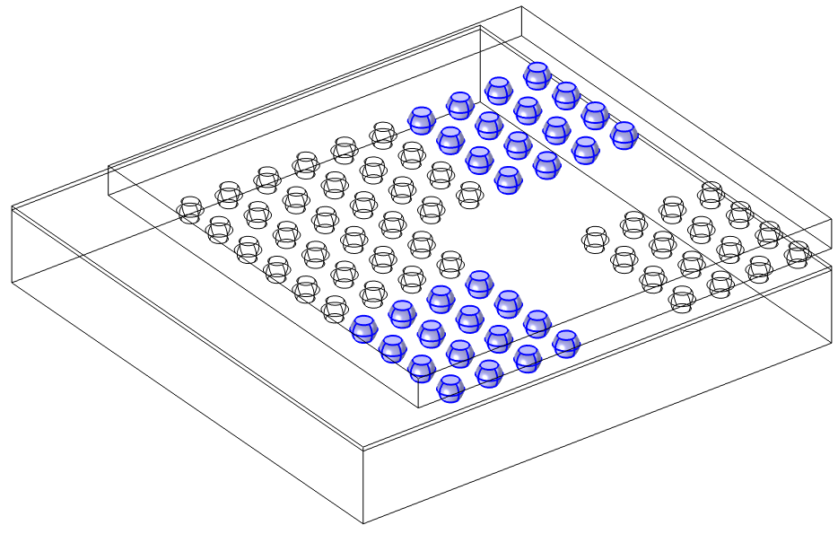
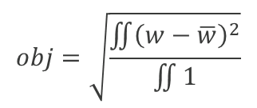
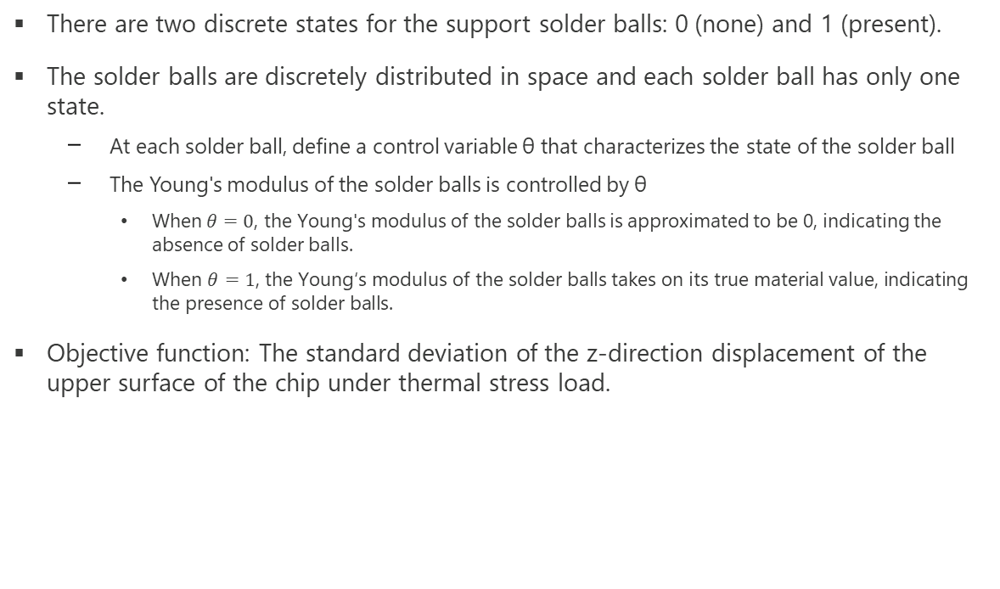
Model Definition
There are two discrete states for the support solder balls: 0 (none) and 1 (present).
The solder balls are discretely distributed in space and each solder ball has only one state.
At each solder ball, define a control variable θ that characterizes the state of the solder ball
The Young's modulus of the solder balls is controlled by θ
When$θ=0$, the Young's modulus of the solder balls is approximated to be 0, indicating the absence of solder balls.
$\text{When} θ=1\text{, }\text{the} \text{Young}\text{′}\text{s} \text{modulus} \text{of} \text{the} \text{solder} \text{balls} \text{takes} \text{on} \text{its} \text{true} \text{material} \text{value}\text{, }\text{indicating} \text{the} \text{presence} \text{of} \text{solder} \text{balls}\text{.}$
Objective function: The standard deviation of the z-direction displacement of the upper surface of the chip under thermal stress load.
Define a state variable for each solder ball

Slide 5
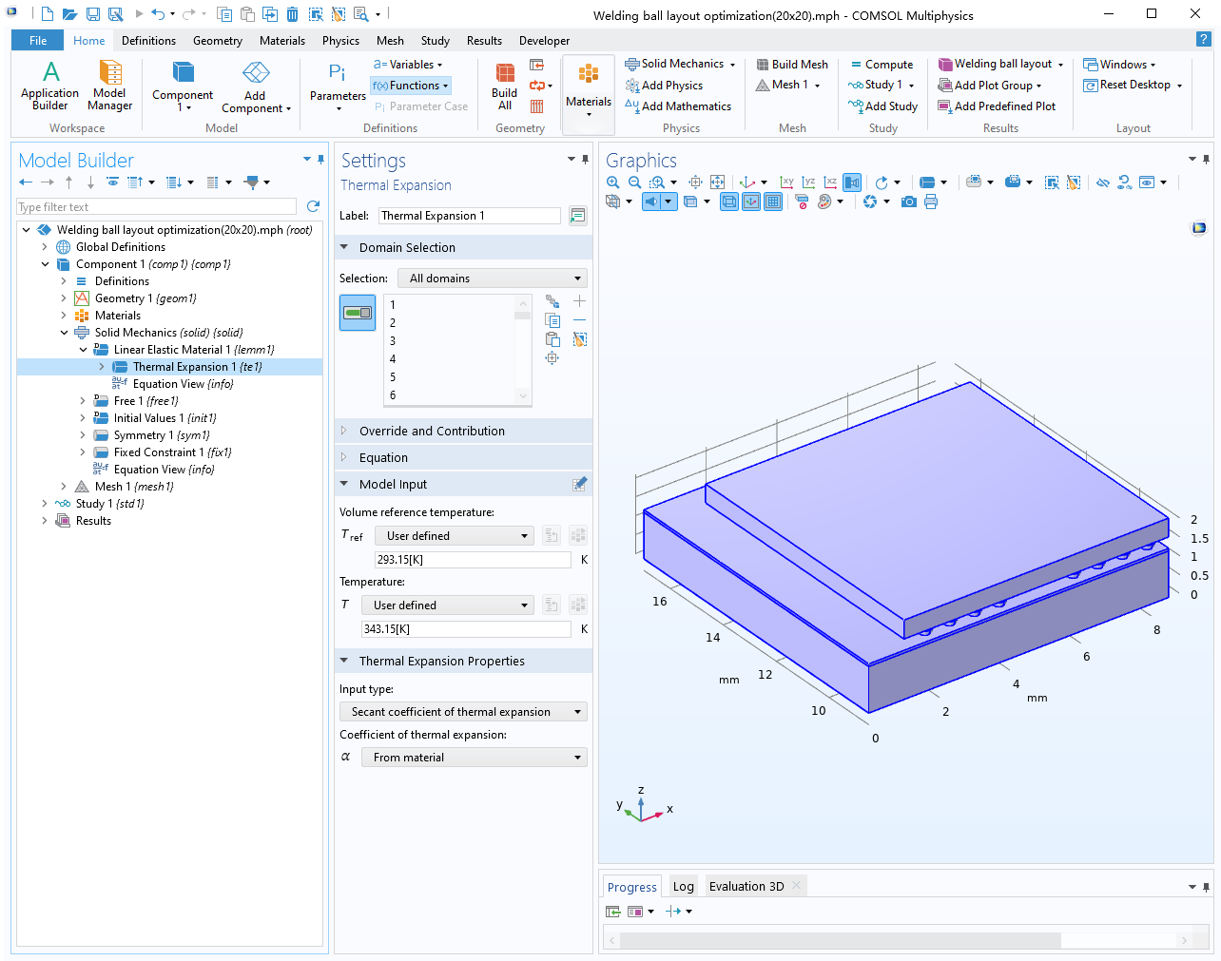
Physics Settings
Thermal Expansion: The temperature rises from 20 ˚C to 70 ˚C.
The bottom of the PCB board is fixed.

Slide 6
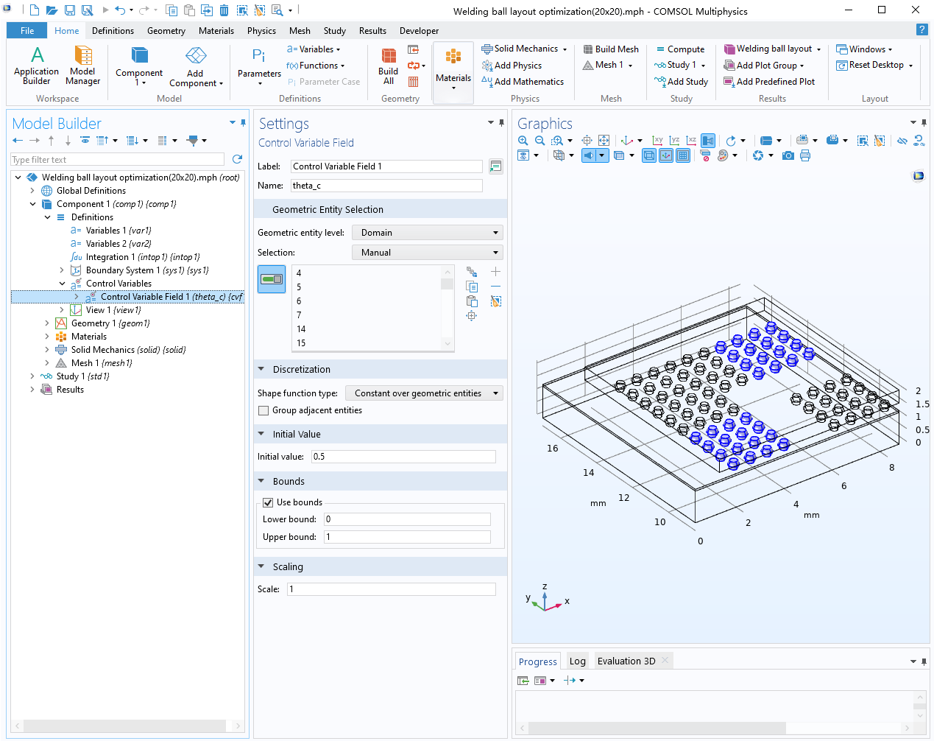
Control Variable Field Settings
Add a control variable field sub-node
Select each solder ball that needs to be optimized
Shape function type: Constant over geometric entities
Set boundary from 0 to 1
Define extra objective function to avoid unphysical values

Slide 7
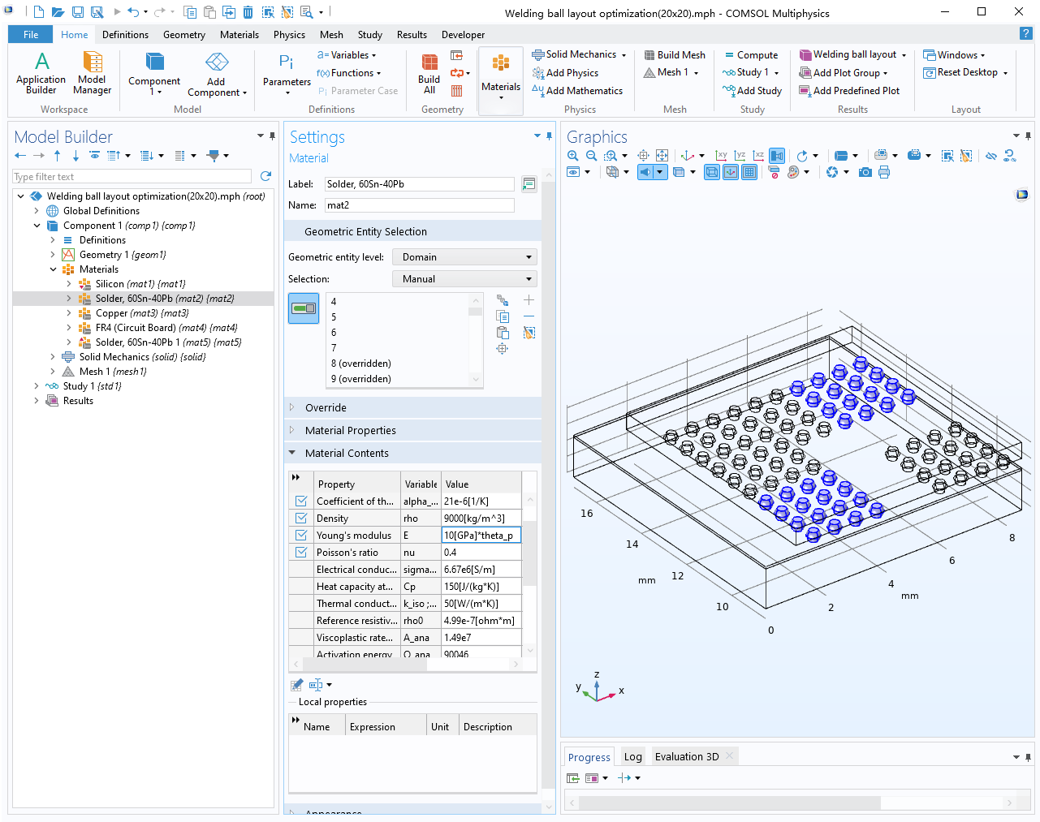
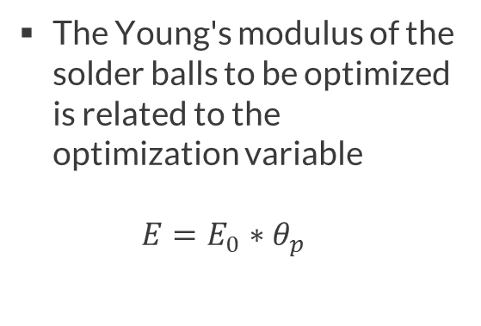
Material Property Settings
The Young's modulus of the solder balls to be optimized is related to the optimization variable $E=E_{0}∗θ_{p}$

Slide 8
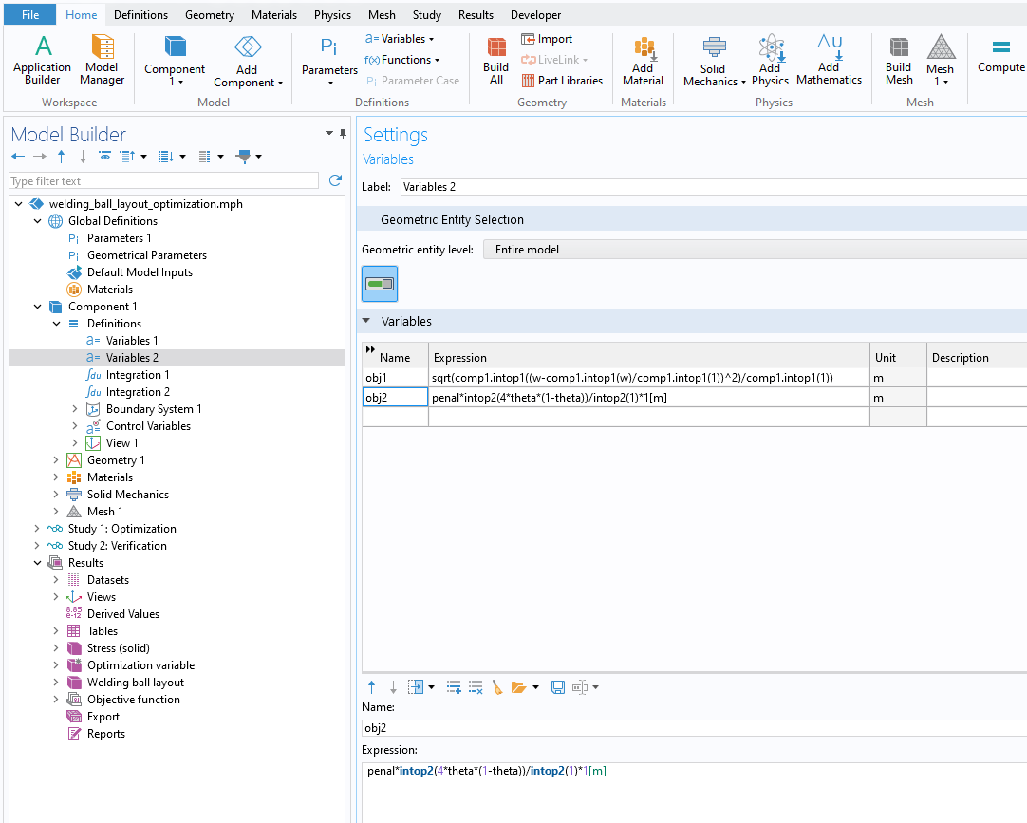
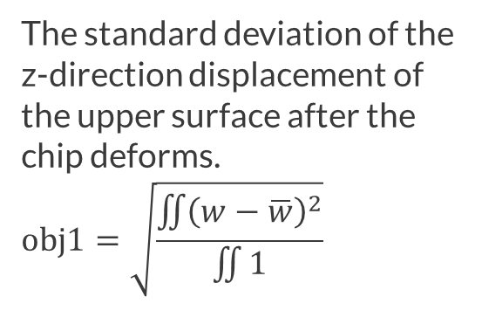
Objective Function
The standard deviation of the z-direction displacement of the upper surface after the chip deforms. $$obj1=\sqrt{\frac{\iint{{\left(w−\overline{w}\right)}^{2}}}{\iint{1}}}$$

Slide 9
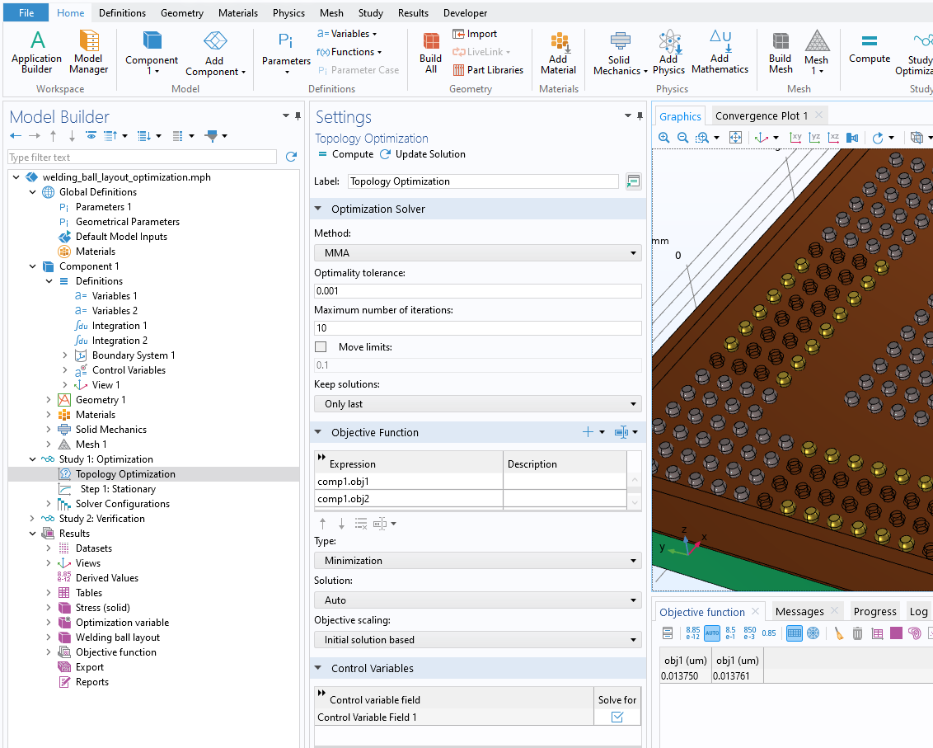
Optimization Study
Select the MMA optimization solver
Add both objectives
z-displacement
Intermediate material

Slide 10
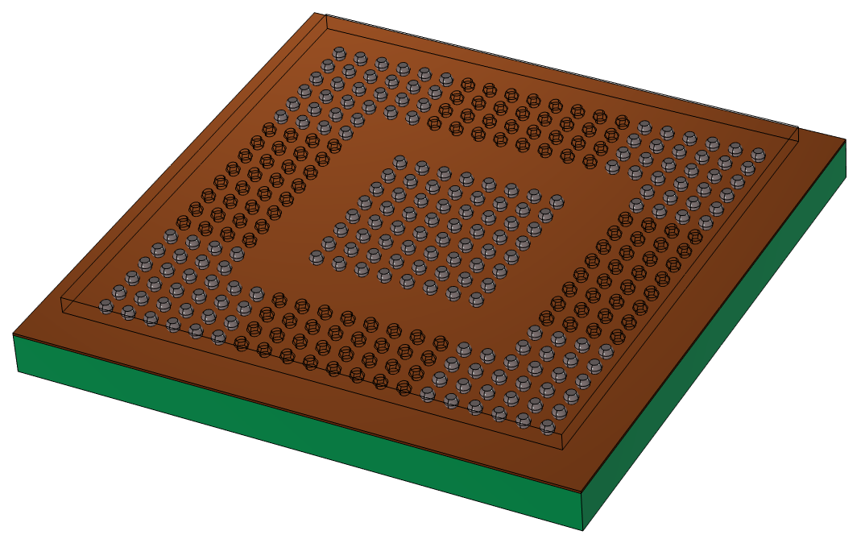
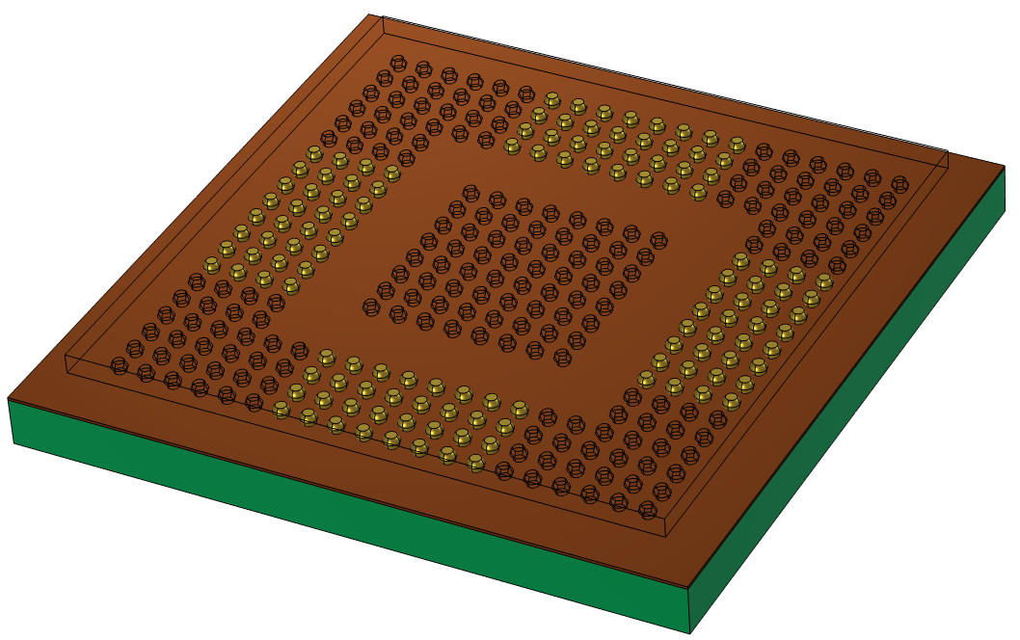
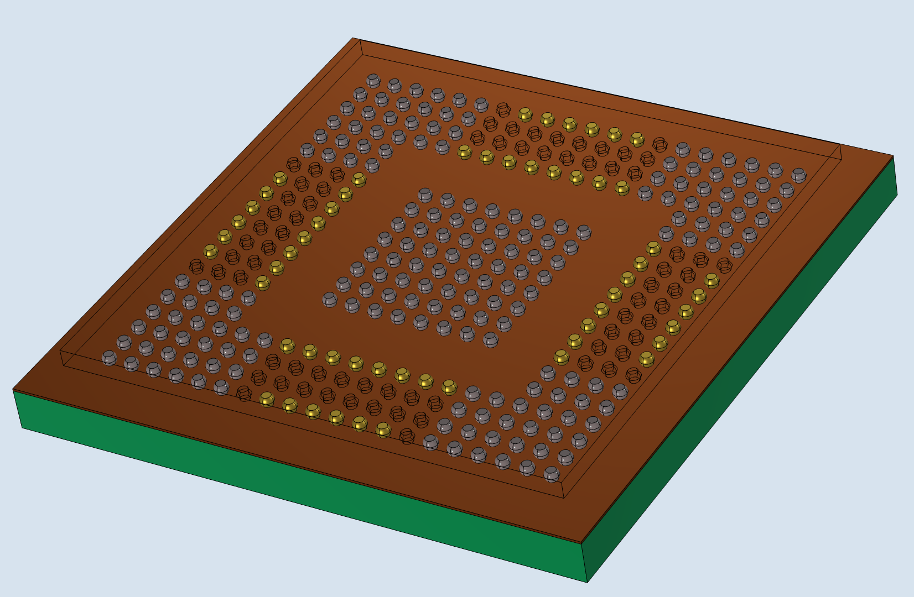
Results
Distribution of Functional Solder Balls
Distribution of Support Solder Balls
Optimized Solder Ball Distribution

Slide 11
Verification
Only functional solder balls: 𝑜𝑏𝑗=0.0262 𝑢𝑚
With all support solder balls: 𝑜𝑏𝑗=0.0162 𝑢𝑚
With optimized solder balls: 𝑜𝑏𝑗=0.0138 𝑢𝑚

