Slide 1
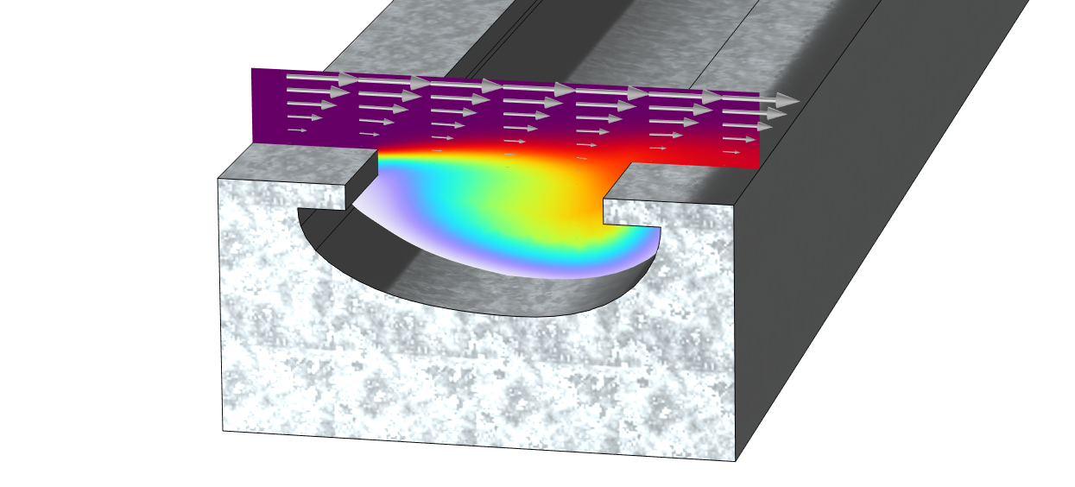
Optimization of Chemical Etching

Slide 2
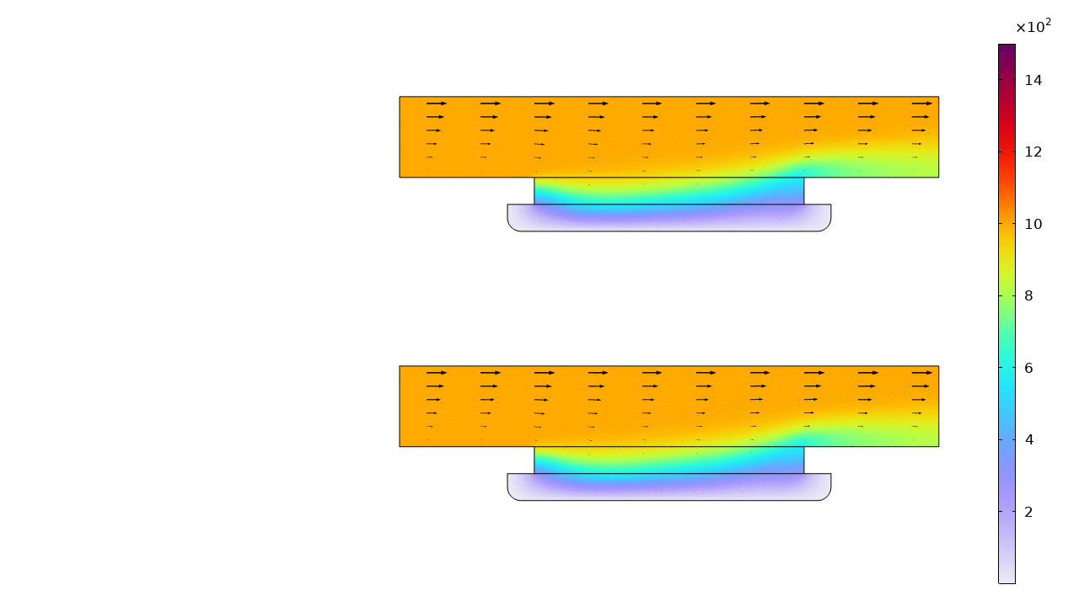
Forward problem
Chemical Engineering
Enforce concentration on left and top boundaries
Out flow on left boundary
Reaction term in bottom
Fluid Dynamics
Drive flow from top boundary
Open boundaries on left and right
Follow mesh movement elsewhere
Deformed Geometry
Normal mesh velocity depending on reaction term
Etching process before optimization

Slide 3
Optimization
Objective
Minimize asymmetry at final time
Controls
Control Functions for
  Varying imposed reaction in time
  Varying imposed convection in time
Solver
Method of Moving Asymptotes (MMA)
Etching process before and after optimization

