Slide 1
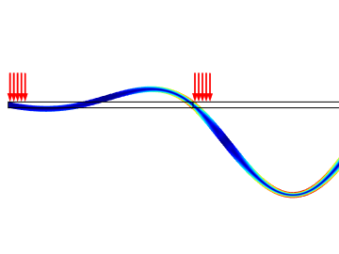
Traveling Load
Model DB 20401

Slide 2
Purpose
Show how to model loads which move along the structure as function of time
Display how different load speeds and spatial periodicities can excite resonances in a structure.

Slide 3
Model
Continuous beam on equally spaced supports
  Modeled with 2D plane stress; only COMSOL Multiphysics required
Equally spaced blocks of loads travel with a constant velocity to the right
All aspects are parameterized:
  Number of spans, Span width, Load speed, Load block width,
  Load block spacing, …

Slide 4
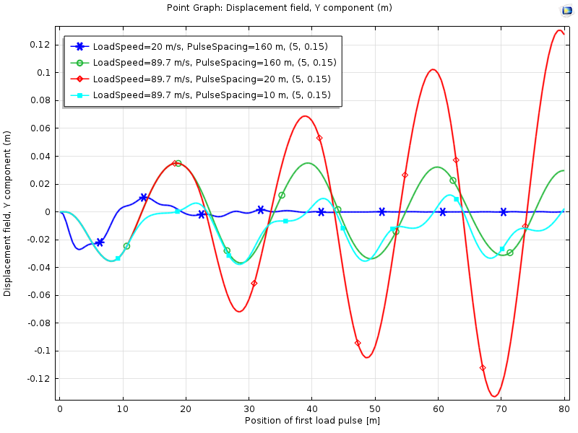
Results
Vertical displacement at midpoint of first span

Slide 5
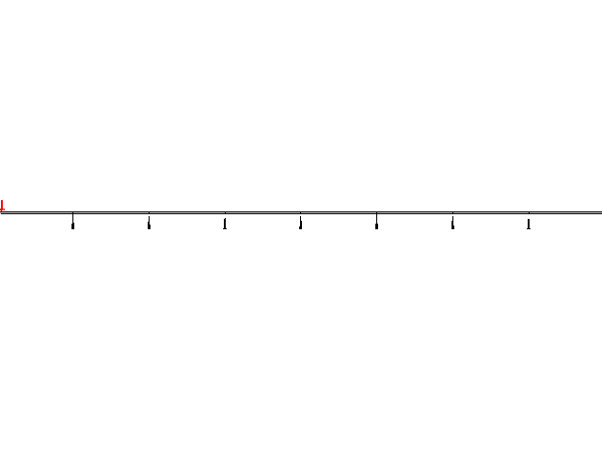

Animations
Low speed, 1 load block
Resonance speed, 1 load block
Resonance speed, load blocks with spacing = 2 spans
Resonance speed, load blocks with spacing = 1 span

