Slide 1
Geometrical View Factor Computation
Computing the view factors between two spheres with the Heat Transfer Module

Slide 2
Summary
When simulating surface-to-surface radiation, we rely on the view factors between elements of diffuse surfaces that emit and receive radiation. To compute surface-to-surface radiation in a given geometry, operators are created by the heat interface and can be used to evaluate view factors in postprocessing.
This model shows how to compute view factors using the operators provided by surface-to-surface radiation features. The geometric configuration consists of two concentric spheres, and the results include computed view factors, which are compared with analytical values.

Slide 3
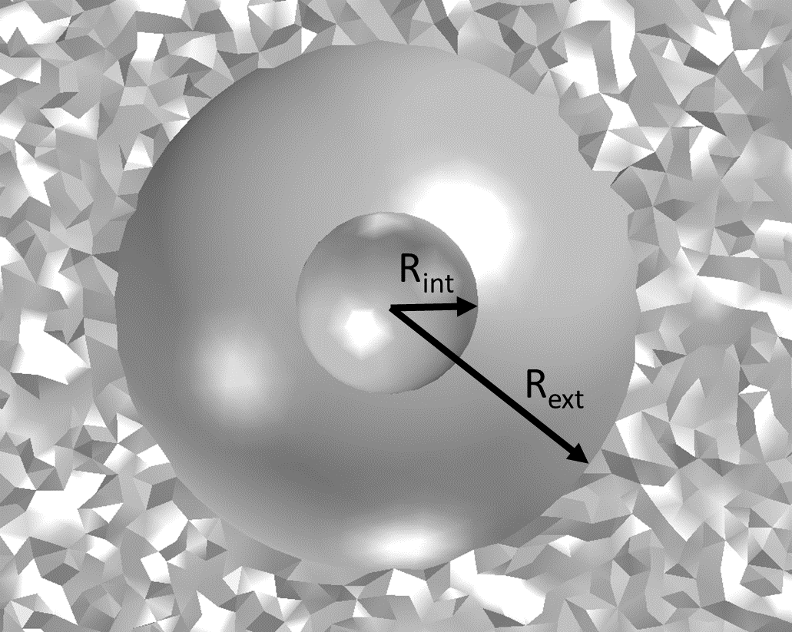
Geometrical Configuration
This simple geometry consists of two concentric spheres

Slide 4
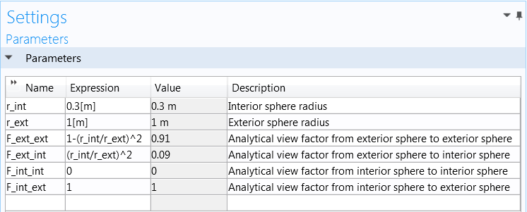
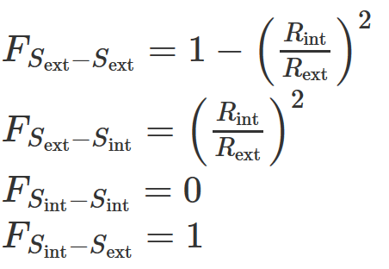
Analytical results

Slide 5
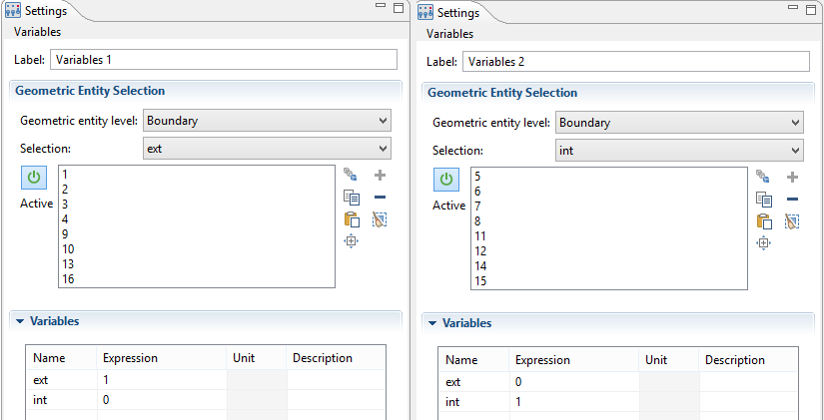
Surface Indicator
The ‘ext’ and ‘int’ variables are used as identity functions for exterior and interior surfaces

Slide 6
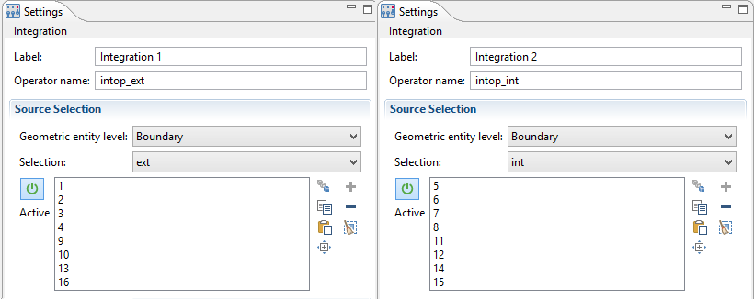
Surface Integral
The ‘intop_ext’ and ‘intop_int’ operators compute surface integrals on exterior and interior surfaces

Slide 7
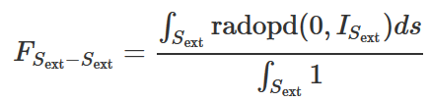

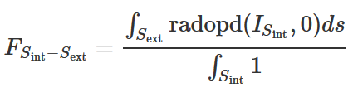

View Factor Computation
intop_ext(comp1.ht.radopd(0,ext))/intop_ext(1)
intop_ext(comp1.ht.radopd(int,0))/intop_int(1)

Slide 8
Results Table
 | Fint_int | Fint_ext | Fext_ext | Fext_int
Analytical | 0 | 1 | 0.91 | 0.09
Computed | 0 | 0.9975 | 0.9102 | 0.0899
Computed error | 0 | 0.0024 | 2.24e-4 | 1.03e-6

