Slide 1
Submodeling Analysis of a Shaft

Slide 2
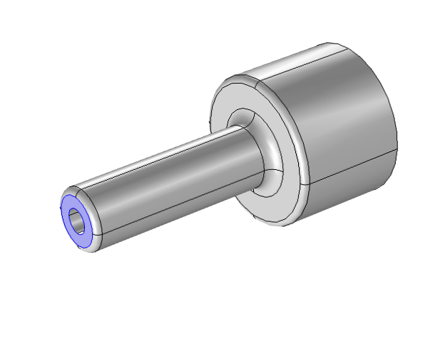
Model Description
Shaft with fillet
Clamp at one extremity
Tensile and bending load
Mechanical stress in the fillet region
F
Model geometry

Slide 3
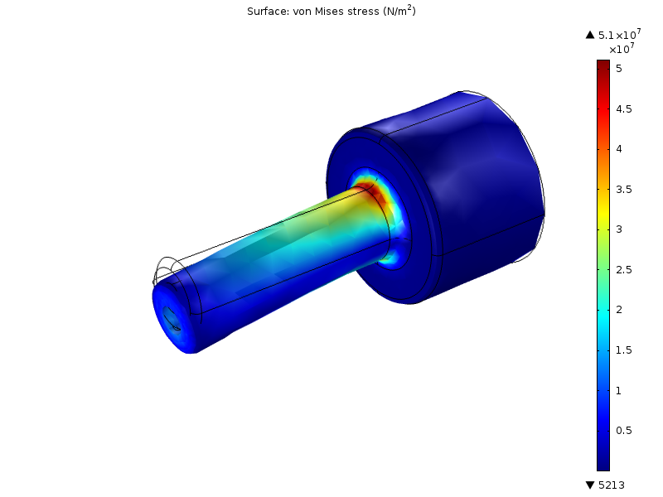
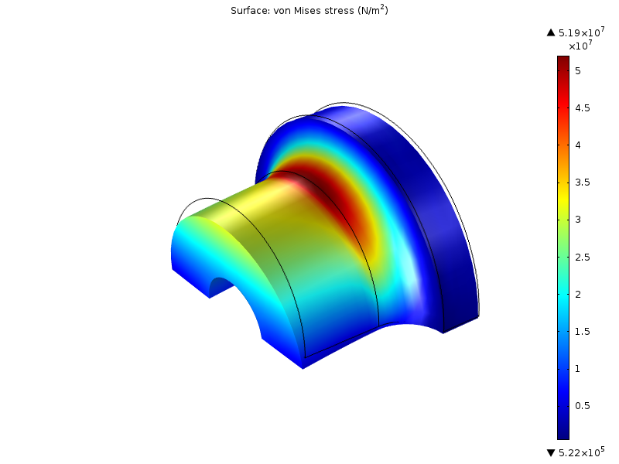
Concept of Submodeling
Refine the solution in a specific region without increasing the computational requirement
Link a global model (using the full geometry) with a submodel (using a detailed geometry)
Von Mises stress in the full model (top) and submodel (bottom)

Slide 4
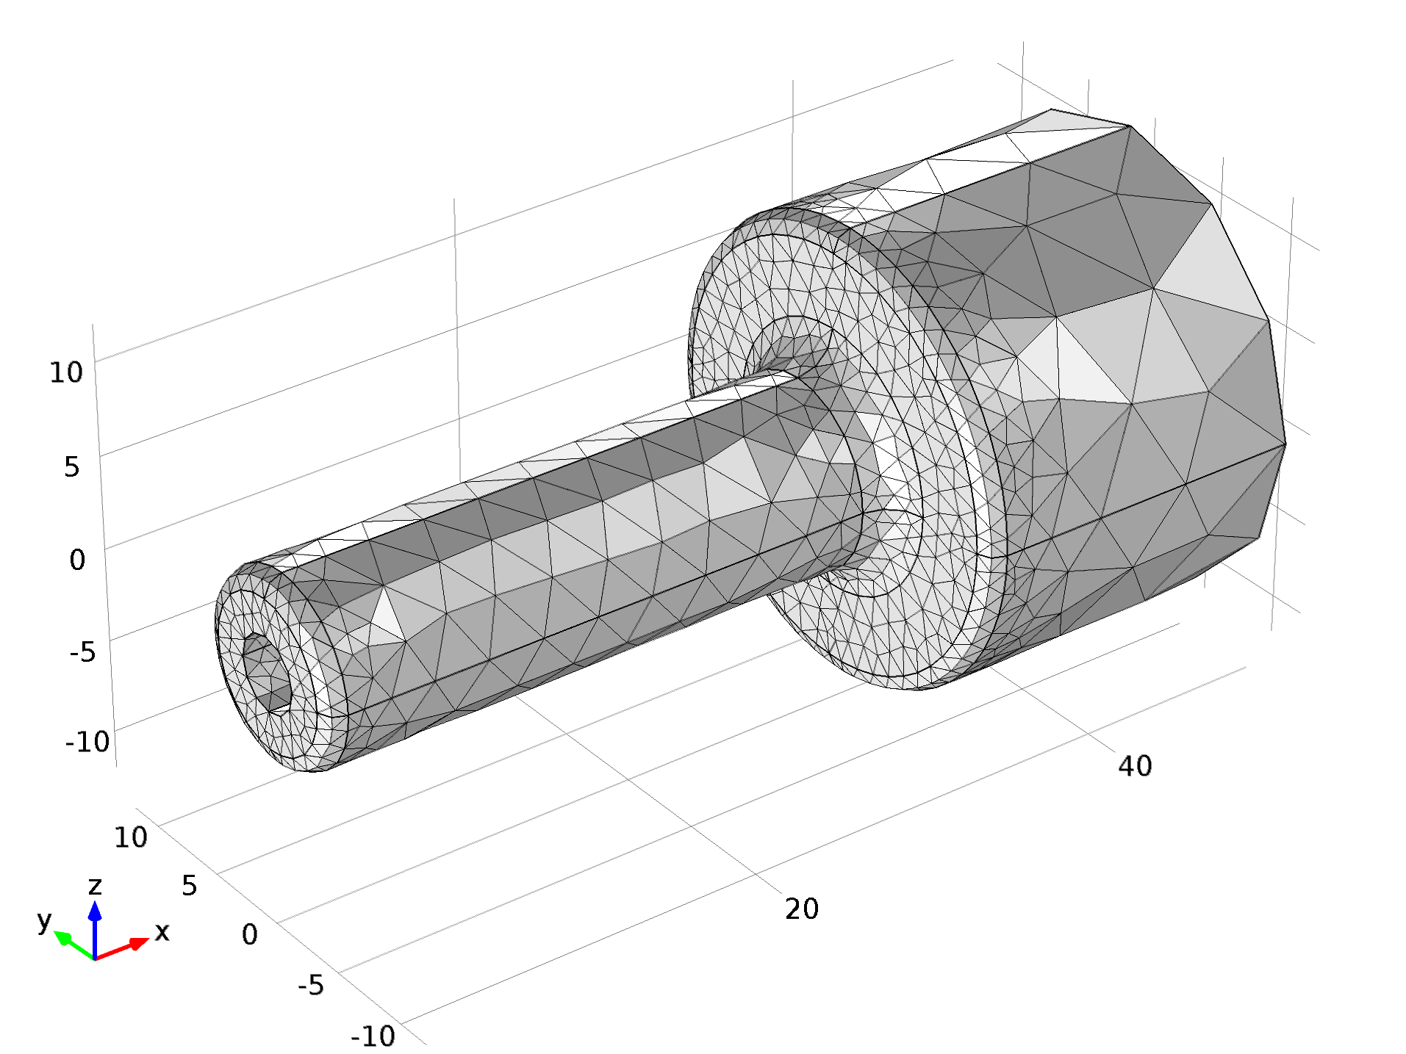
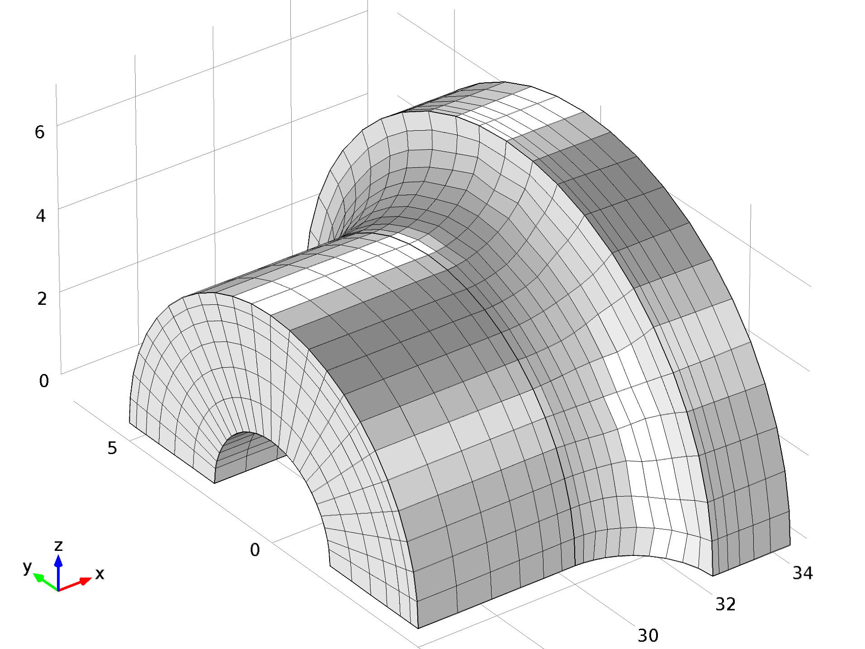
Submodeling in COMSOL Multiphysics
Use general extrusion coupling operator to map the displacement from the global model to the submodel
Mesh independently each model
Solve independently the model
The submodel requires at least the full model solution
Mesh in the full model (top) and submodel (bottom)

Slide 5
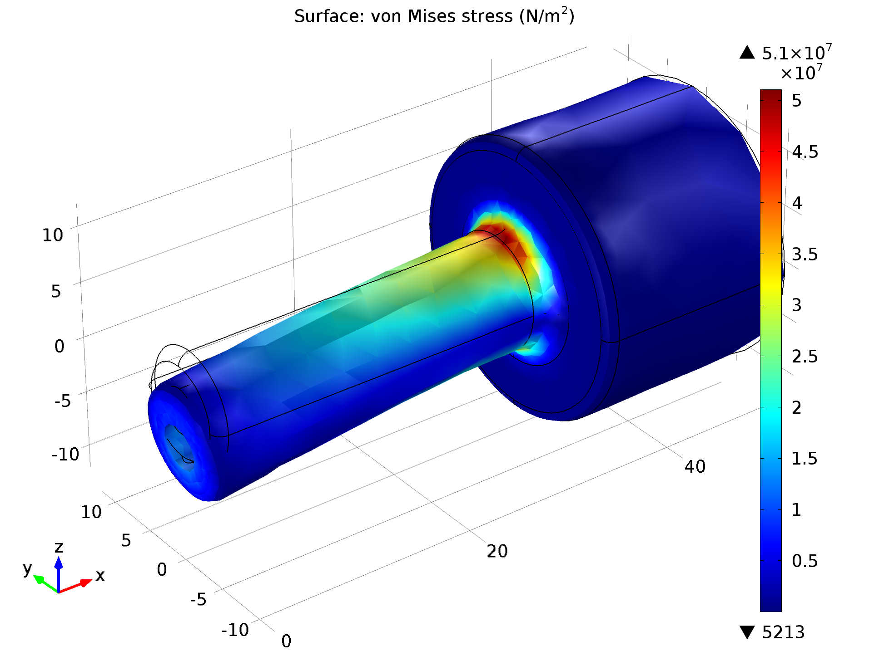
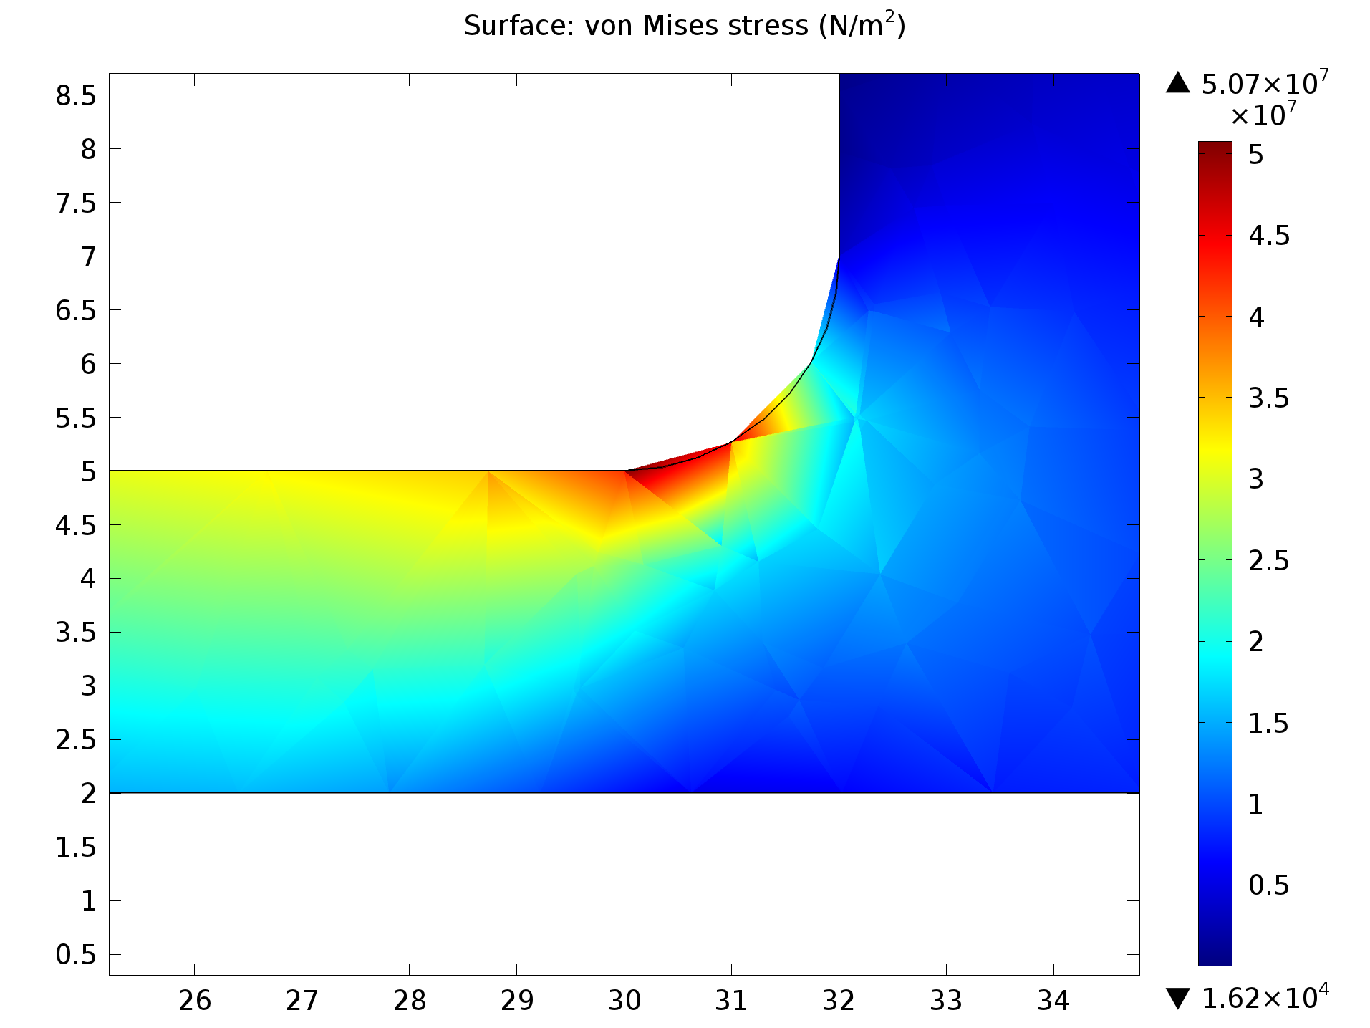
Results, Full Model
Stress in the global model is not resolved accurately
The maximum stress values are not consistent
Von Mises in the full model at the surface (left) and inside (right)

Slide 6
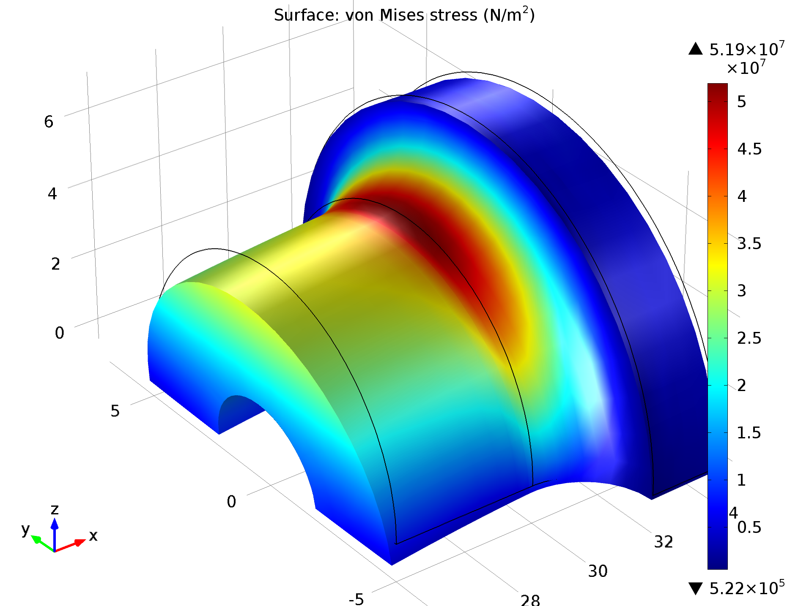
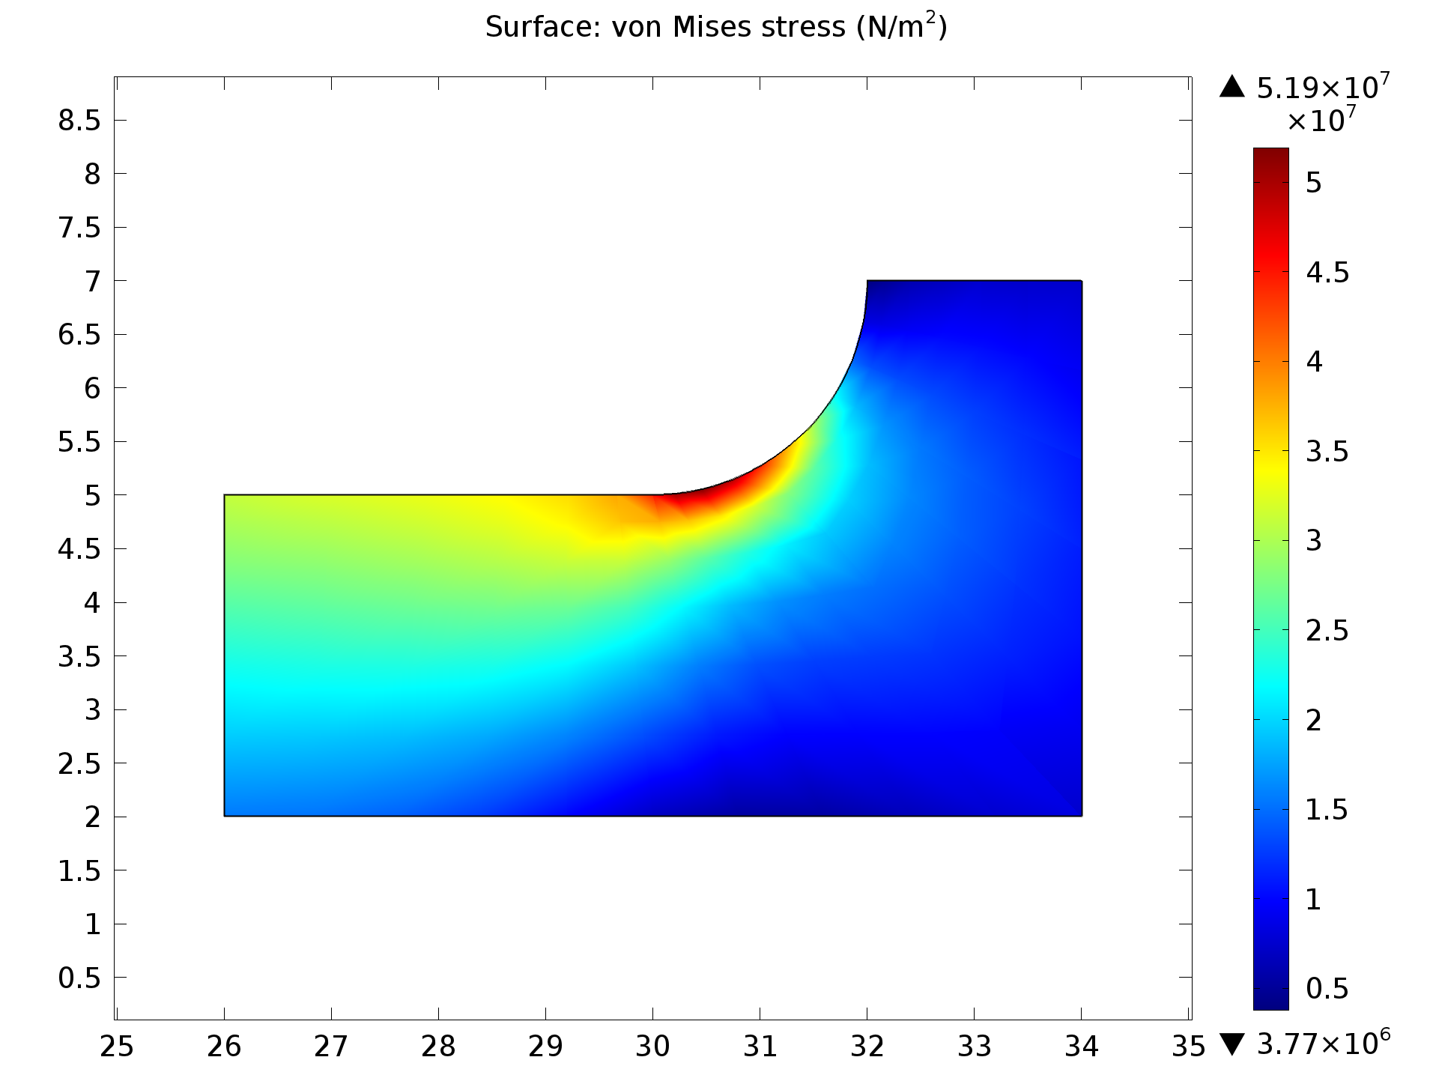
Results, Submodel
Stress in the submodel is resolved accurately
The maximum stress values are consistent
Von Mises in the submodel at the surface (left) and inside (right)

Slide 7
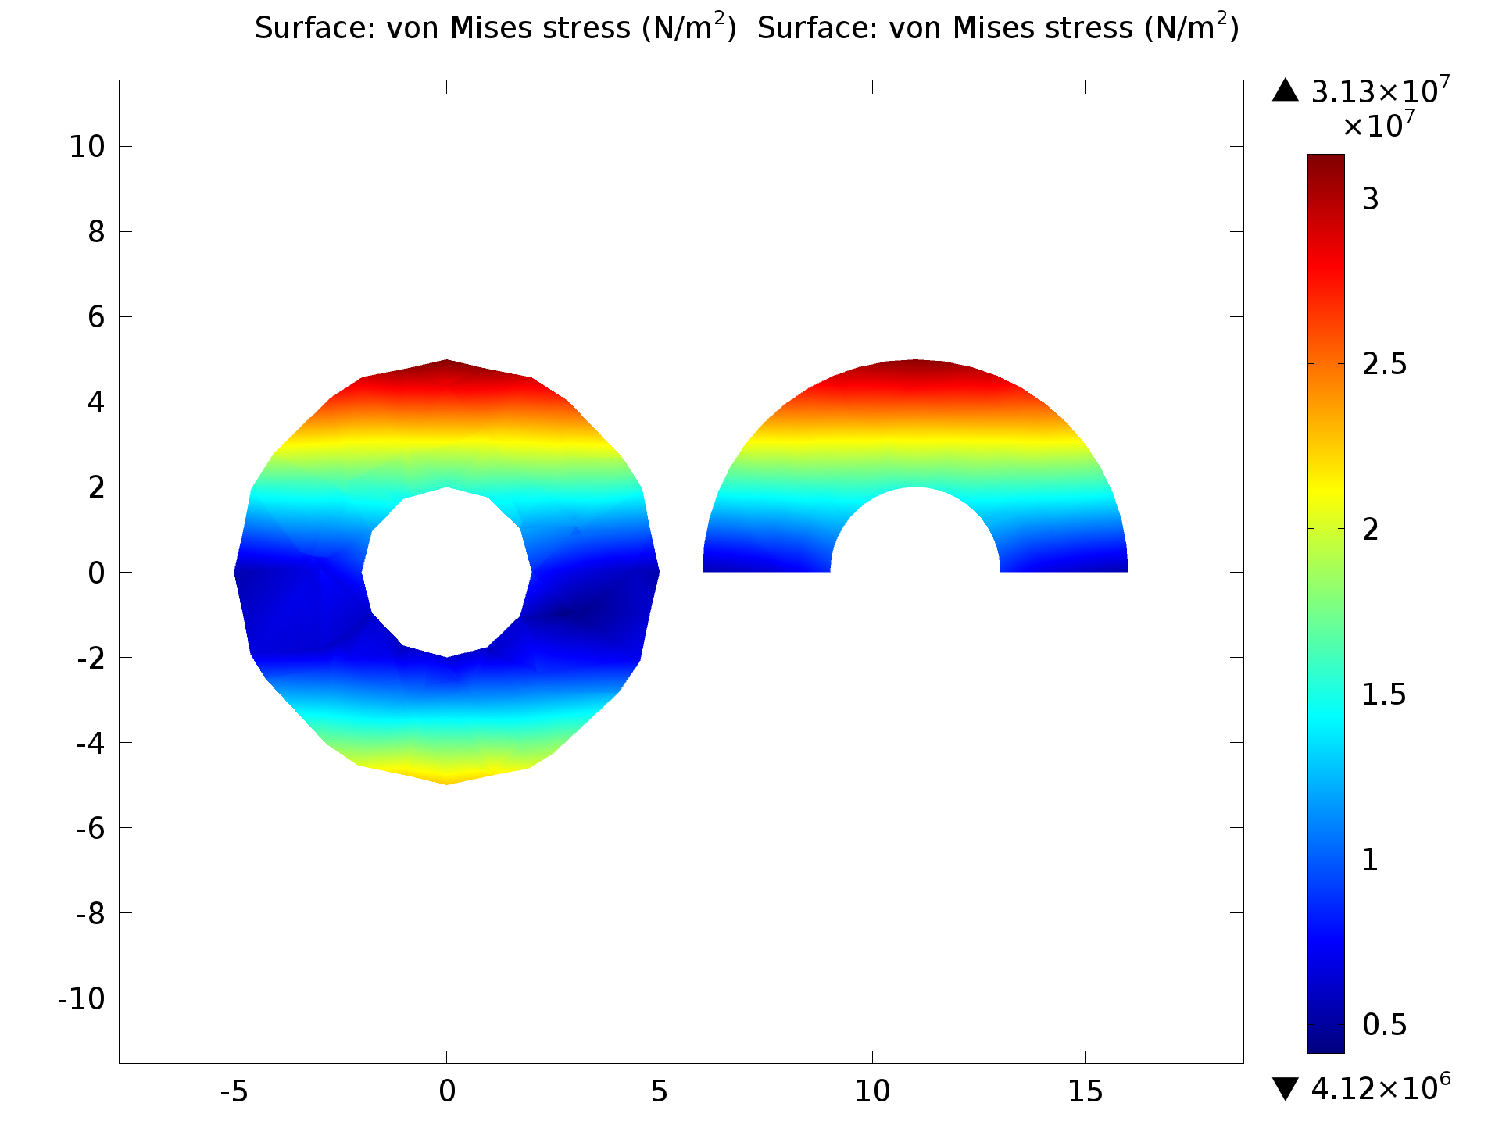
Validation of the Submodel
Stress at the connecting regions are similar in both full model and submodel
Von Mises at the connecting region between the full model (left) and the submodel (right)

