Slide 1
Shallow Water 1D

Slide 2
Introduction
The Shallow Water equations are frequently used for modeling both oceanographic and atmospheric circulation.
Models of such systems lead to the prediction of areas eventually affected by pollution, coast erosion and polar ice-cap melting.
This 1D model investigates the settling of a wave over a variable bed as a function of time.

Slide 3
Problem Definition
The Saint-Venant’s shallow water equations is used in this example. The equations are given by: where z is the thickness of the water layer, v is the horizontal velocity, g the gravitational constant and ν the kinematic viscosity.

Slide 4
Problem Definition
The thickness of the water layer, z, is defined as z_{s}-z_{f} where z_{s} and z_{f} are defined in the figure above.
z_{s}
z_{f}
x

Slide 5
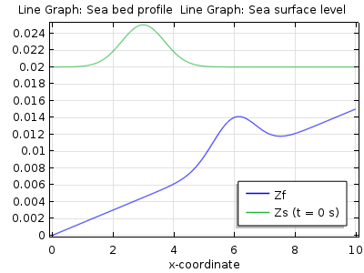
Model Definition
This model studies a simple example of water above a variable bed as shown above.
Note the scale differences in the x and y directions.
Initially, the water level is perturbed according to the figure.
Initial water level
Sea bed

Slide 6
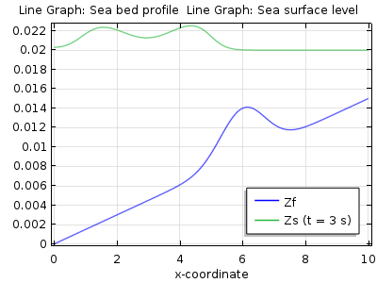
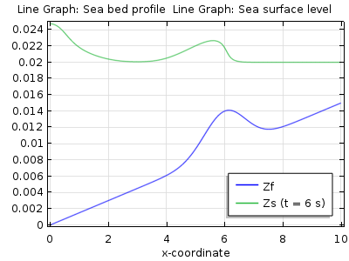
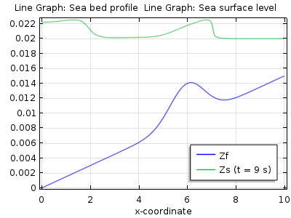
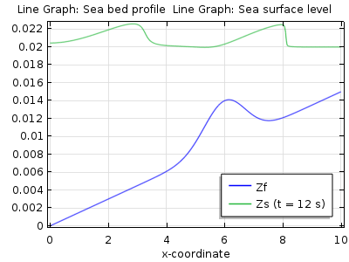
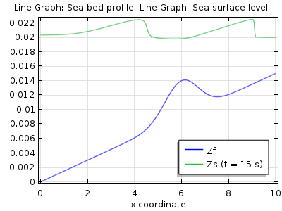
Results
The water surface at six output times. Time increases from left to right.

