Slide 1
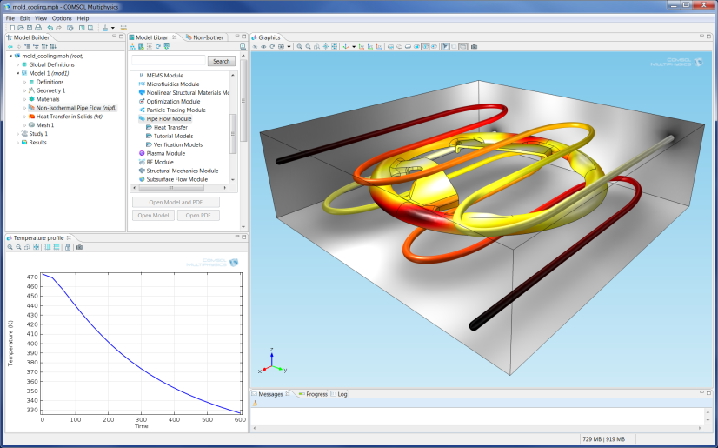
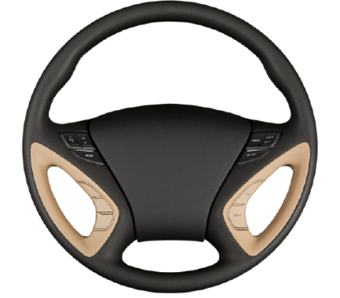
Mold Cooling
This model shows how you can use the Non-Isothermal Pipe Flow interface together with the Heat Transfer in Solids interface to model a mold cooling process in the automotive industry.
The Wall Heat Transfer feature of the Pipe Flow Module makes the bidirectional pipe-3D heat coupling easy to define.

