Slide 1
Half-Wavelength Dipole Antenna
This model is also discussed in the following post on the COMSOL Blog:
Put_link_here

Slide 2
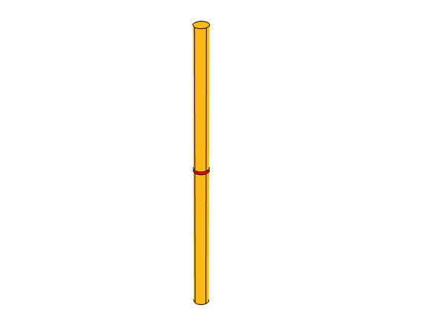
Simulation Geometry and Setup
Antenna diameter is d = l/100
The antenna is a Perfect Electric Conductor.
It is surrounded by a spherical air domain, and a Perfectly Mated Layer has been added to the exterior of the air sphere to absorb the outgoing radiation.
A Lumped Port is applied to the gap.
Height of gap feed is g = d
Antenna length is l = 0.47λ
Note that image is not to scale.

Slide 3
Antenna Reciprocity
To demonstrate reciprocity, two studies are performed.
In Study 1, a voltage is applied to the Lumped Port, similar to the dipole antenna model discussed in https://www.comsol.com/model/dipole-antenna-8715.
In Study 2, the Lumped Port excitation is turned off, and a background field study is used, similar to the model discussed in https://www.comsol.com/model/detecting-orientation-of-a-metallic-cylinder-embedded-in-a-dielectric-shell-19871.
The gain and antenna impedance from Study 1 are used to calculate the power this antenna would receive if it was illuminated with a 1 V/m plane wave in (1,0,0).
Study 2 directly calculates the power received when illuminated with a 1 V/m plane wave in (1,0,0).
Both methods return 2.6 μW.

Slide 4
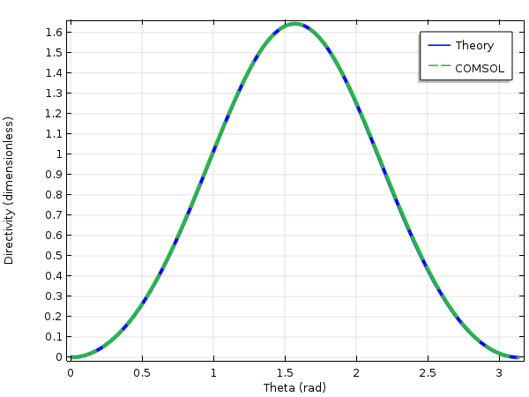
Comparison with Theory
Theory used is for a infinitely thin antenna, found in any standard antenna text.
Maximum directivity is 1.64
Impedance is ≈ 73 Ω
Note that real antenna parameters vary substantially with finite antenna radius, and the geometry here was intentionally chosen to be close the theoretical results.
Simulated impedance is 73 + 3j Ω
This agrees well with published values http://ieeexplore.ieee.org/document/1696826/

