Slide 1
Coupling a Full-Wave Simulation to a Beam-Envelopes Simulation
This model is also discussed in the following post on the COMSOL Blog:
Put_link_here

Slide 2
Linking Full-Wave and Beam-Envelopes
It is occasionally useful to simulate radiation in the intermediate zone that is several wavelengths away from an antenna or scatterer.
The Electromagnetic Waves, Frequency Domain interface, called a Full-Wave simulation is ideally suited for simulating close to an antenna or scatterer, but the simulation size must be small for efficient use of computational resources.
The Electromagnetic Waves, Beam Envelopes interface, called a Beam-Envelopes simulation, is ideally suited for simulating propagating radiation with a known phase function, but it is inefficient to use in a domain with a scattering or radiating geometry.
We can combine these two complementary simulations to efficiently calculate fields that would be beyond either individually.

Slide 3
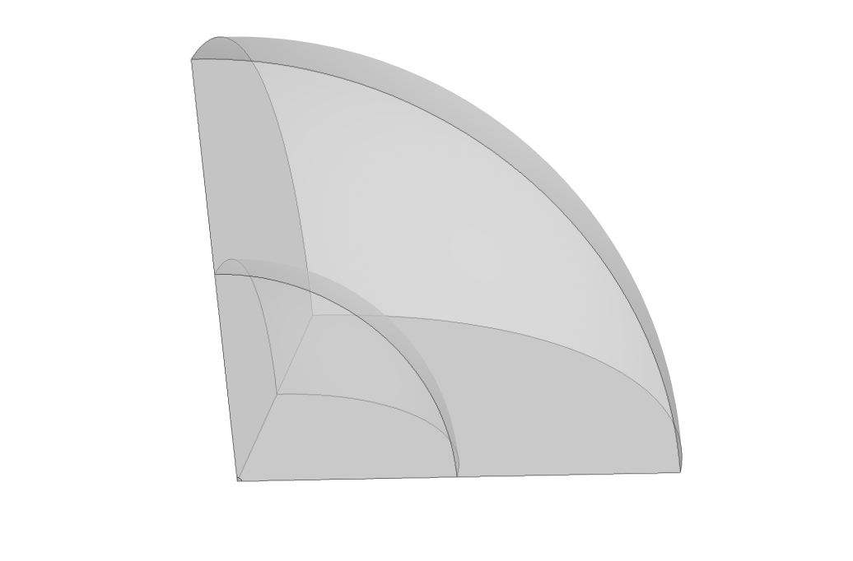
Simulation Assignments
A Matched Boundary Condition is used to absorb the outgoing radiation.
Beam-Envelopes
To exploit symmetry, PMC planes are used in the xz- and yz-planes. PEC in the xy-plane.
Full-Wave
To compare with theory, an electric dipole is placed at the origin. It is oriented in z.
Note that image is not to scale.

Slide 4
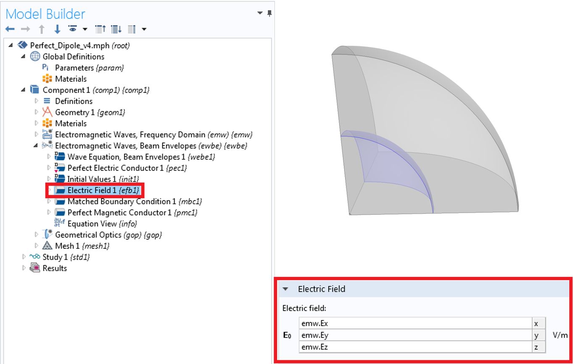
Linking at the Interface
PMC is used for the same boundary in the Electromagnetic Waves, Frequency Domain interface.
This is described further in the accompanying post on the COMSOL Blog.
Note that image is not to scale.

Slide 5
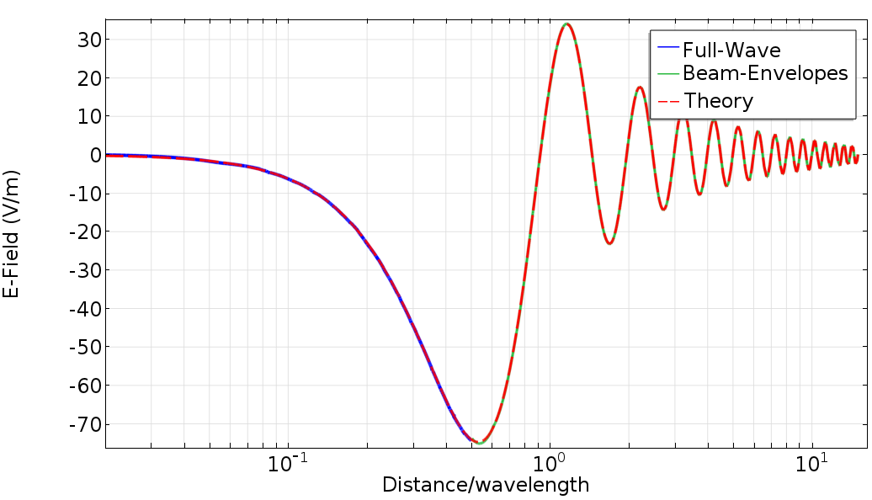
Comparison with Theory

