Slide 1
Example: Concentration Control in Process

Slide 2
Introduction
Reactor with two inlet gas mixtures
Control the gas composition in one measurement point
Regulate the inlet velocity of the low concentration gas to achieve set value
Transient Navier-Stokes, together with Diffusion and Convection
PID-control algorithm controls inlet velocity

Slide 3
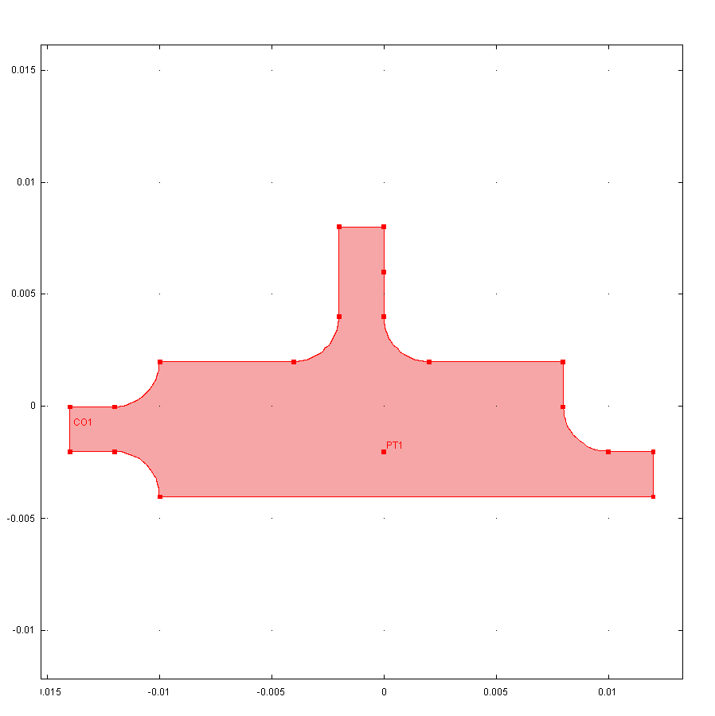
Geometry and Conditions
Walls are insulting and no slip
Species diffusivity is: 1e-4 m²/s
Fluid properties of atmospheric air
Initial conditions:
u = (0,0)
c = 0.5
Top inlet:
u = 10 mm/s; c = 1 mol/m³
Controlled inlet:
u = controlled
c = 0.2 mol/m³
Outlet
Measurement point:
c_{set}=0.5 mol/m³

Slide 4
PID-Control Algorithm
Control algorithm defined in a “Global ODEs and DAEs” interface
Equation:
u_{in} is the controlled inlet velocity of the physical model
The measured value is obtained using a “Point probe”

Slide 5
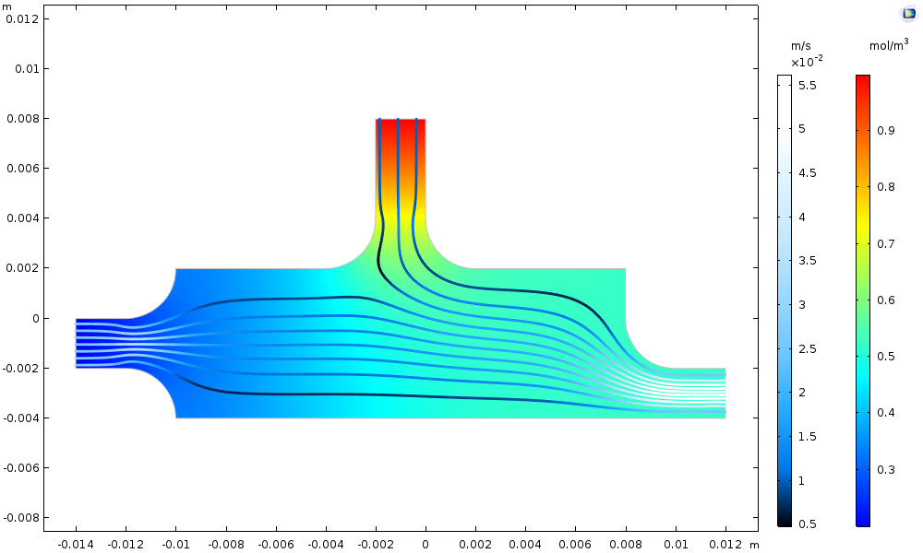
Concentration and Velocity Streamlines at 3 Seconds

Slide 6
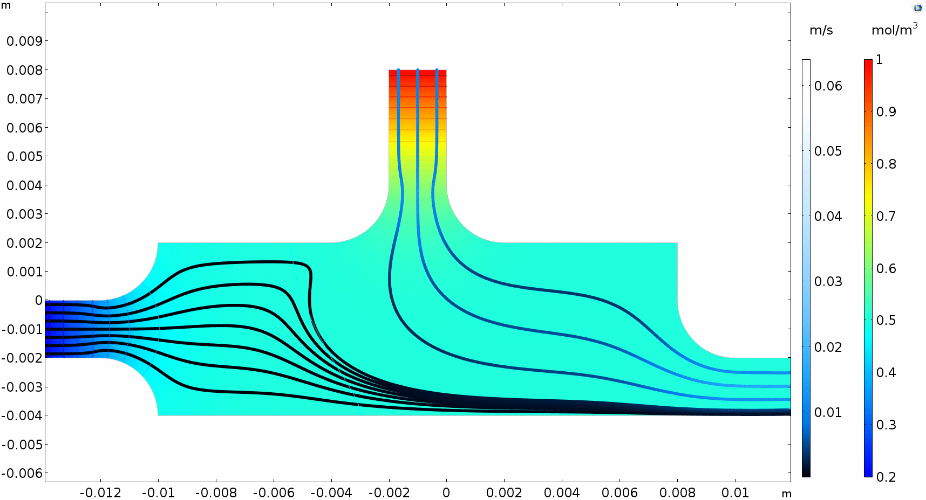
Concentration and Velocity Streamlines, Animation

Slide 7
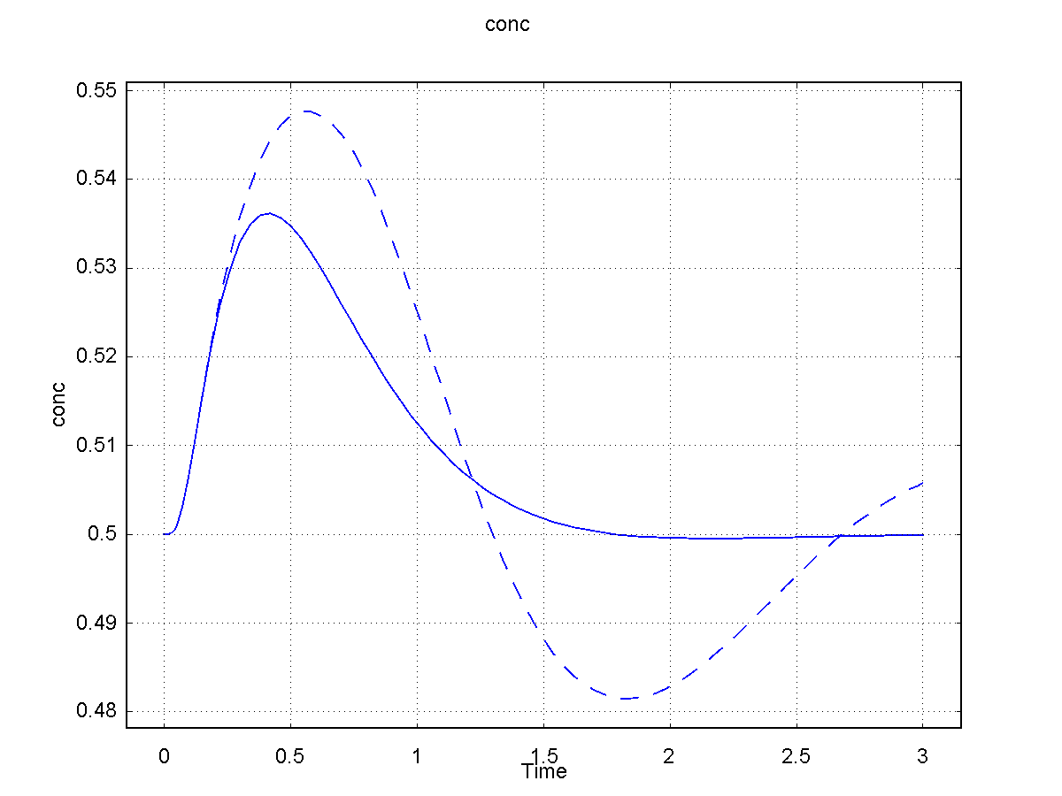
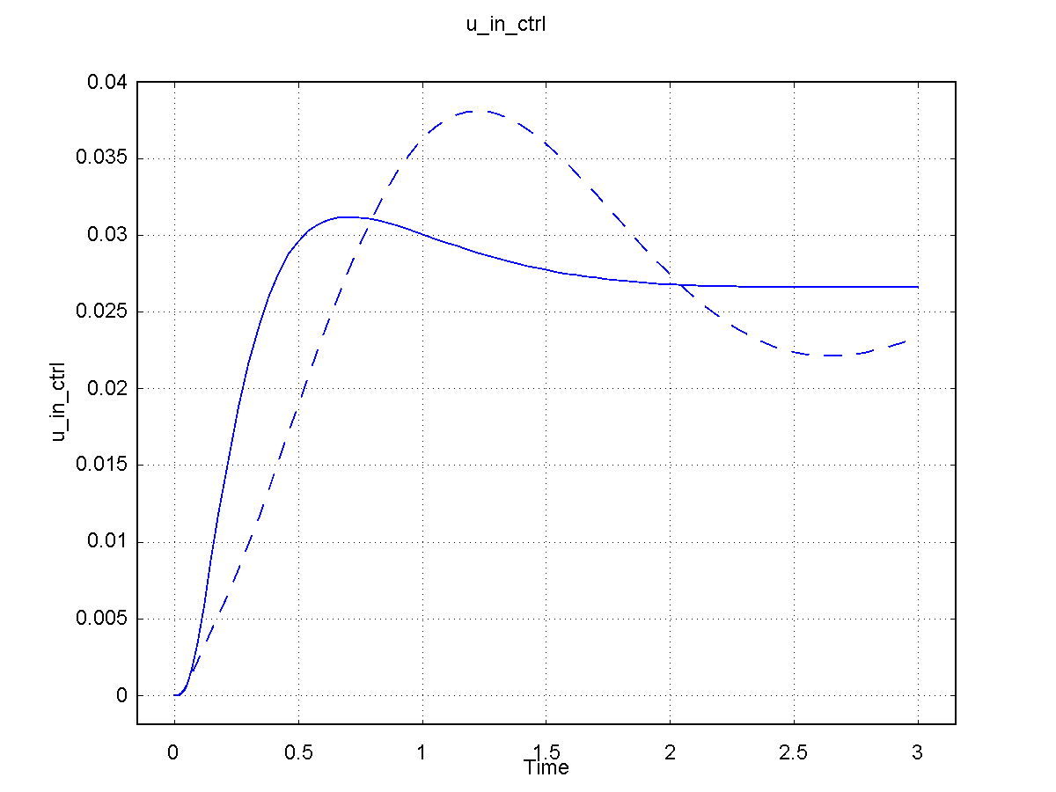
Varying the PID-Parameters
1st case results in stable control
2nd case is less stable
P=0.5, I=1, D=1e-3
P=0.1, I=1, D=1e-3

