Slide 1
Computing the Geometric Modulation Transfer Function (MTF)
Using the Ray Optics Module and a Model Method

Slide 2
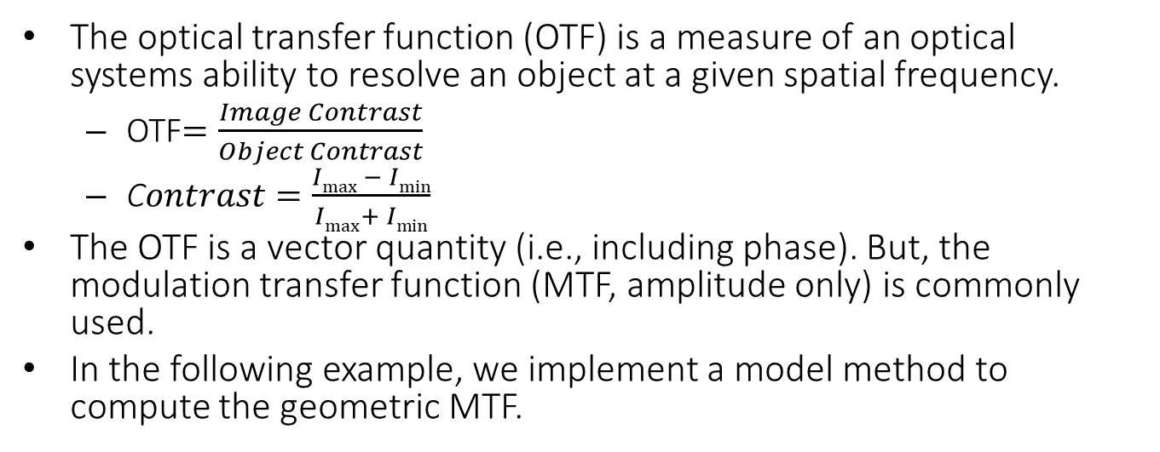
The Modulation Transfer Function
The optical transfer function (OTF) is a measure of an optical systems ability to resolve an object at a given spatial frequency.
OTF$=\frac{Image Contrast}{Object Contrast}$
C$ontrast=\frac{Imax − Imin}{Imax+ Imin}$
The OTF is a vector quantity (i.e., including phase). But, the modulation transfer function (MTF, amplitude only) is commonly used.
In the following example, we implement a model method to compute the geometric MTF.

Slide 3
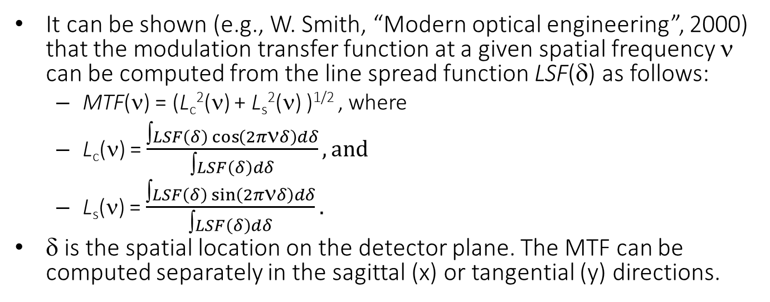
The calculation
It can be shown (e.g., W. Smith, “Modern optical engineering”, 2000) that the modulation transfer function at a given spatial frequency ν can be computed from the line spread function LSF(δ) as follows:
MTF(ν) = (L_{c}²(ν) + L_{s}²(ν) )^{1/2} , where
L_{c}(ν) = $\frac{∫LSF\left(δ\right)\cos\left(2π\text{ν}δ\right)dδ}{∫LSF\left(δ\right)dδ}, and$
L_{s}(ν) = $\frac{∫LSF\left(δ\right)\sin\left(2π\text{ν}δ\right)dδ}{∫LSF\left(δ\right)dδ}.$
δ is the spatial location on the detector plane. The MTF can be computed separately in the sagittal (x) or tangential (y) directions.

Slide 4
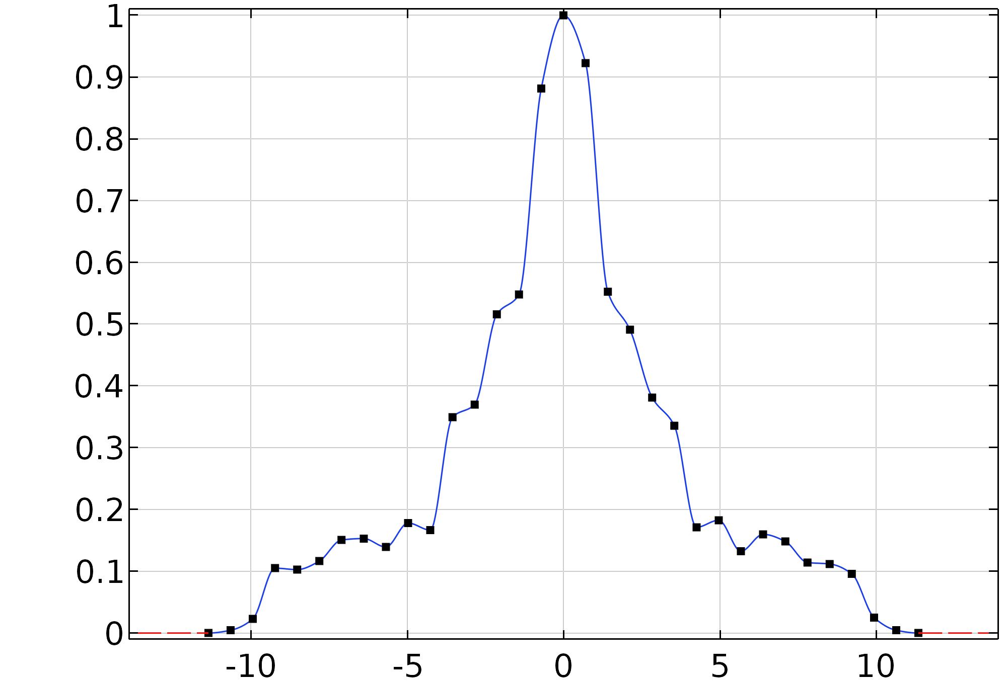
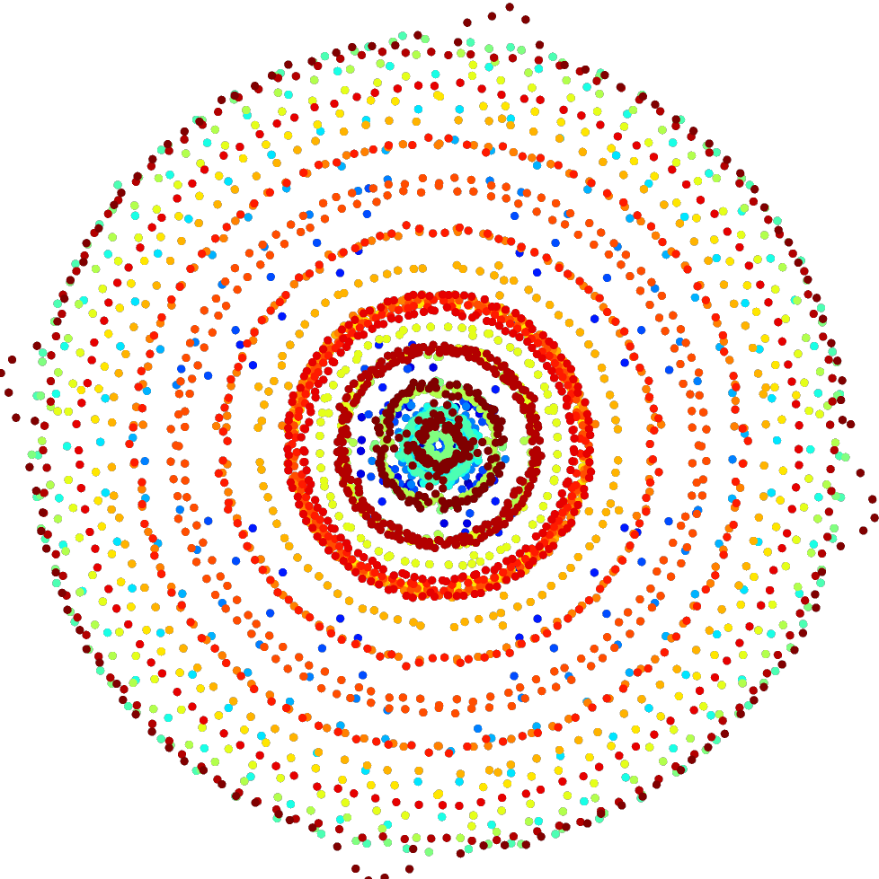
The Model Method (1)
For the current model method we compute the LSF using a geometrical optics ray trace. The accuracy of the LSF is therefore related to the number of rays being traced, and the number of spatial bins.
The sagittal and tangential LSFs are captured in Interpolation functions. These can then be used to construct Analytic functions to be used in the integration of the expressions shown on the previous page.
Normalized Line Spread Function (LSF)
Spot diagram
Box is +/- 11.4μm square
Spatial Dimension (μm)

Slide 5
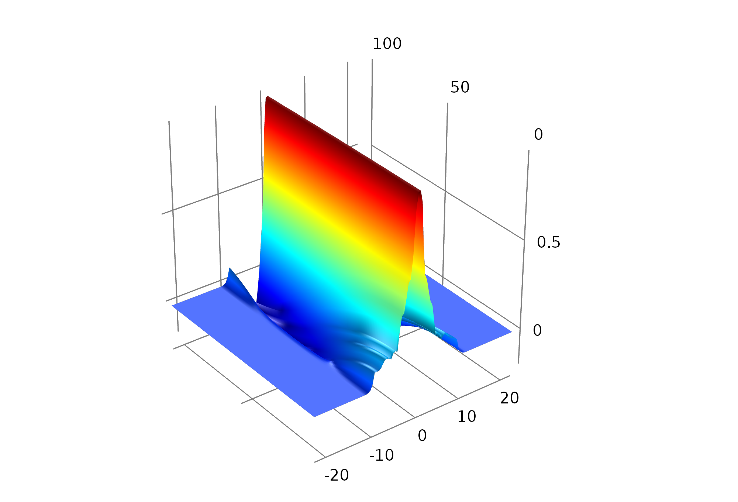
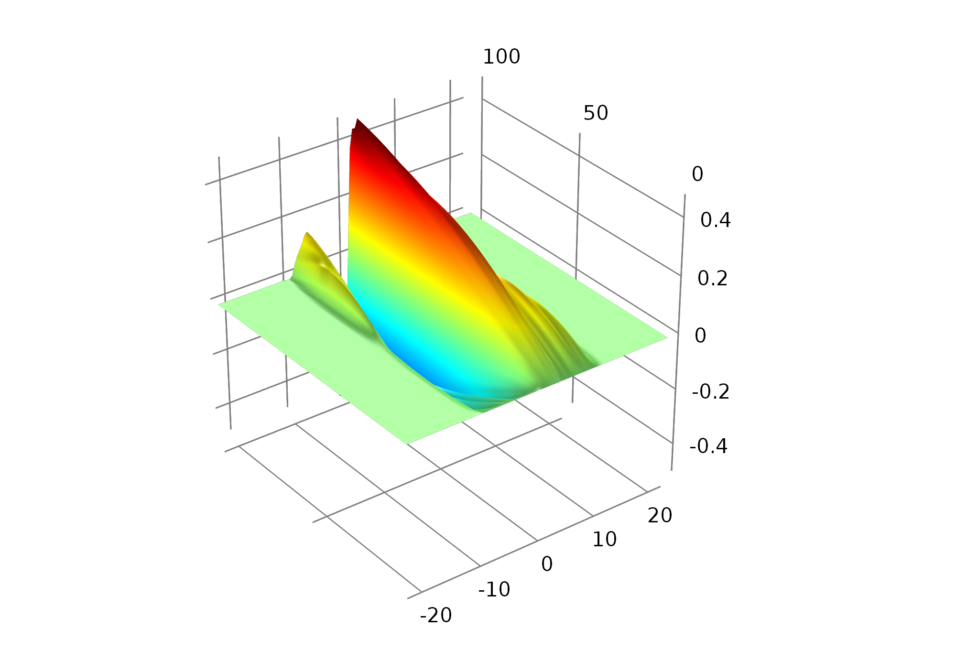


The Model Method (2)
An intermediary step is the multiplication of the LSF with the cosine and sine functions.
The area under each curve (as a function of spatial frequency ν) gives the top line of the L_{c} and L_{s} computations.
$LSF(x)\cos\left(2π\text{ν}x\right)$:
$$LSF(x)\sin\left(2π\text{ν}x\right):$$
ν (mm⁻¹)
ν (mm⁻¹)
x (μm)
x (μm)

Slide 6
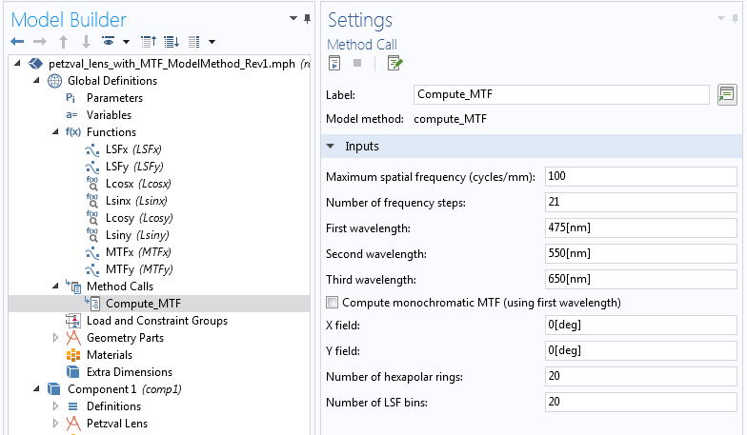
The Model Method (3)
The model method has a number of inputs that control the output. Their behavior can be adjusted by modifying and/or further extending the model method.
Note that the hexapolar grid release is best suited for this calculation as it ensures a uniform sampling of the entrance pupil.

Slide 7
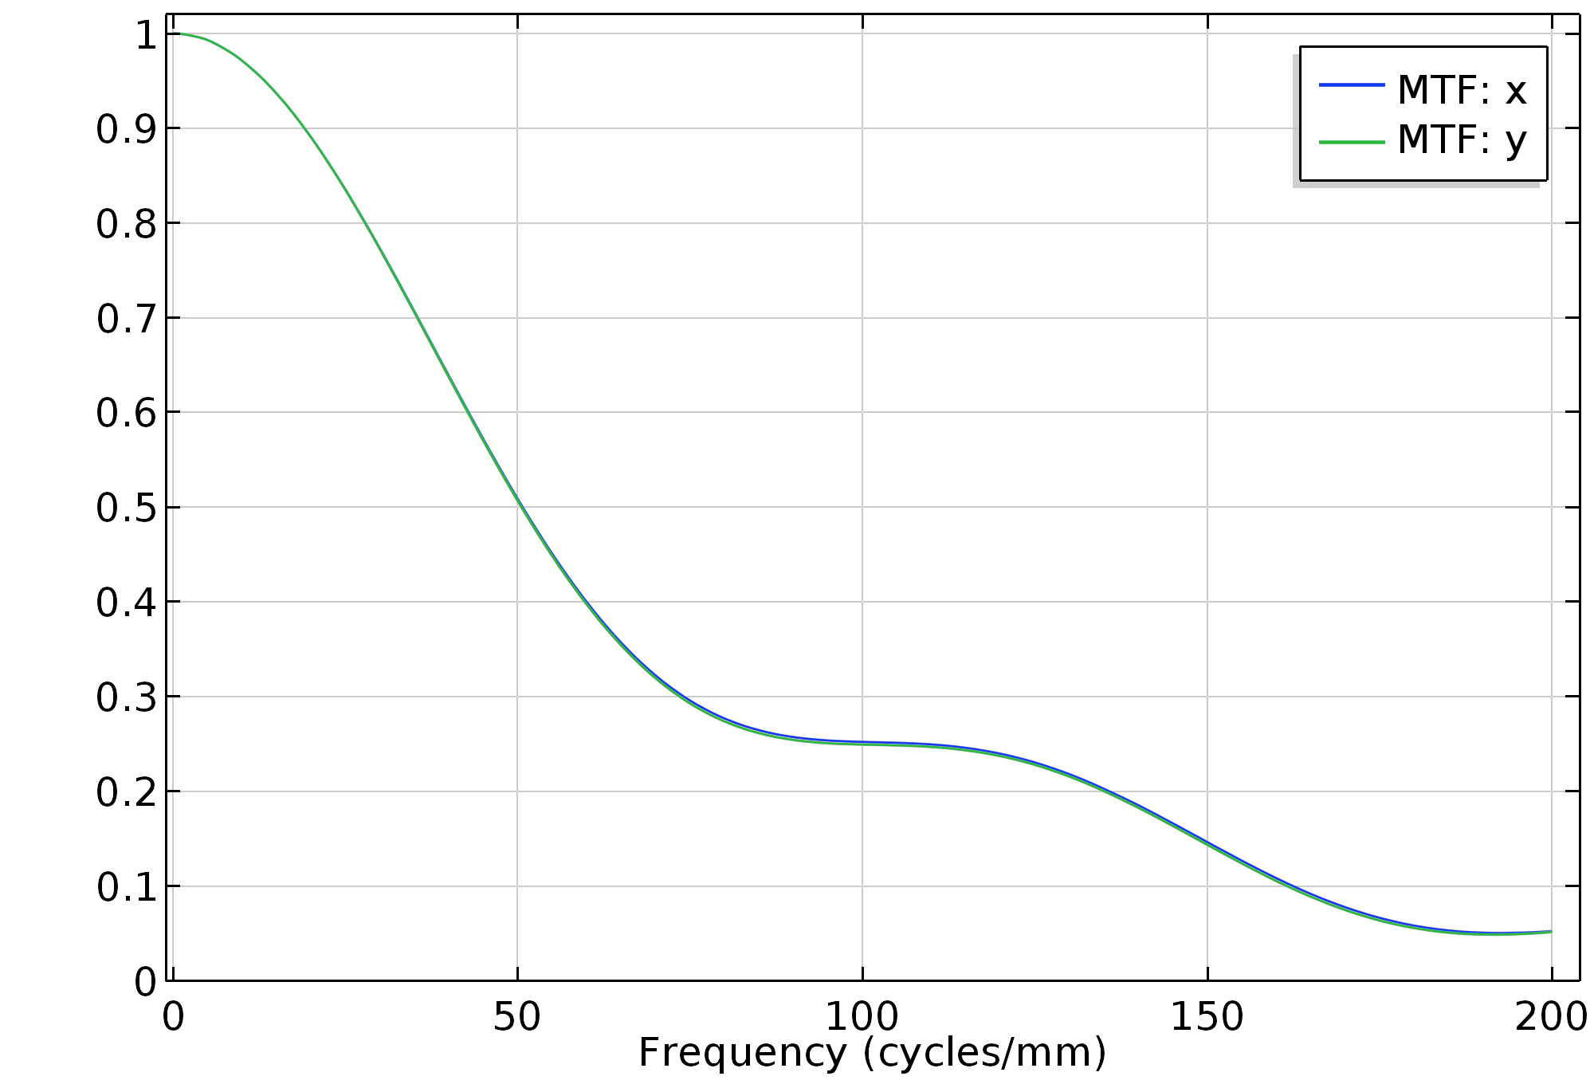
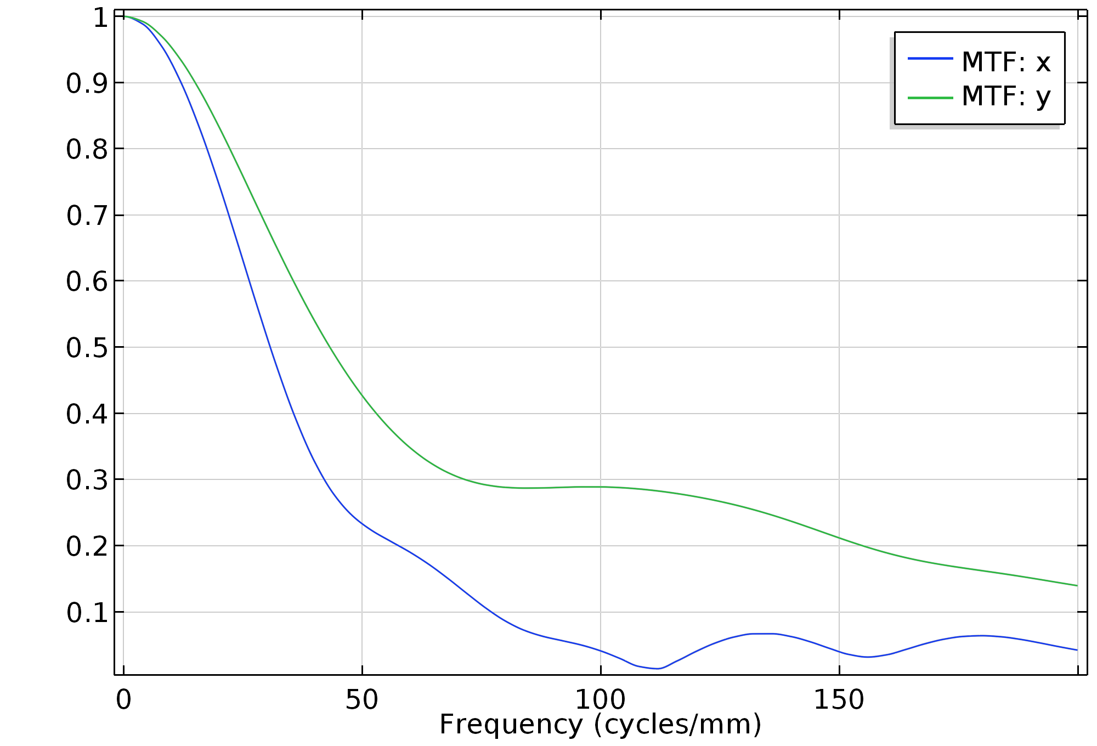
Some results: “Petzval Lens”
MTF: [θ_{x},θ_{y}] = [0°, 0°]
MTF: [θ_{x},θ_{y}] = [10°, 0°]
(The original “Petzval Lens” model is available here: https://www.comsol.com/model/petzval-lens-55491)

