Slide 1

Example - Effective Diffusivity in Porous Materials
Notes:
1

Slide 2
Introduction and Aim
Transport through porous structures is usually treated using simplified homogeneous model.
This model compares the transport through an porous structure with a simplified homogeneous porous media.
The exercise consist of two parts:
The first part describes how to create the model with a detailed geometry.
The second part shows how to define homogeneous model for porous media using an effective diffusivity.

Slide 3
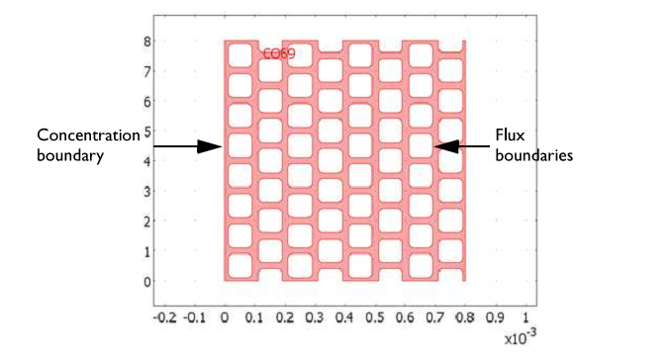
Geometry of porous structure

Slide 4




Model definition - part 1
The model uses standard transient diffusion equation
The boundary conditions are of three types
Concentration at inlet
Mass transfer flux at outlet
Insulation at other

Slide 5



Model definition - part 2
The second part uses a homogenized 1D model with effective transport properties
The effective diffusivity is calculated according to
Where
L1 is the length of the geometry along the x-axis
N_average is the average flux integrated over the outlet boundary

Slide 6
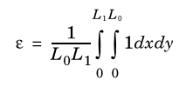

Model definition - porosity
The porosity of the modeled structure is obtained from integrating the active diffusive area and dividing by the dimensions of the block
The effective and free diffusivites are related
Where tortuosity (τ), a measure of the length a molecule has to diffuse in porous structure, can be estimated.

Slide 7
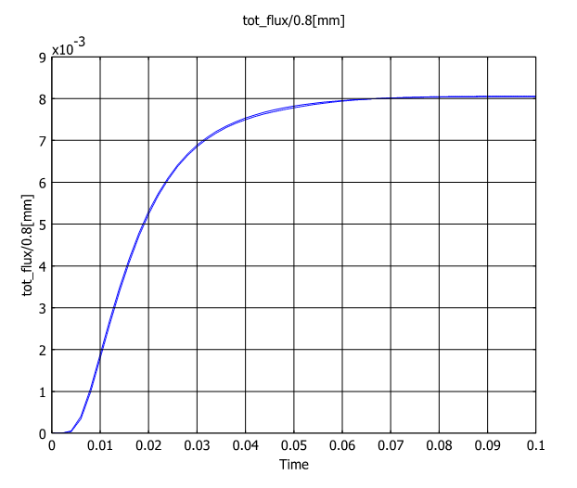
Results
The difference in time-dependent flux is hardly visibile between the two cases.

Slide 8
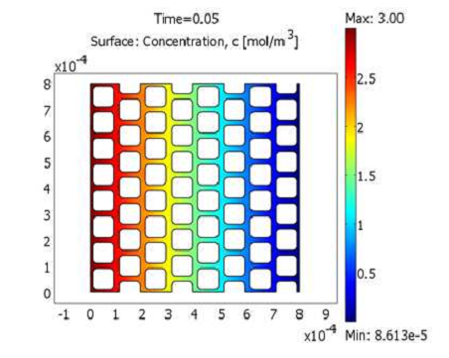
Results
The concentration profile reaches a steady-state within 0.1 seconds.

