Slide 1
Electrodynamics of a Power Switch

Slide 2
Introduction
Events such as overcurrent or overload can seriously damage electrical circuits or power lines. A possible solution to this problem is the implementation of circuit breakers in the form of automatic electrical switches, which mechanically interrupt the current flow by moving a plunger as soon as a defect is detected. In contrast to a fuse, that has to be replaced after its activation, a circuit breaker can be reset.

Slide 3
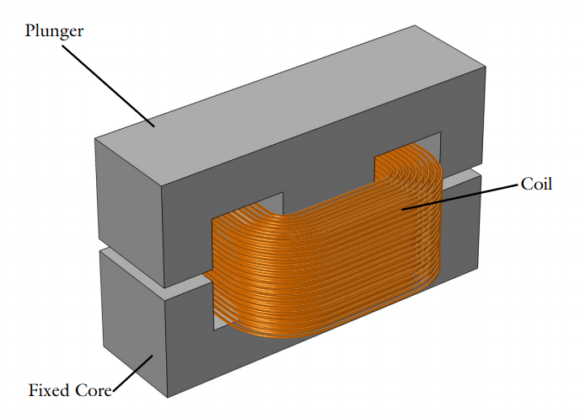
Geometry
Geometry of the switch

Slide 4
Problem Definition
The model includes the rigid body dynamics under the influence of: magnetic forces, induced currents, and spring/constraint arrangements that keep the plunger in its equilibrium position.

Slide 5
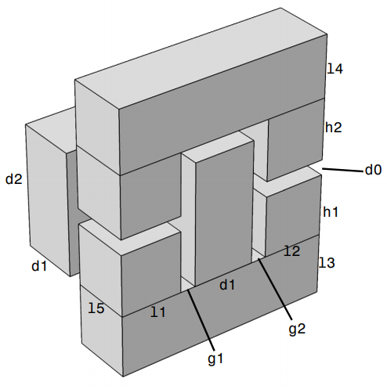
Implementation
The geometry is built using COMSOL Multiphysics’ CAD tools and taking advantage of parametrized Geometry Parts, allowing a finer control on the geometry. Due to the symmetry of the device, it is possible to represent only a quarter of the geometry.
The figure shows the simulation geometry, complete with size specifications, which are added as model parameters in COMSOL Multiphysics. In order to compute the electromagnetic fields, the power switch is embedded in an air domain.

Slide 6
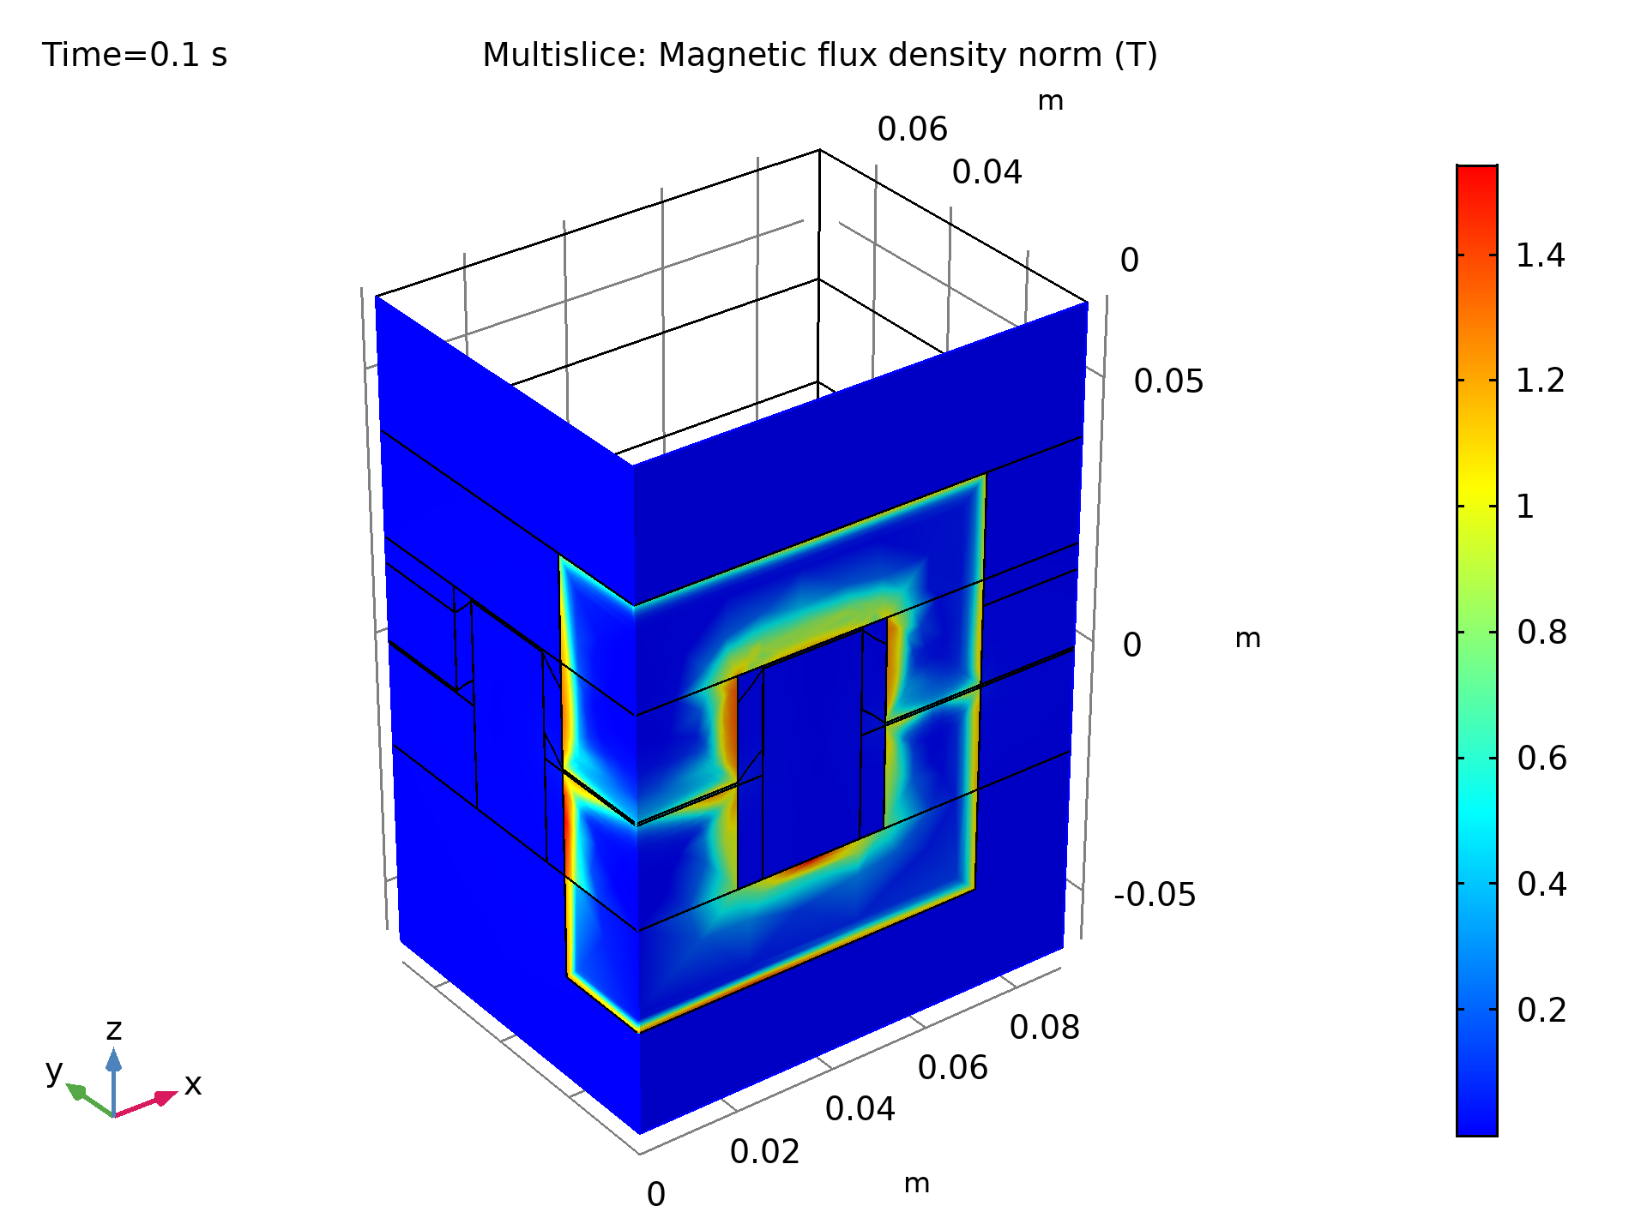
Magentic Flux Density Norm
The figure show the magnetic fields on symmetry planes when the gap is closed.
It is evident that induced eddy currents are screening the interior of the core from the field. These currents are limited to a region as large as the skin depth, resolved by the boundary layer mesh.
Magnetic flux density norm at t= 0.01s, when the gap is closed

Slide 7
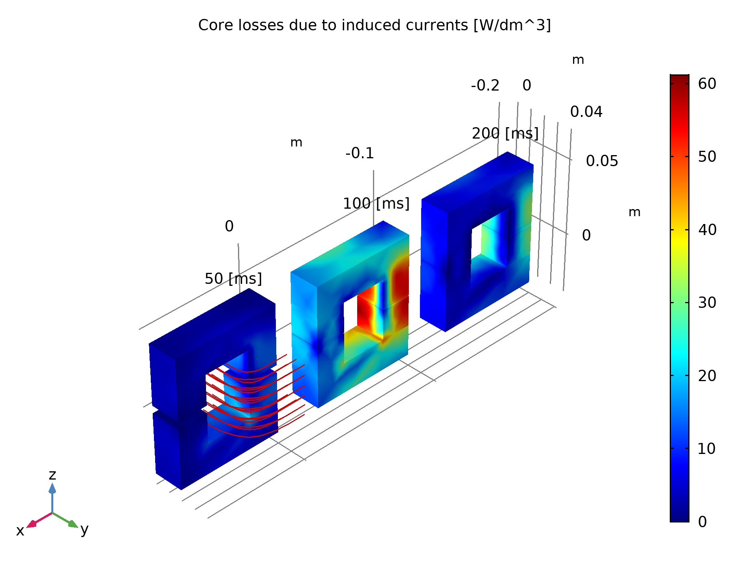
Core Losses Due to Induced Currents
The figure shows the core losses in the device due to induced current density. This information may be relevant in order to predict possible overheating of the device.
Core losses due to induced currents at different time instants.

Slide 8
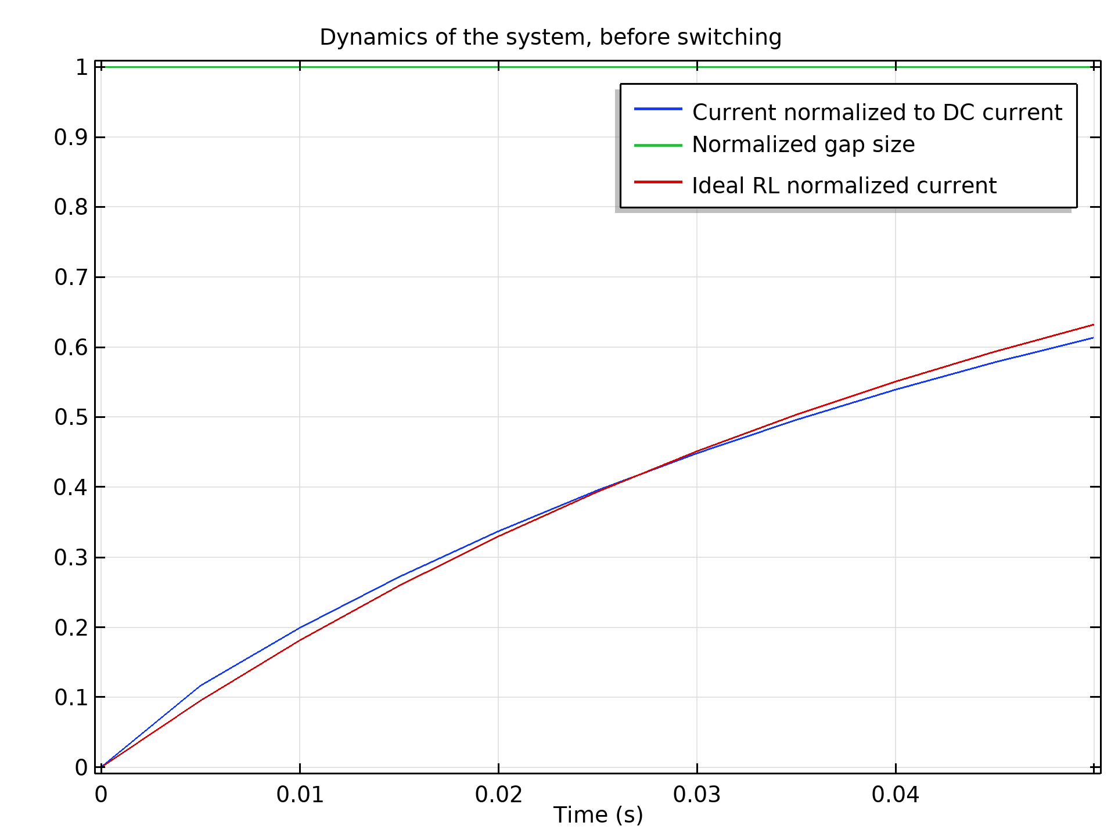
Before Plunger Motion
The figure shows the first stage of the simulation, when the spring is not yet compressed. Blue and green lines represent normalized currents and gap size respectively.
Red line is an exponential fit for the RL current dynamics of the initially non-moving inductor — the response of an
ideal system.
Magnetic flux density norm at t = 0.1 s, when the gap is closed

Slide 9
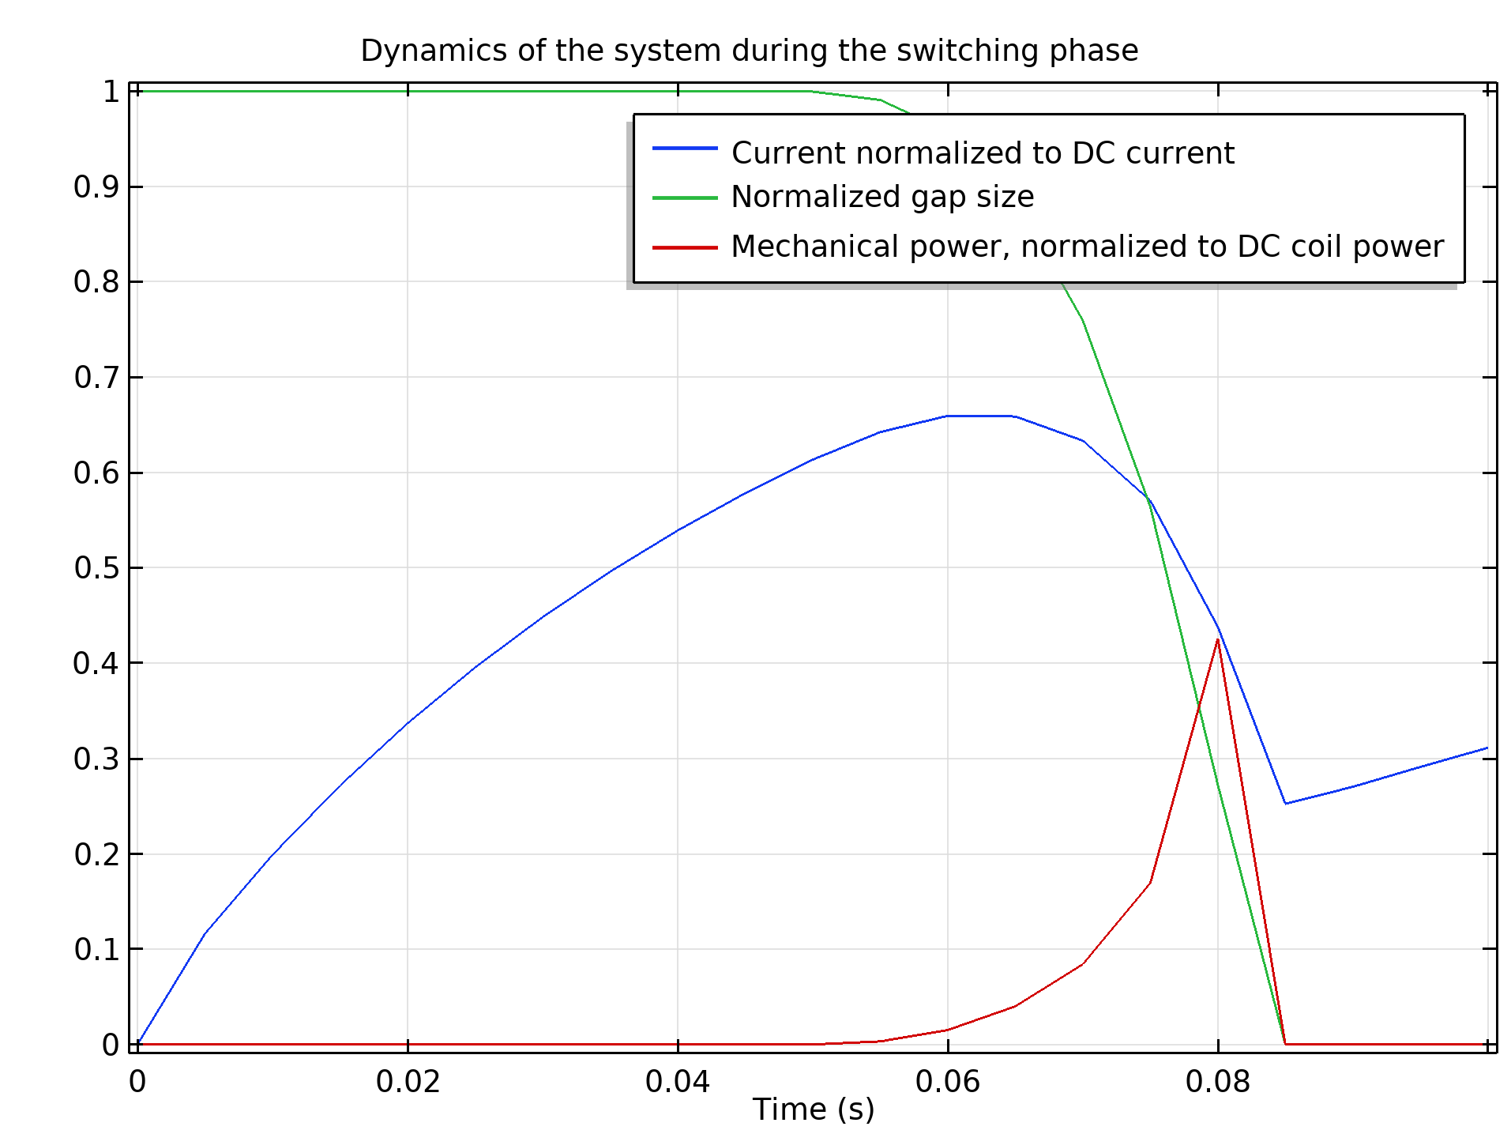
During Plunger Motion
The compression of the spring and the resulting closure of the gap are visualized in the figure.
Normalized currents and gap size are represented by blue and green lines respectively, the red line showing instead the mechanical power (which is nonzero only during the motion of
the plunger).
Magnetic flux density norm at t = 0.1 s, when the gap is closed

Slide 10
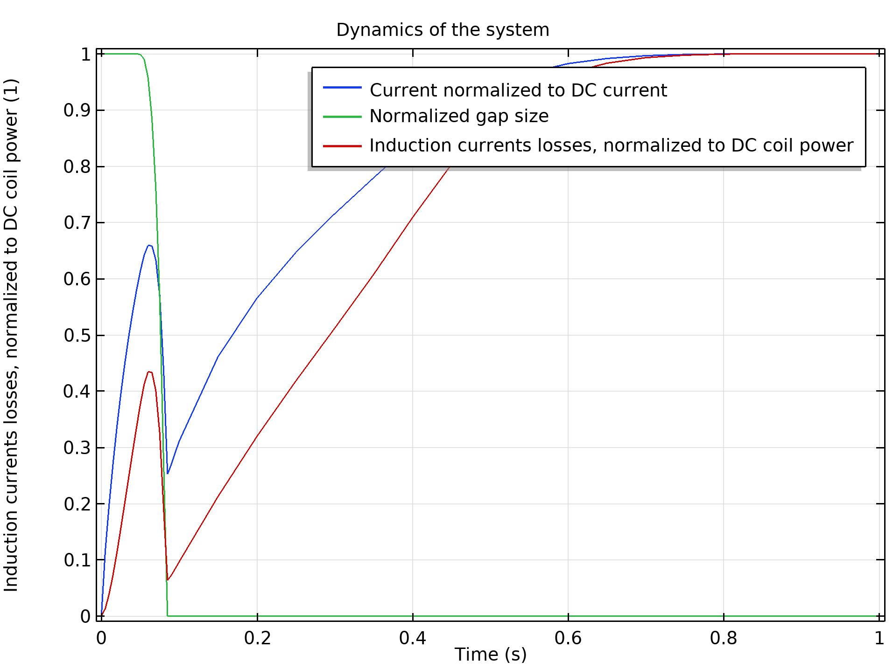
After Plunger Motion
The figure refers to the last stage of simulation, when the spring is completely compressed. The red line shows the induction losses in the core, which are significant during the movement of the plunger.
Depending on the details of the device and the desired performance, this aspect may need to be taken into account during the design process. After the movement is completed, the current starts increasing again as expected in a (nonlinear) RL circuit.
Magnetic flux density norm at t = 0.1 s, when the gap is closed.

Slide 11

Contact Us
Questions?
  comsol.com/contact
Request a demo
  comsol.com/request-a-demo
Product download
  comsol.com/product-download
www.comsol.com
  Product information
  Tutorial model and application files
  Product videos
  User success stories
  Discussion forum
  COMSOL Blog
Notes:
Update screenshot if needed

