Slide 1
Multiphysics Modeling and Digital Twins

Slide 2
Model or Digital Twin?
Model:
Often validated by comparing to experimental data during the design and development of a product, device, or process
May be connected to a real device during operation for control and system identification purposes, but often using a limited set of data
Digital twin (DT)
Tightly connected to the real device
Follows a device or process throughout its lifetime, from development to disposal
May contain and process a vast amount of data, not only for modeling
Is specific for that unit; i.e., not only for that make and model of the product
Notes:
In contrast to a model, which is usually detached from its real counterpart, a DT implies a very tight connection between the real device and the model. The DT also follows a device or process throughout its lifetime. An important requirement in the concept of the digital twin is that it should be dynamic, continuously updated representation of the real physical product, device, or process.
The term “digital twin” was coined by Michael Grieves at the University of Michigan in 2011. The concept was formulated by Grieves already in 2002 but was then referred to as “mirrored spaces model”.

Slide 3
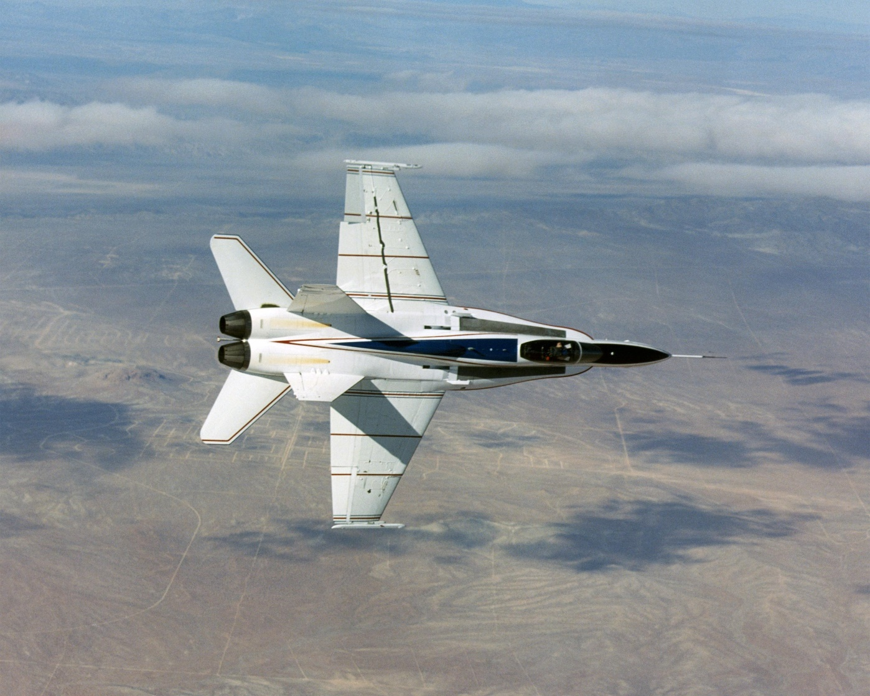
Early Adopters: Aerospace and Defense Industry
“A digital twin is an integrated multiphysics, multiscale, probabilistic simulation of an as-built vehicle or system that uses the best available physics models, sensor updates, fleet history, etc., to mirror the life of the corresponding flying twin.”
Glaessgen (NASA) and Stargel (US Airforce), 2012
Fighter jets are expensive devices that require safe operation and detailed control, and at the same time are subjected to very high demands on performance.
NASA Photo / Jim Ross
Notes:
One of the first industries to consider the use of digital twins is the aerospace industry. In a very insightful paper, Glaessgen and Stargel (ref 1) explain the use of digital twins for vehicle certification and fleet management. The digital twin for a vehicle would be used to “continuously forecast the health of the vehicle or system, the remaining useful life and the probability of mission success”. The description of the digital twin is the following: “A digital twin is an integrated multiphysics, multiscale, probabilistic simulation of an as-built vehicle or system that uses the best available physical models, sensor updates, fleet history, etc., to mirror the life of its corresponding flying twin.”
NASA Image: https://www.nasa.gov/centers/dryden/multimedia/imagegallery/AAW/EC03-0039-1.html

Slide 4
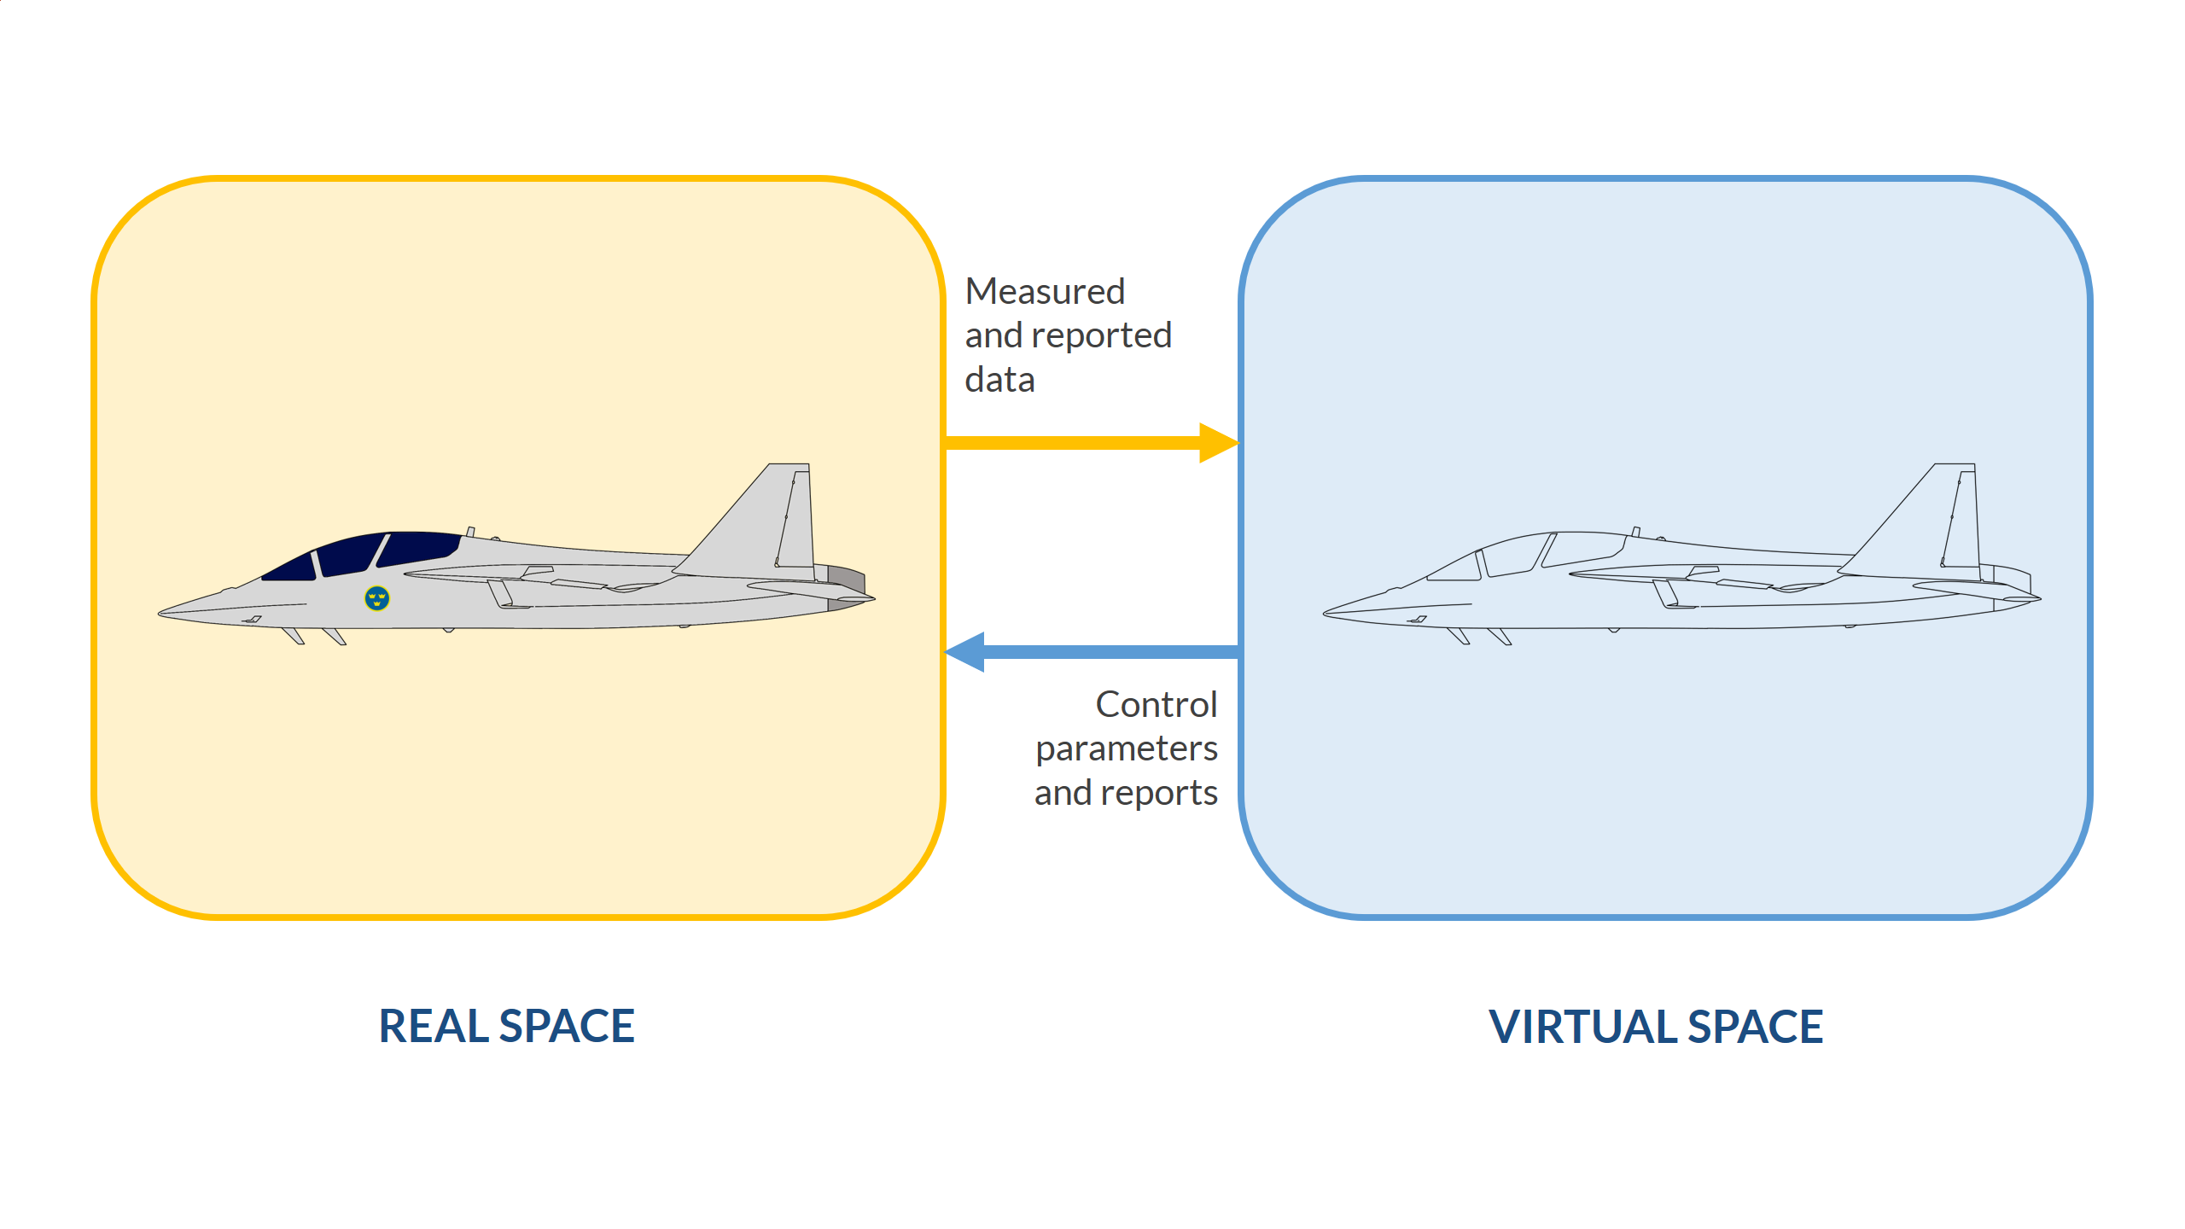
The Digital Twin Concept
Notes:
The digital twin concept consists of a real space and a virtual space. The virtual space contains all the information gathered from the real space. It also contains a high-fidelity description of the physical device or process from the microscopic level to the geometric macroscopic level. The description provided by the digital twin should be “virtually indistinguishable from its physical counterpart”
The communication from the real space to the virtual space consists of sending sensor data, measured data, and other observations from the real space to one or several computers that create the DT in the virtual space.
The models incorporated in the DT may then use this data for parameter estimations and for updating the models that describe the real device. The purpose is to use the data and the models to predict the behavior, life, and to optimize the operation of the real device exactly at the current state.
The communication from the virtual space to the real space may therefore consist of sending control parameters, constraining parameters, and reports that determine the operation of the real device in order to meet the criteria required from it; for example, regarding performance, safety, and remaining life of the device.

Slide 5
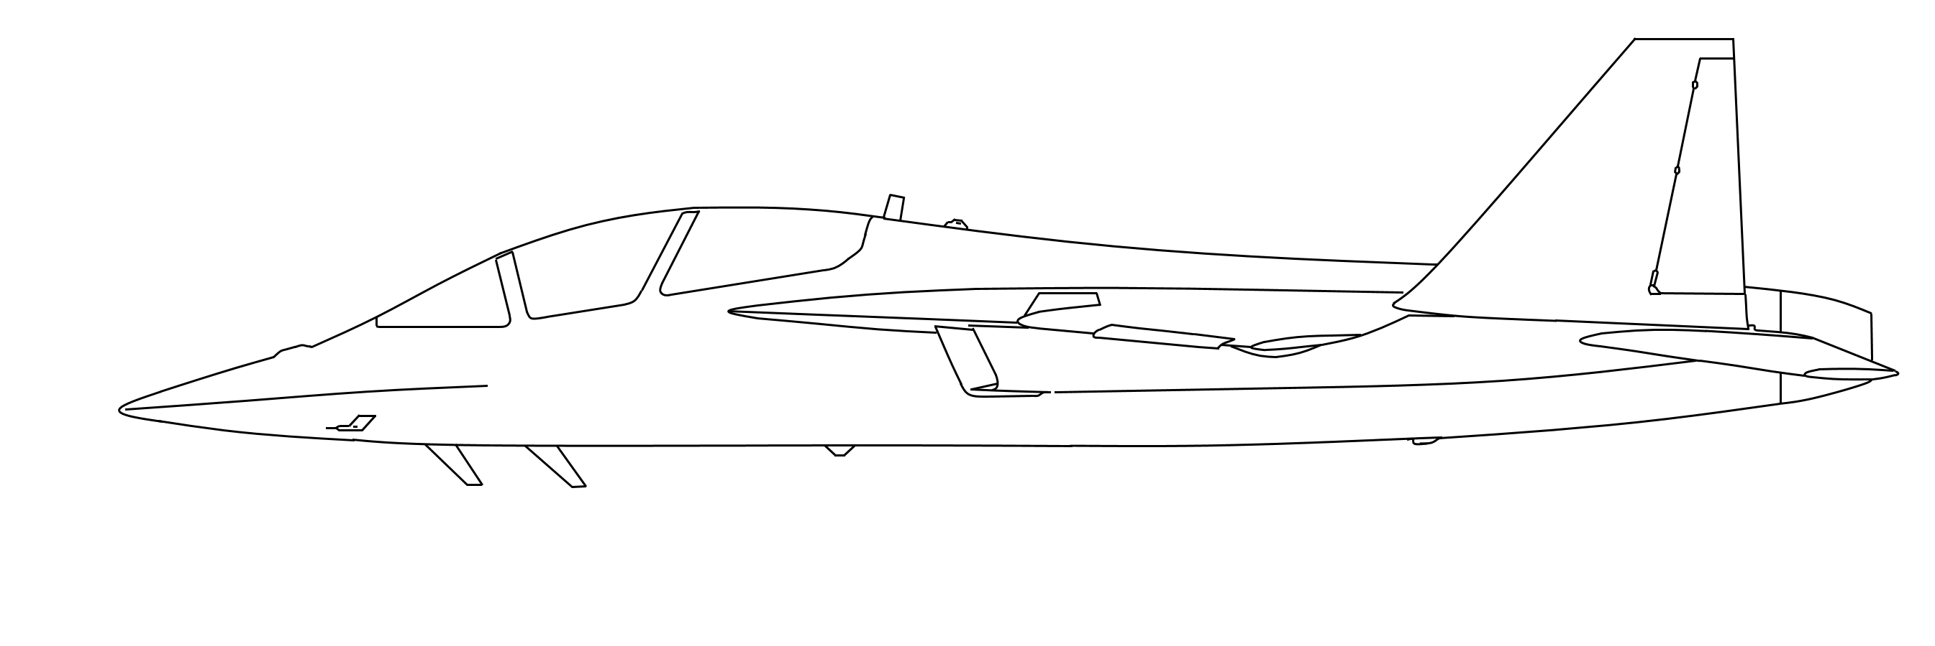
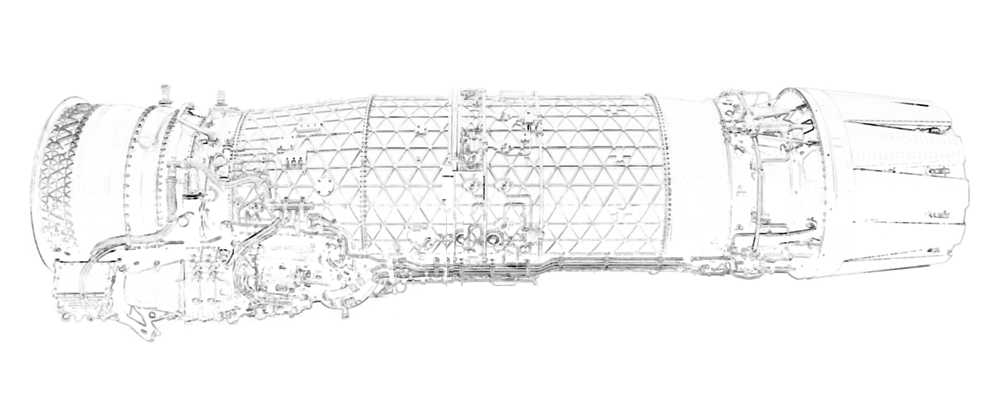
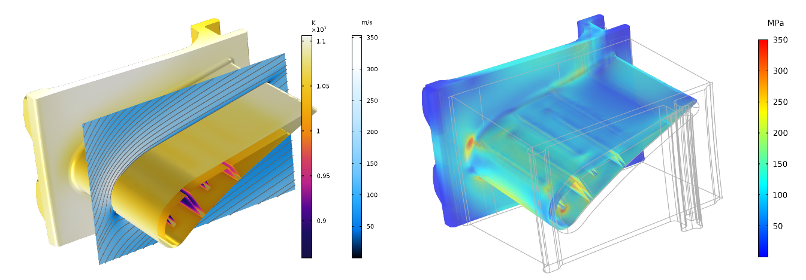
Multiphysics Models in Digital Twins
Thousands of critical parts may require high-fidelity multiphysics models
Each critical part is in turn part of a larger subsystem
Each subsystem may require its own DT
A turbine stator is just a small component in a turbine engine, which in turn is a subsystem of the fighter jet.
Notes:
It is easy to imagine that a complex system such as a fighter jet incorporates many complex subsystems. If we just look at the turbines, we may have accurate multiphysics models to describe critical parts of the turbine; for example, turbine parts that are subjected to thermal cycling and very high stresses and strains.
The turbine itself may consist of a fan module, a core engine module, a fan drive turbine module, and an afterburning module; each module with critical parts and corresponding subsystems.

Slide 6
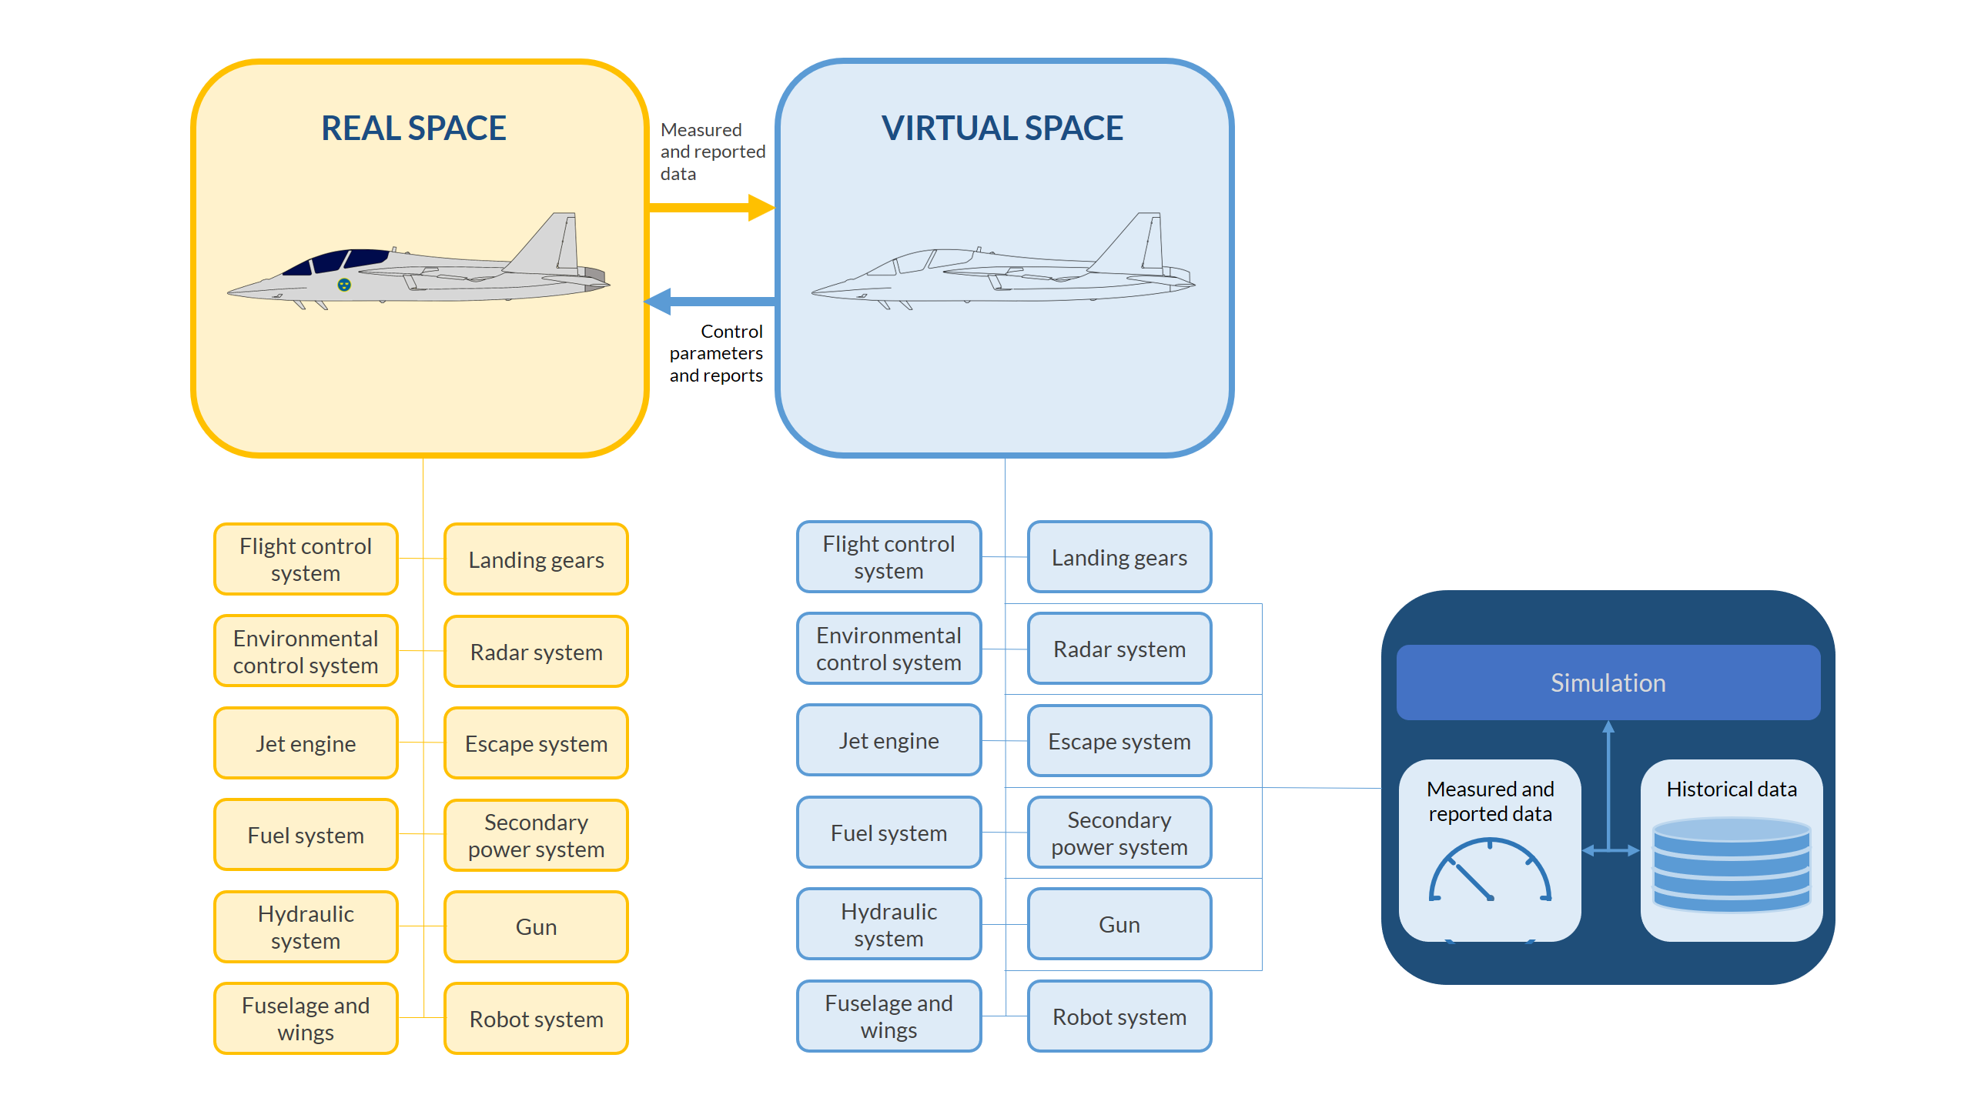
Digital Twin Aggregates
Notes:
It is not only the turbine. The jet fighter may incorporate a flight control system, an environmental control system, a fuel system, landing gears, radar system, escape system, hydraulic system, secondary power system, a gun, fuselage and wings, a robot system, the mentioned turbines, etc. This means that a jet fighter may require thousands of multiphysics models in order to be described accurately.
A system that comprises thousands of models and sensors has to incorporate many DTs, which can communicate with each other and may query each other for predictions and data. Such a system is referred to as a digital twin aggregate (DTA).

Slide 7

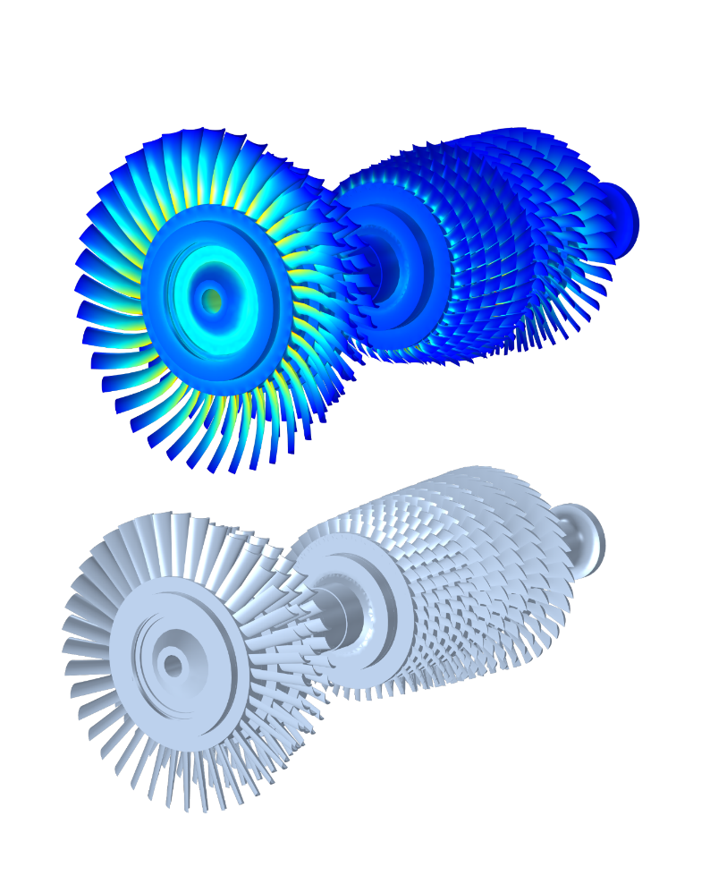
Lightweight Models and Reduced-Order Models (ROM)
2. Sector model, 50 kDOFs
1. Full model, tens of millions of degrees of freedom (DOFs)
3. ROM, 100 DOFs
https://hal.archives-ouvertes.fr/hal-01130542/document
Notes:
High-fidelity models can typically be used to estimate the health of critical components in a system. For example, based on the cycle history, temperature history, and the loads that a part has been subjected to, a high-fidelity model may predict the structural health of that component. This information may be used in the lightweight reduced-order models in order to predict control parameters that align to the current status of that critical component to prevent failure.

Slide 8
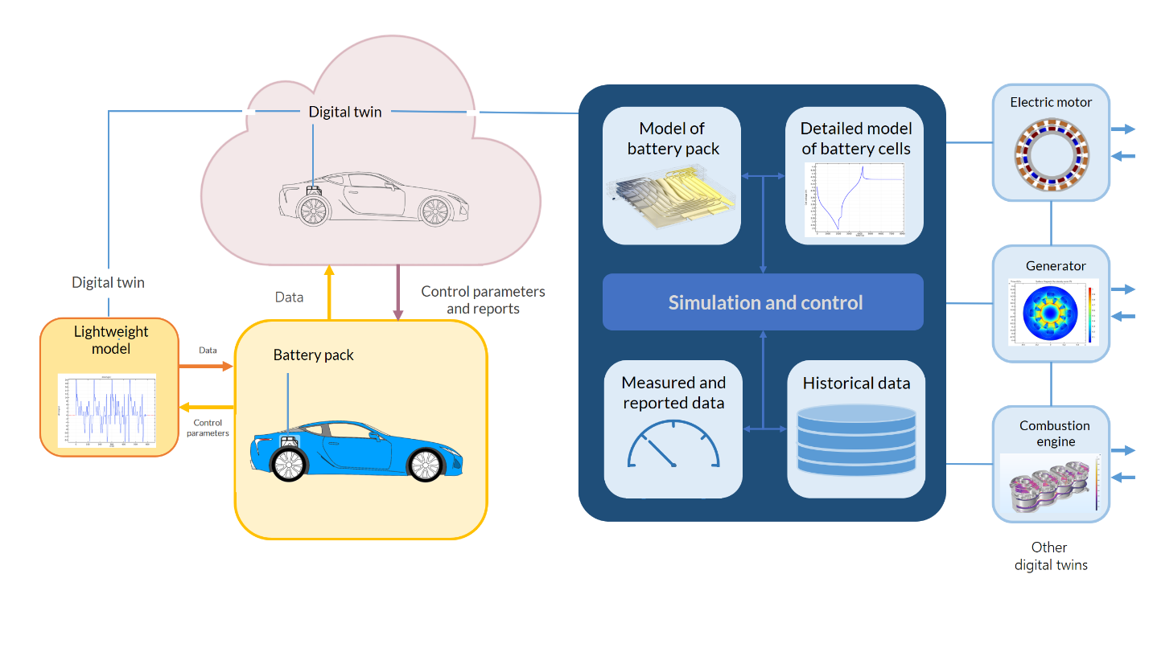
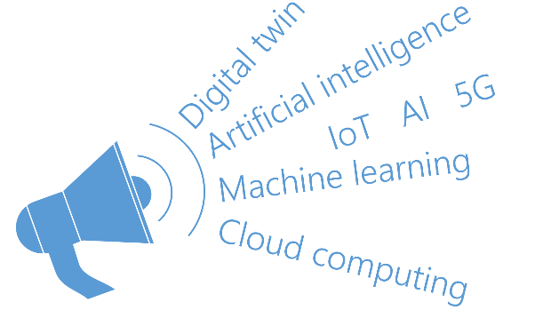
Civil Applications Rely on New Technology
Cloud computing
Machine learning (AI)
5G
Internet of things (IoT)
The implementation of a DTA in civil applications, such as for the battery system in a hybrid car, may rely on emerging technologies such as machine learning and IoT.
Not just hype!
Notes:
Machine learning (a subset of artificial intelligence) may be used to build aggregate models that incorporate the DTA in order to determine when the subsystems should query each other and what commands should be triggered by input data, sensor data, and model results.
Computing resources are abundant for military applications, but for civil applications, high-fidelity models have to be run on expensive cluster systems, which explains the interest of cloud computing providers’ interest in the DT concept.
The demand on communication in the DTA and also between sensors and devices in civil applications can probably be met with new wireless broadband communication, such as 5G. For civil applications, the internet of things (IoT) may encompass internet connectivity, real-time operations, machine learning, and other technologies that allow sensors and devices to communicate according to certain technical standards. This would enhance the possibilities to create DTAs connected to systems of devices in the real space.

Slide 9
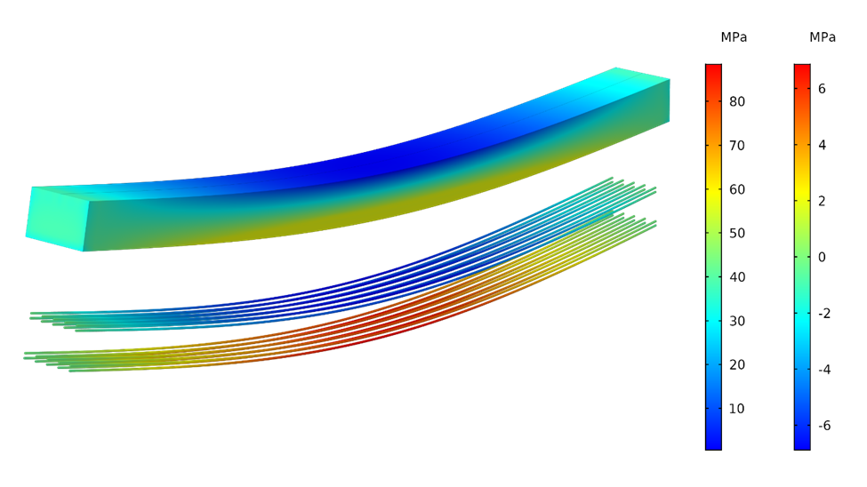
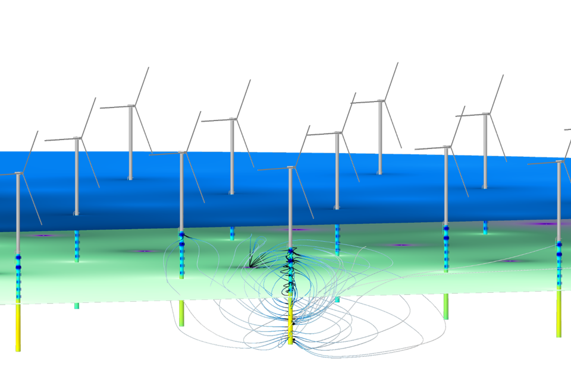
Mundane Earthbound Applications
Design of concrete structures
Monitor and control the construction and curing process
Monitor the status and structural integrity of the structure
Control and maintain corrosion protection systems
Schedule maintenance
Predict life of the structure
The properties of a concrete structure and its durability can be evaluated and followed with a DT.
These structures can be very complex and include corrosion protection systems for offshore applications.
Notes:
So far, we have discussed the DT concept by looking at the fighter jet example, which makes sense, since it is in the defense and aerospace industry that the concept has been adopted. Are there more mundane and conventional applications? The answer is yes. Every major investment in the development, manufacturing, and operation of a device or system is a potential DT application.
Take the example of concrete structures in the construction industry. These are expensive structures that are also sensitive to the conditions during the construction and use of the structure. During the process of concrete curing, the water content and the temperature determine the future strength and durability of the structure. The hydration reaction in the curing process requires water. If drying is too fast, there will be not enough water to create a quality product. It is also important that the moisture content and the temperature is uniformly distributed during the curing process.
A multiphysics model is able to describe the curing process and, using correlations, also predict the properties of the structure once the curing process in completed. Moisture and temperature sensors are also relatively easy to incorporate into a concrete structure, which allows for a continuous validation and adaptation of the multiphysics models to the measured data. Also, weather data, measured and forecasted, can be used as input to the model to predict if moisture should be added and when, or if the structure should be protected from cold temperatures and large temperature gradients. This is a good example of the use of a relatively mundane yet extremely useful application of a DT. The DT may also be used to keep track of the status of the structure, schedule maintenance, and predict the life of the structure.
Needless to say, concrete structures can be very complex, involve very large investments, and be critical to the infrastructure of a region or even a country. The design, construction, and operation of a bridge may also involve hundreds of multiphysics models and involve systems of DTs in a DTA.
For example, a wind farm involves both concrete and metal structures that have to be protected from the corrosive seawater. The statuses of these structures have to be carefully monitored and correlated to weather conditions using DTs. The underwater steel structure of the wind turbines in a wind farm is protected by a corrosion protection system. The state of the structure, the remaining life of the protecting anodes, and the operation of the corrosion protection system can all be monitored and controlled using a DTA.

Slide 10
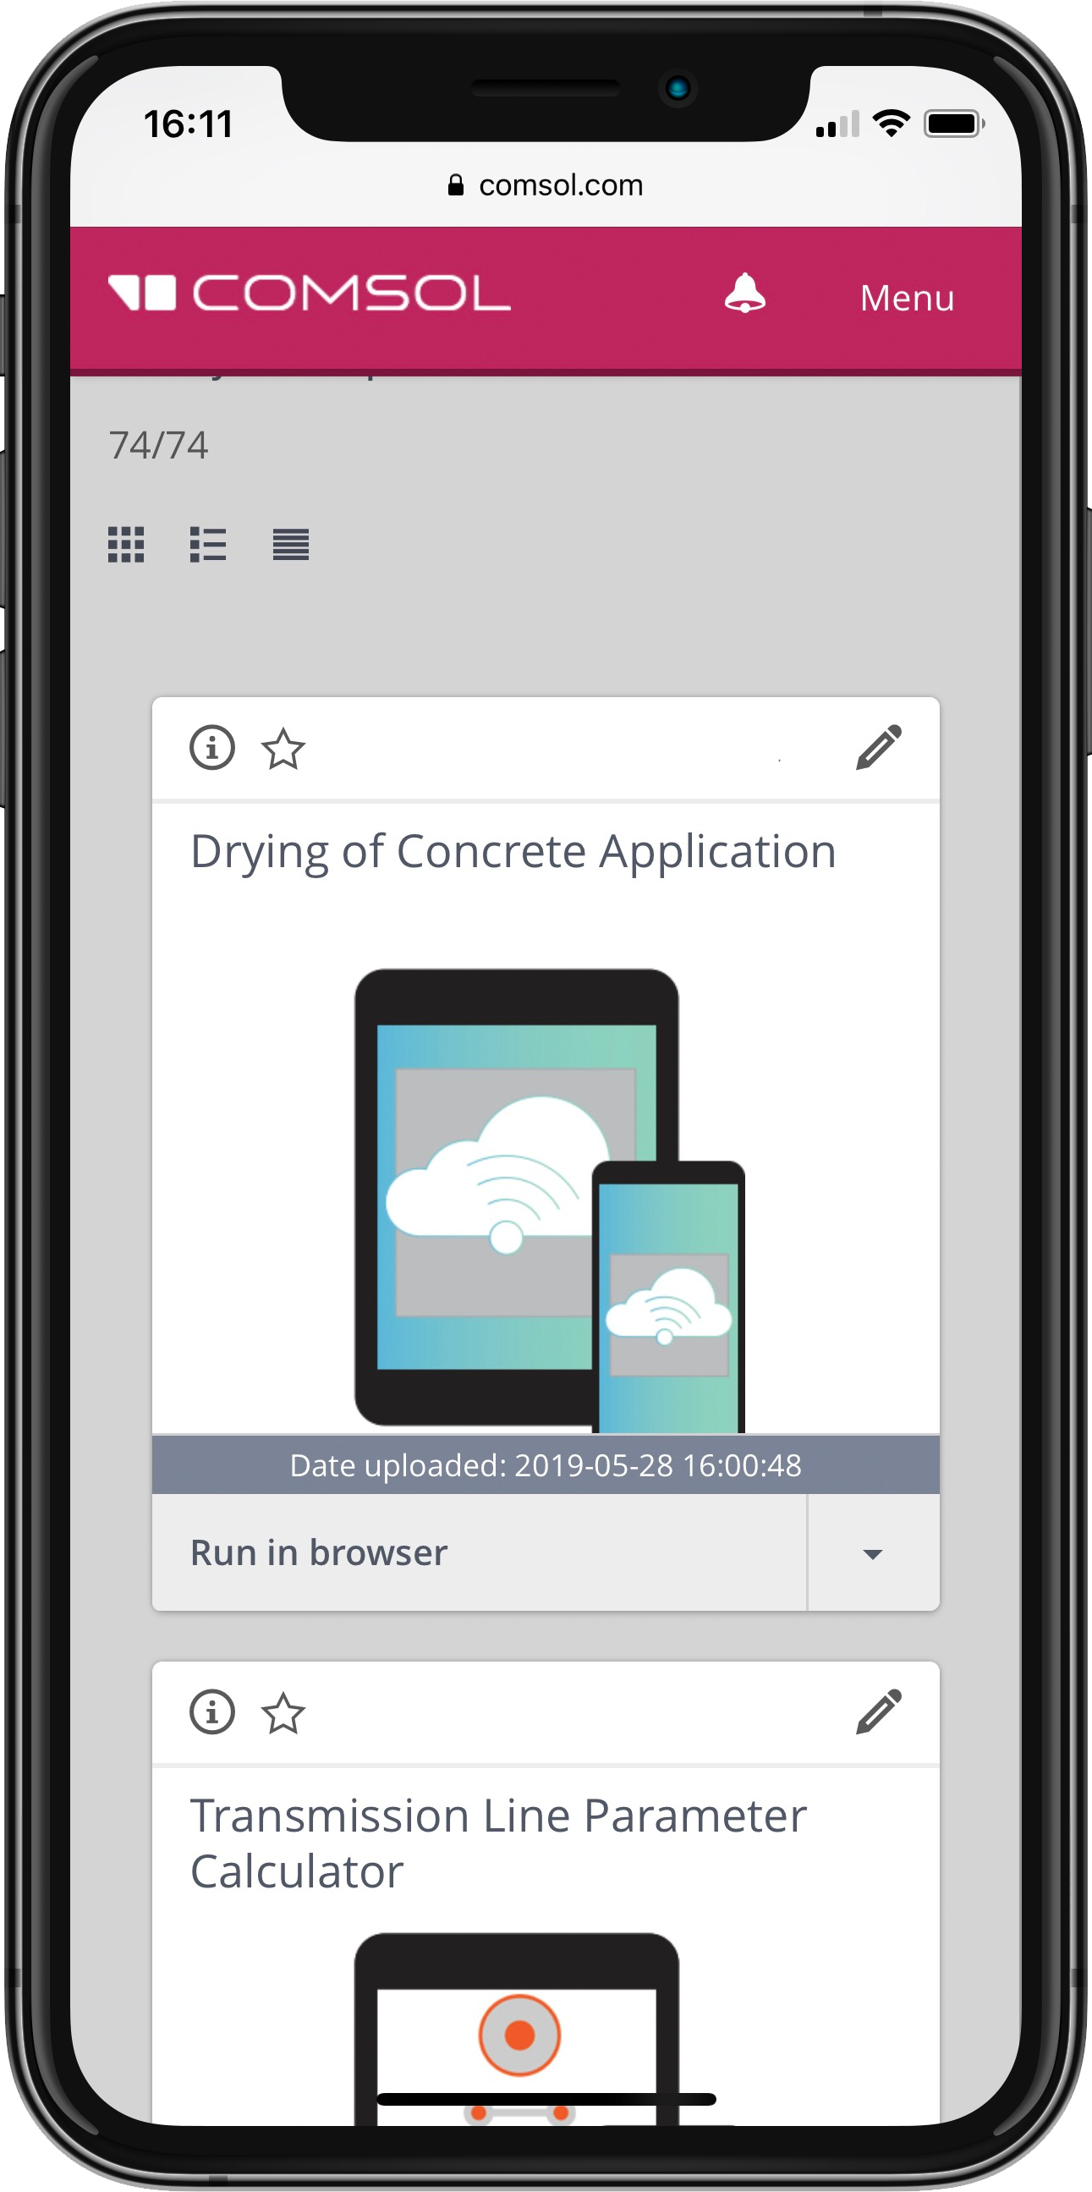
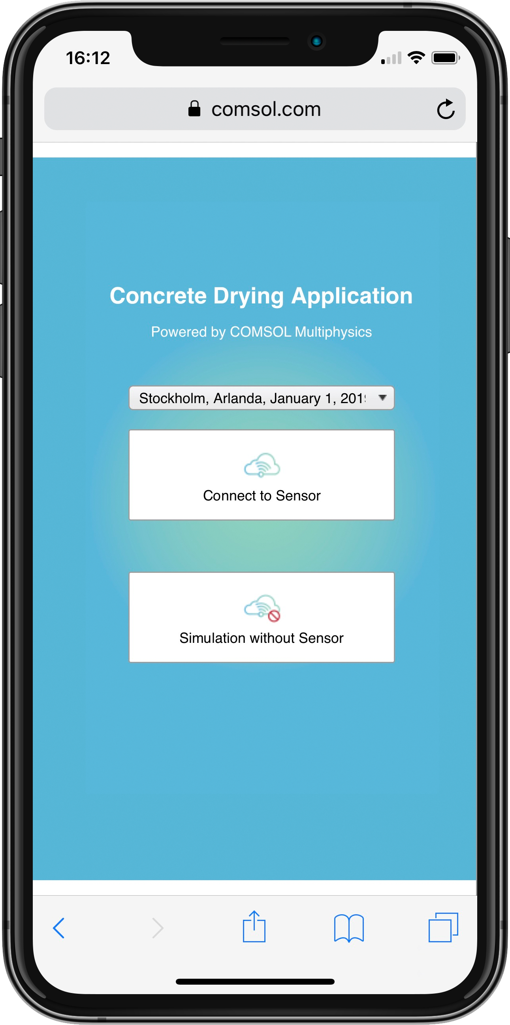
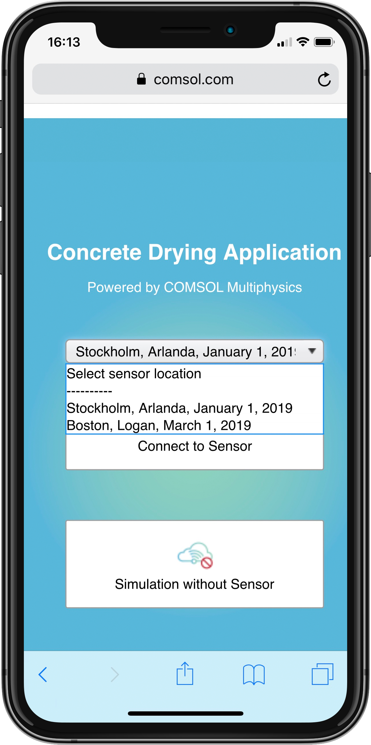
DT Tutorial
DT for concrete curing
Typically part of a DTA
Reads sensor data for moisture and temperature
Loads weather data, including relative humidity and temperature
Predicts and keeps track of concrete curing process
Tutorial for using the Application Builder to set up DTs
Notes:
This is a simple tutorial of a DT implemented in COMSOL. The purpose is to show how to set up a DT in COMSOL. This is a very simple tutorial but it contains the main component of a DT:
A high-fidelity multiphysics model (chemical reactions and heat transfer)
Reads sensor data regarding moisture content and temperature in the concrete slab
Receives weather data in the form of temperature and relative humidity in order to predict the curing process accounting for weather changes
Can tell the constructor when water has to be added to the slab
Gives a prediction of when the curing process can be completed
Tells the constructor when the curing is completed so that the building project can proceed

Slide 11
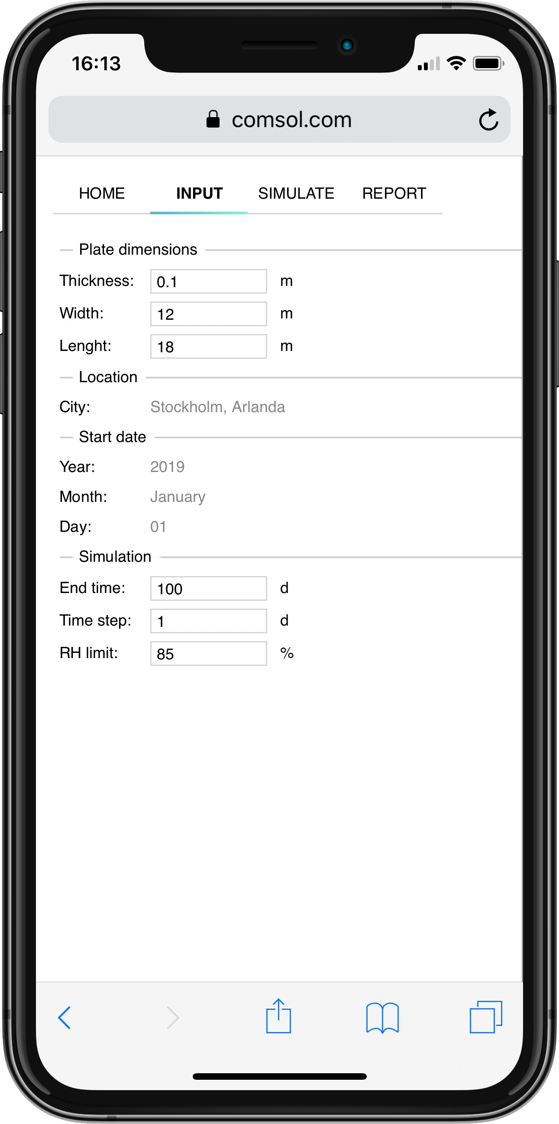
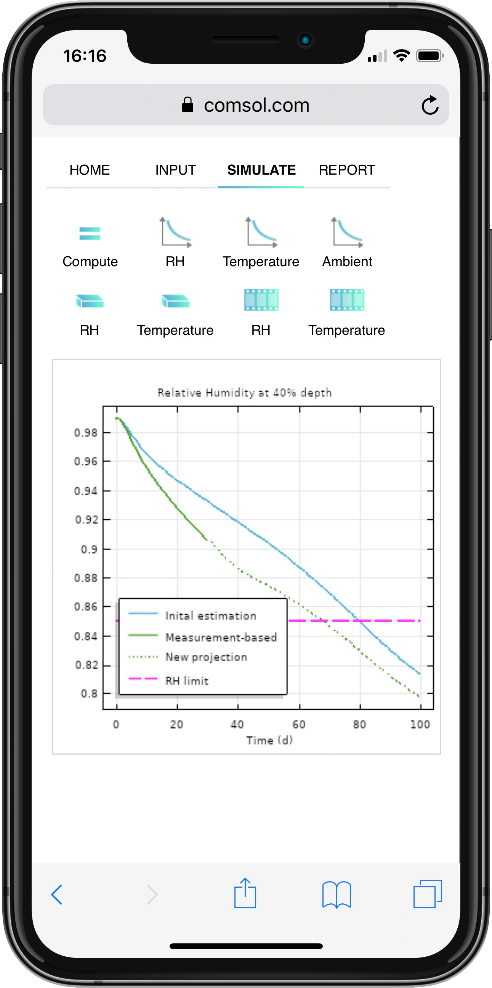

DT Tutorial
DT for concrete curing
Typically part of a DTA
Reads sensor data for moisture and temperature
Loads weather data, including relative humidity and temperature
Predicts and keeps track of concrete curing process
Tutorial for using the Application Builder to set up DTs
Updated prediction of moisture content
Initial prediction of moisture content
Notes:
The simulation application receives input about the concrete slab design through its user interface. It receives moisture, temperature and weather data every hour or according to a desired schedule. The prediction of the concrete curing process is updated every hour based on this data. In the Report page, the DT can generate a report; send an email; and store the model, sensor, and weather data into the cloud for documentation and traceability purposes.
We can imagine that this is just a part of a real DT for a concrete structure. A concrete bridge would be a much more complex project, and consequently, the DT for such a bridge would be very complex. Such a DT would include the design of the bridge and the bill of materials. The structural analysis, the corrosion protection system; the construction project plant; the building process; the maintenance plan; the load history; the weather history (strong winds, vibrations, etc); and many more information may influence the integrity and life of the bridge.

Slide 12
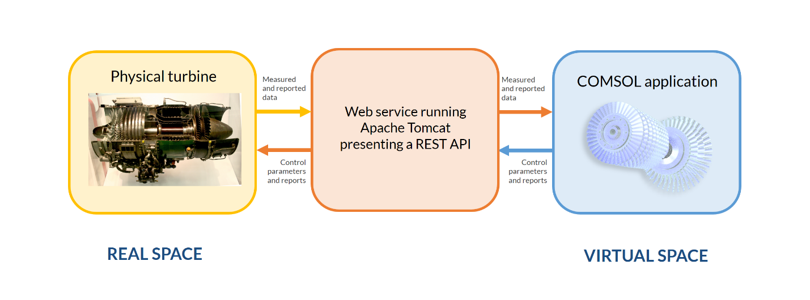
DT Implementation in COMSOL®
COMSOL ® API for use with Java® using dynamic link library files*
Virtual space as a web service running inside Tomcat presenting a representation state transfer API (REST API)
*API = application programming interface
Notes:
The most powerful way of connecting COMSOL models to measure data that is updated in real time is to use the COMSOL API for use with Java. The Java model file can communicate with external systems using dynamic link library files (dll-files). It is also possible to implement the virtual space as a web service, such as a Java-based web service running inside Tomcat. Such a web service could present a representation state transfer application programming interface (REST API) for communicating with the real space.

Slide 13
comsol.com/contact

