Slide 1

Process Simulation of Directed Energy Deposition process using COMSOL Multiphysics®
Vaibhav Nain^{a,*}
ª Irepa Laser, Parc d’Innovation, 67400 Illkirch-Graffenstaden, France

Slide 2
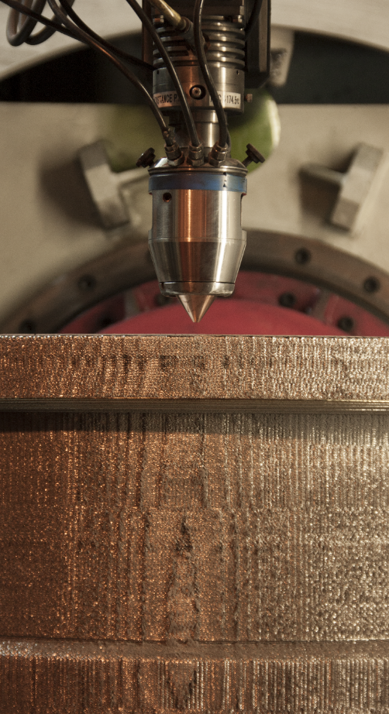
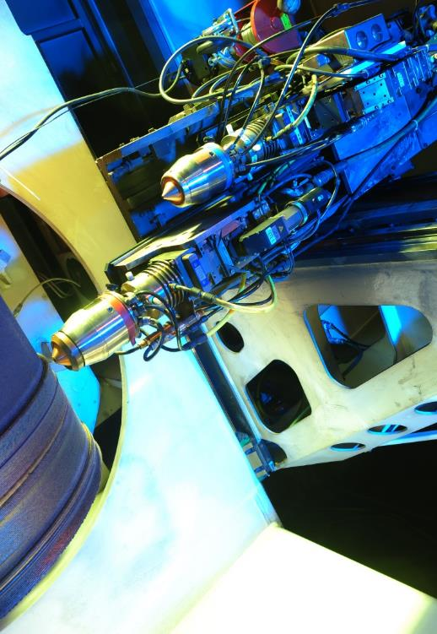
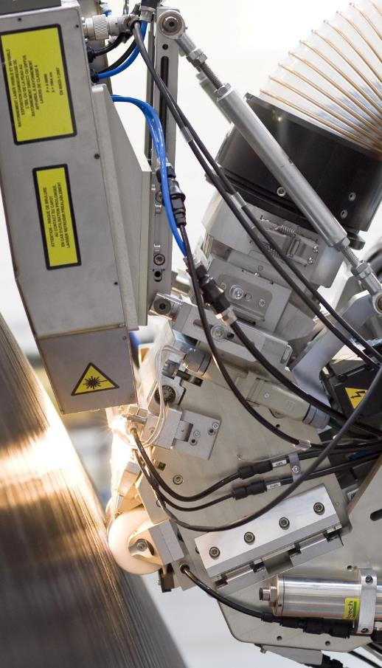
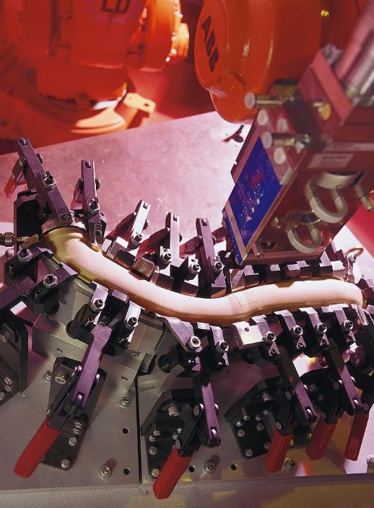
Thermo-mechanical Simulation for DED
DED
Why simulation?
Challenge!
Project Goals!

Slide 3
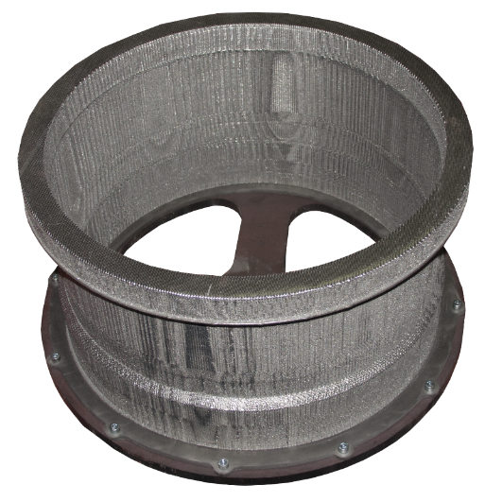

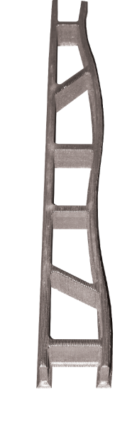


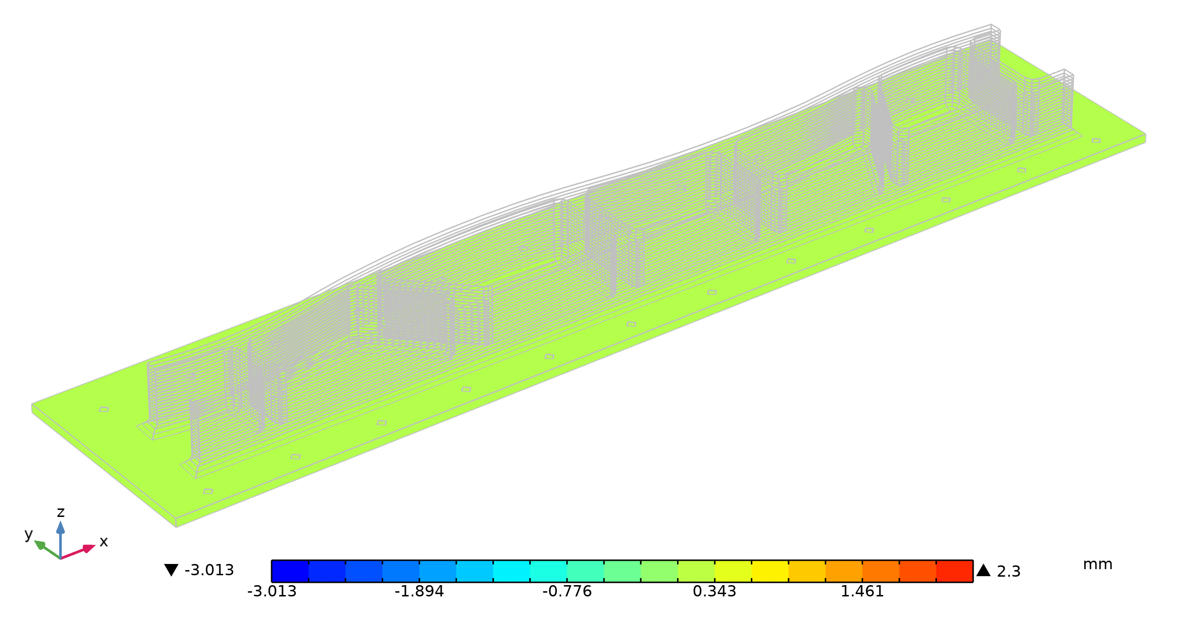
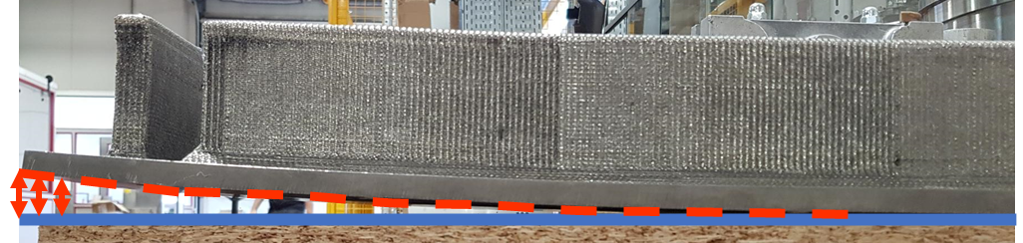
Directed Energy Deposition (DED)
Material | Ti-6Al-4V
Construction | Total : 155h
Weight | 71kg
Diameter | 680 mm
Part defects
Material | Ti-6Al-4V
Construction | Total : 33h
Weight | 14,2kg
Length | 1070 mm
DED fabricated part failure
What if!
Distortion accumulation > 20 mm
Part rejected
Digital test

Slide 4
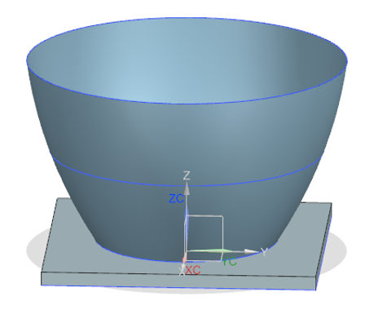
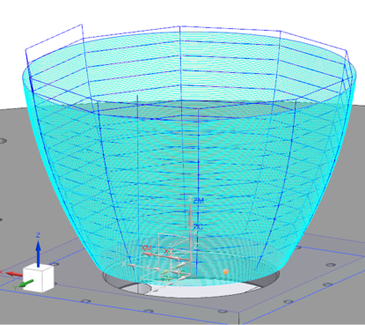
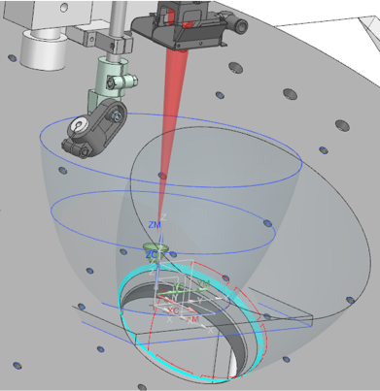
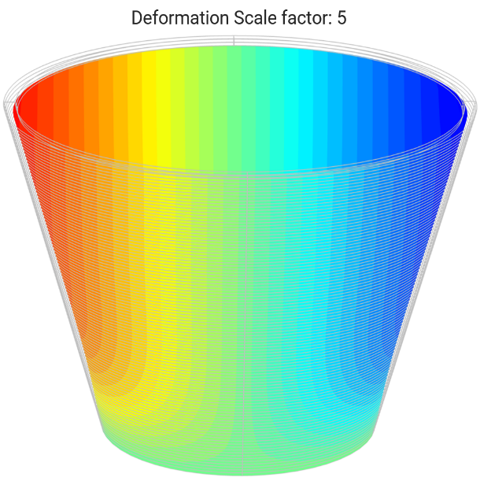
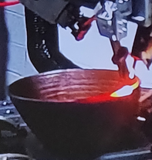
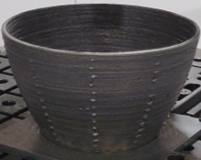
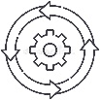

Why simulation?
Digital Chain: Currently used in industry for large-part fabrication
Ideal: Complete the missing link
1
2
3
4
4
5
CAD DESIGN
& OPERATIONS
CAM
PROGRAMMING
MACHINE
SIMULATION
PROCESS PARAMETERS
OPTIMIZATION
PROCESS PARAMETERS
OPTIMIZATION
PART
FABRICATION
Perform & finalize part design
Decompose part geometry
Different operations on bodies
Specify additive material
Apply deposition strategies
Finish & obtain deposition path
Machine simulation
Collisions verification
Machine & path verification
Simulate DED process
Predict part response
Distortion-compensated CAD
Transfer CAM to DED machine
Part fabrication
Process data optimization
Trial & error approach
Lots of time & money
Cannot predict deformation

Slide 5


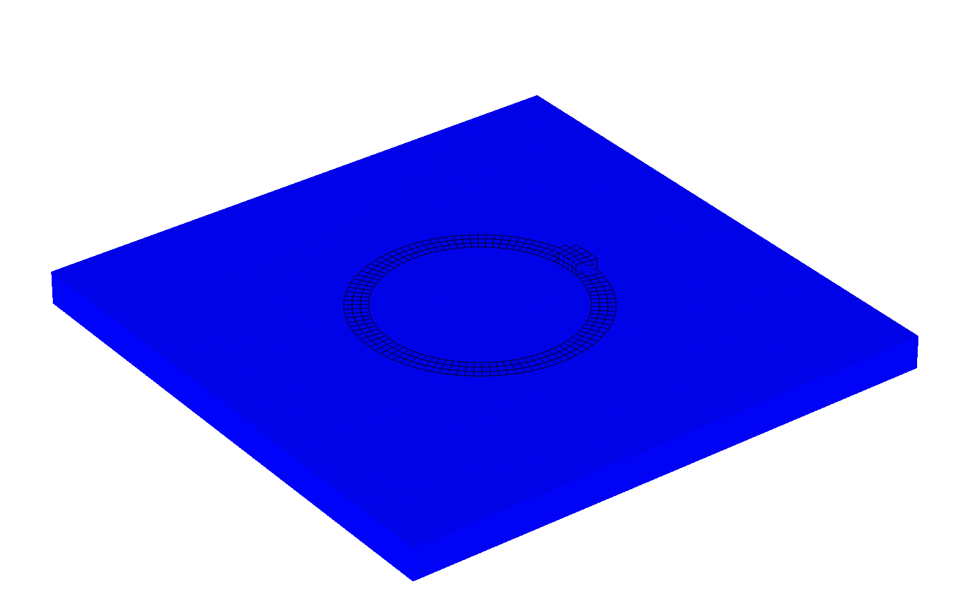
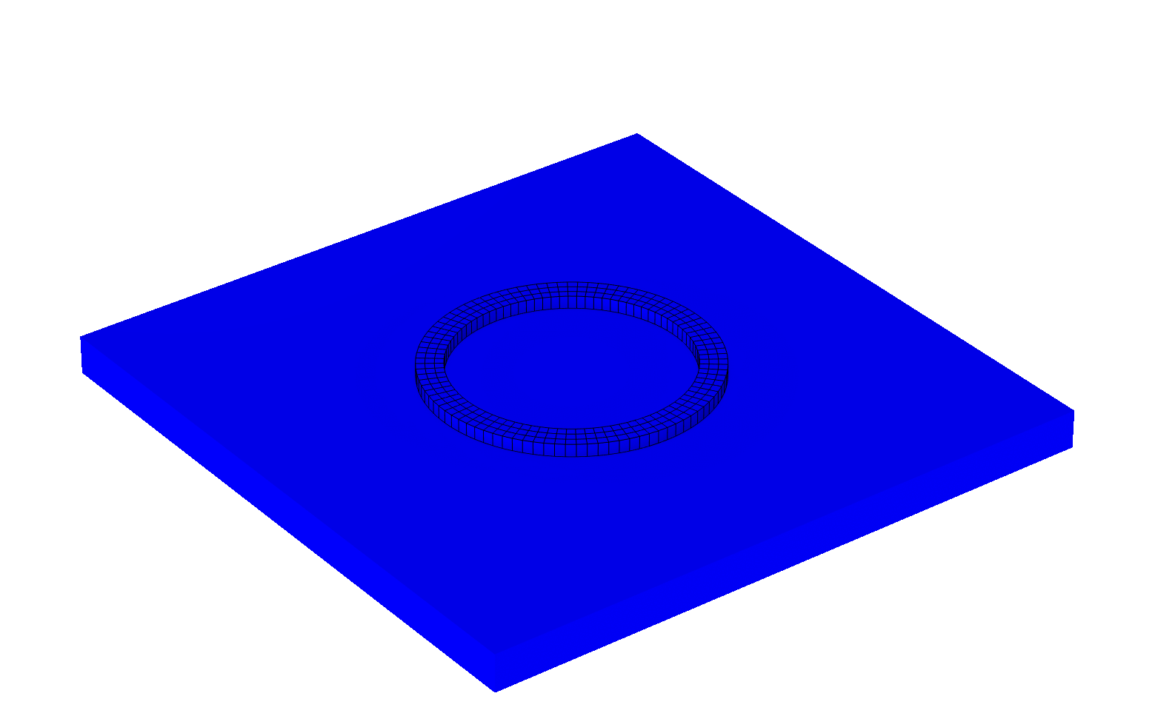

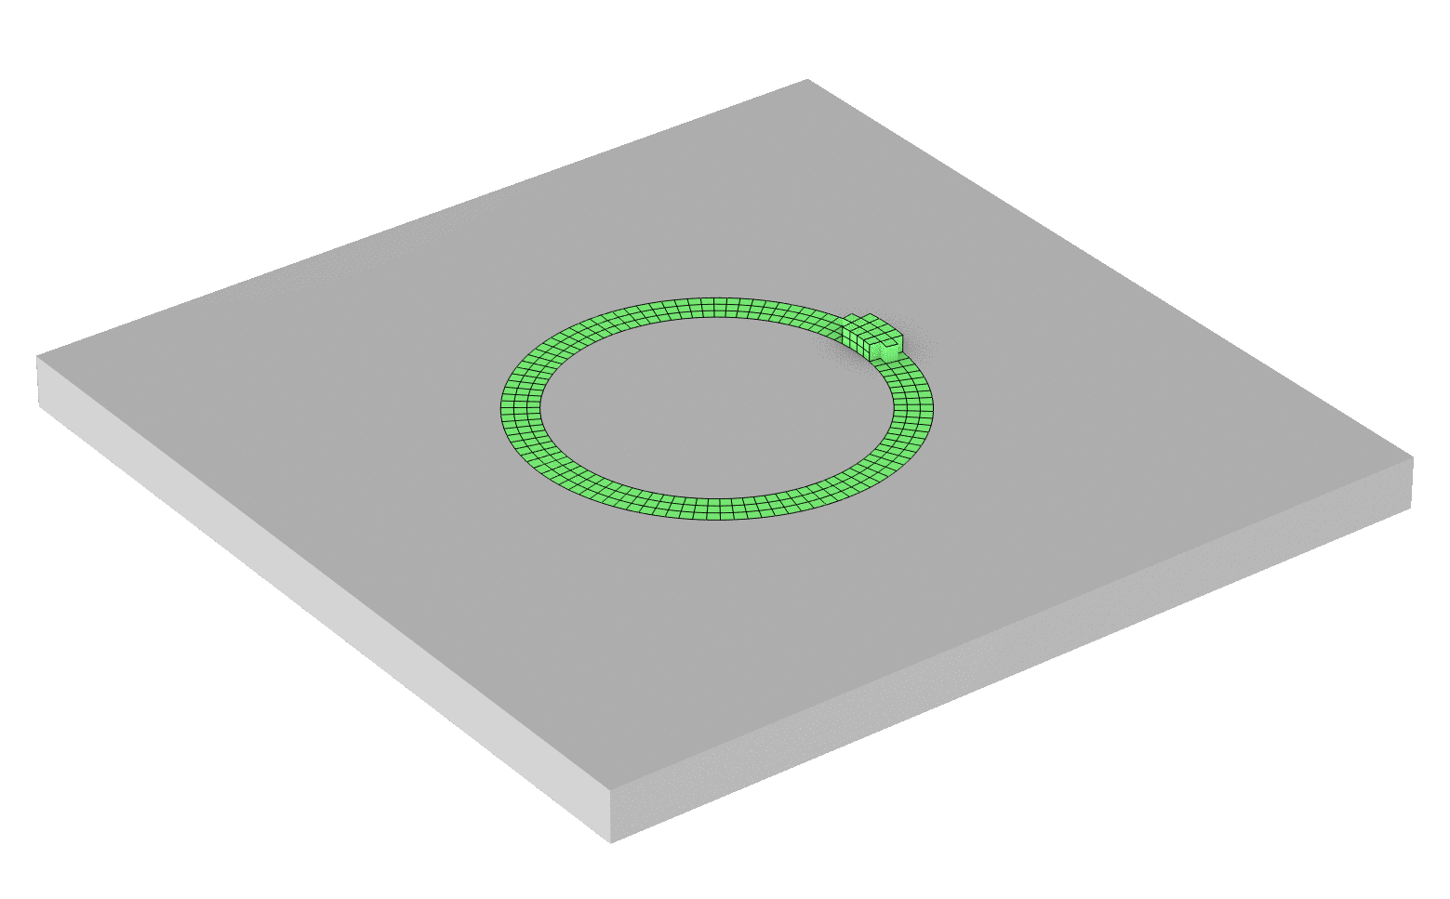

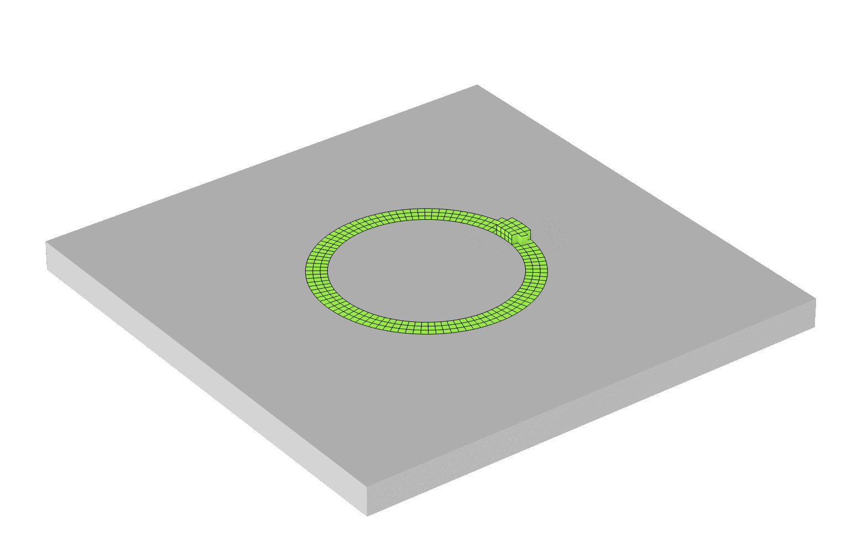
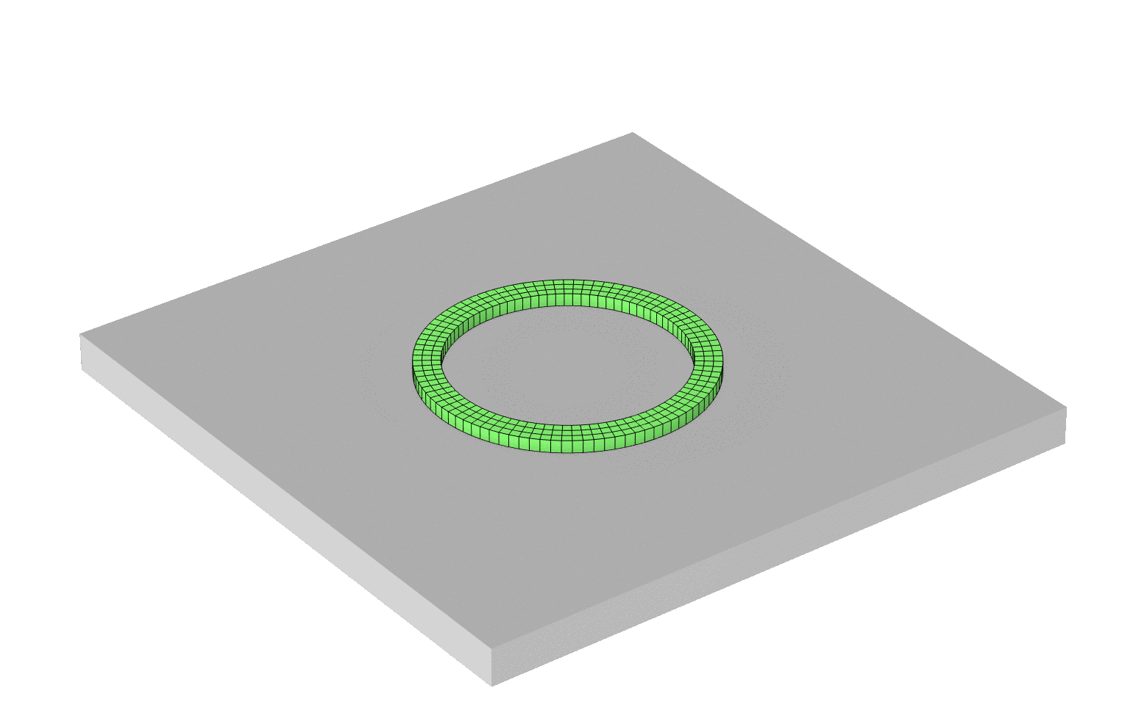
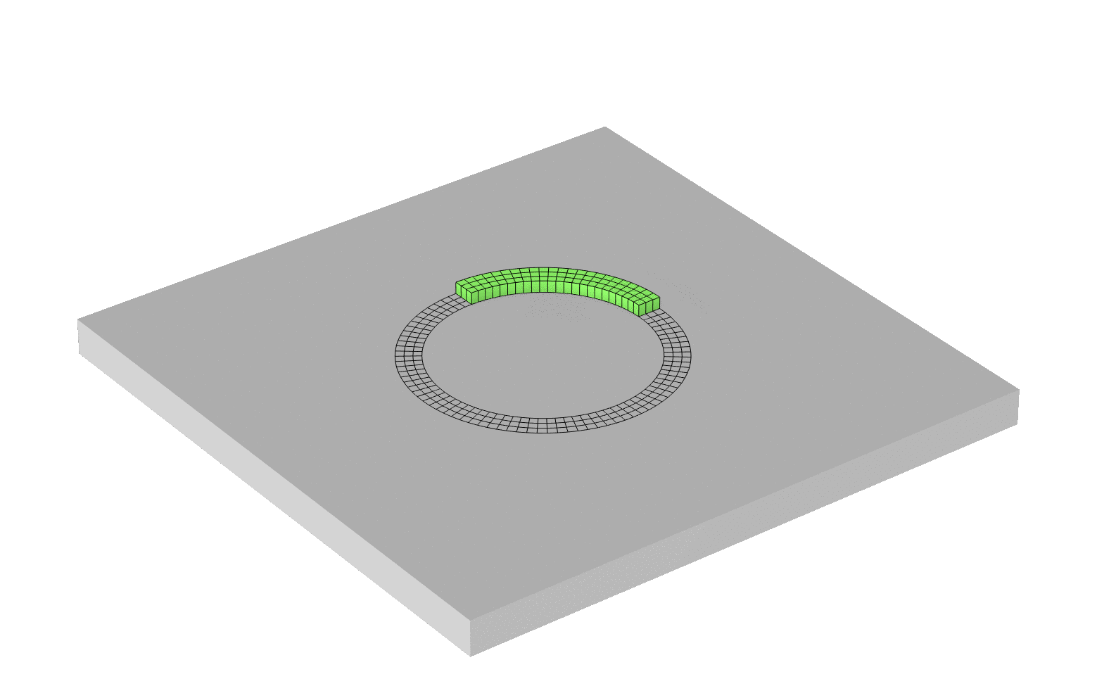
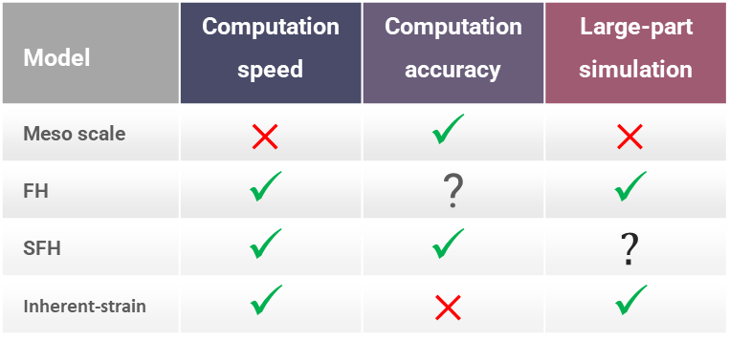
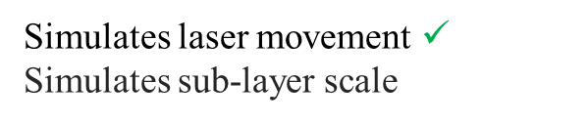
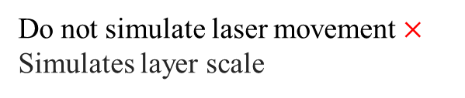
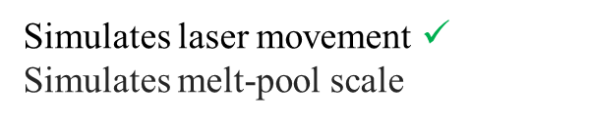
Challenge!
Model | Computation speed | Computation accuracy | Large-part simulation
Meso scale | $$×$$ | $$✓$$ | $$×$$
FH | $$✓$$ | ? | $$✓$$
SFH | $$✓$$ | $$✓$$ | $$?$$
Inherent-strain | $$✓$$ | $$×$$ | $$✓$$
V. Nain (PhD 2019-22)
[1]
[2]
[3]
[4]
Computation time
Meso-scale
Part-scale
Flash Heating (FH)
Sequential FH (SFH)
Inherent Strain
Simulates laser movement $✓$
Simulates melt-pool scale
Do not simulate laser movement$×$
Simulates layer scale
Simulates laser movement $✓$
Simulates sub-layer scale
Meso: Calculate Inherent Strain
Part: Apply Inherent Strain
AS OF TODAY: THE MODELING STRATEGY FOR LARGE DED PART IS NOT VALIDATED
COMPUTATION TIME & ACCURACY

Slide 6
Project Goals!
Digital tool for large-part DED
OUTCOME: PREDICTIVE SIMULATION TOOL FOR LARGE-PART DED
1
2
VALIDATE: With experiment data
3
FOCUS: Computation time reduction
4
DEVELOP: DED process simulation model
5
INVESTIGATE: Current modeling methods

Slide 7
Methods and use of COMSOL Multiphysics®
Experiment
Numerical model development
Numerical model set-up
Numerical analyses

Slide 8
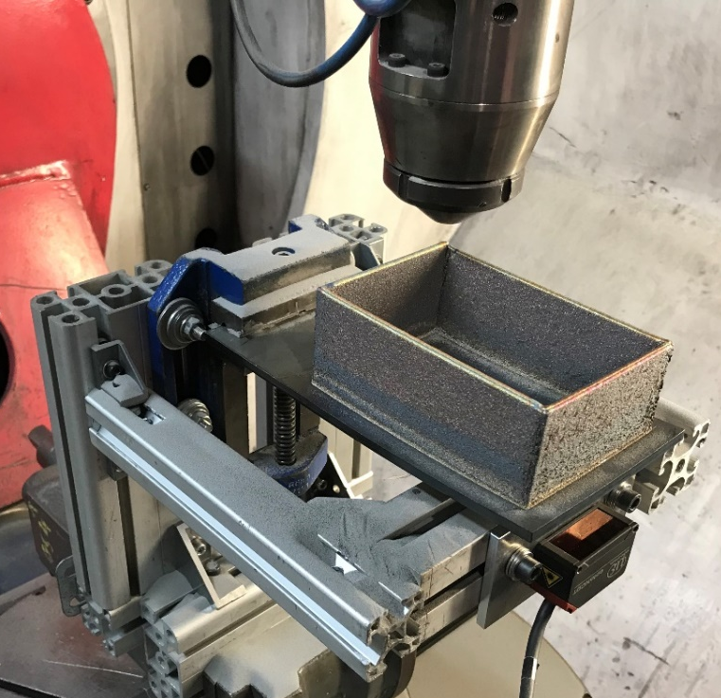
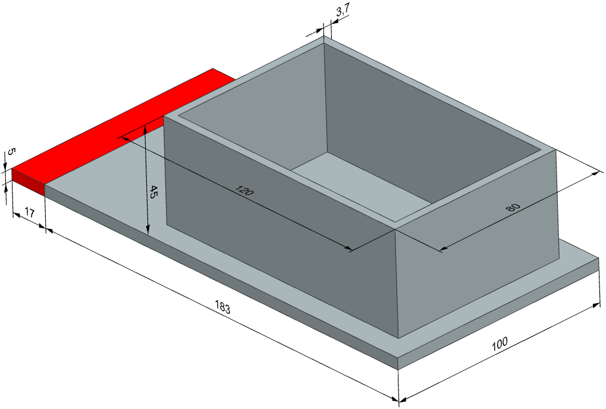
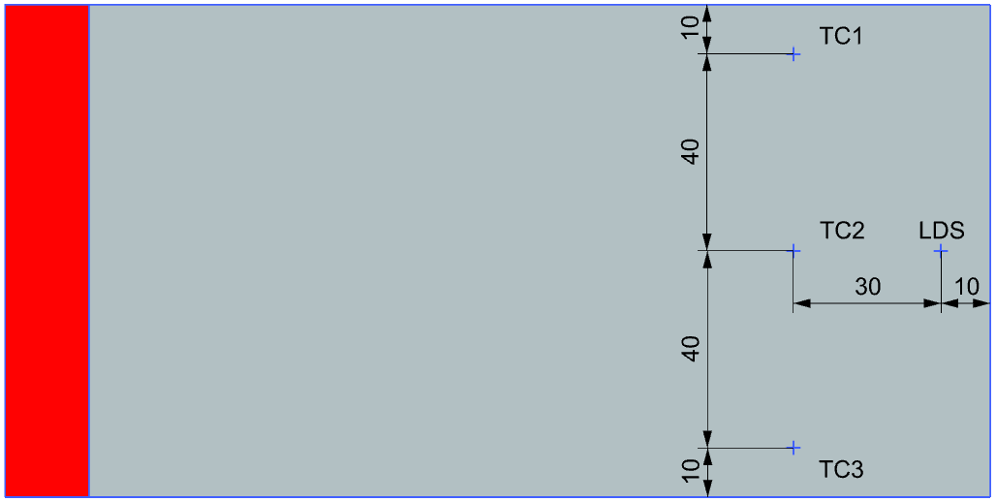
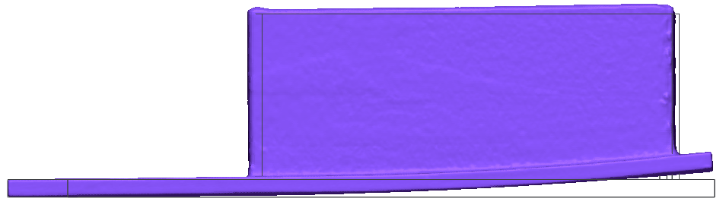
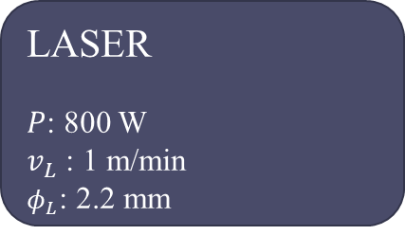
Experiment
Experiment DOE
LASER
$P$: 800 W
$v_{L}$: 1 m/min
$φ_{L}$: 2.2 mm
MATERIAL
Substrate: S235
Build part: SS 316L
DIMENSIONS
100 layers (2 tracks/layer)
Total weld length: 80 m
Experiment
CAD
Sensors location
6.97 mm
Scan data v/s CAD

Slide 9
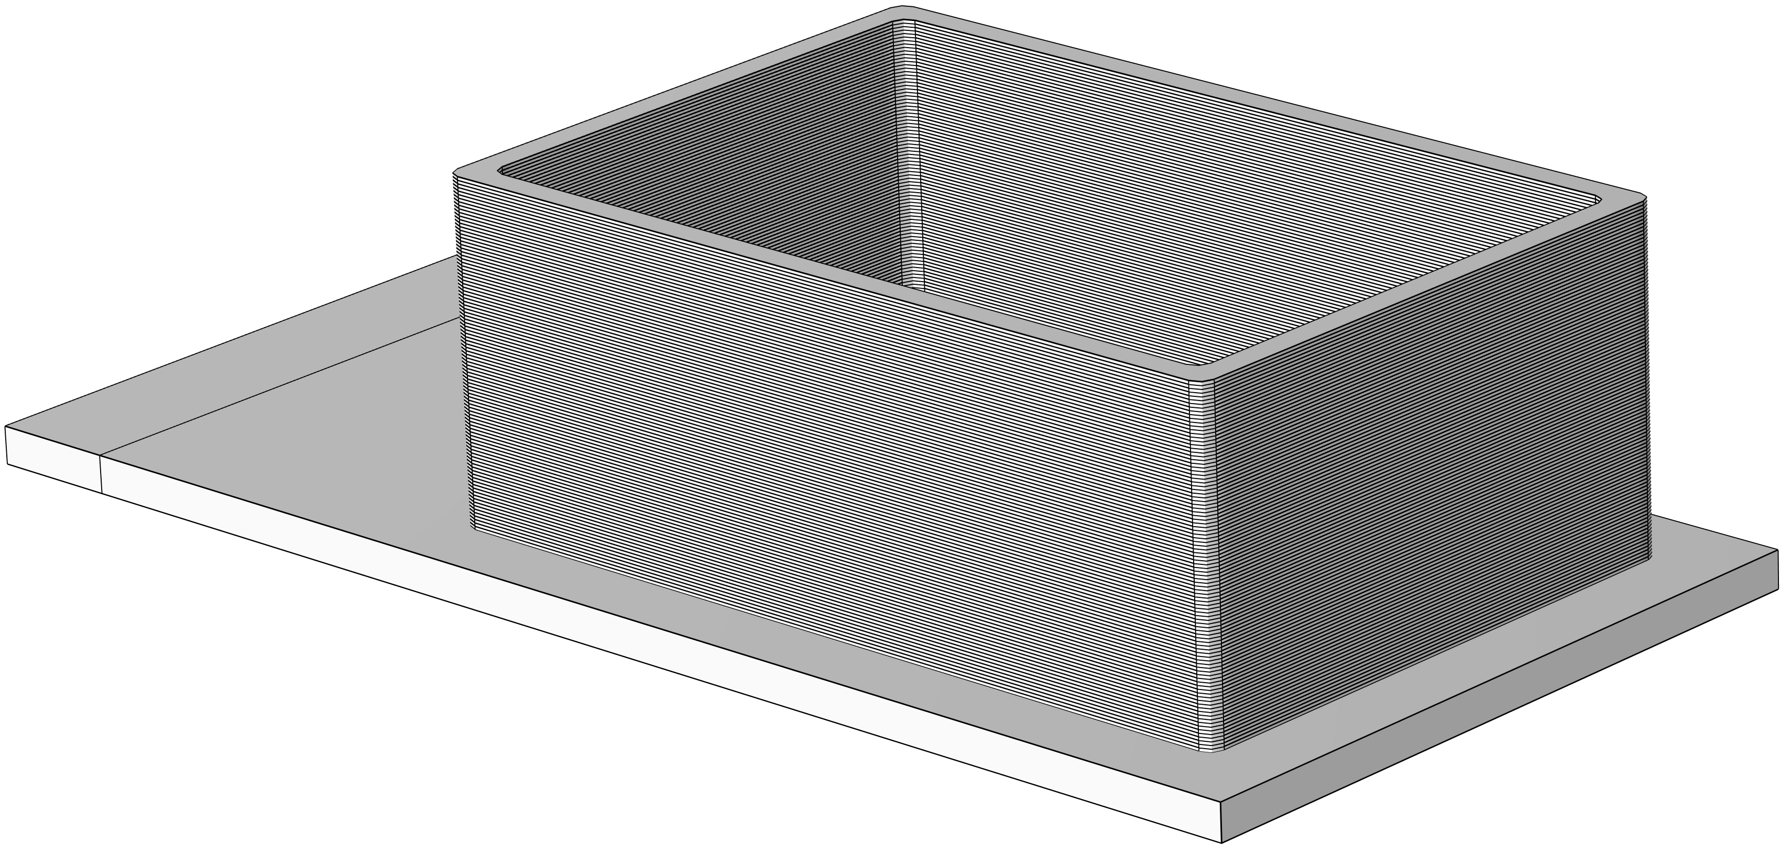
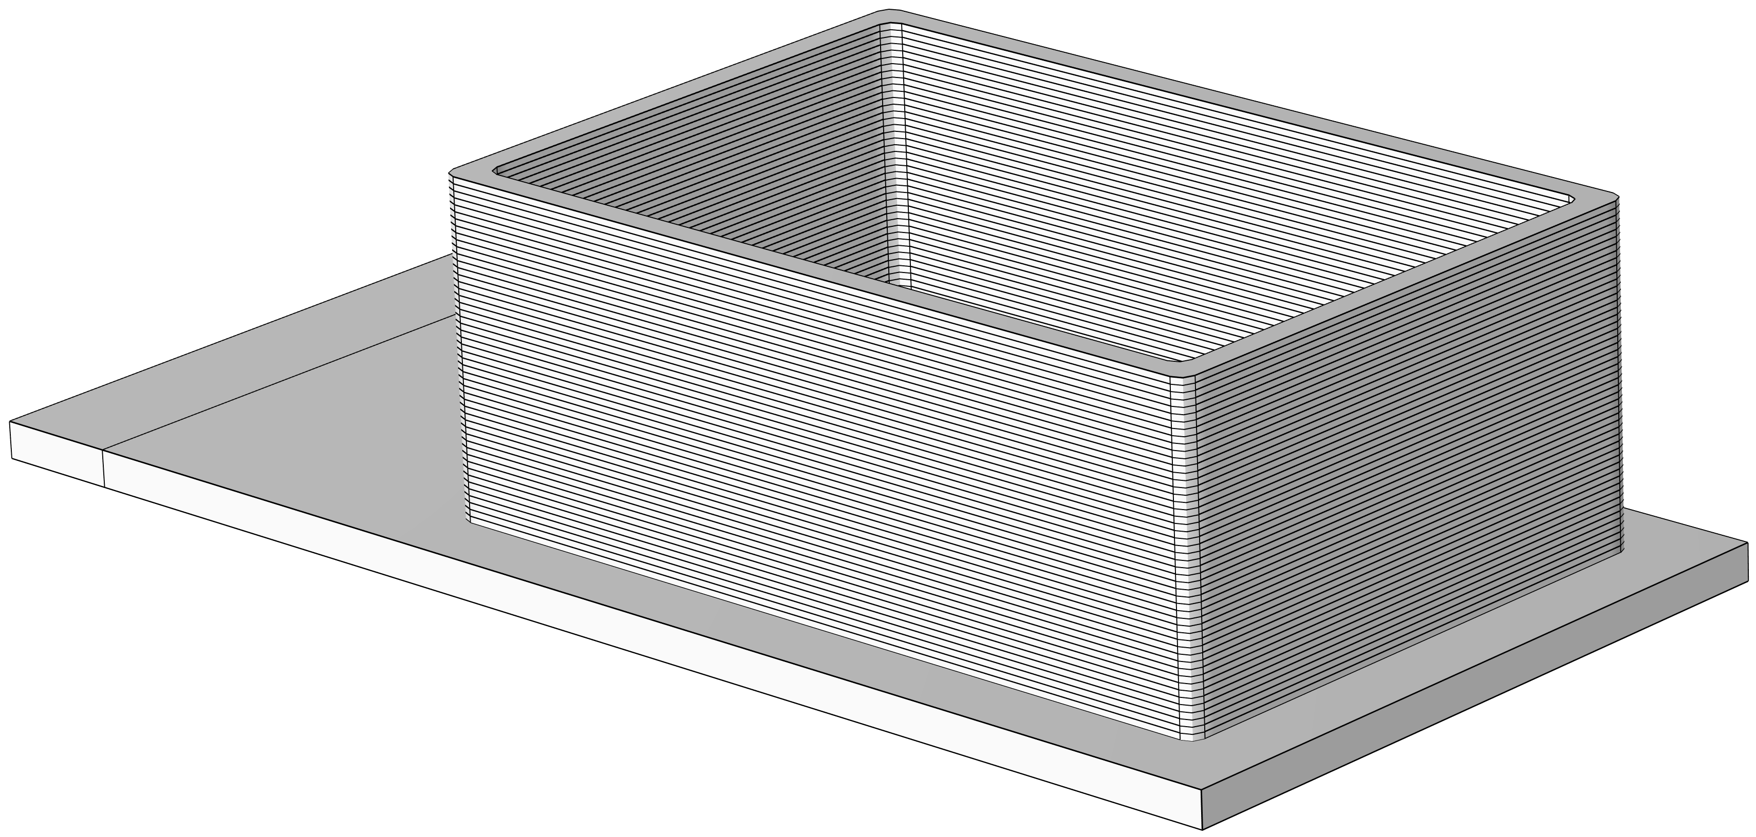
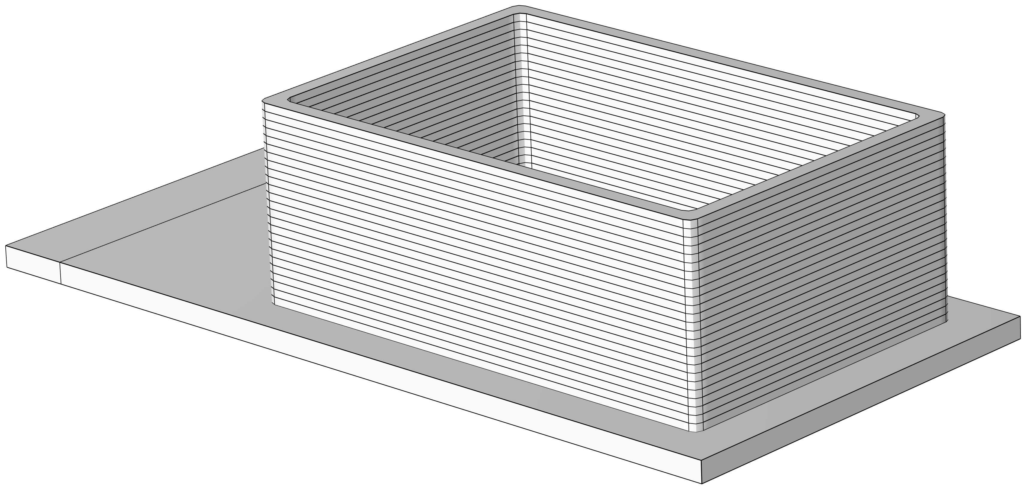

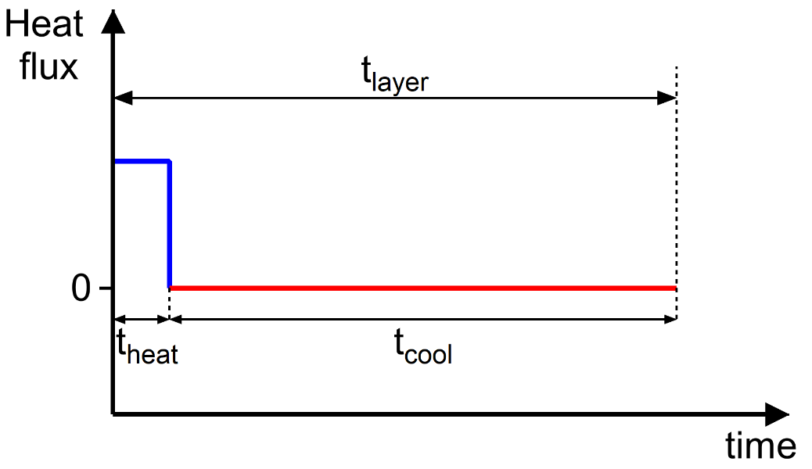

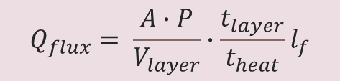
Numerical model development
FH & Layer Lumping method for DED
No lumping
∆z_{t}: 0.45 mm
2-layer lumping
∆z_{t}: 0.9 mm
4-layer lumping
∆z_{t}: 1.8 mm
8-layer lumping
∆z_{t}: 3.6 mm
$$Q_{flux}= \frac{A∙P}{V_{layer}}∙\frac{t_{layer}}{t_{heat}}l_{f}$$
(a)
(b)
Undeposited (quiet)
Undeposited (quiet)
$$t_{heat}=h_{f}\frac{φ_{L}}{υ_{L}}$$
Currently heated for t_{h}
SUBSTRATE
Layer lumping method
Undeposited (quiet)
Undeposited (quiet)
Currently heated for t_{h}
Undeposited (quiet)
Previously deposited
Currently cooled for t_{cool}
Sim. parameters | Lumping configuration
 | No | 2 | 4 | 8
Macro layers | 100 | 50 | 20 | 10
∆z_{t} (mm) | 0.45 | 0.9 | 1.8 | 3.6
Mesh elements | 58970 | 37136 | 32203 | 28305
SUBSTRATE
SUBSTRATE
(a) Time decomposition for a single layer (b) FH method schematic

Slide 10
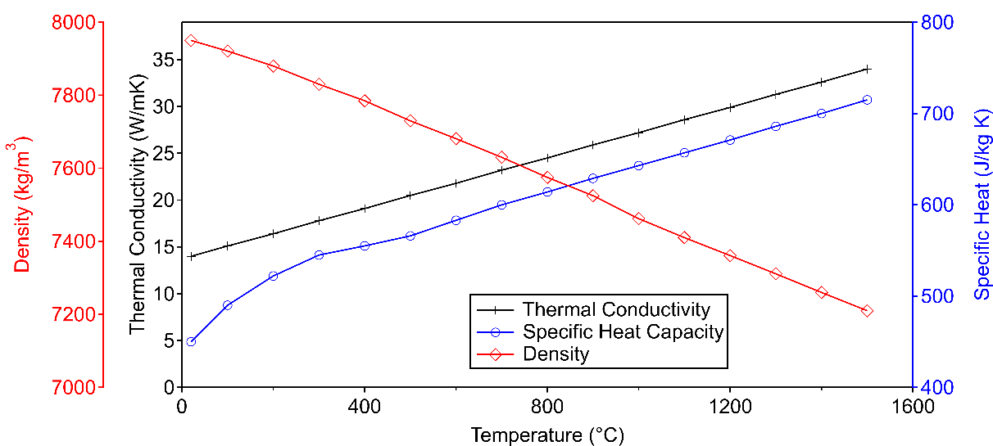


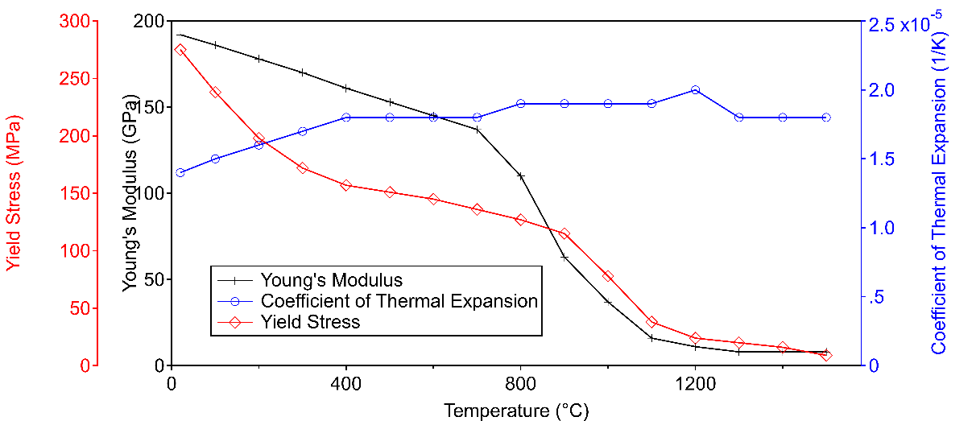

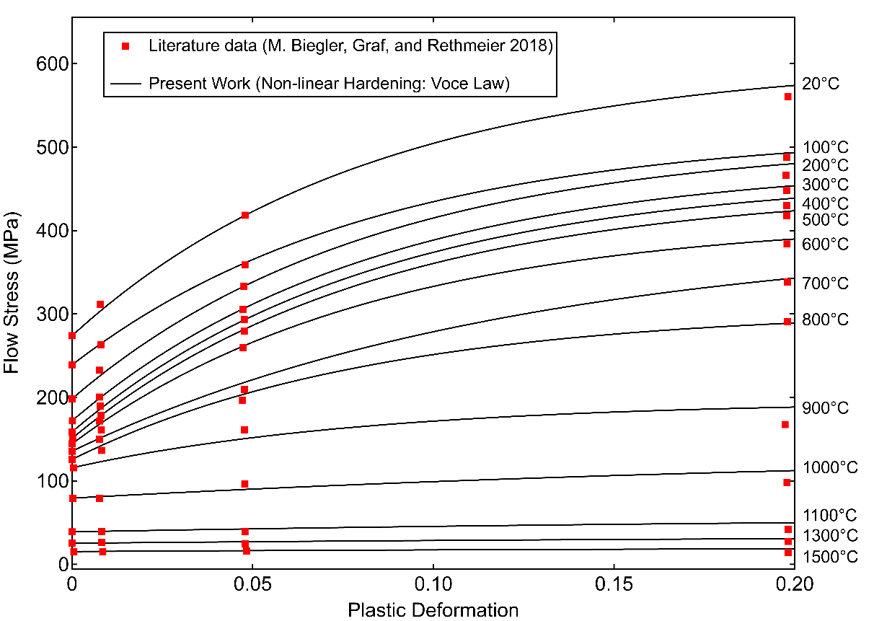



Numerical model set-up
Multiphysics simulation
Heat transfer in solids (ht)
Laser heat input
Heat losses (convective & radiative)
Solid mechanics (sm)
Elasto-plastic model
Non-linear material hardening (Voce)
Events (ev)
Discrete states i.e., FH (1 or 0)
Explicit Events (t_{heat} & t_{cool})
Multi-physics
Thermal expansion (te)
Coupling link between ht & sm
Material
Material activation: Quiet element (sm)
Material properties f(T)

Slide 11



Numerical analyses
Sequential coupling
Thermal
Simulation
Mechanical Simulation
Process parameters
CAD (sliced layers)
Temperature
field
Deformation
Stresses
Thermal strain
Thermal strain

Slide 12
EXP v/s SIM
Simulation results

Slide 13
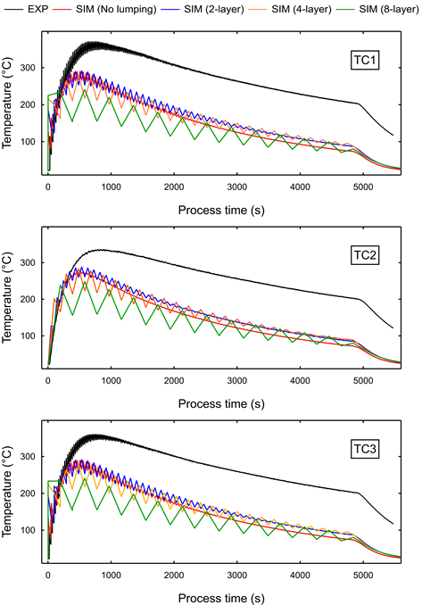
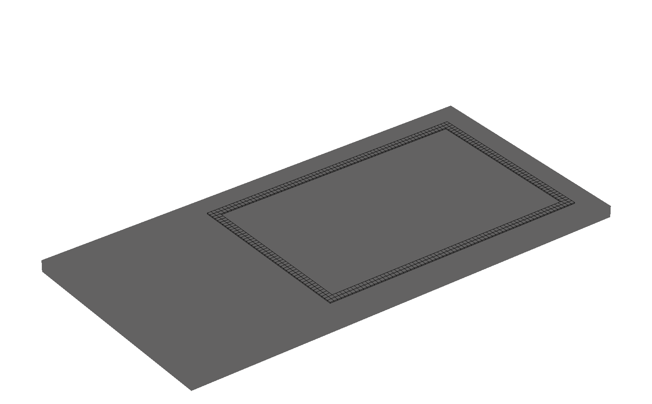
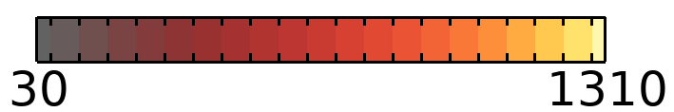
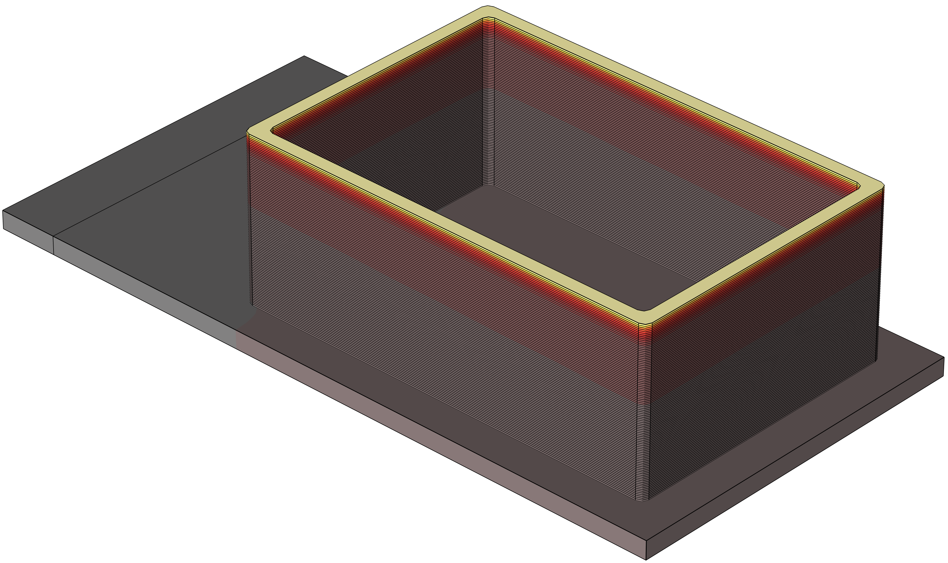
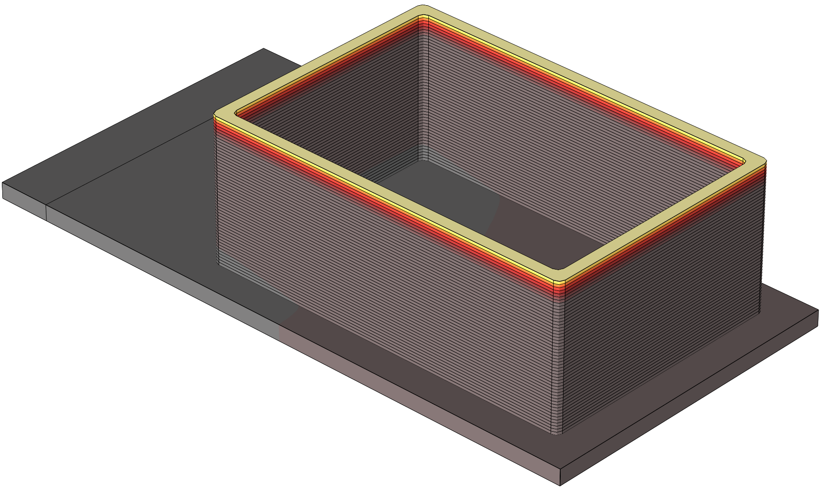
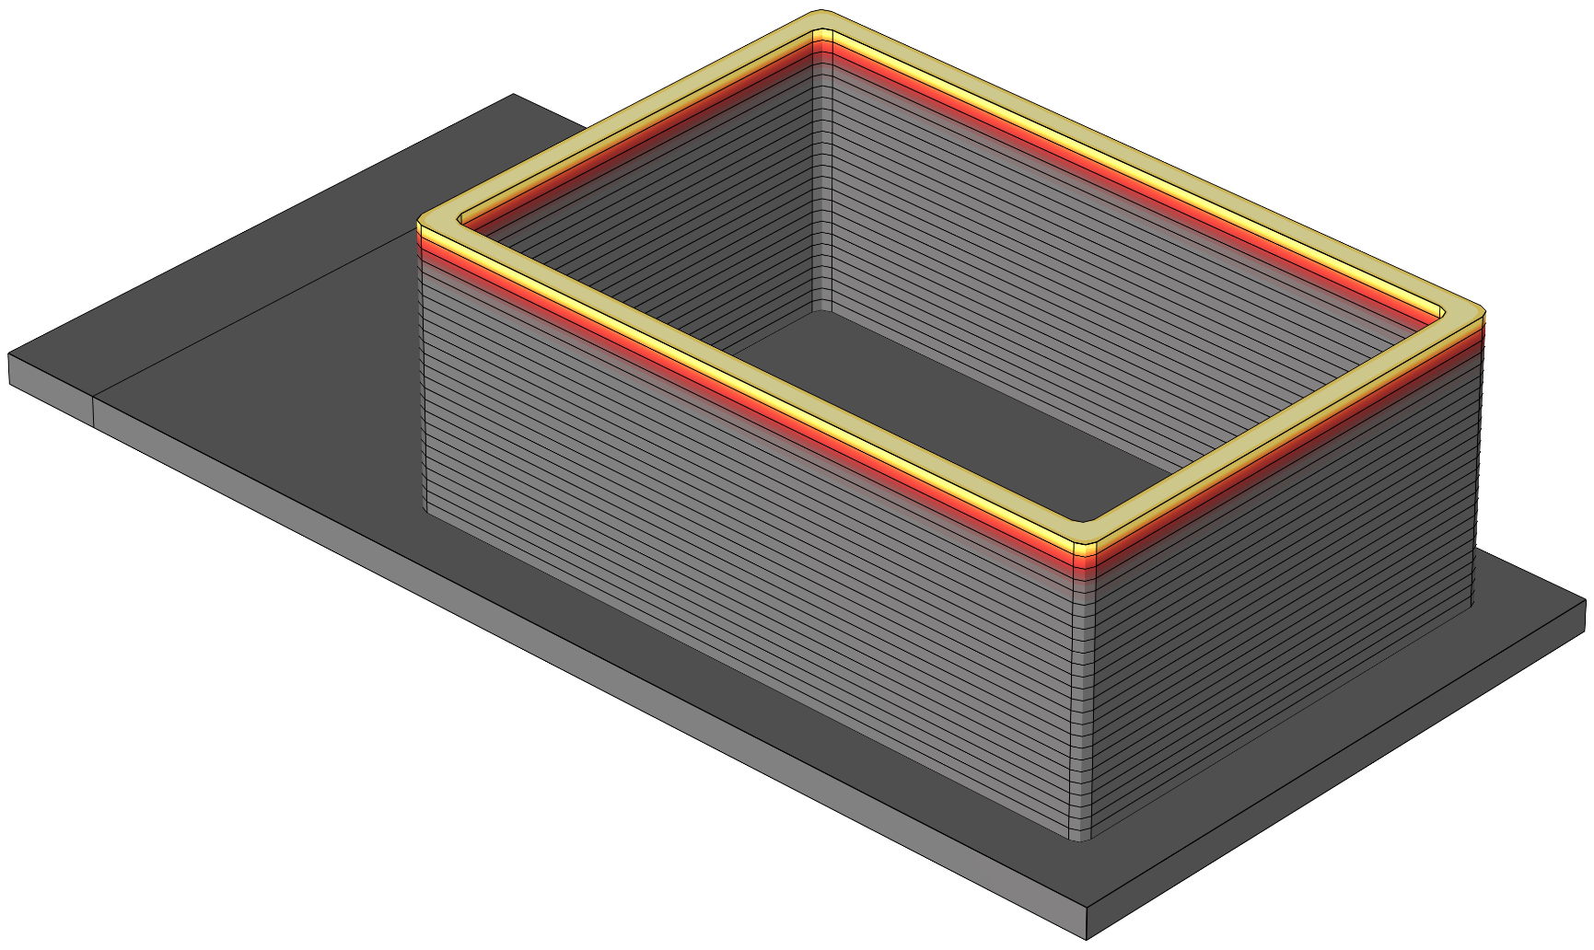

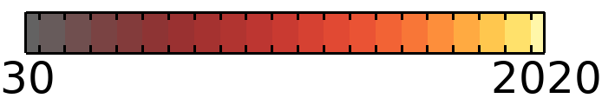
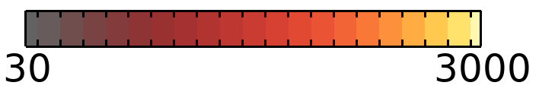
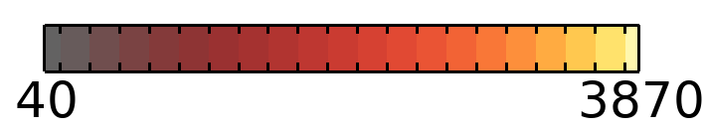
Simulation results
EXP v/s SIM (Thermal)
No lumping
2-layer
4-layer
8-layer

Slide 14
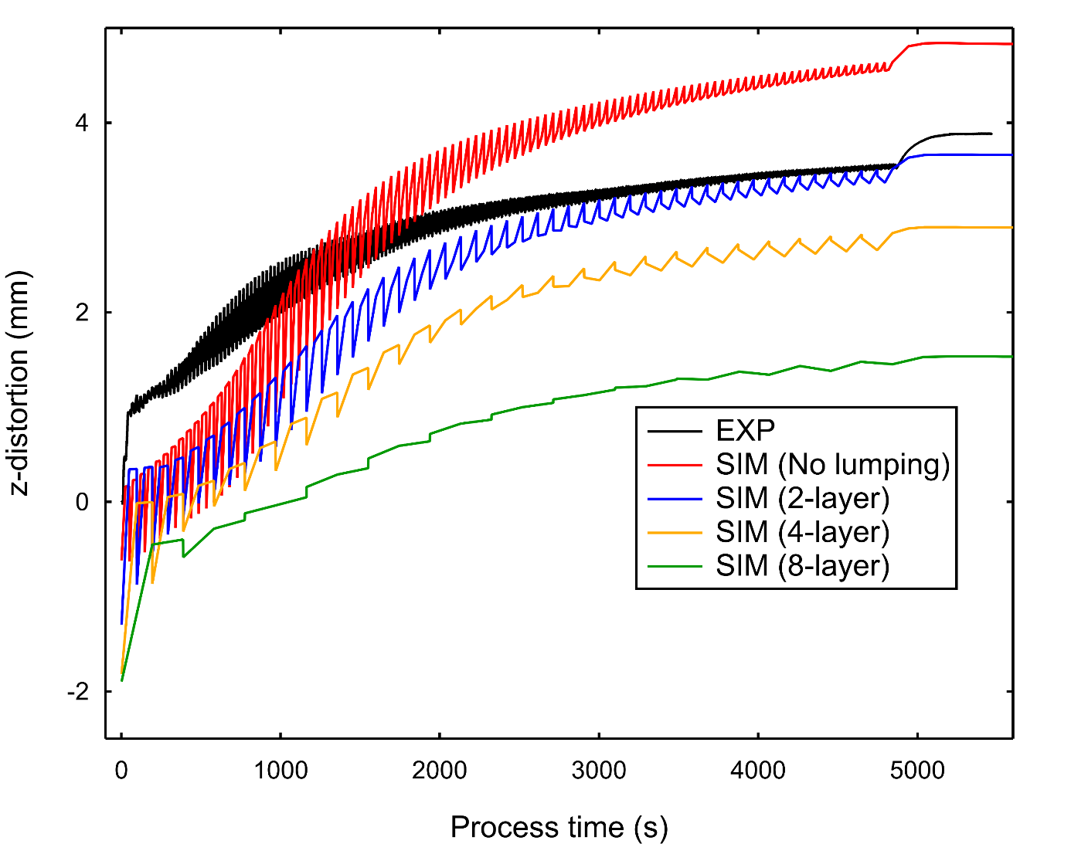
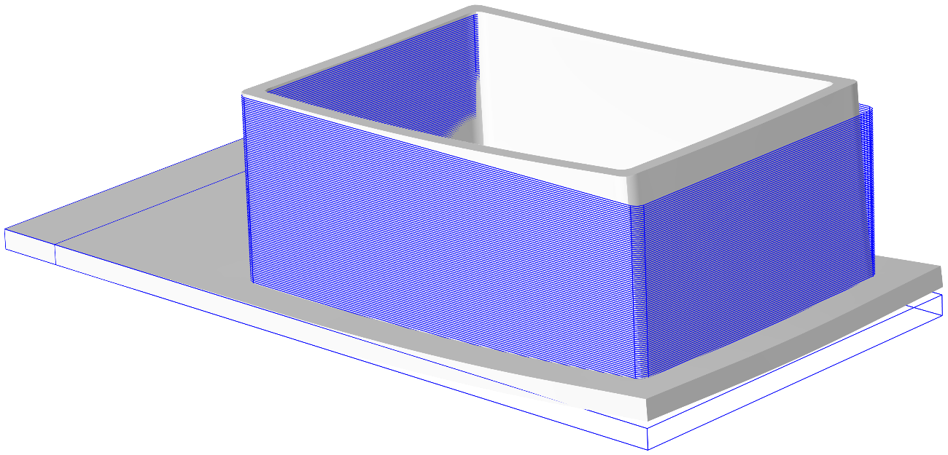




Simulation results
Final z-distortion (mm) | LDS location
Experimental | 3.88
No-lumping simulation | 4.83
2-layer lumping simulation | 3.65
5-layer lumping simulation | 2.89
10-layer lumping simulation | 1.53
EXP v/s SIM (Mechanical)
No lumping
2-layer
4-layer
8-layer

Slide 15




Simulation results
EXP v/s SIM (Mechanical)
6.97 mm
EXPERIMENT
No lumping
2-layer lumping
6.68 mm
5.06 mm
4-layer lumping
8-layer lumping
3.98 mm
2.09 mm

Slide 16

Project Impact!
Industrial part simulation

Slide 17















Industrial part simulation
Computation time:
Thermal analysis: 65 min
Mechanical analysis: 32 min
“ PRINT PART 1st TIME RIGHT ”
0s
60s
Size 128 x 660 mm
Fabricated part with 60s cooling
CAD
CAM
THERMAL SIMULATION
MECHANICAL
SIMULATION
Influence of inter-layer dwell time (SIM)
With an addition of 60s in simulation (optimized value)
  Peak temperatures are controlled during fabrication.
  Deformation is reduced by 43%. Validated with EXP data.
  Complex part “ PRINTED 1st TIME RIGHT “.
Helical rotor of a Moineau™ cavity pump
EXP: DEFORMATION

Slide 18
Conclusions
FH method with energy conservation rule is accurate
01
04
Layer lumping size needs to be calibrated
Conclusions
Layer lumping drastically reduces the computation time
02
05
Suitable for large-part simulation
Layer lumping negatively affects computation accuracy
03
06
Further validation on industrial part is required

Slide 19

Contact-us !
Vaibhav Nain
vn@irepa-laser.com

