Slide 1
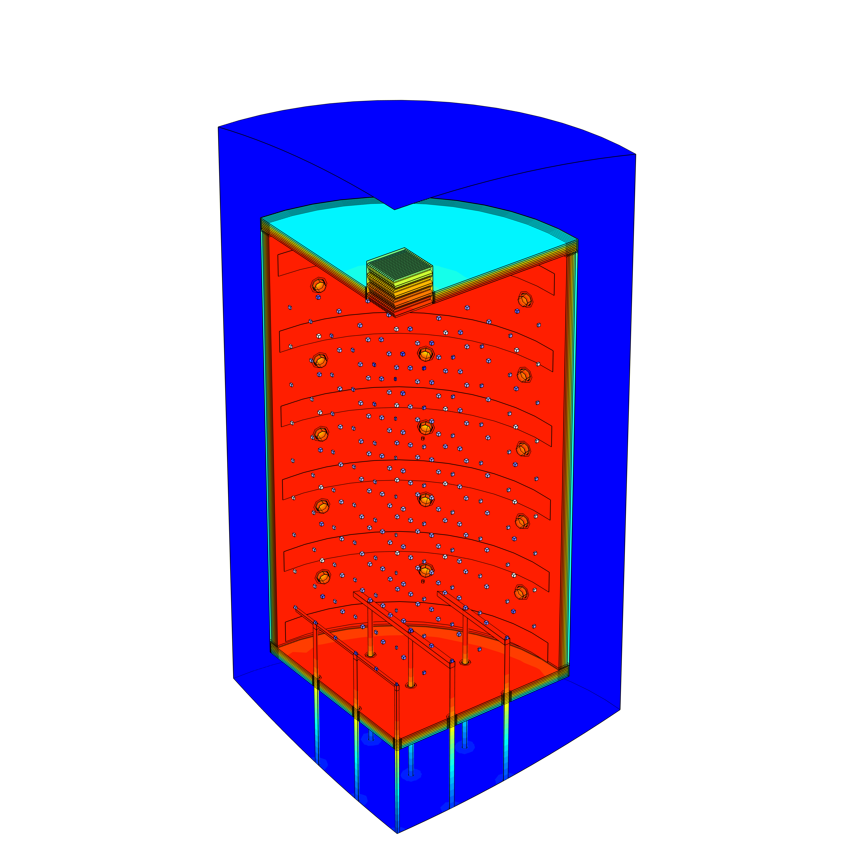

Multi-Physical Simulation Based Analysis of Temperature Homogeneity in Vertical High Temperature Vacuum Furnaces
Karl-Heinz Leitz, Bernhard Valentini
PLANSEE SE, Reutte, Austria

Slide 2
Agenda
Plansee Group
High Temperature Vacuum Furnaces
Thermo-Electric Model
Temperature Homogeneity and Power Consumption at
  different evaluation procedures
  gas system concepts
  heating systems
Conclusions

Slide 3
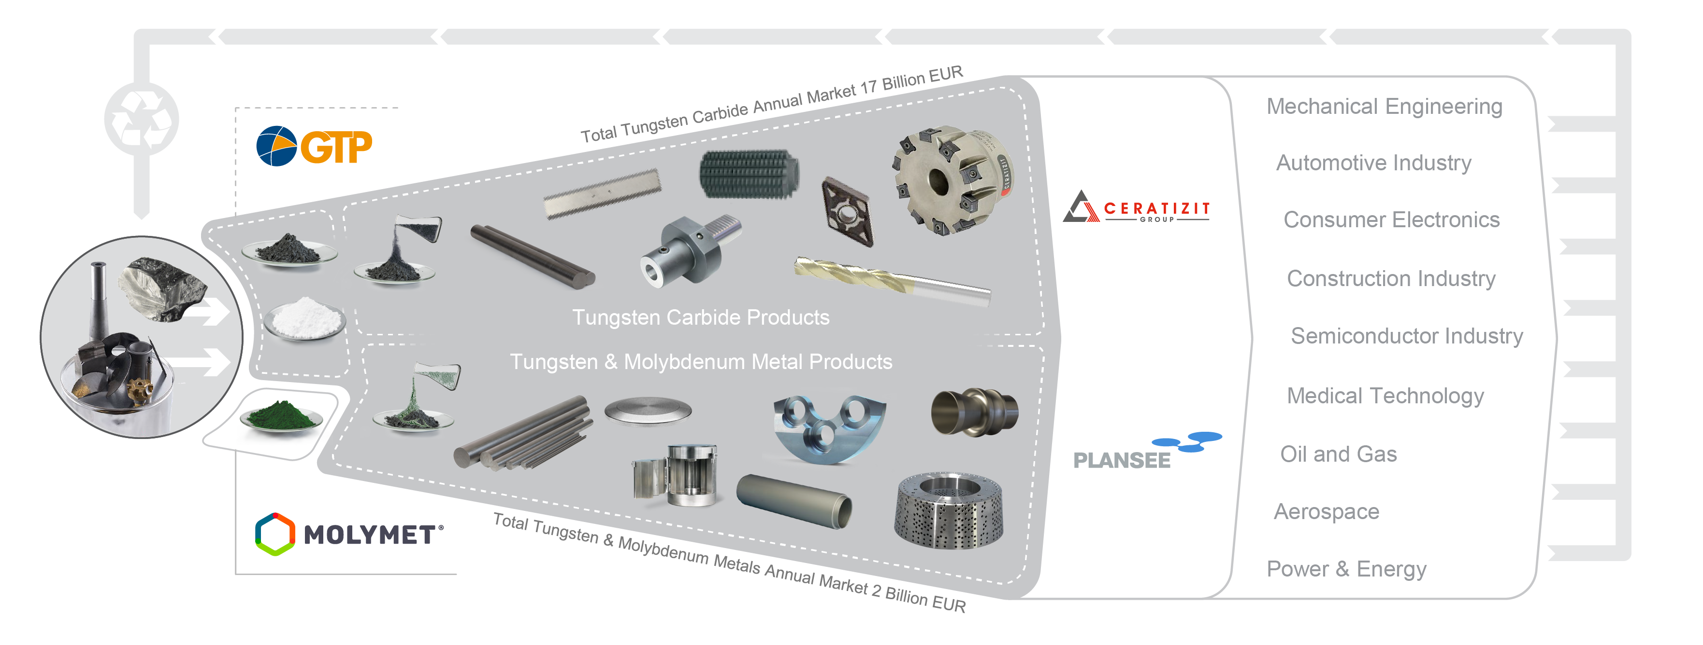

Plansee Group
With its divisions,
the Plansee Group
covers every stage of production from ore concentrates up to customer-specific components and the recycling of scrap.
Figures 2023/2024
11,200 employees
2.28 billion sales

Slide 4
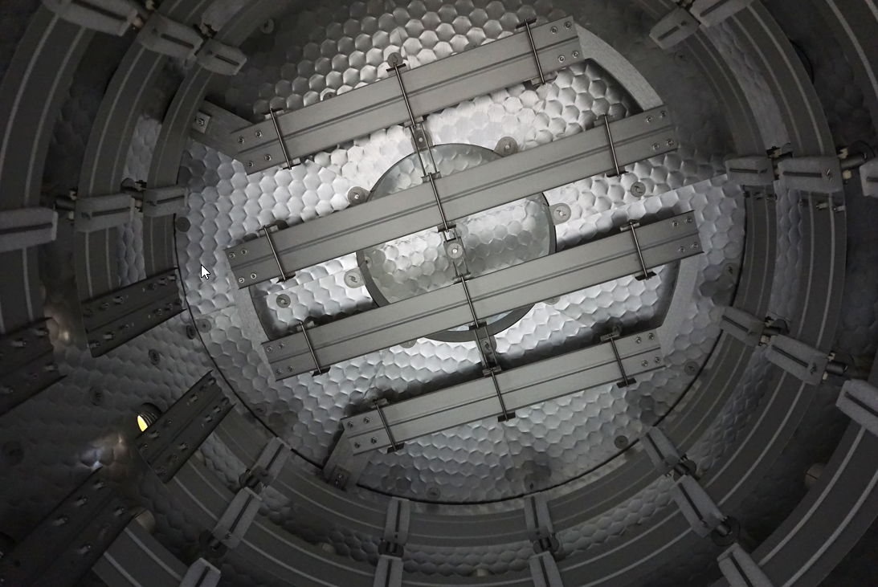
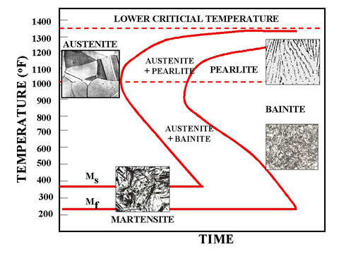
High Temperature Vacuum Furnaces
Heat Treatment
High Temperature Vacuum Furnaces
multi-layer refractory metal shielding
temperatures up to 1600 °C
power of several 100 kW
generally equipped with a fast cooling system
Heat Treatment
defined heating and cooling rates to achieve defined metallurgial states
temperature homogeneity extremely important for a uniform heat treatment result
Refractory metal hot zone of vertical high temperature vacuum furnace
Time-Temperature-Transformation diagram steel
source: www.metallurgyfordummies.com (13.09.2024)

Slide 5
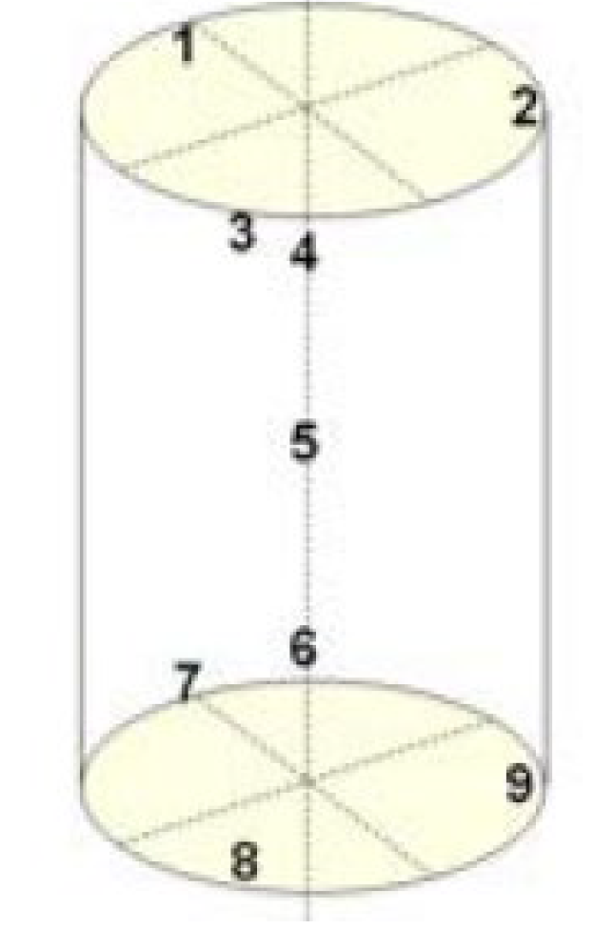
Temperature Homogeneity of High Temperature Furnaces
Temperature Uniformity Survey (TUS) according to AMS 2750
Aerospace Material Specification AMS 2750
For work zone volumes between 0.085 and 6.4 m³ AMS 2750 suggests a minimum number of nine sensors. Three should be located at the periphery of each end, one at the approximate center and the other two to best represent the qualified work zone.
TUS sensor locations for cylindrical volumes
source: "Aerospace Material Specification AMS 2750 G," SAE International, 2022.

Slide 6
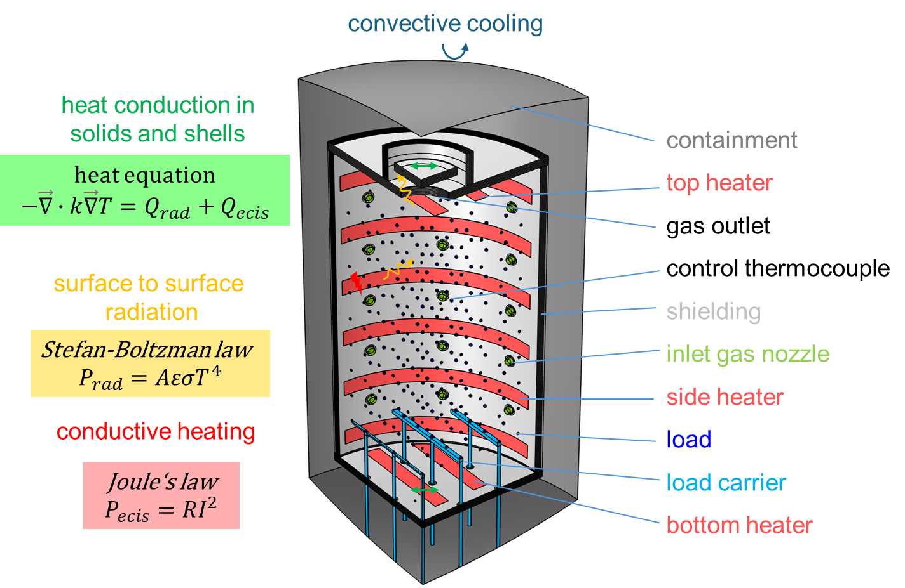
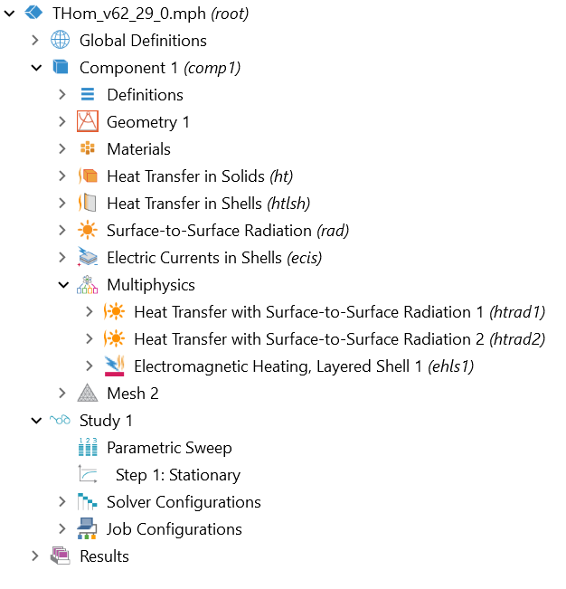
Multi-Physical Model
Thermo-Electric Stationary Model

Slide 7
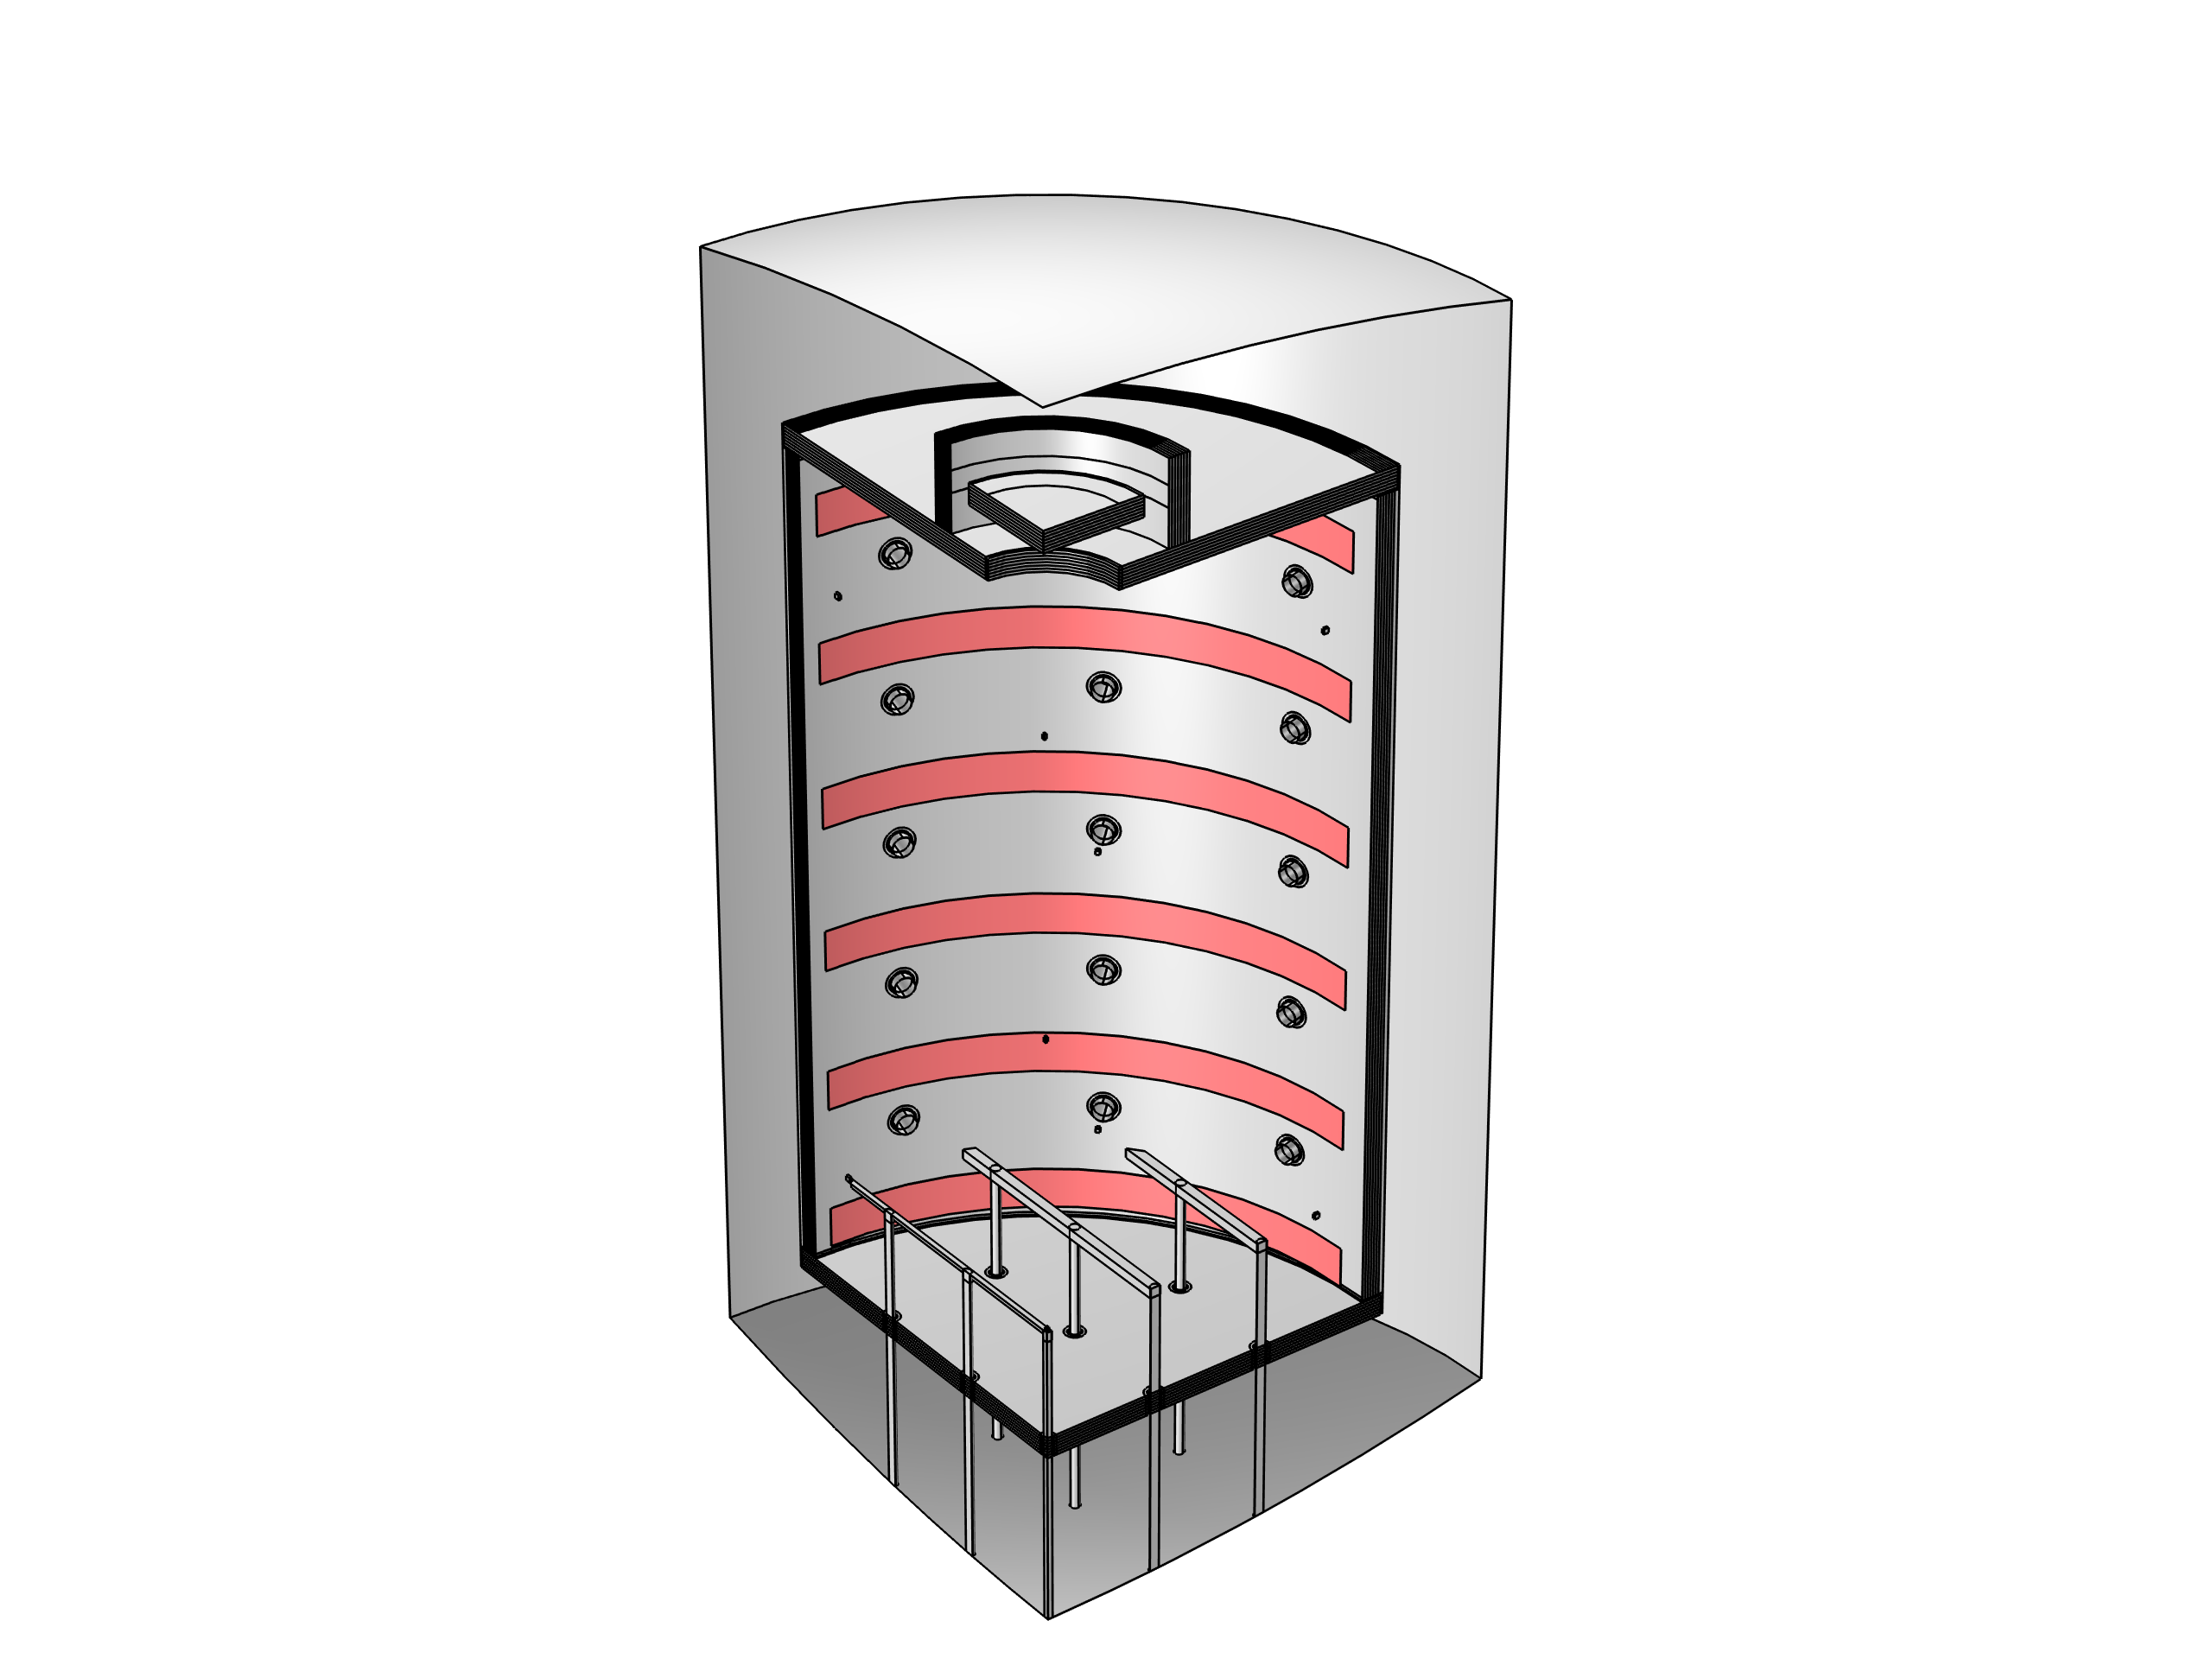
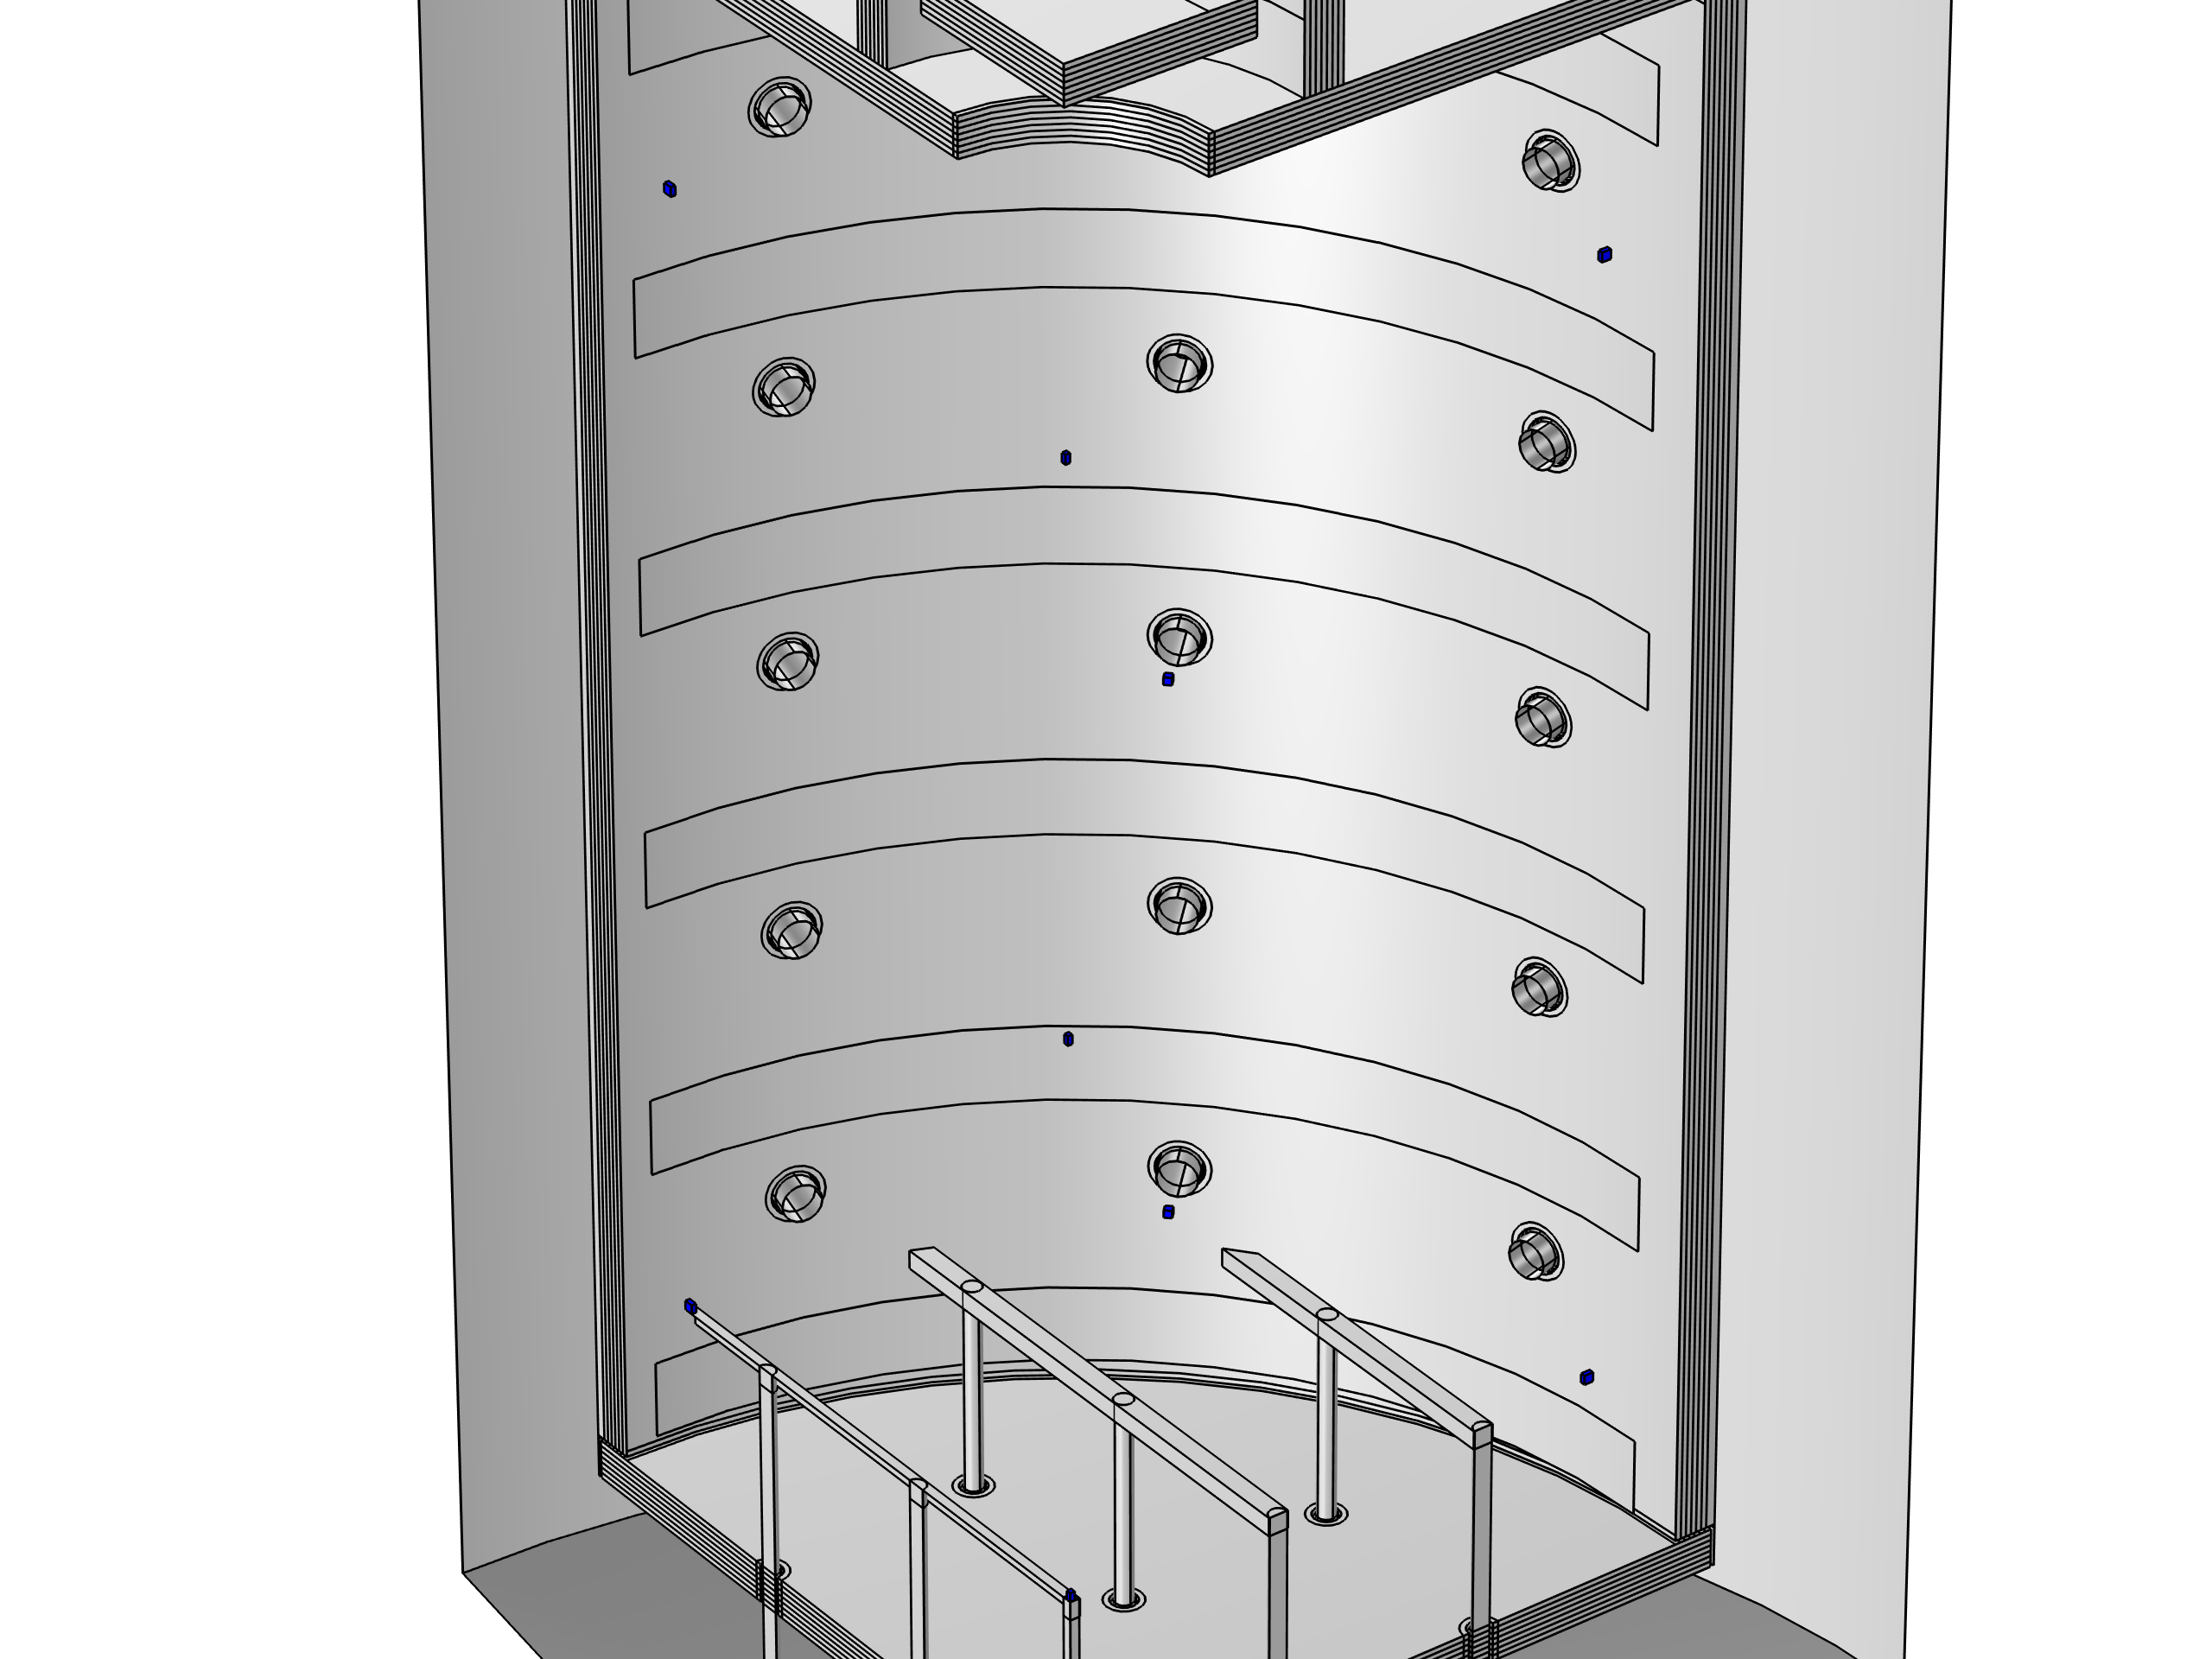
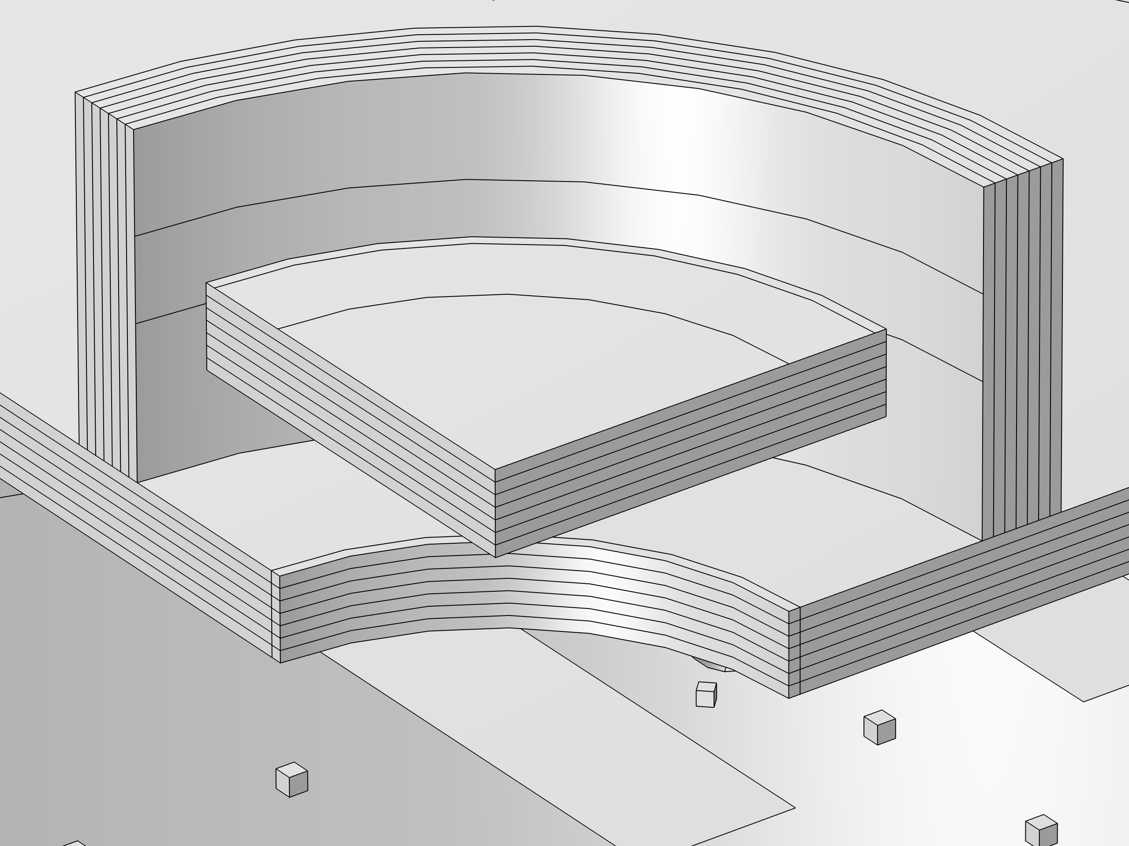
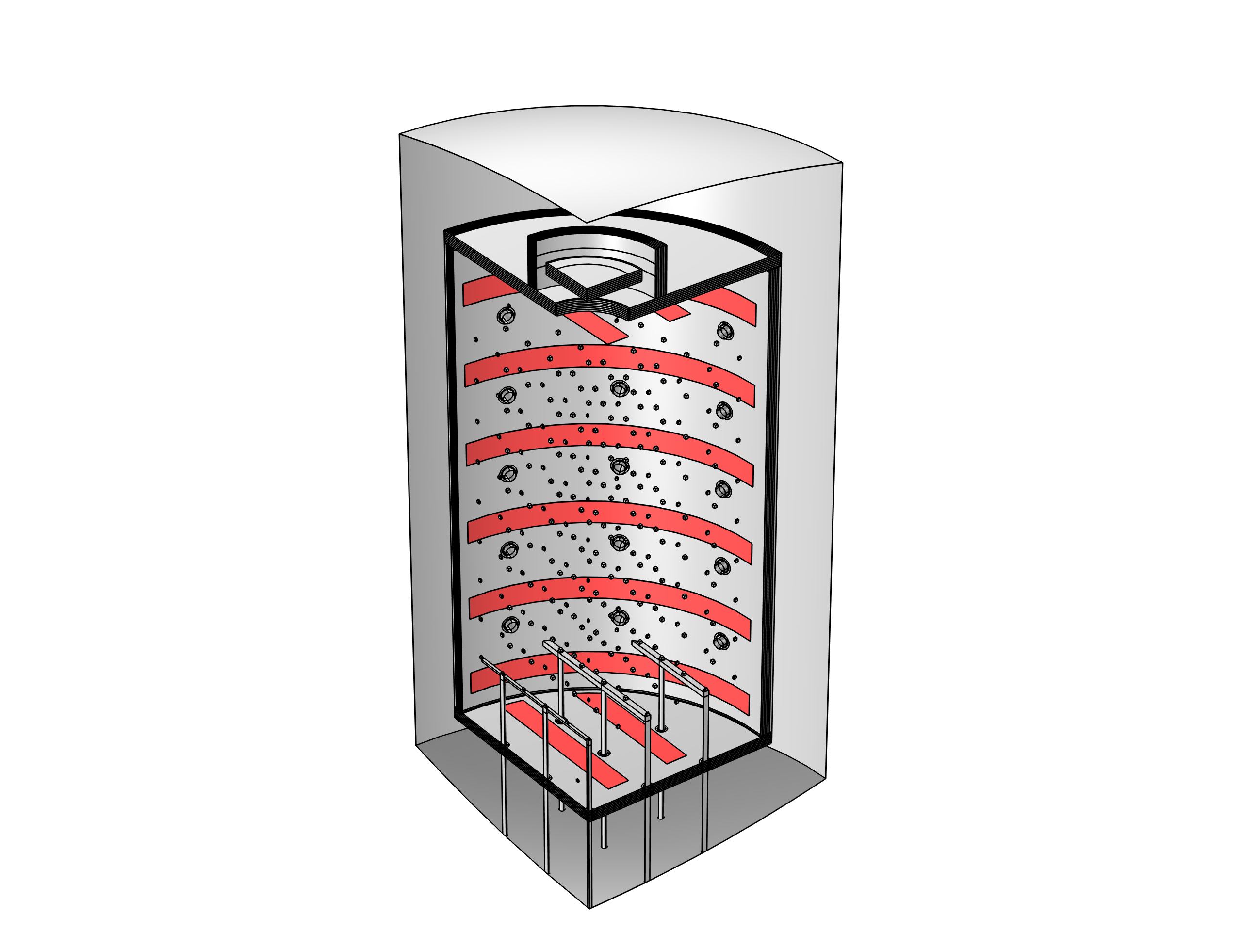
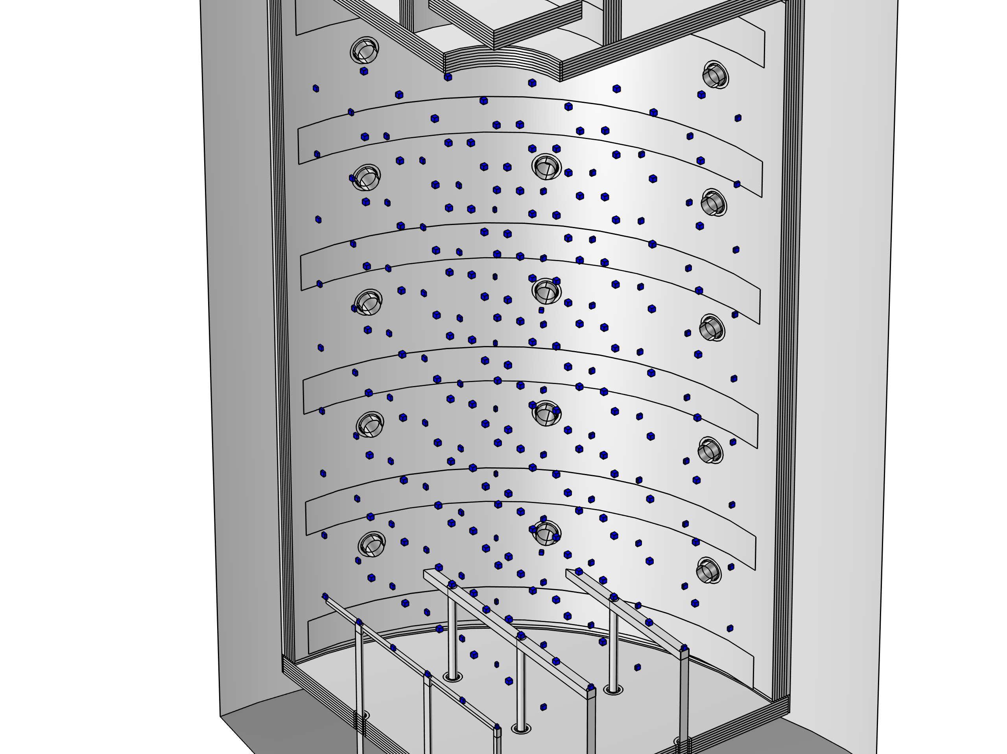
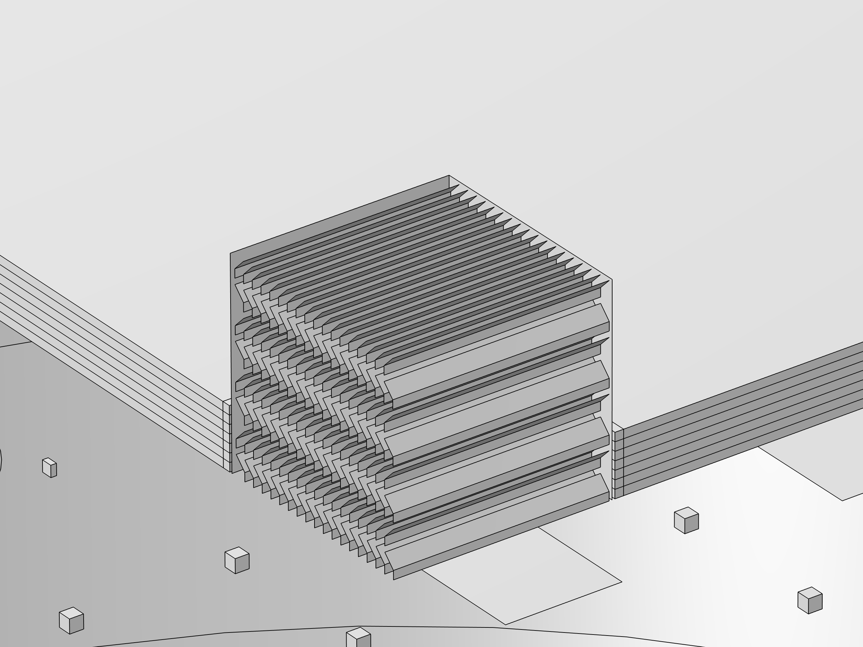
Configurations
Temperature Homogeneity, Gas and Heating System
Temperature Homogeneity
Heating System
Gas System
TUS
Highly resolved
Only side heaters
Top and bottom heater
Classical
„FlowBox“

Slide 8
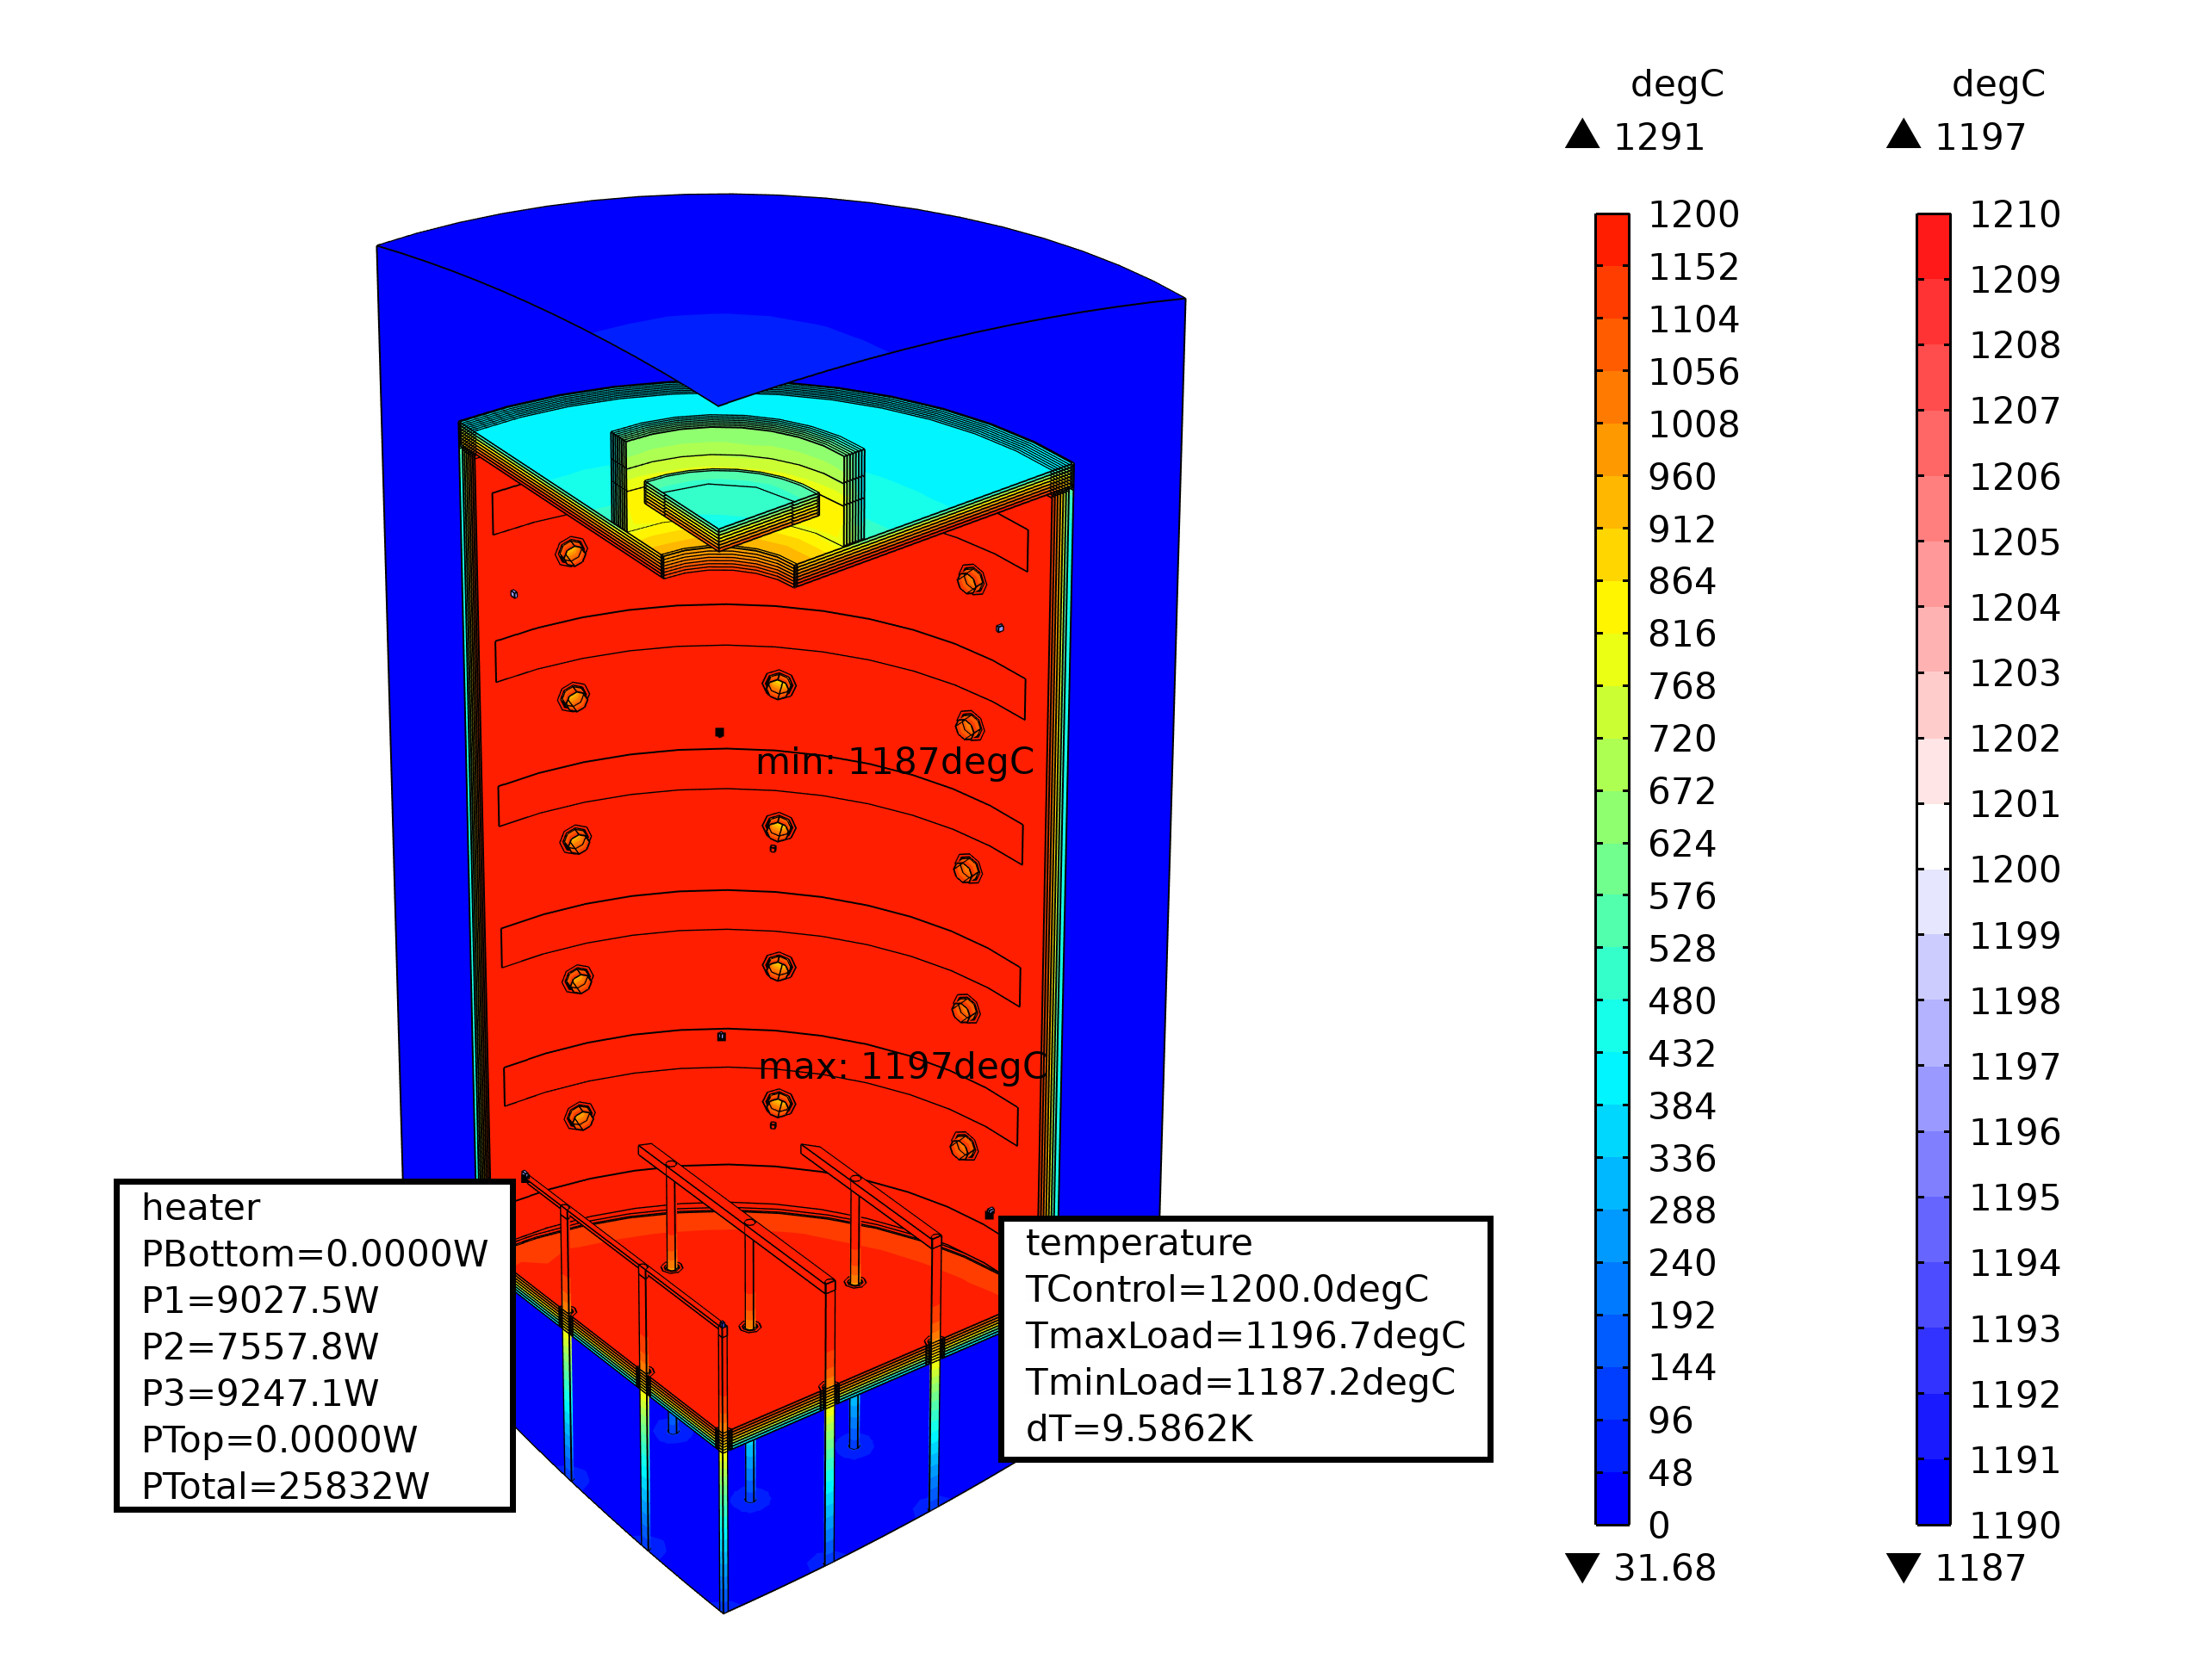
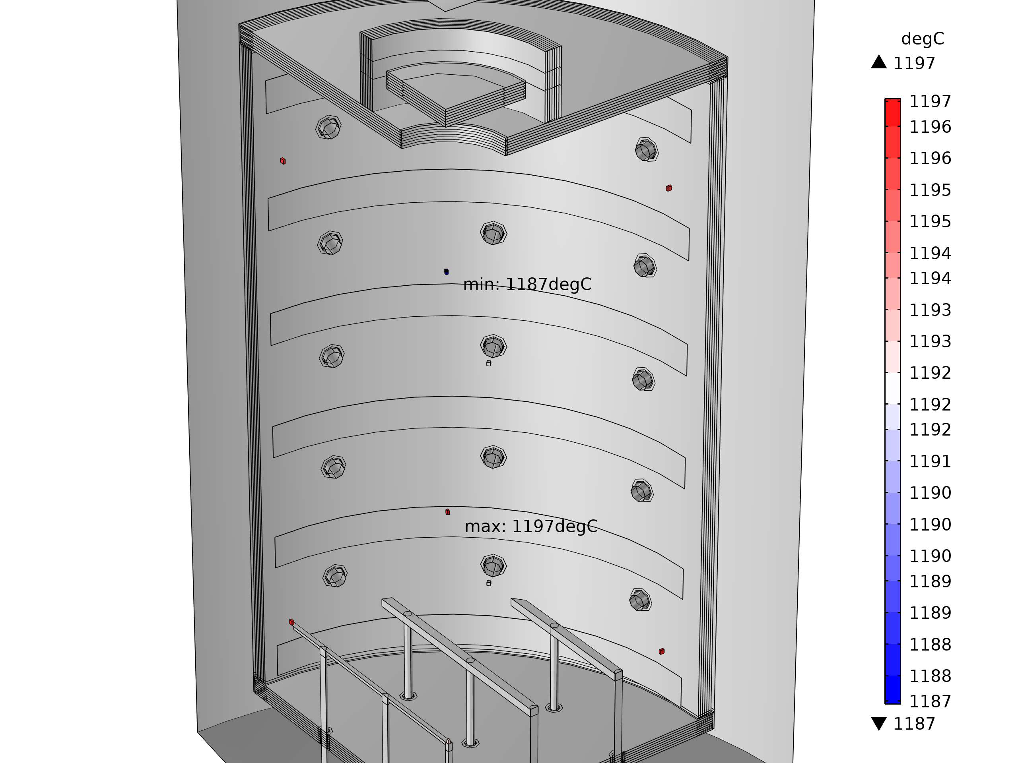
Simulation Results
TUS Temperature Homogeneity and Power Consumption
Classical Gas System
dT = 10 K; P = 103 kW
Minimum temperature in the region of the top gas outlet, maximum temperature in the center

Slide 9

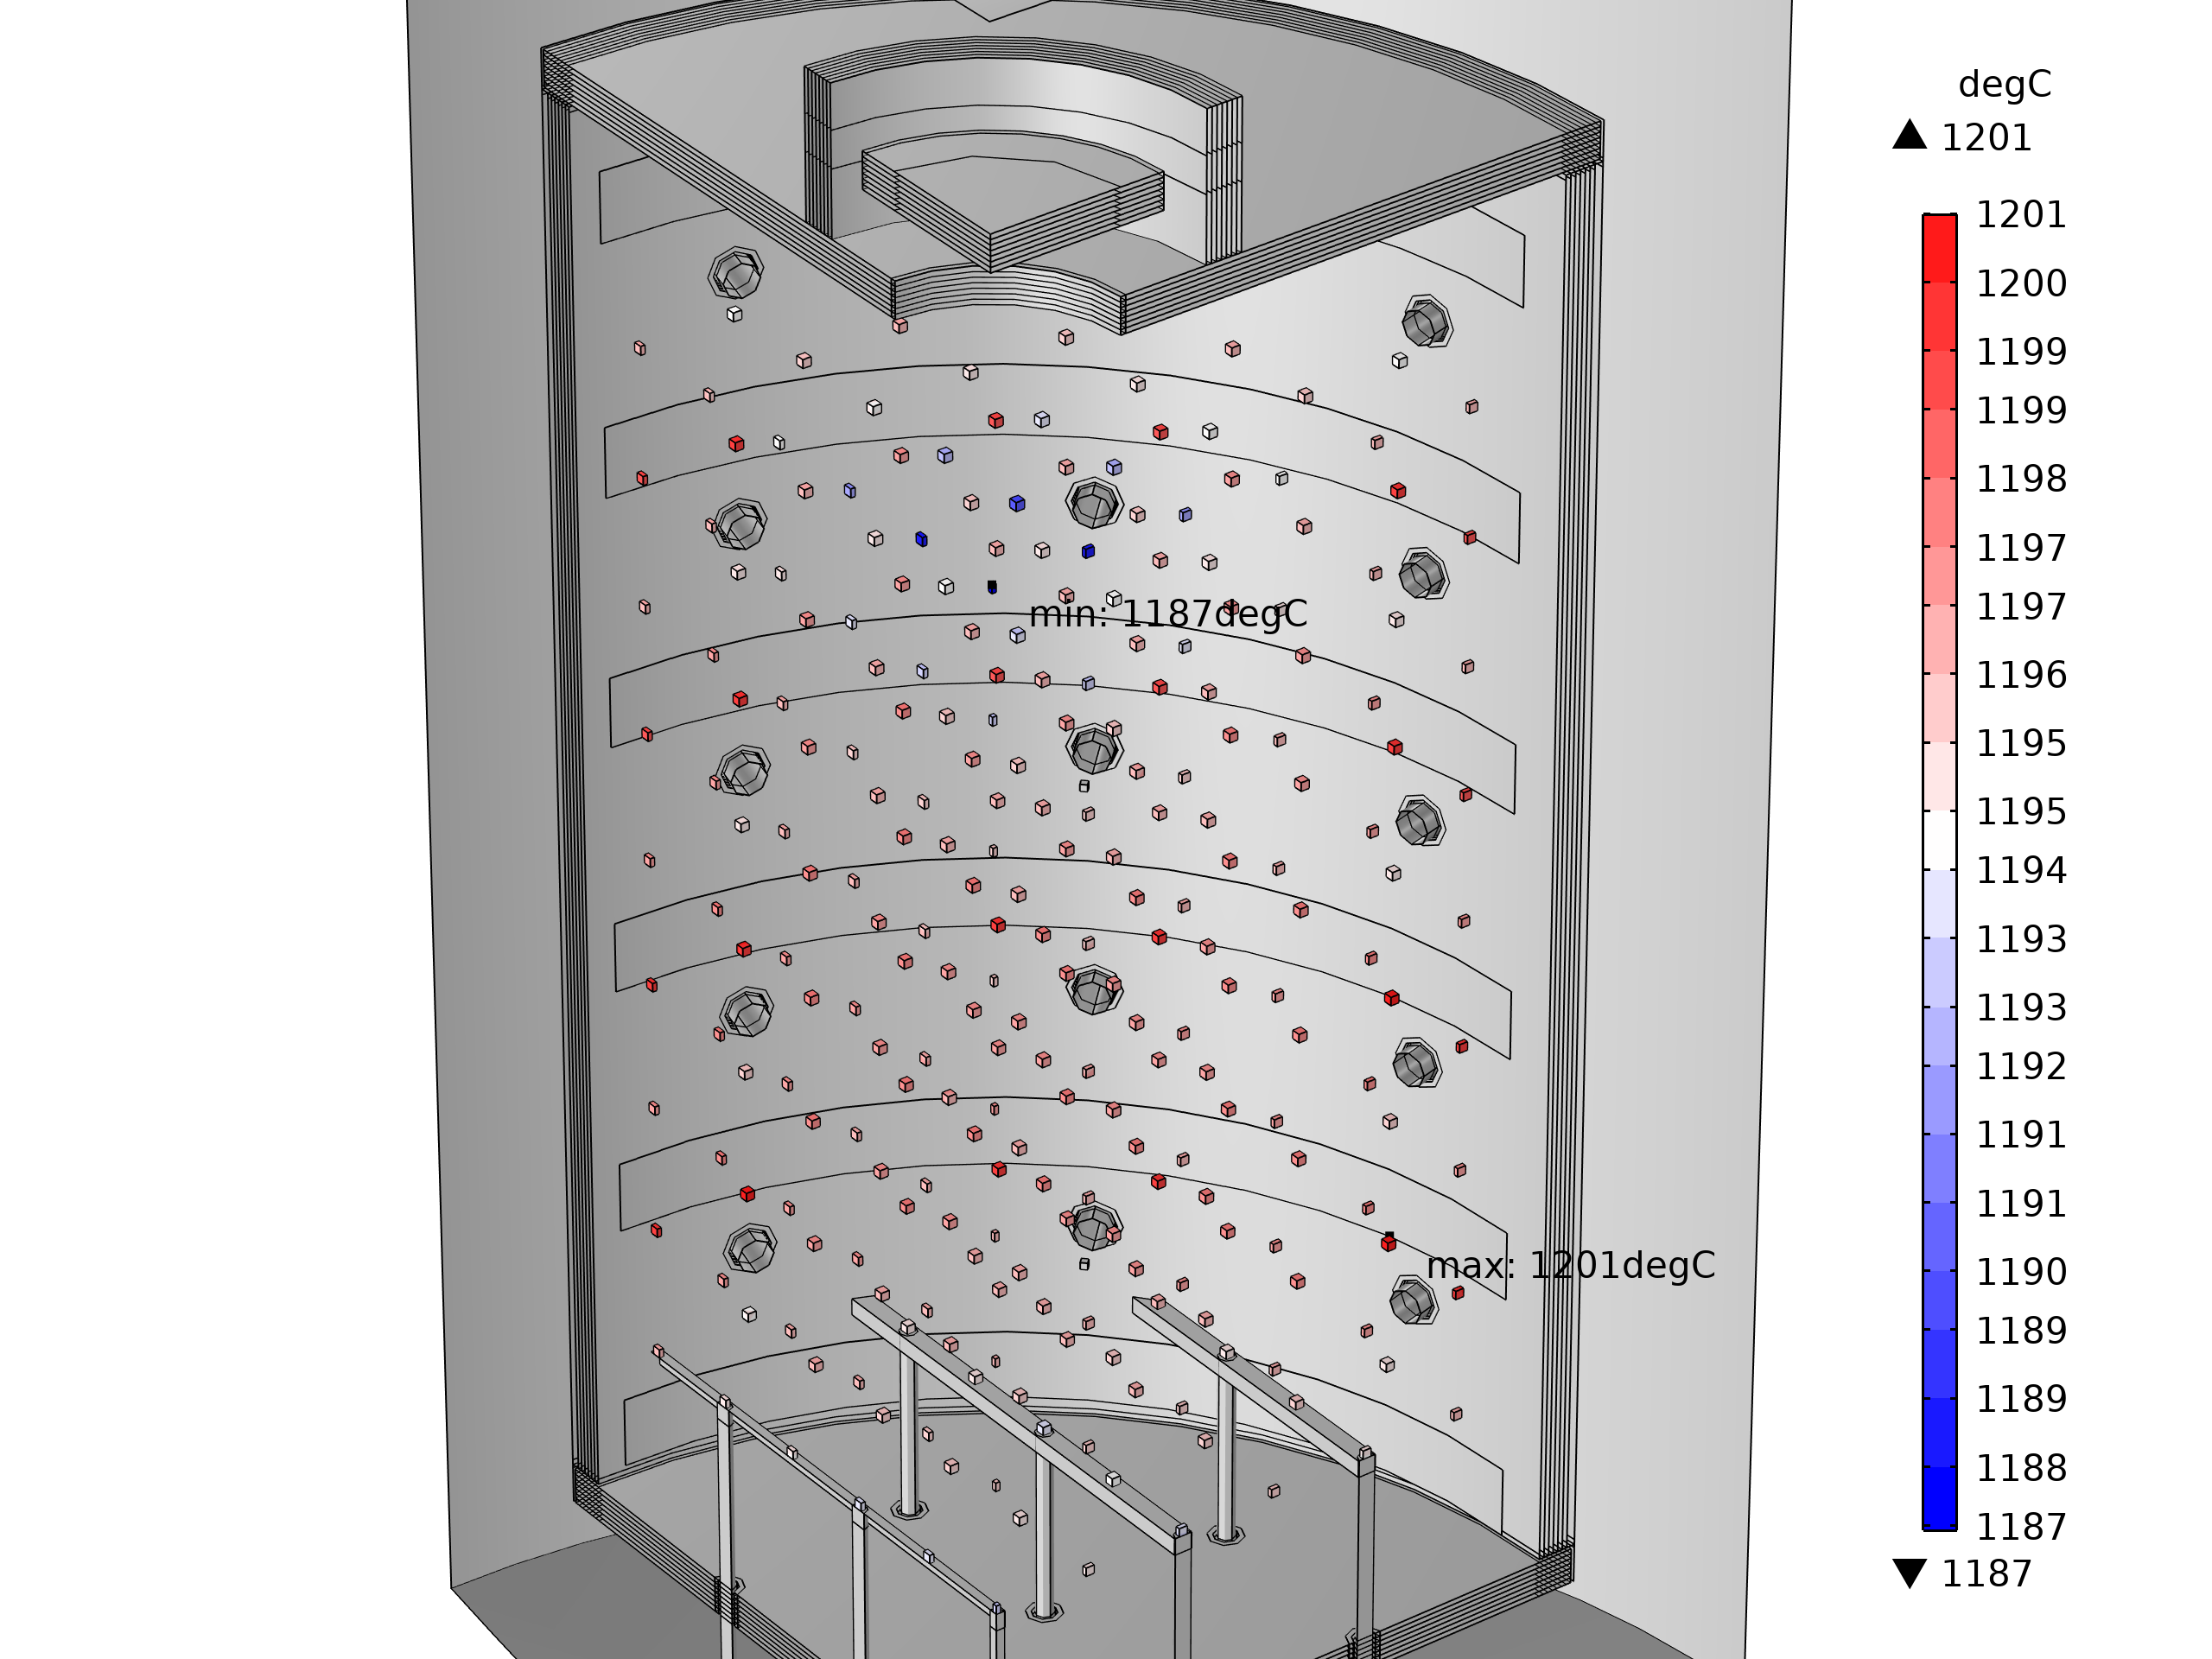
Simulation Results
Highly Resolved Temperature Homogeneity and Power Consumption
Classical Gas System
dT = 13 K; P = 104 kW
Limitations of TUS measurement procedure for evaluation of temperature homogeneity

Slide 10

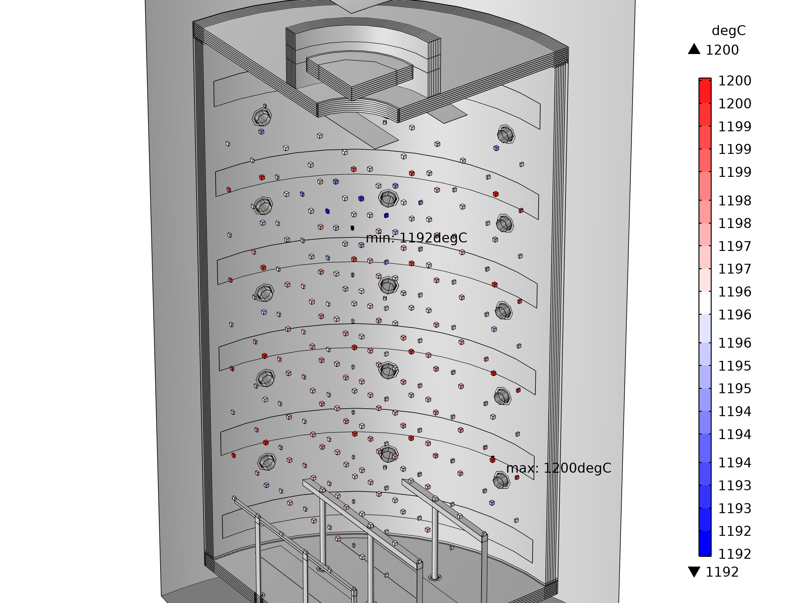
Simulation Results
Highly Resolved Temperature Homogeneity and Power Consumption
Classical Gas System
+
Top and Bottom Heater
dT = 8 K; P = 106 kW
Improved temperature homogeneity but 2% increased power consumption

Slide 11
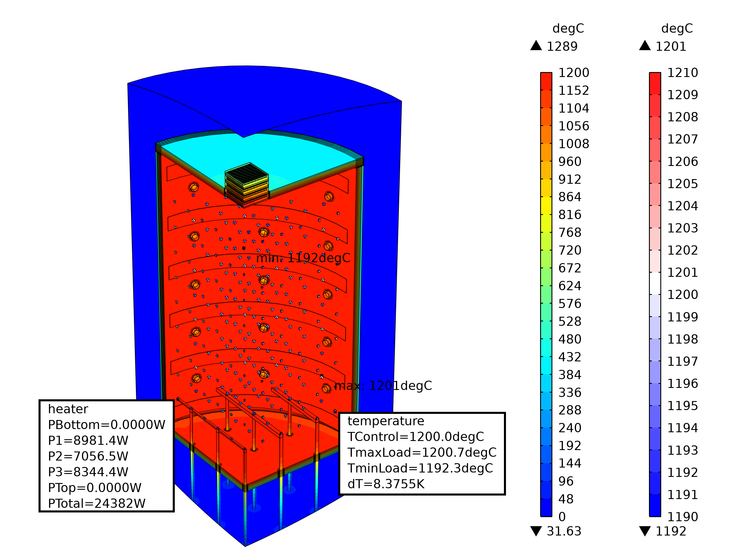
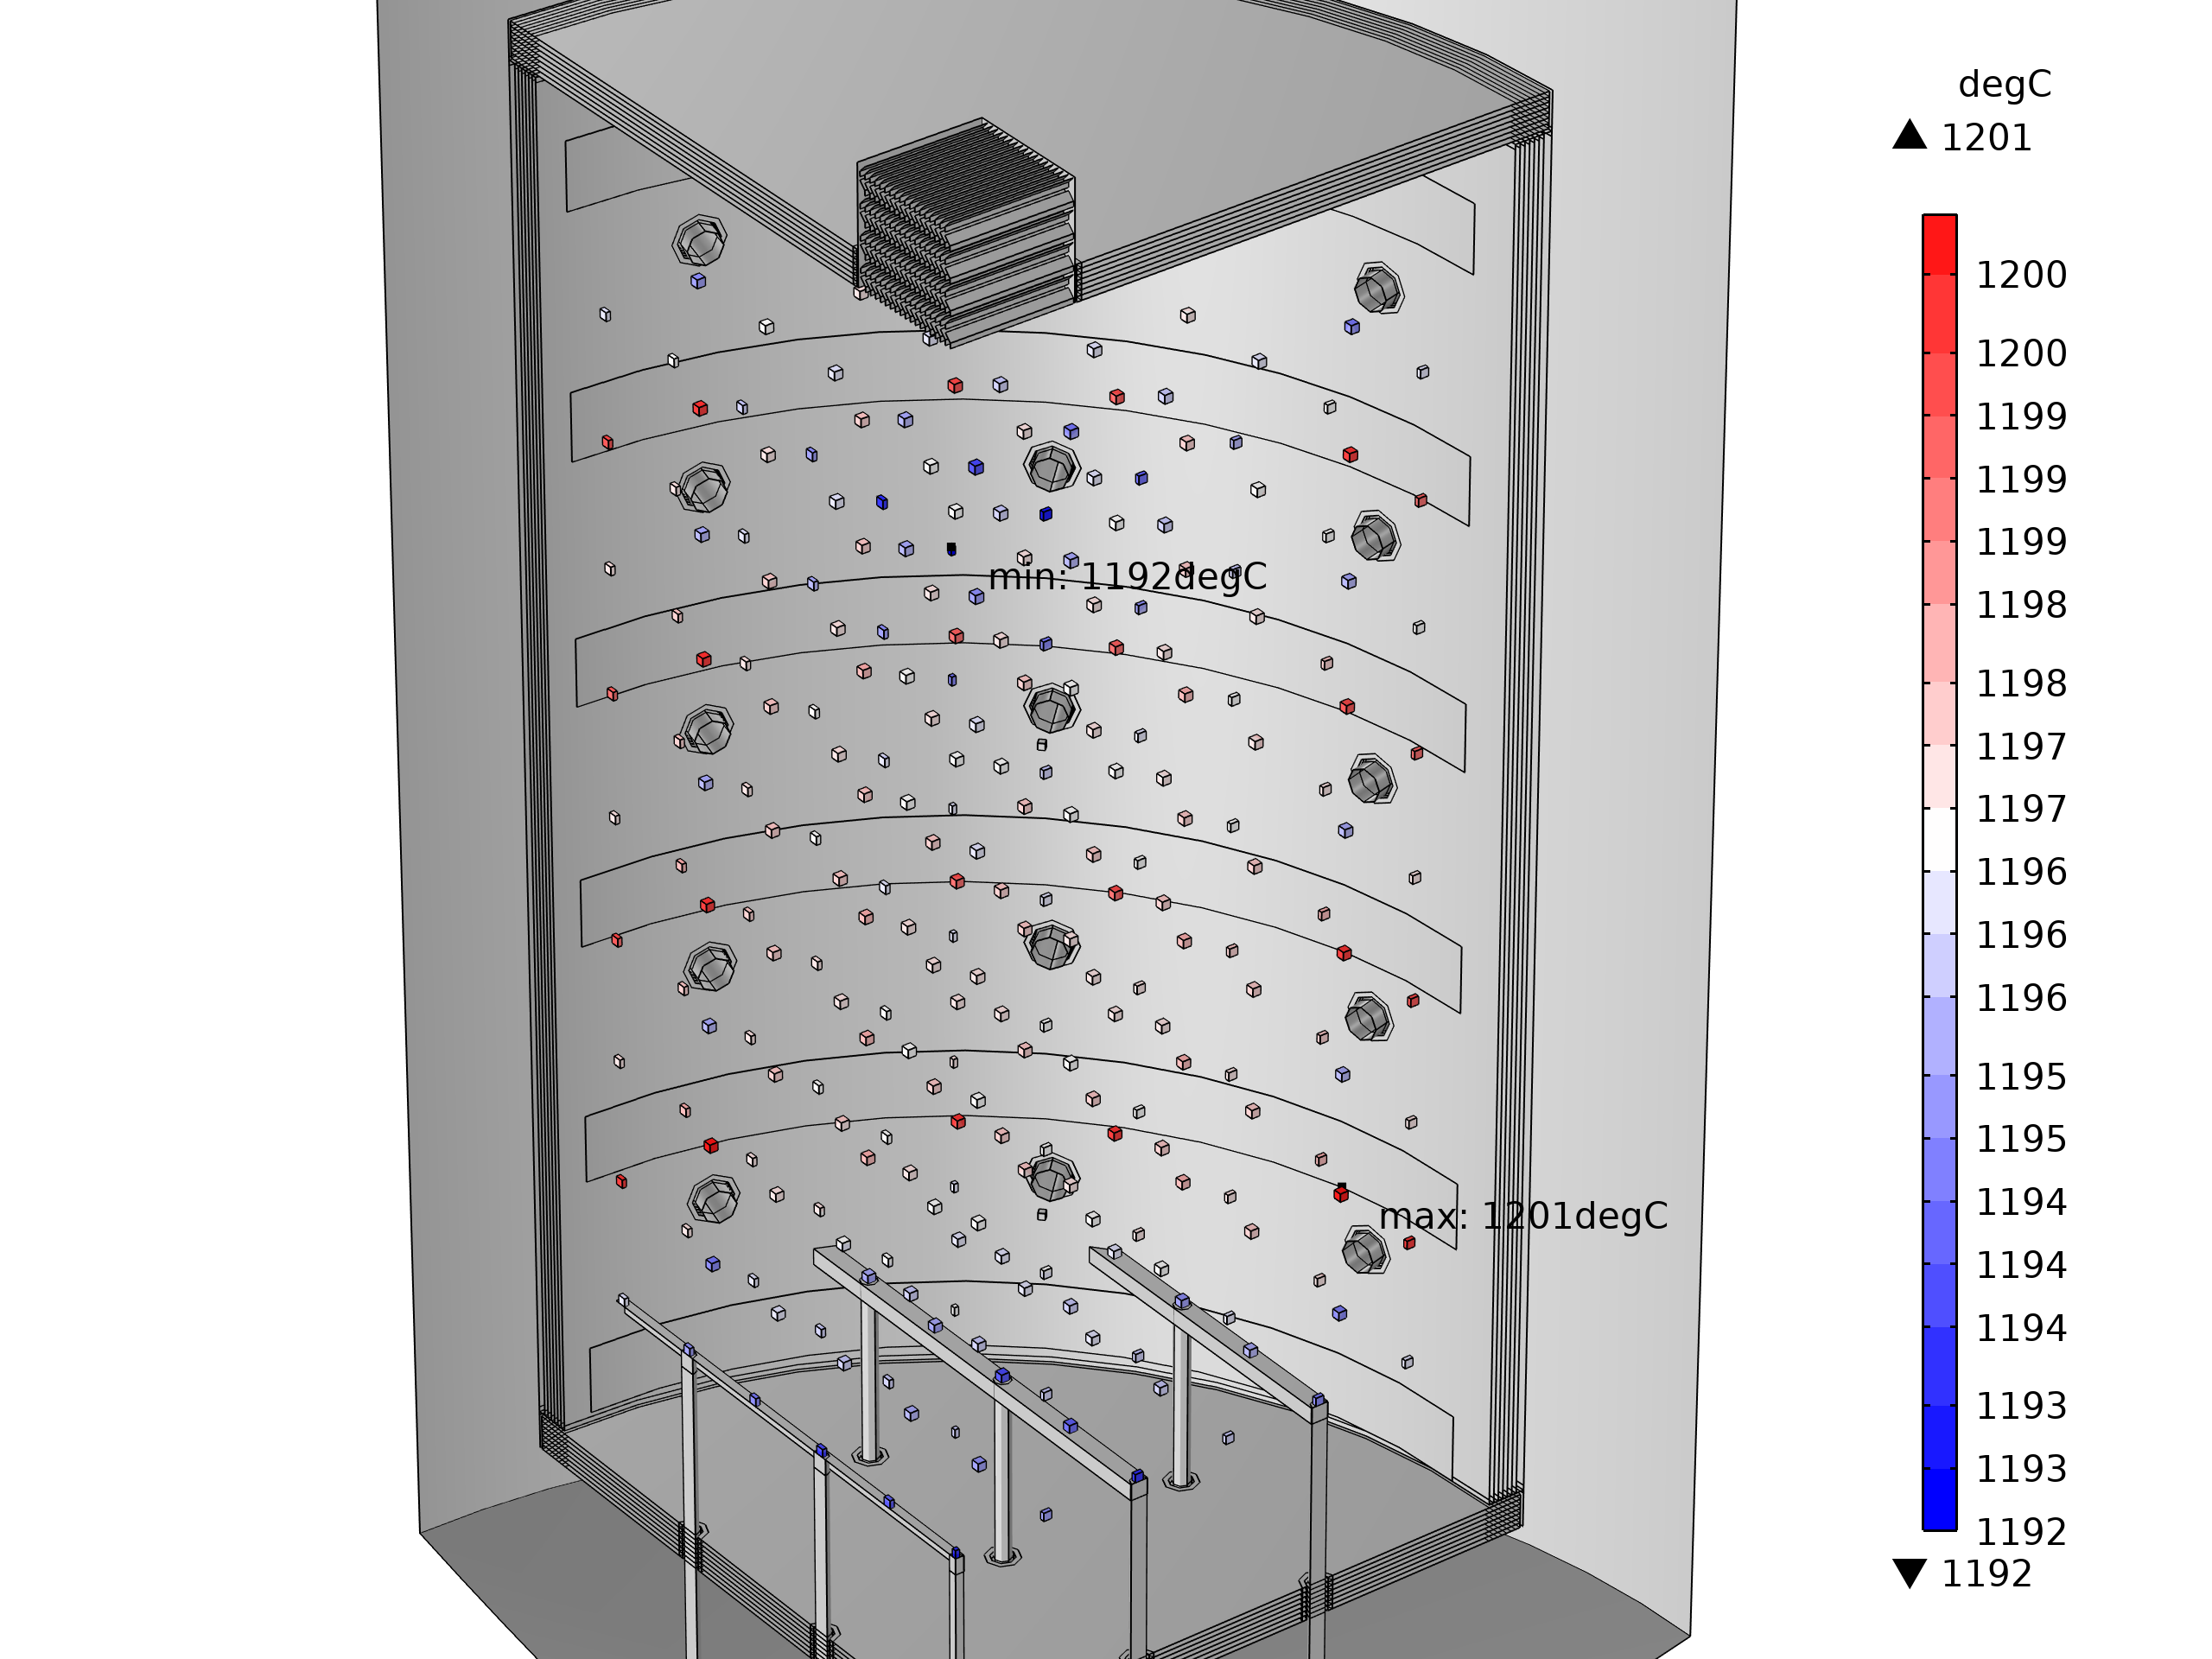
Simulation Results
Highly Resolved Temperature Homogeneity and Power Consumption
„FlowBox“
dT = 8 K; P = 98 kW
Improved temperature homogeneity and 8% reduced power consumption

Slide 12
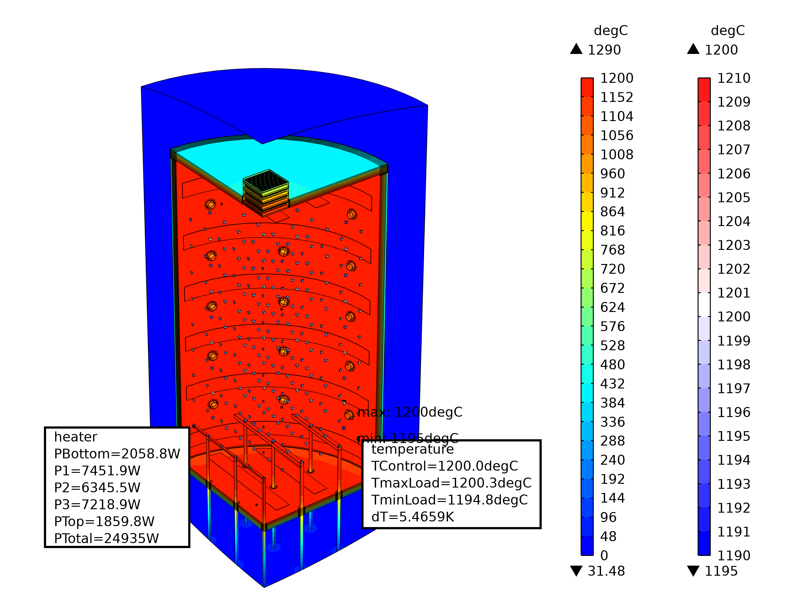
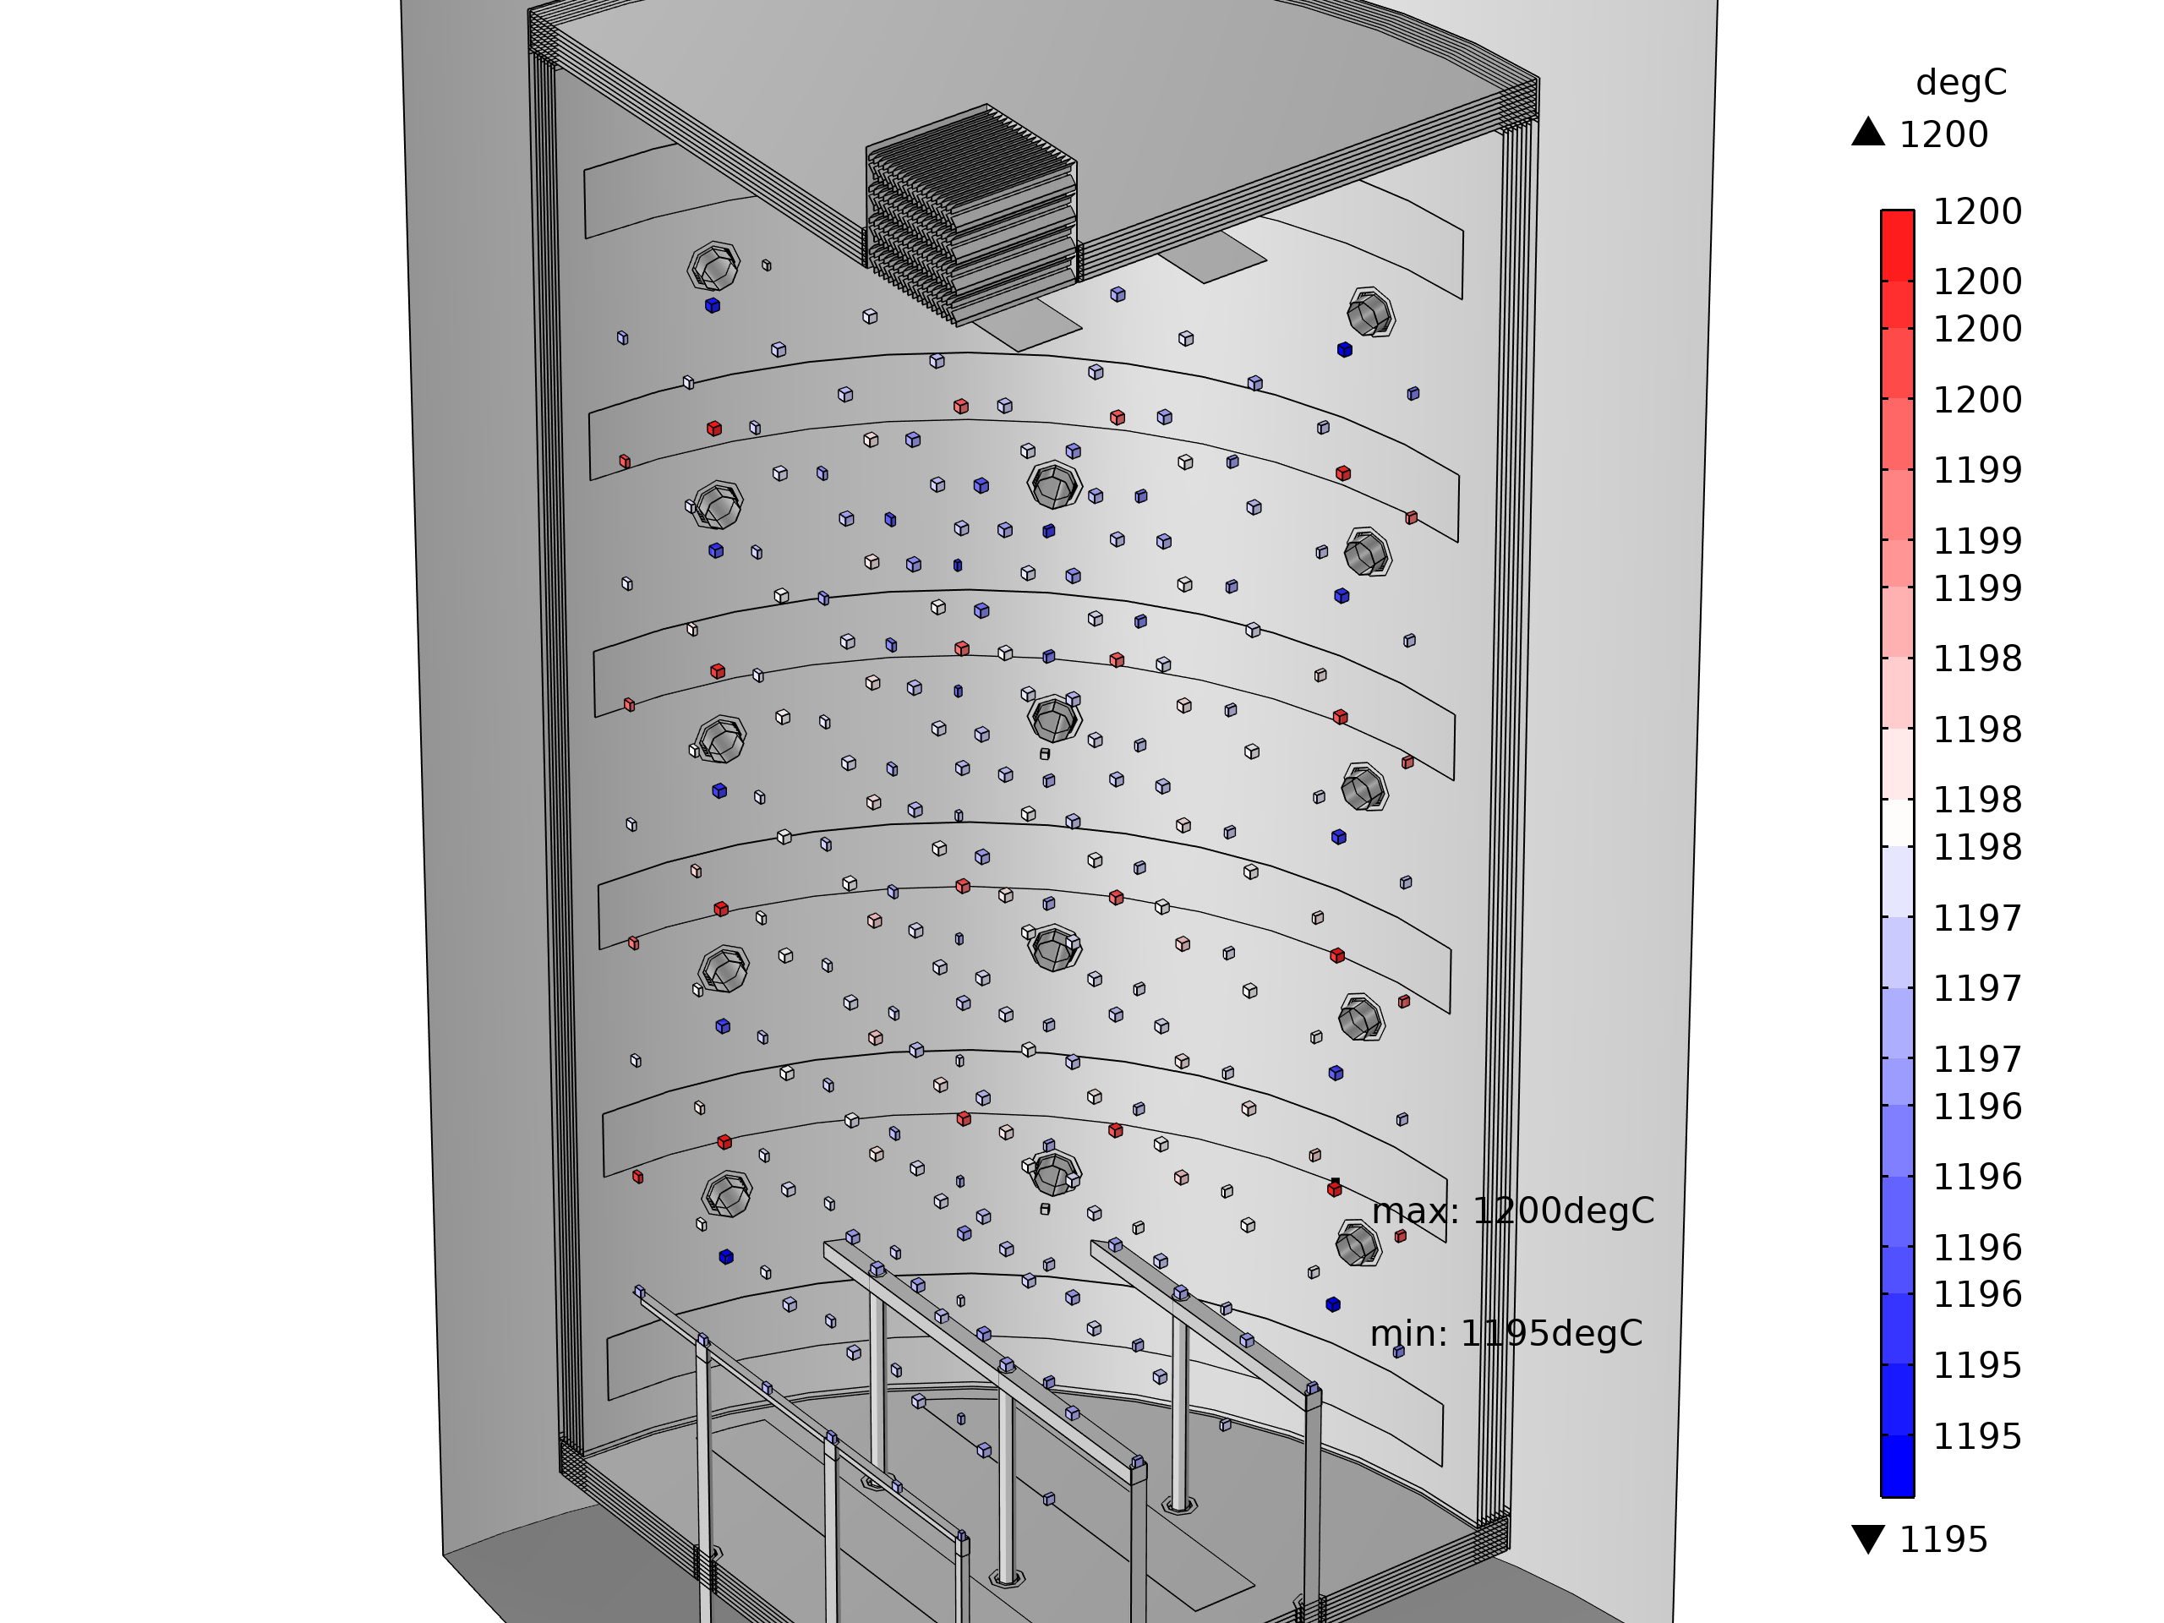
Simulation Results
Highly Resolved Temperature Homogeneity and Power Consumption
„FlowBox“
+
Top and Bottom Heater
dT = 5 K; P = 100 kW
Significantly improved temperature homogeneity and 6% reduced power consumption

Slide 13
Conclusions
Stationary Thermo-Electric Model
… delivers information on
  temperature homogeneity &
  power consumption
… of vertical high temperature vacuum furnaces.
… is a valuable tool for …
  their optimization &
  the evaluation of new design concepts.
Key Findings
Model allows a more accurate evaluation of temperature homogeneity than standard measurement procedures.
Temperature homogeneity of a vertical high temperature vacuum furnace can be improved by additional top and bottom heaters at a slightly increased power consumption.
The “FlowBox”-concept allows a comparable or even improved temperature homogeneity at a significantly reduced power consumption.

Slide 14

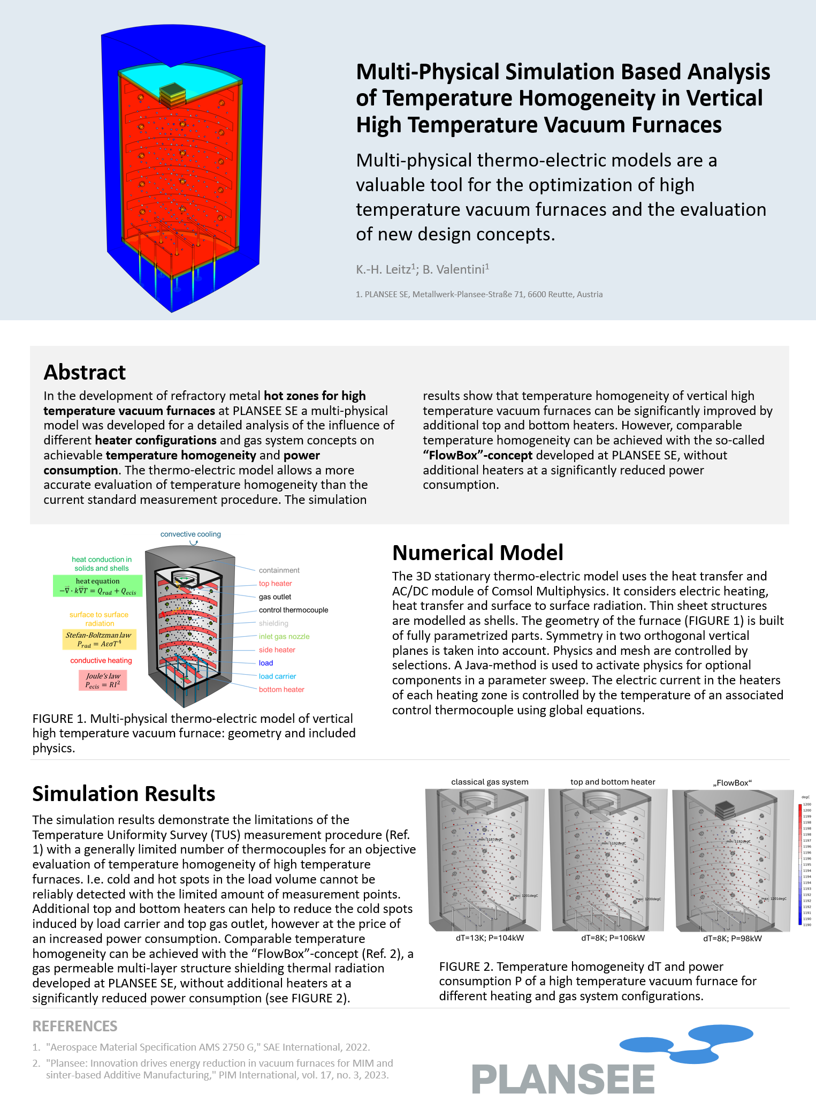
Thank you very much for your attention!
Dr. Karl-Heinz Leitz
Computational Methods
Corporate Research & Development
Plansee SE
Metallwerk-Plansee-Straße 71, 6600 Reutte, Austria
Tel.: +43 5672 600 2805
karl-heinz.leitz@plansee.com

