Slide 1
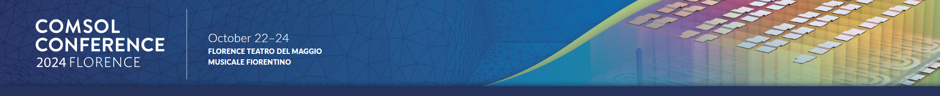
Model Building and Parameter Estimation for Electrodialysis Systems
Marcello Fidaleo, Leonel Tsague
Department for Innovation in Biological, Agrofood and Forest Systems (DIBAF)
University of Tuscia, Viterbo, Italy

Slide 2
Electrodialysis (ED)
Unit operation used to remove electrolytes from solutions and to concentrate electrolyte solutions. It uses two types of membranes consisting of a polymer skeleton and fixed charges arranged alternately in packs (of several hundred).
feed
CM AM CM AM CM AM
The electric field that is generated forces ions to cross membranes.
+
+
+
+
-
diluting
concentrating

Slide 3
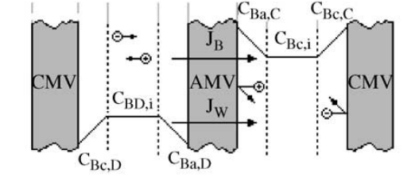
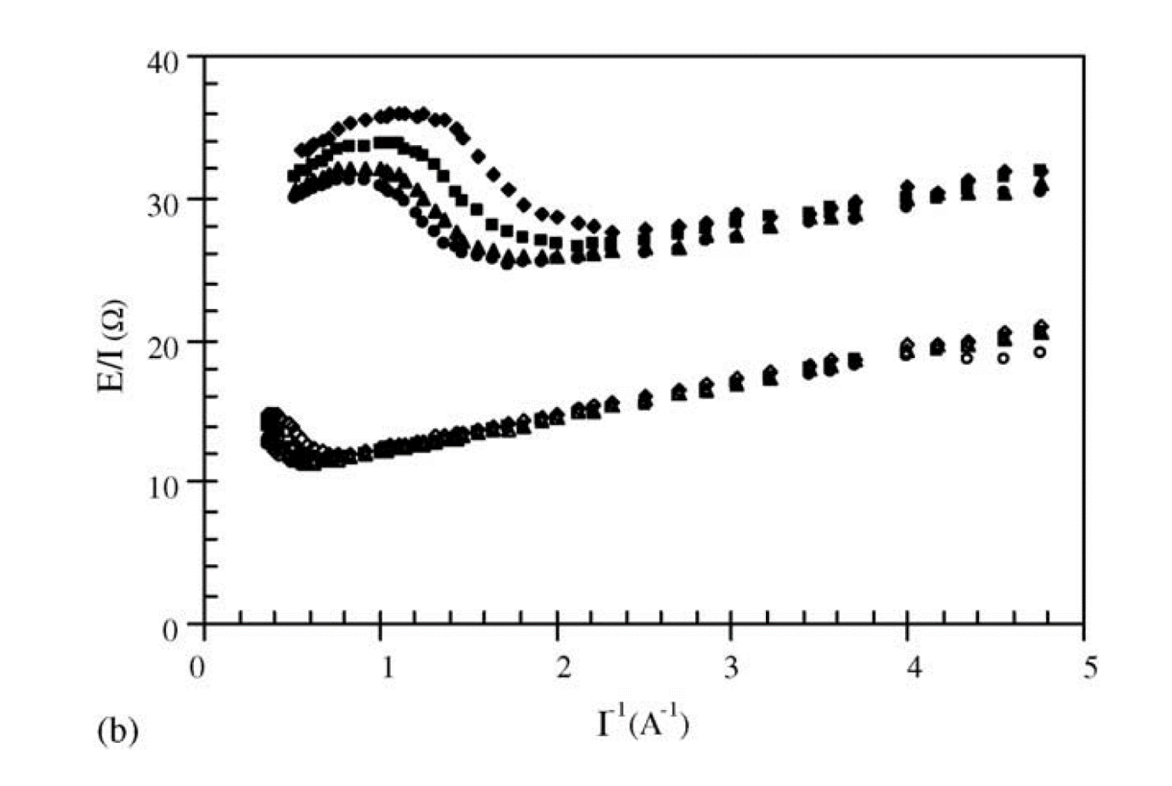
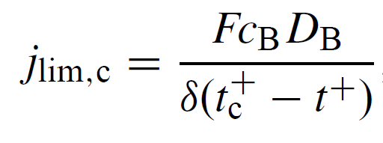



ED modeling
Water flux
$$J_{W}= \frac{t_{W}}{F}j+L_{W}∆π$$
Salt flux
$$J_{B}= \frac{t_{B}}{F}j+L_{B}∆c_{B}$$
Electric potential
$$E+E_{j}+E_{D}=jr$$
Limiting current density

Slide 4
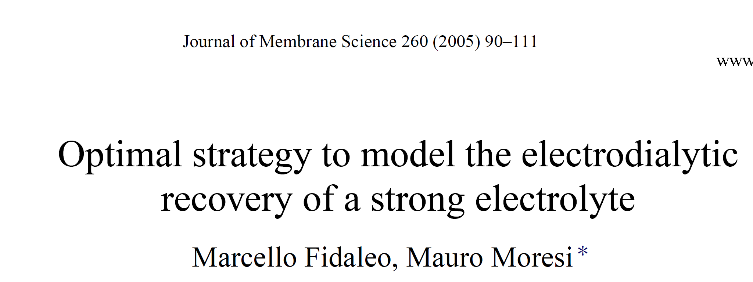
Determination of model parameters
Electric conductivity measurements
Desalting tests
I-E experiments with only one type of membrane
t⁺, t⁻, D°, k
t_{B}, t_{w}, L_{B}, L_{W}
E_{el}, R_{a}, R_{c}, I_{lim,a}, I_{lim,c}, a_{me}

Slide 5
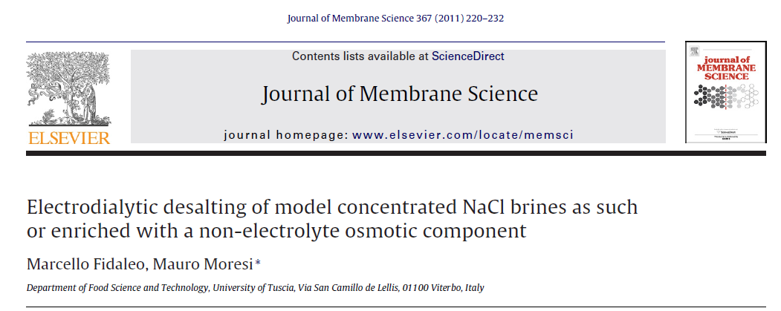
Determination of model parameters
Electric conductivity measurements
Desalting tests
I-E experiments with both types of membrane
t⁺, t⁻, D°, k
t_{B}, t_{w}, L_{B}, L_{W}
E_{el}, R_{a}+R_{c}, I_{lim}, a_{me}

Slide 6
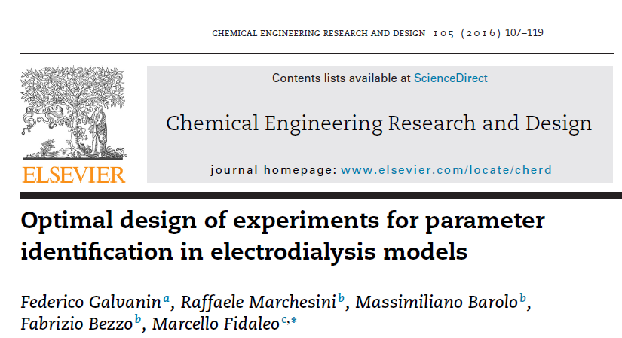
Determination of model parameters
Electric conductivity measurements
Desalting tests
t⁺, t⁻, D°, k
t_{B}, t_{w}, L_{B}, L_{W}, E_{el}, R_{a}+R_{c}, a_{me}

Slide 7
Design of experiments based on model
Given the model the optimal experiment for parameter estimation is designed.
The I(t) trajectory that maximizes the information content of the experiment is determined.

Slide 8
Aim of this work
If we equip the plant with very precise online sensors for solution conductivity and volume and use a time dependent electric current function to feed the stack, can we estimate some model parameters with just one batch desalting experiment?
Can we accomplish this task by using COMSOL Multiphysics?

Slide 9
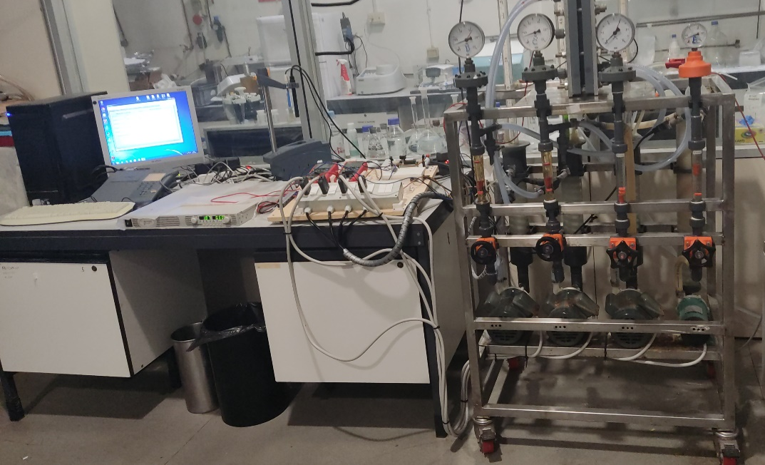
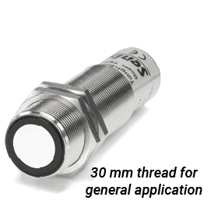
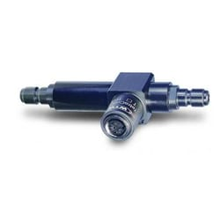
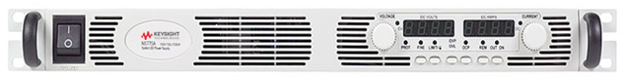
M&M: batch electrodialysis plant
ED plant control station
ED stack model EUR2 (Eurodia industrie SA)
Conductivity sensor
DC generator
Level sensor

Slide 10
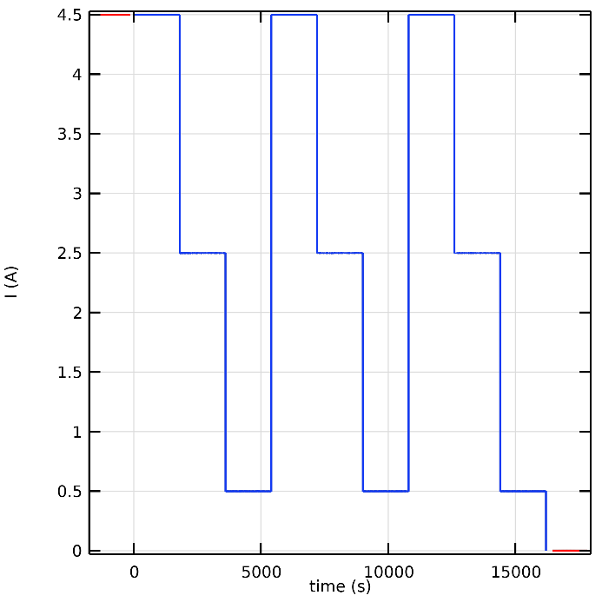
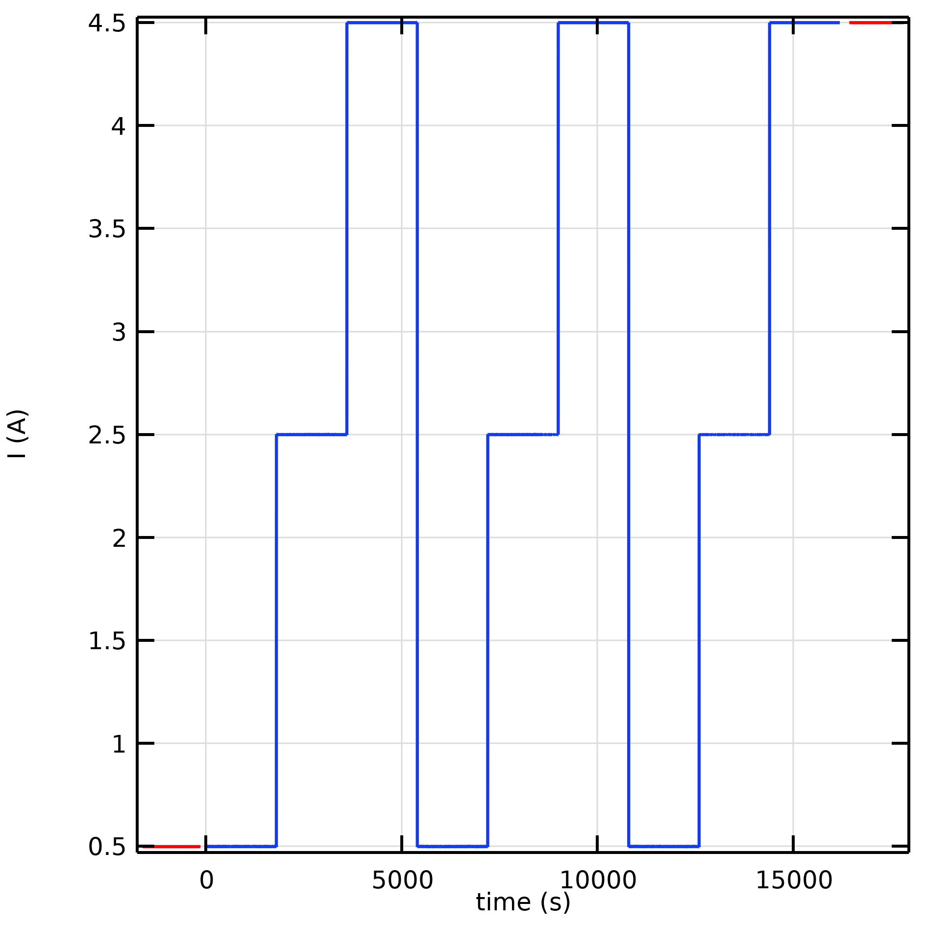
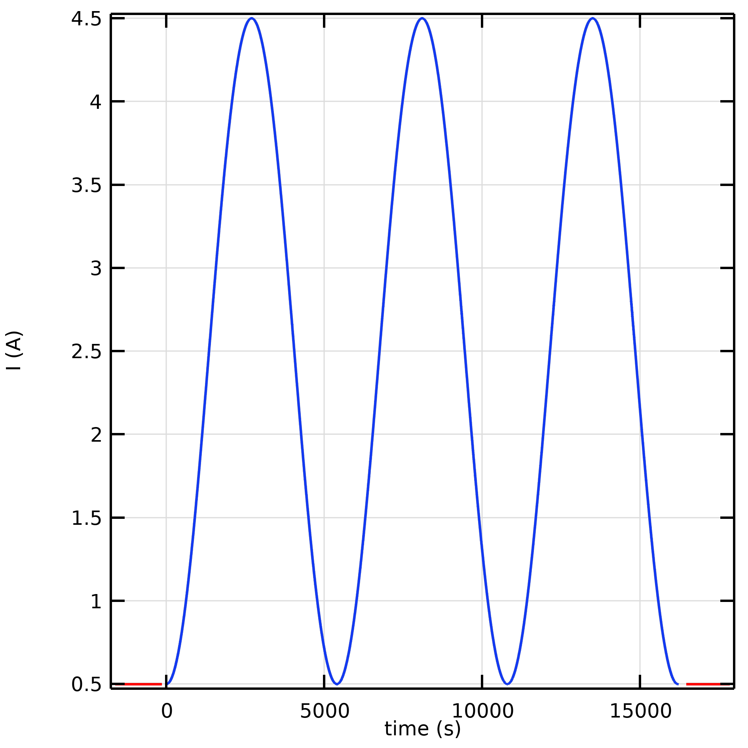
Experimental plan
Three batch desalination experiments with different electric current inputs
decreasing step
increasing step
sinusoidal
Conductivity and level of solutions, electric current and potential acquired at 1 Hz sampling rate.

Slide 11
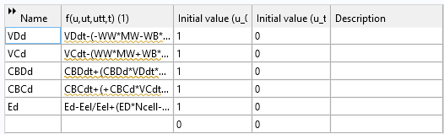
Model simulation and parameter estimation
Mathematical formulation
4 ODEs for concentrations (C) and volumes (V) of the solutions in the concentrating (C) and in the diluting (D) tanks
1 DAE for electric voltage (E)
4 parameters for water (L_{W}, t_{W}) and salt (L_{B}, t_{B}) transport properties
COMSOL implementation
0D dimension, Mathematics, global ODEs and DAEs, parameter estimation

Slide 12
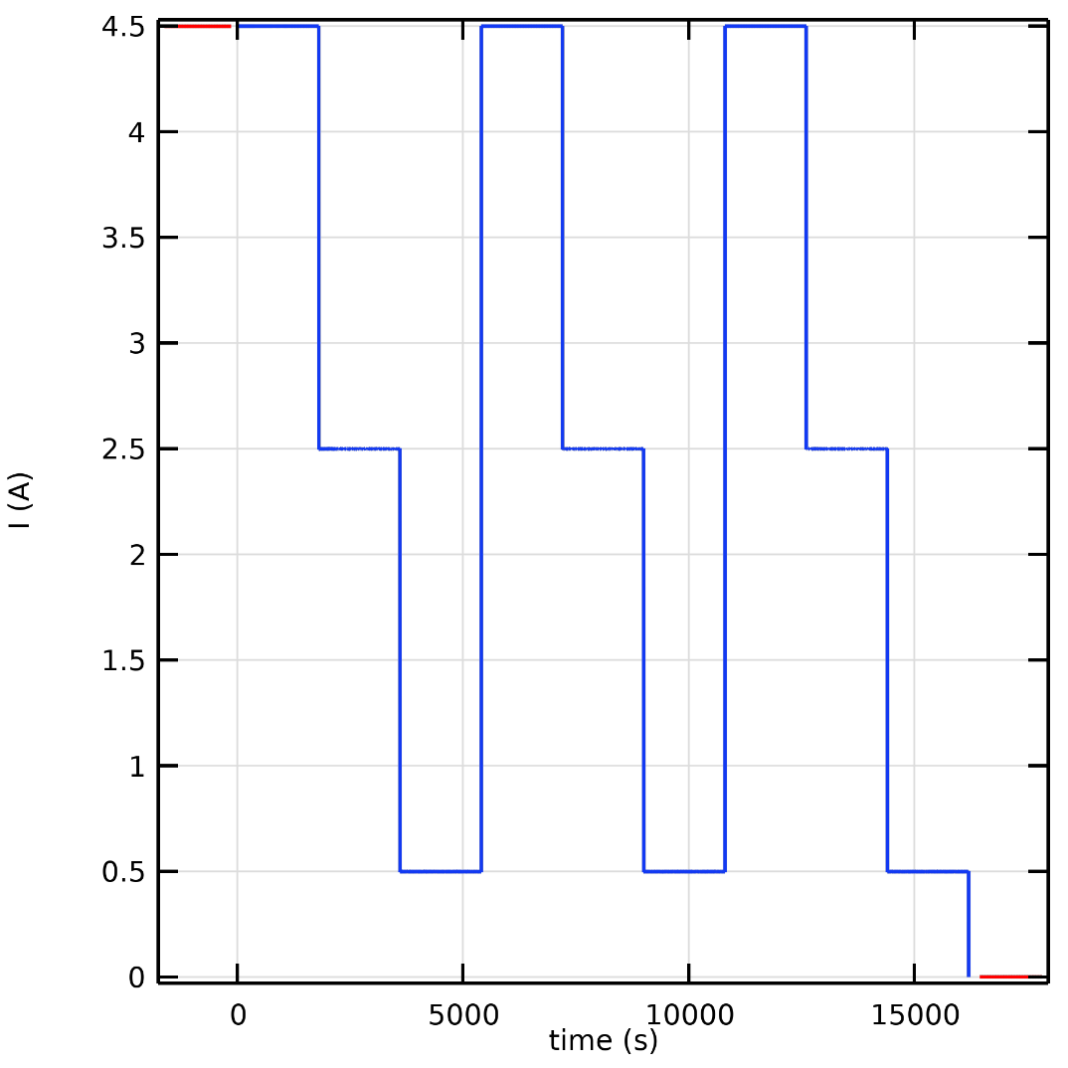
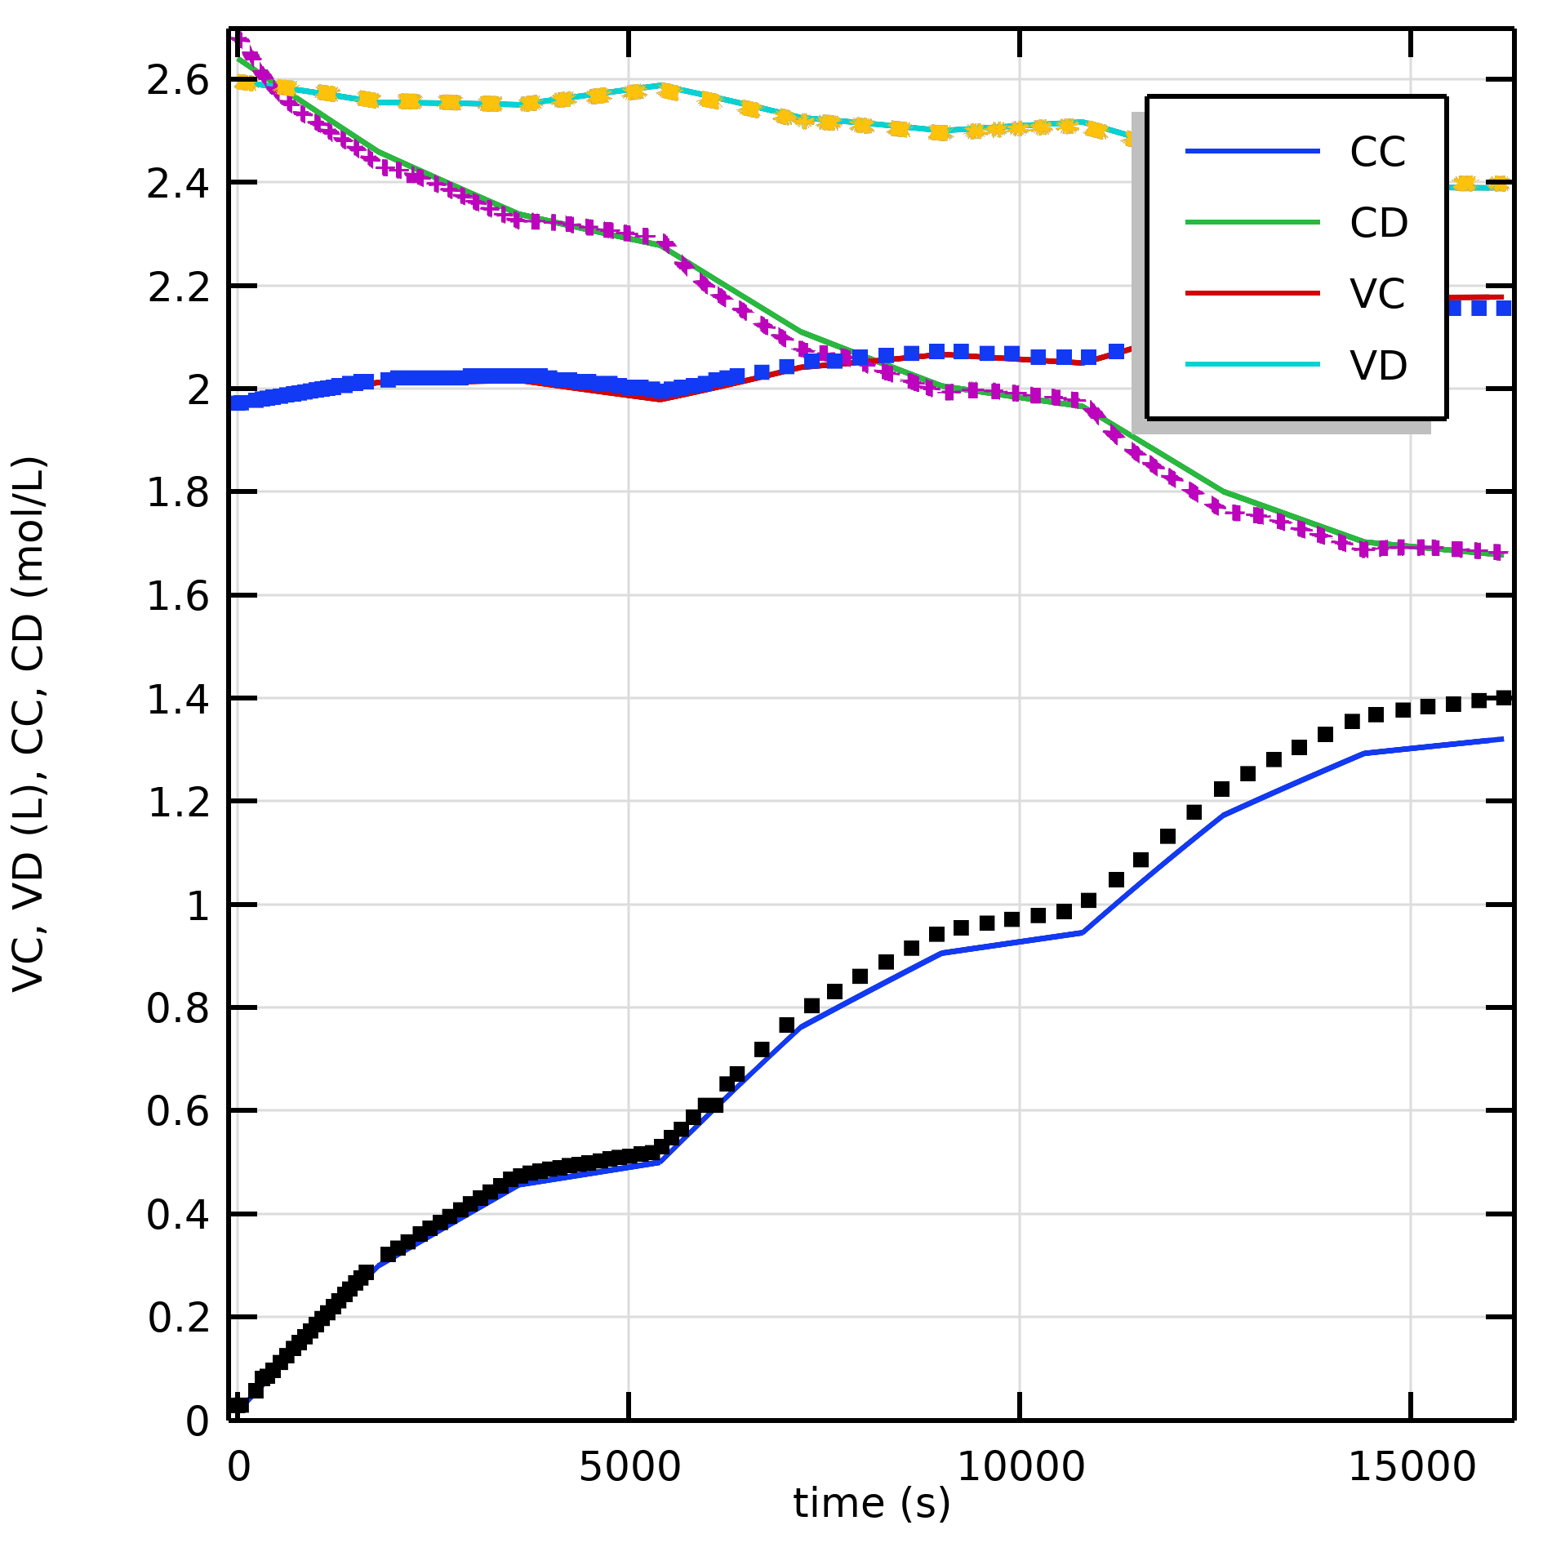
Results
Decreasing step pattern
Electric current
Volumes and concentrations

Slide 13
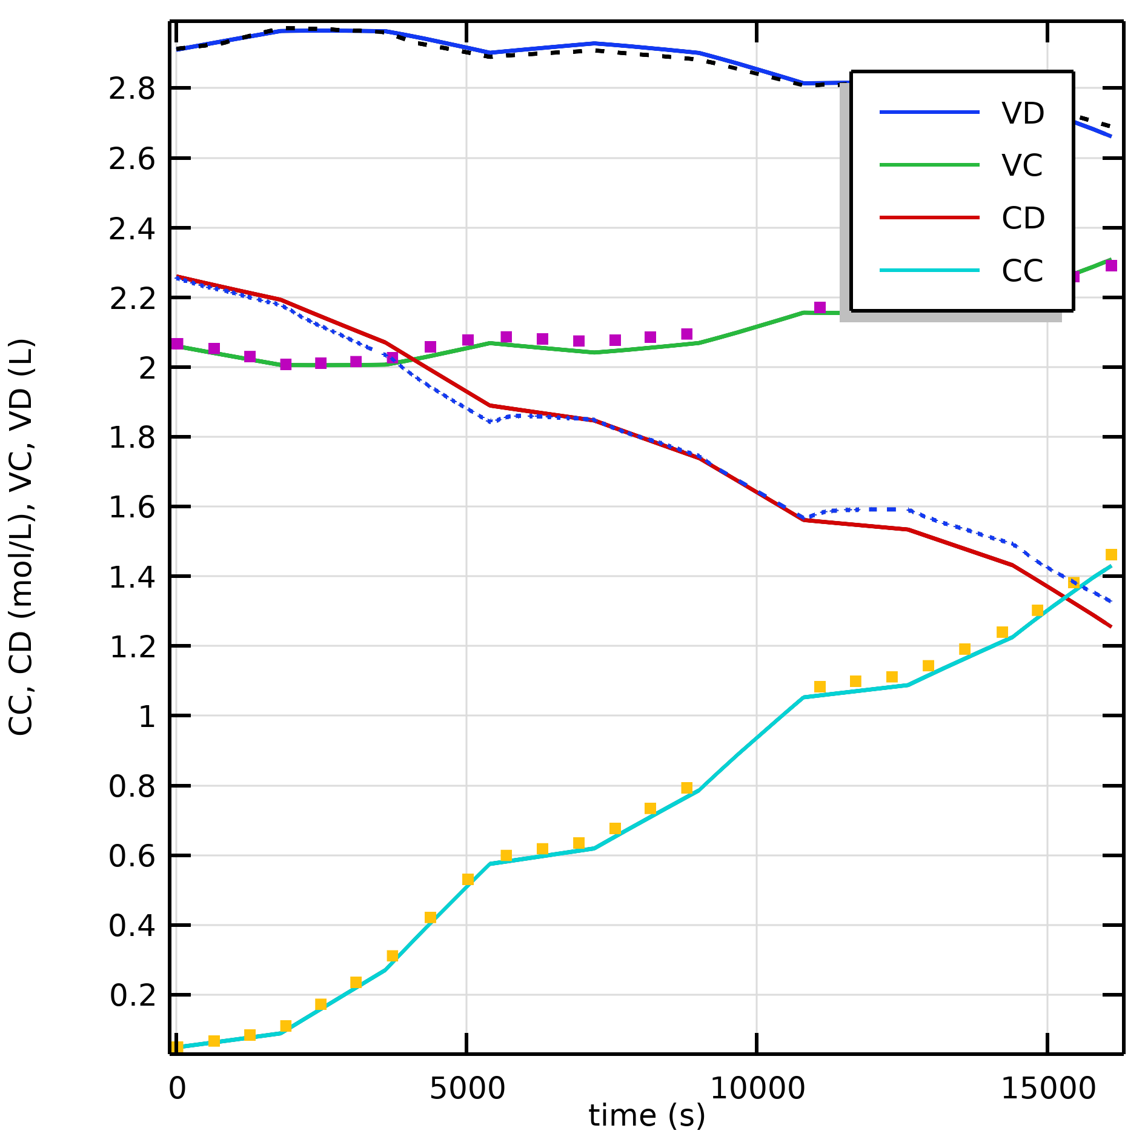
Increasing step pattern
Electric current
Volumes and concentrations

Slide 14
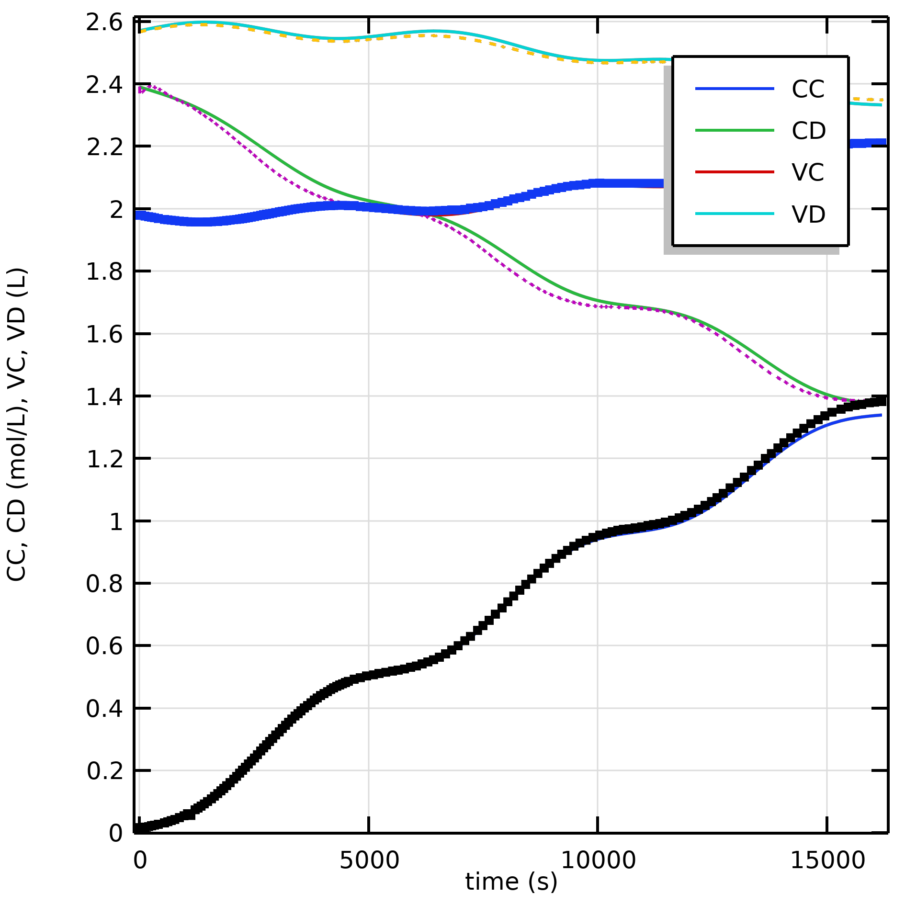
Sinusoidal pattern
Electric current
Volumes and concentrations

Slide 15
Parameters estimate comparisons
It seems that parameter estimate is possible considering that the estimates are very close

Slide 16
Conclusions
The use of online sensors allowed to acquire high-frequency and very precise measurements for concentrations and volumes.
Model simulation and parameter estimates were easily carried out by using COMSOL Multiphysics.
Further work is required to validate the results obtained by expanding the experimental data set.

