Slide 1
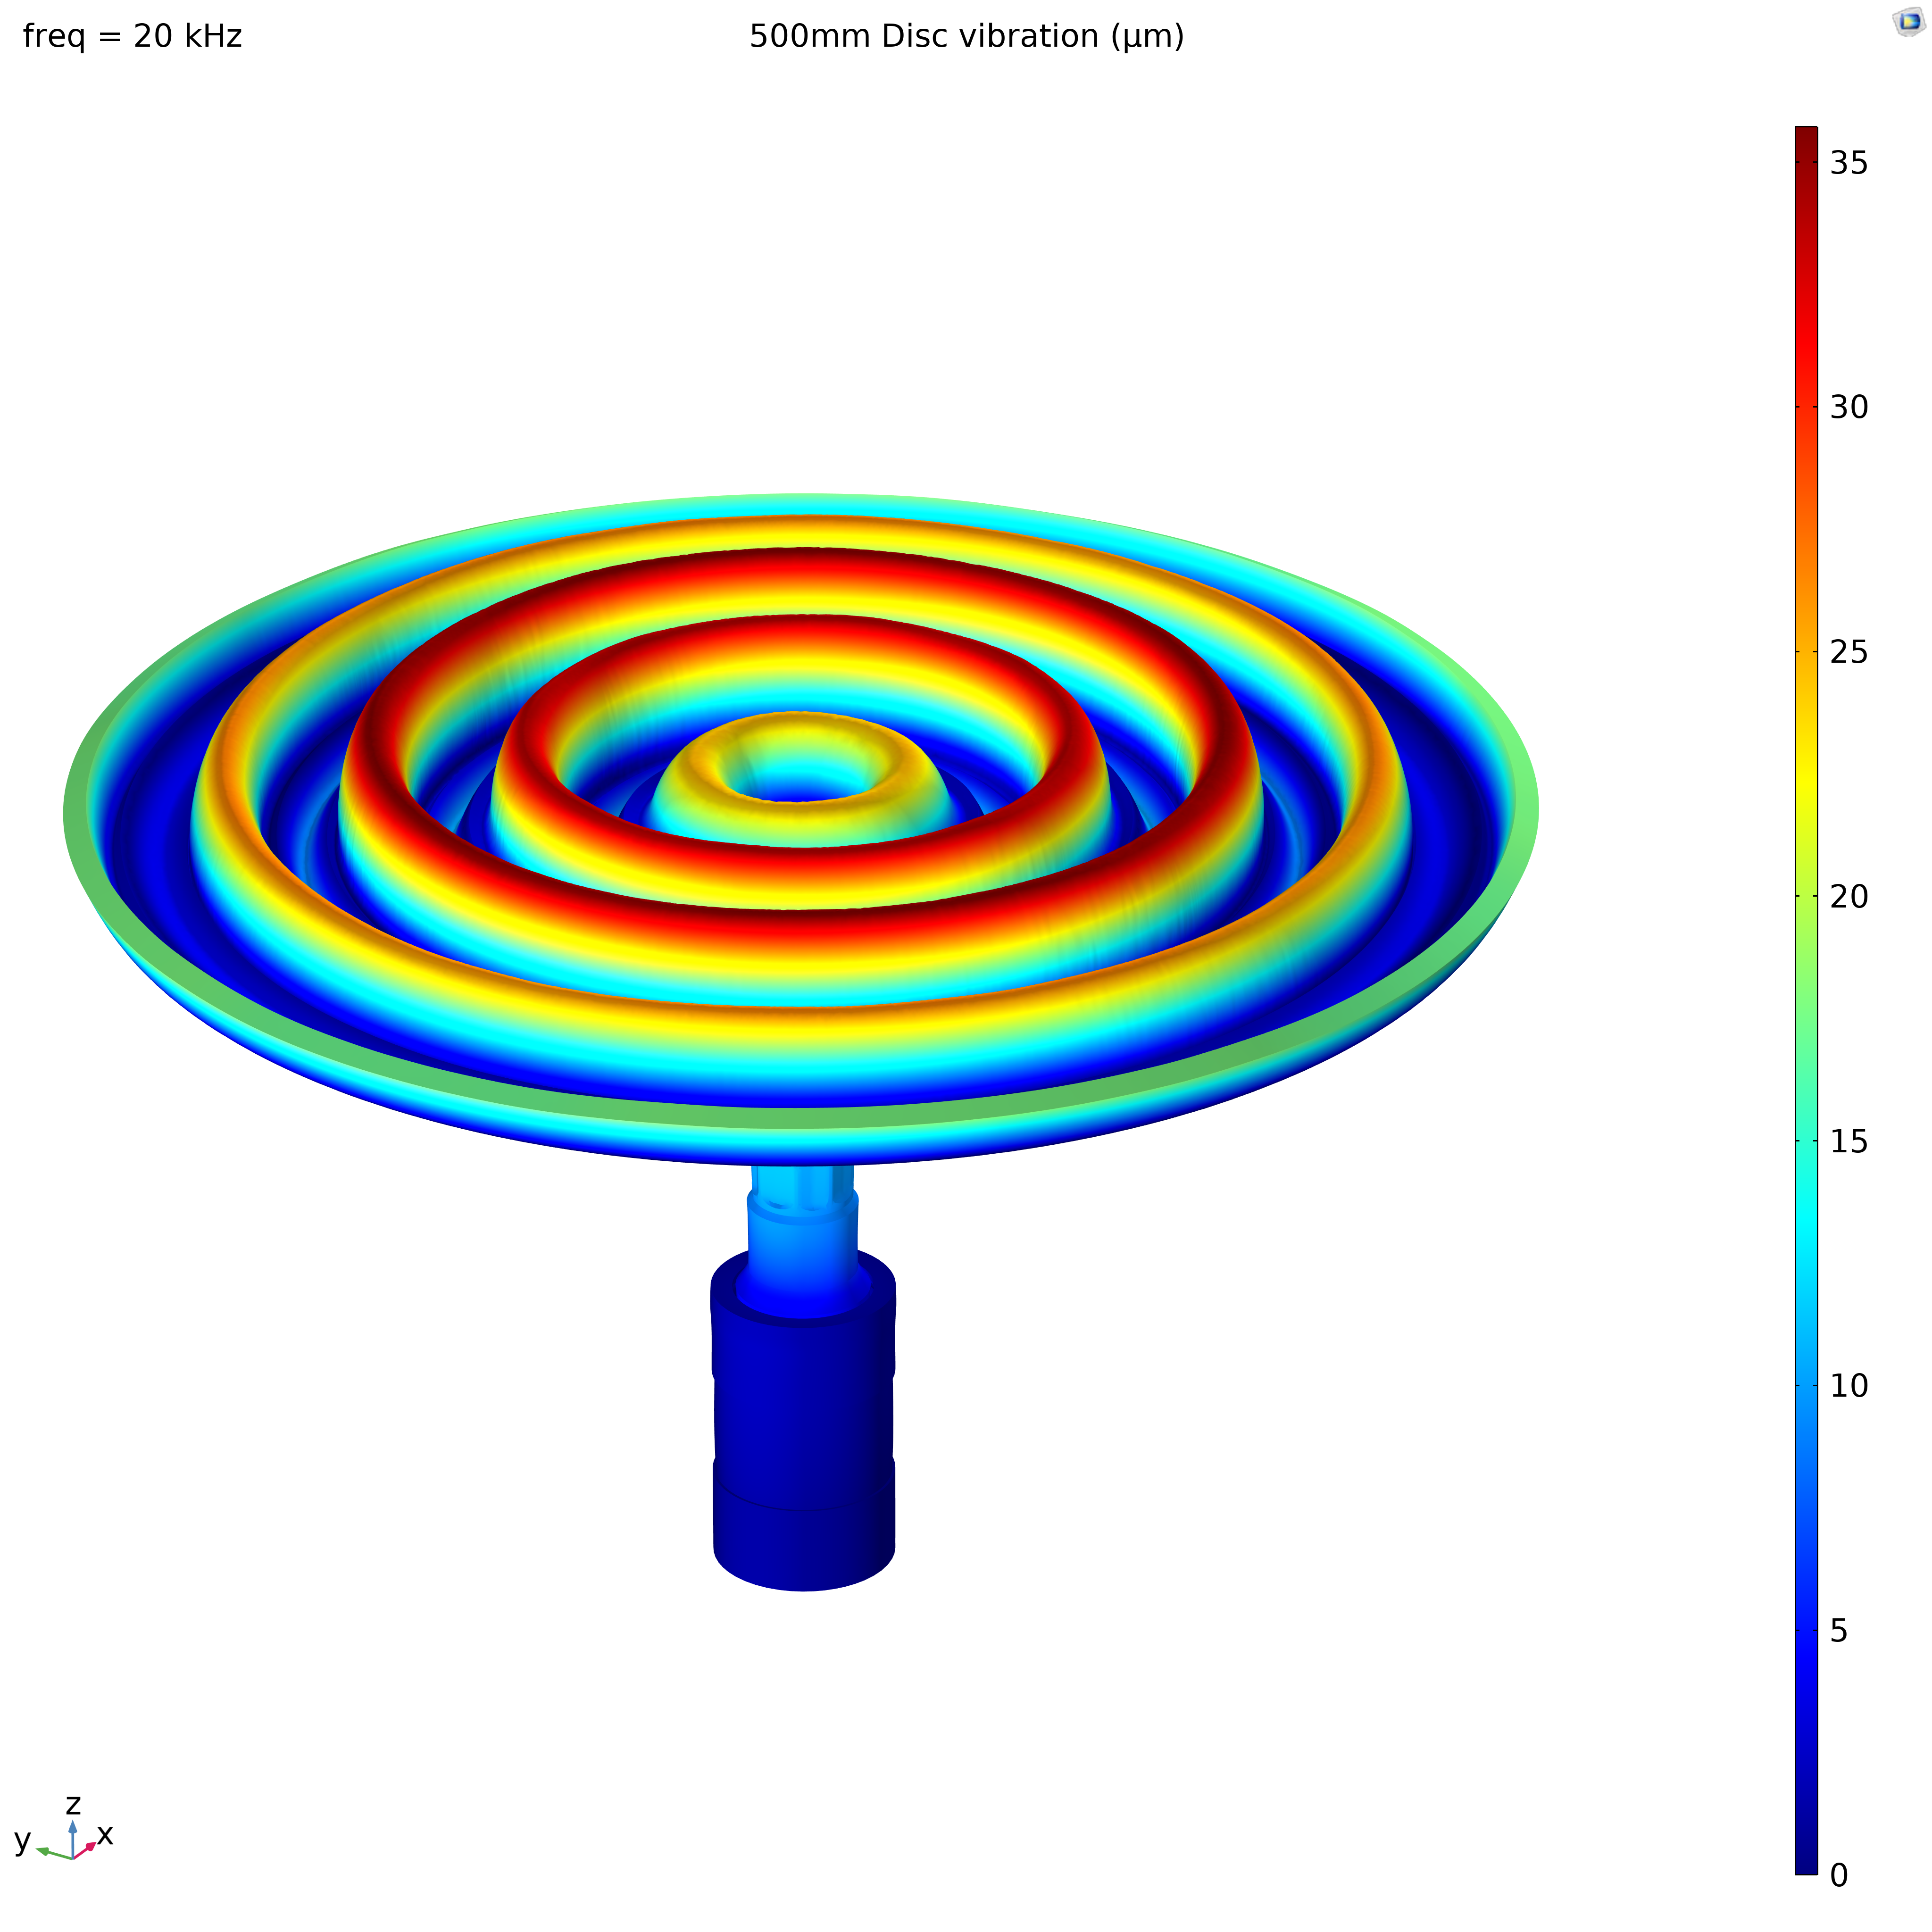

Design of an Airborne Ultrasonic System with High SPL, Large Focusing Range
L.Spicci,
Everywave Srl, Via dell’Artigianato 27/28, 35010, Villa del Conte (PD), Italy

Slide 2
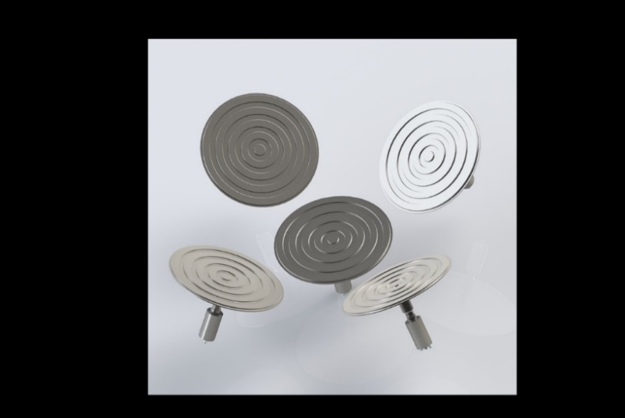
Goals, challenges and solutions
This work reports the FEM design of a high-power ultrasonic system, capable of emitting acoustic radiation at 20kHz with SPL up to 160dB. Such pressure level can be found as a requirement for some special industrial applications ([1],[2]), like foam reduction or gas processing.
An important design issue for high power airborne ultrasonic systems lies in the air low acoustic impedance, resulting in poor power transfer.
The best solution was found to be an array of special ultrasonic radiators that lie on a spherical surface whose center is the required focus of the system.
Each unit is a high-power ultrasonic device, operating at 20kHz and connected to a disc sonotrode optimized for ‘in-phase’ radiation across its entire surface [1].

Slide 3
Ultrasonic radiation in air ?
Issue : air low acoustic impedance >> poor power transfer.
Possible ways to overcome the problem and get high SPL & beam focusing at large distances :
increase the electrical generator power
exploit an acoustic impedance matching ‘horn’
enlarge the radiator surface area as much as possible
design an array of radiators
The first and second solution listed above are not viable for high power ultrasound systems operating in the kHz range, while the third and fourth are both effective.

Slide 4
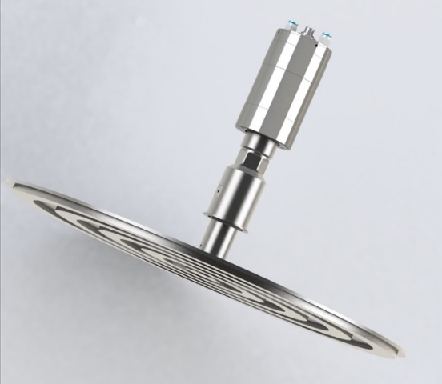
Generator Power
Issue : Cooling
High power ultrasonic transducers are special devices where not all types of cooling are applicable directly on the active part; generally only air cooling is easy to implement.
It’s generally not easy to draw heat from such devices: the cooling system will eventually set the limit to the maximum operating power.
Heat drain
kW??
Ultrasonic wave

Slide 5
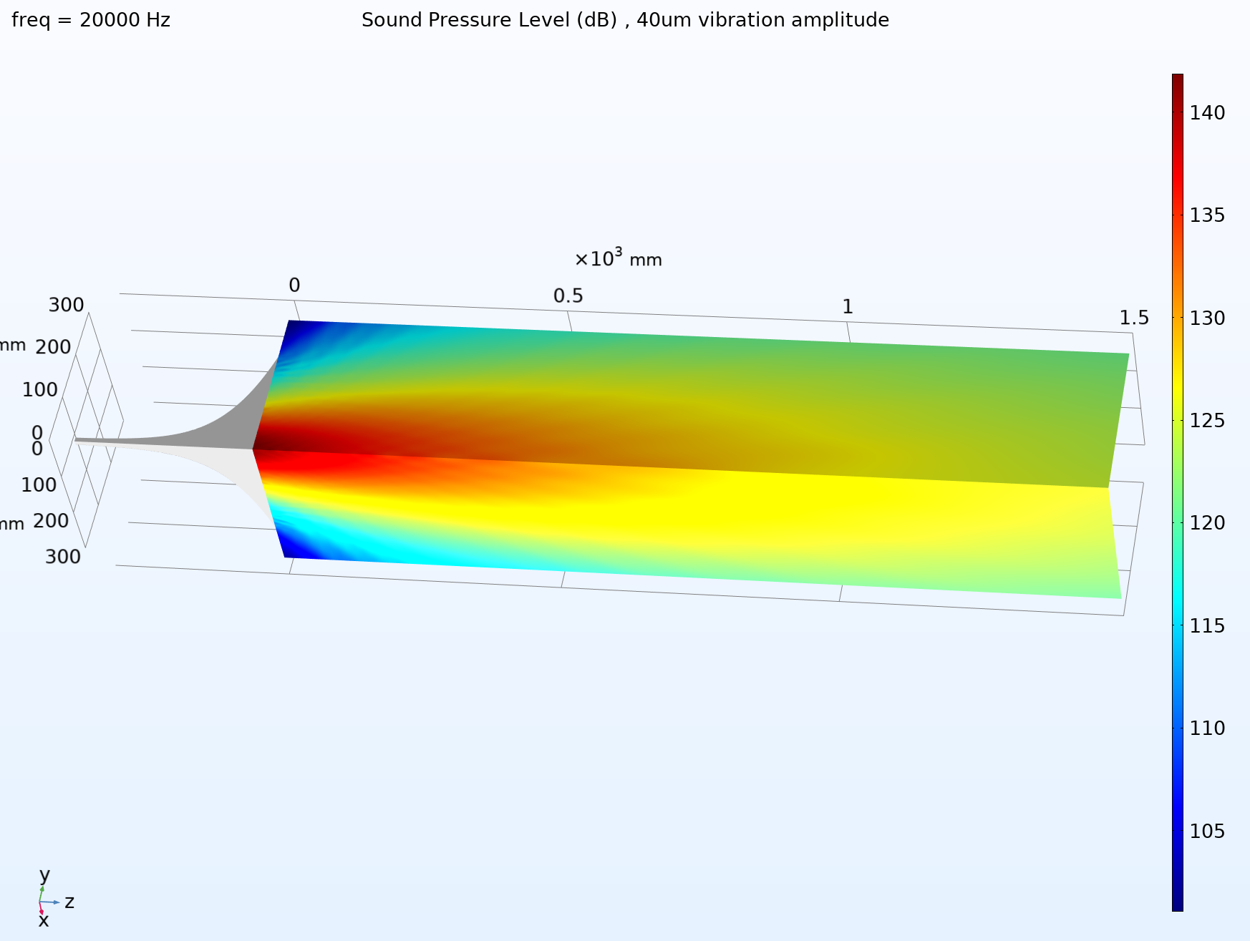
Horn ?
Even if a horn is the best impedance adapter for mid/high audio frequency devices (tweeter), it's not viable for high power ultrasound systems operating in the kHz range.
Indeed, horns have specific dimensional requirements for best operation, that cannot always be met in practice.
For the present ultrasonic system the horn throat needs to have a diameter of only 9mm (at 20kHz). Such value would lead to a very small sonotrode, resulting in a system with a low SPL and low focusing.

Slide 6
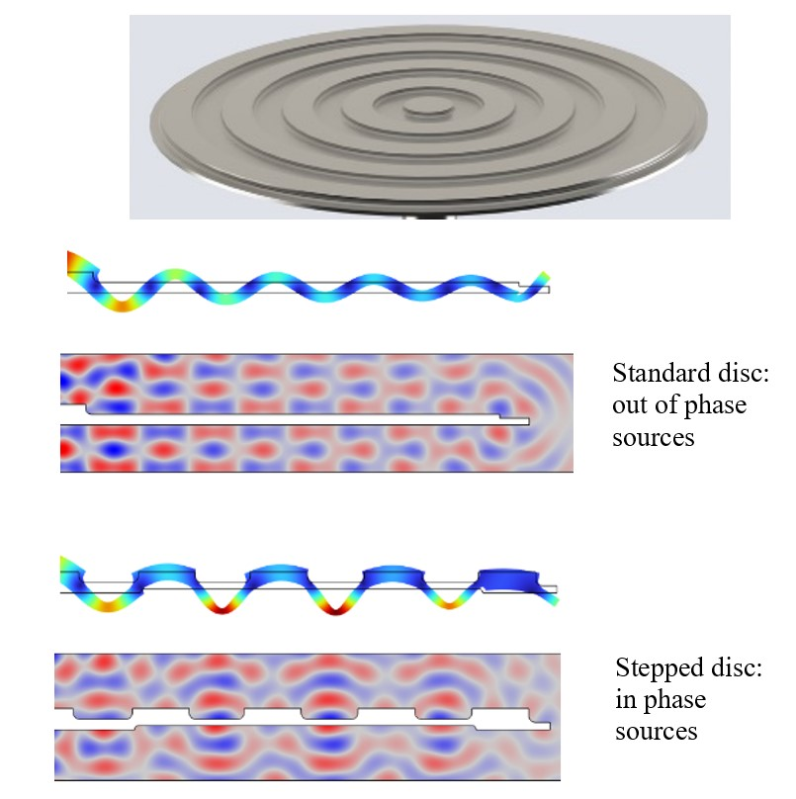
Large radiator : phase issue and stepped disc
Enlarging the radiating surface leads to a better loading of the sonotrode and allows to get a better focusing of radiation on the system axis, thus resulting in higher SPL.
That is only possible to some extent, as spurious vibrations increase in number and intensity and a 'wave-like' deformation of the disc is unavoidable.
Such wave shape leads to different phase of the acoustic wave departing from the disc from different radial position and the resulting radiation from a simple flat disk is a non-constructive interference pattern, that is of course undesirable.
A way to correct that is a 'stepped' shape for the disk surface [1] that put sources of radiation ‘back in phase’

Slide 7
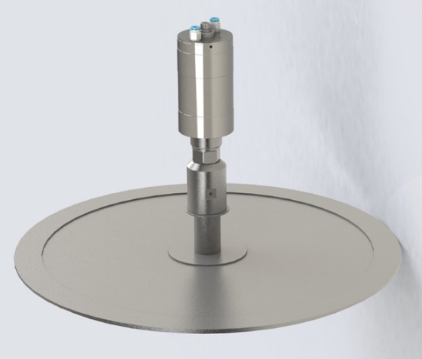
COMSOL Model for the high-power ultrasonic disc
A detailed FEM for the ultrasonic system was built using COMSOL Multiphysics® 6.1, making use of Solid Mechanics, Piezoelectric, Acoustics and Solidworks link modules.
The system consists of three parts: Transducer or ‘Converter’, ‘Booster’, Disc sonotrode.
It’s a special device designed to operate with very sharp resonance and high power in the low ultrasound range (20kHz). A deep know-how on high power ultrasound is essential to develop it, as maximum efficiency is crucial for both performances and reliability.
Converter
Booster
Sonotrode

Slide 8
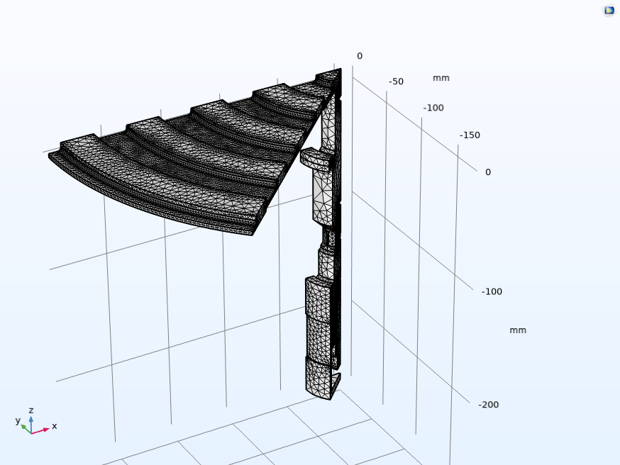
COMSOL Model – Structural Mechanics
The design of the ultrasonic system and surrounding acoustic domain are developed in the frequency domain, in 3D space, making use of symmetries and approximations, to keep the required CPU load and required memory to acceptable levels.
For the mechanical optimization it is possible to use a 2D-axialsymmetric or 3D model ‘slice’ of the system, exploiting symmetries.
The electro-mechanical converter is based on a prestressed stack of four hard-PZT-8 piezoelectric rings: In the Structural Mechanics module, a piezoelectric material special domain is available, that takes into account the anisotropy, piezoelectricity and electro-mechanical connections of the PZT materials

Slide 9
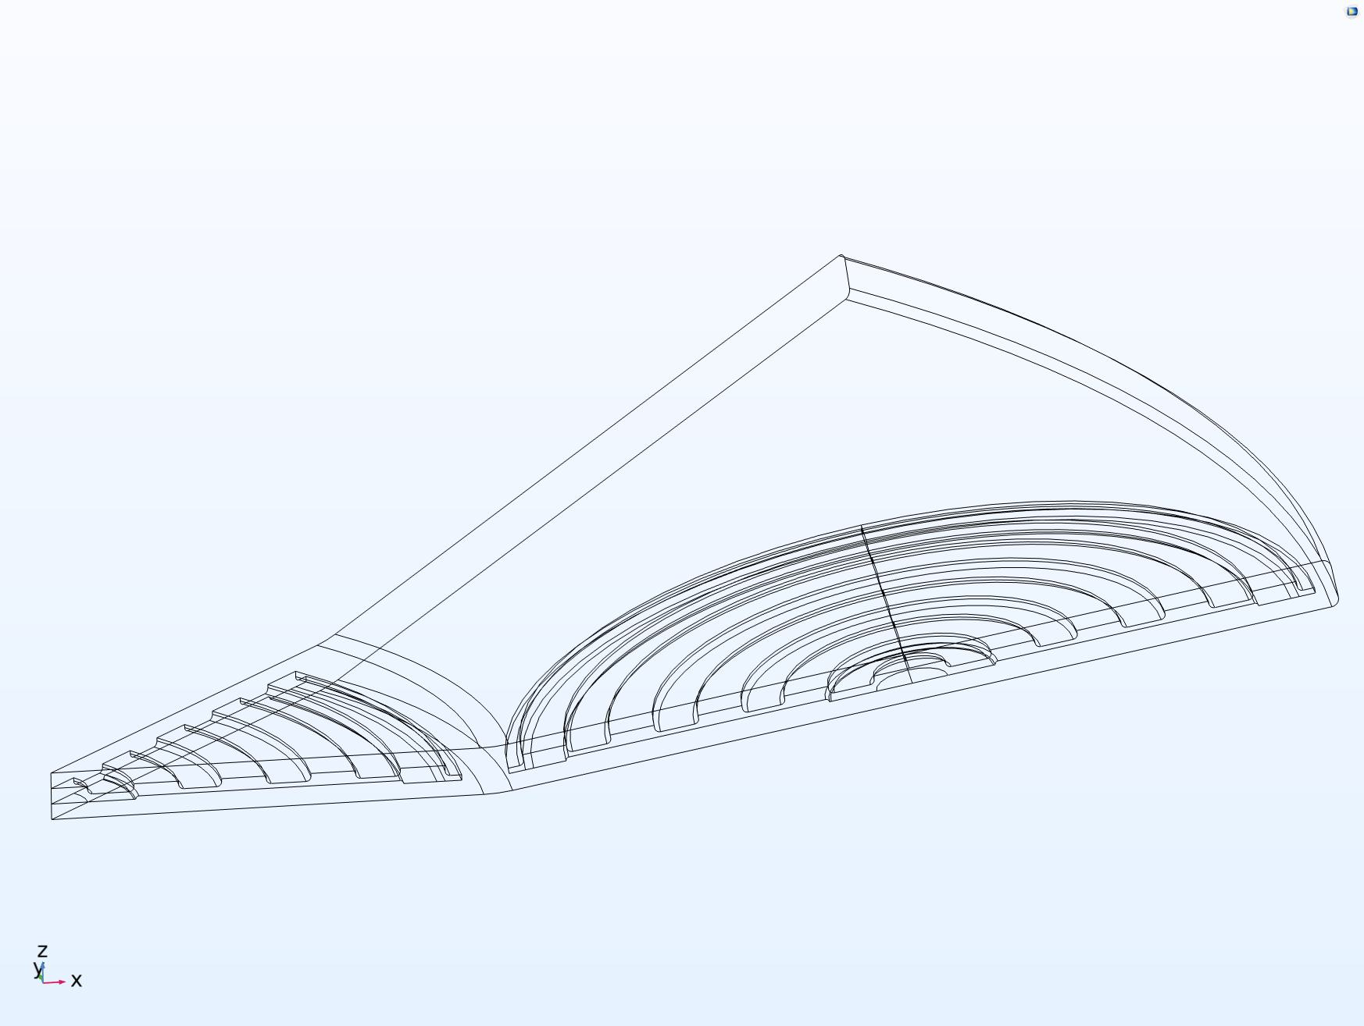
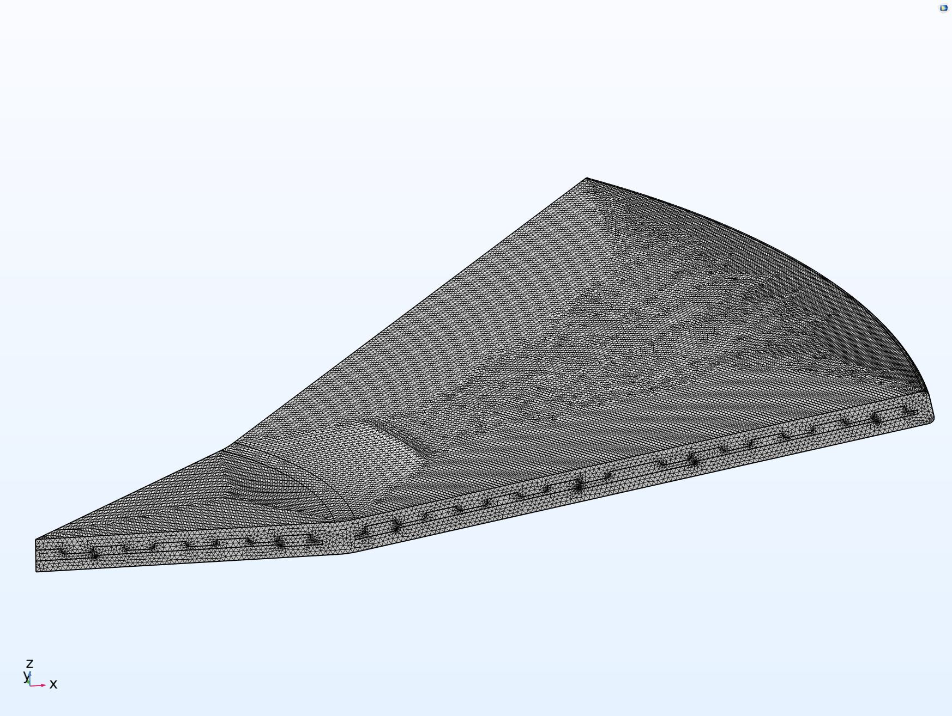
COMSOL Model – Acoustics
Many FEM features are employed to cut calculation load to an acceptable level :
a ‘slice’ of the system is modeled and symmetries are set on boundaries.
Acoustic domain is limited to the surrounding of the discs with PMB (Perfectly Matched Boundaries) on borders
external pressure calculation is performed through external field calculation feature (Helmholtz-Kirchhoff integral)
only the discs are modeled as structural mechanics parts, excited at the resonant frequency found in previous step to replicate the same vibration, thus generating the corresponding acoustic field.

Slide 10
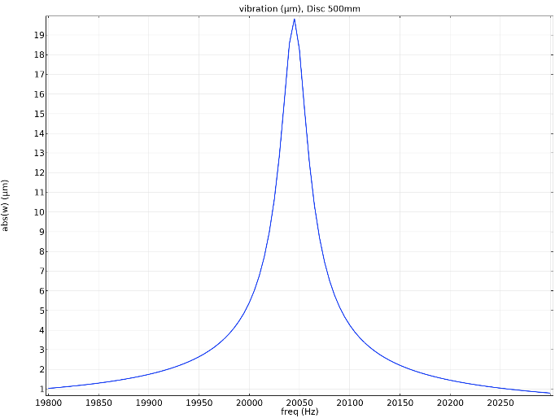
Results – Structural Mechanics
The following results shows that the FEM design optimization has led to:
a strong resonance at 20kHz, without unwanted spurious vibrations
Good deformation at resonance (up to 35 microns), 'well-shaped' across the disk while being low on the converter (as desired)
Acceptable value of stress on the titanium alloy disk (Ti-6Al-4V): 0.3 GPa max., safely lower than the material tensile strenght, equivalent to approx. 1GPa

Slide 11
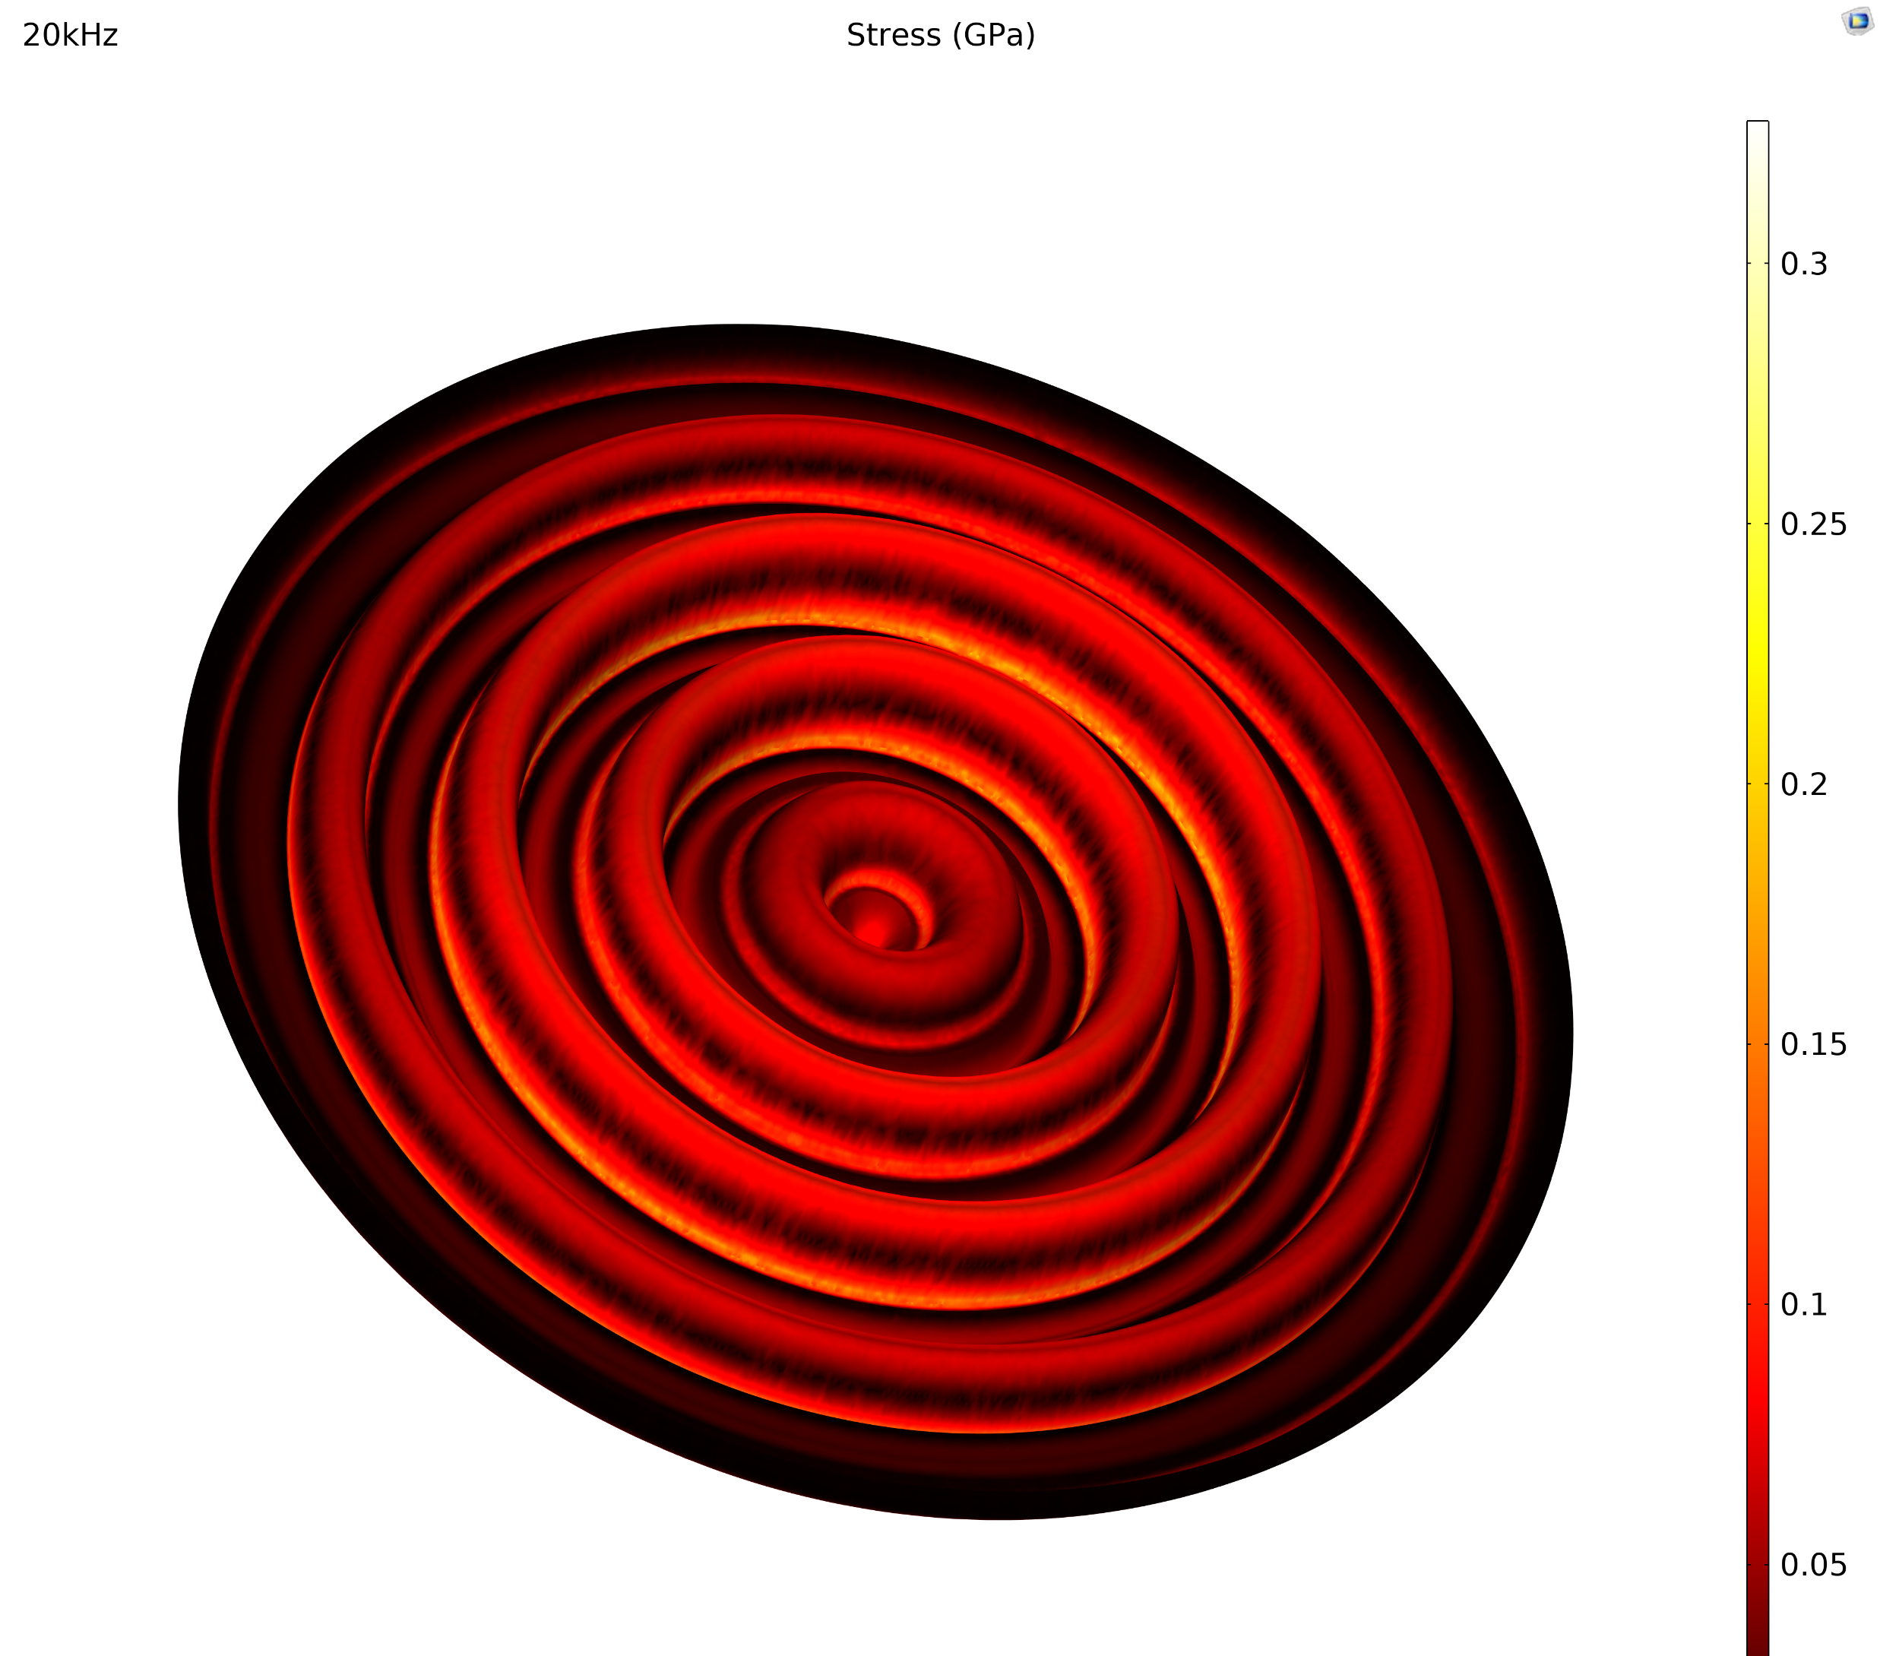
Results – Structural Mechanics

Slide 12
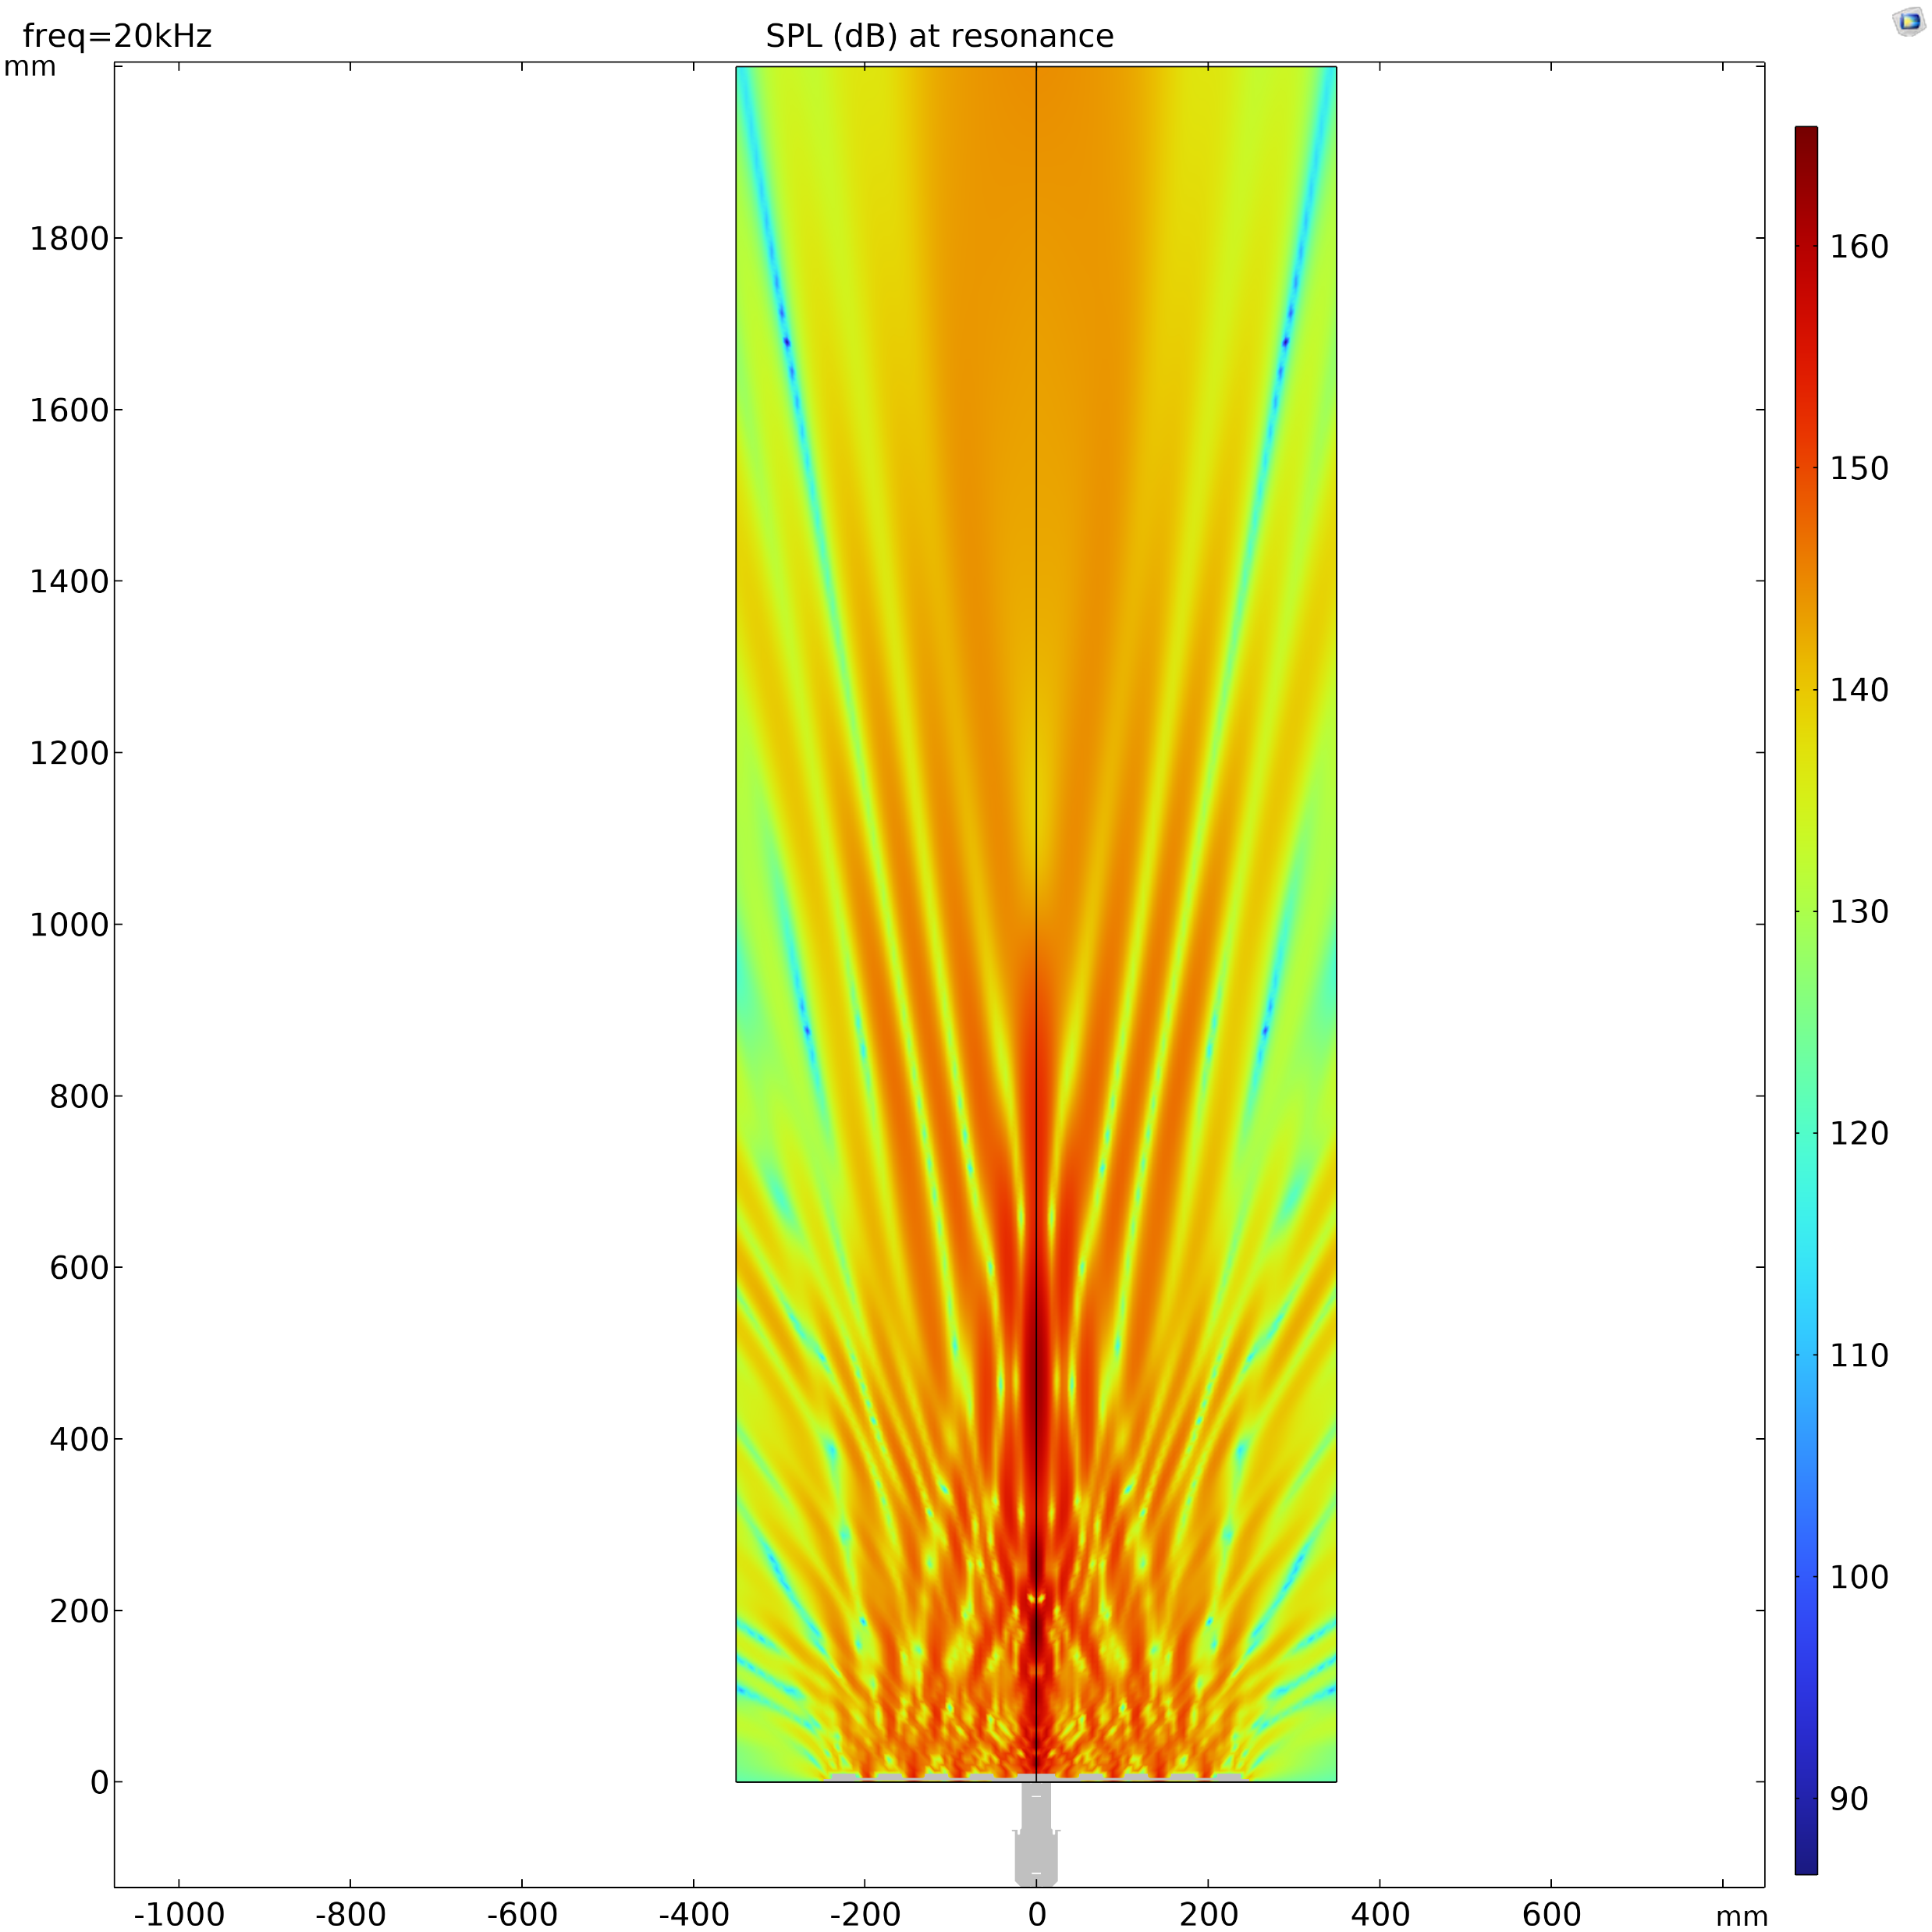
Results – Acoustics , Single disc
As the electromechanical efficiency is optimized, it was possible to get the following results for the acoustic performances of a single disc system:
SPL on axis is 162dB at focus distance: enough for the system requirements
Focus distance of the system is short, at approx. 0.5m
Beamwidth at -6dB from max. is approx. 20° aperture

Slide 13
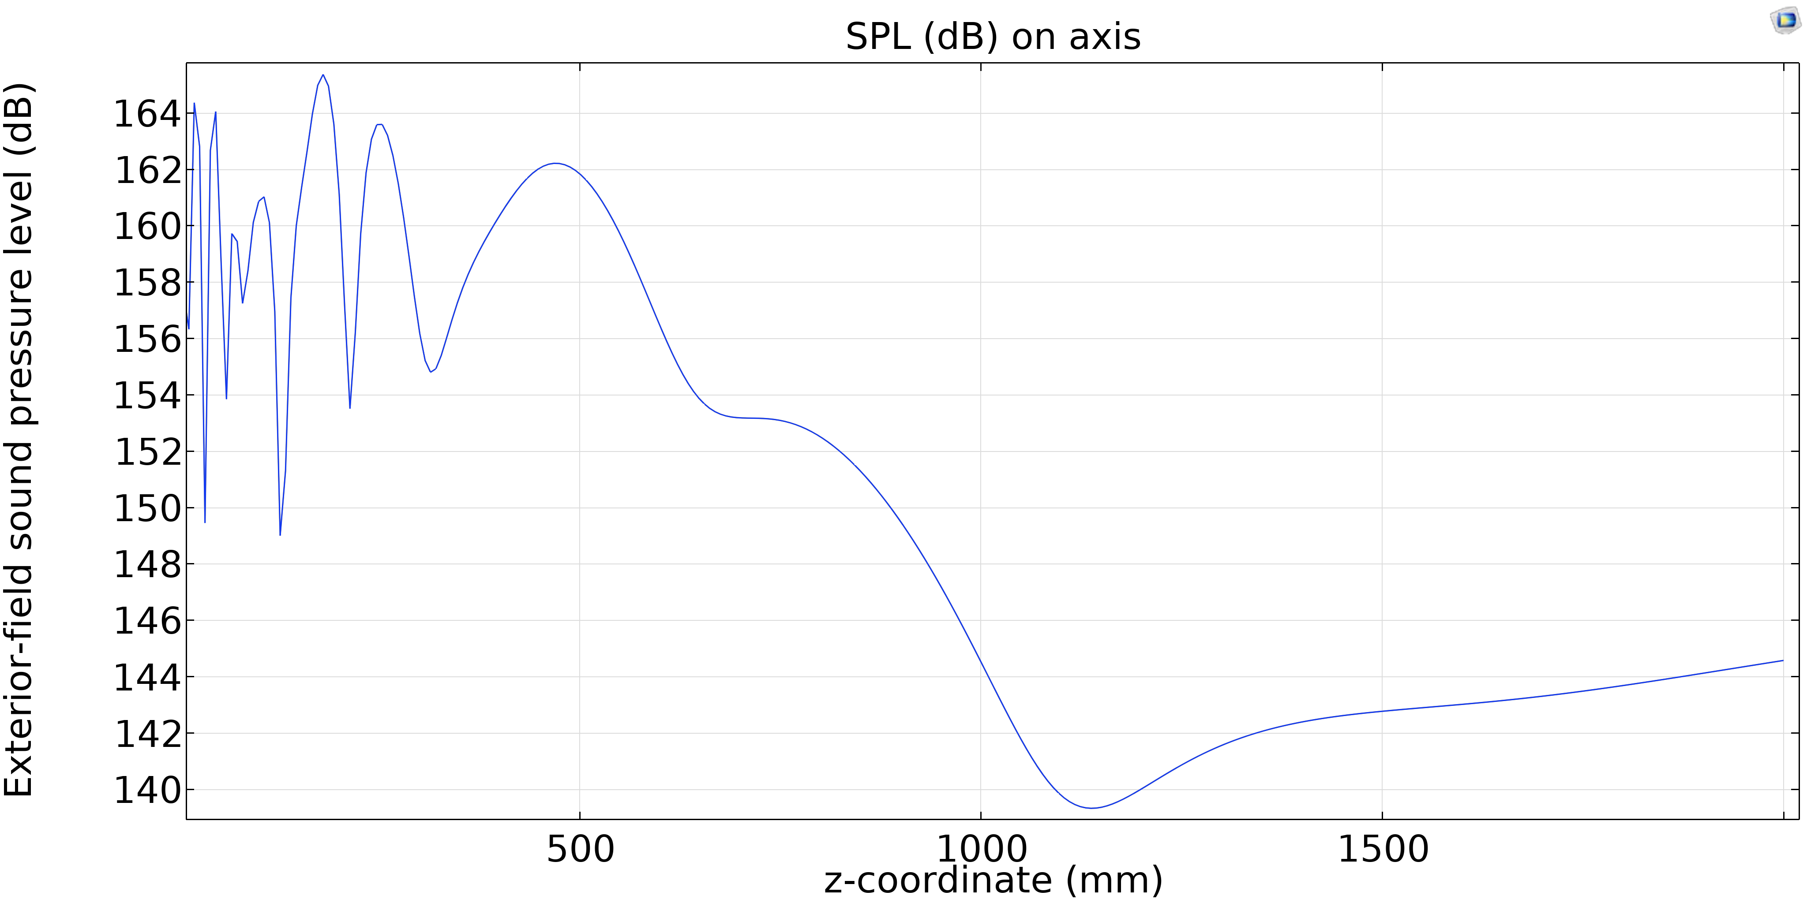
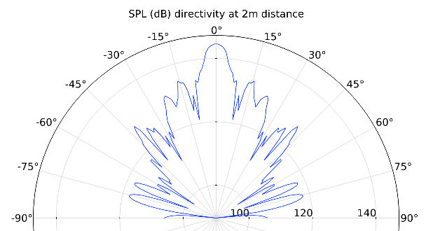
Results – Acoustics , Single disc

Slide 14
Results – Acoustics , 5 disc spherical array
Finally, the best solution is conceived: a spherical array of 5 discs.
The idea is simple: many radiating units lie on a spherical surface whose center is the focus of the system (in the shape of a surgical lamp), so that the focus of the system can be significantly increased compared to that of the single unit.

Slide 15
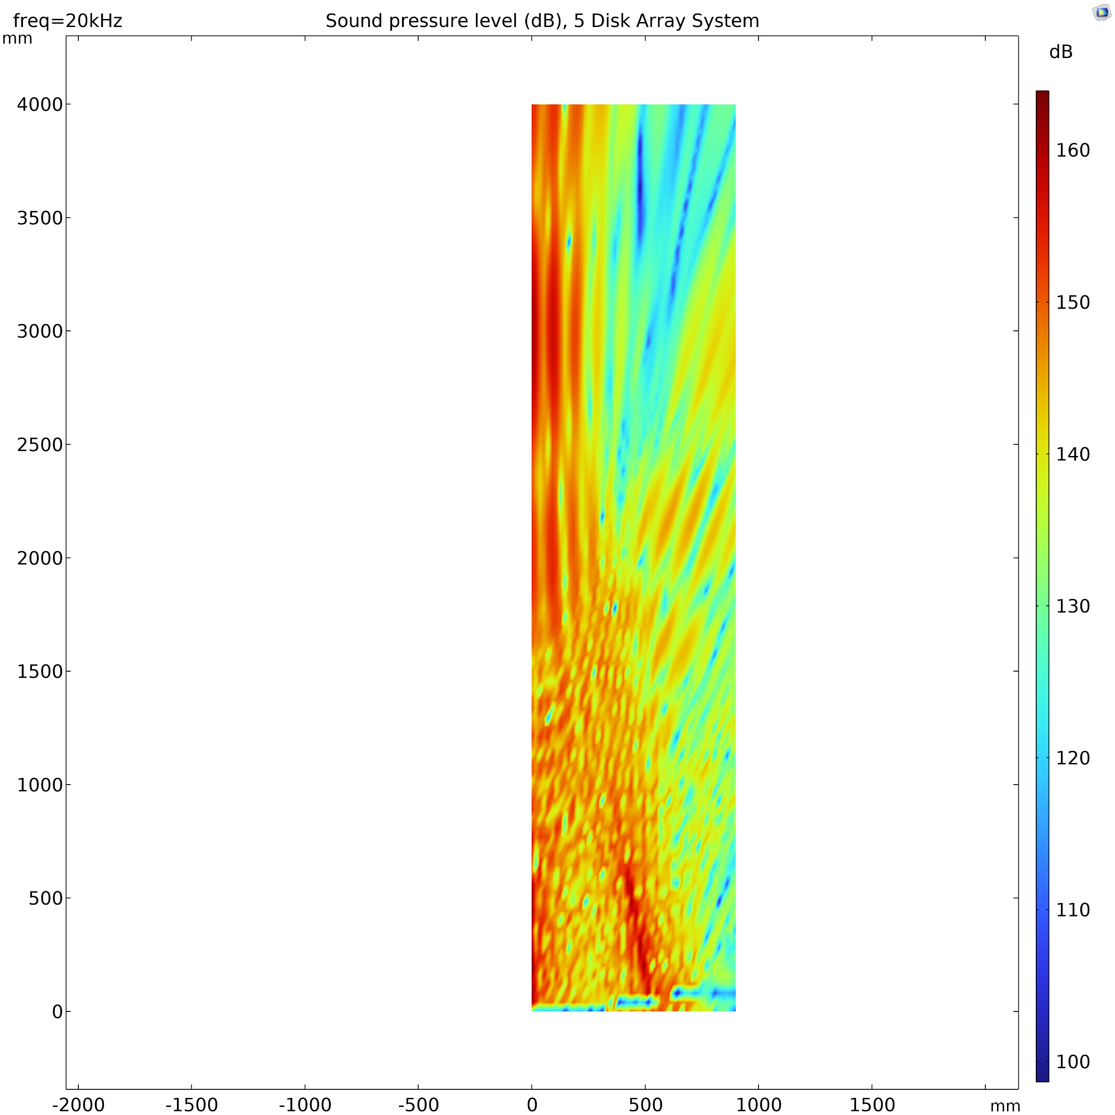
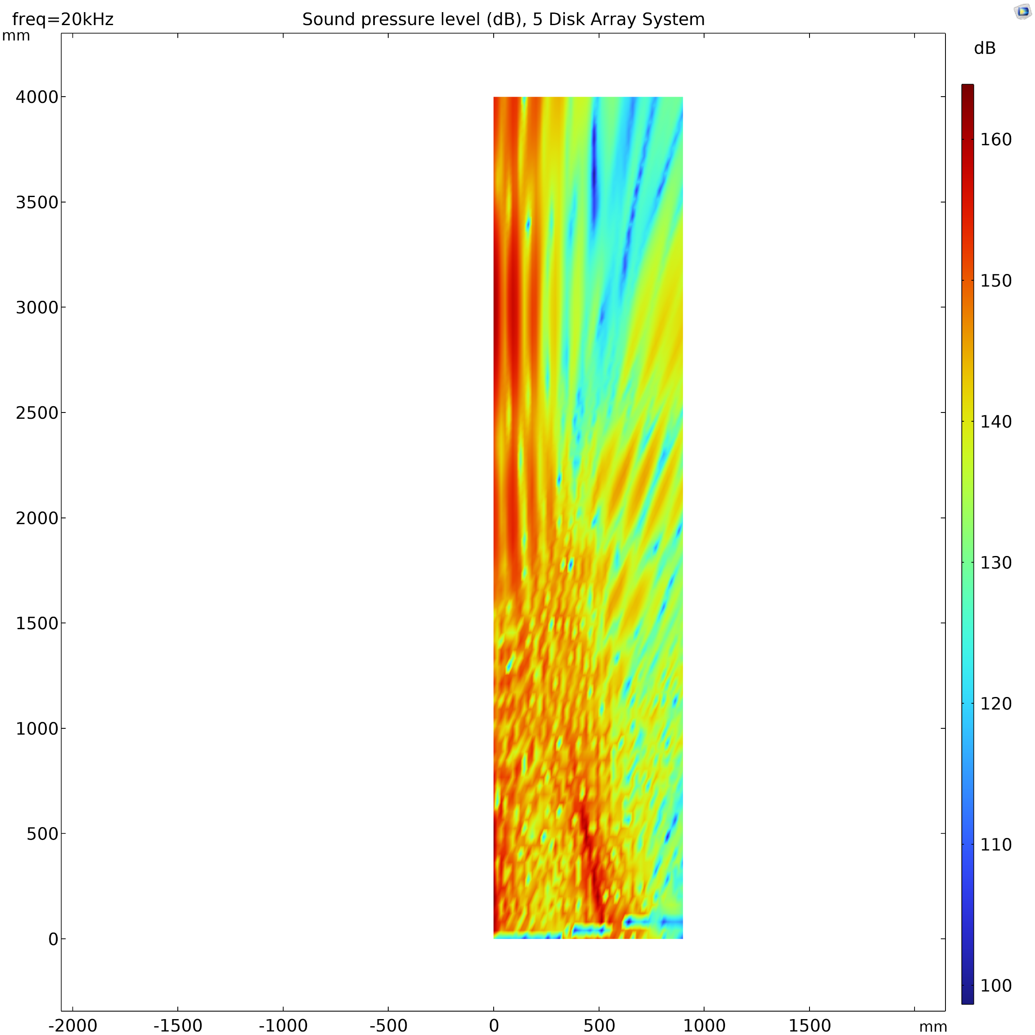
Results – Acoustics , 5 disc spherical array
Results for the array system are the following:
SPL on axis is more than 160 dB at focus
Focus distance value is 3 meters
Beam directivity is good, with a strong and narrow center lobe of radiation (Beamwidth at -6dB from max. is approx. 10° aperture)

Slide 16
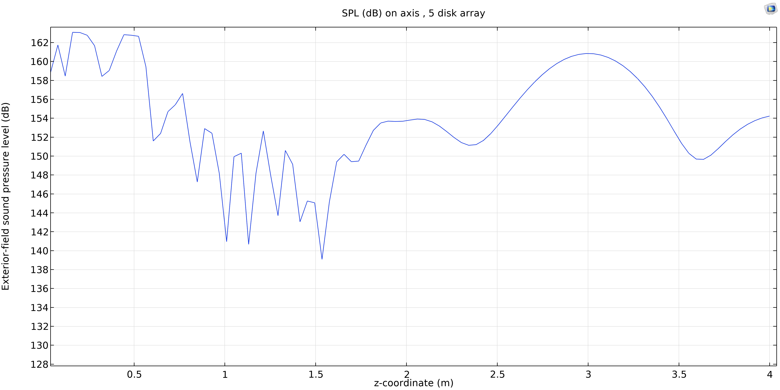
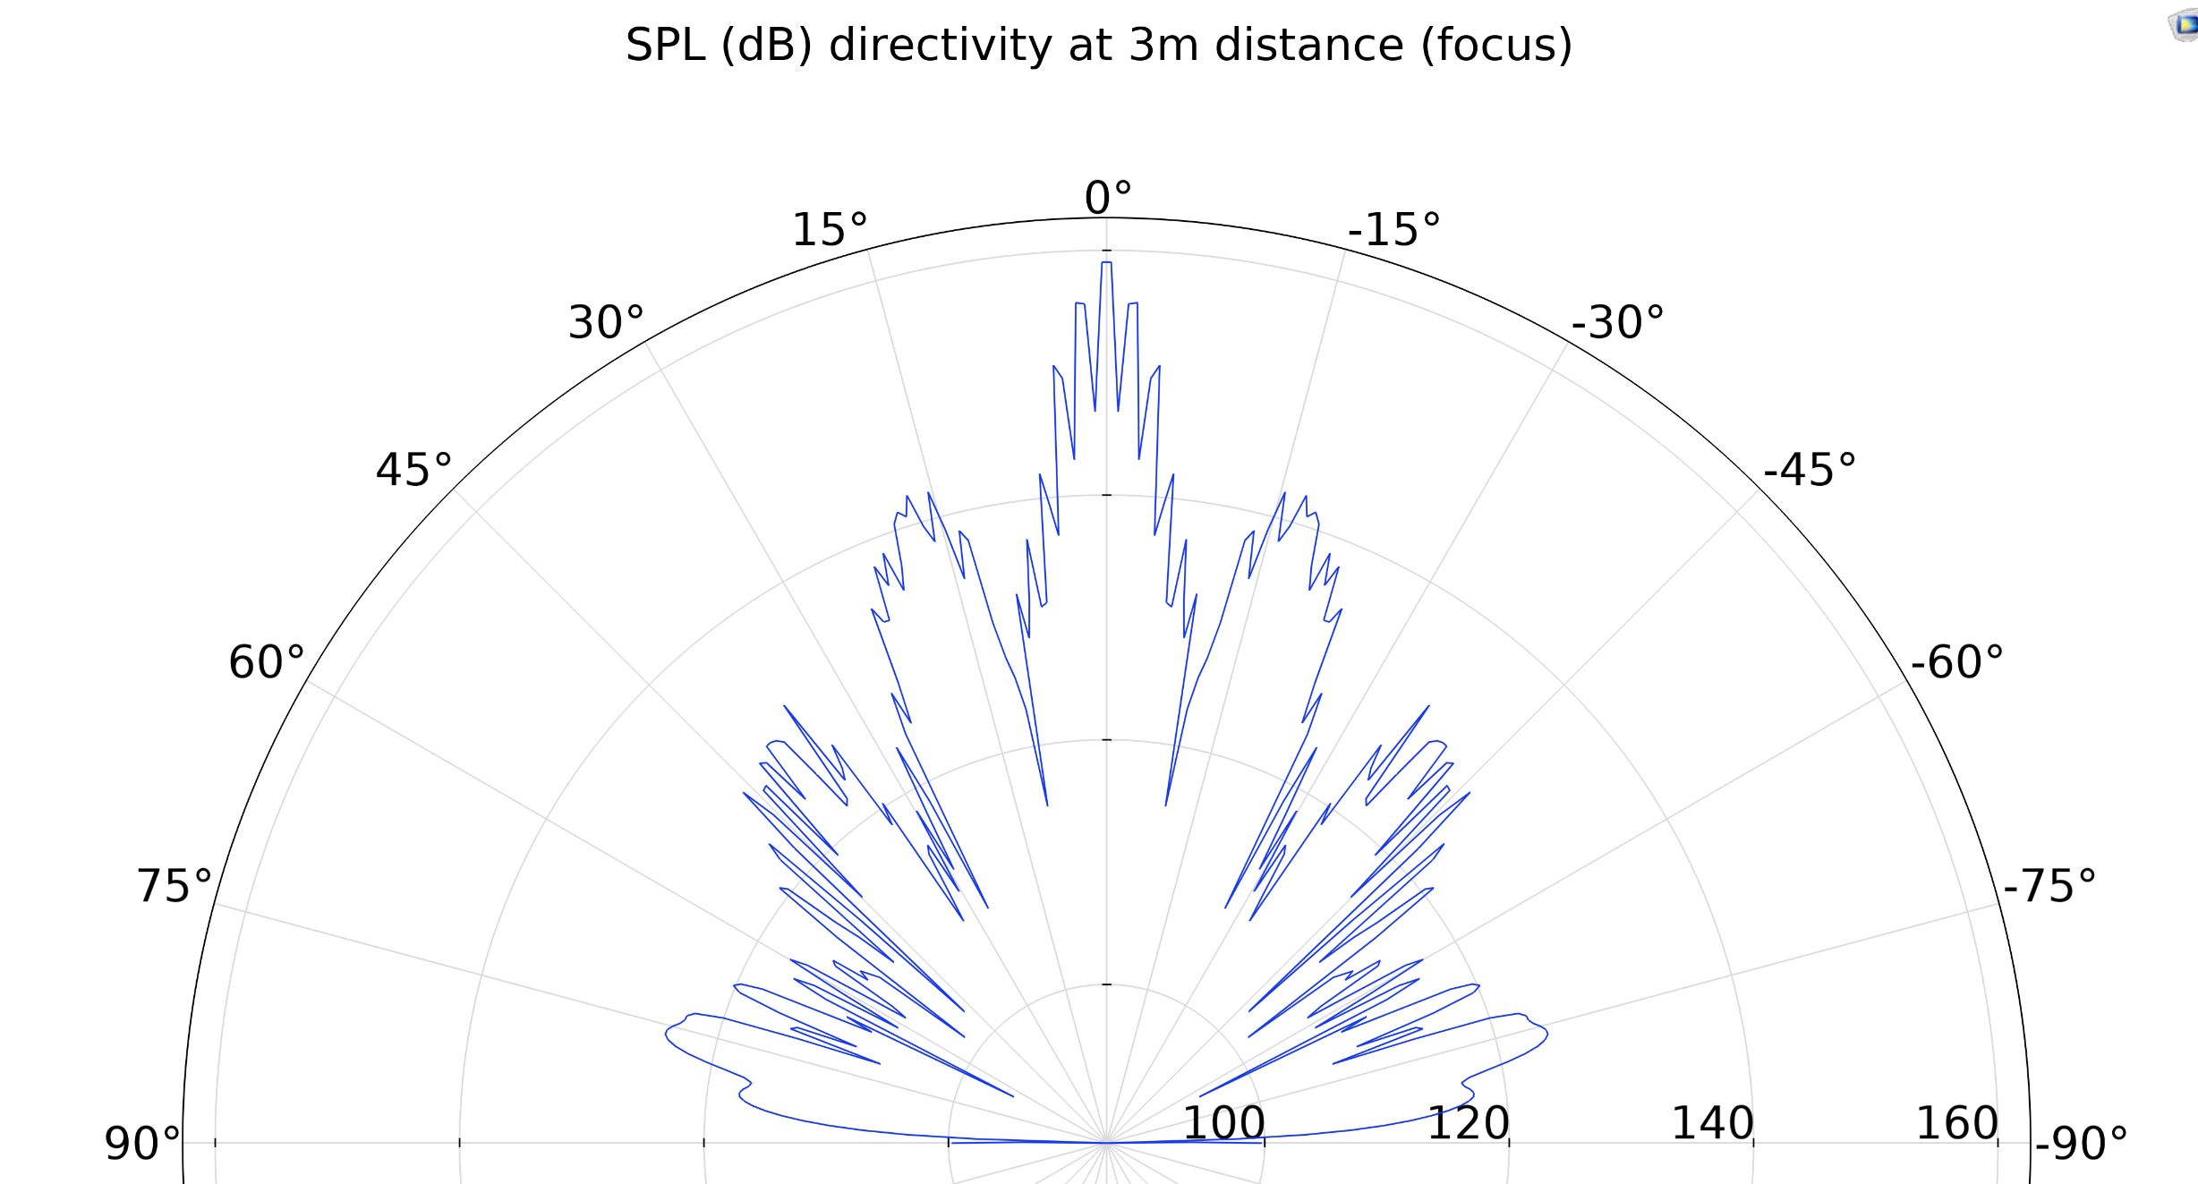
Results – Acoustics , 5 disc spherical array

Slide 17
Conclusions
A high-power 'airborne' ultrasonic system was designed, to fulfil the requirement of high SPL(160dB) and large focus distance(1m). The design and optimization of the system was performed through Acoustical-Structural FEM simulations and deep know-how on high power ultrasonic systems.
The best solution was a spherical array of special radiating units, capable of:
SPL of more than 160 dB on axis
Focus distance as high as 3 meters from the system
Good directivity with a strong and narrow center lobe of radiation
all performances reported here are achievable with acceptable electrical powers, that never exceeded 1kW/unit
REFERENCES
1. Power ultrasonic transducers with vibrating plate radiators, J.A Gallego-Juarez et al.
3. Advanced technique to reduce emissions of fine particulate matter using ultrasounds, B. Bergmans et al.

