Slide 1



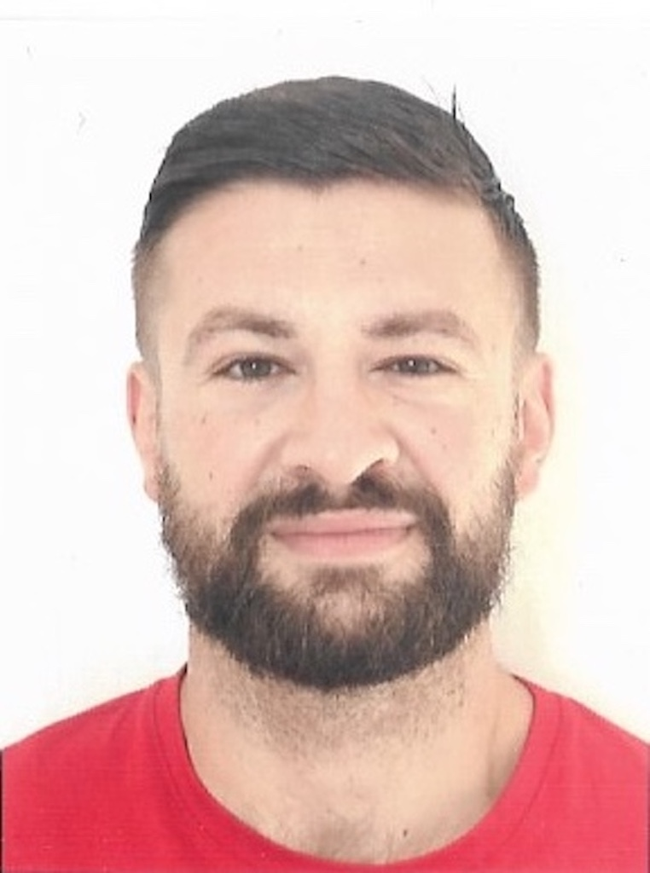


Modeling and simulating the pasta drying process via comsol multiphysics
Gaetano Adduci
gaetano.adduci@dimes.unical.it
Master Degree in Chemical Engineering, DIMES, Università della Calabria, 2019
PhD Student in Information and Communication Technologies, DIMES, Università della Calabria
DATE
COMSOL Conference, Firenze, October 2024

Slide 2









Research Team
Stefano Rossi
Global Pasta & Milling Pasta Process & Technology Development & Digitalization at Barilla Group
Stefano Curcio
Head of DIMES and Research Supervisor
Emily
Cardaropoli
Food Engineer
Sara
Guadagnucci
Chemical Engineer
Eleonora
Manoli
Mathematical Engineer
Gaetano
Adduci
Chemical Engineer
Gerardo
Coppola
Chemical Engineer
Francesco Petrosino
Chemical Engineer
Gaetano Adduci – COMSOL Conference, Firenze, October 2024

Slide 3
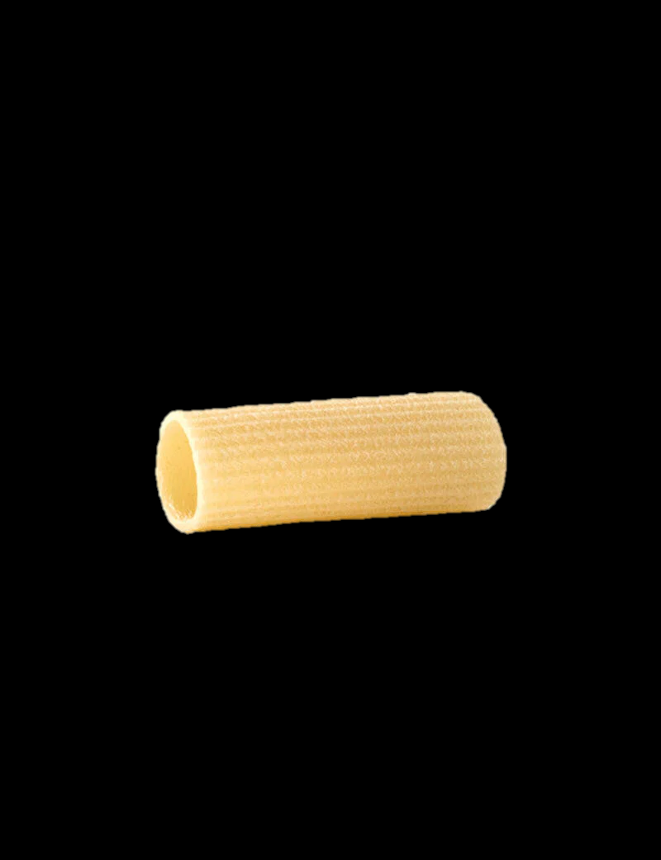



1. Problem Outline
HEAT transfer
AIR FOOD
4. Simulation software
3. Numeric-Engineering approach
2. Problem to be solved
1. Physical-Mathematical model
Heat Transfer Balance
Mass Transfer Balance
Momentum Transfer Balance
System of unsteady, non-linear PDEs
Finite Element Method
COMSOL Multiphysics 6.2
MOISTURE transfer
FOOD AIR
Gaetano Adduci – COMSOL Conference, Firenze, October 2024

Slide 4
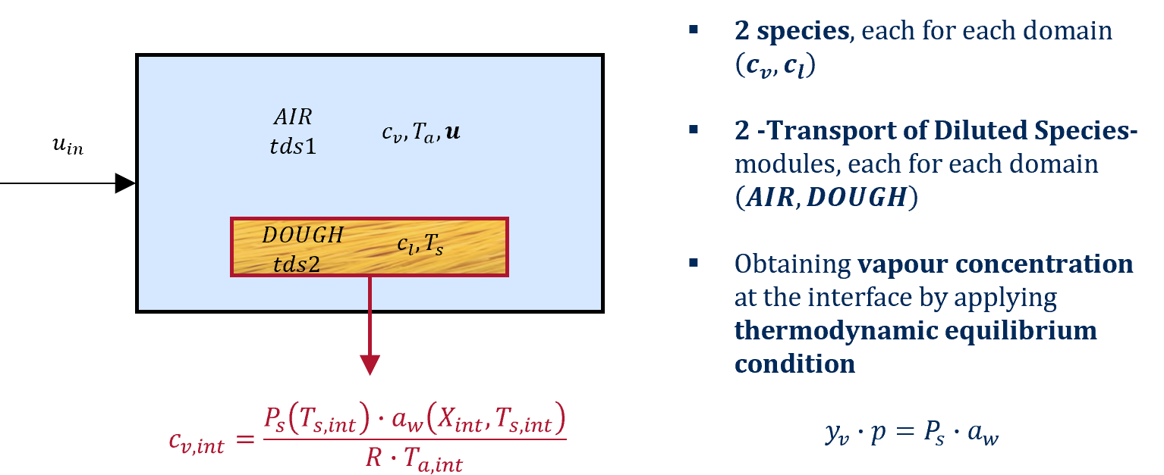
2. Model Structure
‘’Transport phenomena in pasta drying: a dough-air double domain advanced modeling’’,
      G. Adduci, F. Petrosino, E. Manoli, E. Cardaropoli, G. Coppola, S. Curcio, Journal of Food Engineering 2024, https://doi.org/10.1016/j.jfoodeng.2024.112052
Gaetano Adduci – COMSOL Conference, Firenze, October 2024

Slide 5
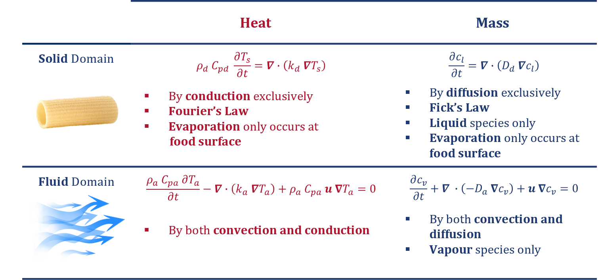
3. Heat / Mass Transfer
‘’Transport phenomena in pasta drying: a dough-air double domain advanced modeling’’,
      G. Adduci, F. Petrosino, E. Manoli, E. Cardaropoli, G. Coppola, S. Curcio, Journal of Food Engineering 2024, https://doi.org/10.1016/j.jfoodeng.2024.112052
Gaetano Adduci – COMSOL Conference, Firenze, October 2024

Slide 6
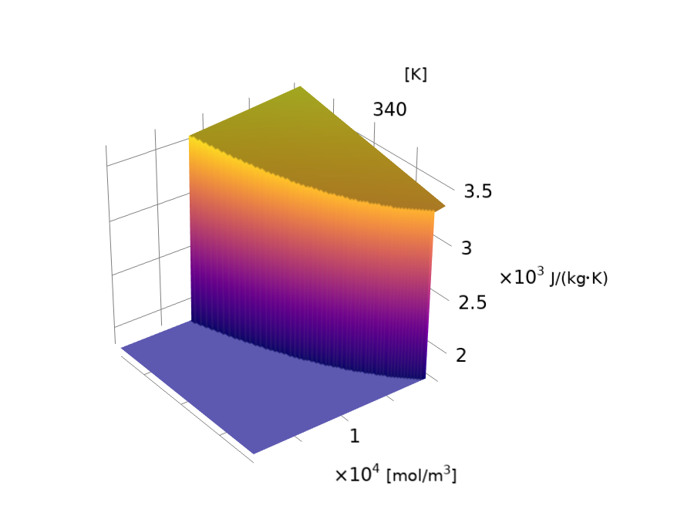
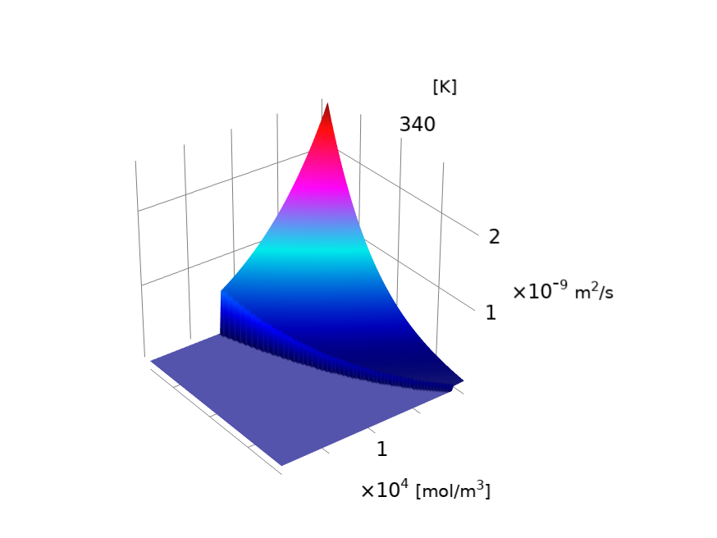
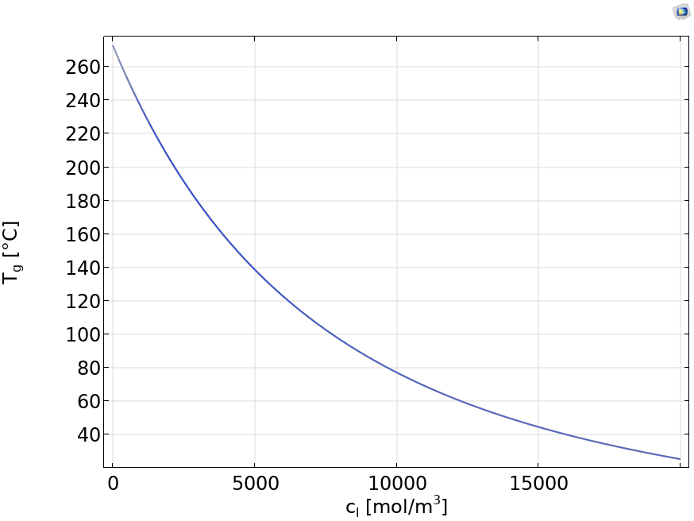



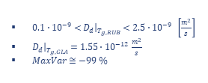

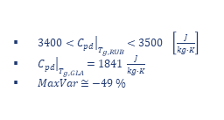
4. Glass Transition Phenomena
$T_{g}$ from Kwei’s Model
Adjusted $C_{pd}=f\left(c_{l}, T\right)$
Adjusted $D_{d}=f\left(c_{l}, T\right)$
$T_{g}=f\left(c_{l}\right)$
Rubbery state above, glassy state below
$T_{g}$ increases as $c_{l}$ decreases
$3400<{\left.C_{pd}\right|}_{T_{g, RUB}}<3500 \left[\frac{J}{kg∙K}\right]$
${\left.C_{pd}\right|}_{T_{g, GLA}}=1841 \frac{J}{kg∙K}$
$MaxVar≅−49 \%$
$0.1∙{10}^{−9}<{\left.D_{d}\right|}_{T_{g, RUB}}<2.5∙{10}^{−9} \left[\frac{m^{2}}{s}\right]$
${\left.D_{d}\right|}_{T_{g, GLA}}=1.55∙{10}^{−12} \frac{m^{2}}{s}$
$MaxVar≅−99 \%$
Gaetano Adduci – COMSOL Conference, Firenze, October 2024

Slide 7


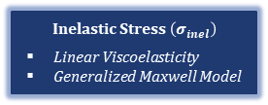
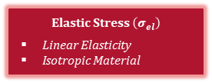
5. Structural Analysis
$$σ=σ_{el}+σ_{inel}$$
Elastic Stress $\left(σ_{el}\right)$
Linear Elasticity
Isotropic Material
Inelastic Stress $\left(σ_{inel}\right)$
Linear Viscoelasticity
Generalized Maxwell Model
$σ_{el}=σ_{el,dev}+σ_{el,vol}=$ $\left\|C\right\|:ε_{el}$
$$σ_{inel}=σ_{0}+σ_{ext}+σ_{ve}=σ_{ve,dev}$$
0
0
Hygroscopic Swelling $\left(ε_{hs}\right)$
$$ε_{hs}=β∙M_{l}∙\left(c_{l}−c_{l,ref}\right)$$
$$\left\{dε\right\}=\left\{dε_{el}\right\}+\left\{dε_{ve}\right\}+\left\{dε_{hs}\right\}$$
Gaetano Adduci – COMSOL Conference, Firenze, October 2024

Slide 8
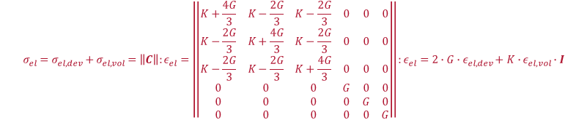

5. Structural Analysis (II)
$$σ=σ_{el}+σ_{inel}$$
$$σ_{el}=σ_{el,dev}+σ_{el,vol}$$
Elastic Stress
Linear Isotropic Elasticity
$$σ_{el}=σ_{el,dev}+σ_{el,vol}=\left\|C\right\|:ε_{el}=\left\|\begin{matrix}K+\frac{4G}{3} & K−\frac{2G}{3} & K−\frac{2G}{3} & 0 & 0 & 0 \\ K−\frac{2G}{3} & K+\frac{4G}{3} & K−\frac{2G}{3} & 0 & 0 & 0 \\ K−\frac{2G}{3} & K−\frac{2G}{3} & K+\frac{4G}{3} & 0 & 0 & 0 \\ 0 & 0 & 0 & G & 0 & 0 \\ 0 & 0 & 0 & 0 & G & 0 \\ 0 & 0 & 0 & 0 & 0 & G\end{matrix}\right\|:ε_{el}=2∙G∙ε_{el,dev}+K∙ε_{el,vol}∙I$$
Gaetano Adduci – COMSOL Conference, Firenze, October 2024

Slide 9
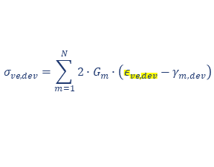
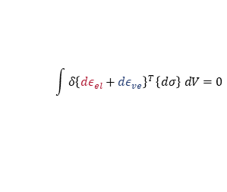
5. Structural Analysis (III)
$$σ=σ_{el}+σ_{inel}$$
$$σ_{inel}=σ_{0}+σ_{ext}+σ_{ve}=σ_{ve,dev}$$
0
0
Inelastic Stress
Linear Viscoelasticity
Generalized Maxwell Model
$$\int{δ{\left\{dε_{el}+dε_{ve}\right\}}^{T}}\left\{dσ\right\} dV=0$$
$$\left\{dε\right\}=\left\{dε_{el}\right\}+\left\{dε_{ve}\right\}+\left\{dε_{hs}\right\}$$
$$σ_{ve,dev}=\sum_{m=1}^{N}{2∙G_{m}∙\left(ε_{ve,dev}−γ_{m,dev}\right)}$$
Hygroscopic Swelling
$$ε_{ve,dev}=γ_{m,dev}+τ_{m} {\dot{γ}}_{m,dev}$$
$$ε_{hs}=β∙M_{w}∙\left(c_{w}−c_{w,ref}\right)$$
Gaetano Adduci – COMSOL Conference, Firenze, October 2024

Slide 10
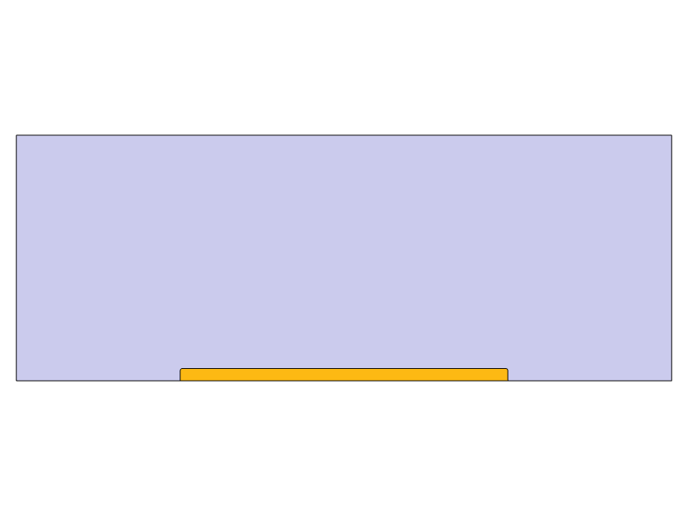


6. System Geometry
3D
2D
$$u_{in}$$
$$\frac{V}{S_{exp}} ⟺ \frac{S}{L_{exp}}$$
Basic geometry equivalent to a ‘’Tortiglione’’ pasta
Better understanding of transport phenomena propagating close to the interface
Facilitated structural analysis
Gaetano Adduci – COMSOL Conference, Firenze, October 2024

Slide 11
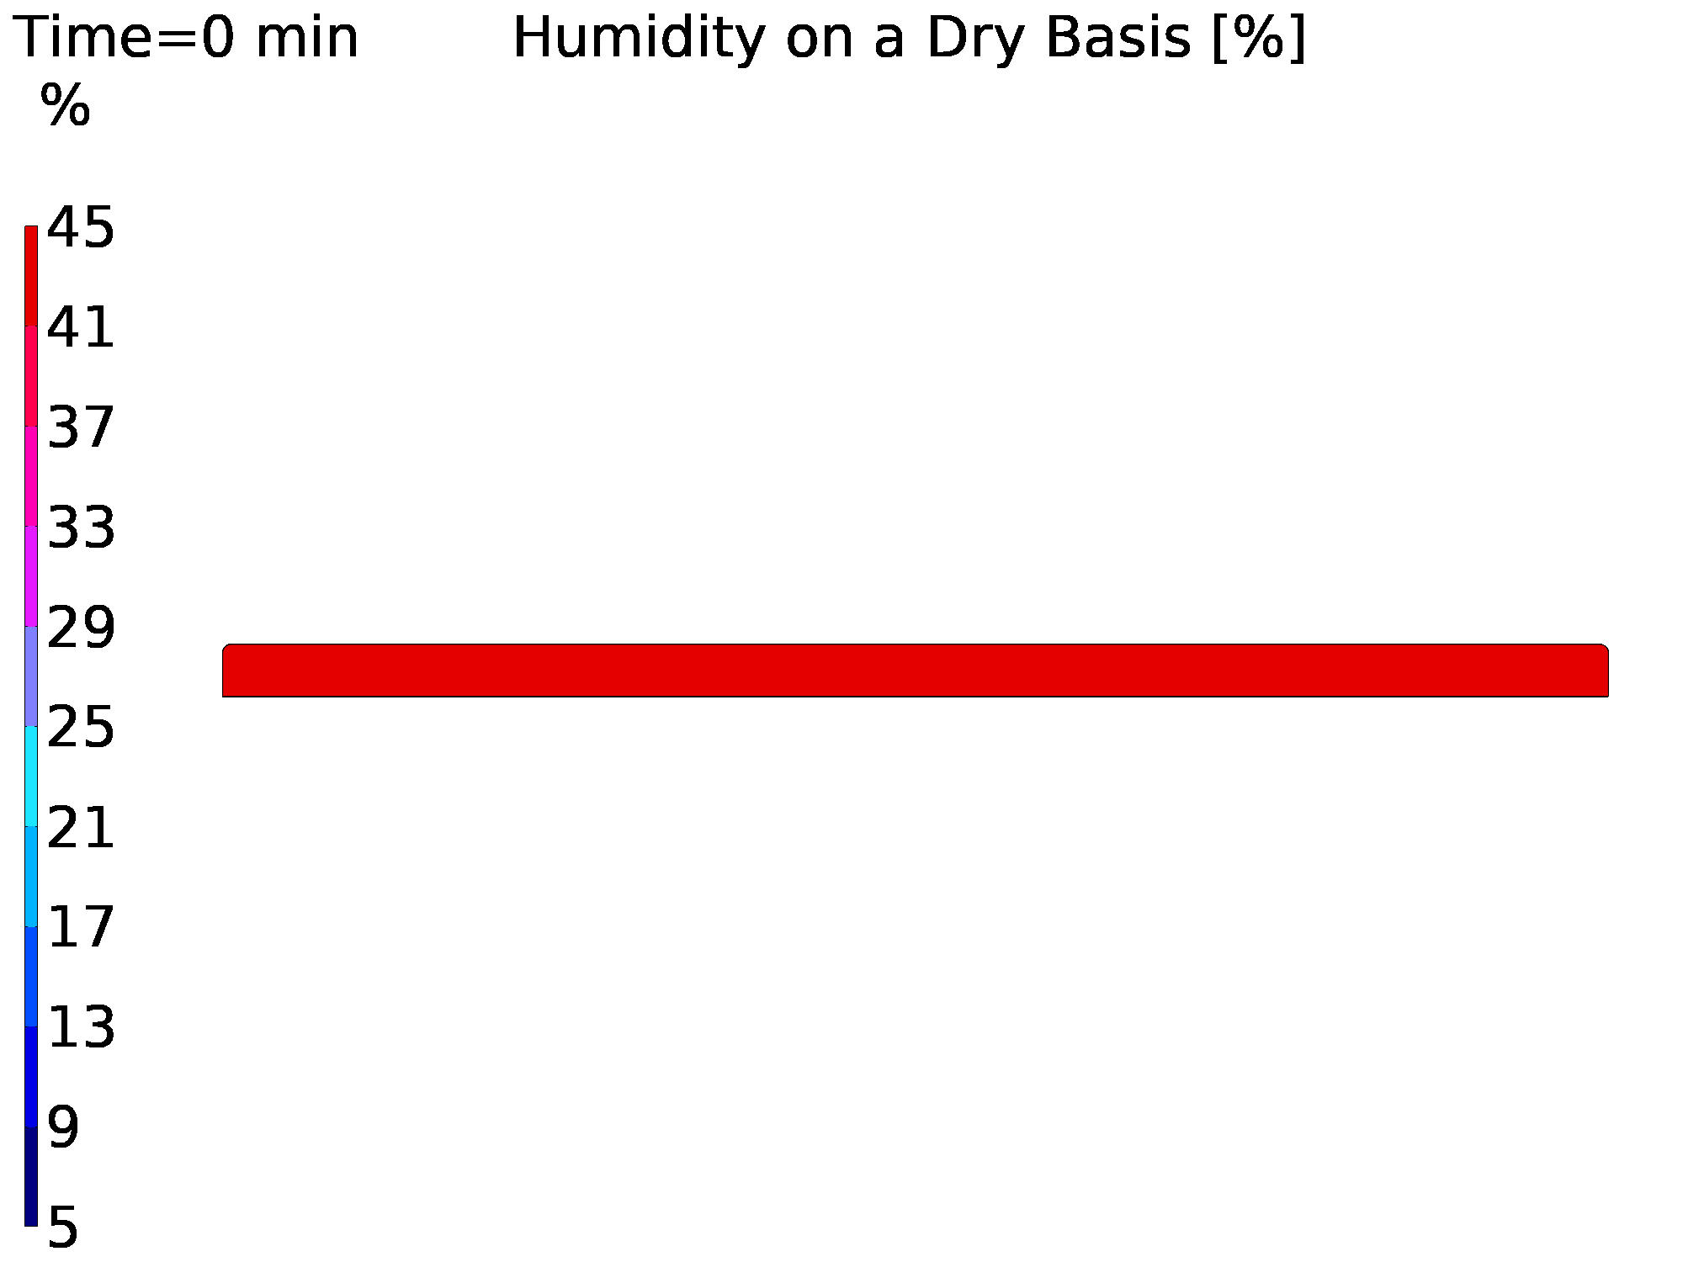
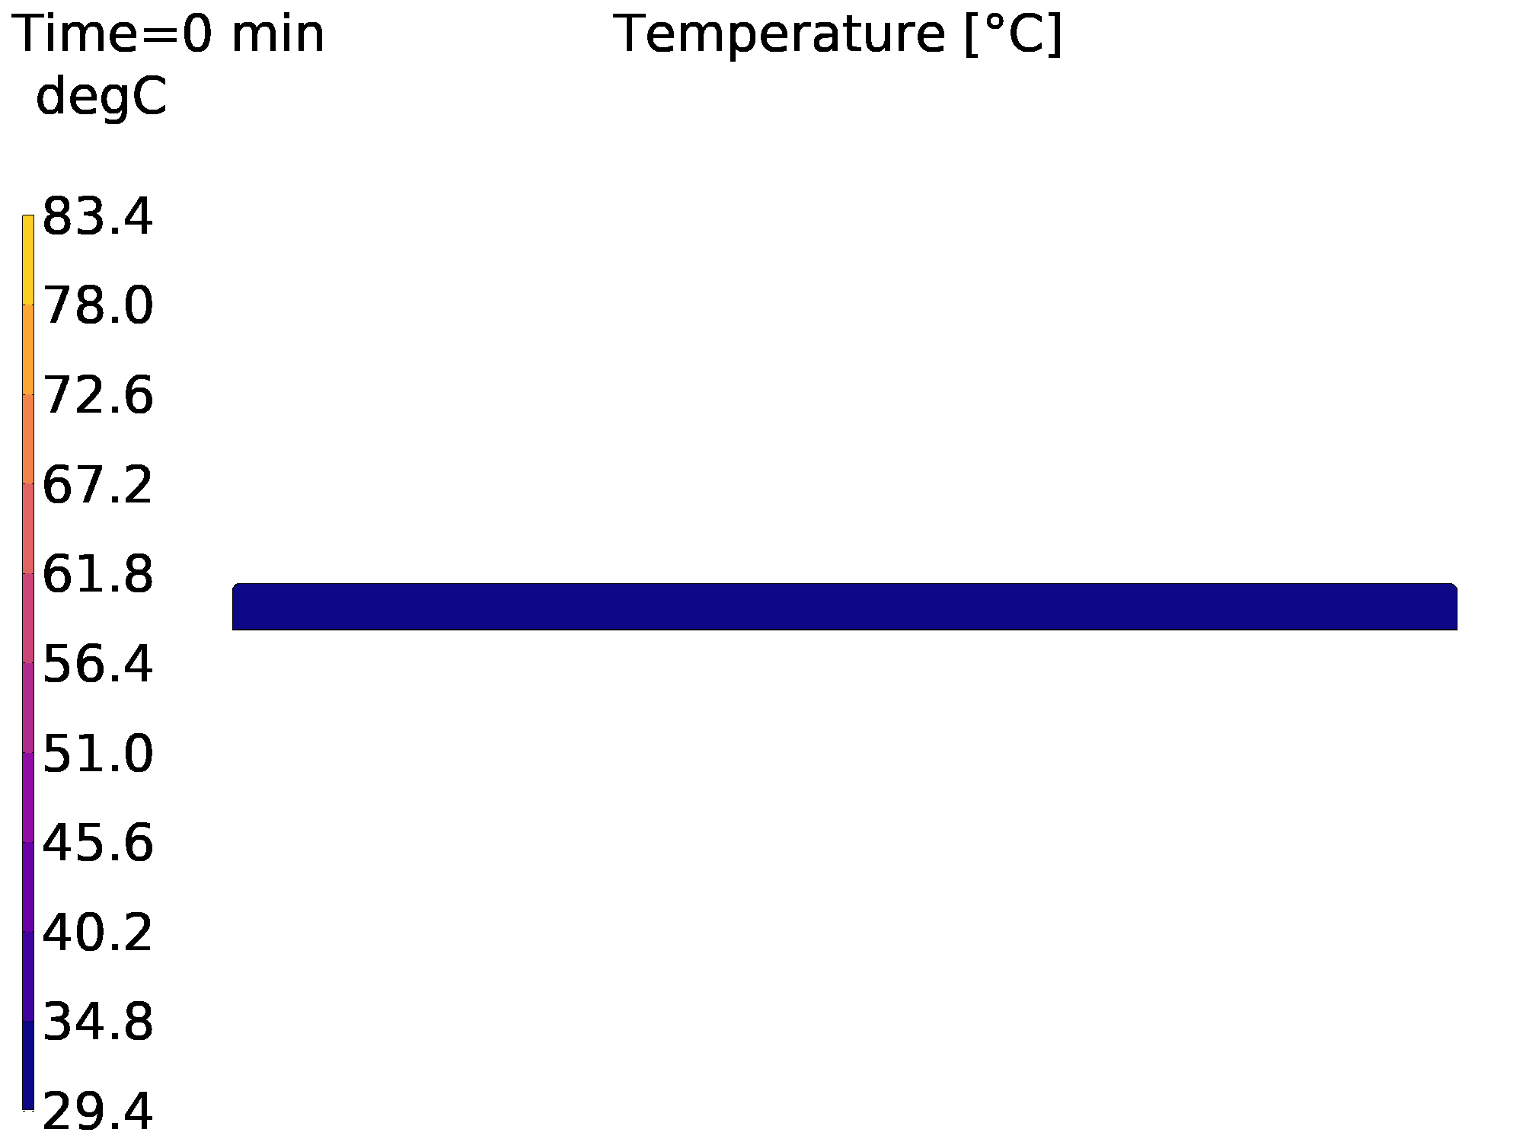
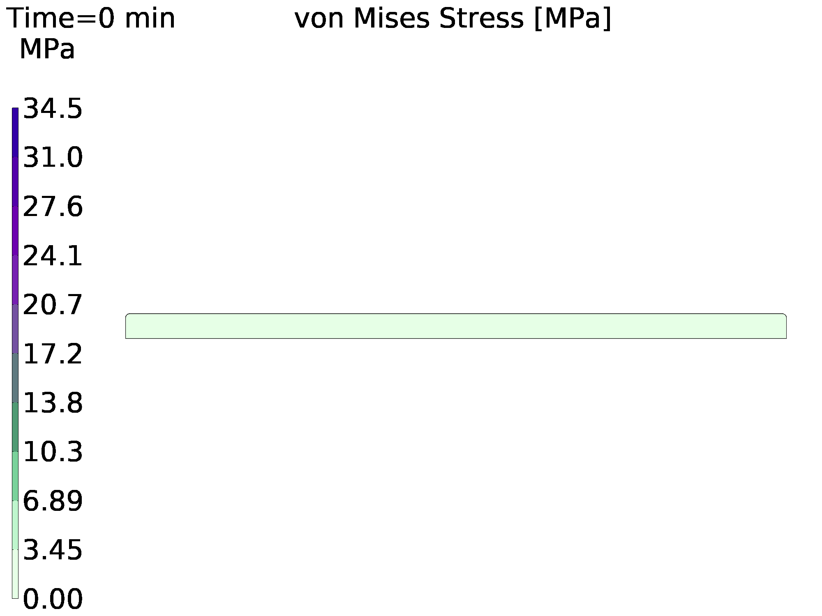
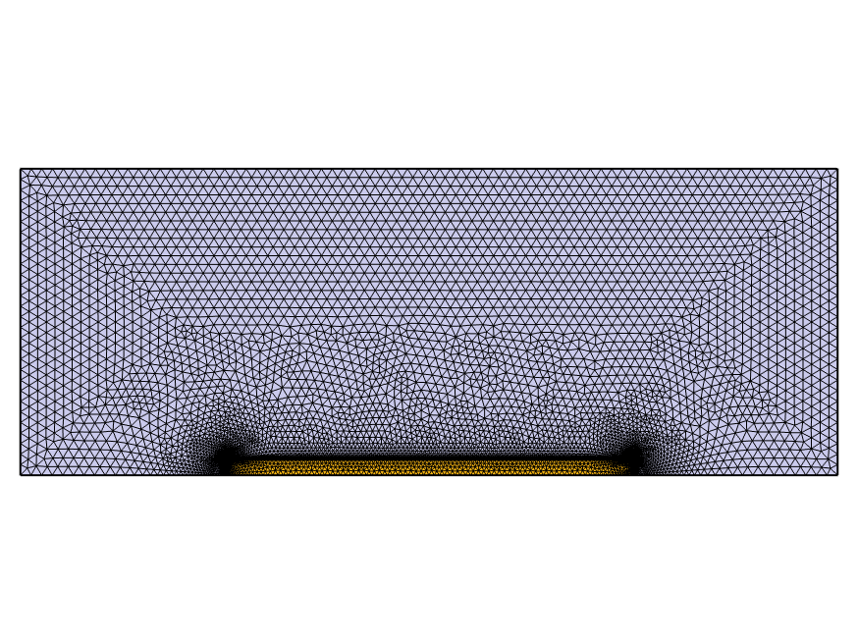

7. Results (I)
Number of Elements 12063
Mesh Vertices 6599
Mesh Area $9600 {mm}^{2}$
Average Element Quality 0.8663
Gaetano Adduci – COMSOL Conference, Firenze, October 2024

Slide 12
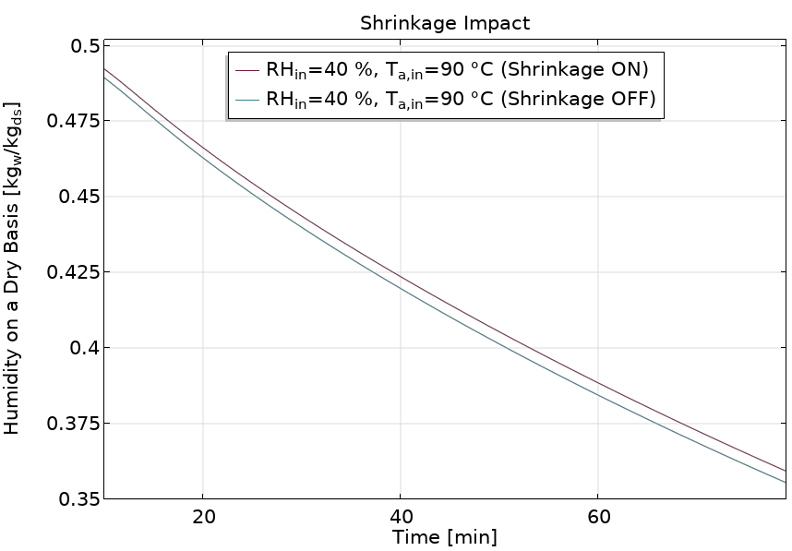
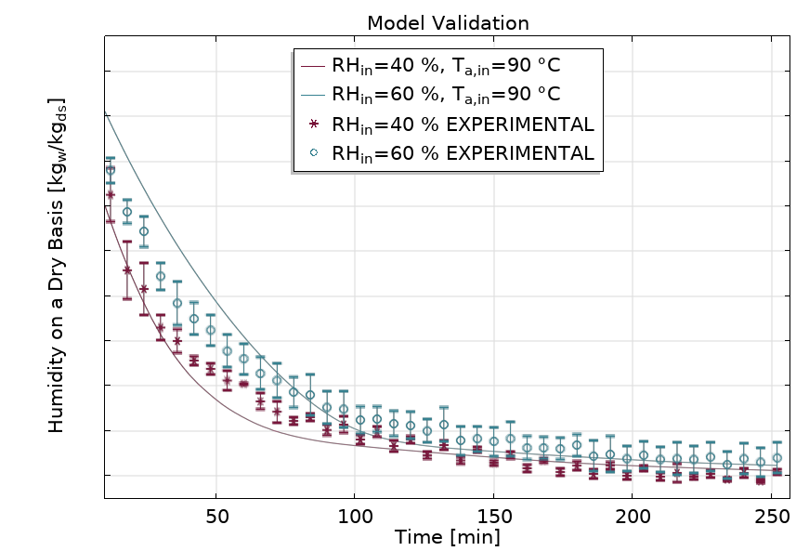
8. Results (II) and Model Validation
Gaetano Adduci – COMSOL Conference, Firenze, October 2024

Slide 13
Conclusions
Transport phenomena within a drying chamber were first modelled and then simulated via COMSOL Multiphysics.
COMSOL implementation of 2 tds interfaces, each for each domain.
The proposed model totally disregards the use of the transport coefficients of mass and heat at the interface between the samples to be dried and the drying air.
Glass transition phenomena were taken into account.
A structural analysis was conducted.
Simulations reflect the physics governing the process by closely mirroring the validated tests.
Gaetano Adduci – COMSOL Conference, Firenze, October 2024

Slide 14



