Slide 1




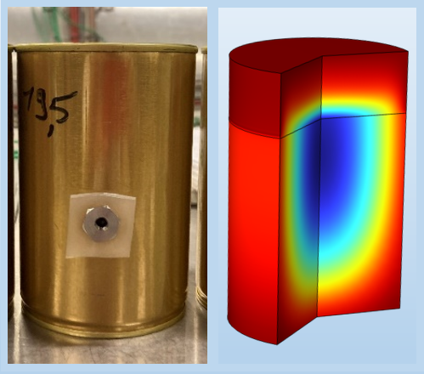
CFD-based Approach For Prediction Of Headspace Pressure In Can During Thermal Sterilization Of Foods
Authors:
Sadhan Jyoti Dutta^{1,2}, Olivier Rouaud¹,
Patrice Dole²,
Alexandre Thillier³, Nicolas Belaubre², Sebastien Curet^{1*}
¹Oniris, Nantes Université, CNRS, GEPEA, UMR 6144, F-44000 Nantes, France
²CTCPA, 64 Rue de la Géraudière, 44322 Nantes Cedex, France
³SAIREM - 82 Rue Elisée Reclus, 69150 Décines-Charpieu, Lyon, France
COMSOL Conference 2024, Florence, 22 – 24 October 2024
01

Slide 2
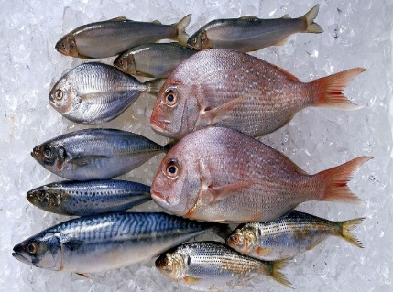
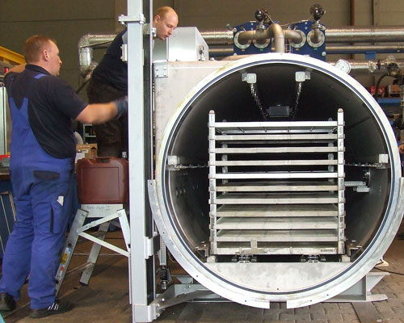
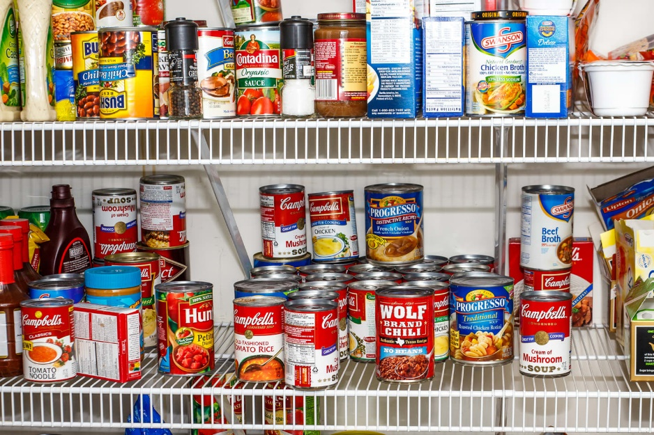
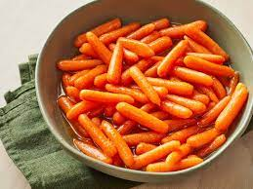
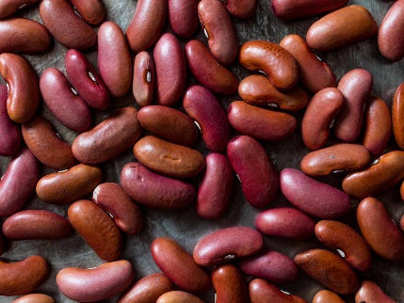
Introduction Experimental Setup Numerical Modelling Results Conclusion and perspectives
Context
What is Thermal Sterilization?
Thermal sterilization using Retort
^{Heat treatment above 100°C}
^{Destroys heat-resistant spores}
Canned Foods with longer shelf life (eg. ^{≥ 2 years)}
^{Raw Food}
02

Slide 3
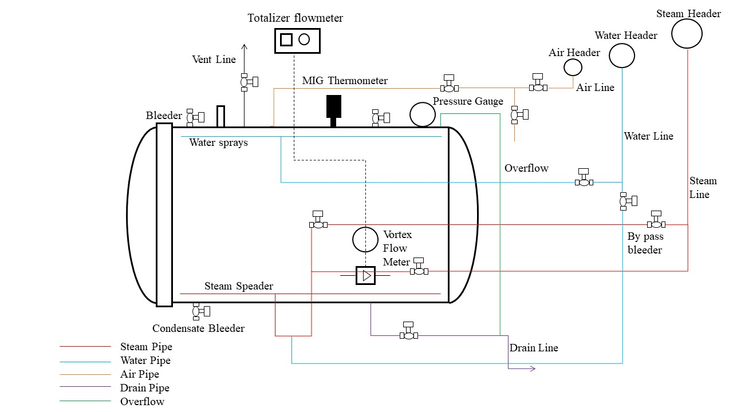
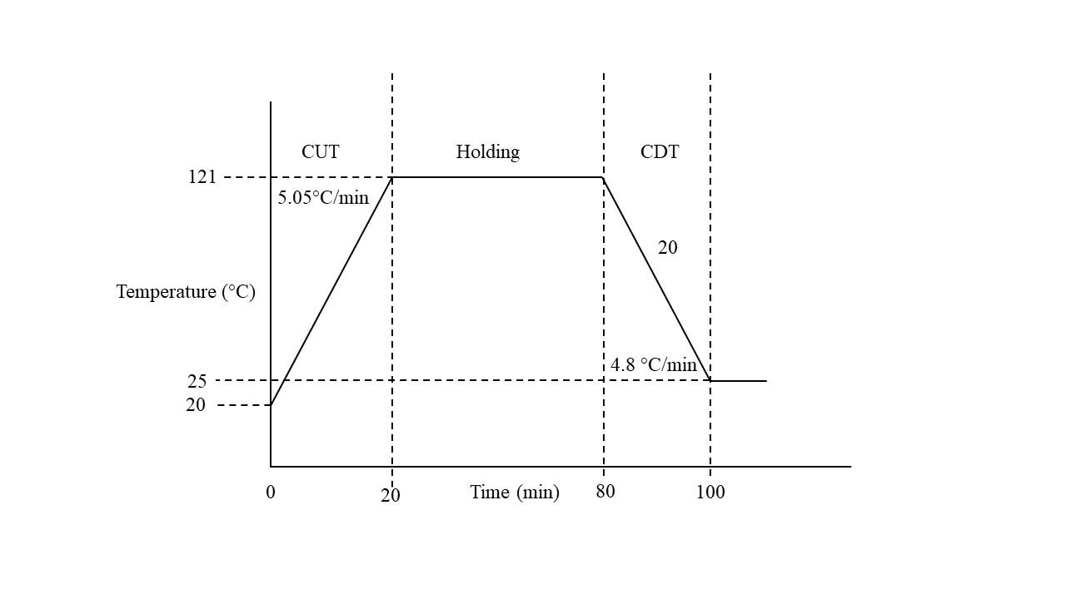

Introduction Experimental Setup Numerical Modelling Results Conclusion and perspectives
Context
Retort Overview
Can with model food
Temperature profile during thermal sterilization
Schematic of a conventional retort for thermal sterilization
03

Slide 4
Introduction Experimental Setup Numerical Modelling Results Conclusion and perspectives
Challenge and Goal
Headspace Pressure
Challenge
Measuring headspace pressure due to water vapour in the food industry is a big challenge.
External counter-pressure is required to tackle inner pressure generated in canned foods which is related to headspace pressure.
Goal
To predict local temperatures and internal headspace pressure in cans during thermal sterilization process, which accounts for water vapor generation and dry air pressure in the headspace.
Heat Flux
Headspace Pressure
Headspace
Air
Heat Flux
Water Evaporation
Heat Flux
Model Food
Heat Flux
04

Slide 5
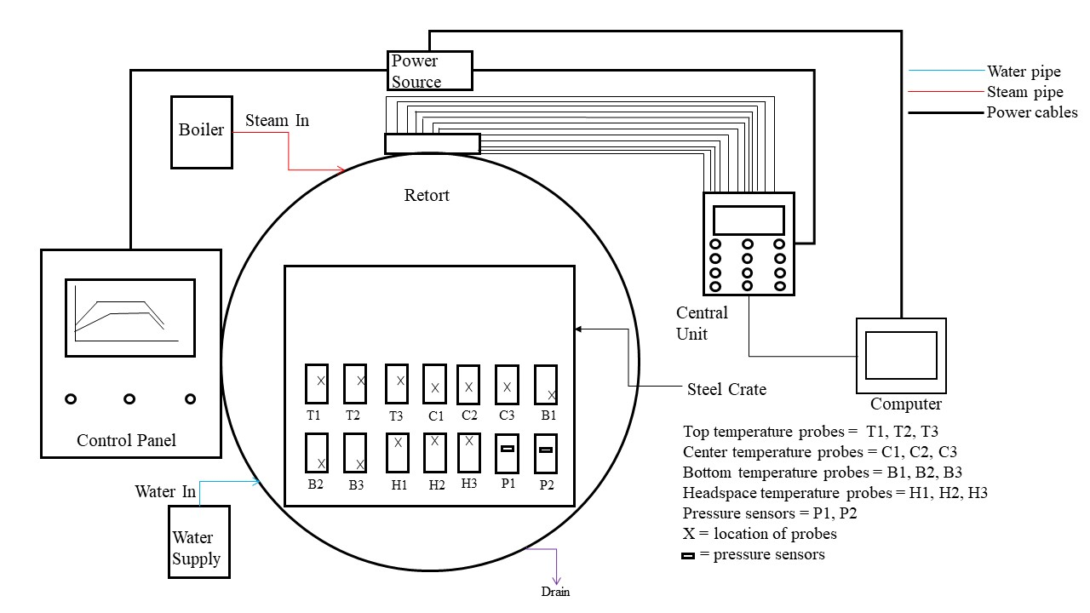
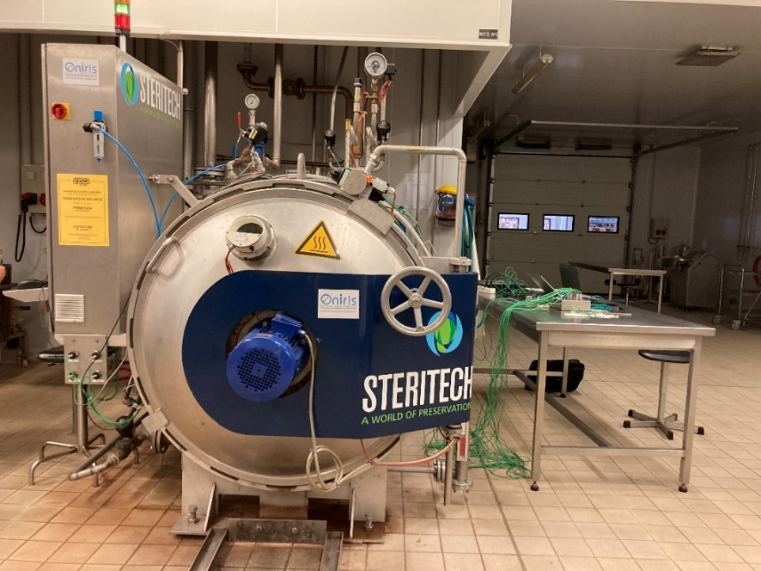
Introduction Experimental Setup Numerical Modelling Results Conclusion and perspectives
Materials and Methods
Experimental Setup
STERITECH Retort in Oniris, Nantes, France
Schematic of experimental setting
05

Slide 6
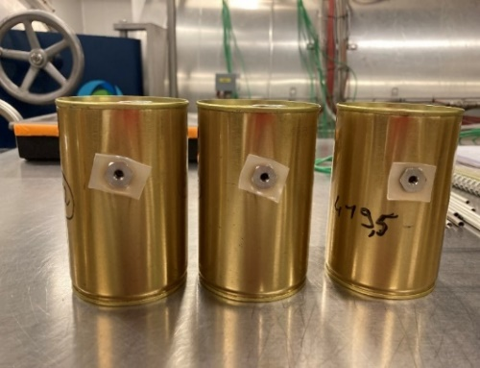
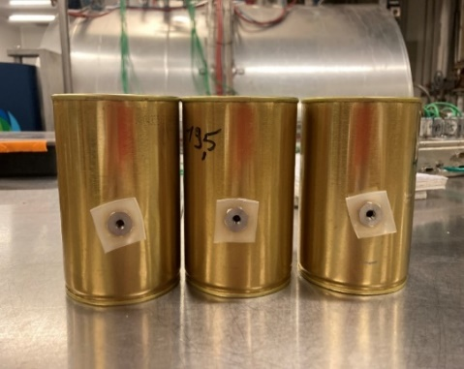
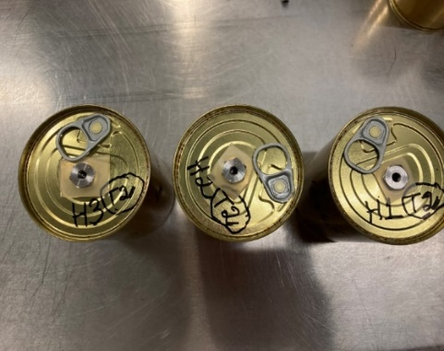
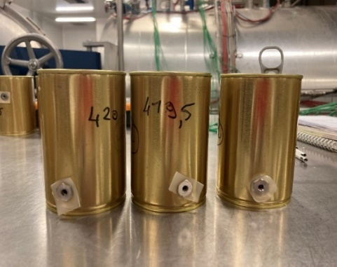
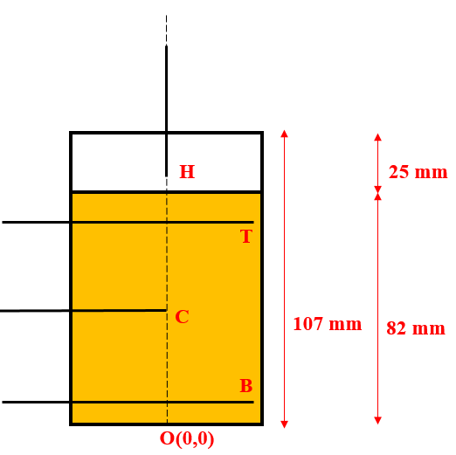
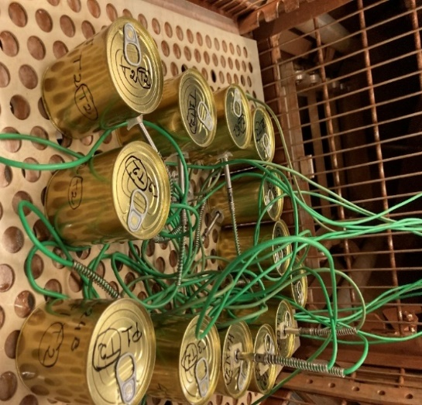
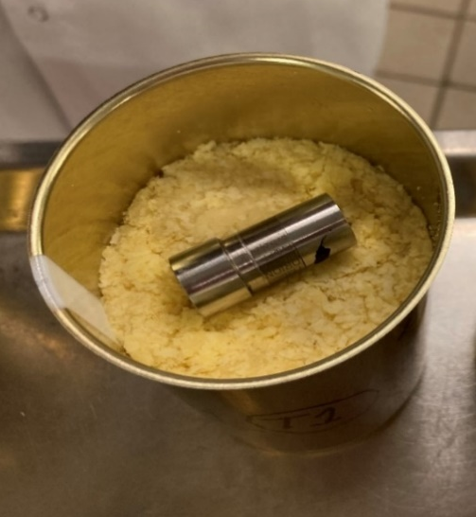
Introduction Experimental Setup Numerical Modelling Results Conclusion and perspectives
Materials and Methods
Experimental Setup
Mass of mashed potato = 279.96 ± 0.42 g
3 cans for top temperature
3 cans for center temperature
3 cans for headspace temperature
3 cans for bottom temperature
Temperature probes
Pressure sensor inside cans
Location of temperature probes in the cans
06

Slide 7
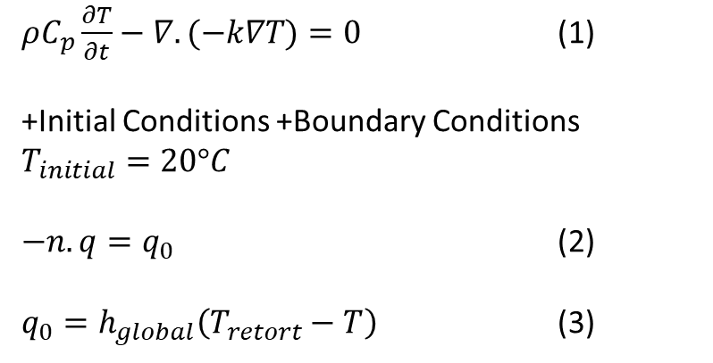
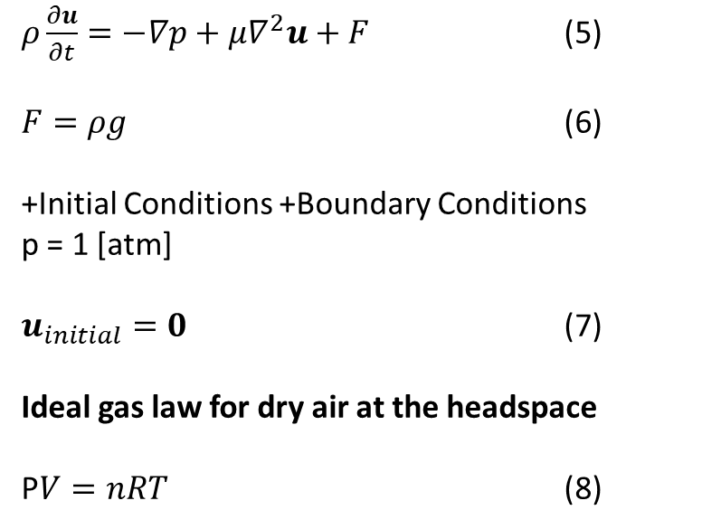
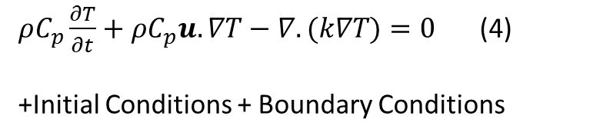
Introduction Experimental Setup Numerical Modelling Results Conclusion and perspectives
Governing Equations
Numerical Modelling: Governing Equations
Heat Transfer in Solids (mashed potato)
Fluid Mechanics : Navier-Stokes equations with the Boussinesq approximation (air at the headspace)
$ρC_{p}\frac{∂T}{∂t}−∇.(−k∇T)=0$ (1)
+Initial Conditions +Boundary Conditions
$T_{initial}=20°C$
$−n.q=q_{0}$ (2)
$q_{0}=h_{global}\left(T_{retort}−T\right)$ (3)
$ρ\frac{∂u}{∂t}=−∇p+μ∇^{2}u+F$ (5)
$F=ρg$ (6)
+Initial Conditions +Boundary Conditions
p = 1 [atm]
$u_{initial}=0$ (7)
Ideal gas law for dry air at the headspace
P$V=nRT$ (8)
Heat Transfer in Fluids (air at the headspace)
$ρC_{p}\frac{∂T}{∂t}+ρC_{p}u.∇T−∇.(k∇T)=0$ (4)
+Initial Conditions + Boundary Conditions
07

Slide 8
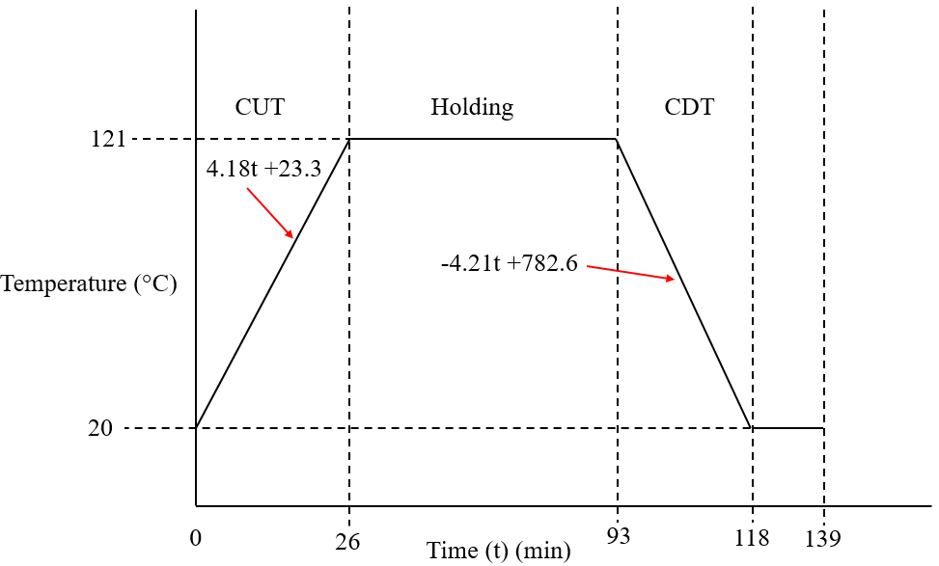
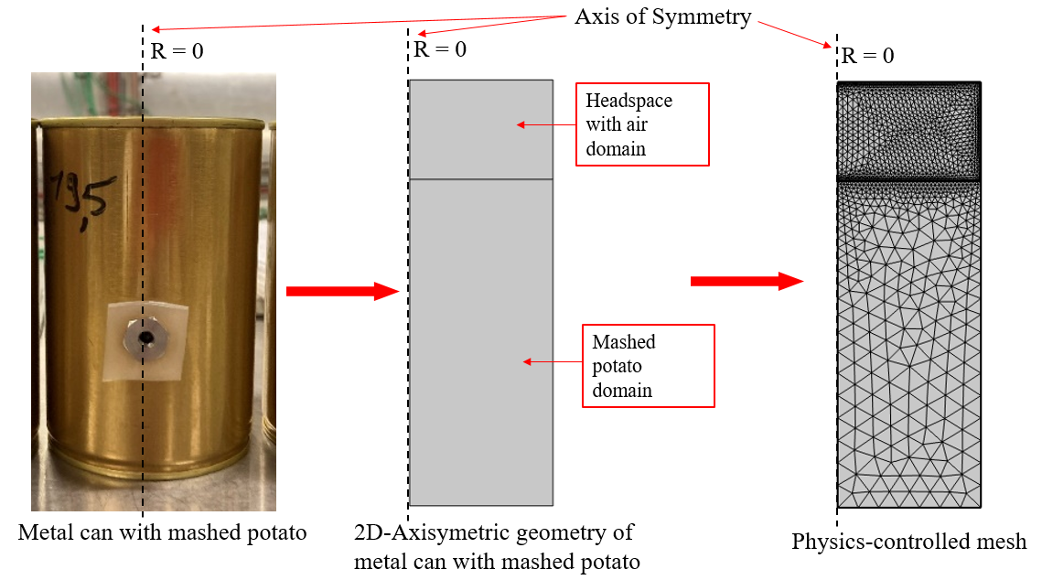
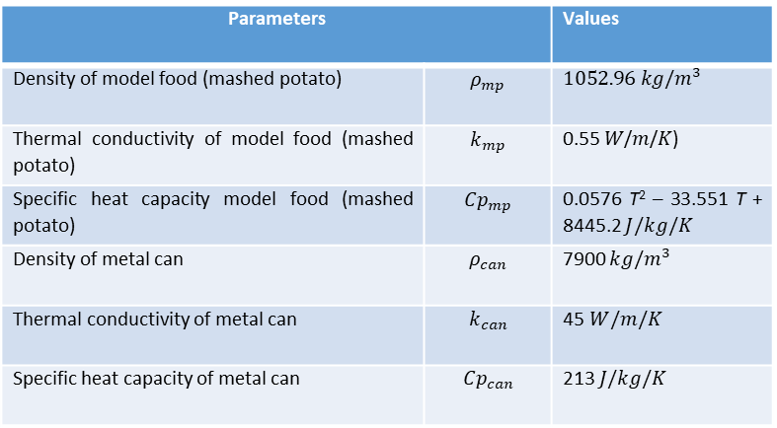
Introduction Experimental Setup Numerical Modelling Results Conclusion and perspectives
COMSOL
COMSOL Modelling: Implementation
Experimental temperature profile for model input
Parameters |  | Values
Density of model food (mashed potato) | $$ρ_{mp}$$ | $1052.96 kg/m^{3}$
Thermal conductivity of model food (mashed potato) | $$k_{mp}$$ | 0.55 𝑊/𝑚/𝐾)
Specific heat capacity model food (mashed potato) | $${Cp}_{mp}$$ | 0.0576 T² – 33.551 T + 8445.2 $J/kg/K$
Density of metal can | $$ρ_{can}$$ | 7900 $kg/m^{3}$
Thermal conductivity of metal can | $$k_{can}$$ | 45$W/m/K$
Specific heat capacity of metal can | $${Cp}_{can}$$ | 213 $J/kg/K$
Model geometry
08

Slide 9
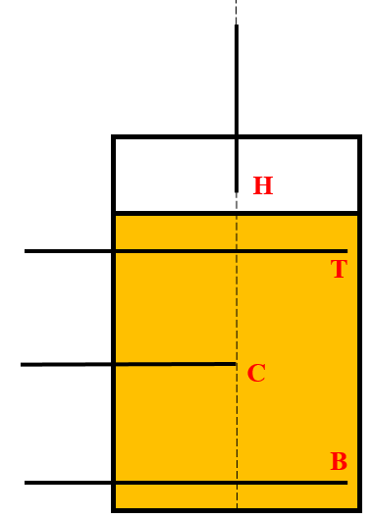
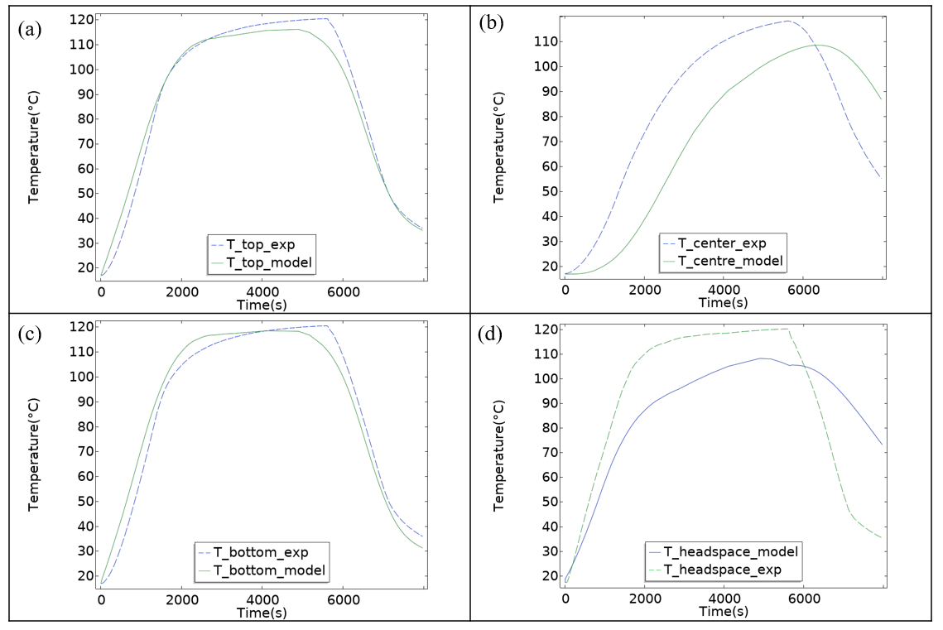
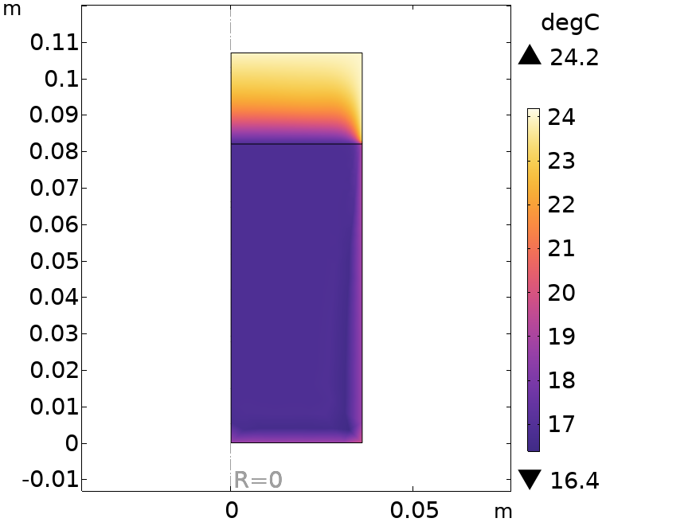
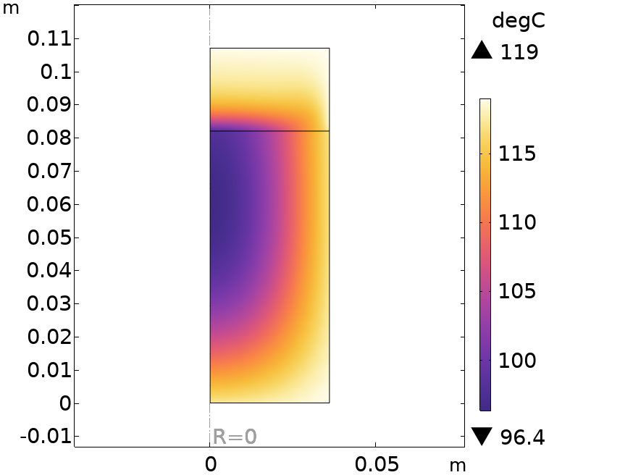
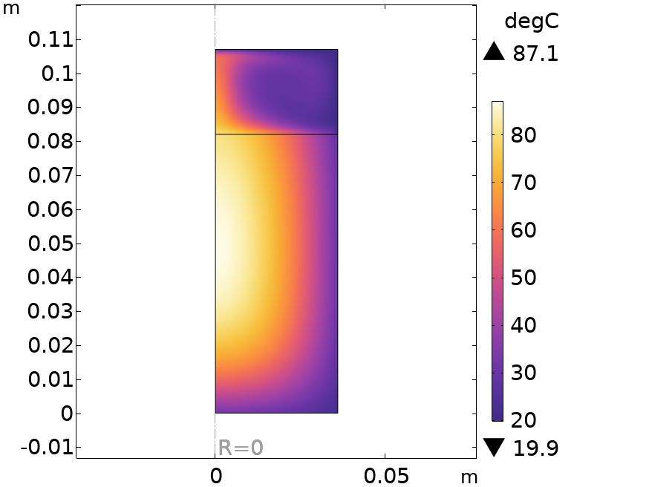
Introduction Experimental Setup Numerical Modelling Results Conclusion and perspectives
Simulation Results
Temperature evolution
Location of temperature measurement
Temperature distribution at 10 s
Experimental and simulated temperature profile at (a) Top location (b) Center location (c) Bottom location (d) Headspace location.
Temperature distribution at 4821 s
Temperature distribution at 7968 s
09

Slide 10
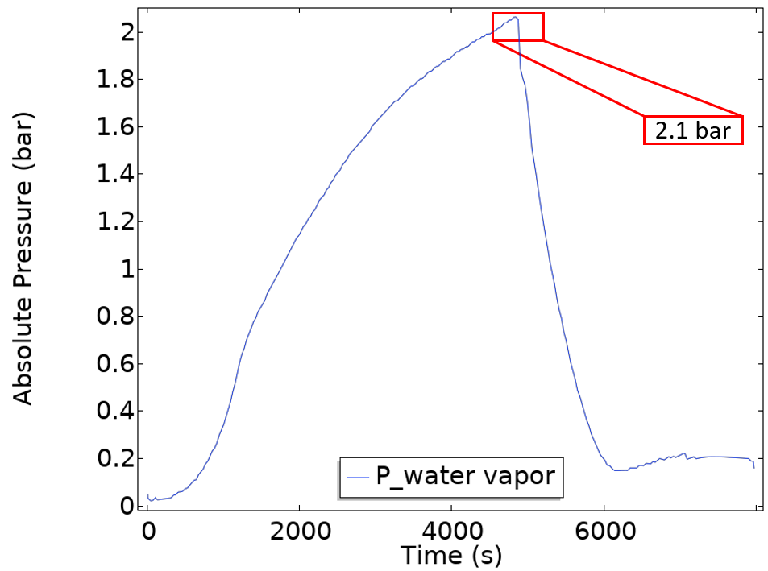
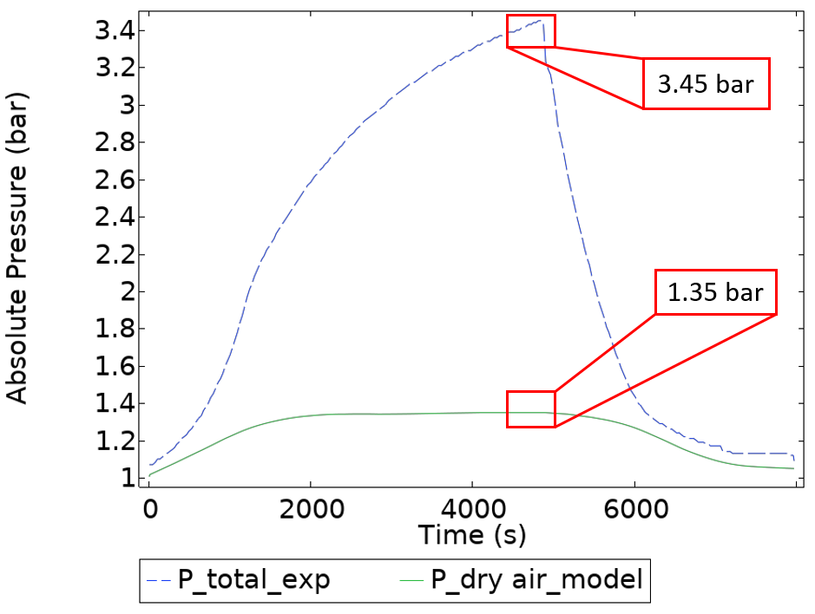
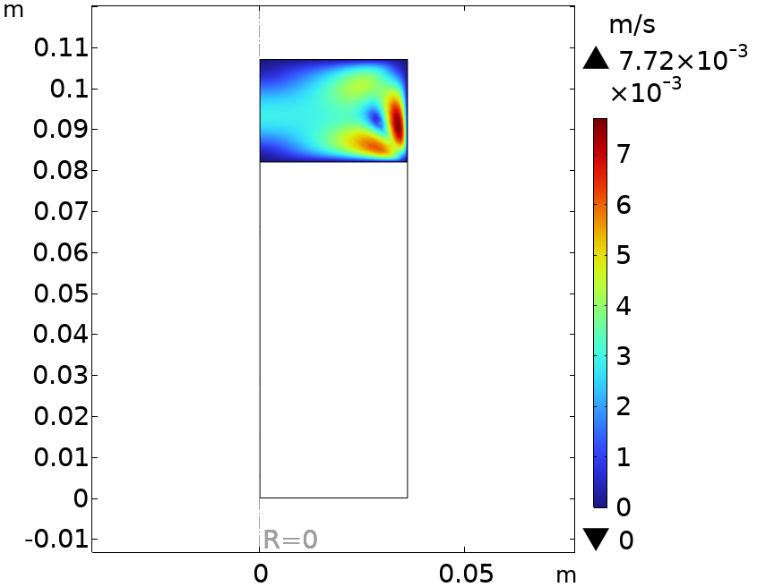
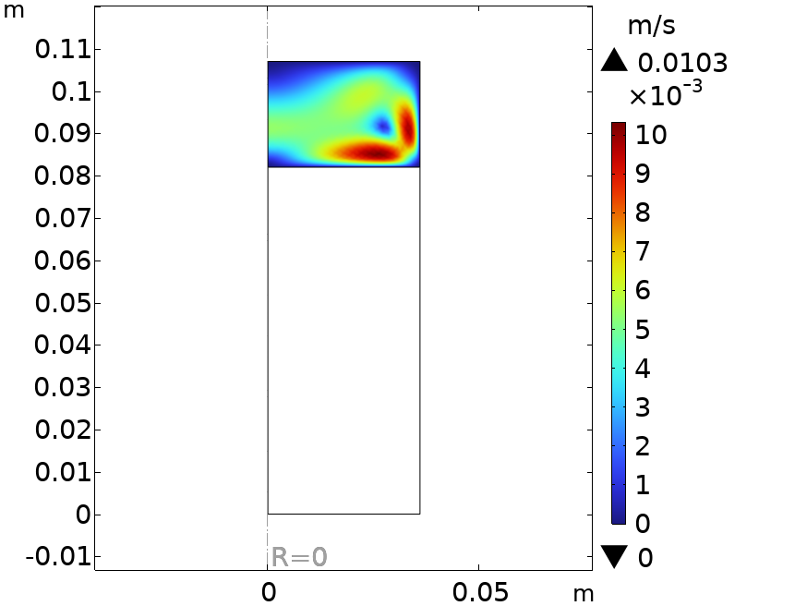
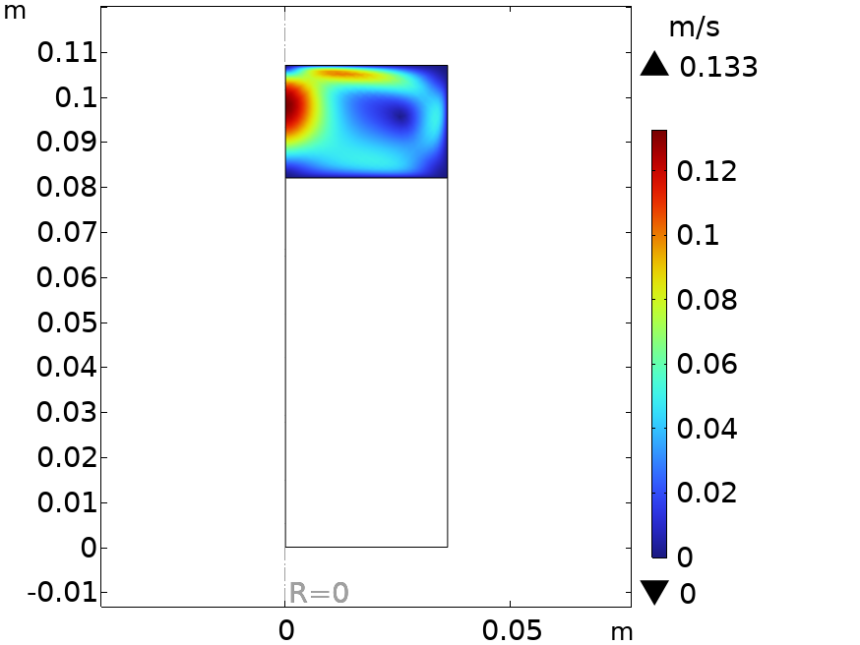
Introduction Experimental Setup Numerical Modelling Results Conclusion and perspectives
Simulation Results
Pressure and Velocity
Experimental pressure profile of total pressure in comparison to simulated pressure profile of dry air.
Estimated water vapor pressure profile.
Air velocity field at 10 s
Air velocity field at 4821 s
Air velocity field at 7968 s
10

Slide 11
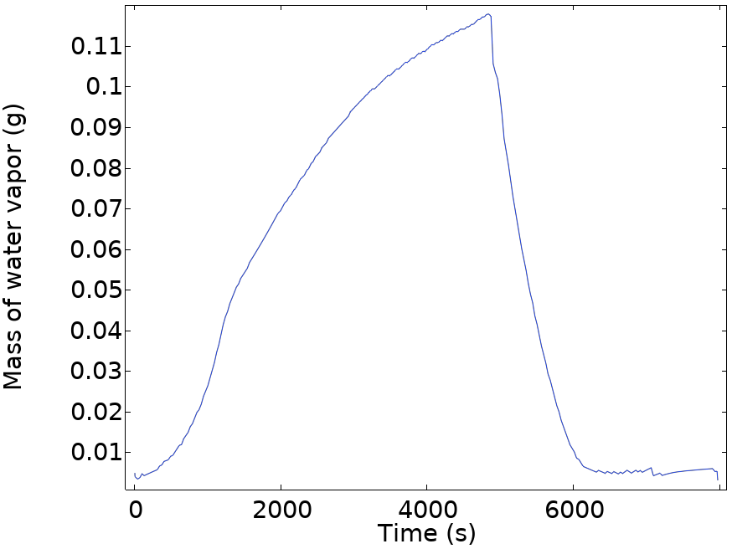
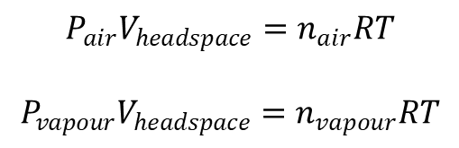

Introduction Experimental Setup Numerical Modelling Results Conclusion and perspectives
Simulation Results
Water Vapour Generation
0.12 g
$$P_{air}V_{headspace}=n_{air}RT$$
$$P_{vapour}V_{headspace}=n_{vapour}RT$$
$P_{total}=P_{air}+P_{vapour}$
Experimental measurement for water vapour generation was of the same order of magnitude: less than 0.5 g
11

Slide 12
Introduction Experimental Setup Numerical Modelling Results Conclusion and perspectives
Conclusions and Perspectives
The numerical model coupled to the experimental investigation enables to:
Predict local temperature profiles at different locations in canned foods.
Predict dry air pressure in the headspace.
Estimate the water vapour pressure contributing towards headspace pressure
Evaluate the mass of water vapour generated during the thermal sterilization process.
Perspectives
Improvement of the numerical model by integrating water vapour evaporation flux in the CFD model.
12

Slide 13
Introduction Key properties Numerical modelling Results and optimization Conclusion and perspectives
Thank You Very Much For Your Attention
Contact: Sadhan-jyoti.dutta@oniris-nantes.fr
Sjyotidutta@ctcpa.org
13

