Slide 1
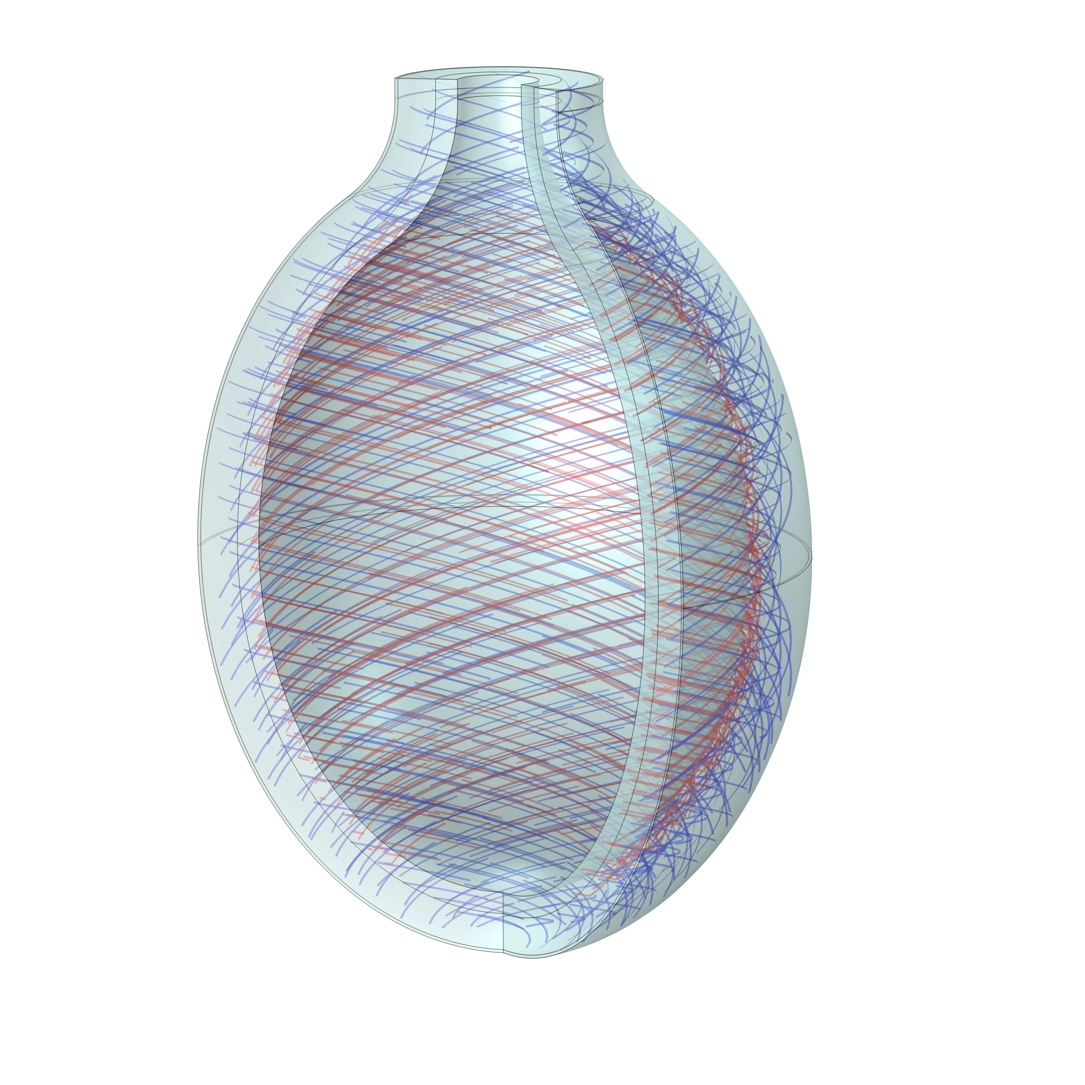
BOOM: towards a digital twin of the bladder
Kieran Boniface¹, Shaghayegh Zamani Ashtiani³, Naoki Yoshimira², Anne Robertson³, Paul Watton^{1,3}
Department of Computer Science, University of Sheffield, UK
Department of Urology, University of Pittsburgh, US
Department of Mech. Engineering and Materials Science, University of Pittsburgh, US

Slide 2
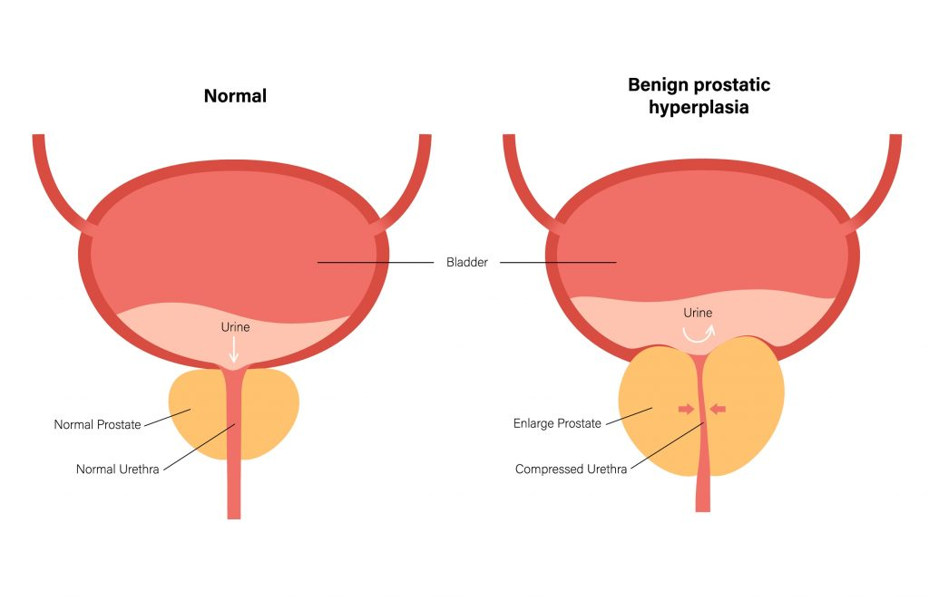
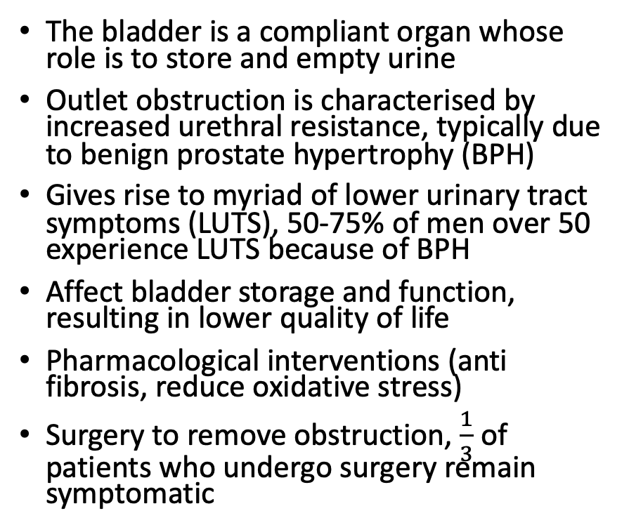
Bladder Outlet Obstruction (BOO)
The bladder is a compliant organ whose role is to store and empty urine
Outlet obstruction is characterised by increased urethral resistance, typically due to benign prostate hypertrophy (BPH)
Gives rise to myriad of lower urinary tract symptoms (LUTS), 50-75% of men over 50 experience LUTS because of BPH
Affect bladder storage and function, resulting in lower quality of life
Pharmacological interventions (anti fibrosis, reduce oxidative stress)
Surgery to remove obstruction, $\frac{1}{3}$ of patients who undergo surgery remain symptomatic
https://aareurology.sg/conditions/bladder-outlet-obstruction/

Slide 3
Bladder outlet obstruction mechanobiology (BOOM)
Bladder must generate greater pressures to void to overcome increased resistance
Mechanobiological response to this increased resistance
Changes in bladder structure, impacting functionality
3 key stages of BOO progression

Slide 4
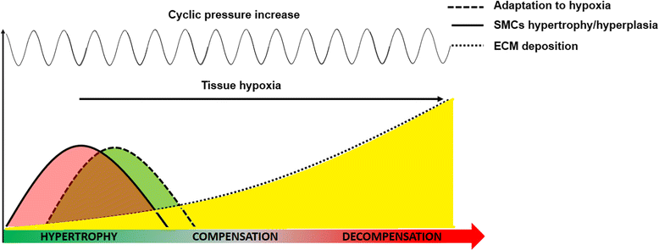
BOO Progression
Hypertrophy: SMC growth to overcome increased urethral resistance
Compensation: growth stabilises and increased ECM deposition
Decompensation: increased collagen deposition, SMC apoptosis and loss of functionality
Objectives
Develop a digital twin of the bladder to understand mechanistic relationship between bladder remodelling and function
Understand, predict and design surgical treatments and pharmacotherapies
Predict response to surgery
Rate based constrained mixture models to simulate changes in wall structure
First steps: develop a framework for tissue growth and remodelling in COMSOL
Fusco et al. Progressive bladder remodeling due to bladder outlet obstruction: a systematic review of morphological and molecular evidences in humans. BMC Urol 18, 15 (2018).

Slide 5

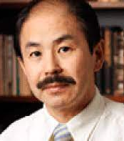
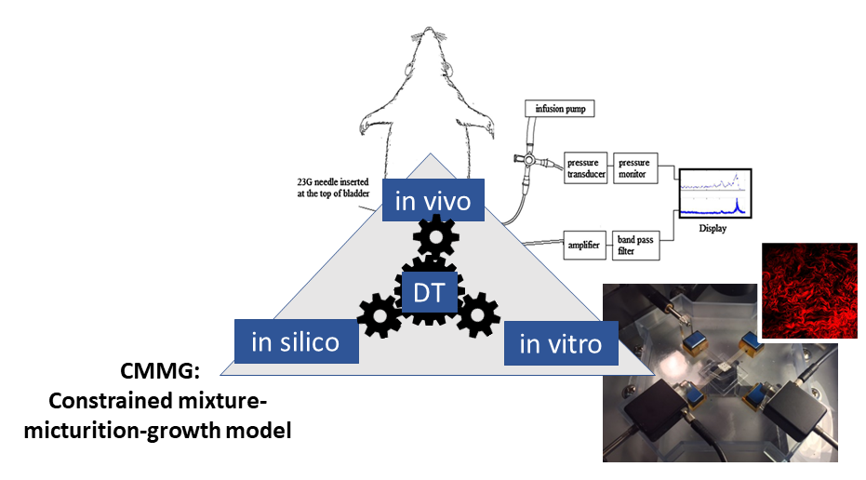




Integrative modelling approach
Naoki Yoshimura
Paul Watton
Anne Robertson

Slide 6
Constrained mixture models
Biological tissues are made of several distinct constituents/cells
Each constituent/cell:
  Have distinct unloaded configurations
  These configurations can evolve
Tissues evolve to maintain homeostasis, i.e. a stable internal environment
How do tissues remodel in response to changes due to e.g. development, ageing, disease?

Slide 7
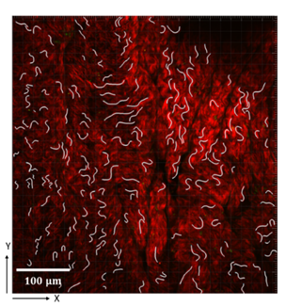











Multiple natural configurations
$$κ_{R}$$
$$λ_{c}$$
Collagen fibres wavy in unloaded configuration
$$λ_{R}$$
Homeostasis
$$κ_{V}$$
$$κ_{0}$$
$$κ_{F}$$
$$λ_{c}=λ_{c}^{h}$$
$$λ_{m}=λ_{m}^{h}$$
Voided configuration
$$λ_{R_{m}}$$
$$λ_{m}$$
Unloaded configuration
$$κ_{m}$$
Filled configuration

Slide 8
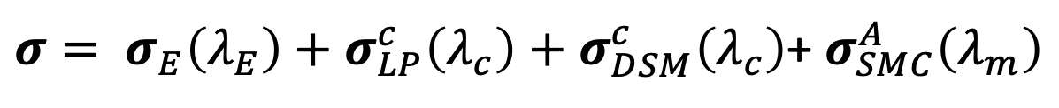
Constrained mixture model of the bladder
Bladder wall is modelled as a multi-layered, heterogenous tissue with passive (collagen, ground matrix) and active (smooth muscle cells) components
Total stress in the bladder wall is given by
where stresses are functions of each constituent/cell stretch
$σ= σ_{E}\left(λ_{E}\right)+σ_{LP}^{c}\left(λ_{c}\right)+$ $σ_{DSM}^{c}\left(λ_{c}\right)$+ $σ_{SMC}^{A}\left(λ_{m}\right)$

Slide 9
Growth and remodelling in COMSOL
Passive ground matrix
Nonlinear Structural Materials module
SMC contraction and hypertrophy
Active stress decomposition: $σ= σ^{P}+σ^{A}$ with the active stress a function of muscle stretch (implement using External Stress node)
Active stress decomposition: 𝜎= 𝜎^𝑃+𝜎^𝐴 with the active stress a function of muscle stretch (implement using External Stress node)
Collagen remodelling
Collagen fibres modelled using the Fiber node
Passive components modelled as incompressible, isotropic neo-Hookean
Filling of the bladder implemented using the Enclosed Cavity feature
SMC growth: $\text{F}={\text{F}}_{e}\text{G}$, where $\text{G}$ describes changes in shape and volume due to growth (implement using External Strain node)
SMC growth: "F"="F" _𝑒 "G", where "G" describes changes in shape and volume due to growth (implement using External Strain node)
Remodelling to maintain homeostasis ⇨ update recruitment stretch
$\frac{∂λ_{R}}{∂t}=α_{c}\left(\frac{λ_{c}−λ_{c}^{h}}{λ_{c}^{h}}\right)$,
(𝜕𝜆_𝑅)/𝜕𝑡=𝛼_𝑐 ((𝜆_𝑐−𝜆_𝑐^ℎ)/(𝜆_𝑐^ℎ )),
Update recruitment stretch at end of each time step, implemented using State Variables node

Slide 10
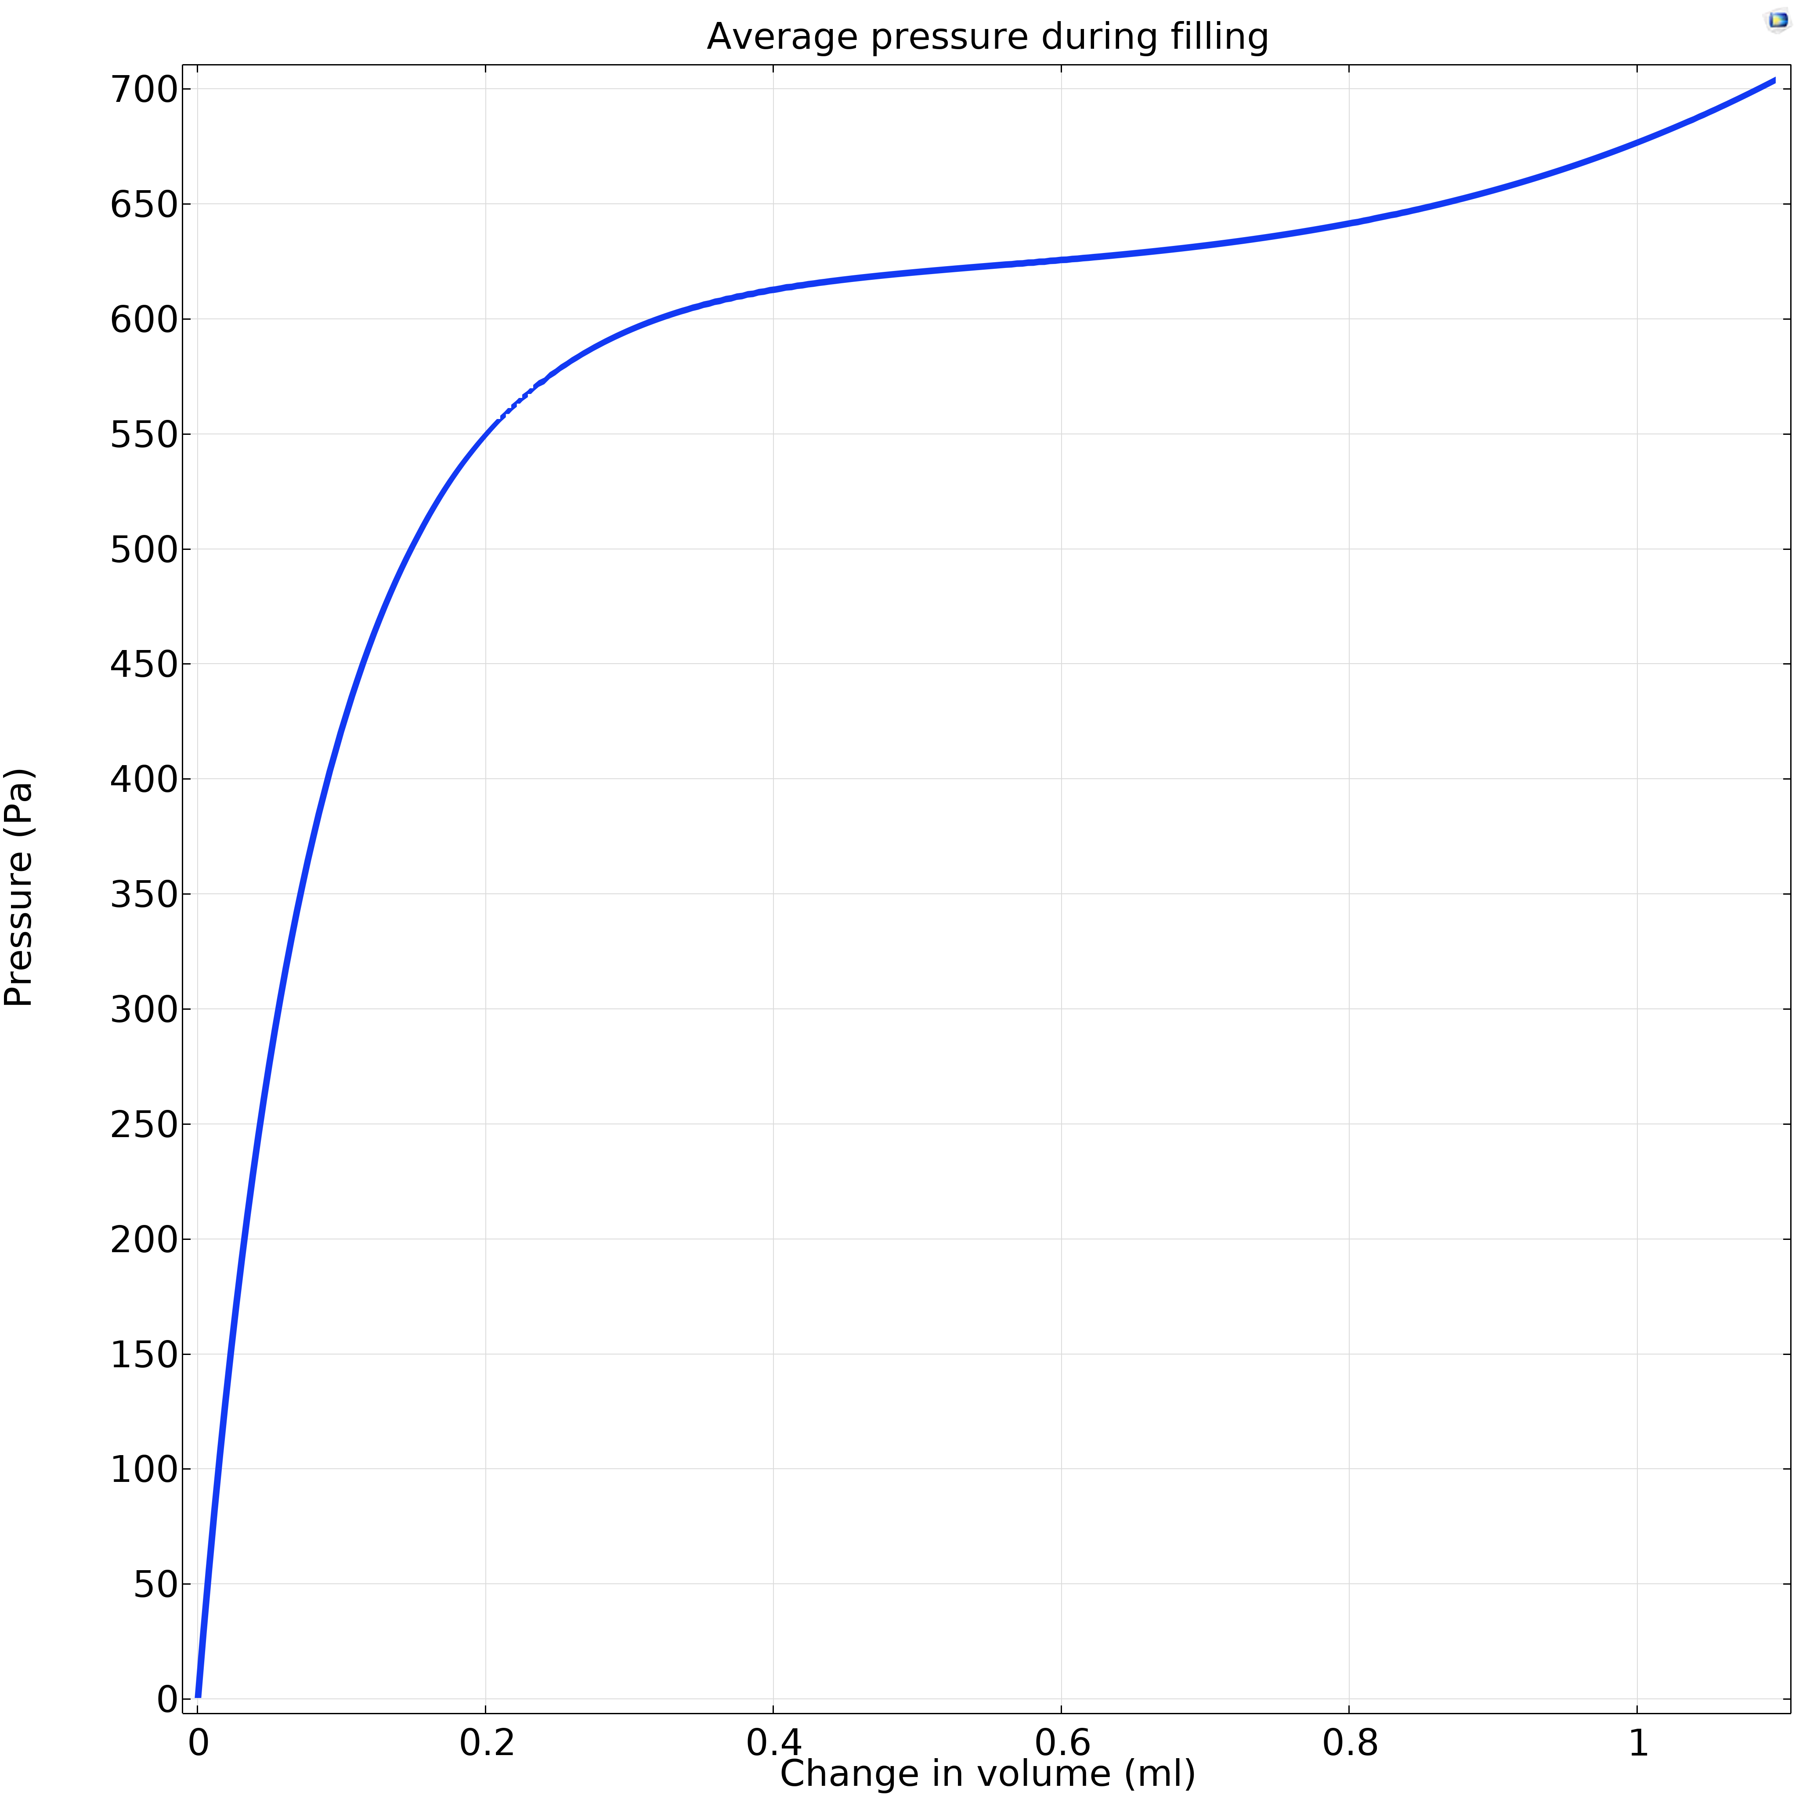
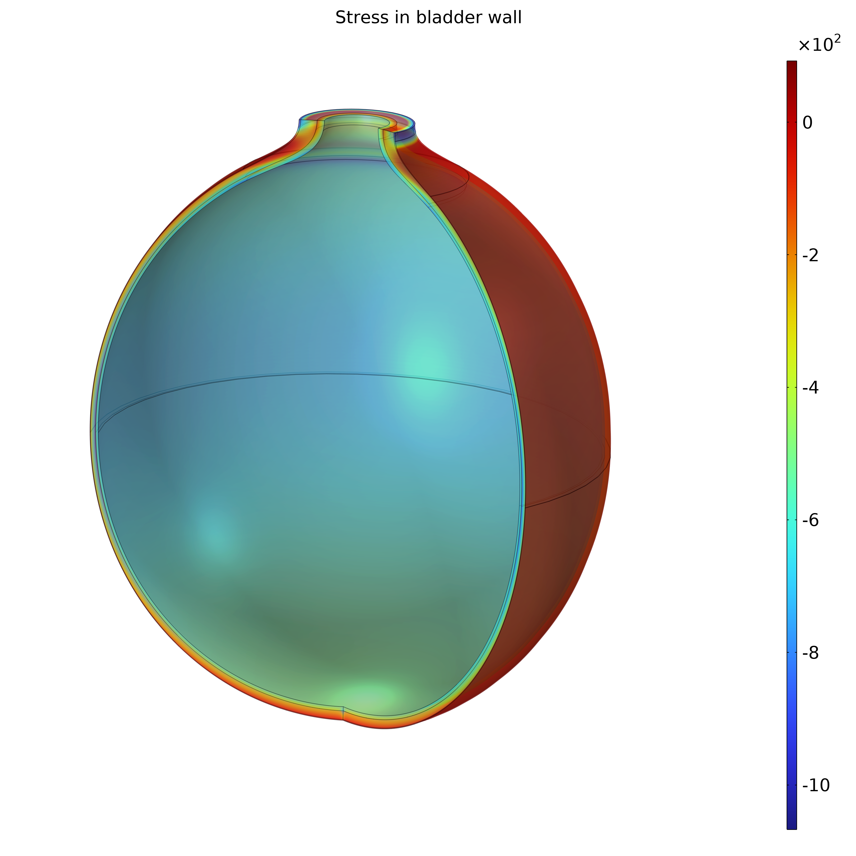
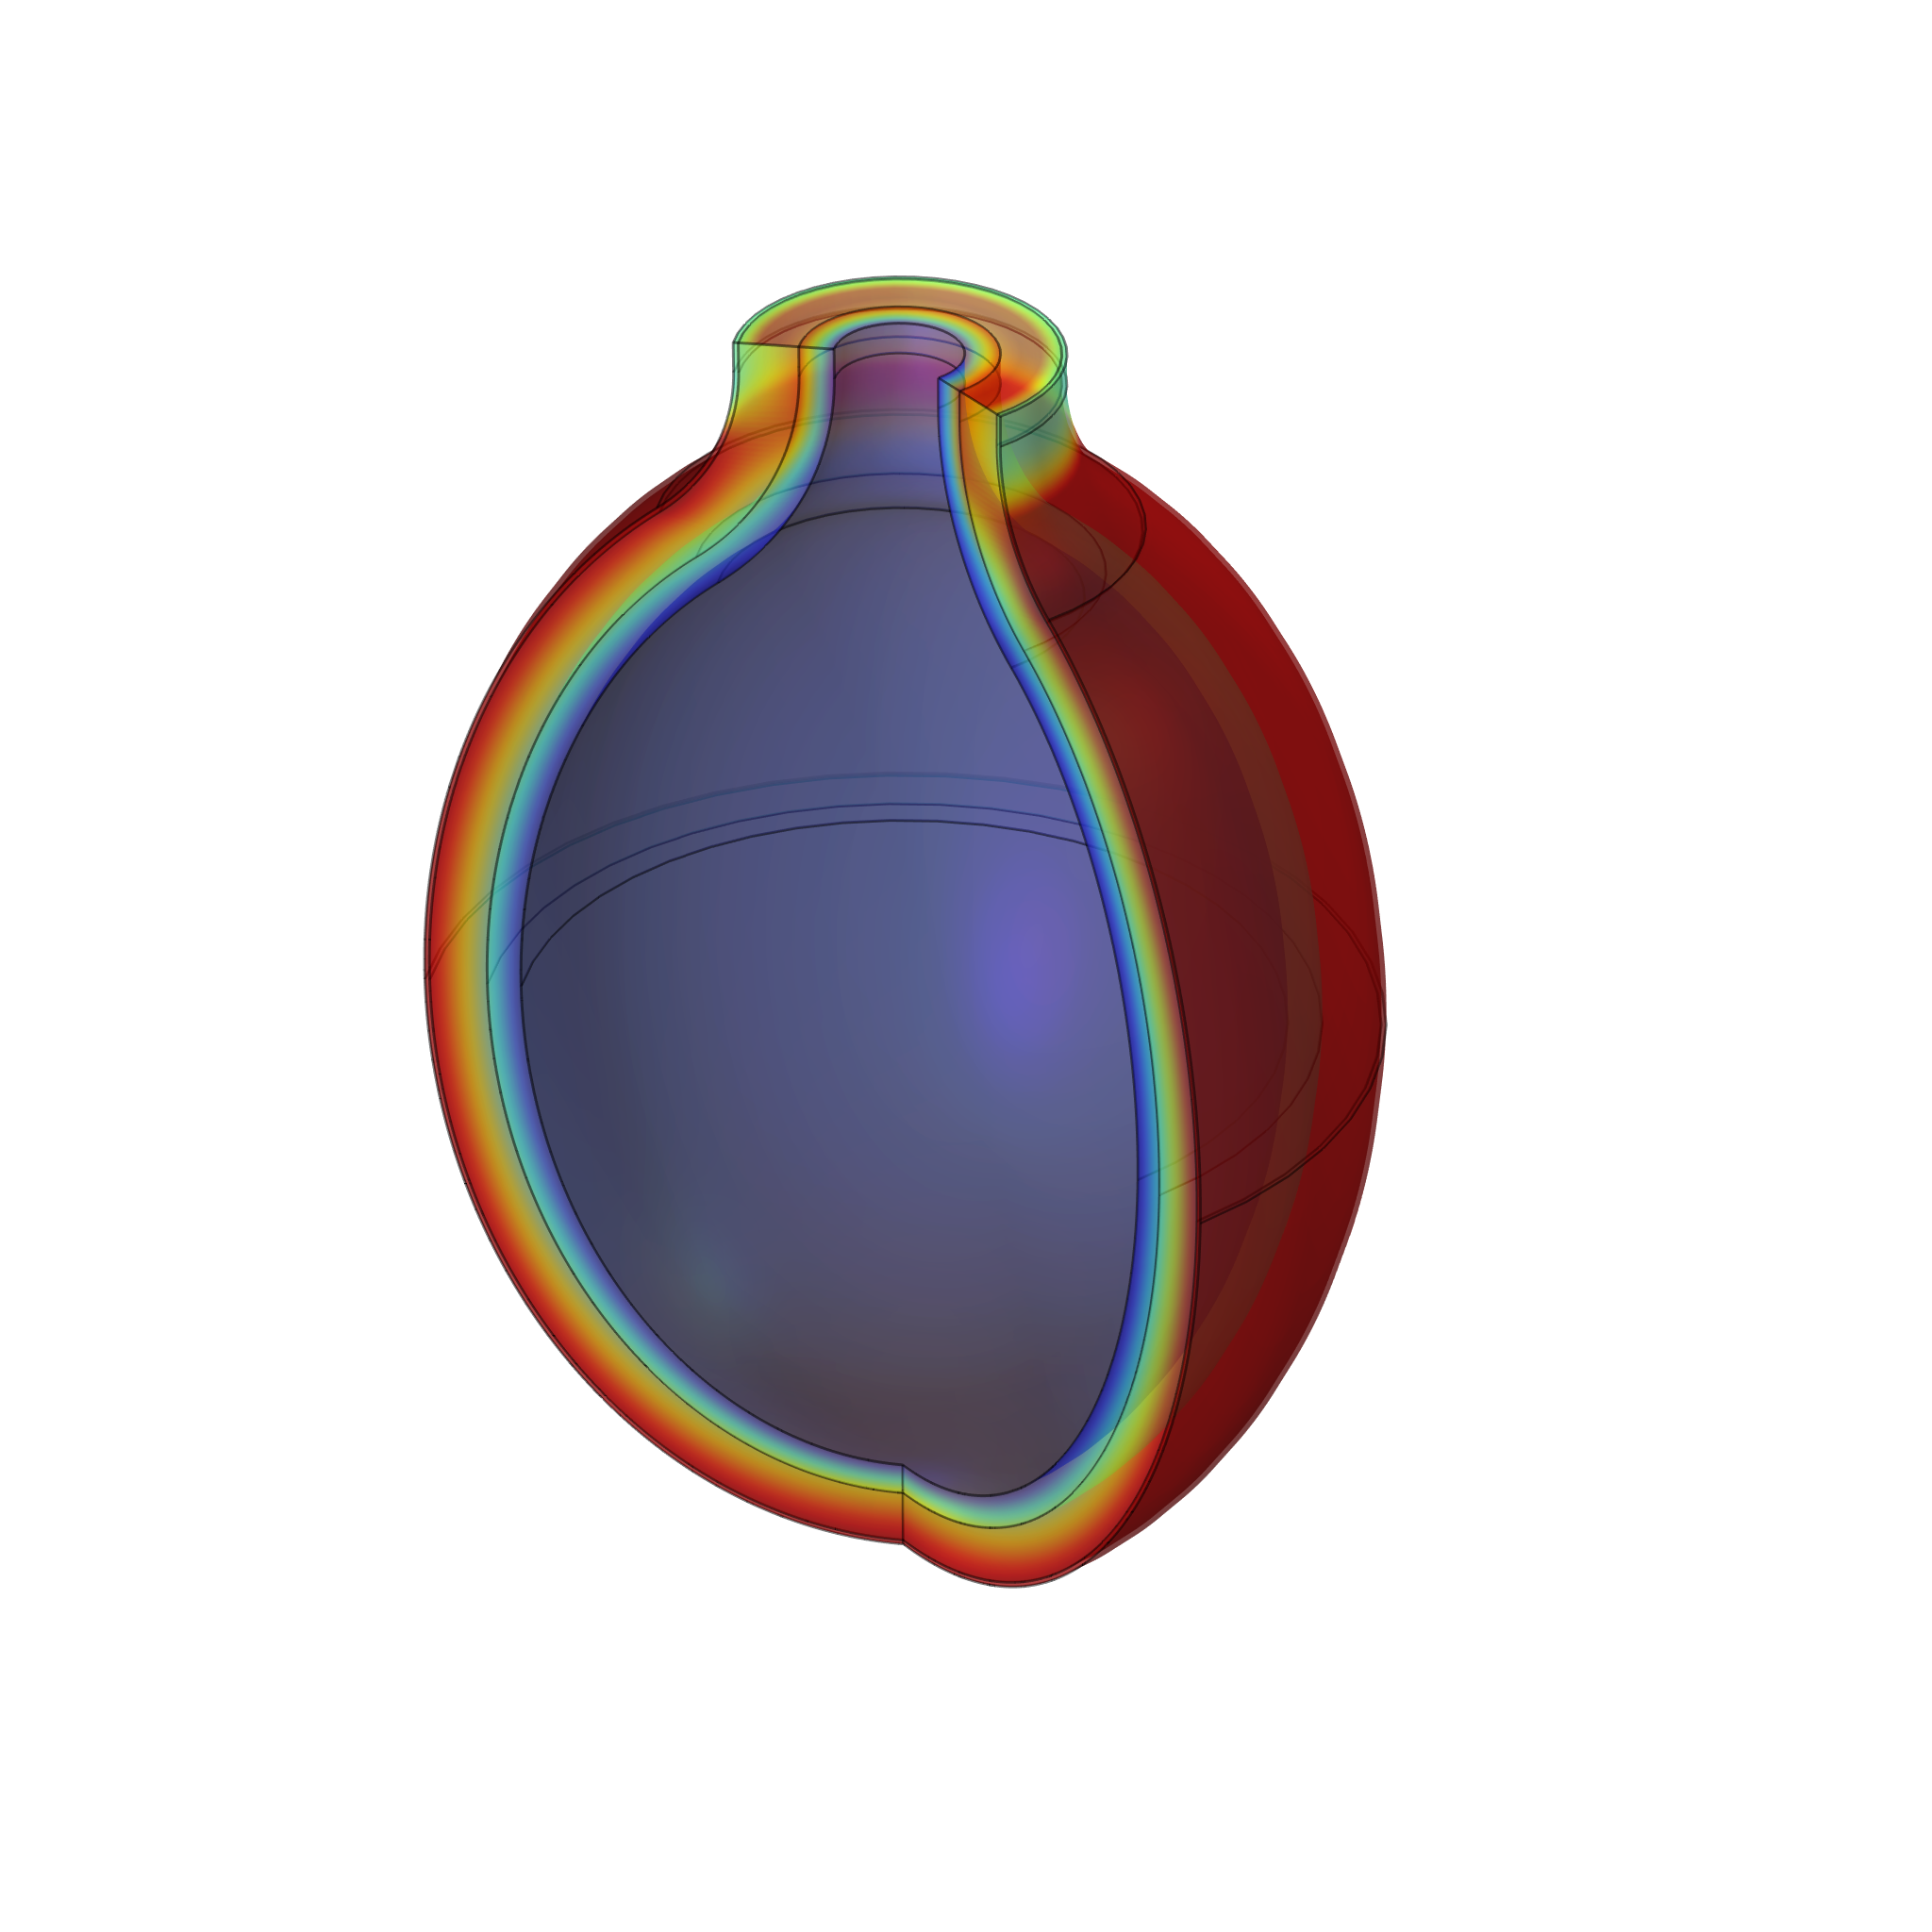
Passive filling
Filling
Growth and remodelling algorithms run about this full state

Slide 11
Passive filling
Filling
Growth and remodelling algorithms run about this full state

Slide 12
Passive filling
Filling
Growth and remodelling algorithms run about this full state

Slide 13
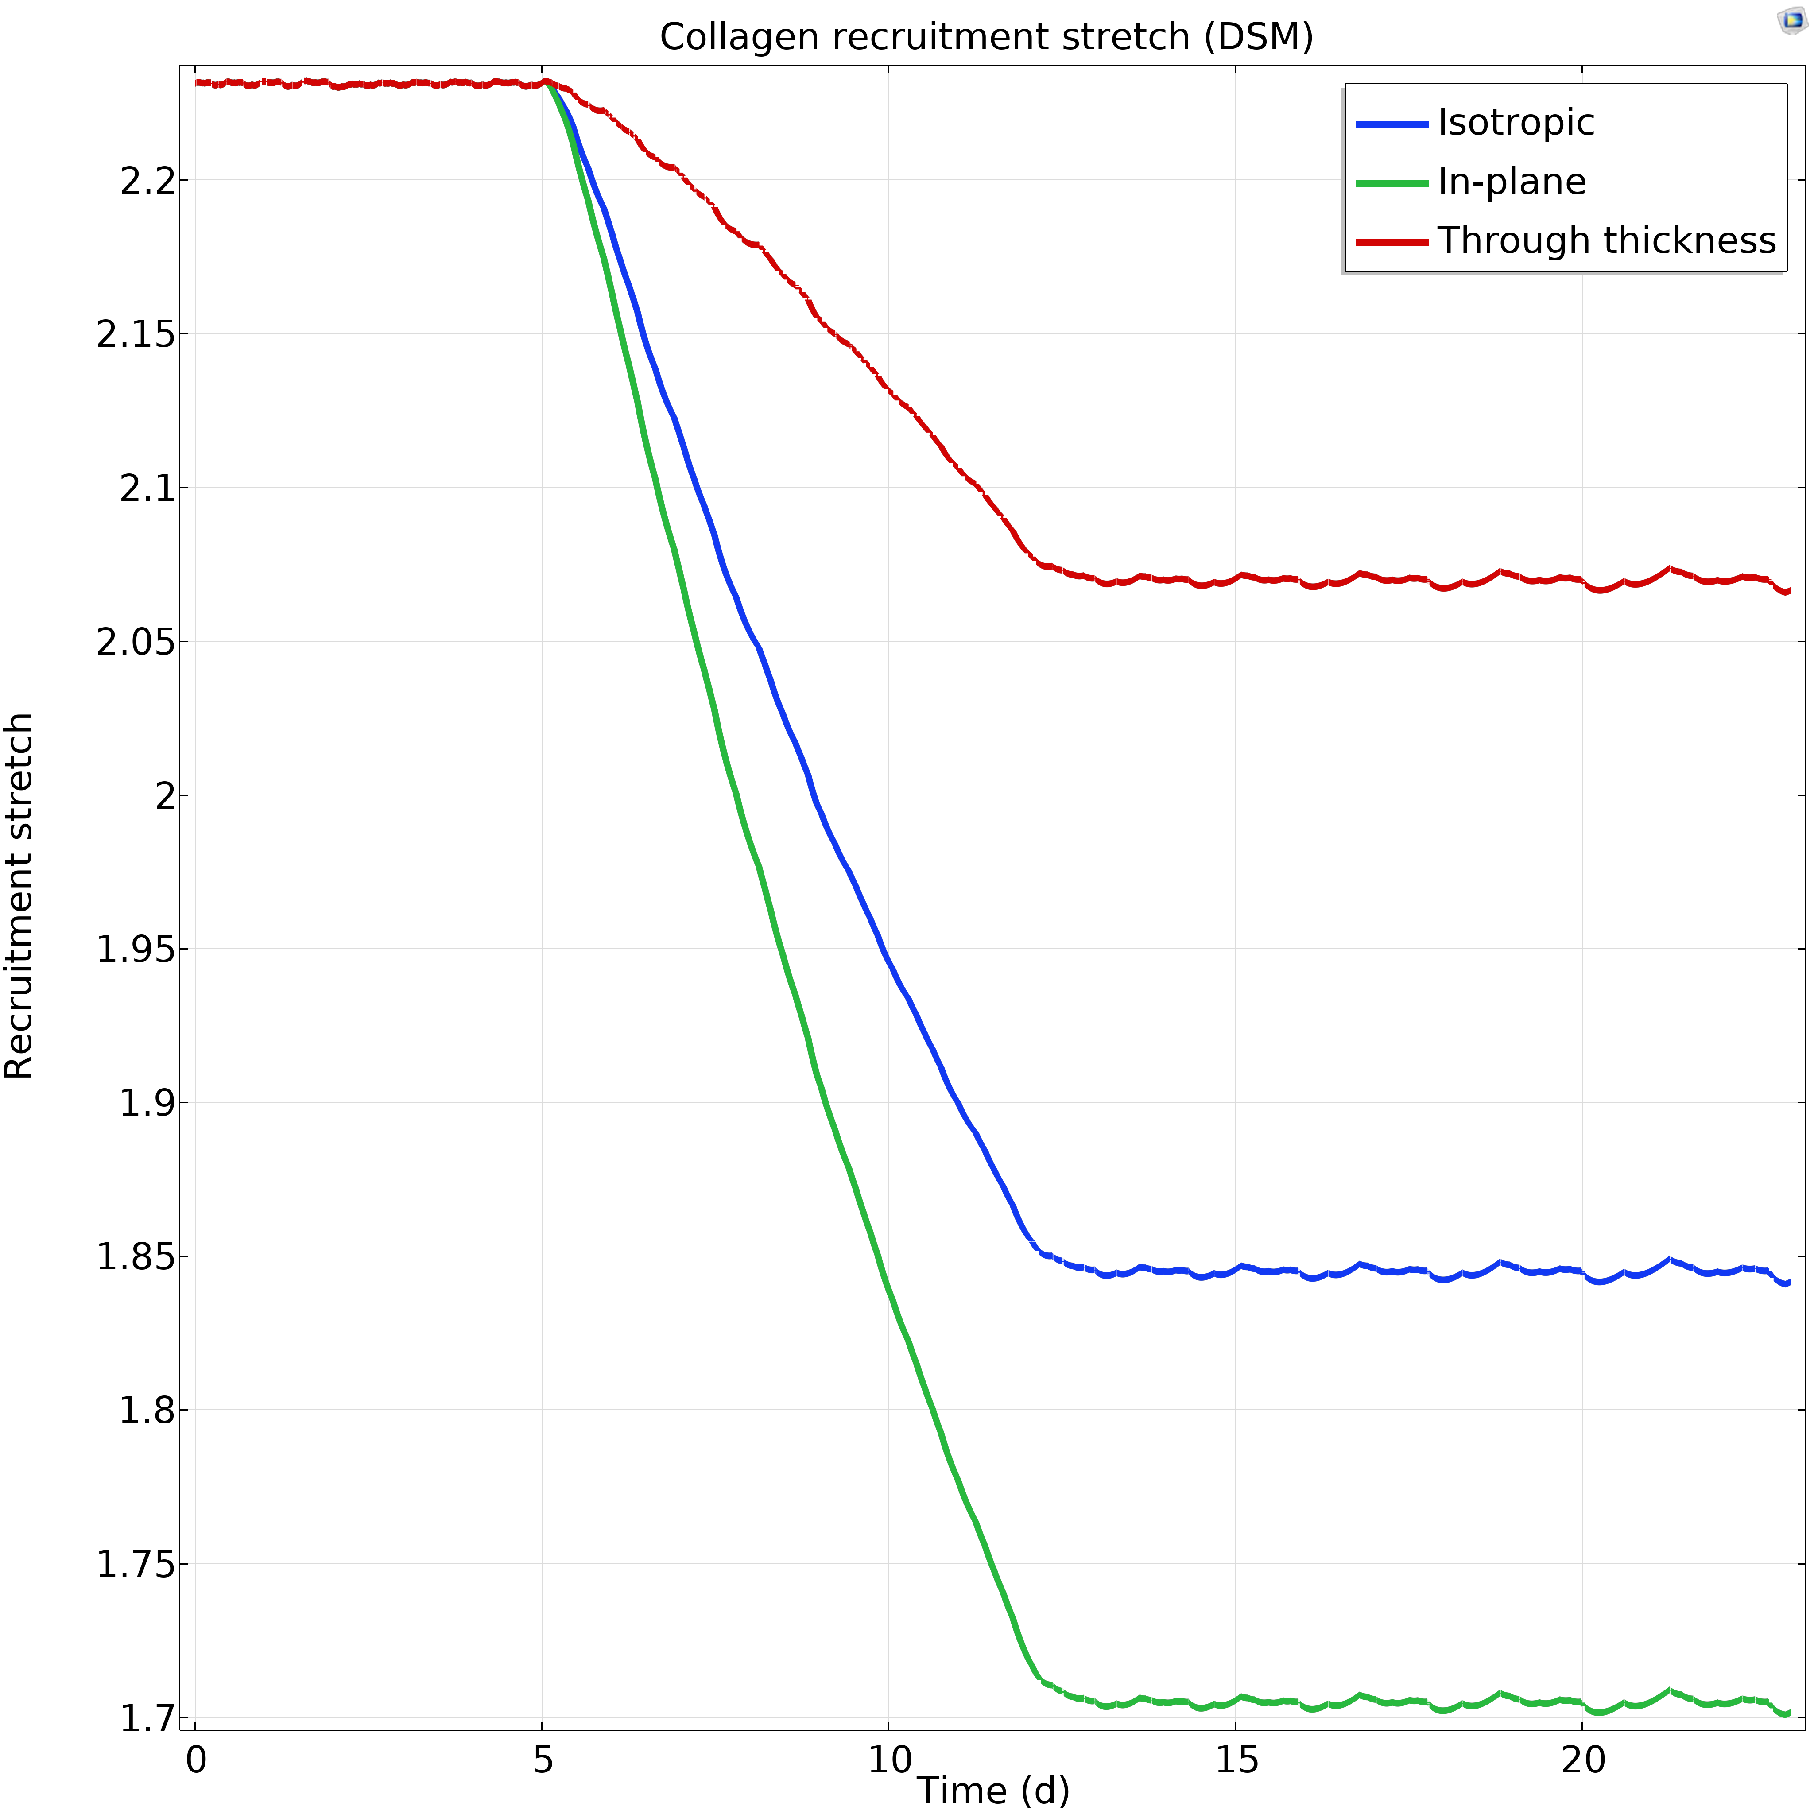
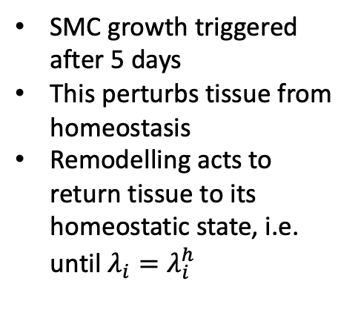
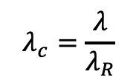
G&R Illustration
Growth and remodelling algorithms run about this full state
SMC growth triggered after 5 days
This perturbs tissue from homeostasis
Remodelling acts to return tissue to its homeostatic state, i.e. until $λ_{i}=λ_{i}^{h}$
$$λ_{c}=\frac{λ}{λ_{R}}$$
Constituent turnover/remodelling

Slide 14
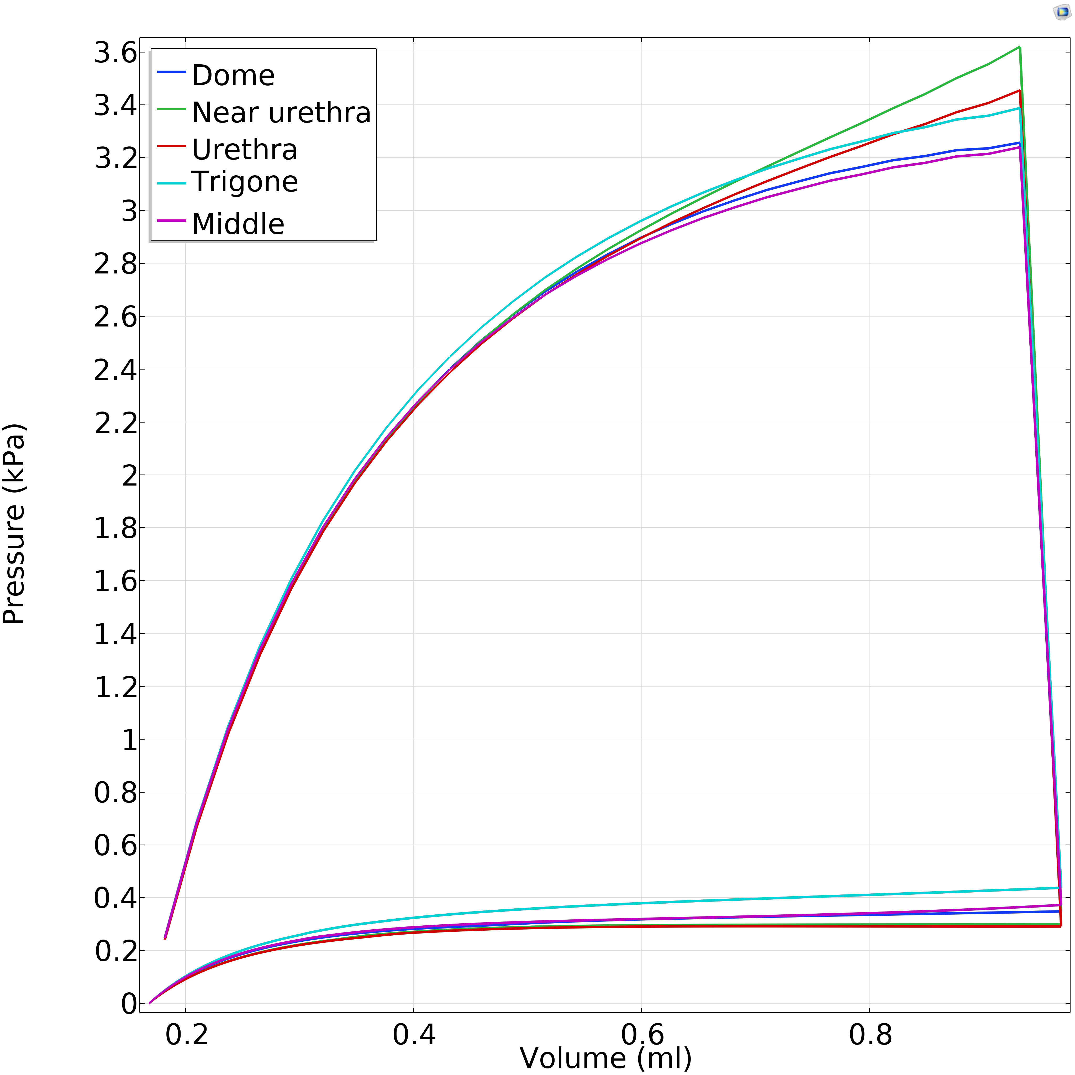
Micturition model
See my poster!

Slide 15
Summary and outlook
We have developed an initial framework for tissue growth and remodelling in COMSOL
Rate-based constrained mixture model for healthy bladder growth and remodelling
Can use this framework to test G&R hypotheses
Next steps:
  Combine G&R model with micturition model
  Introduce obstruction and simulate response to BOO
  Pathway signalling model and collagen growth (fibrosis)

Slide 16


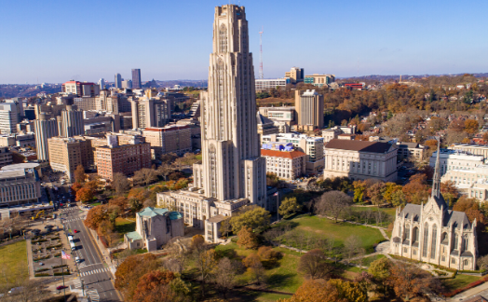
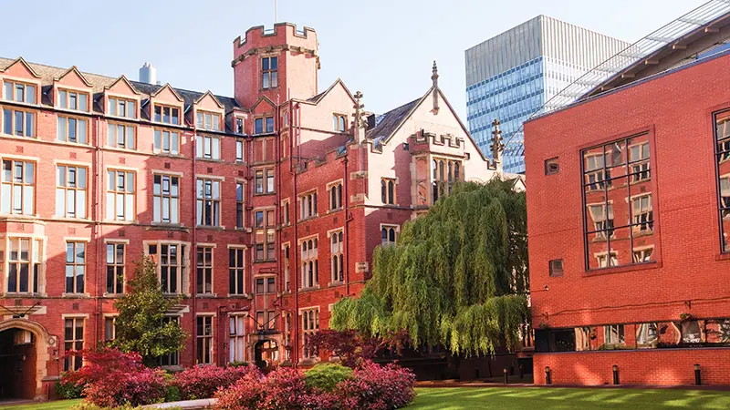
US NIH-R01 (Aug 2023-July 2028)
A Digital Twin for Designing Bladder Treatment informed by
Bladder Outlet Obstruction Mechanobiology
Anne Robertson (PI), Pittsburgh, US
Naoki Yoshimura (MPI), Pittsburgh, US
Paul Watton (MPI), Sheffield, UK

Slide 17



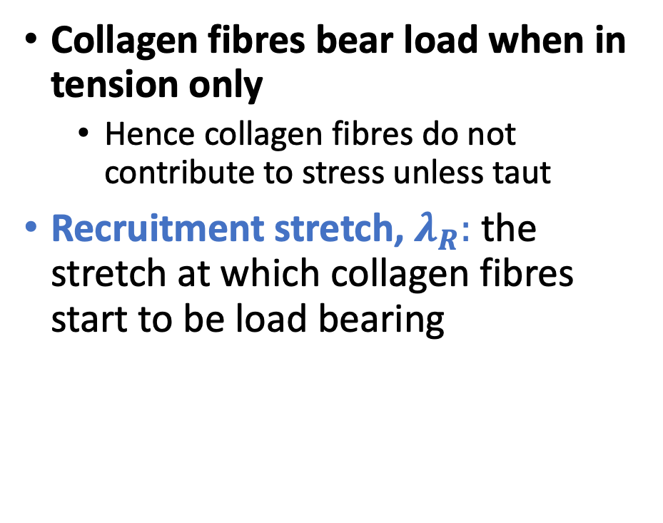






Recruitment and homeostatic stretches
$$L$$
Collagen stretch, $λ_{c}$
Collagen fibres bear load when in tension only
  Hence collagen fibres do not contribute to stress unless taut
Recruitment stretch, $λ_{R}:$ the stretch at which collagen fibres start to be load bearing
$$λ_{c}<1, σ_{c}=0$$
$$λ_{R}L$$
$$λ_{c}=1, σ_{c}=0$$
$$λL$$
Homeostatic stretch, $λ_{i}^{h}:$ stretch of constituent $i$ when tissue is in homeostasis
$$λ_{c}>1, σ_{c}>0$$
$$λ_{c}=\frac{λ}{λ_{R}}$$

Slide 18
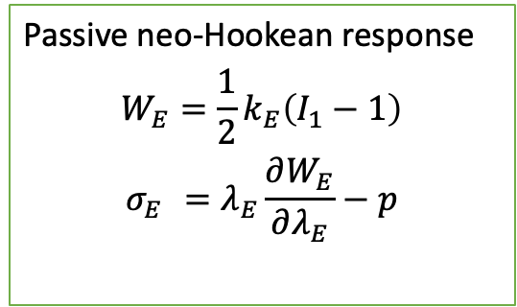

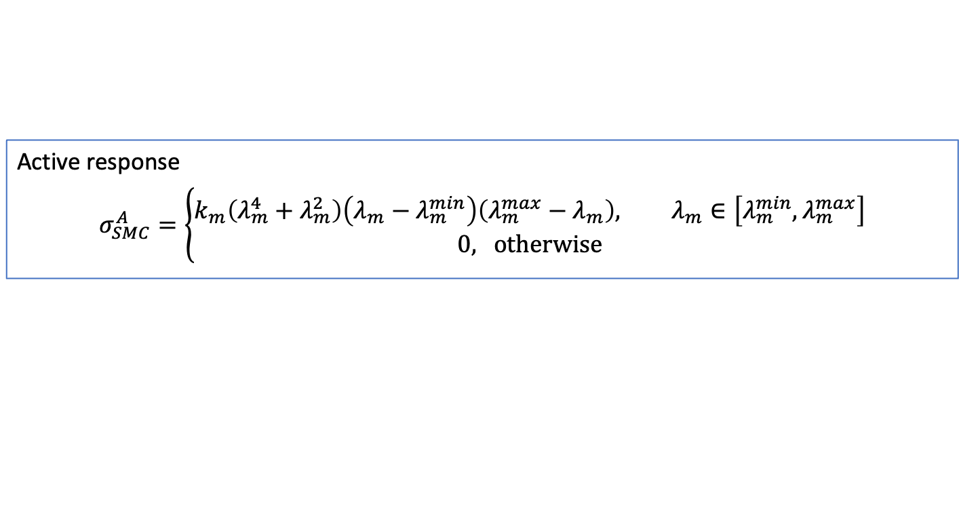
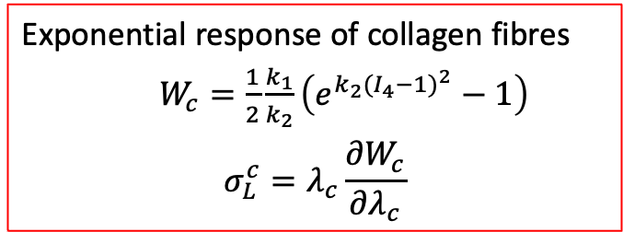
Constrained mixture model of the bladder
$σ= σ_{E}\left(λ_{E}\right)+σ_{LP}^{c}\left(λ_{c}\right)+$ $σ_{DSM}^{c}\left(λ_{c}\right)$+ $σ_{SMC}^{A}\left(λ_{m}\right)$
Passive neo-Hookean response
$$W_{E}=\frac{1}{2}k_{E}\left(I_{1}−1\right)$$
$$σ_{E}^{}=λ_{E}\frac{∂W_{E}}{∂λ_{E}}−p$$
Exponential response of collagen fibres
$W_{c}=\frac{1}{2}\frac{k_{1}}{k_{2}}\left(e^{k_{2}(I_{4}−1)^{2}}−1\right)$
$$σ_{L}^{c}=λ_{c}\frac{∂W_{c}}{∂λ_{c}}$$
Active response
$$σ_{SMC}^{A}=\left\{\begin{aligned}k_{m}\left(λ_{m}^{4}+λ_{m}^{2}\right)\left(λ_{m}−λ_{m}^{min}\right)\left(λ_{m}^{max}−λ_{m}\right), λ_{m}∈\left[λ_{m}^{min},λ_{m}^{max}\right] \\ 0\text{, }\text{otherwise}\end{aligned}\right.$$

