Slide 1

Battery Cell Anomaly Detection via IAV Virtual Battery Testbench based on COMSOL® API
COMSOL Conference Florence 2024
Dr. Johannes Werfel, Dr. Reik Laubenstein,
Dr. Jakob Hilgert, Dr. Maria Kalogirou

Slide 2


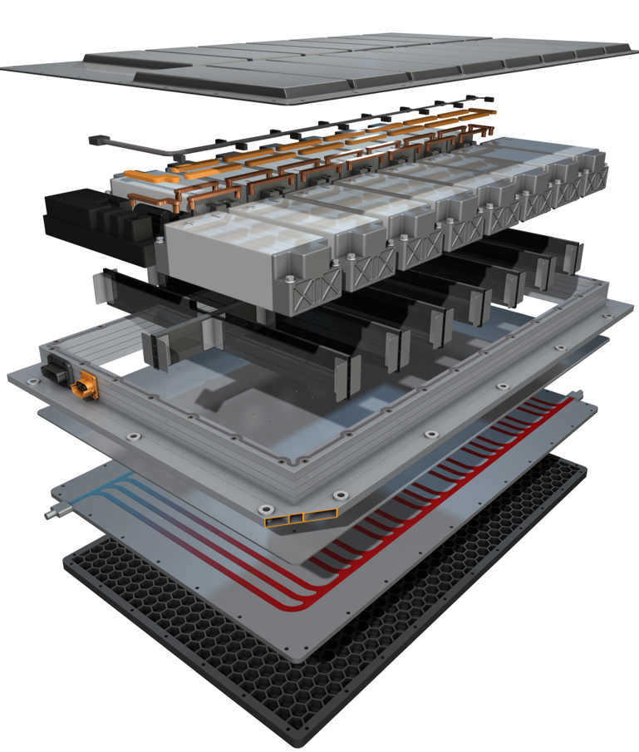







IAV Battery Development
Concept
Development
Simulation
  More then 30 years
  of experience in EV & battery development
Serial
Development
New Cell Chemistries
Over > 1,000 EV & battery specialists
Integration & Calibration
Thermal Management
SoP
Fast Charging
Providing tech solutions worldwide at 24 locations
EoL
BMS HW & SW using AI

Slide 3



Virtual Development
COMSOL APP
    Battery expert
    Broad expertise in battery cell modelling
    Model distribution to specialists in other fields
    Uses COMSOL Multiphysics® and COMSOL CompilerTM
    Other models (e.g., GT AutolionTM, PyBAMM) can also be used
COMSOL Cell Model
API
Probes
virtual Battery Testbench
OIIOI
FMU
    BMS / thermal management / vehicle experts
    Can run parallel calculations within their usual tool chains and developing environments (e.g., INCA-FLOWTM, GT-SUITETM, SIMULINK® etc.) without the need of a COMSOL license.
Other Models
Simulation Environment
Virtual development is the key to achieve the needed reduction of time and costs for the development of electric vehicles
FMU: Functional Mock-Up Unit
API: Application Programming Interface
SOC / SOH: State of Charge / Health

Slide 4

Timeline for Thermal Runaway and Propagation
Production
  Controlling of process, material and final product. Elimination of faulty or problematic cells through quality management.
Early Detection
  Internal changes and strange behavior of cell voltage during idle and runtime. External signals usually undetectable.
Detection
  Detection of increased temperature (internal and/or external). After Point of no return exothermic reactions exceed cooling capacity.
Propagation
  Heat generation during thermal runaway high enough to propagate on neighboring cells. Only drastic solutions capable to prevent spreading or damp event.
years
months
days
hours
minutes
seconds
Early detection of cell anomaly supports preventing catastrophic battery scenarios

Slide 5
Anomaly Detection – Overview Approach
Driving profile
Boundary conditions
    The cell model is abstracted to JAVA code and compiled into a COMSOL App
    Balancing function applies shunt to corresponding cell
    Simulink
Fault diagnosis methods
Cell model
Cell model
Cell model
Analytic model based
Signal processing based
Knowledge
based
    Healthy cell
    Faulty cell
Cell model 1
    COMSOL
Balancing
Parameter estimation
Transformation
Machine learning
Recursive least squares
Filter
Wavelet
Fourier
Random forest
u, i
Battery
Noise & Quantization
ECU
State estimation
Correlation analysis
Fuzzy logic
Kalman filters
Luenberger observer
Correlation coefficient
    Simulink
BMS
with algorithm
Parity space
Entropy
Neural networks
Fault detection
Nonlinear parity equations
Shannon

Slide 6
Anomaly Detection – Overview Input
    Model set-up
    Current profile contains idle, driving and charging phases
    12 cells, NMC811 chemistry, 12s1p configuration, 78 Ah, initial SOC 80%
    Cell models in COMSOL APP feature adjustable statistical differences in capacity and state of aging
    Variation of cell parameters:
      Healthy cells R_{isc} either 10,000 or 1,000,000 Ω; faulty cell R_{isc} is 100 Ω (●)
      Cell capacity scales between ± 2%
      Cell film resistance scales between ± 5%
Voltage signals of cells with varying R_{ISC} not distinguishable without application of algorithms
SOC: State of Charge
R_{isc}: resistance of the internal short circuit

Slide 7






Anomaly Detection – Recursive Least Squares Method
    Parameter estimation of Δu_{ocv} and Δr_{i} to minimize error between linear mean difference model (difference of each cell to mean value) and measured values
input
Battery System
output
$$Δu_{i}$$
$$i$$
$$Δu_{i}=Δu_{ocv}+i⋅{Δr}_{i}$$
Mean Difference Model
$${Δr}_{i}$$
$$i$$
$$Δu_{ocv},{Δr}_{i}$$
$$Δu_{i}=u_{i}−\frac{1}{n}\sum_{i=1}^{n}{u_{i}}$$
$$Δu_{ocv,i}$$
Parameter Estimation
error
Parameter estimation depends on input (dynamic or steady state operation point)

Slide 8
Anomaly Detection – Recursive Least Squares Method
    Results
    Estimated parameter of Δu_{i} and Δr_{i} for all 12 cells are shown
    Δr_{i}: cells with high and low capacities
    (● ● ●) detectable as outliers
      Small influence of the low R_{isc} (100 Ω) for the faulty cell (●)
    Δu_{ocv}: cells with high & low capacities (● ● ●) and faulty cell (●) detectable as outliers
    Continues self discharge due to low R_{isc} for faulty cell detectable as permanent deviation of measured and estimated Δocv value (●)

Slide 9
Anomaly Detection – Random Forest Classification Method
Training data set
Feature extraction
Training of RF model
Accuracy depends on the definition and extraction of features.
Model parameters
Test data set
Classification with trained model
Result
Selected Features:
Energy loss during discharge and charge cycle
Change in equivalent resistance of the cell
Voltage drop during idle time
Input data set with n features
…
Each tree uses a subset of n features
Tree 1
Tree 2
Tree m
Final class through majority voting

Slide 10
Anomaly Detection – Random Forest Classification Method
State of cell | Healthy | Unhealthy
Accuracy on test samples | 87.5% (7/8) | 80% (4/5)
    Adjustment of set-up (COMSOL model)
    Input of 52 cells → Adjustment of the model to increase number of cells
    R_{ISC} values of 100, 1,000 and 10,000 Ohm examined
    From available data 75% used for training, 25% as test data
    Results
    Detection of faulty cells with low internal short circuit resistance (100 Ohm) mostly correctly classified
Despite small size of training data set, good accuracy for identification of faulty cells

Slide 11



Summary & Outlook
    Model-based approaches are the key to achieve the needed reduction of time and costs in the development process of electric vehicles
    IAV has established a holistic virtual development process for batteries using COMSOL Application Builder in conjunction with COMSOL CompilerTM
    The exemplary use-case of cell anomaly detection development was presented
      Identification of cells with a low internal
      short circuit resistance via BMS-available
      signals
      Signals of faulty and healthy cells were
      generated via cell models
      Two different fault detection algorithms
      with different approaches were selected
      and compared (a third one is shown on the
      poster)
Random Forest
Accuracy
Recursive Least Square
Computational cost

Slide 12
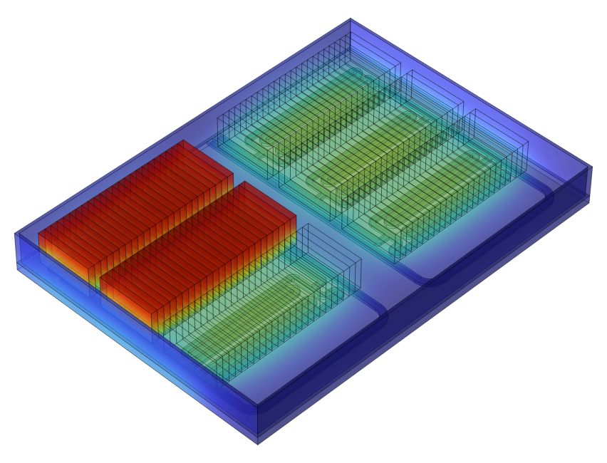
electrified by vision
Dr. Johannes Werfel
IAV GmbH
Carnotstraße 1, 10587 Berlin, GERMANY
Phone +49 152 56408750
johannes.werfel@iav.de
www.iav.com

Slide 13

Backup

Slide 14

Anomaly Detection – Shannon Entropy Method
moving window →
    Probability p of each cell i at each sampling point j
    Entropy h at each sampling point
    Weight factor of entropy
    (green / Σ yellow)
    Score for each cell is entropy times weight factor
    Difference score of each cell to mean value
$$h_{j}=−\sum_{i=1}^{n}{p_{i,j}\log_{2}{p_{i,j}}}$$
−2σ
−σ
μ
σ
2σ
Accuracy depends on selected sampling frequency and size of window

Slide 15
Anomaly Detection – Shannon Entropy Method
    Results
    High difference score for cells with high and low capacities (● ● ●) during driving phase
    Specifically during idle and charging phases the damaged cell (●) difference score on high level or increasing
    Extension of idle phase leads to permanent increasing difference score for the faulty cell
Faulty cell behavior pre-dominantly visible during idle phase

Slide 16
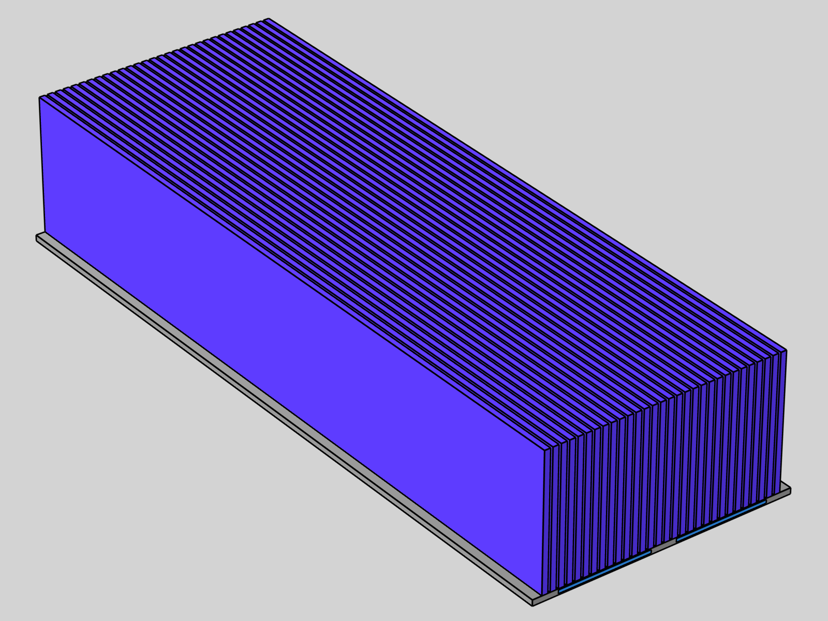
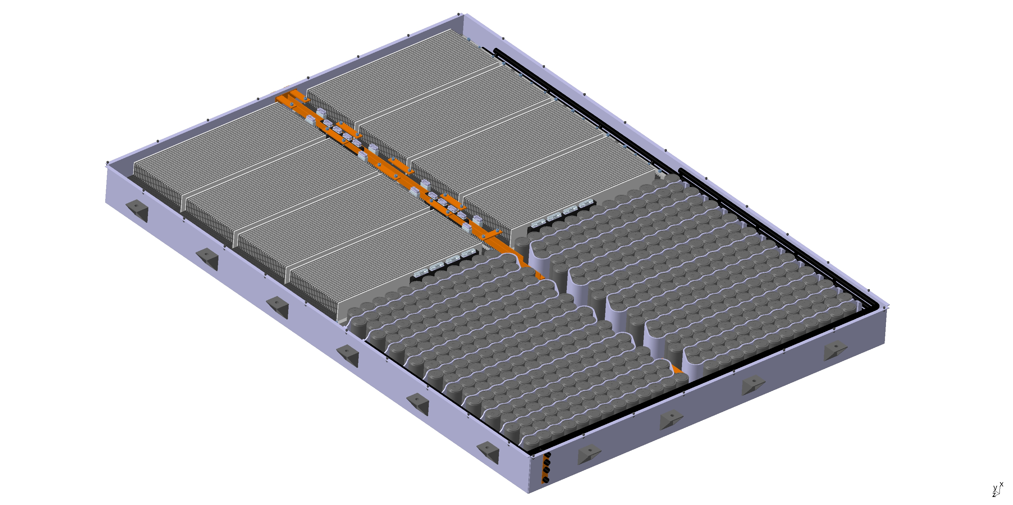
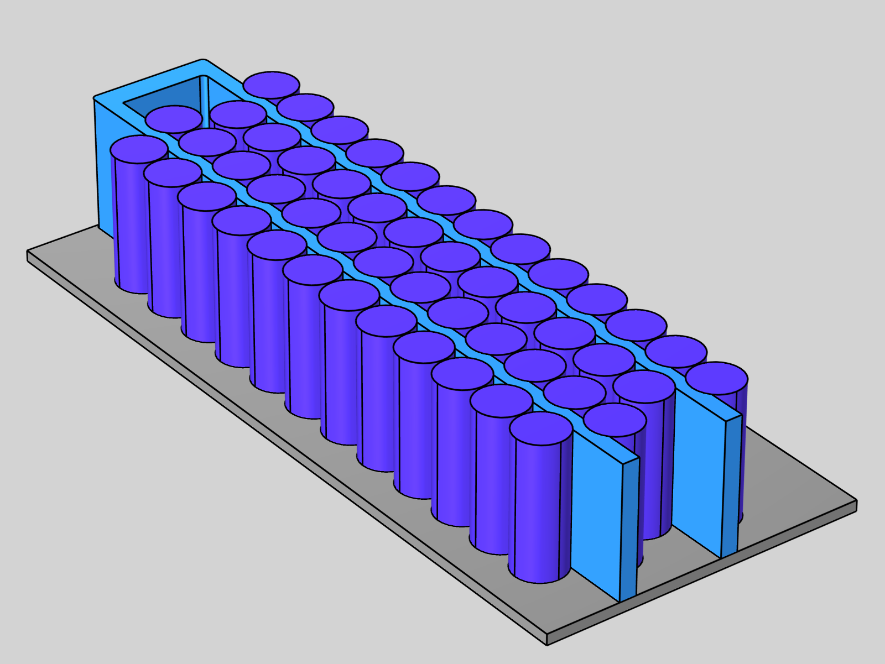
Application Examples
COMSOL APP
Novel Battery Concept with an Innovative Thermal Management*
COMSOL Cell Model
API
Probes
virtual Battery Testbench
OIIOI
Early Cell Anomaly Detection with BMS-accessible Signals**
FMU
Other Models
Simulation Environment
BMS
Algorithm
* More details at “IAV’s multi-purpose 3D coupling solution for electrophysicochemical Battery models via COMSOL-API”, COMSOL Conference Munich 2023
** More details at “Early Fault Detection in Lithium-Ion Batteries with Smart BMs”, 41st International Battery Seminar, 2024.​
.​

Slide 17
Thermal Runaway & Propagation – The Battery plays Domino
Causes
Mechanisms
Degradation modes
Thermal runaway
Thermal propagation
    Low temperature charging
    Contamination and defect
    Local mechanical deformation
    Overheating
    Overcurrent
    Overcharge
    Over-discharge
    Electrolyte degradation
    Separator degradation
    Short-circuit
    Cell level
    Module level
    Dendrites
    Exothermic
    self-heating
    Pack level
    Electrolyte degradation
    Solid electrolyte interphase degradation
    Electrode degradation

Slide 18
Internal Short Circuit
Charge
Discharge
Electrical equivalent model:
Modelling of low frequency behavior
No electro-chemical process
Cu current collector
Anode
SEI
Electrolyte
Separator
Interphase
Cathode
Al current collector
Li+
Li+
R₁
R₀
i₀
i_{load}
Li+
i_{isc}
Li+
C₁
OCV
R_{isc}
Internal short circuit can be modelled as a parallel resistor in the equivalent circuit

Slide 19
Shannon Entropy Method – 10 Ohm R_{isc}

Slide 20
Shannon Entropy Method – 50 Ohm R_{isc}

Slide 21
Shannon Entropy Method – 100 Ohm R_{isc}

