Slide 1

Architecture of a thermo-mechanical-optical model of a laser amplifier for laser fusion applications
G Friedman¹², G LeTouze¹², B LeGarrec¹², G Cheriaux¹, D Hammond¹, C Paradis¹²
¹Focused Energy GmbH - Darmstadt, Germany + NorCal, USA
²Pulsed Light Technologies GmbH – Leipzig, Germany
22/10/2024

Slide 2
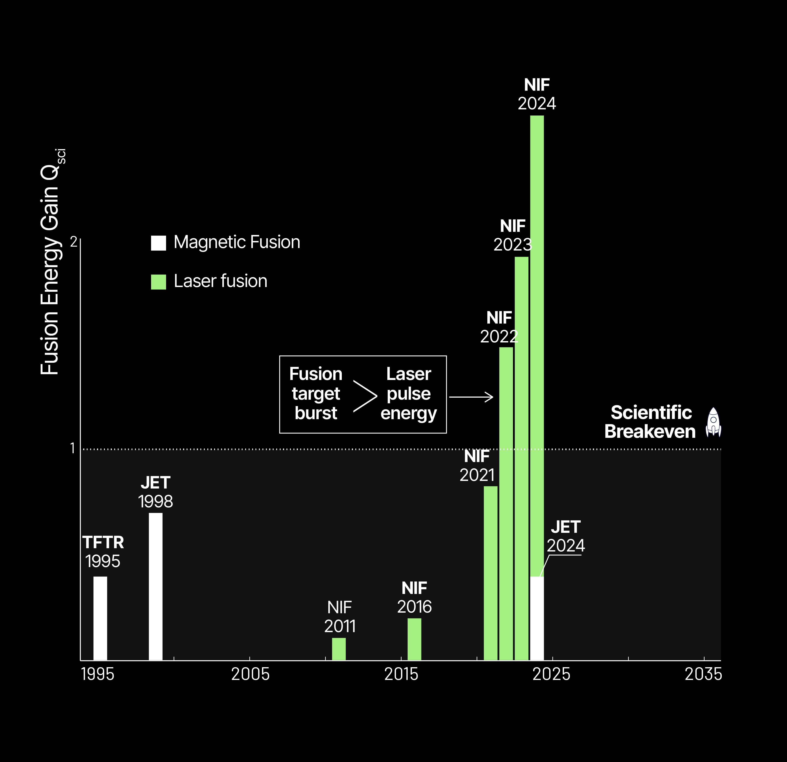
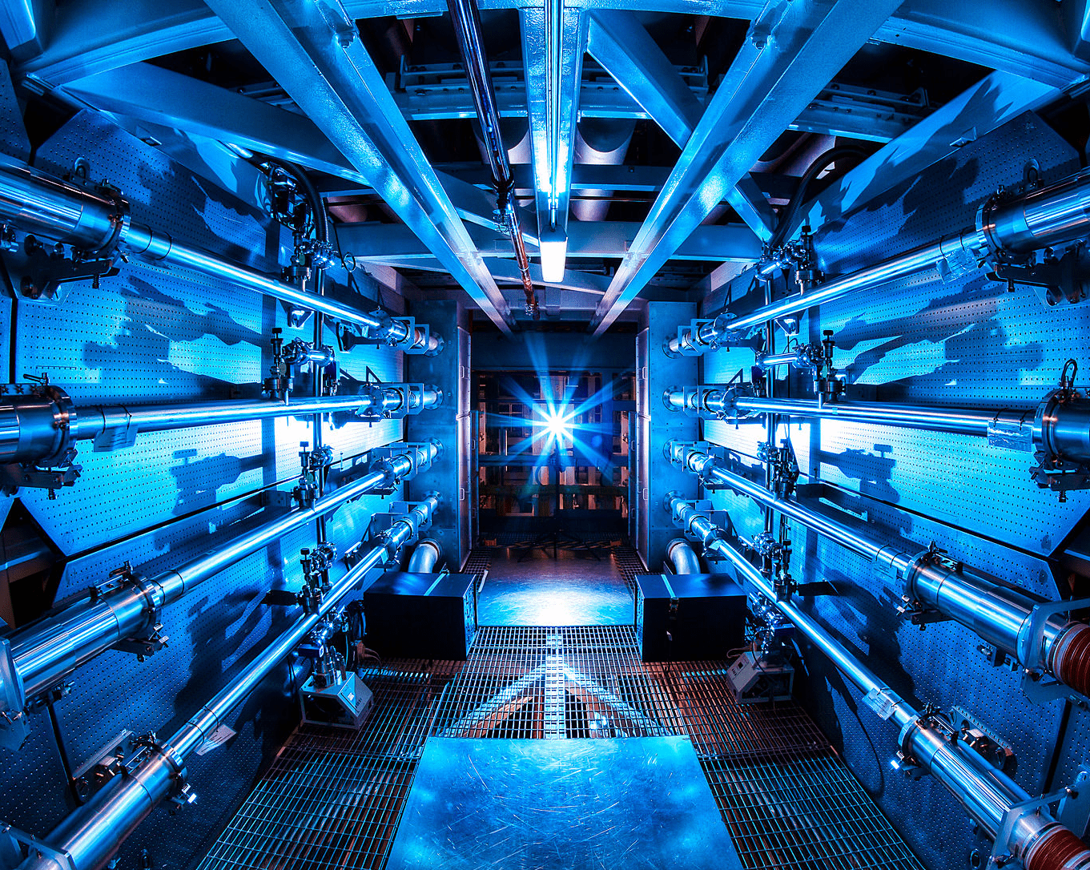
IFE Breakthroughs have burst open the door for Commercial Laser Fusion Power
Fusion Energy Gain Q_{SCI}

Slide 3
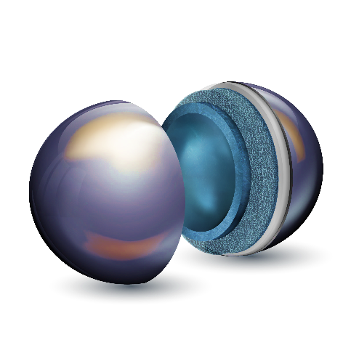
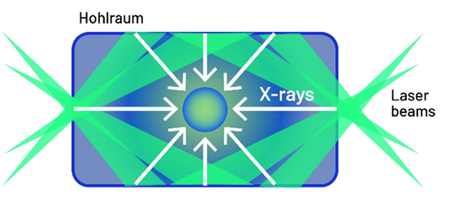
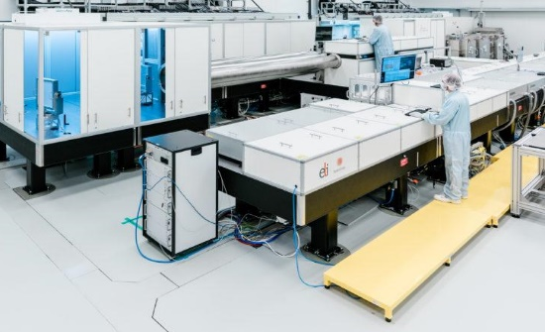
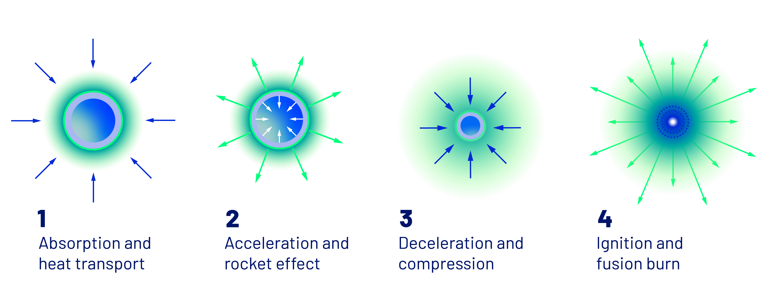

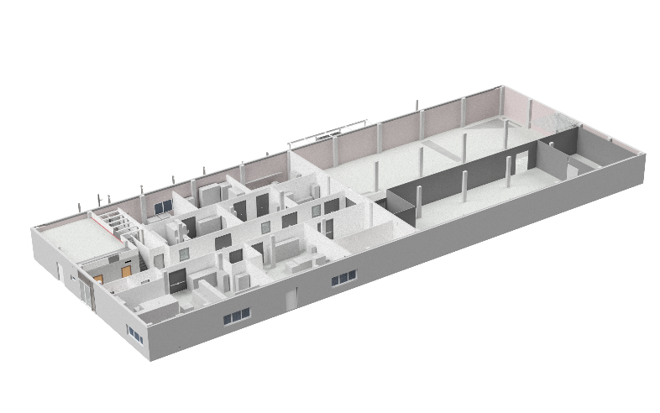
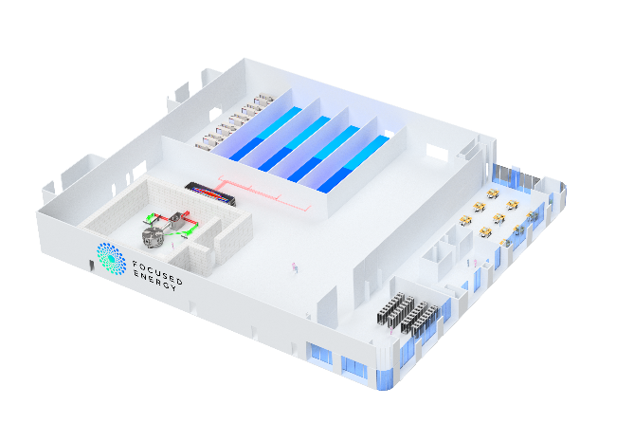

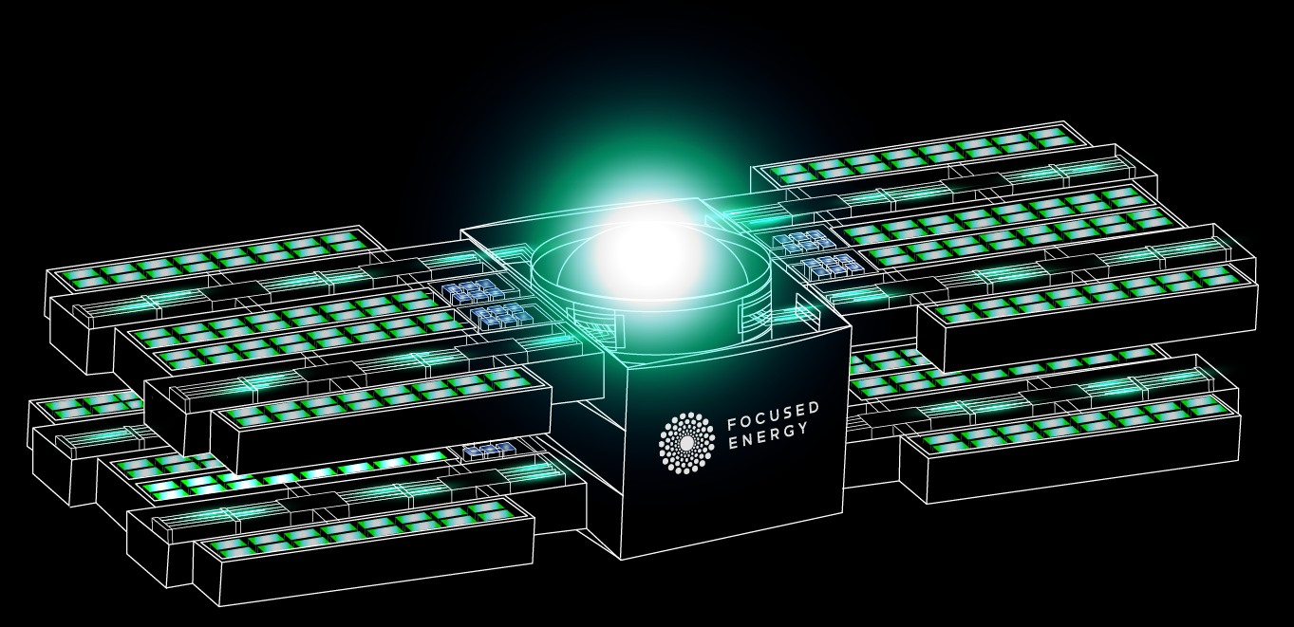

Our Fusion Approach – Direct-Drive Compression with modern Inertial Fusion Energy (IFE) Lasers
The Traditional Indirect Approach
Laser drives X-rays to Compress Fuel
The Direct Drive Approach:
Laser Directly compresses Fuel Cell
The Next-Generation Driver:
Rep-Rated High-Power Lasers
Fuel cell
CH ablator
DT-ice
DT-gas
Schema used by NIF for Breakthrough.
Proprietary IP for high-power, liquid-cooled lasers.
First unit in use at the ELI research facility in Prague.
The Focused Energy Roadmap
Target & Laser R&D Lab
Q1 2025
Location:
R&D Facility
Commissioning: 2027
Location:
Sub-Scale Facility
Integrated Implosion Facility
Planned: 2030-2032
Location:
Pilot Plant
Commercial Validation
Planned: 2039
Commercial Plant
Fusion Energy to the Grid
2039 onwards
<1kJ
~5kJ
50kJ
2MJ

Slide 4
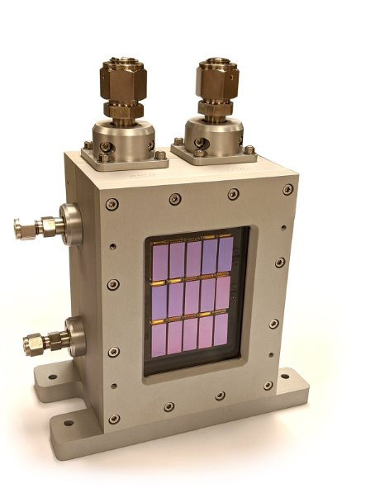
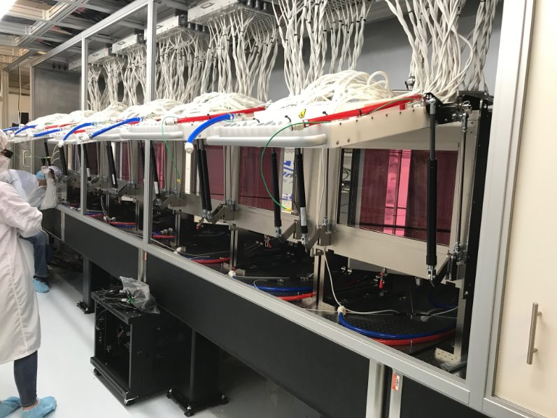
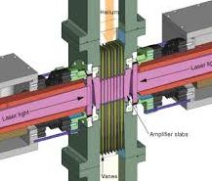
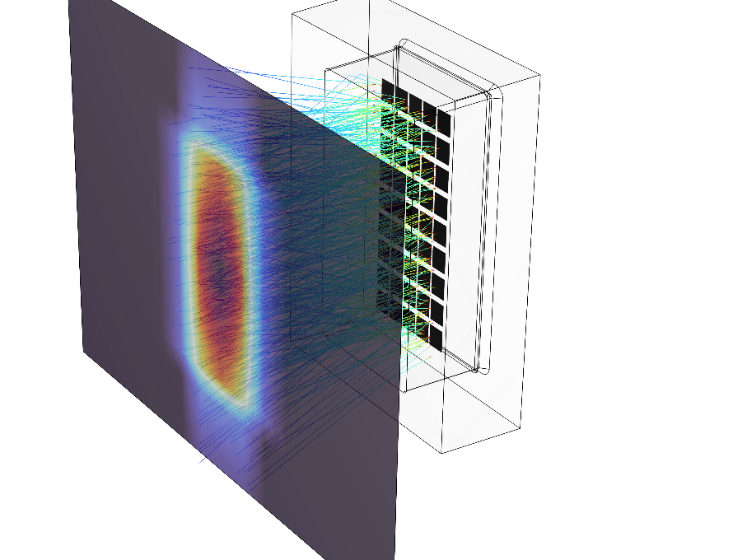
Our Lasers: Cutting-edge light sources and cooling architectures, yet to be seen at scale on existing IFE systems
Laser Material
IFE Laser Amplifier Elements
Pump/Excitation Source
Ion-Doped Glass/Crystal/Ceramic
with Active Cooling
Diode or Flashlamp Arrays
Gas or liquid flow
Between slabs
Laser Material
Beam
Laser Material
Flashlamps or diode arrays
Notes:
This is

Slide 5
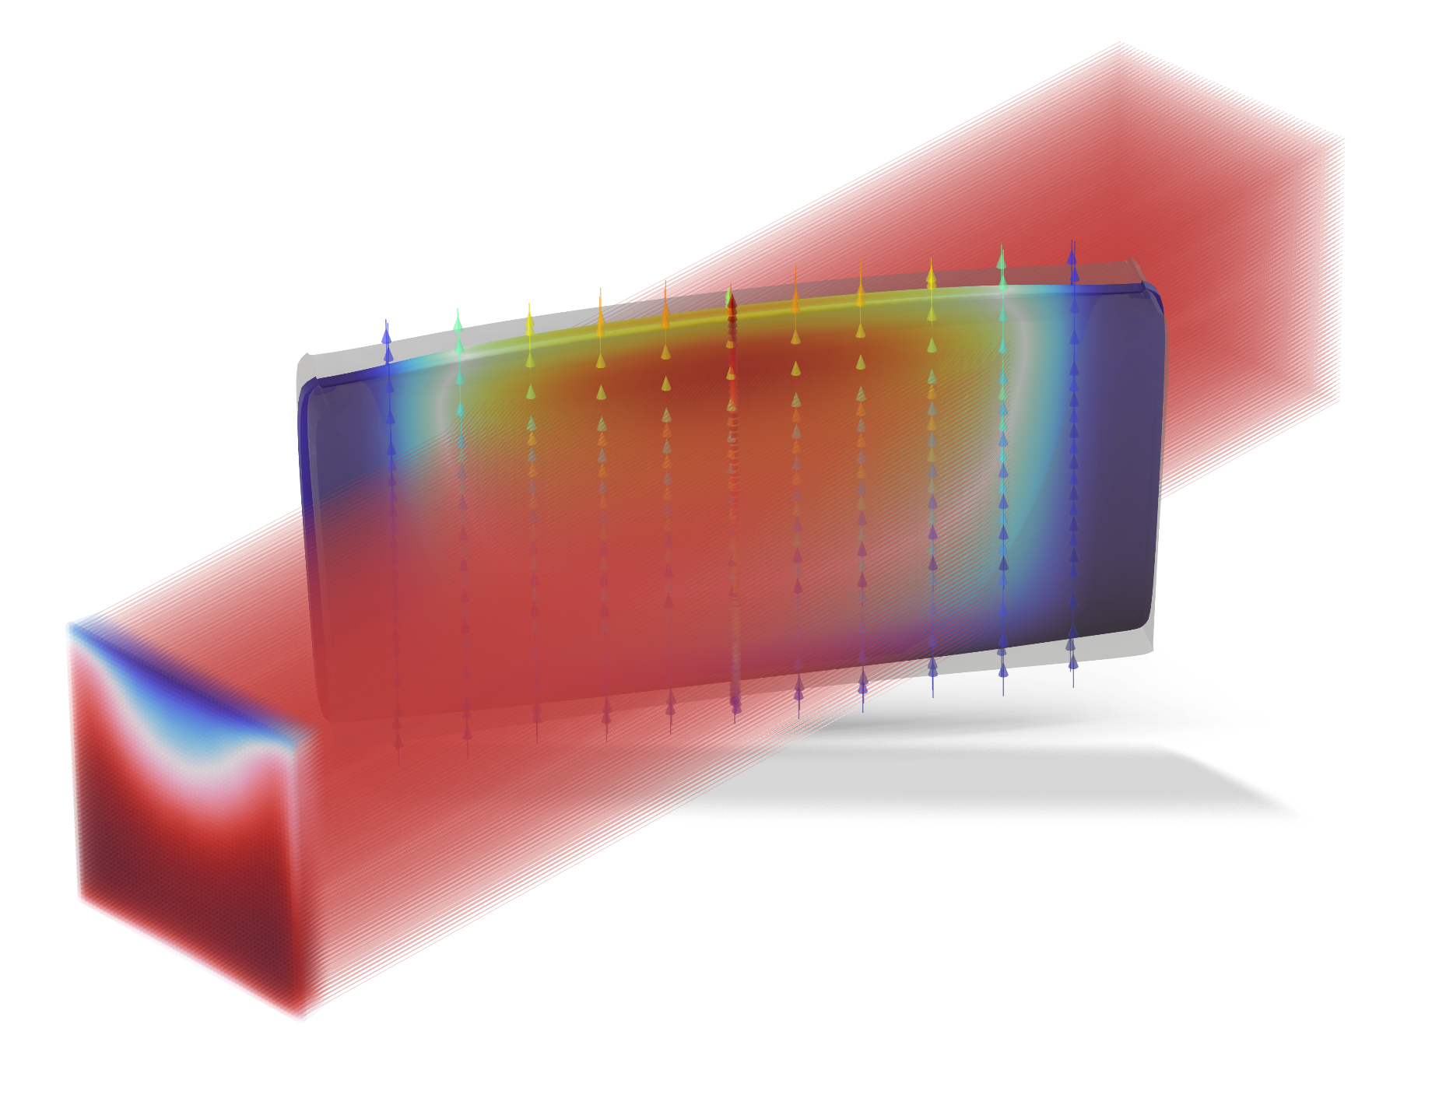
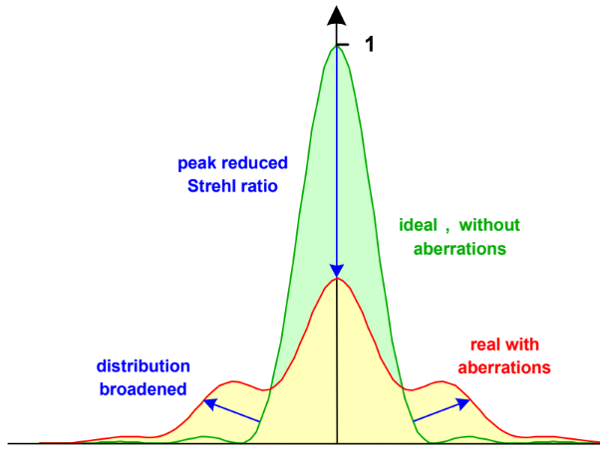
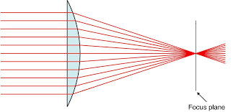

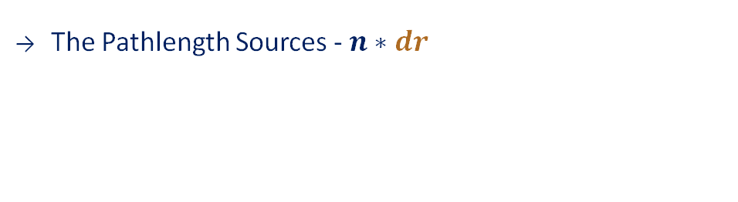
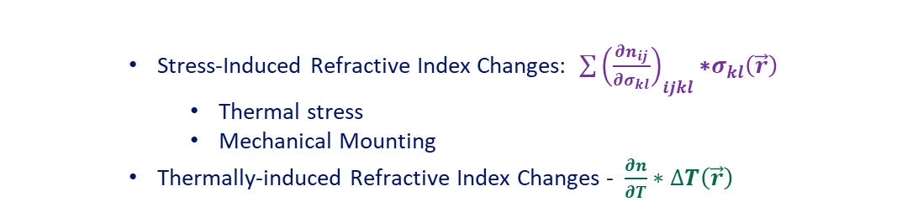
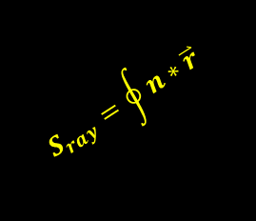

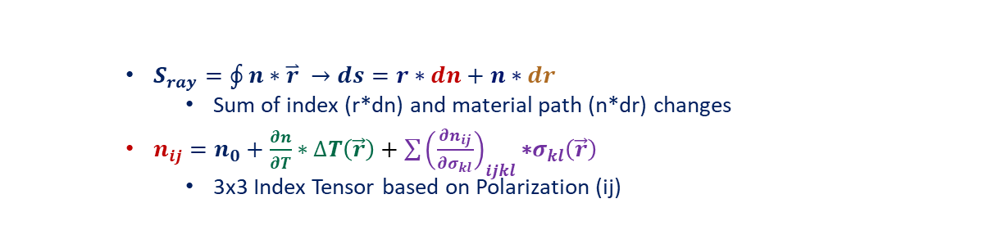

Amplifier Thermo-mechanical-optical behavior drives laser quality
How does wavefront effect laser quality?
  Optical techniques can only remove a portion of the distortion
  Residual phase reduces size of the final focus → Lower Intensity
Effect 1: Wavefront and Focusability
Amplifier Wavefront or Optical Phase Distortion - S(x,y)
$$S_{ray}=\oint{n∗\overset{⃑}{r}}$$
Why is it critical to quality?
  $S_{ray}=\oint{n∗\overset{⃑}{r}} →ds=r∗dn+n∗dr$
    Sum of index (r*dn) and material path (n*dr) changes
  $n_{ij}=n_{0}+\frac{∂n}{∂T}∗∆T\left(\vec{r}\right)+\sum{{\left(\frac{∂n_{ij}}{∂σ_{kl}}\right)}_{ijkl}\text{∗}σ_{kl}\left(\vec{r}\right)}$
    3x3 Index Tensor based on Polarization (ij)
Adaptive Optics
The Index Sources - $r∗dn$
  Stress-Induced Refractive Index Changes: $\sum{{\left(\frac{∂n_{ij}}{∂σ_{kl}}\right)}_{ijkl}\text{∗}σ_{kl}\left(\vec{r}\right)}$
    Thermal stress
    Mechanical Mounting
  Thermally-induced Refractive Index Changes - $\frac{∂n}{∂T}∗∆T\left(\vec{r}\right)$
$$I(\vec{r})$$
The Pathlength Sources - $n∗dr$
$$\vec{r}$$
  CTE Expansion
  Index- and CTE-Induced Focusing → New Ray Paths
$$\vec{r}$$

Slide 6
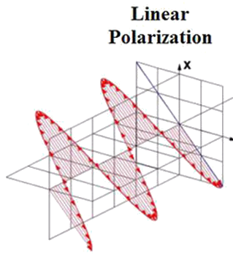




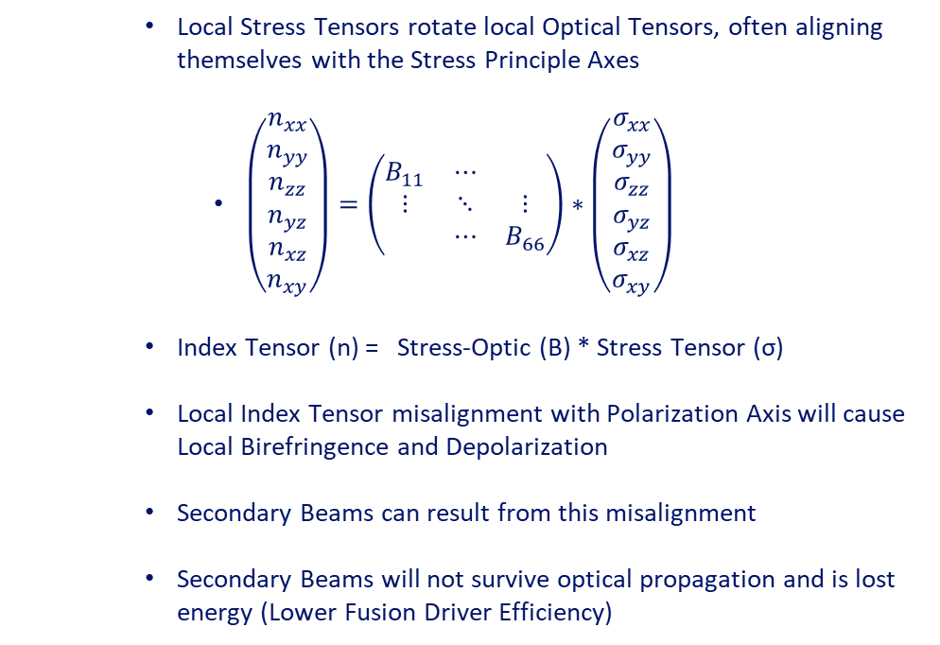


Amplifier Thermo-mechanical-optical behavior drives laser quality
How does Polarization effect laser quality?
  Laser is optimized for single polarization
  Other polarizations will be quickly removed --> Energy loss
Effect 2: Depolarization and birefringence
Polarization - $\vec{P}$(x,y)
$${\vec{P}}_{0}$$
  Local Stress Tensors rotate local Optical Tensors, often aligning themselves with the Stress Principle Axes
    $\left(\begin{matrix}n_{xx} \\ n_{yy} \\ n_{zz} \\ n_{yz} \\ n_{xz} \\ n_{xy}\end{matrix}\right)=\left(\begin{matrix}B_{11} & ⋯ & \\ ⋮ & ⋱ & ⋮ \\ & ⋯ & B_{66}\end{matrix}\right)∗\left(\begin{matrix}σ_{xx} \\ σ_{yy} \\ σ_{zz} \\ σ_{yz} \\ σ_{xz} \\ σ_{xy}\end{matrix}\right)$
  Index Tensor (n) = Stress-Optic (B) * Stress Tensor (σ)
  Local Index Tensor misalignment with Polarization Axis will cause Local Birefringence and Depolarization
  Secondary Beams can result from this misalignment
  Secondary Beams will not survive optical propagation and is lost energy (Lower Fusion Driver Efficiency)
$${\vec{P}}_{0}$$
Why is it critical to quality?
Adaptive Optics
Birefringent Beam
Rotated Local
Optical Tensors in Amplifier Media
$${\vec{dP}}_{0}$$
$${\vec{P}}_{f}$$
$${\vec{P}}_{0}$$

Slide 7
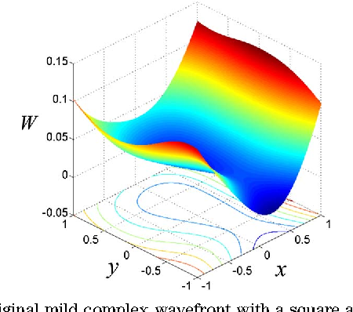

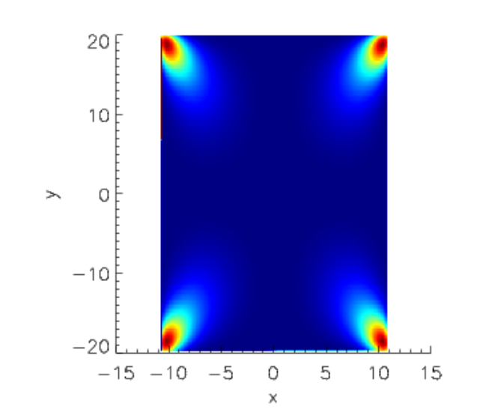
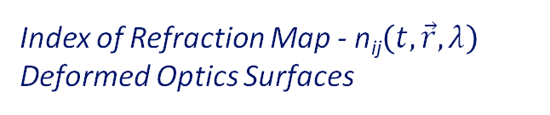


Segregated Solver to capture complete chain of events from pump to propagation
Pump Light Ray-Trace
Excited State Energy Deposition
Pumping
Energy Map:$Eupper(t,\vec{r})$
Transient Laser Energetics
Thermal Energy Storage
Energetics
Heat Map:$Q(t,\vec{r})$
Fluid Dynamics
Conjugate Heat Transfer
Thermal Stress
Surface Bowing and Deformations
Thermo-
Mechanics
Index of Refraction Map - n_{ij}$\left(t,\vec{r},λ\right)$
Deformed Optics Surfaces
Thermo-Optic Distortions
Local Birefringence
Propagation thru Deformed Optics
Propagation

Slide 8
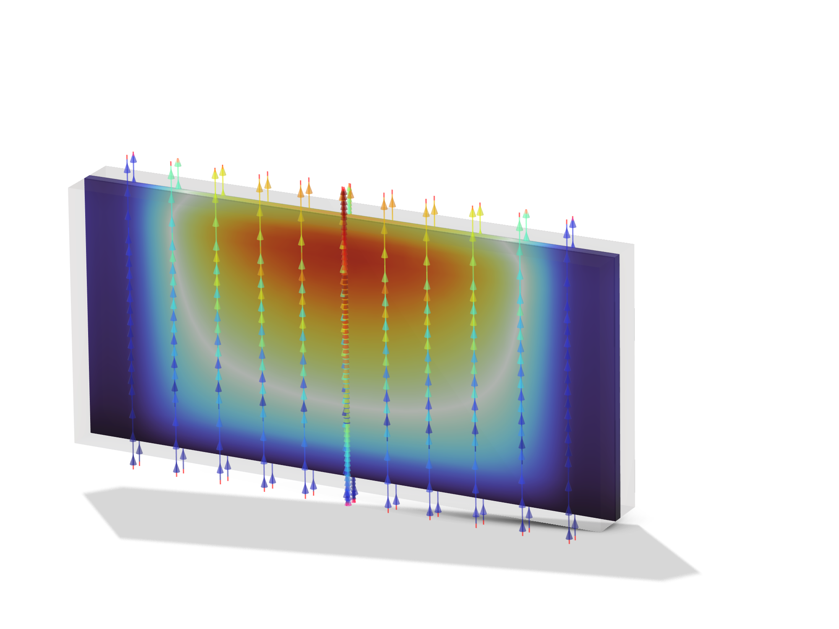
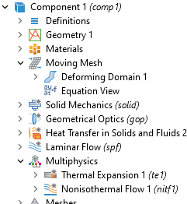

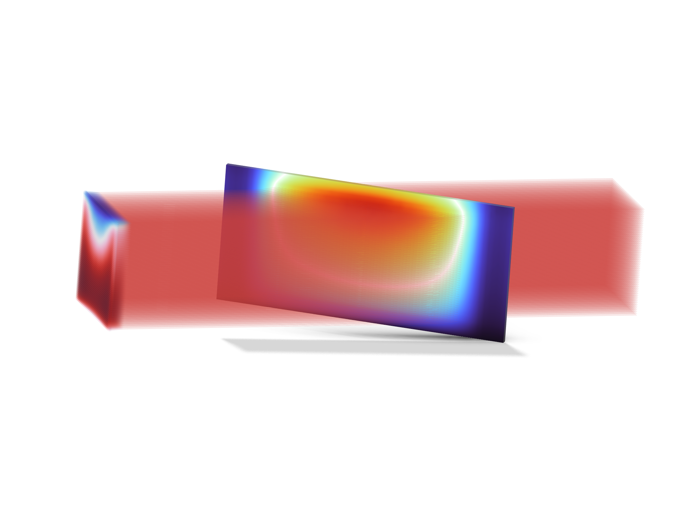
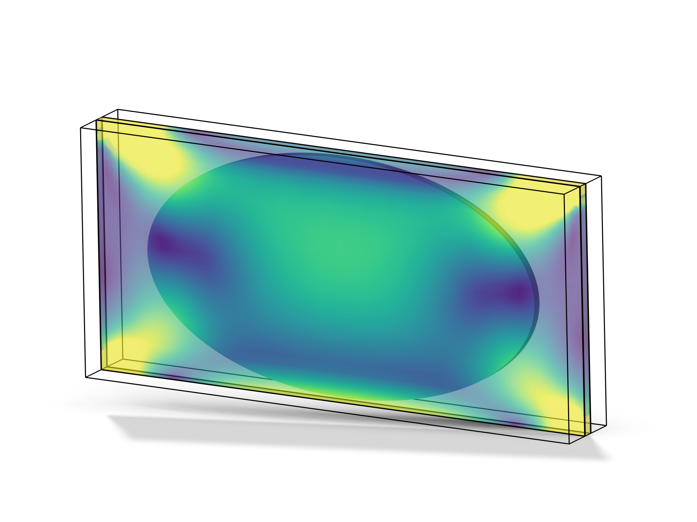
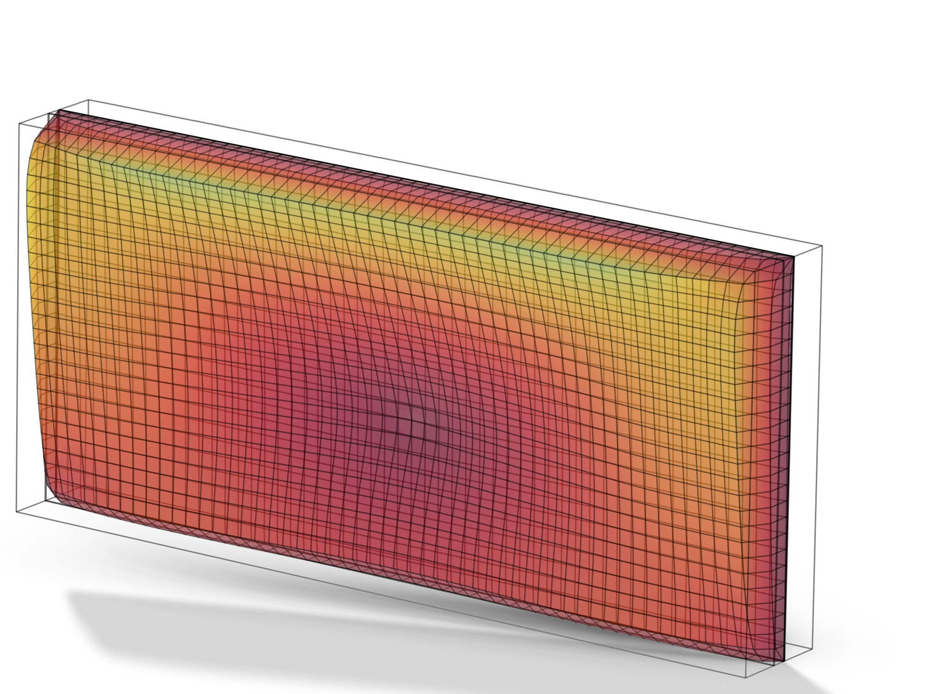
The solution leverages built-in modules with encapsulation of benchmarked laser codes and manufacturing data
Pump Source Modelling
+Ext Modelling of Diode Characteristics
Heat Transfer + CFD
+Ext Module: Diode Excitation to Heat Map
Ray Optics
+Mfg Data on Stress-Optical Tensors
Moving Mesh
+Capture evolving micro-channel & optic definition
Solid Mechanics
+Mfg Data on Elastic Tensor Axes

Slide 9
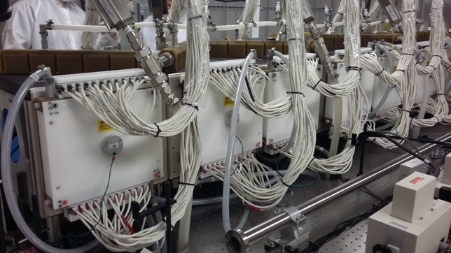
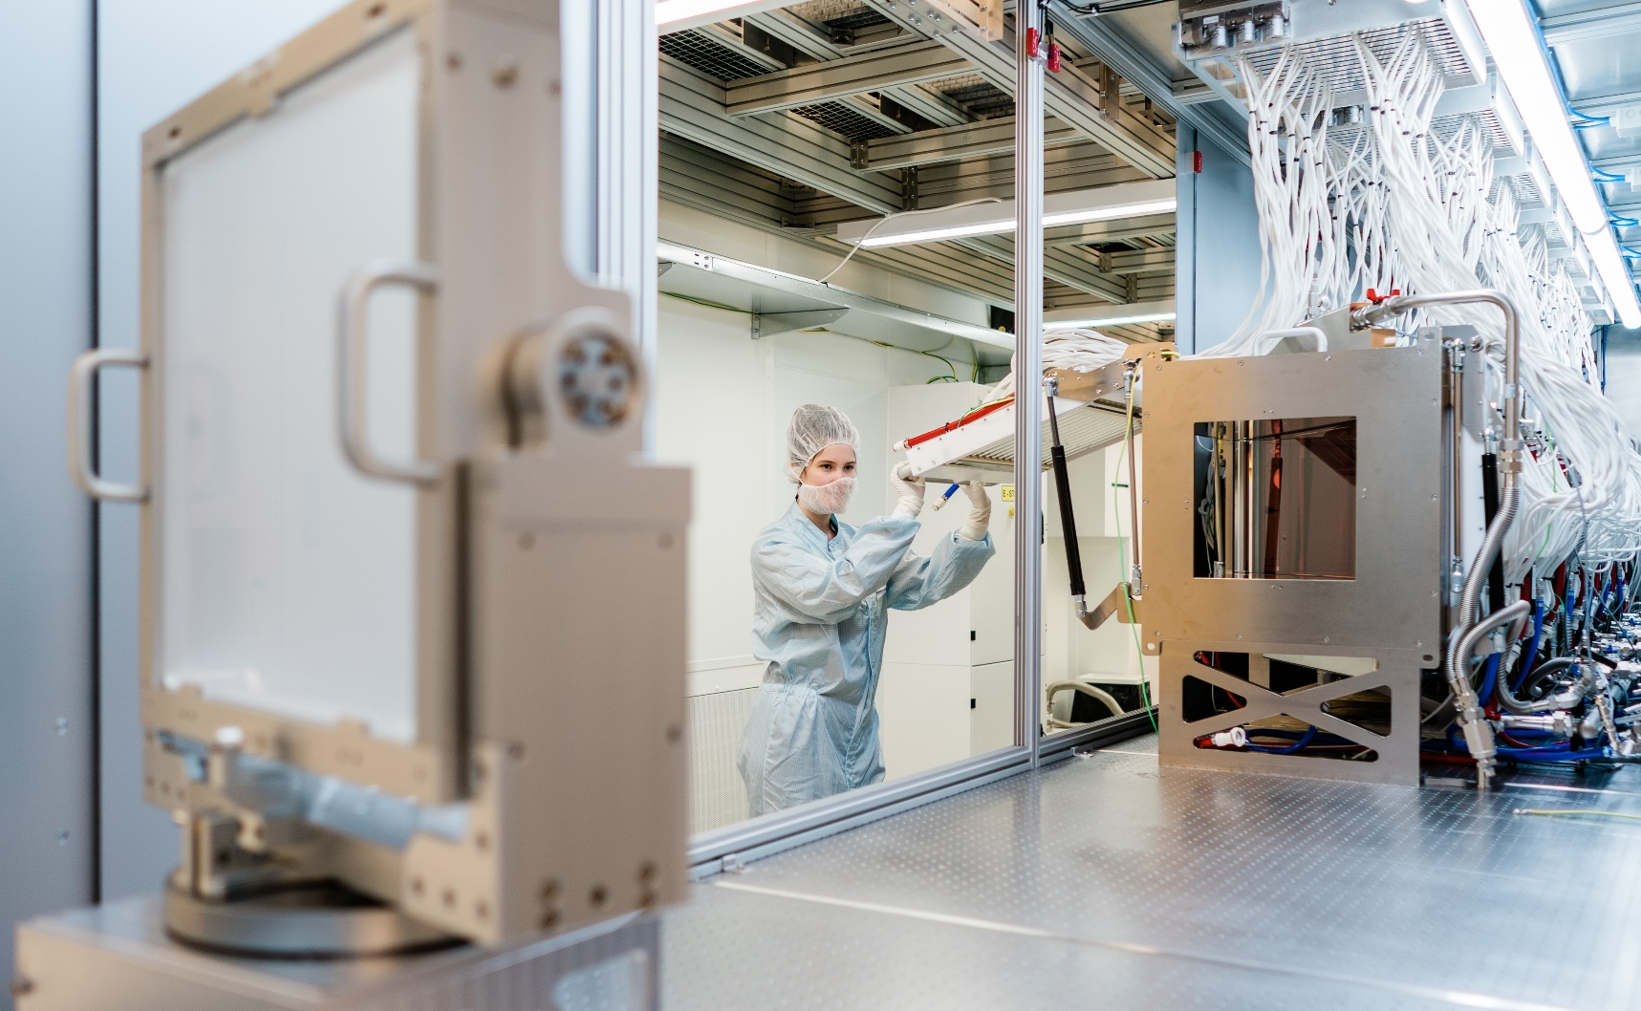


Code benchmarking relative to known performance of existing actively-cooled lasers by former system experts in-house
CNE400 Pump Laser – Saclay, FR
Flashlamp-Pumped – 400J @ 1054nm
L4-Aton Laser – Prague, CZ
Flashlamp-Pumped – 1500J @ 1054nm
Each laser equivalent to 1 of the N Lasers required to compress the fuel pellet for a Laser Fusion Power Plant
Next generation of Amplifiers builds upon and extends the performance

Slide 10
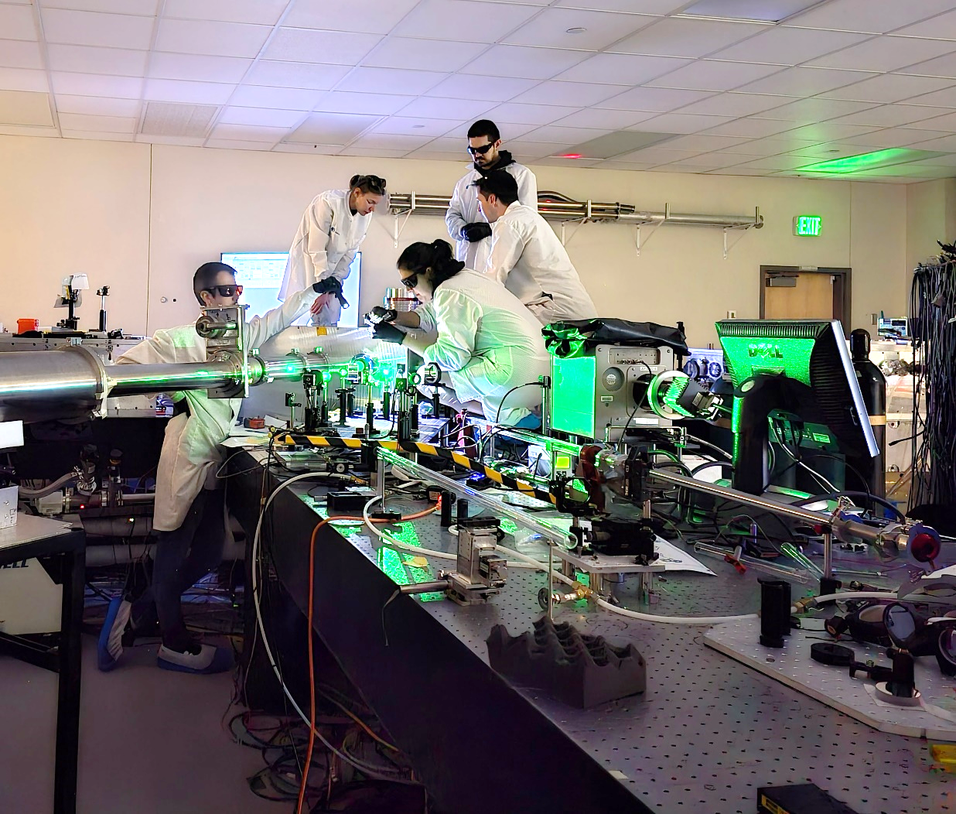
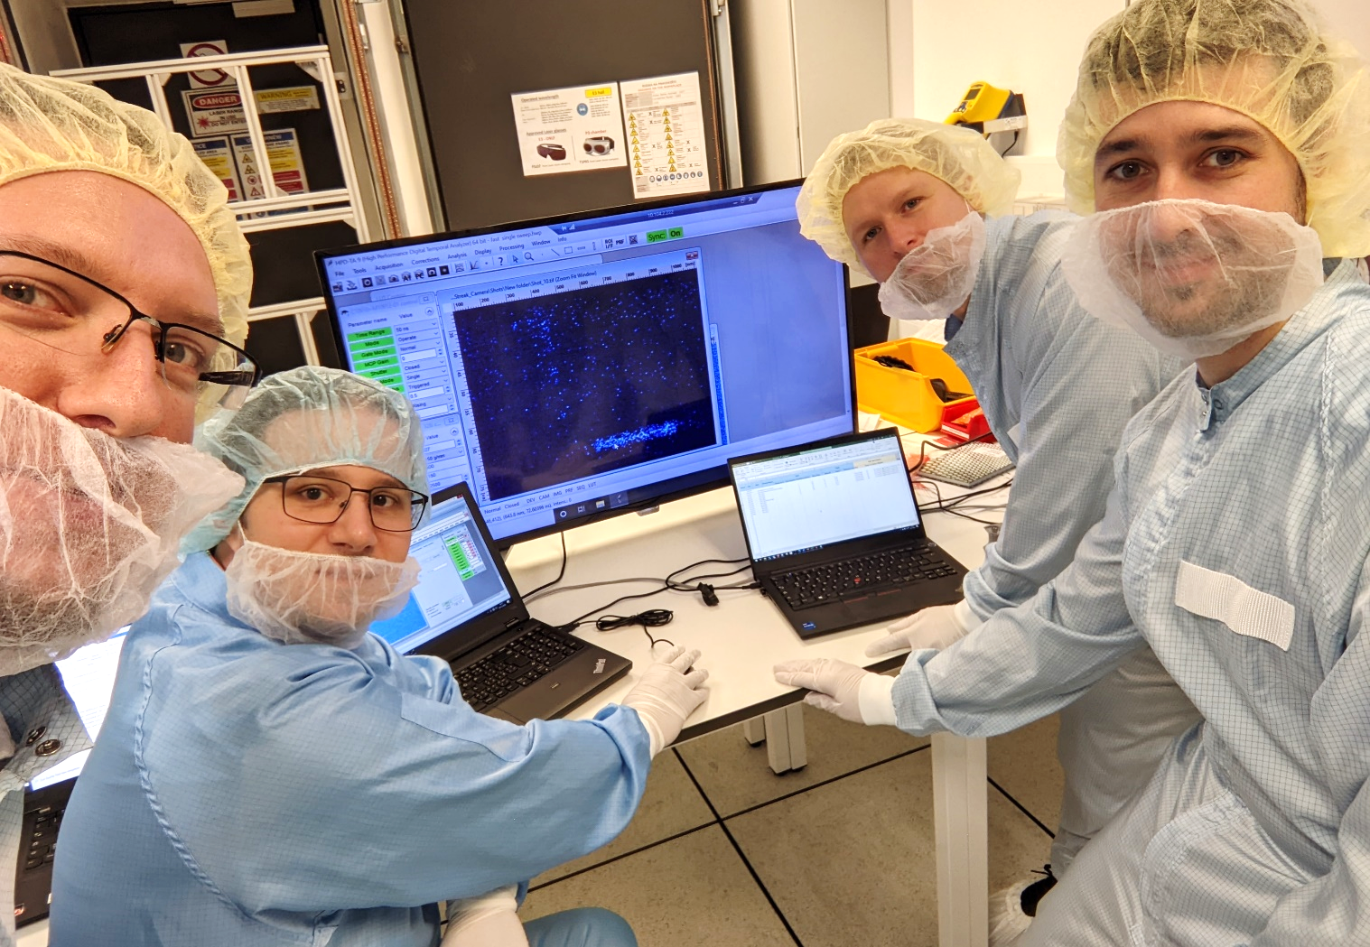
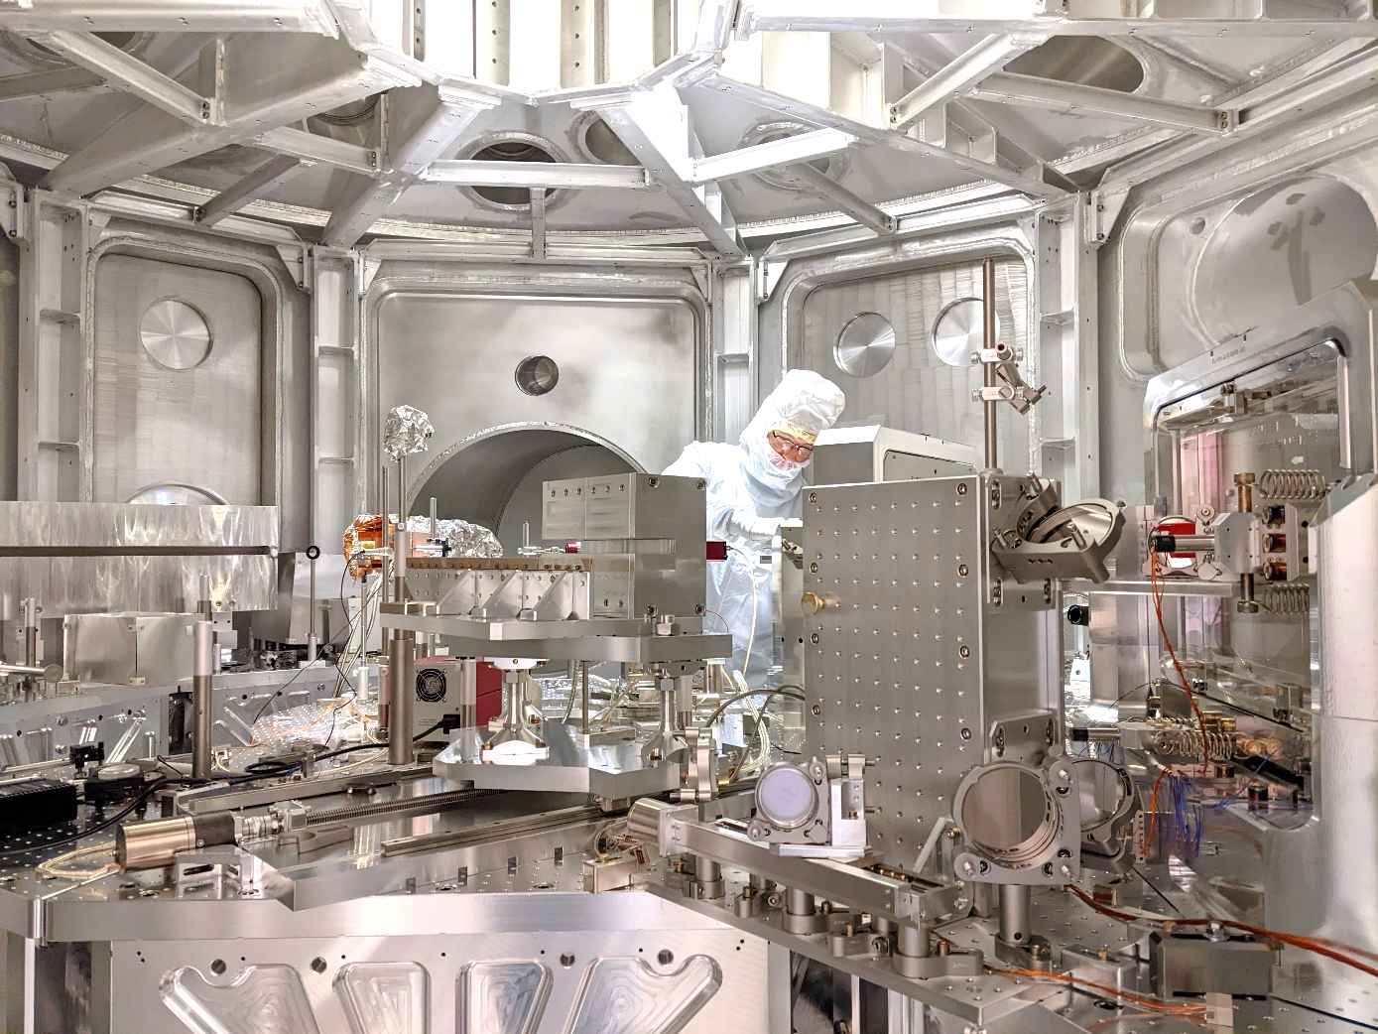

Thanks for your attention and interest in Fusion Energy!
We are happy to field any questions or comments at this time
Interested in joining one of our expanding teams?
Reach out or go to www.focused-energy.world and Select “Careers” to see active opportunities. Spontaneous applications also welcome!

