Slide 1
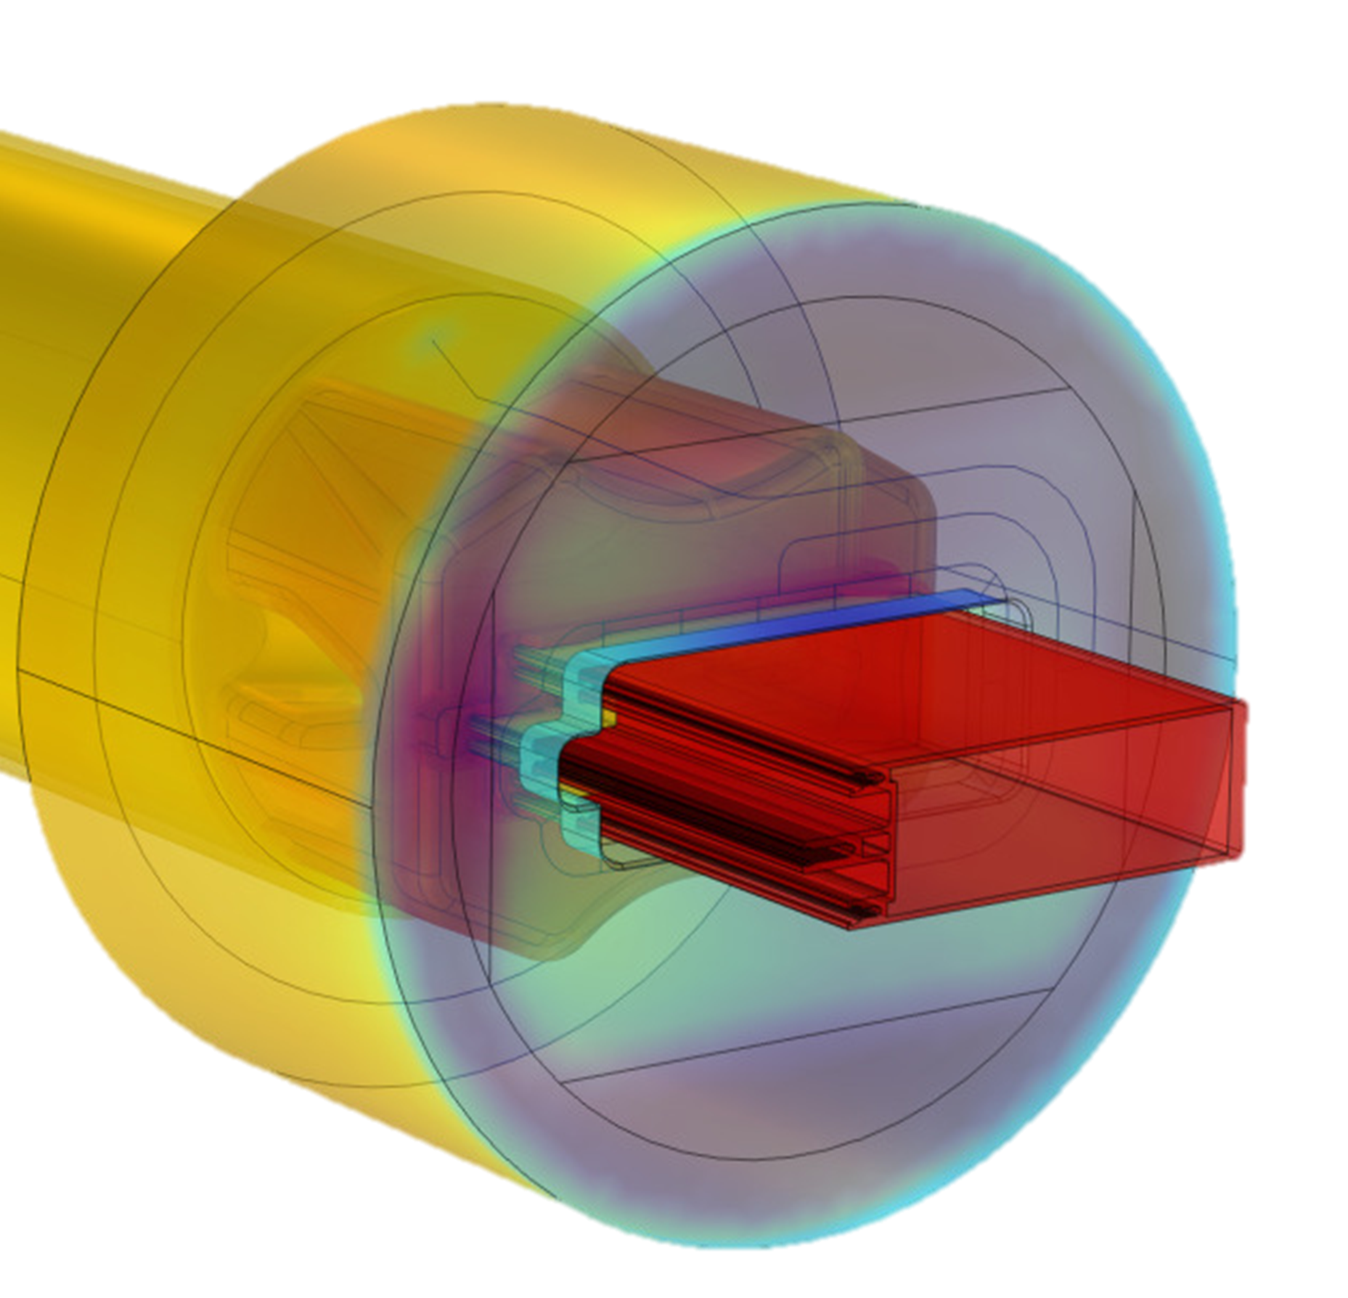

Advanced multi-physics models for the optimization of the hot extrusion process of light alloys
R. Pelaccia^{1*}, B. Reggiani¹, M. Negozio², S. Di Donato³, L. Donati³
DISMI - Department of Sciences & Methods for Engineering. University of Modena & Reggio Emilia
DISTI– Department of Engineering for Industrial Systems and Technologies University of Parma
DIN- Department of Industrial Engineering, University of Bologna
*Corresponding author email: riccardo_p@unimore.it

Slide 2
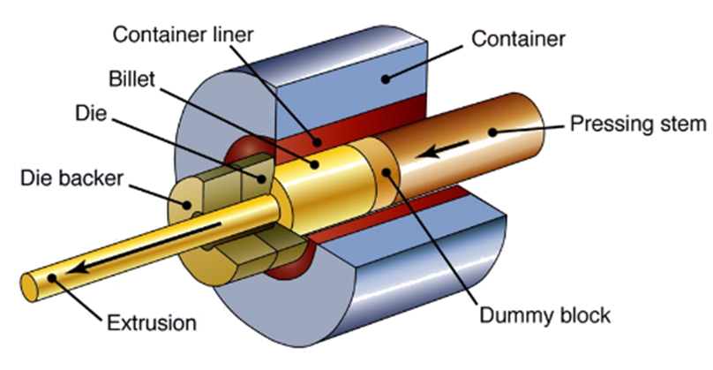
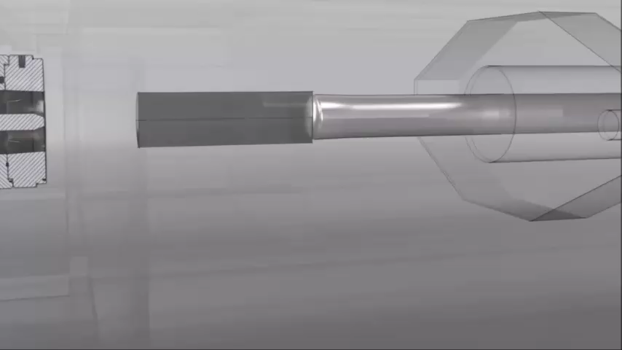
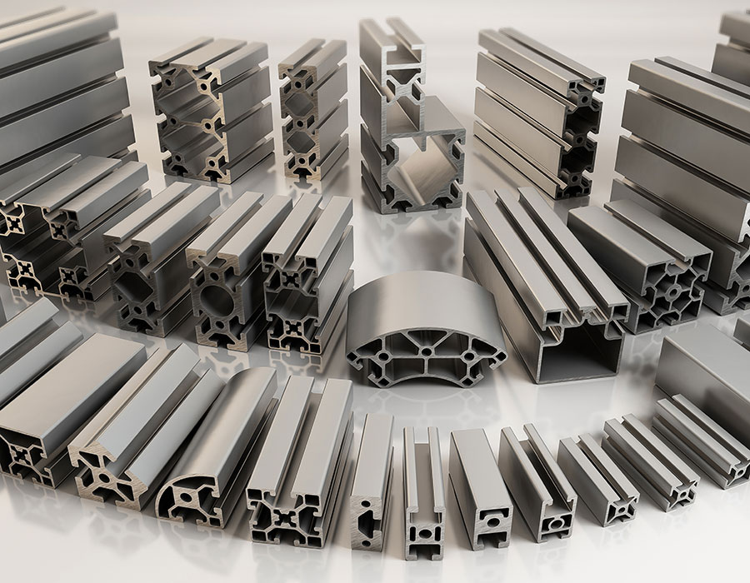
The hot extrusion process of light alloys
Some Fields of Application:
Furniture design
Automotive
Aeronautics
Railway transportation
Construction…
Extruded Aluminum:
High geometric complexity
High strength-to-density ratio
High Corrosion Resistance
High Crash Resistance…
High quality and shape complexity required
Aim of the work
Show the recent advancements in the simulation of the extrusion process
The use of simulation becomes essential
Very competitive market

Slide 3
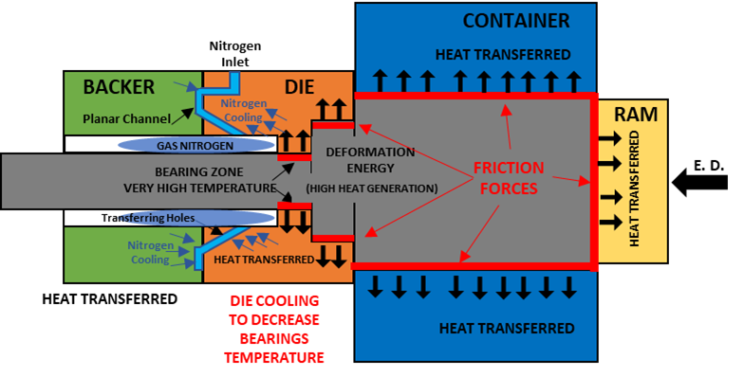
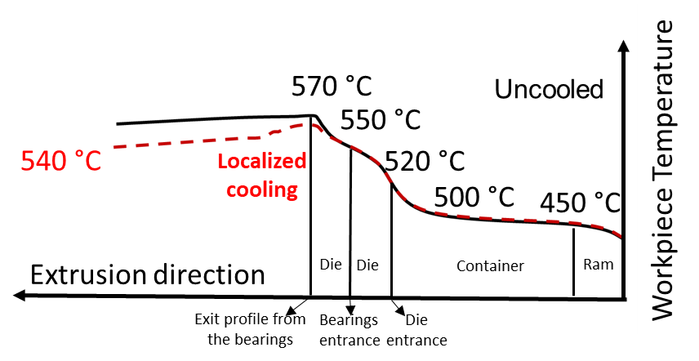
From real process to numerical simulation
Involved phenomena
Deformation energy and friction forces are converted into heat
High temperatures are necessary to promote the proper material flow and to reduce the extrusion load
Exit profile temperature can limit the maximum productivity (nitrogen cooling possible solution)
Continuous process (high productivity) lead to interaction between two subsequent billet (unavoidable defects)
Identify what is necessary to simulate
Prediction of thermal field and extrusion load
Prediction of material flow behavior
Tooling-set stress analysis
Prediction of extrusion defects

Slide 4
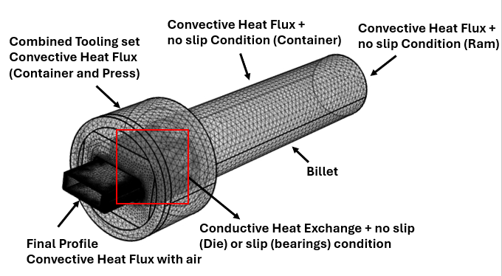
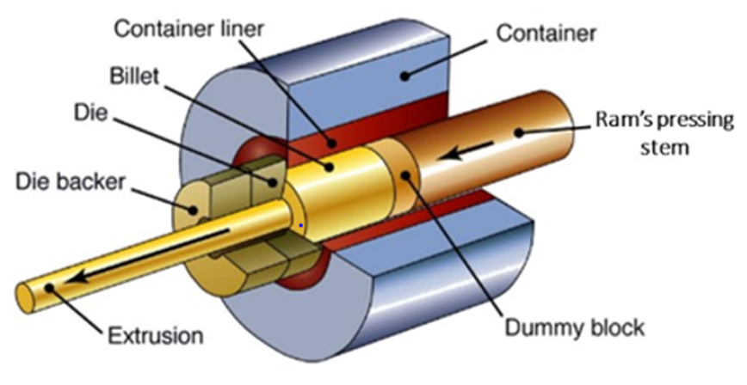
Model Implementation (Uncooled Extrusion Process)
Real Extrusion Process
COMSOL Model
Container and Ram replaced with equivalent thermal and frictional conditions (Eulerian approach )
Material under deformation treated as a fluid at very high viscosity (Laminar Flow)
Viscosity is temperature and strain-rate depended (Zener-Hollomon model)
Heat Transfer and Laminar Flow equations are coupled
Solid Mechanics Interface is added for the tooling set stress analysis

Slide 5
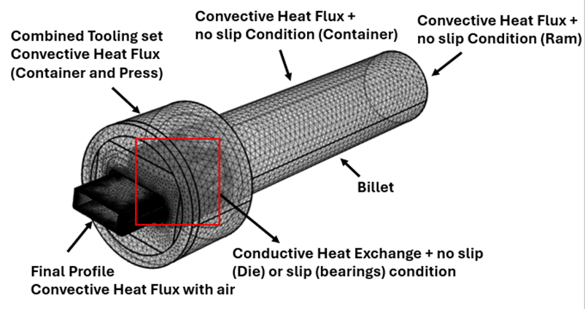
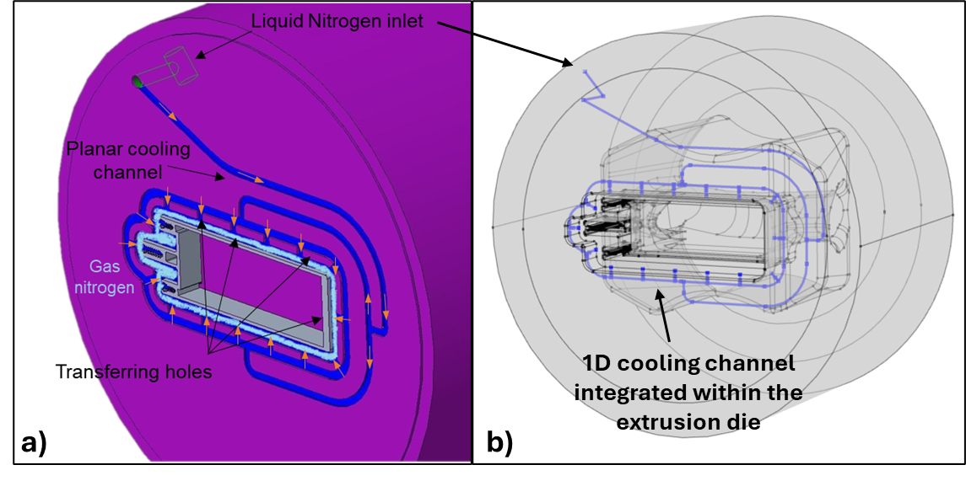
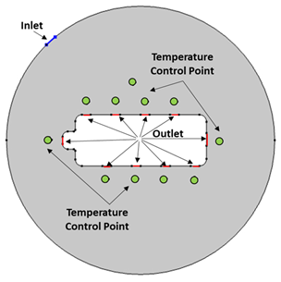
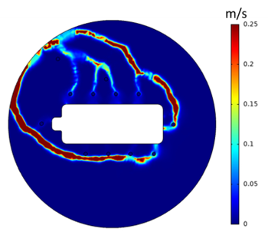
Model Implementation (Extrusion Process with Nitrogen Cooling)
The 3D model of extrusion process is coupled with 1D model of cooling channel
Non-Isothermal Pipe Flow is added and coupled with the Heat Transfer interface
If necessary, a preliminary evaluation of the channel design is possible with Topological Optimization interface (Density Model + Porous Media)
Backer is “virtually milled” to obtain the cooling path

Slide 6
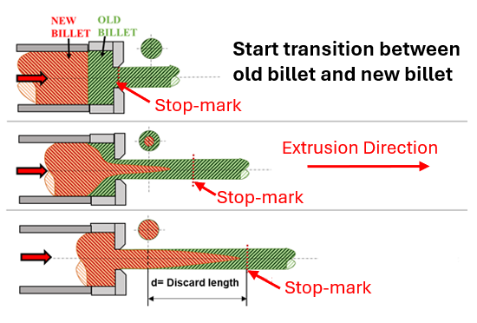
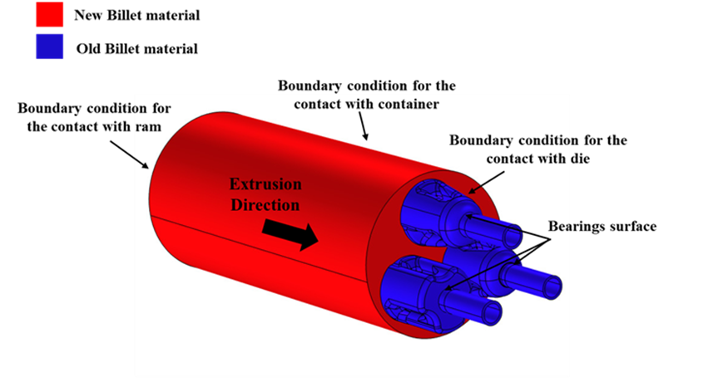
Model Implementation (Extrusion defects)
Since the extrusion is performed in continuous process, a certain length of the profile is contaminated by the interaction between the old and the new billet material for each run.
This contaminated length is unavoidable scrap (low mechanical properties)
Phase field interface was chosen to describe the interaction between two immiscible fluids

Slide 7
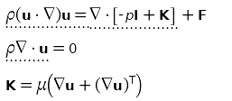
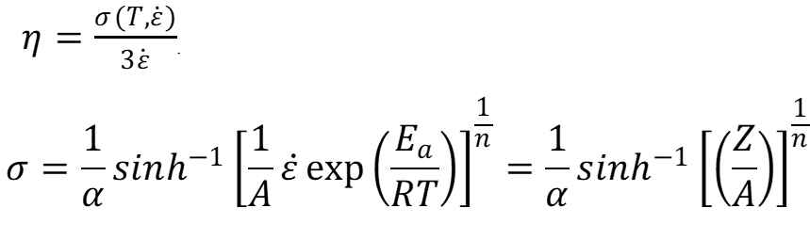

Equations (Material Flow and Heat Exchange)
Navier-Stokes Equations for incompressible flow (Laminar Flow Interface)
Conservation of momentum
Conservation of mass
Viscous term
COUPLED SYSTEM
Perzyna viscoplastic model
Zener-Hollomon Model of material flow stress
Fourier Equations for heat transfer in solid and fluid (Heat Transfer in Solid and Fluid Interface)

Slide 8
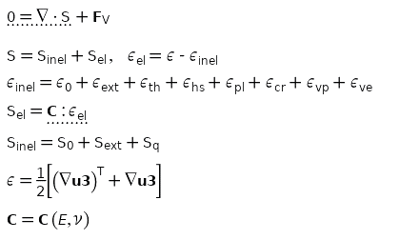
Equations (Die-stress analysis)
Tooling set subjected to compression state
Solid Mechanics Interface
Momentum balance
Fixed
Aluminum under deformation
Thermal expansion from Heat Transfer Interface
Fixed
Pressure on die-set from Laminar Flow Interface

Slide 9
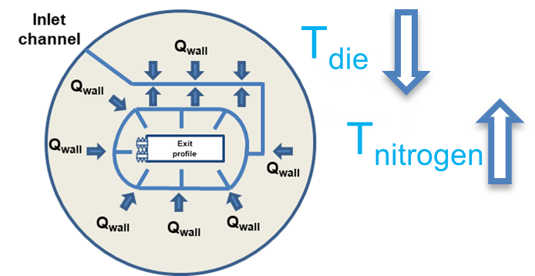

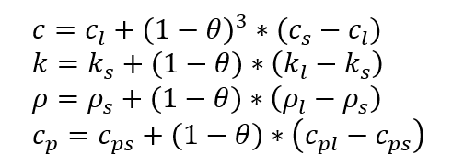

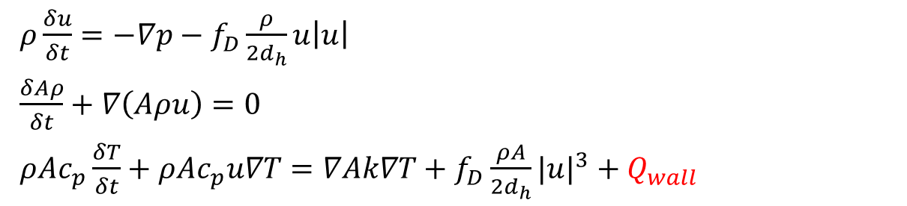
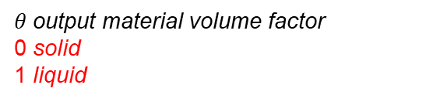
Equations (Nitrogen Cooling)
$ρ\frac{δu}{δt}=−∇p−f_{D}\frac{ρ}{2d_{h}}u\left|u\right|$
$\frac{δAρ}{δt}+∇\left(Aρu\right)=0$
$ρAc_{p}\frac{δT}{δt}+ρAc_{p}u∇T=∇Ak∇T+f_{D}\frac{ρA}{2d_{h}}|u|^{3}+Q_{wall}$
Conservation of the momentum
Conservation of the mass
Heat transfer equation
4. Convective contribute with the die
5. Heat transfer equation for the die
Hydraulic diameter variable along the path
Non-Isothermal Pipe Flow Interface
h is not constant
$Q_{wall}=hZ(T_{die}−T)$
$ρ_{2}C_{p2}\frac{{∂T}_{die}}{δt}=∇⋅k∇T_{die}$- $Q_{wall}$
Heat Transfer in Solid and Fluid interface
Phase change of nitrogen is not simulated
C_{p}, ρ, k function of temperature to consider the effect of nitrogen phase change (Homogenous fluid model)
Topological Optimization interface
Porous domain virtually milled
Density Approach
Penalization functions
Permeability
Conductivity
Density
Specific Heat Capacity
$θ$output material volume factor
0 solid
1 liquid

Slide 10
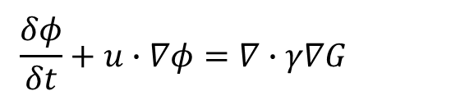
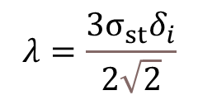
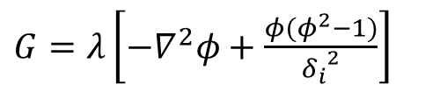

Equations (Extrusion defects)
Velocity field from Laminar Flow interface
Chemical Potential
$$\frac{δφ}{δt}+u∙∇φ=∇∙γ∇G$$
Cahn-Hilliard equation
Mobility tuning parameter
ϕ phase field parameter:
-Value 0 fluid 1
-Value 1 fluid 2
$$γ=χ{δ_{i}}^{2}$$
$G=λ\left[−∇^{2}φ+\frac{φ(φ^{2}−1)}{{δ_{i}}^{2}}\right]$
$$λ=\frac{3σ_{st}δ_{i}}{2\sqrt{2}}$$
Surface tension

Slide 11
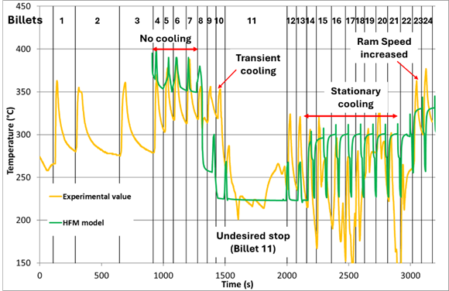
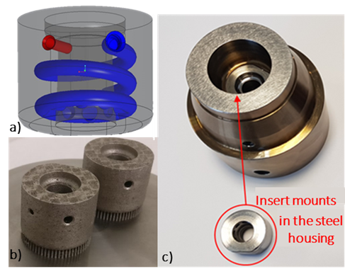
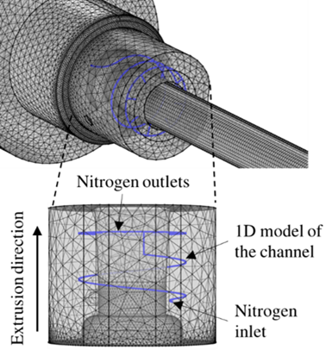
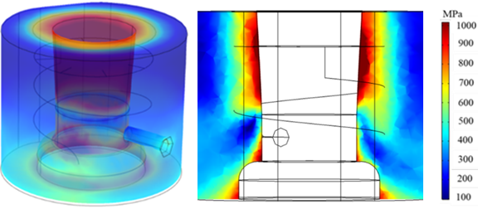
Case Study 1: Multi-die design with conformal cooling channel
Insert for extrusion die realized with 3D manufacturing technology (SLM)
Thermal History recorded by the thermocouple
Thermocouple hole
Helicoidally conformal cooling channel
RESULTS
COMSOL Model and Process Parameters
Die stress analysis
All points under the yield stress
Insert resisted the whole campaign without defects

Slide 12
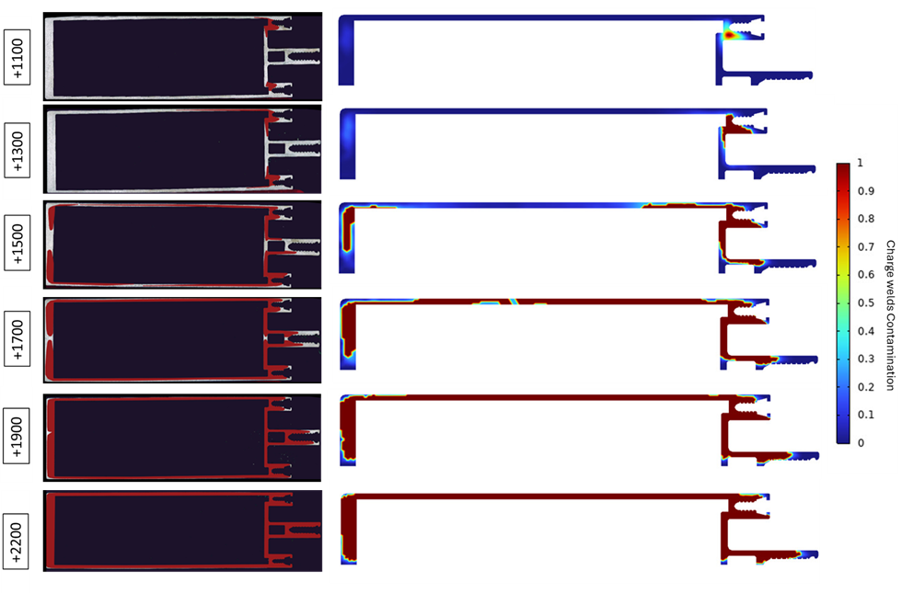
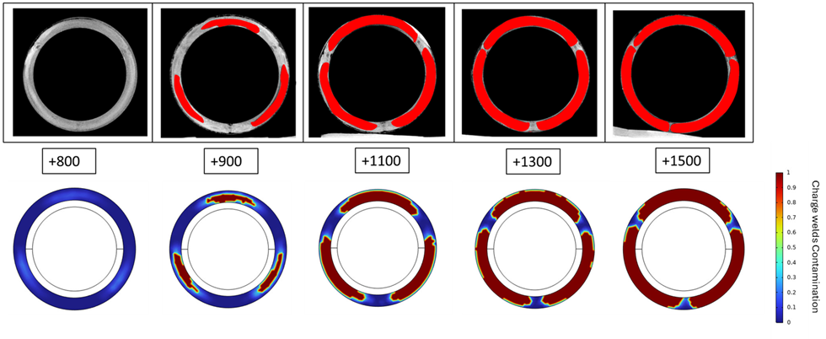
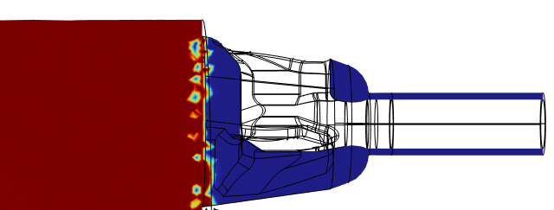
Case Study 2: Phase field method for the assessment of the new-old billet material interaction
New billet material (visible after chemical etching)
Distance from the stopmark
Experimental Analysis is a time and cost consuming activity
Empirical and analytical approach not accurate
Excessive scrap
or
Not Enough Scrap

Slide 13
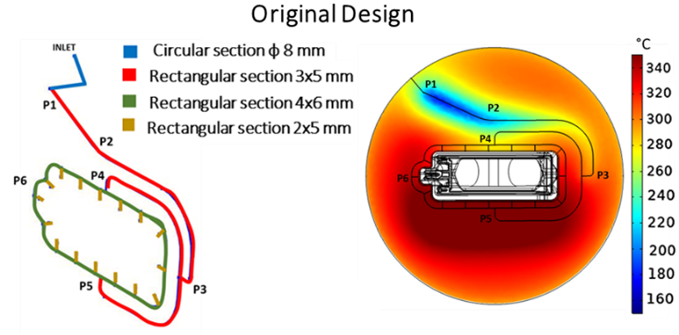
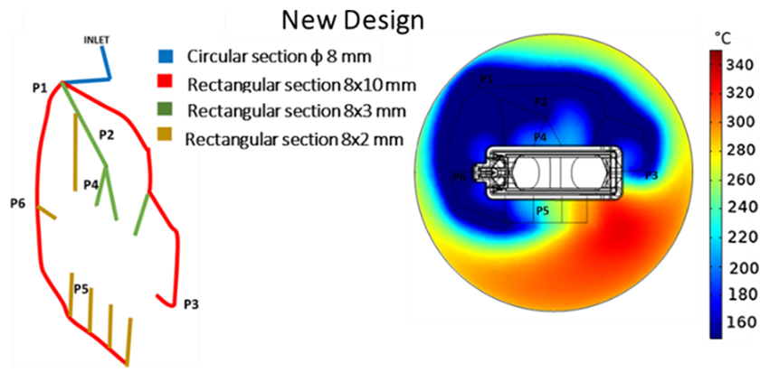
Case Study 3: Cooling Channel re-design by means of topological optimization interface
Gas formation
Channel designed by the die maker without numerical tools
Experimental results evidenced not efficient cooling
Numerical error below 10%
Same process parameters of the experimental trial
Topological optimization
Velocity field of nitrogen
Same inlet of original design, outlets reduced from 16 to 10
Temperature control points for objective function (balanced cooling around the die exit)
Maximum 25% of hollowed-out volume for cooling channel as constraint
Gas formation

Slide 14
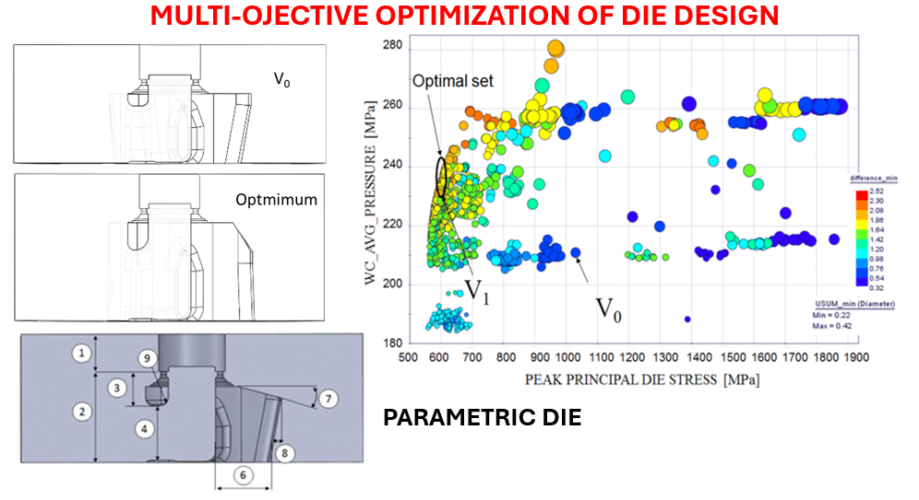
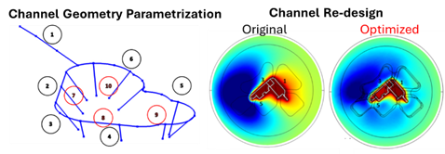
Case Study 4: Multi-objective optimization of extrusion die
MULTI-OBJECTIVE OPTIMIZATION OF COOLING CHANNEL
Change variable
Parametric CAD
Define new design
Initial Population
Optimization Platform
(Modefrontier)
Balanced cooling with the optimized design (max temperature difference from 60°C to 16°C)
Nitrogen consumption reduced of 60%
COMSOL with Matlab
Objective Functions
Constraints
Genetic Algorithm to optimize the problem
Test automatically all initial configuration
Test the new design
In the original die design a break occurred after 64 extrusion.
The optimal design showed a peak principal die stress reduced of 46%
Ram speed doubled
Mechanical properties of profile improved

Slide 15
Conclusions
Different interfaces were coupled to generate advanced models able to assess the hot extrusion process from different points of view.
The accuracy of numerical predictions was demonstrated in terms of extrusion load, thermal field, scrap assessment, cooling efficiency, and die stress analysis.
The experimental-numerical comparisons also showed the limits of industrial practices, sometimes based on experience and/or empirical approaches.
An advanced iterative procedures based on the use of genetic algorithms evidenced the concrete possibility of automatically optimizing the die design as well as the entire process concerning the objectives to be achieved.
References
R. Pelaccia, M. Negozio, et al., “Extrusion of Light and Ultralight Alloys with Liquid Nitrogen Conformal Cooled Dies: Process Analysis and Simulation”, J. Mater. Eng. Perform. 31, pp. 1991-2001, 2021.
S. Di Donato, R. Pelaccia and M. Negozio, “Phase Field Method for the Assessment of the New-Old Billet Material Interaction during Continuous Extrusion Using COMSOL Multiphysics”, J. of Materi Eng and Perform, 2024.
R. Pelaccia, B. Reggiani, et al., “Investigation on the topological optimization of cooling channels for extrusion dies”, Mater. Res. Proc. 28, pp. 533-542, 2023.
B. Reggiani, L. Donati and L. Tomesani, "Multi-goal optimization of industrial extrusion dies by means of meta-models", Int J Adv Manuf Technol 88, pp. 3281–3293, 2017.
R. Pelaccia, M. Negozio, et al., "Assessment of the Optimization Strategy for Nitrogen Cooling Channel Design in Extrusion Dies", Key Eng Mater. 926, pp. 460–47, 2022.

Slide 16
THANK YOU FOR YOUR ATTENTION
^{Contacts:}
Riccardo Pelaccia: riccardo_p@unimore.it
Barbara Reggiani: barbara.reggiani@unimore.it
Marco Negozio: marco.negozio@unipr.it
Sara Di Donato: sara.didonato2@unibo.it
Lorenzo Donati: l.donati@unibo.it

