Slide 1

Advanced FEM Simulation of Loudspeaker Performance:
The Impact of Cone and Surround Materials
Wednesday October 23rd, 2024
AUTHOR:
Adriane Replogle
POLITECNICO DI MILANO 1863
Music and Acoustic Engineering
ADVISOR:
Fabio Antonacci, Politecnico di Milano
CO-ADVISOR:
Chiara Corsini, Luca Villa, Faital S.p.A.
Slide n. 1
Notes:
Good afternoon, everyone. My name is Adriane Replogle, and today I will be presenting my masters thesis work ‘Advanced FEM Simulation of Loudspeaker Performance: The Impact of Cone and Surround Materials.’ This research was conducted under the guidance of my advisor, Professor Fabio Antonacci, and co-advisors, Chiara Corsini and Luca Villa. This work was done in collaboration with FAITAL S.p.A., Italian Loudspeaker Manufacturer in San Donato Milano.

Slide 2
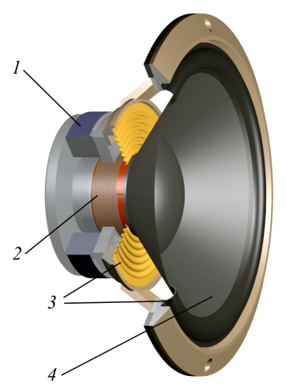
Loudspeaker Components
Introduction
Magnetic Circuit
  Provides a magnetic field for the voice coil
Voice Coil
  Electromotive Lorentz Force
Suspension System: Spider and Surround
  Keeps the moving components centered
  Provides restoring forces to bring to equilibrium
Cone
  Radiates sound; converts electrical signals into sound waves
Dust Cap
5
Notes:
We’ll start today with a quick recap of a dynamic loudspeakers main components: the magnetic circuit, the voice coil, suspension system comprising of the spider and surround, the cone, and finally the dust cap.

Slide 3
Loudspeaker Components
Introduction
Magnetic Circuit
  Provides a magnetic field for the voice coil
Voice Coil
  Electromotive Lorentz Force
Suspension System: Spider and Surround
  Keeps the moving components centered
  Provides restoring forces to bring to equilibrium
Cone
  Radiates sound; converts electrical signals into sound waves
Dust Cap
Membrane
5
Notes:
For clarity, this work analyzes the loudspeaker membrane which we consider both the loudspeakers cone and surround. The membrane of the loudspeaker is essential as it acts as the bridge passing from the electrical to the acoustic domain, and directly effects the performance of the loudspeaker. Even small variations in the material mechanical properties of the loudspeaker membrane can affect how the sound is propagated.

Slide 4
Motivation and Aim
Introduction
The effectiveness of FEM hinges on its ability to replicate the loudspeaker’s behavior accurately.
Variations in membrane materials can significantly influence performance.
Accurately modeling loudspeakers allows for the exploration of new designs, utilizing new materials
This work aims to…
Understand the magnitude of variations within membrane materials
Deepen understanding of how material properties affect loudspeaker performance
Present a robust FEM framework for analyzing loudspeaker materials
Notes:
The effectiveness of FEM hinges on its ability to replicate the loudspeakers behavior accurately. Variations in membrane materials, even small and even within membranes that are theoretically identical, can significantly influence loudspeaker performance. Of course, accurately modeling loudspeakers allows for the exploration of new designs, utilizing new materials.
A study was done last year, by G. Dong considering material effects on loudspeaker behavior, however the COMSOL library loudspeaker geometry was considered, and material information taken from Granta EduPack Material database, with no validation of results. While material libraries are a great starting point in loudspeaker design..
This work aims to better understand the magnitude of variations within membrane materials, deepen the understanding of how material properties affect loudspeaker performance, and present a robust FEM framework for analyzing loudspeaker materials.

Slide 5
Approach
M&M
Analysis of Material Mechanical Properties
FEM Optimization of Material Properties
Modeling of Loudspeakers
Measurement Verifications
Stage 1
Stage 2
Notes:
This was achieved in two stages
First with,
An in-depth material analysis of existing membrane designs
Coupled with a FEM optimization to obtain material properties
In the second stage,
3 loudspeakers were selected utilizing membranes which underwent material testing and models were built for each loudspeaker.
Finally, the models were validated through physical measurement verifications.

Slide 6
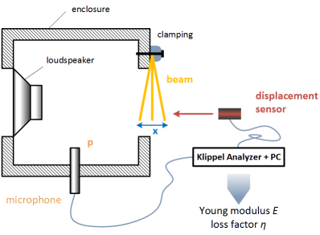
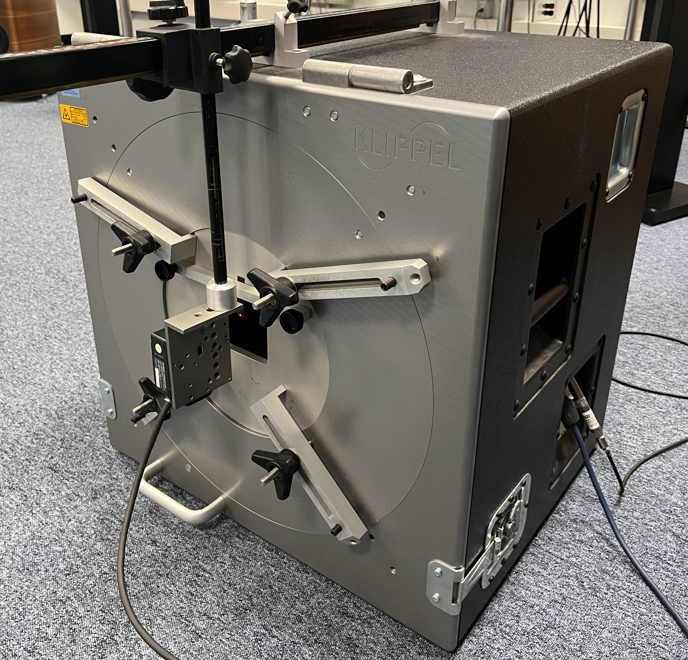
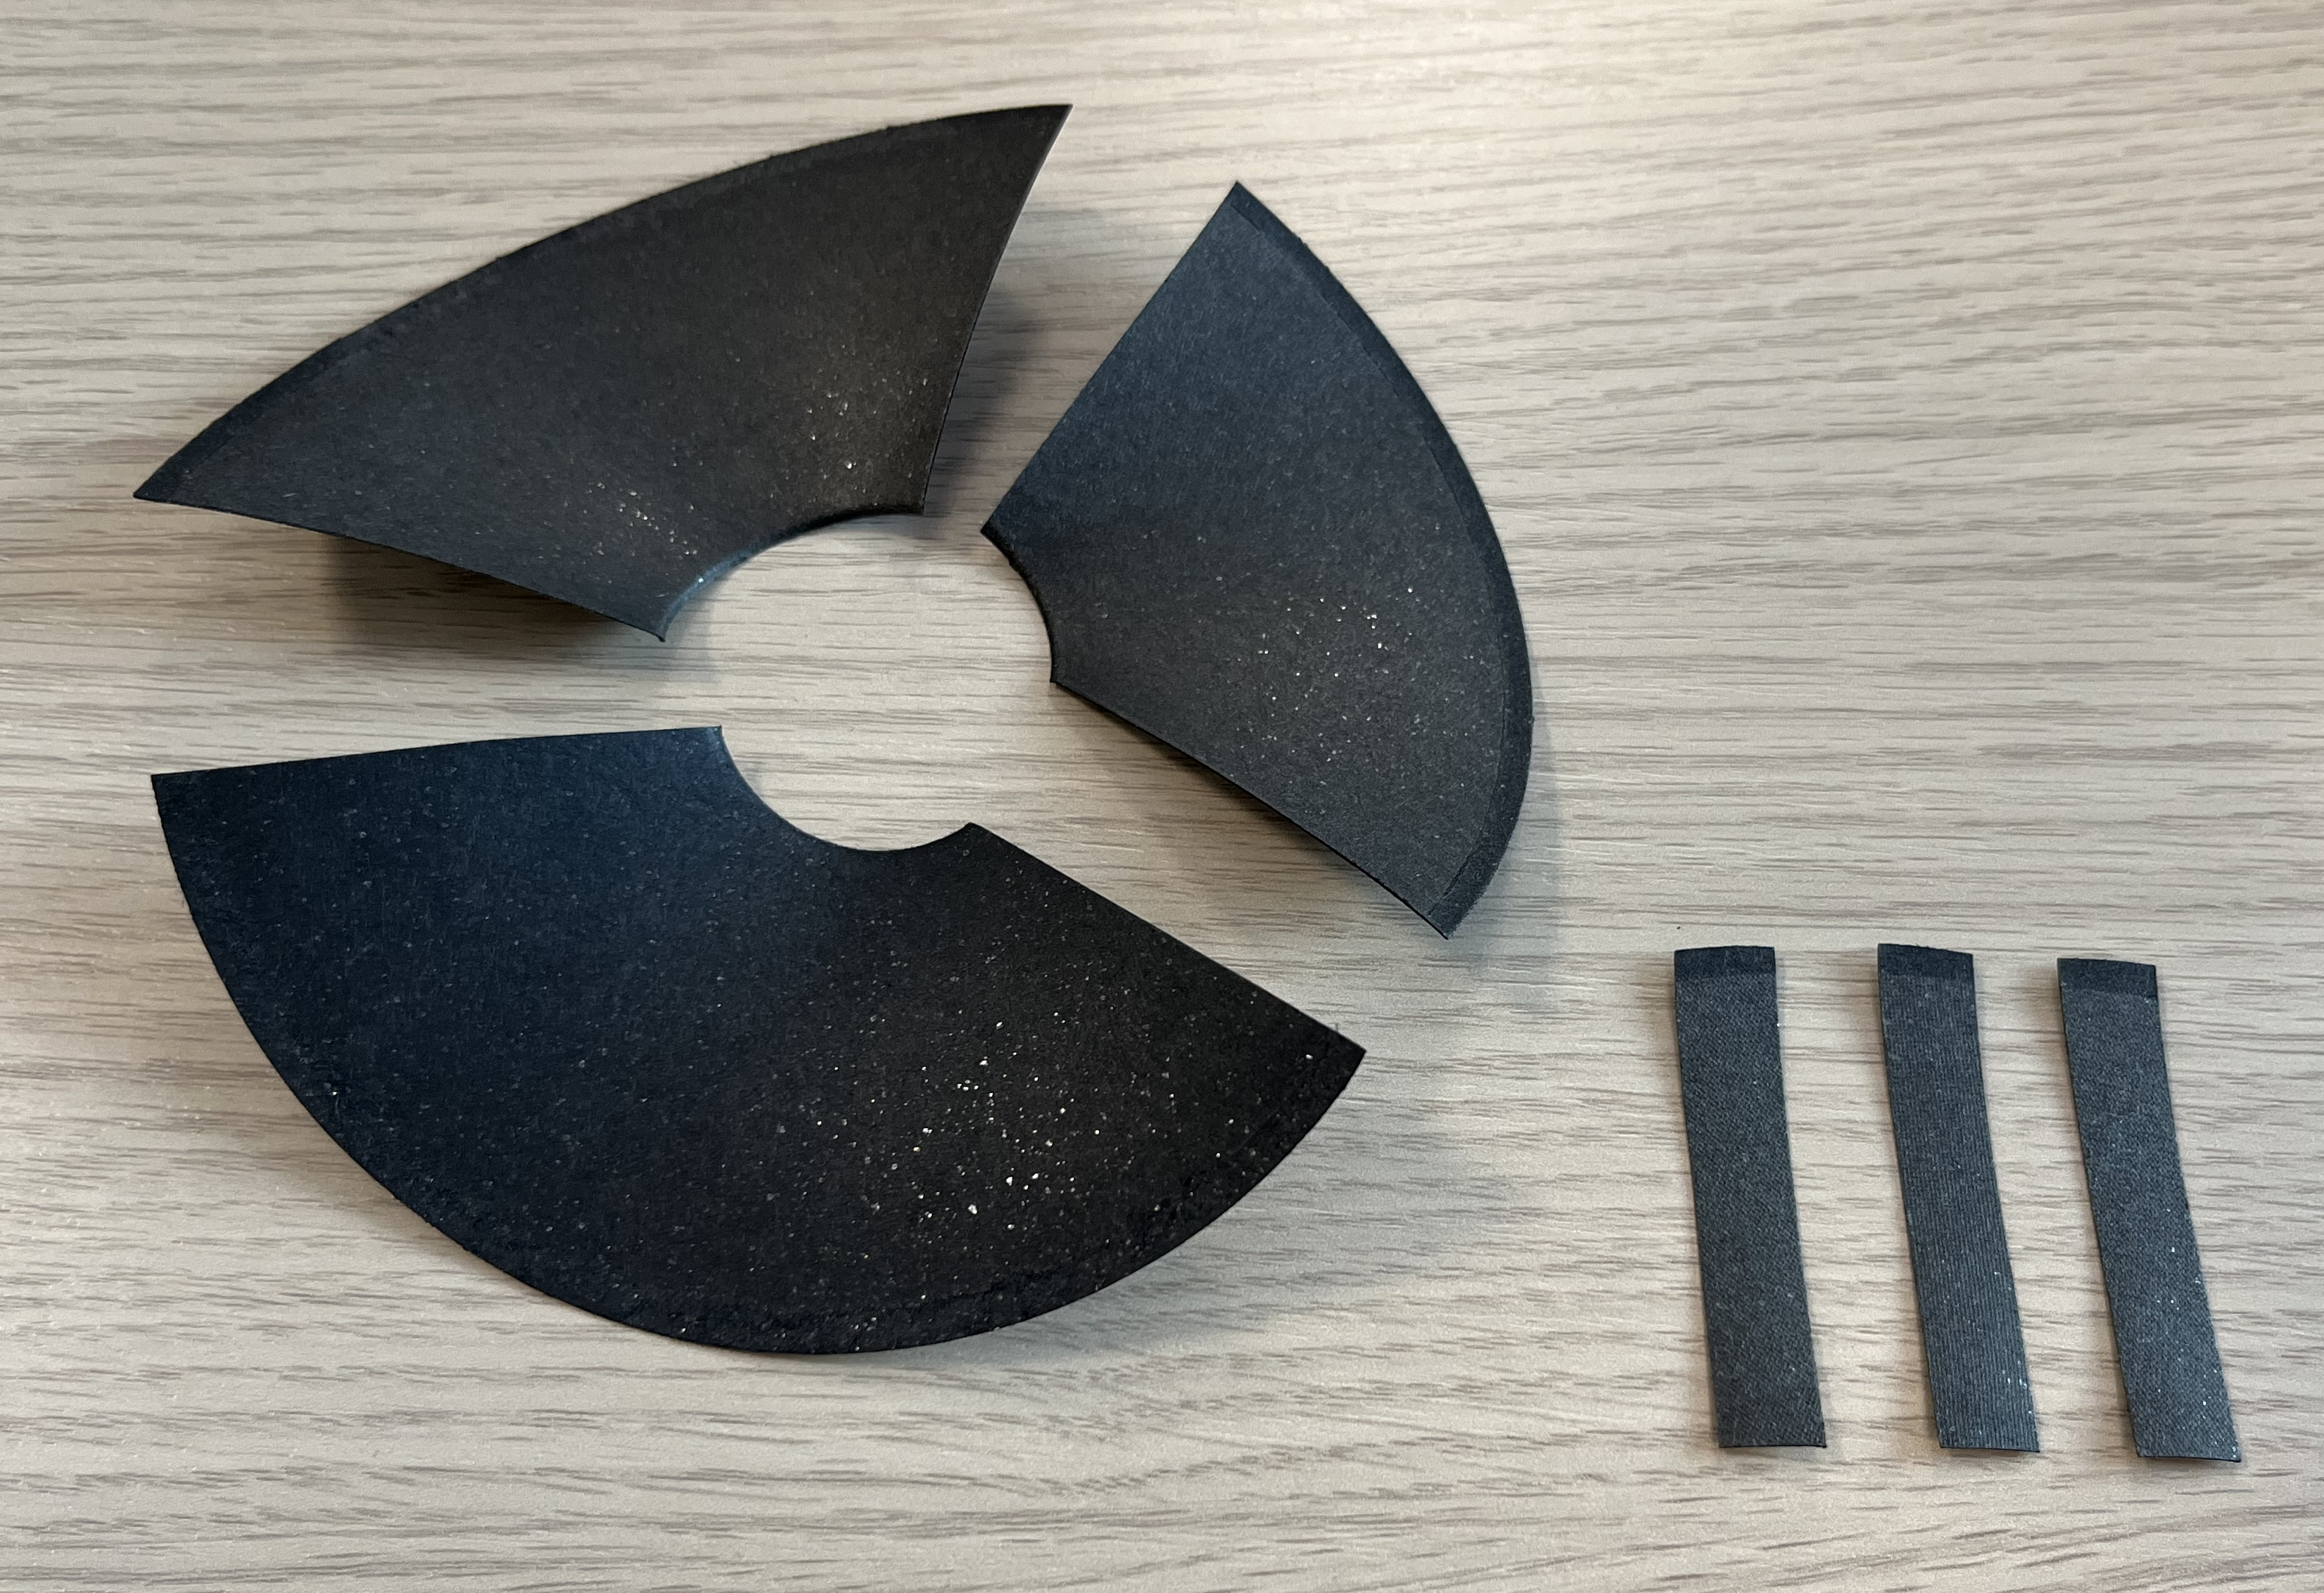
Klippel$®️$ Material Parameter Measurement (MPM)
M&M
Analysis of Materials
FEM Optimization of Properties
Modeling of Loudspeakers
Measurement Verification
The MPM module excites a strip of material by a sine sweep of the loudspeaker.
  Sound pressure p(t) and displacement x(t) are measured simultaneously.
  Transfer Function H(f) = X(f)/P(f) → Resonance Frequency Fs
Notes:
Beginning with the material analysis, Klippel® Material Parameter Measurement (MPM) module was used.
Without going into too much detail, Klippel MPM is a measurement bench which excites a strip of material clamped to one side of the bench by implementing a sine sweep of a loudspeaker attached to the other side.
During this excitation, a microphone inside the bench measured the sound pressure, while outside a laser is used to measure the materials displacement.
This data allows for the calculation of the transfer function: displacement over pressure as a function of frequency which allows for the calculation of material properties including the materials resonance frequency, young’s modulus.
The MPM module allows for the calculation of other material parameters, however these calculations are based on a flat piece of material. Due to the inherent curvature of the loudspeaker membrane, this measurement was chosen to be coupled with a model and optimization function to find each materials properties.

Slide 7
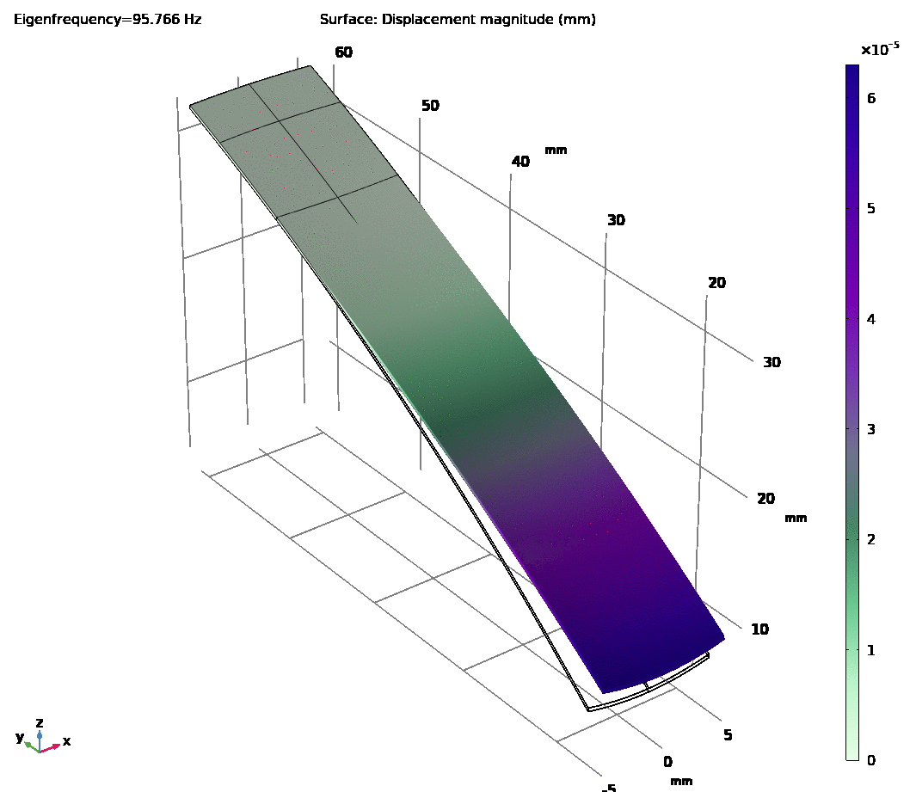
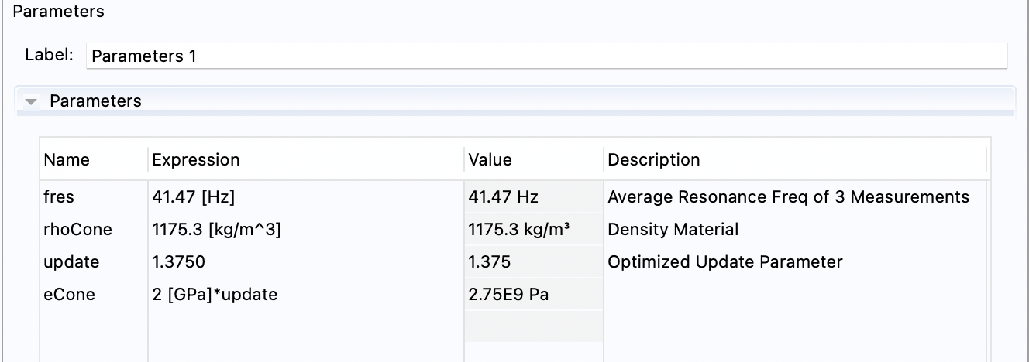
Cone Material FEM Models
M&M
Analysis of Materials
FEM Optimization of Properties
Modeling of Loudspeakers
Measurement Verification
Resonance frequencies were used as input in COMSOL
3-D model
Eigenfrequency study with optimization node to calculate the materials Young’s modulus.
Notes:
This model used the CAD design of each membrane, modeled the excited material under the same conditions in which it was clamped during the MPM measurement, and an optimization node was used to find the young’s modulus of each membrane.

Slide 8
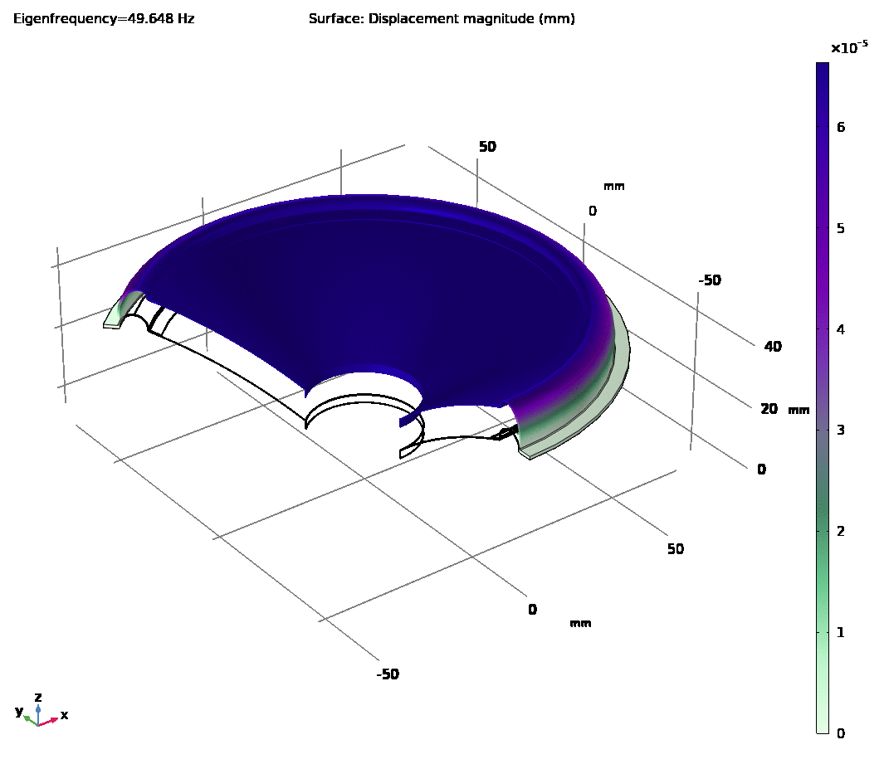
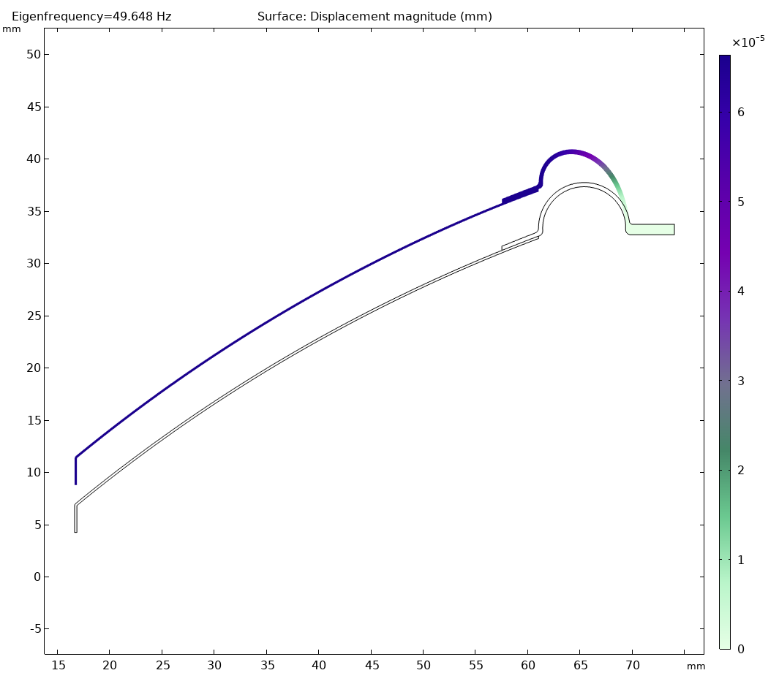
Surround Material FEM Models
M&M
Analysis of Materials
FEM Optimization of Properties
Modeling of Loudspeakers
Measurement Verification
COMSOL model (2-D axisymmetric model) to find the surround Young’s modulus.
Eigenfrequency study with optimization node to calculate the materials Young’s modulus.

Slide 9
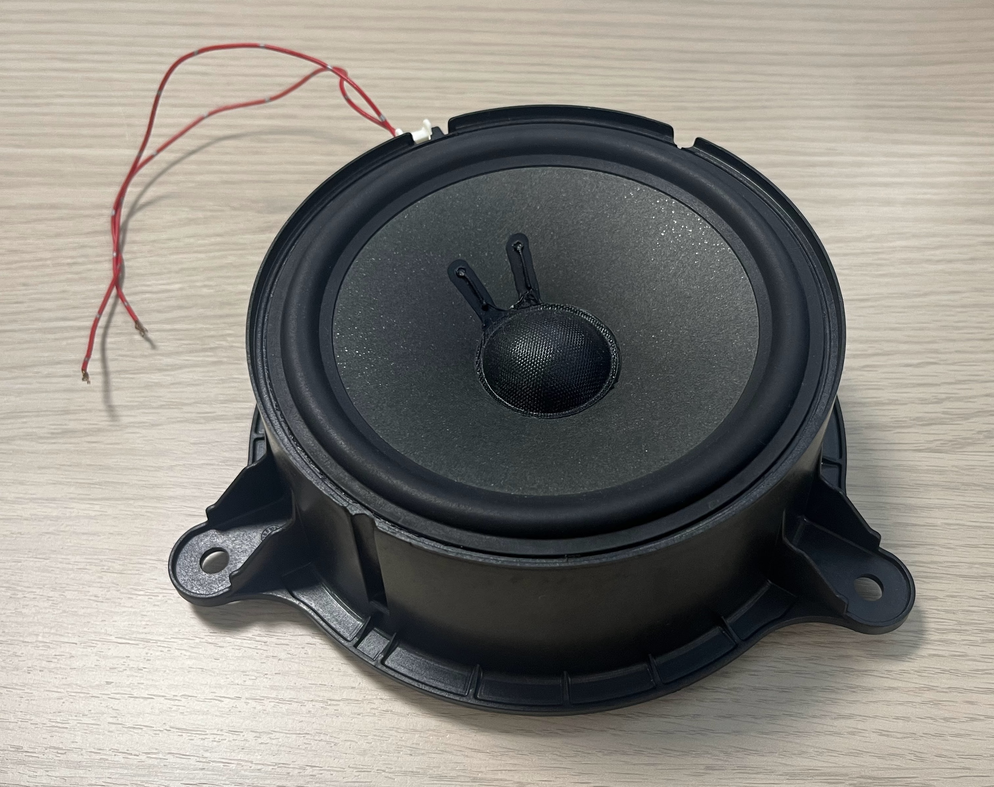
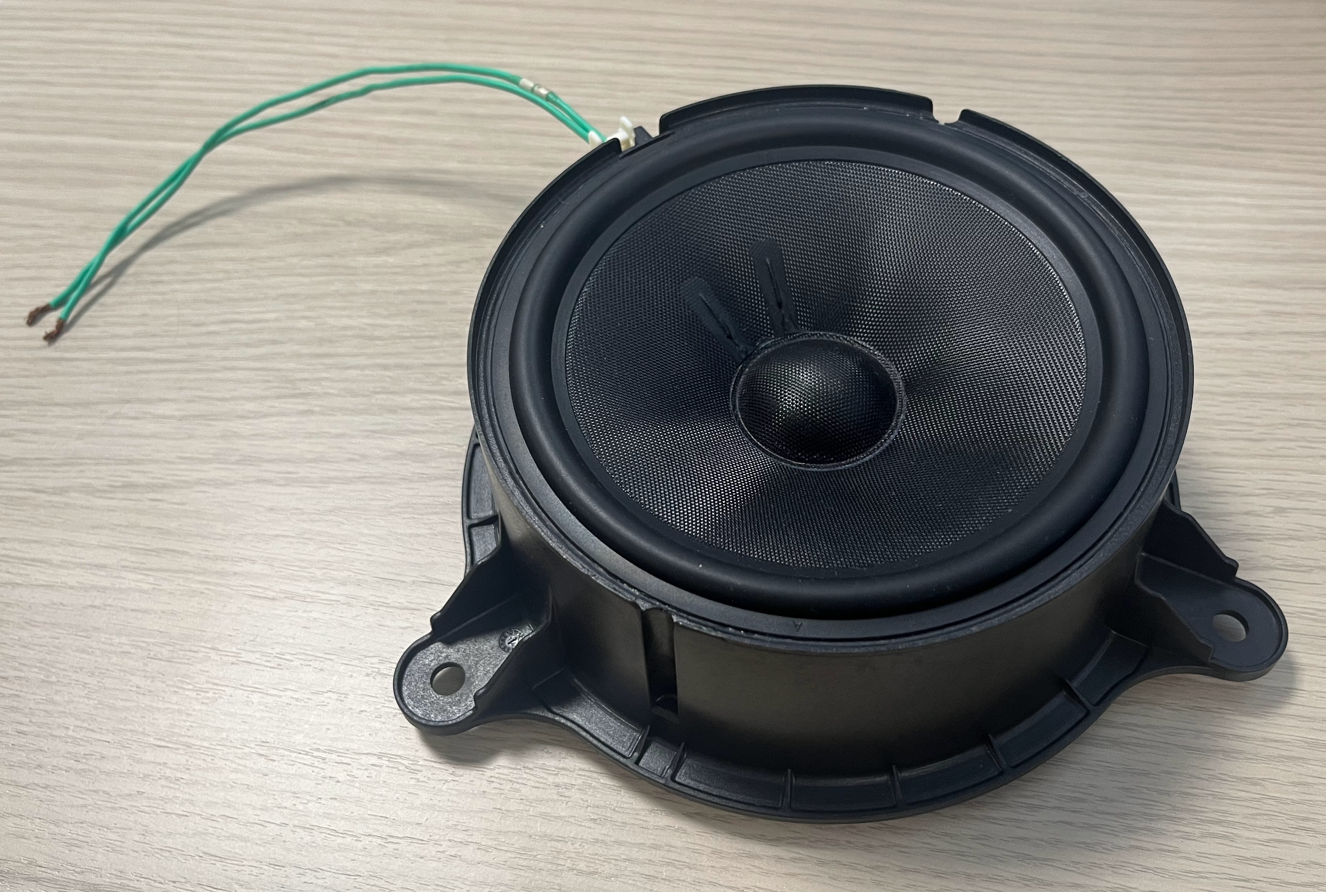
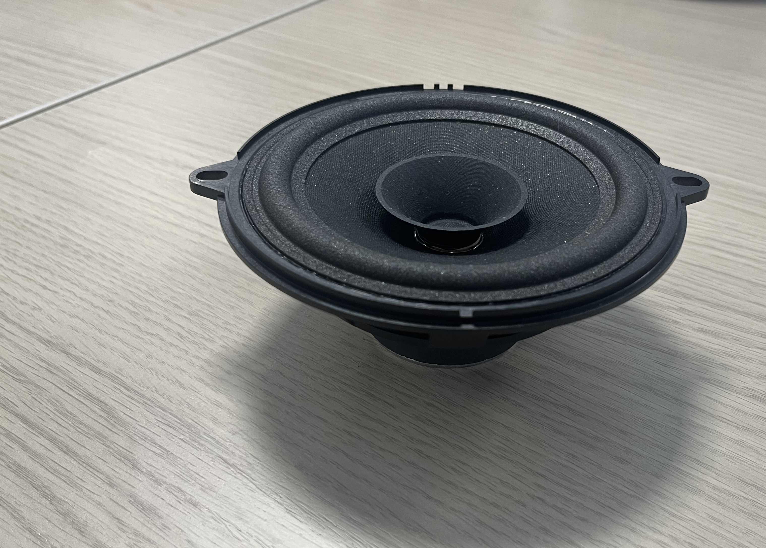
Loudspeaker Selection
M&M
Analysis of Materials
FEM Optimization of Properties
Modeling of Loudspeakers
Measurement Verification
 | Cone Material | Surround Material | Diameter | Apex
Loudspeaker #1 | 15% Mica Paper filtered | Nitril Rubber | 160 mm | Dust Cap (Fiberglass)
Loudspeaker #2 | Fiber glass | Nitril Rubber | 160 mm | Dust Cap (Fiberglass)
Loudspeaker #3 | 10% Mica Paper filtered | Polyurethane Foam | 130 mm | Whizzer
Loudspeaker #1
Loudspeaker #2
Loudspeaker #3
Notes:
In the second stage of this work, 3 loudspeakers were selected comprising of membranes analyzed in the first stage.
The first two are almost identical, both 160mm in diameter with a nitril rubber surround varying only in cone material, which is for loudspeaker 1 …
Loudspeaker 3 is smaller, 130mm in diameter, with a cone 10% Mica Paper filtered and surround material Polyurethane foam
Another variation to loudspeaker #3 is that it has a whizzer which is a small cone at the apex of the loudspeaker in place of the dust cap. A whizzer affects the high frequencies of a loudspeaker which will be observed later.

Slide 10
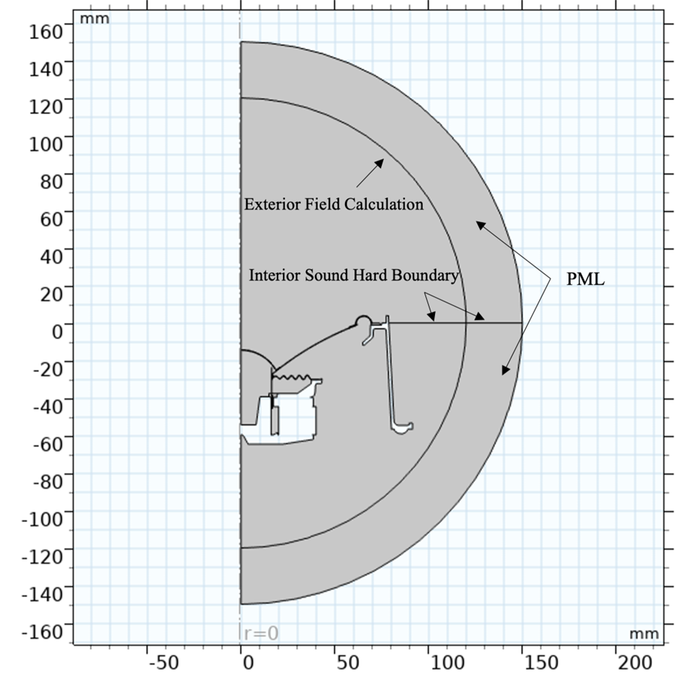
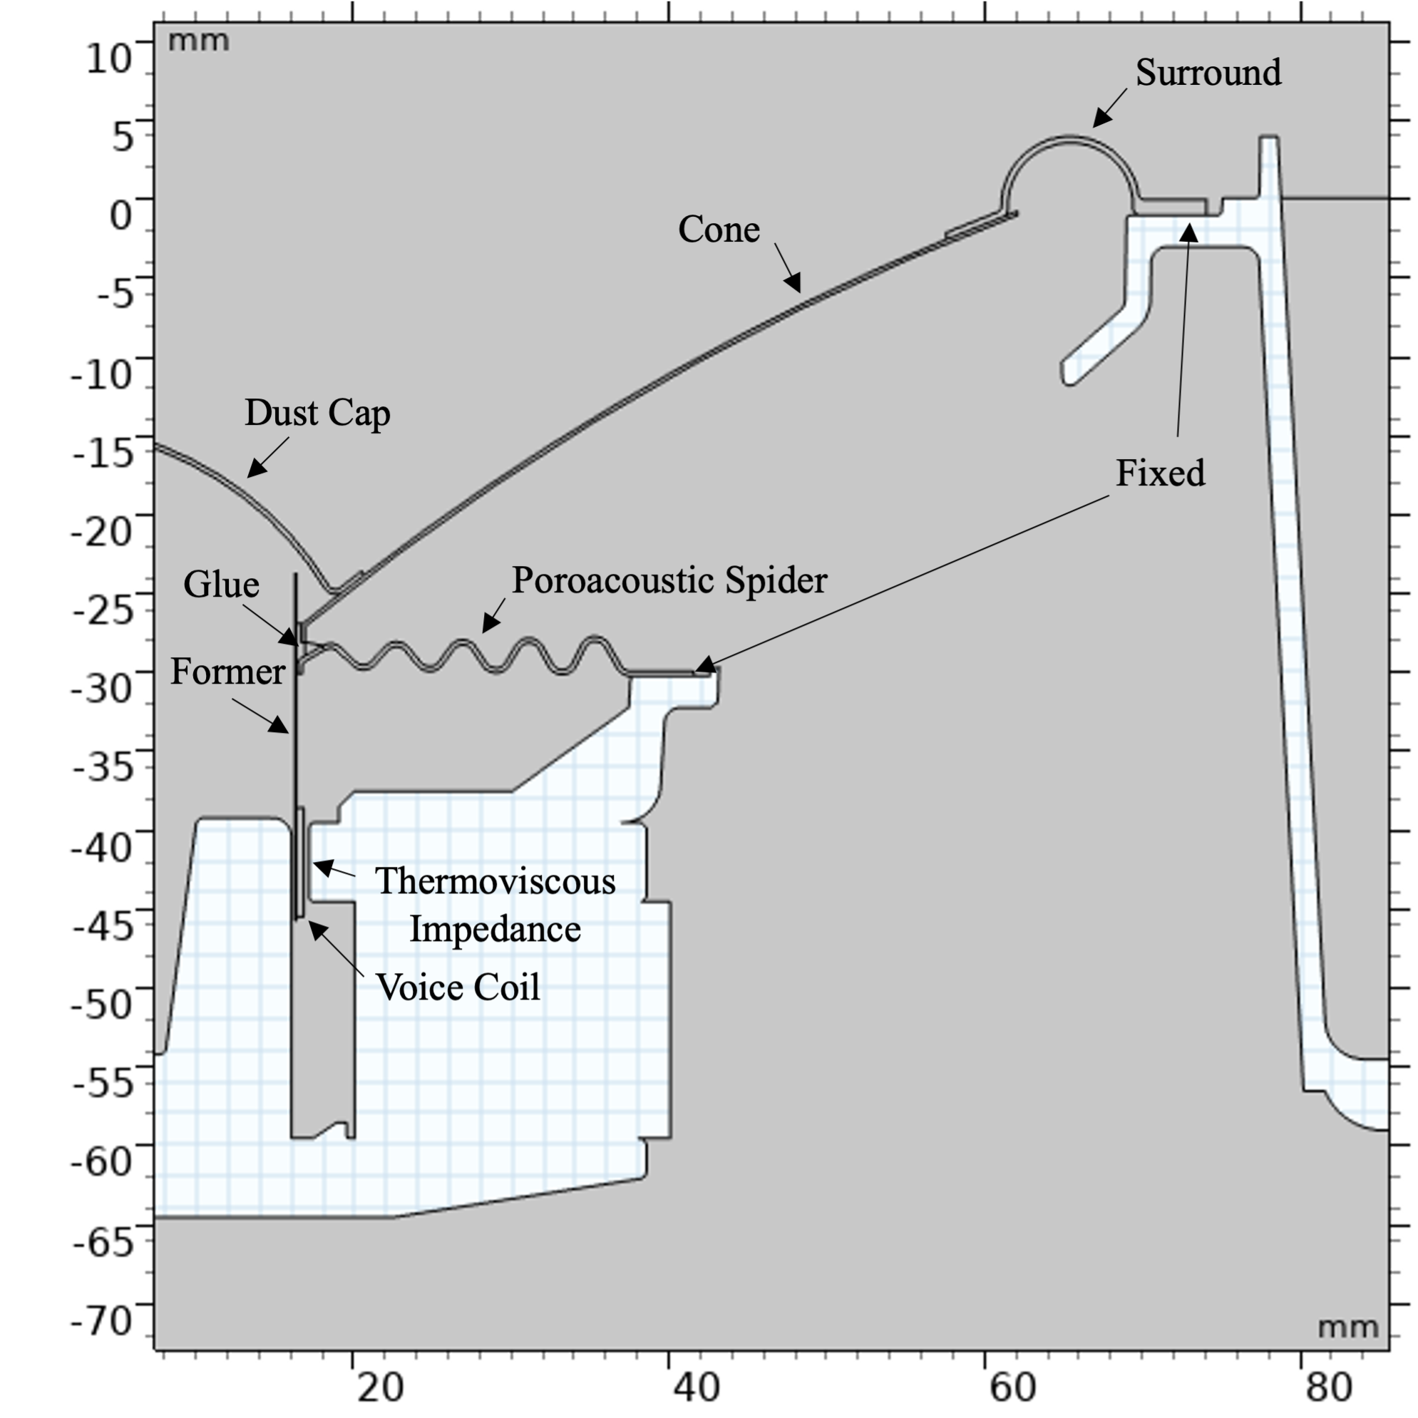
Loudspeaker FEM Models - Physics
M&M
Analysis of Materials
FEM Optimization of Properties
Modeling of Loudspeakers
Measurement Verification
Electrical Domain
  Electrical Circuit interface, utilizing measured lumped parameters
Mechanical Domain
  The Solid Mechanics interface models the structural dynamics of the loudspeaker moving components.
Acoustic Domain
  Pressure Acoustics, Frequency Domain interface simulates the acoustic pressure waves generated by the loudspeaker.
    Perfectly Matched Layer (PML) to allow calculation of the pressure at any distance and angle.
    Thermoviscous boundary layer impedance applied to consider losses due to thermal and viscous dissipation in thin regions.
Notes:
first imported, and component domains such as the cone, coil, surround, spider, dust cap, former, and adhesive were distinguished. To simulate an open boundary condition effectively, a perfectly matched layer (PML) is implemented. This layer absorbs outgoing acoustic waves, minimizing reflections and ensuring an accurate representation of the loudspeaker's acoustic field.
to accurately simulate sound absorption and transmission through its porous structure (poroacoustics)

Slide 11
Loudspeaker FEM Models - Studies
M&M
Analysis of Materials
FEM Optimization of Properties
Modeling of Loudspeakers
Measurement Verification
Eigen Frequency Study Resonance frequency of the membrane.
Stationary Study Spider component characterization for impedance matching
Frequency Domain Study Frequency response and impedance
Additional Studies:
  Frequency Domain Studies
    Parametric sweeps Effects of material parameter changes

Slide 12
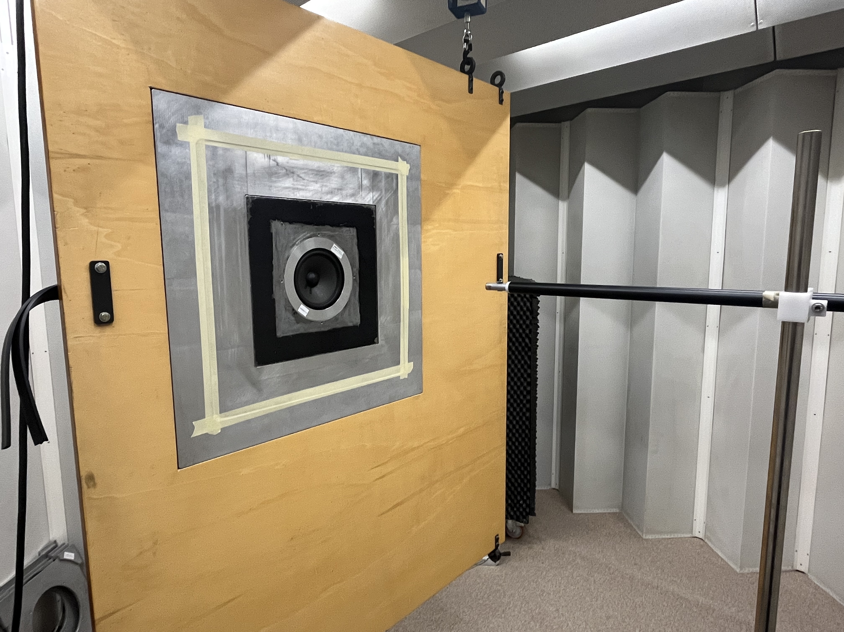
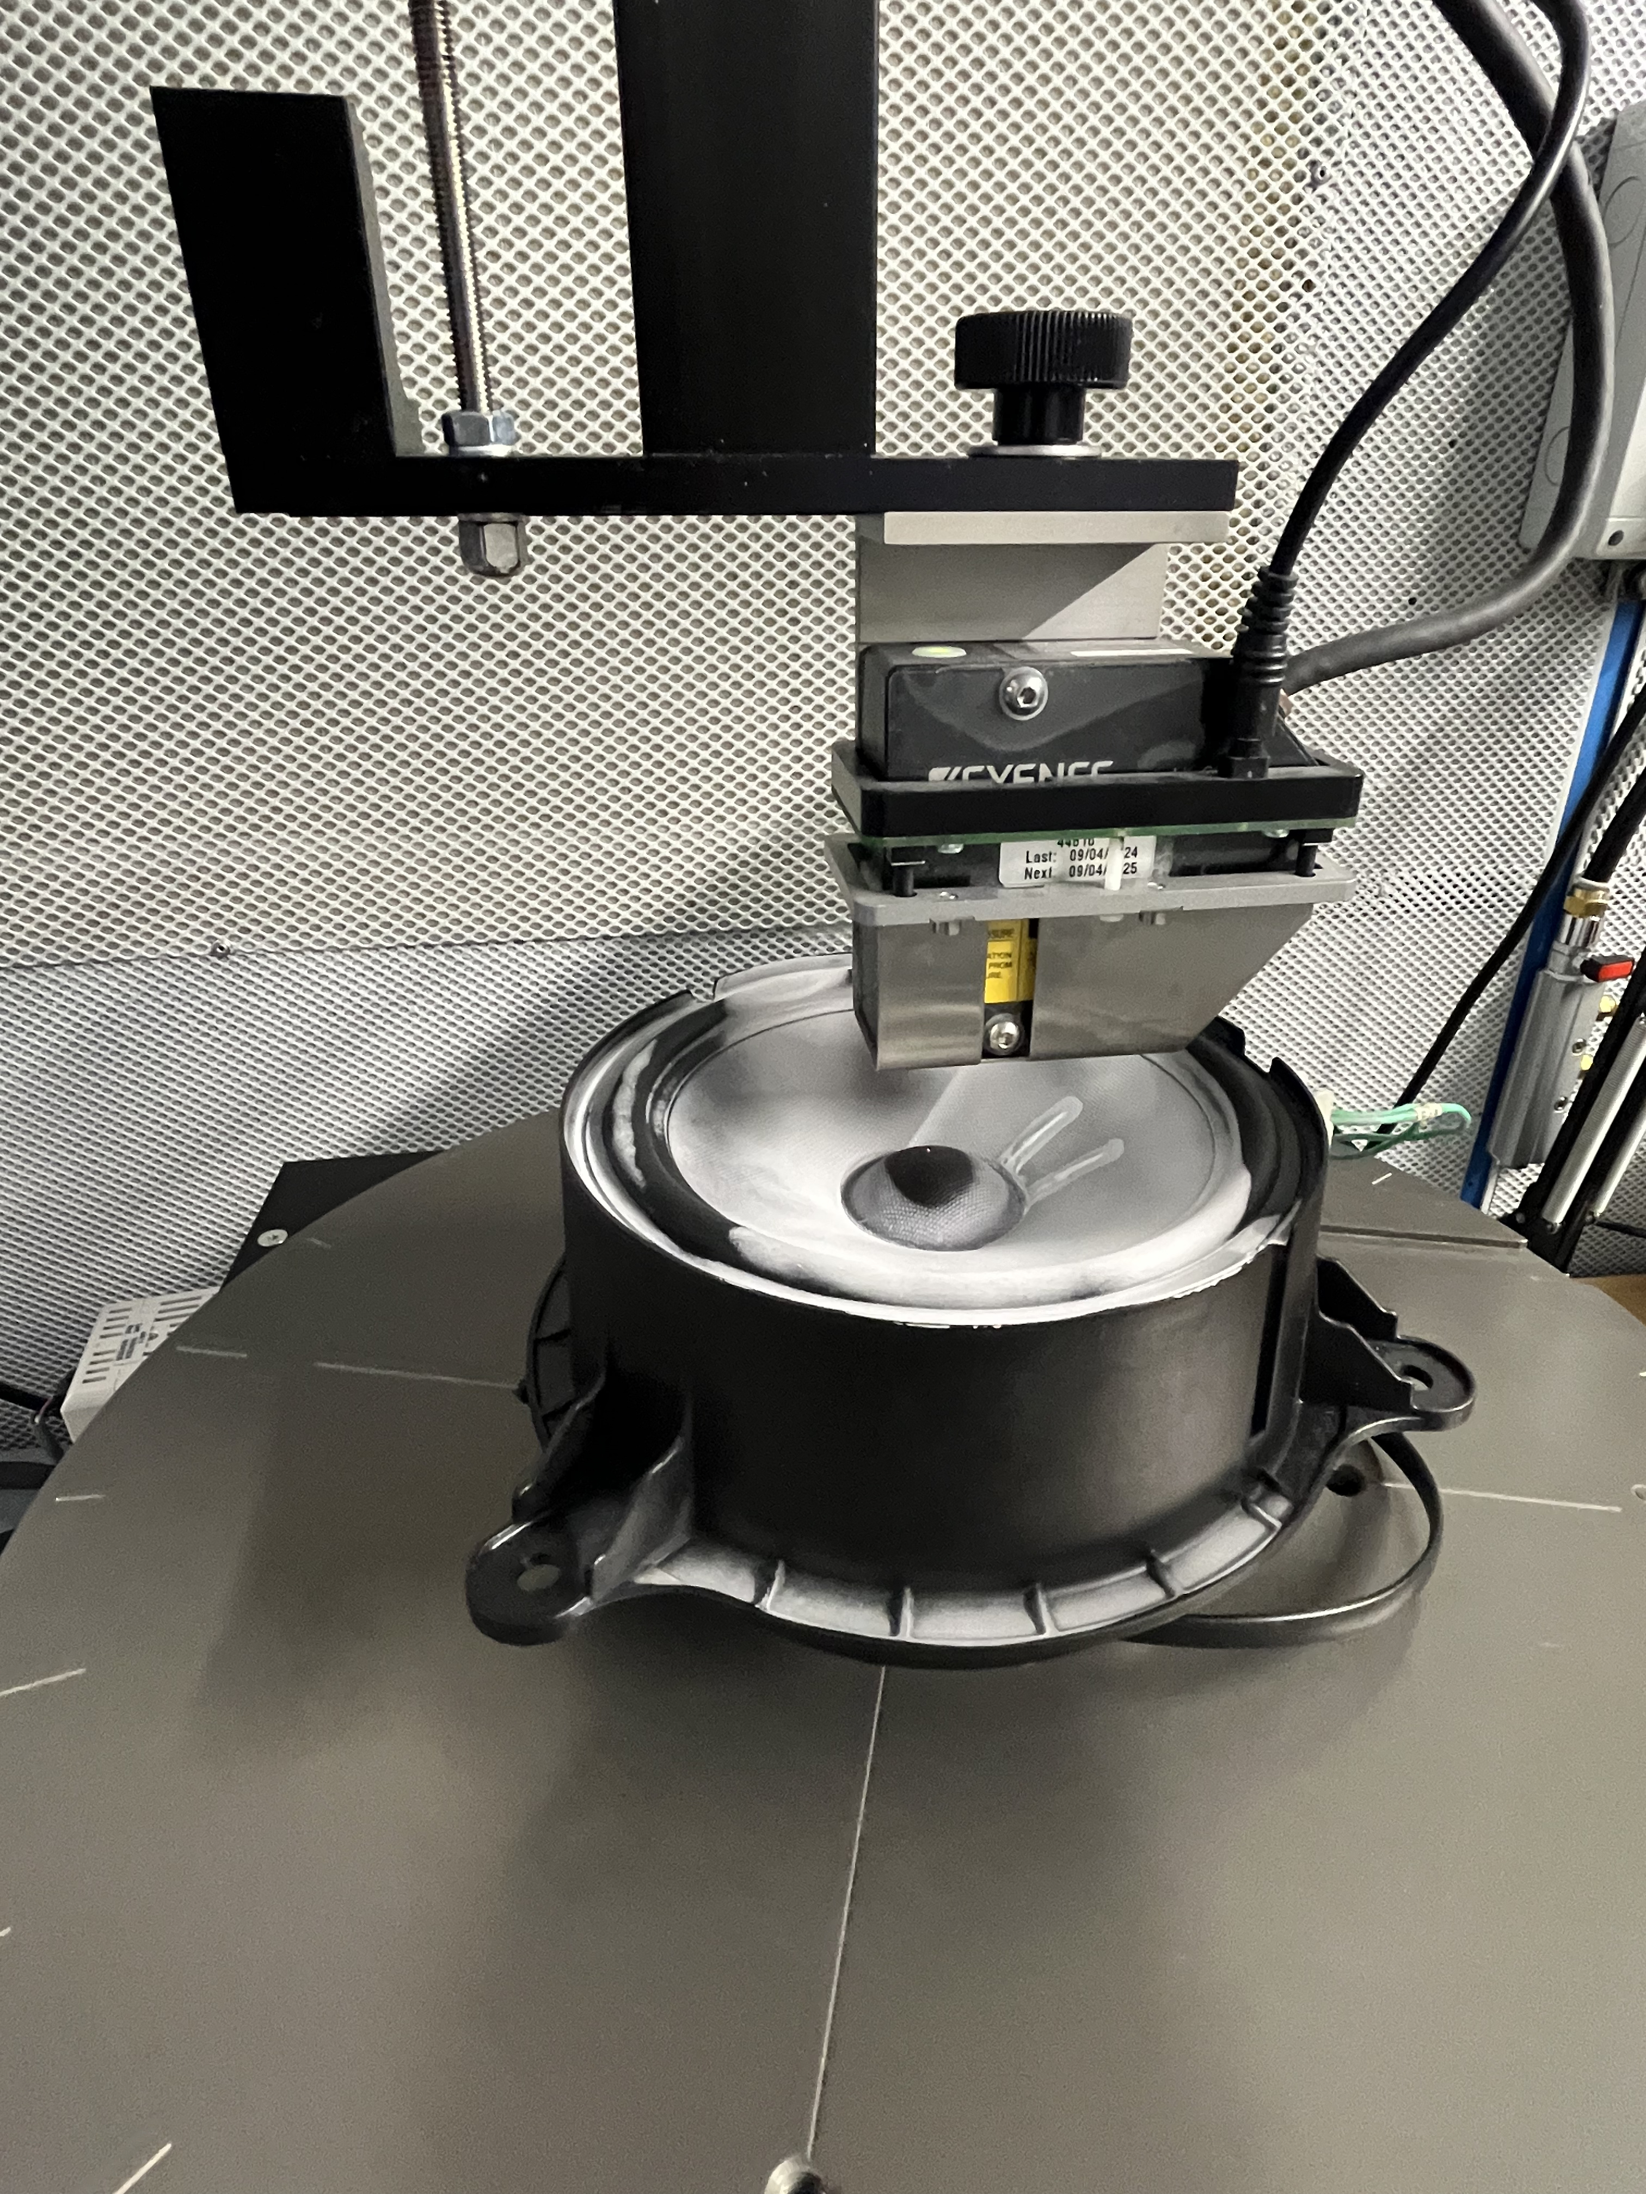
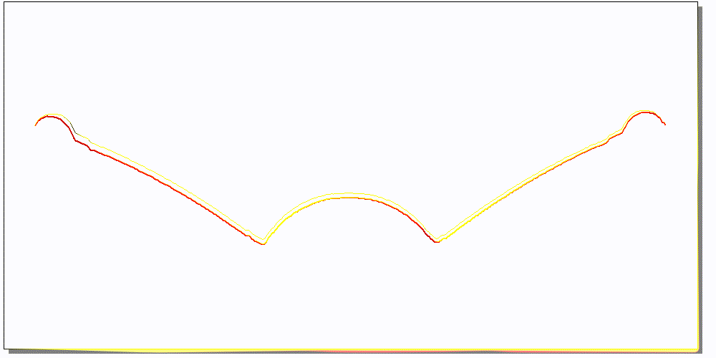

Physical Loudspeaker Measurements
M&M
Analysis of Materials
FEM Optimization of Properties
Modeling of Loudspeakers
Measurement Verification
Klippel$®️$ Scanning Vibrometer (SCN)
Laser displacement sensor over the loudspeaker
Precise measurement of the transducer's surface in polar coordinates
Used for comparison with simulated deformations
Standard impedance measurements
Acoustic response in a semi-anechoic chamber
SCN Deformation Measurement at
180 Hz of Loudspeaker #1

Slide 13
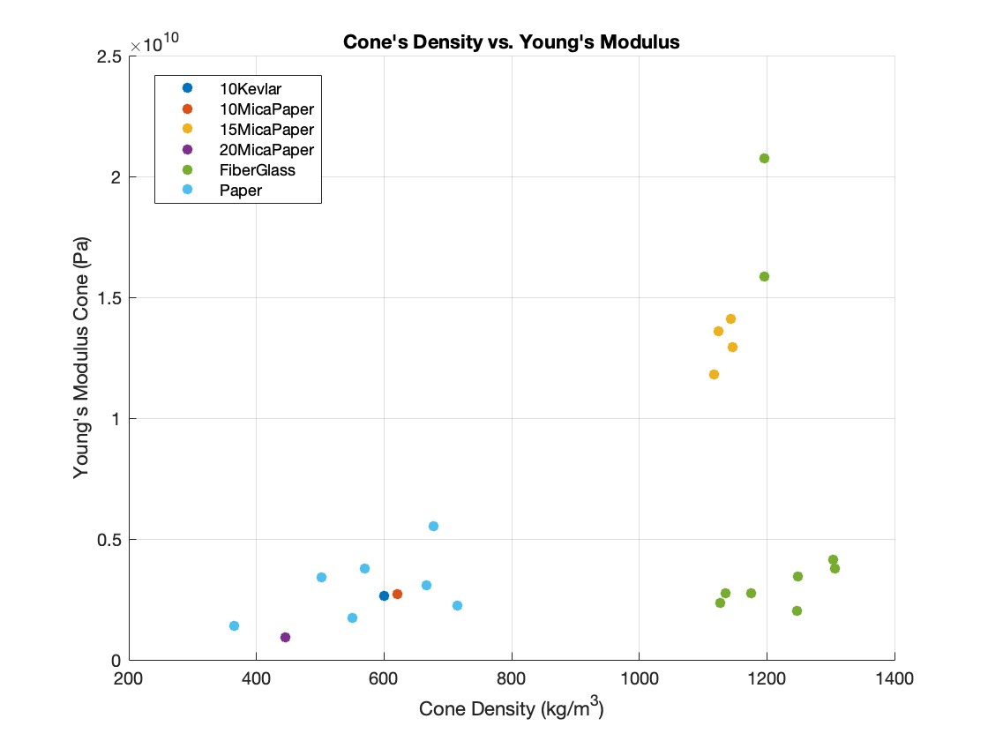
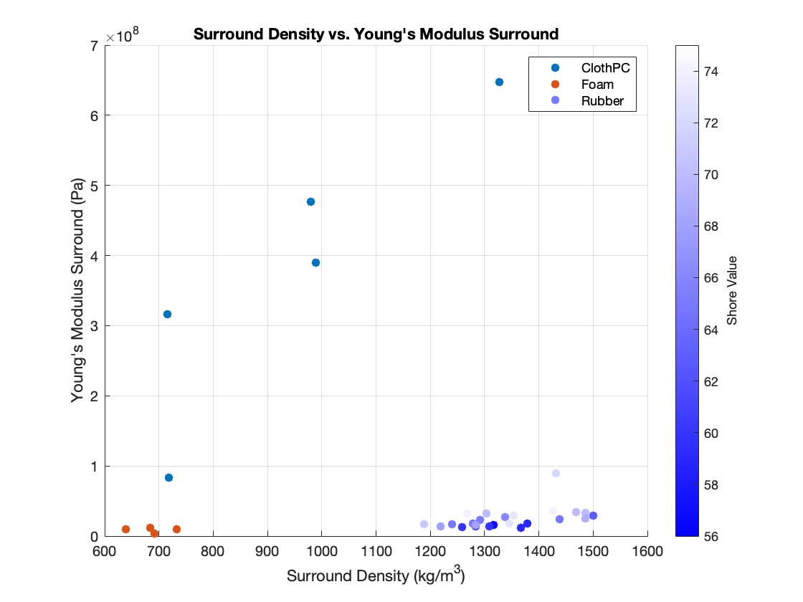
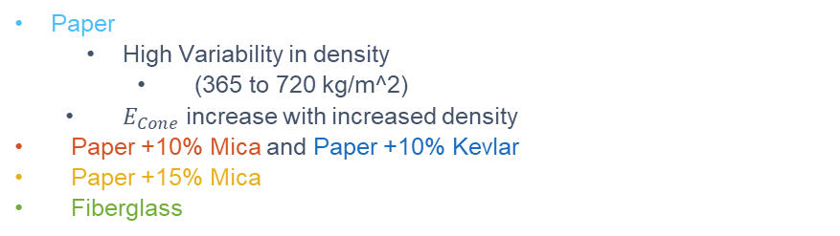
Cone Materials
Results
Analysis of Materials
FEM Optimization of Properties
Modeling of Loudspeakers
Measurement Verification
Paper
  High Variability in density
    (365 to 720 kg/m^2)
  $E_{Cone}$ increase with increased density
Paper +10% Mica and Paper +10% Kevlar
Paper +15% Mica
Fiberglass
Poly-Cotton Cloth
  Very high variability: due to production processes, weaving patterns, or resins used.
Foam
Rubber
Notes:
For the sake of time I will not comment on each of the materials, however something to note considering paper cones is the high variability of plain paper densities with a relatively small range in Young’s modulus. And for surrounds we see not only a large variation in material density, but also a trend with larger densities an increase in Young’s modulus.

Slide 14
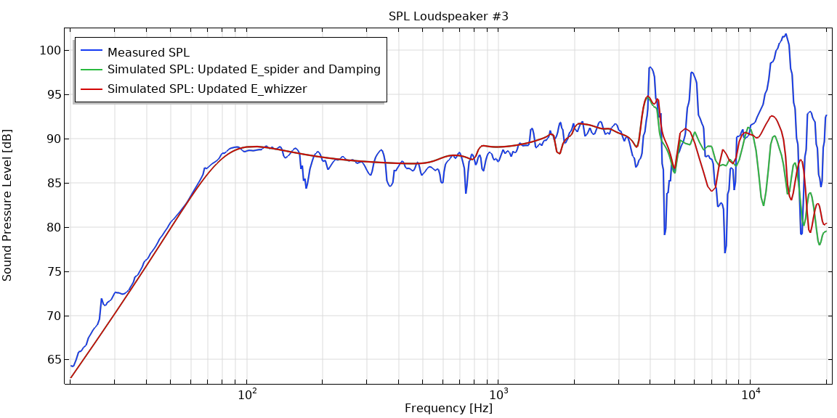
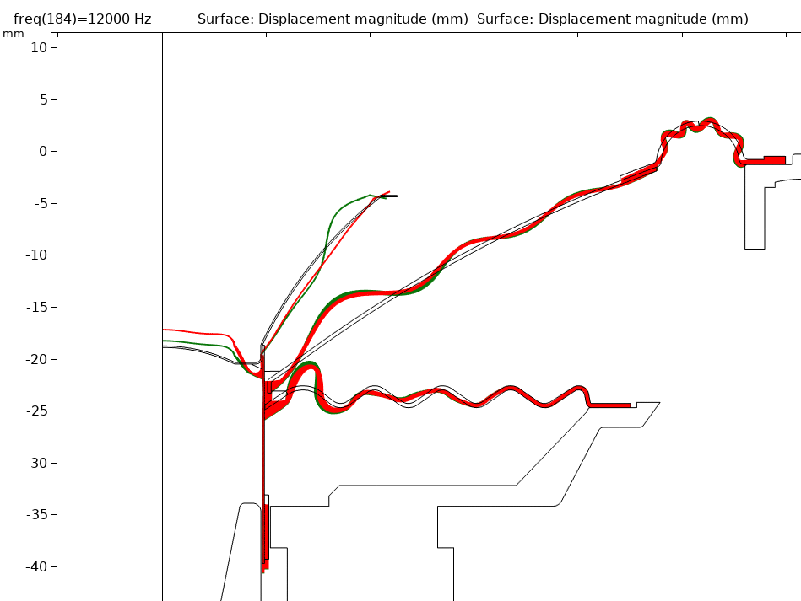
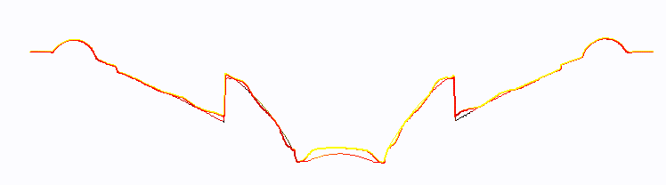


Loudspeaker #3
Results
Analysis of Materials
FEM Optimization of Properties
Modeling of Loudspeakers
Measurement Verification
12kHz
The effect of the whizzer
Lack of matching at higher frequencies → Increased $E_{Whizzer}$
Measured SCN Deformation at 12 kHz
Simulated Deformation at 12 kHz
Before updating $E_{Whizzer}$ & Updated $E_{Whizzer}$

Slide 15
Conclusions
Goal: Advance the understanding of loudspeaker design through a detailed analysis of cone and surround materials
Mechanical properties of loudspeaker membrane materials, particularly Young’s modulus, significantly influence acoustic performance.
Material Behavior:
  Predictable: Paper, foam.
  Variable: Cloth, fiberglass.
Strong agreement between measured and simulated frequency responses.
Notes:
The scope of this thesis was to advance the understanding and optimization of loudspeaker design through a detailed analysis of cone and surround materials and their impact on loudspeaker performance
Through experimental measurements and FEM simulations, it was observed that the mechanical properties of loudspeaker membrane materials, particularly Young’s modulus, significantly influence acoustic performance.
Material Behavior:
Predictable: Paper, foam.
Variable: Cloth, fiberglass.
Strong agreement between measured and simulated frequency responses; refined models to address discrepancies at higher frequencies.

Slide 16
Thank you!
Slide n. 16

Slide 17
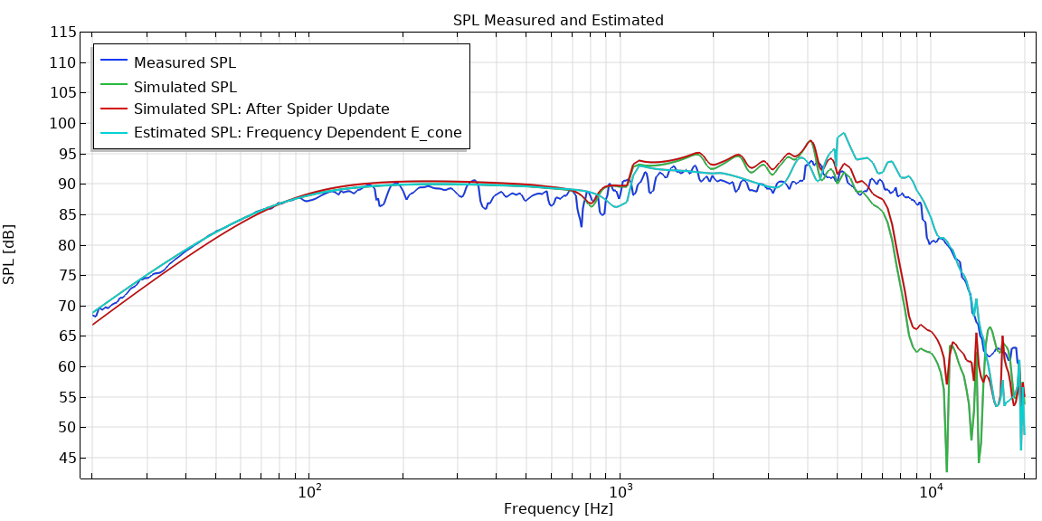

Loudspeaker #2
Results
Analysis of Materials
FEM Optimization of Properties
Modeling of Loudspeakers
Measurement Verification
Loudspeaker #2 showed a lack of matching in higher frequencies
  It was found that $E_{Cone}$ was valid only at low frequencies, and thus frequency dependent.
  A ramp function was applied to $E_{Cone}$ material
Frequency dependence of some materials such as fiberglass should be considered
Cone: Fiberglass
Surround: Nitril Rubber 60A

Slide 18
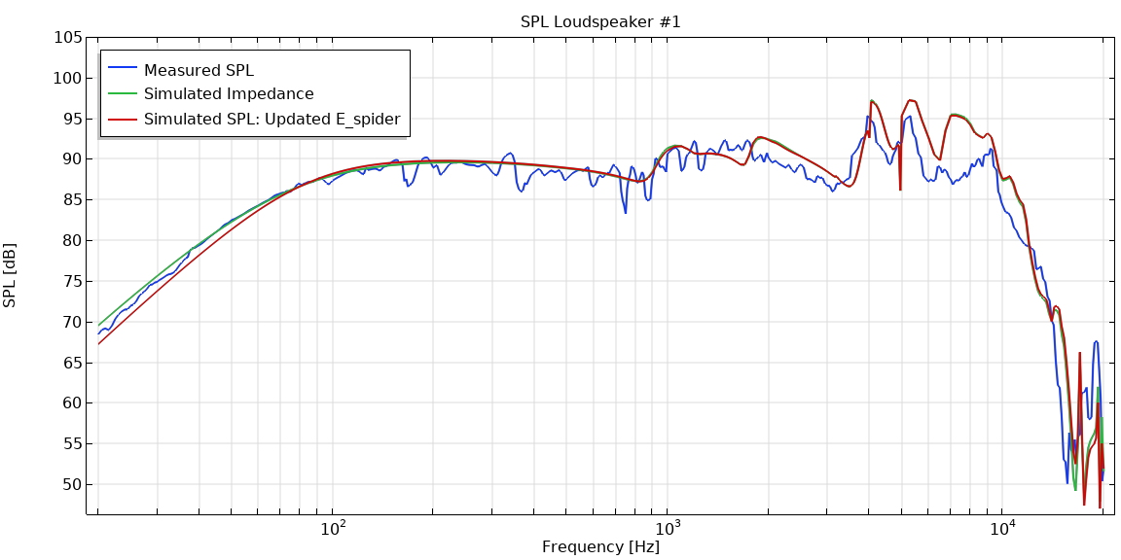

Loudspeaker #1
Results
Analysis of Materials
FEM Optimization of Properties
Modeling of Loudspeakers
Measurement Verification
Loudspeaker #1 from the beginning showed a good matching between measured and simulated results.
  $E_{Spider}$ was updated to 6 MPa, staying within it’s displacement tolerance, matching measured resonance from from 59 Hz to 70 Hz.
  Multiple Frequency Domain studies were performed, in any case, to consider the effects of changes in other parameters.
Cone: Paper + 15% Mica
Surround: Nitril Rubber 60A
Notes:
For example isotropic damping coefficients, and Young’s modulus of each of the materials.
However, for our purposes, we can see that the method for modeling the loudspeaker and its materials proved effective.
Impedance plot it can be observed that by increasing the spider Young's modulus by 60% (to 6e8 Pa), the simulated resonance frequency increases from 59 Hz to the equivalent frequency of 70 Hz matching that of the measurement.

Slide 19
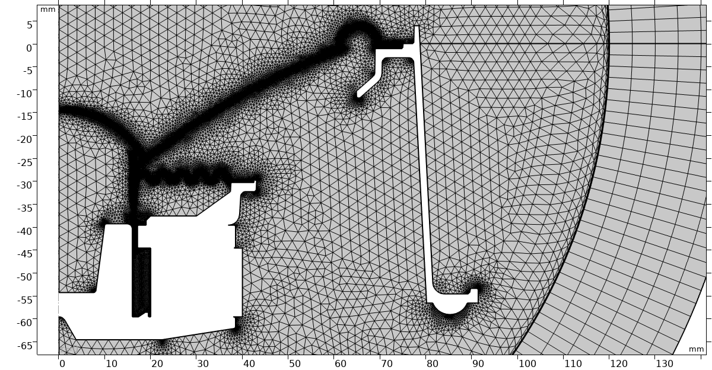
Loudspeaker FEM Models - Mesh
M&M
Analysis of Materials
FEM Optimization of Properties
Modeling of Loudspeakers
Measurement Verification
The mesh is refined in regions with expected large velocity gradients
  Moving components
  Around voice coil where thermoviscous losses are expected
Air domain mesh is configured to ensure a minimum number of elements present per smallest wavelength.

Slide 20
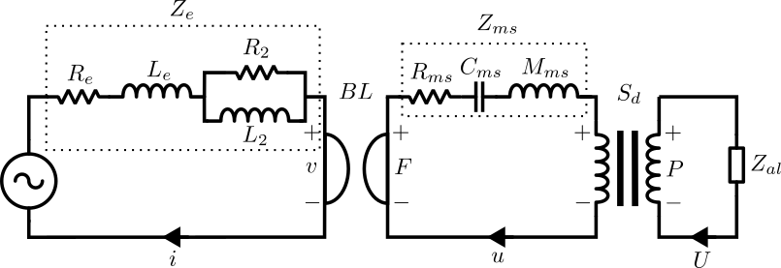
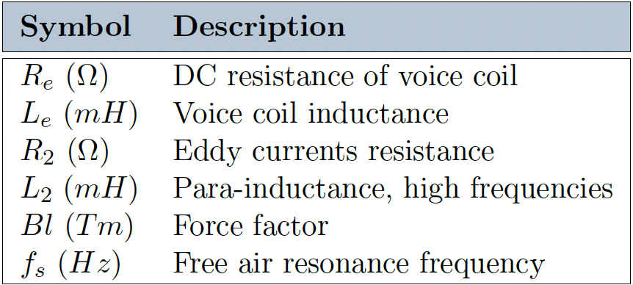
Electro-Mechanical-Acoustical (EMA) Analogies
Analysis of Materials
FEM Optimization of Properties
Modeling of Loudspeakers
Measurement Verification
EMA is a way of describing loudspeakers behavior using simple circuits
Klippel’s model of the electrical domain
Impedance analogy
Thiele-Small (T/S) Parameters
Electrical Thiele-Small (T/S) Parameters
Notes:
It is nessicarry to introduce the Electro-Mechanical-Acoustic (EMA) analogies of a loudspeaker, which describe the loudspeakers behaviors using simple circuits which translate the voltage and current to a force and velocity to a pressure and a volume velocity.
This Lumped Parameter Model is linked via the force factor BL, (connecting the electrical to the mechanical domain), and the surface area of the diaphragm Sd (connecting the mechanical domain to the acoustic domain).
Listed here are the Parameters also called the Thiele-Small or T/S parameters defining the electrical domain as these are used in a hybrid approach in the simulation of each loudspeaker.

Slide 21
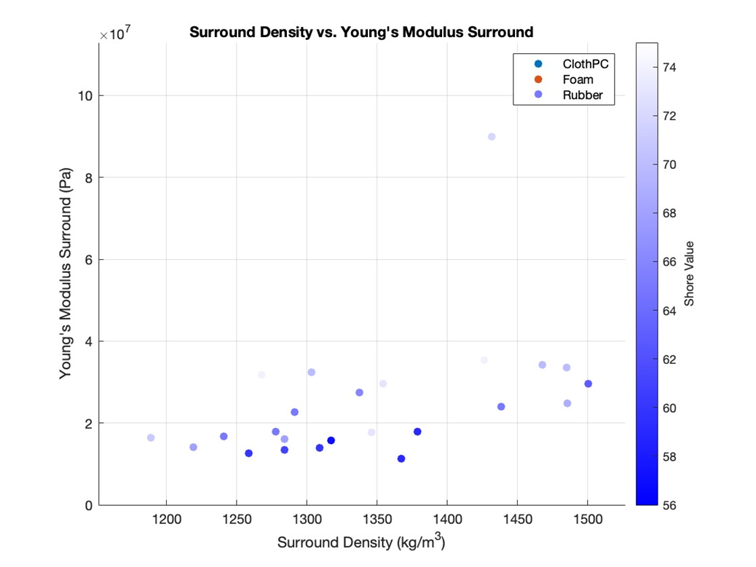
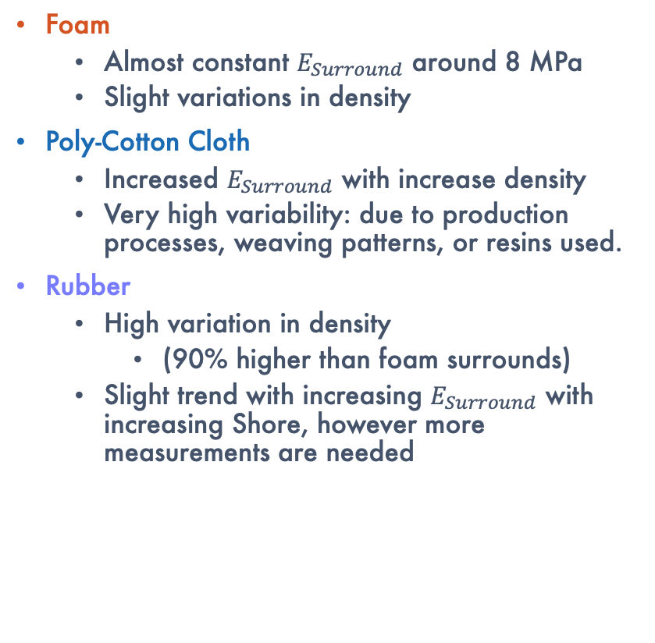
Results – Surround Materials
Analysis of Materials
FEM Optimization of Properties
Modeling of Loudspeakers
Measurement Verification
Foam
  Almost constant $E_{Surround}$ around 8 MPa
  Slight variations in density
Poly-Cotton Cloth
  Increased $E_{Surround}$ with increase density
  Very high variability: due to production processes, weaving patterns, or resins used.
Rubber
  High variation in density
    (90% higher than foam surrounds)
  Slight trend with increasing $E_{Surround}$ with increasing Shore, however more measurements are needed
Notes:
first imported, and component domains such as the cone, coil, surround, spider, dust cap, former, and adhesive were distinguished. To simulate an open boundary condition effectively, a perfectly matched layer (PML) is implemented. This layer absorbs outgoing acoustic waves, minimizing reflections and ensuring an accurate representation of the loudspeaker's acoustic field.
to accurately simulate sound absorption and transmission through its porous structure (poroacoustics)

Slide 22
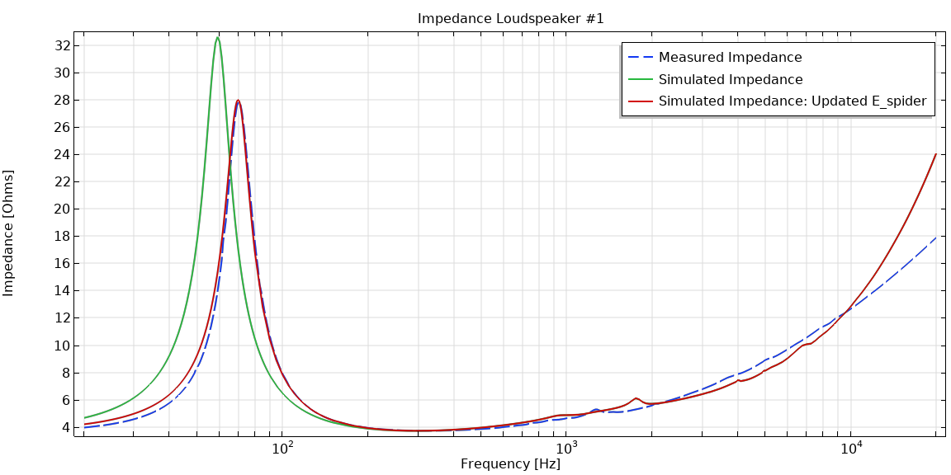
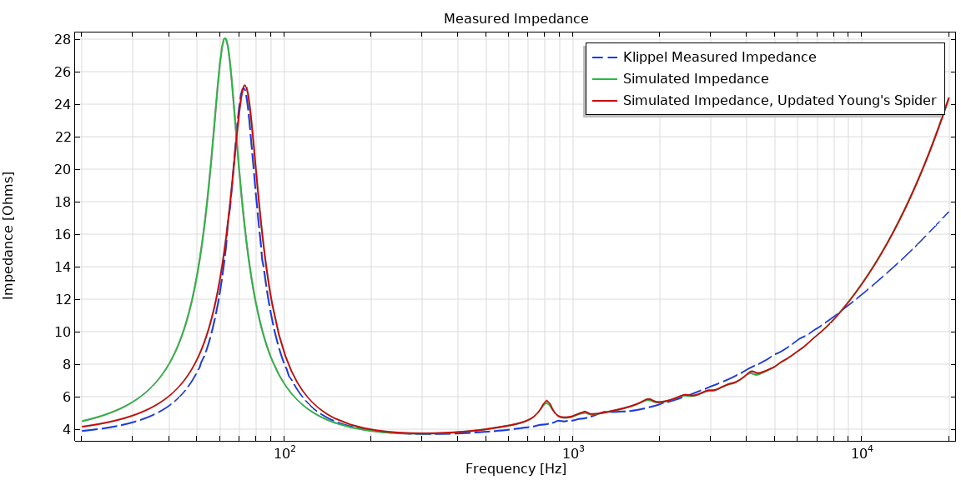
Results – Loudspeaker #1
Analysis of Materials
FEM Optimization of Properties
Modeling of Loudspeakers
Measurement Verification
Cone: Paper + 15% Mica
Surround: Nitril Rubber 60A
Cone: Fiberglass
Surround: Nitril Rubber 60A
Notes:
However, for our purposes, we can see that the method for modeling the loudspeaker and its materials proved effective.
Impedance plot it can be observed that by increasing the spider Young's modulus by 60% (to 6e8 Pa), the simulated resonance frequency increases from 59 Hz to the equivalent frequency of 70 Hz matching that of the measurement.

Slide 23
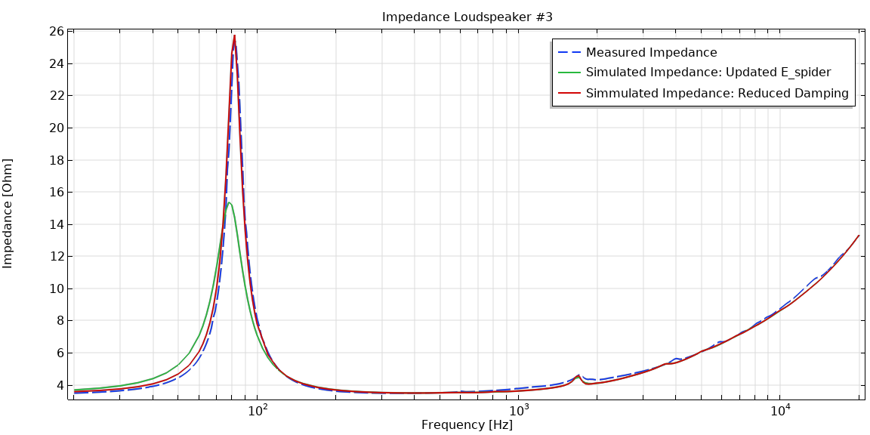
Results – Loudspeaker #1
Analysis of Materials
FEM Optimization of Properties
Modeling of Loudspeakers
Measurement Verification
Cone: Paper +10% Mica
Surround: Polyurethane Foam
Notes:
However, for our purposes, we can see that the method for modeling the loudspeaker and its materials proved effective.
Impedance plot it can be observed that by increasing the spider Young's modulus by 60% (to 6e8 Pa), the simulated resonance frequency increases from 59 Hz to the equivalent frequency of 70 Hz matching that of the measurement.

Slide 24
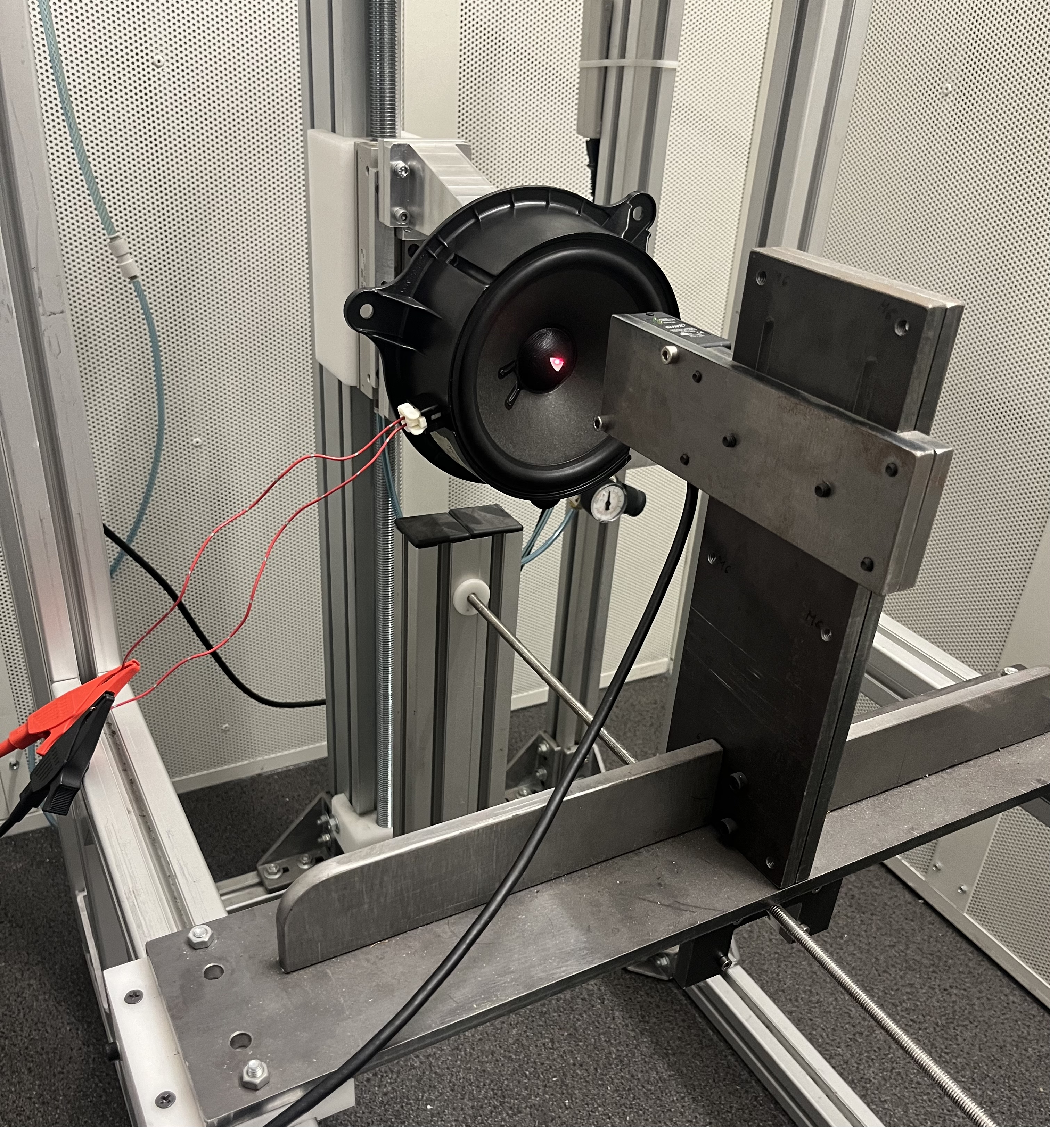
Klippel$®️$ Linear Parameter Measurement (LPM) Module
M&M
Analysis of Materials
FEM Optimization of Properties
Modeling of Loudspeakers
Measurement Verification
Terminal voltage and current to derive electrical impedance while applying a sinusoidal sweep.
Mechanical measurements taken using a laser displacement sensor.
Based on a linear small-signal lumped-parameter model of the loudspeaker
A fitting process is made by optimizing the model parameters
  Minimize difference between measured impedance and the model impedance, to obtain the lumped model parameters.
Notes:
The Thiele-Small Parameters were measured using Klippel Linear Parameter Measurement (LPM) module

Slide 25
Material Samples
M&M
Analysis of Materials
FEM Optimization of Properties
Modeling of Loudspeakers
Measurement Verification
35 Loudspeaker membranes analyzed ⌀96 to ⌀196 mm in diameter
  Cone
    31 Averaged resonance frequency measurements (3 strips from each membrane)
      9 Fiberglass
      7 Paper + mica powder
      4 Paper + Kevlar
      11 Paper filtered
    4 Measurements unable to consider, the test strips too short or too thick.
  Surround
    34 Averaged resonance frequency measurements (3 membranes from the same manufacturer)
      25 Rubber
      4 Foam
      5 Cloth polycotton
    1 unable to consider, even with an added mass
Notes:
(Average of 3 Membranes of the Same Part Number)
(Average of 3 Strips)

Slide 26
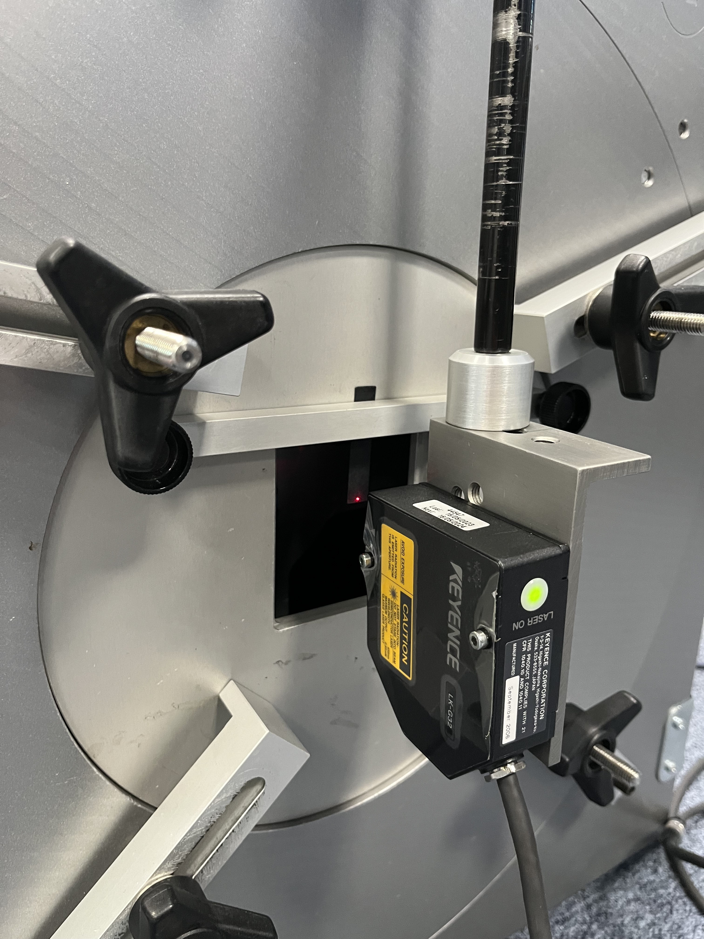
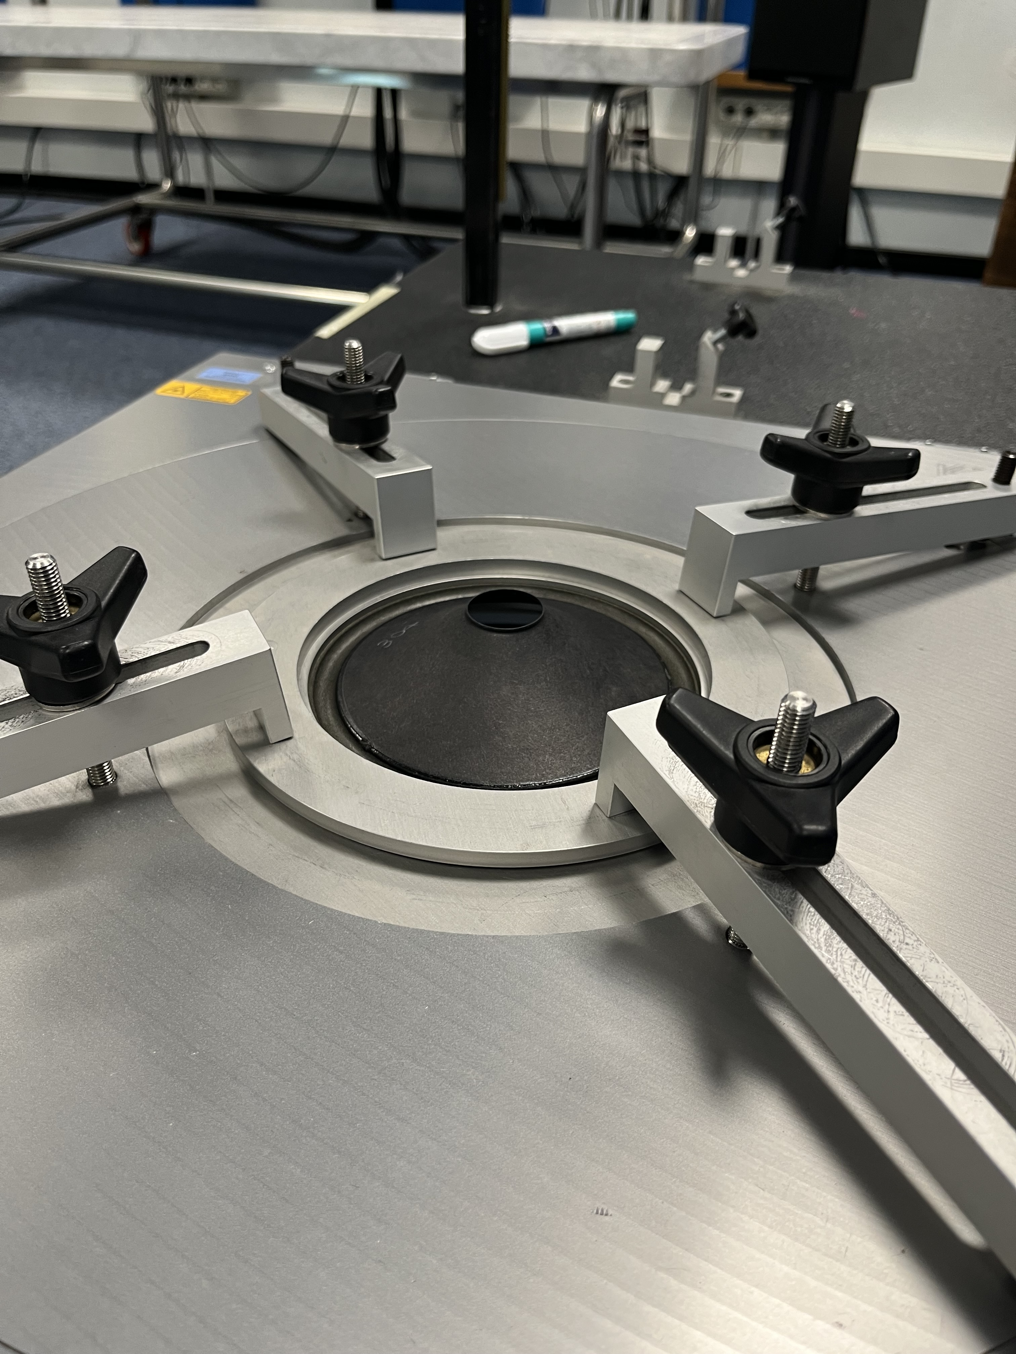
Cone and Surround Material Measurements
M&M
Analysis of Materials
FEM Optimization of Properties
Modeling of Loudspeakers
Measurement Verification
For cone material measurements, standard MPM procedure was followed.
MPM Input:
  Length
  Density
  Thickness
Cone Material Testing:
Surround Material Testing:
Notes:
For cone material measurements, the standard MPM procedure was followed. Meaning 3 strips of 1cm width were cut from each membrane under observation, and then one at a time, clamped to the measurement bench. The length at which the sample is clamped, the density computed from the weight of the cone over its volume integral taken in COMSOL, and its thickness measured with a caliper are input into the MPM software.

Slide 27
Future Works
  Expand dataset and validate trends.
  Explore materials with unique properties.
  Characterize materials under various environmental conditions.
  Optimization algorithm in the FEM environment to automatically adjust material properties → more efficient evaluation of new designs.

