Slide 1



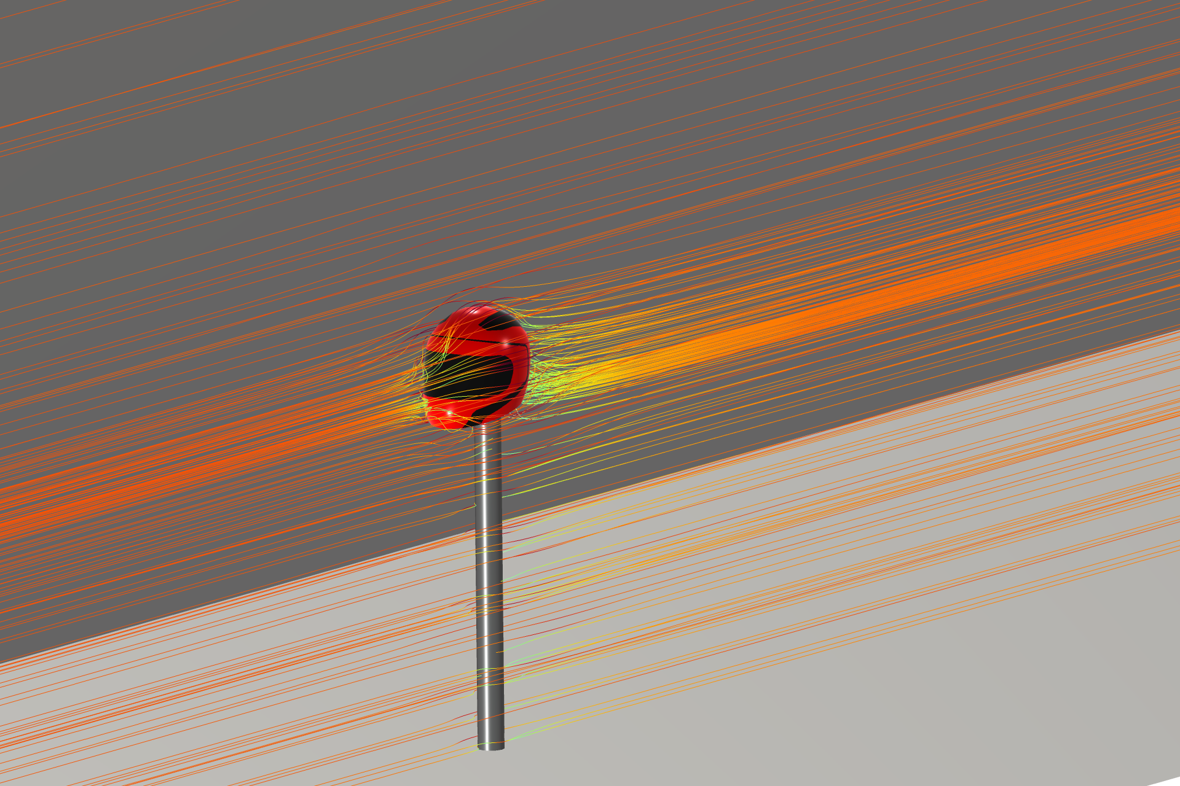
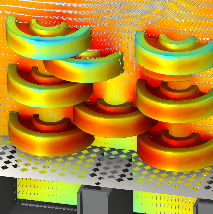
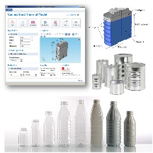
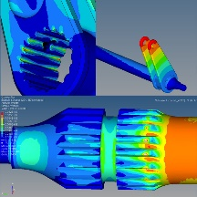
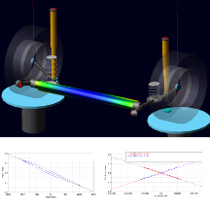

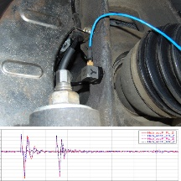

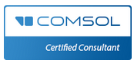
Be challenging, be smart: BE CAE & Test!
A COMSOL App to analyze bacteria lethality during sterilization processes
Florence, 22-24/10/2024
Notes:
Thank you, mister chairman.
Hello everyone! I’m Angelo Barbagallo and I am a mechanical engineer at BE-caetest.
Today I will talk about a COMSOL App to analyze bacteria lethality during sterilization processes,
First, let’s quickly introduce my company.

Slide 2


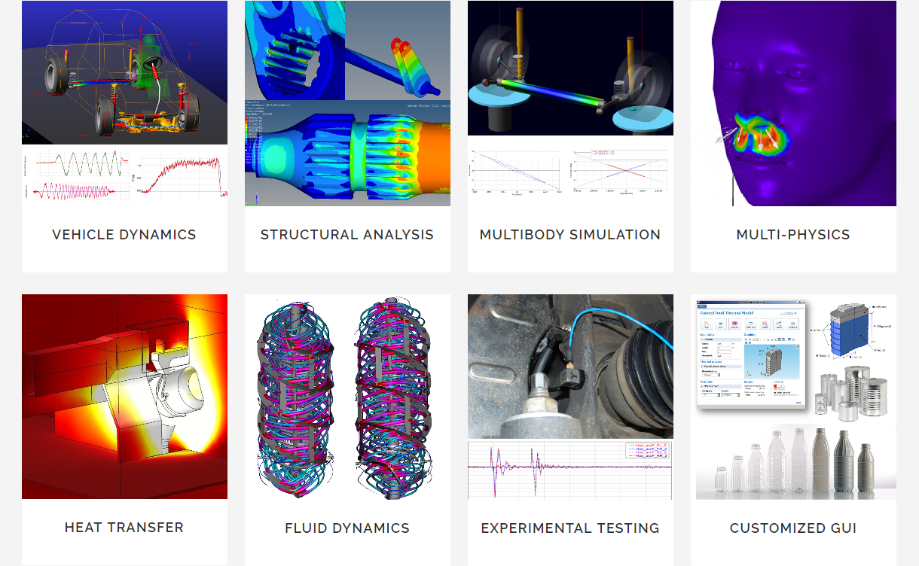

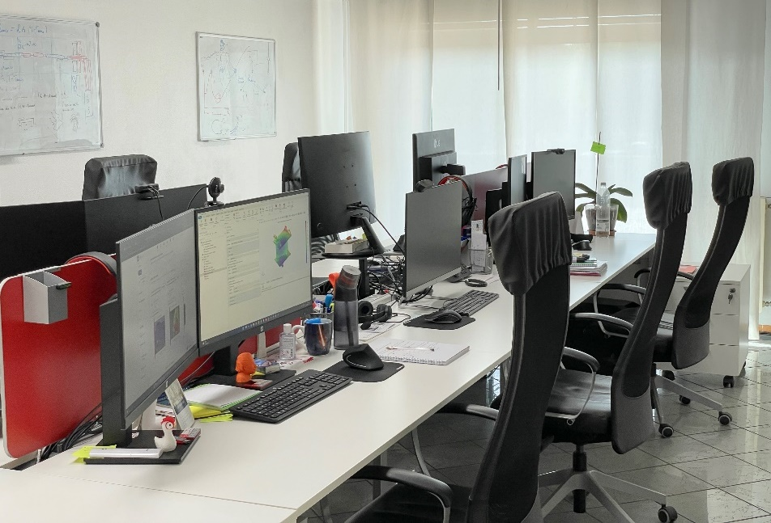
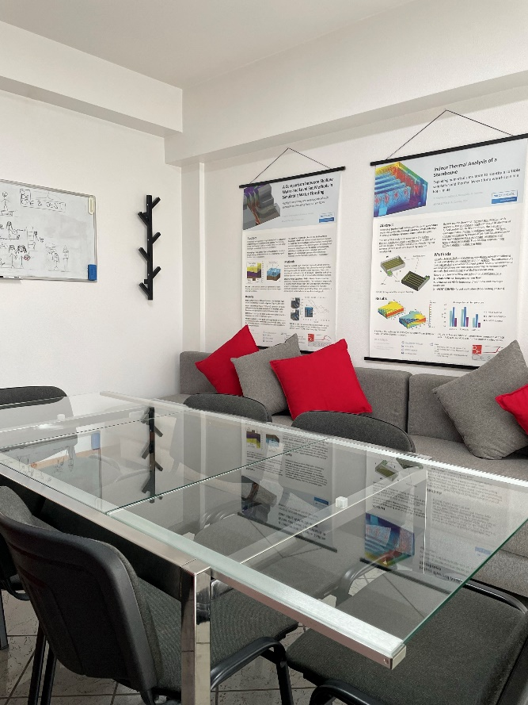
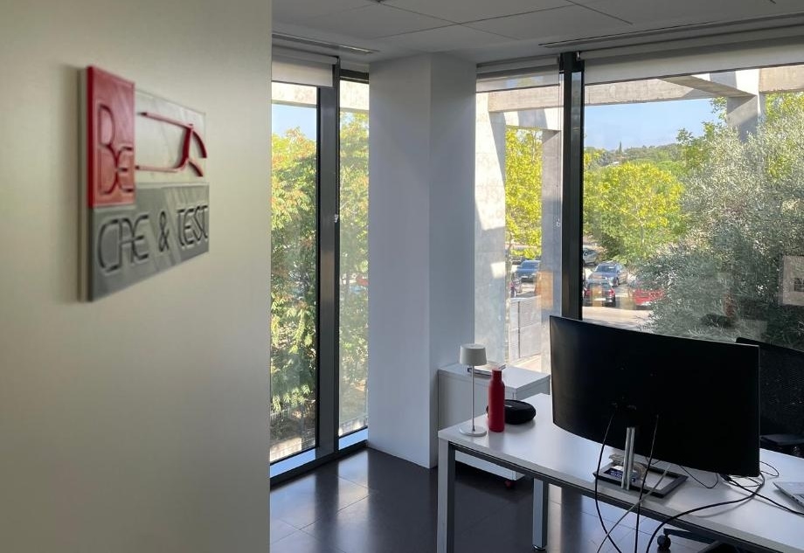


Company profile
About us…
BE CAE & Test provides consultancy services to industrial partners by exploiting CAE software and developing experimental testing.
https://www.comsol.it/certified-consultants
Notes:
BE CAE & Test provides consultancy services by using (si-ai-ei) CAE software and developing experimental testing.
We are COMSOL Certified Consultant since 2008 and our core business concern thermo-fluid-dynamical analyses, but we also provide structural, multibody, vehicle dynamic analyses and, last but not least, we build customized (gi-iu-ai) GUI Application.
I invite you to visit our stand to know more about.

Slide 3
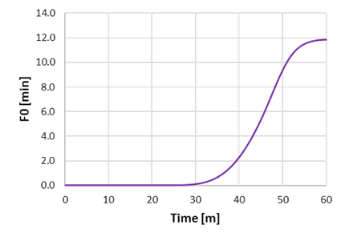
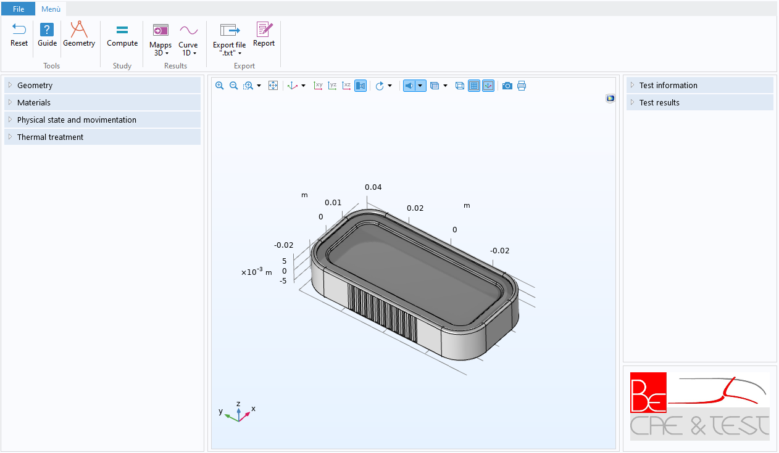
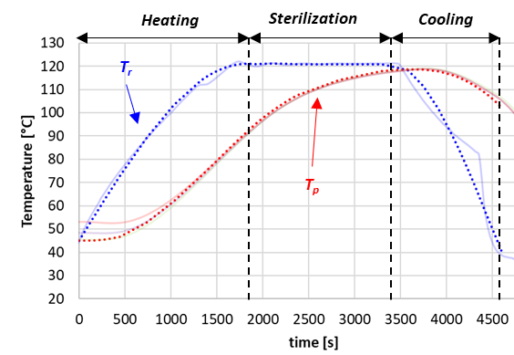
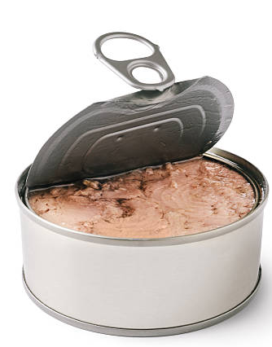
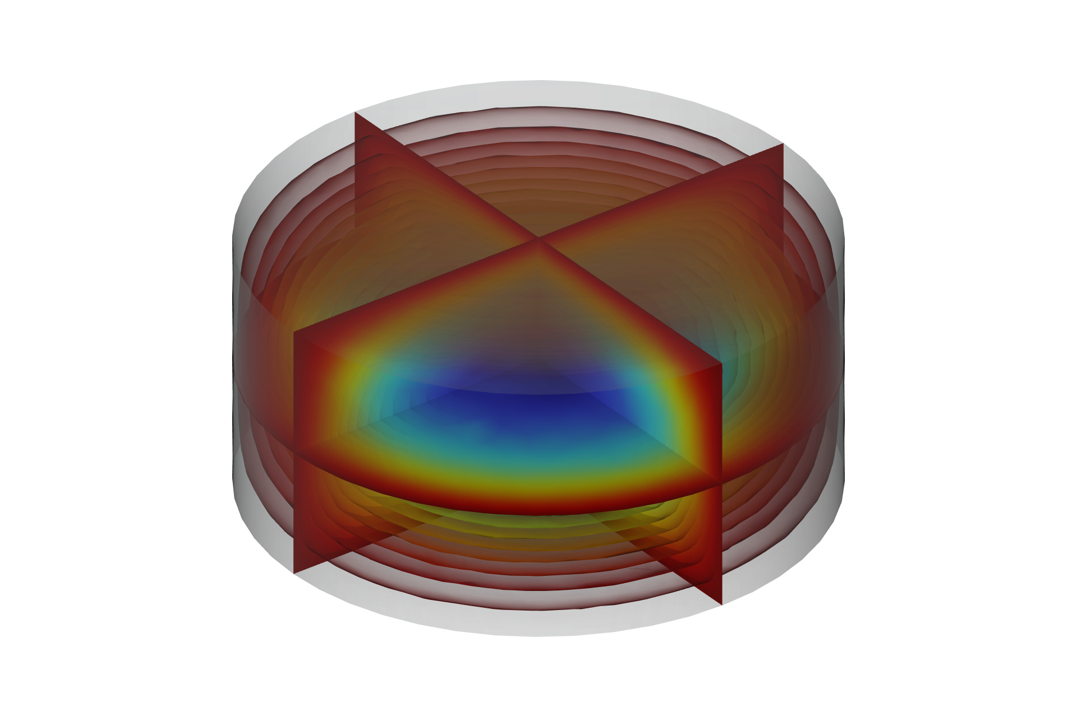

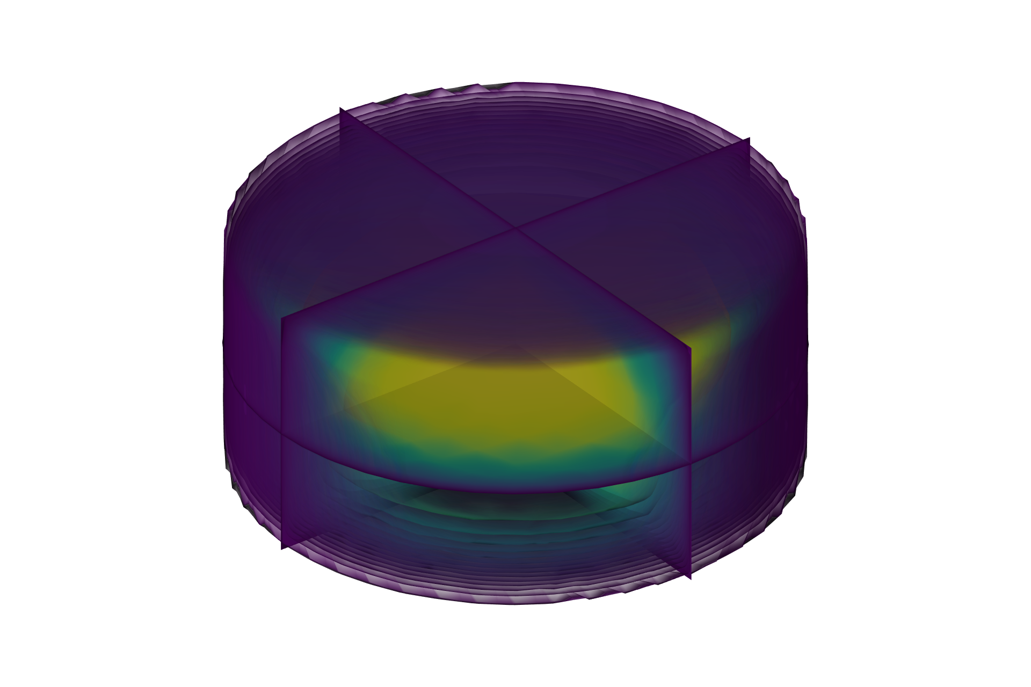
Summary
Introduction
About food safety
Theoretical notes
Method and validation
Food safety parameters analysis
Implementation: model nodes
Num-exp validation
Result
API construction
Forms interface.
How to choose geometry, materials and thermal cycle
Results.
Remarks and conclusion
Notes:
So, today we talk about food safety.
We start from an introduction to the topic,
to move on the methods and the numerical procedure used to simulate the phenomena.
Then, I show you how this application was implemented and how it make “simple” the analysis of this argument.

Slide 4
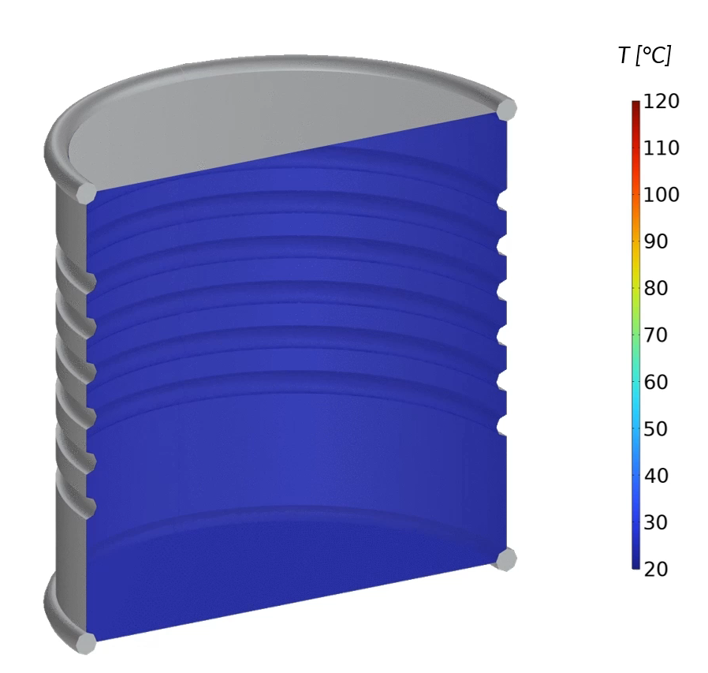


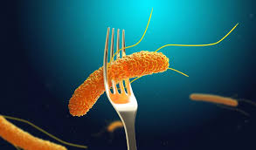
Introduction
Food safety
Historically, food safety is a very critical aspect in the field of the food industry. Making a product safe means preserving the quality for a certain period, so that it can be considered non-harmful for consumers and be marketed. At date, there are specific protocols and treatment useful to guarantee food quality.
Degradation of canned foods depends on the activity and number of bacteria inside.
Our work with COMSOL was to create a stand-alone application that could predict bacteria reduction and product safety in canned food, related to specific treatments.
Notes:
Food safety is a very critical aspect in the field of the food industry. Making a product safe means preserving the quality over time and make it (màrchetebol) marketable .
There are specific protocols useful to guarantee this results, according with Pasteur’s work, from which we know that degradation of canned foods mainly depends on the activity and the number of bacteria inside. So, to achieve the result, we need to neutralize them.
Our work with COMSOL was to create a stand-alone application that could predict bacteria reduction to archive product safety.

Slide 5
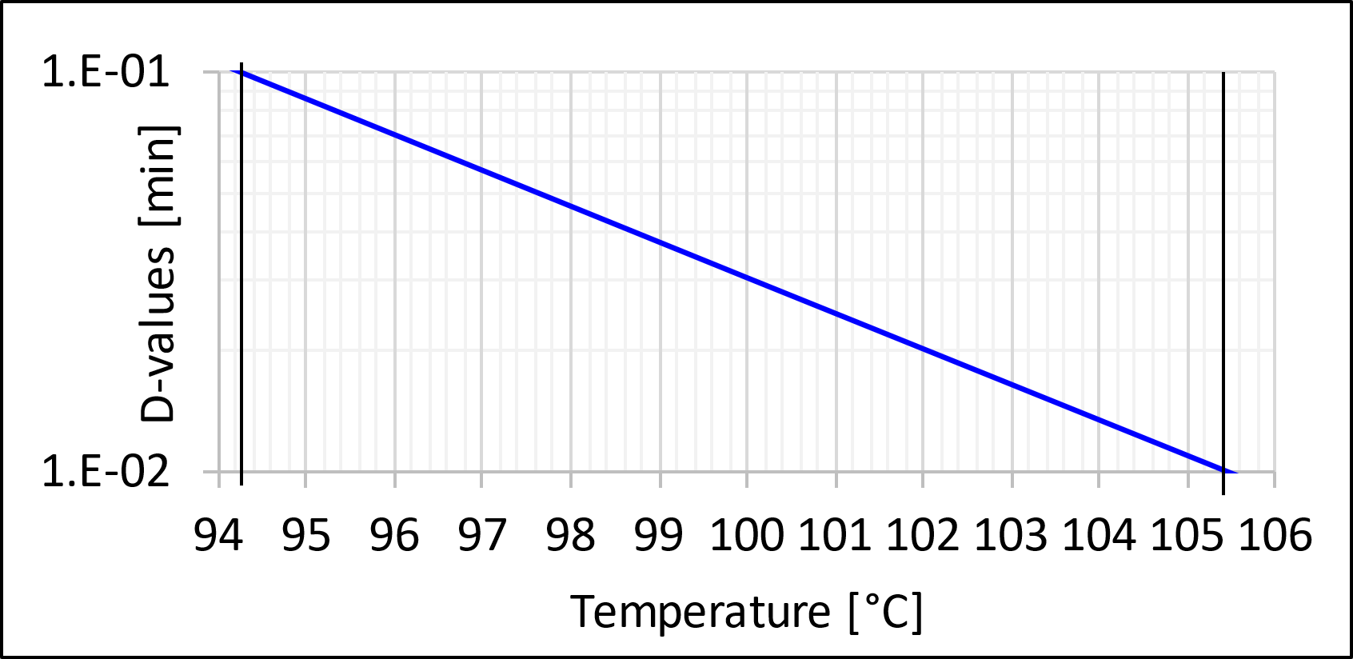
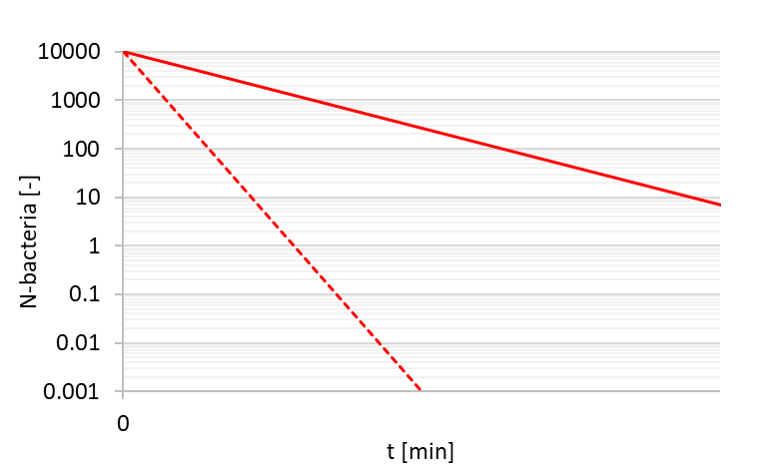
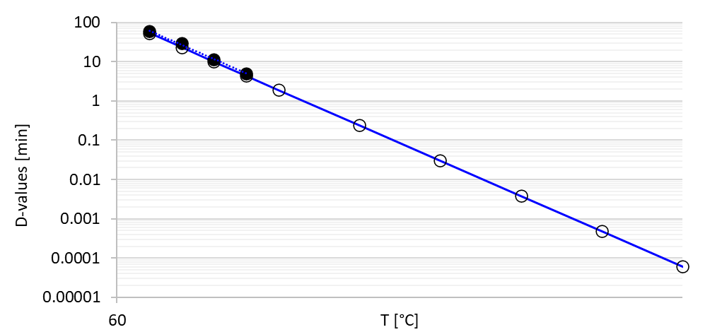





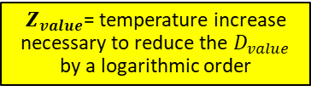
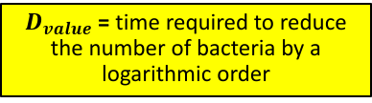
Methods
Bacteria heat sensitivity parameters
Bacteria are sensitive to high temperatures. During heat treatment, they start reducing and can be completely neutralized under specific temperatures and time.
$$Z_{value}$$
T₂
T₁
$$Z_{value}$$
$$D_{value_{1}}$$
$$D_{value_{2}}$$
Red lines = Number of surviving bacteria (N) as a function of the time (t) when a specific constant temperature (T_{i}) are applied.
Blue line = Envelope of D-values as a function of the Temperature (T_{i}).
$D_{value}$= time required to reduce the number of bacteria by a logarithmic order
$Z_{value}$= temperature increase necessary to reduce the $D_{value}$ by a logarithmic order
Notes:
So, the important think to know about bacteria is that they are sensitive to high temperatures and can be completely neutralized with the right combination of temperature and time.
Parameters such as $D_{value}$and $Z_{value}$help us to model this reduction during a heat treatment.
In the left part of the slide, we can see bacteria reduction as a function of the time, in a logaritmic scale.
$D_{value}$ D-value is the time needed to achieve a 90% Bacteria reduction under a specific temperature.
Enveloping 2 or more d-values as a function of the temperature, we obtain the plot in the right part.
$Z_{value}$ represent the temperature increase necessary to reduce the $D_{value}$ by a logarithmic order

Slide 6
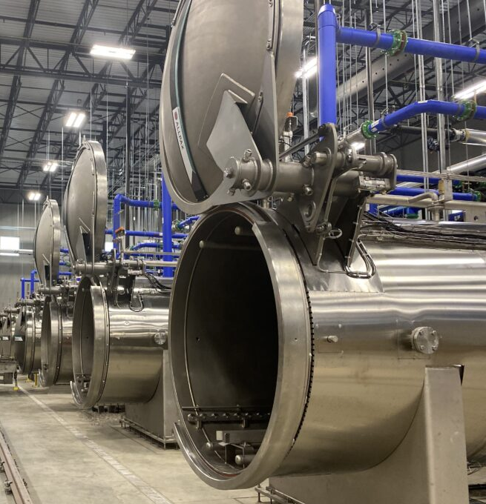
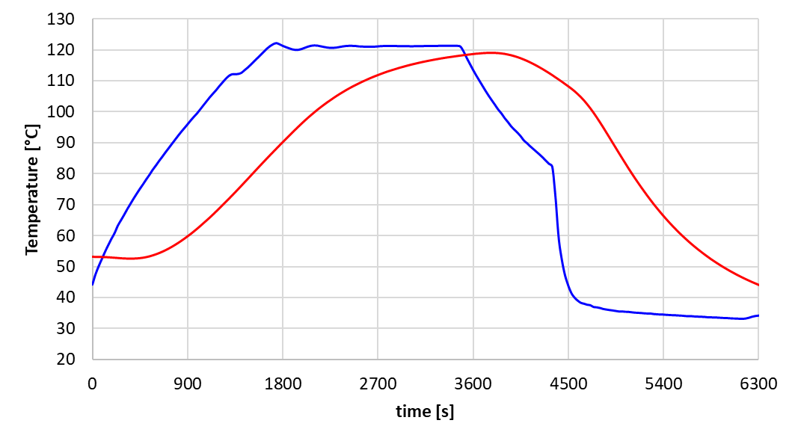
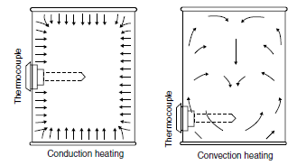


Methods
Heat penetration curve
Typical heat treatment processes are made with retort and are usually composed by 3 steps :
Heating
Sterilization
Cooling
T_{r}
$T_{r}$ = retort temperature.
$T_{p}$ = Coldest product point temperature
T_{p}
The shape of the $T_{p}$ curve can be significantly different as the location of the coldest point in the can, according to their physical state.
Notes:
Here we have a typical heat treatment process, that is usually composed by 3 steps:
Heating, where the retort temperature increase.
Sterilization, where the retort temperature is kept constant.
Cooling, in which the retort temperature drop down..
During the process, the temperature of the product try to follow the retort temperature.
The shape of the coldest point curve depend on the product physical states (solid or liquid).

Slide 7
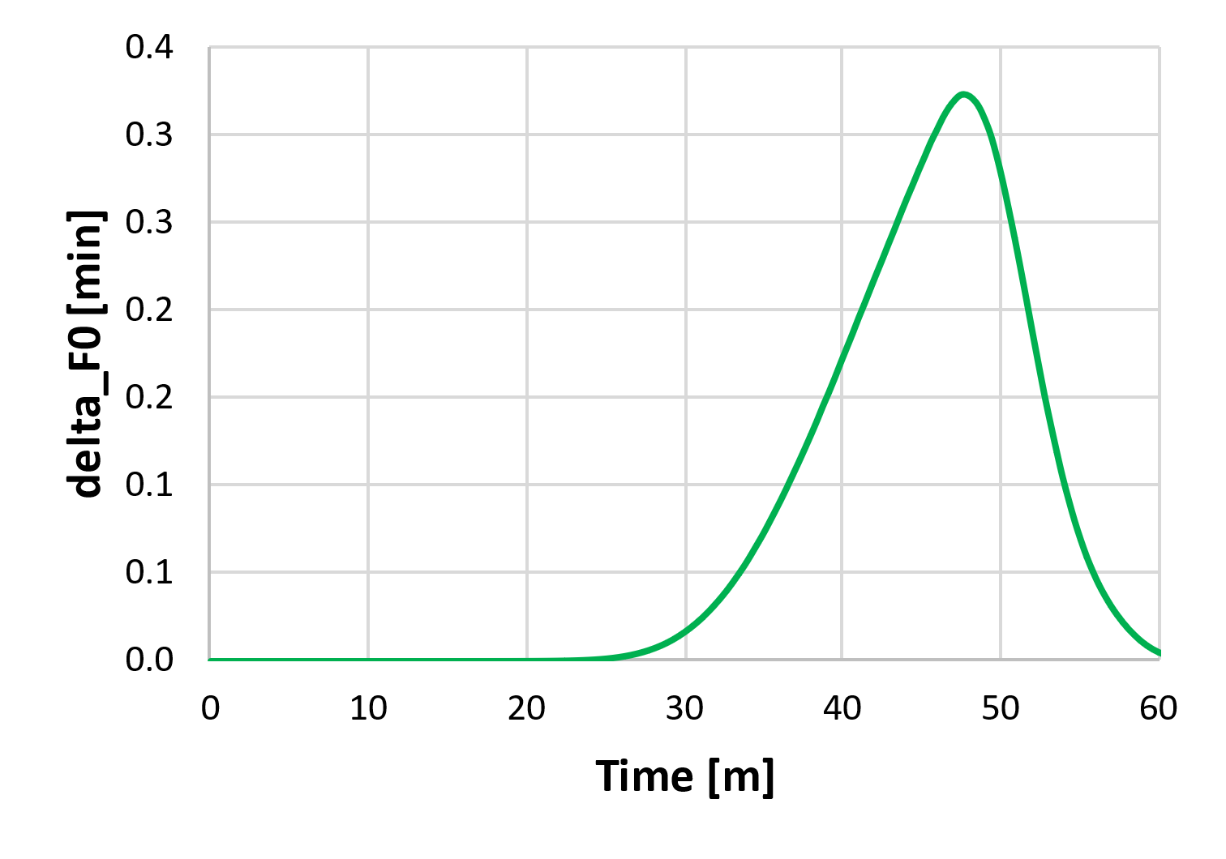
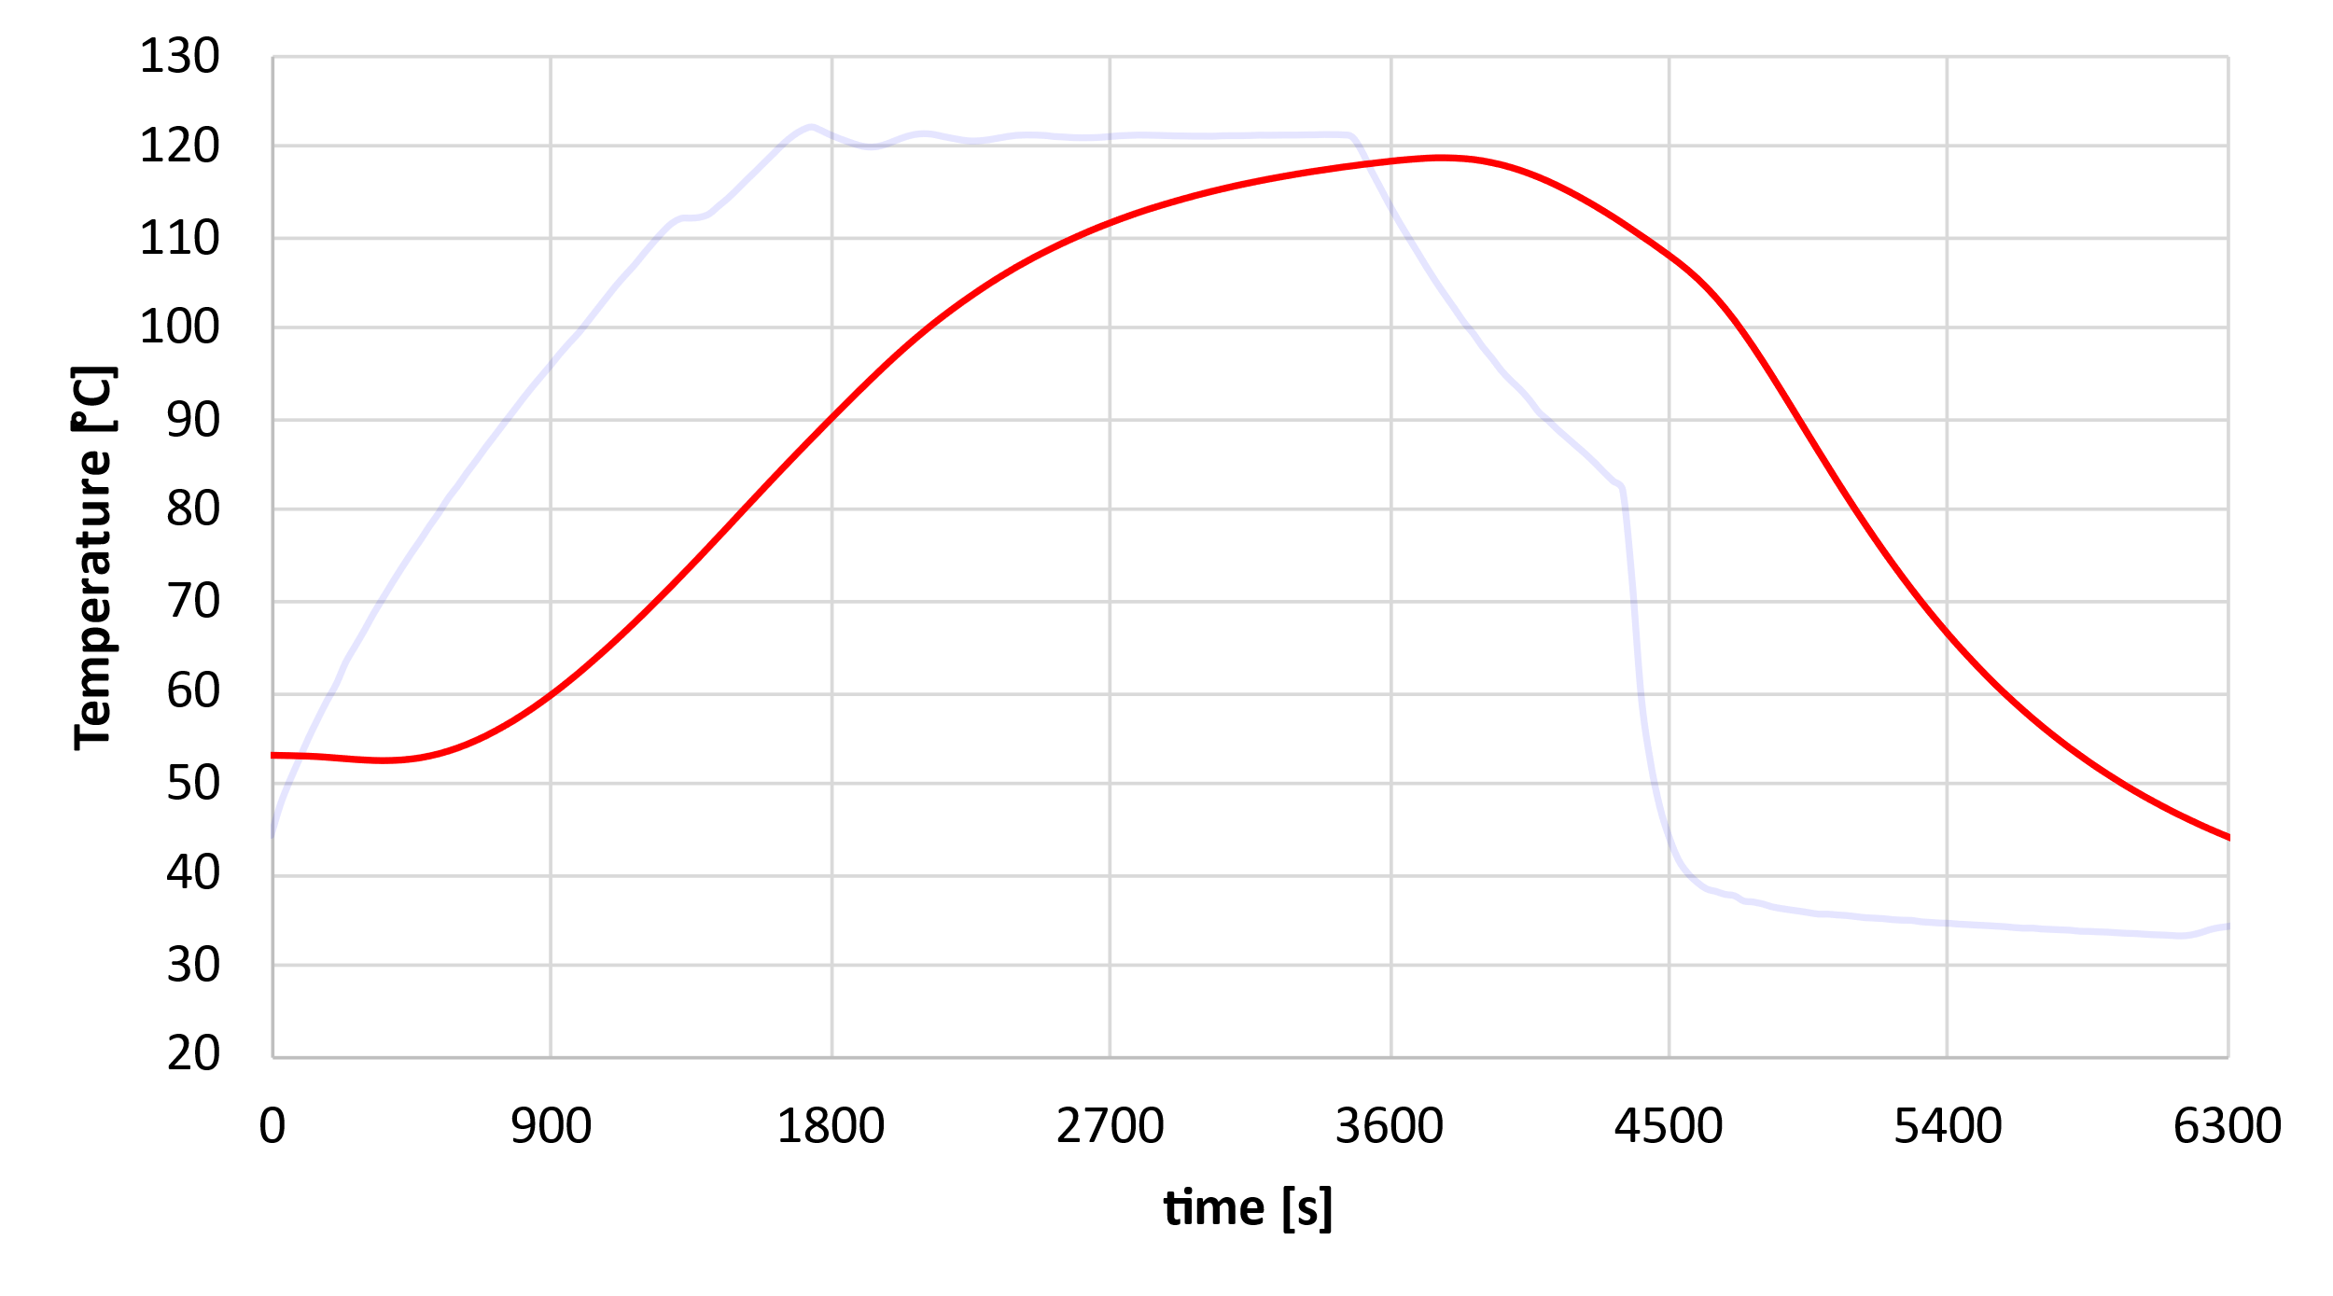
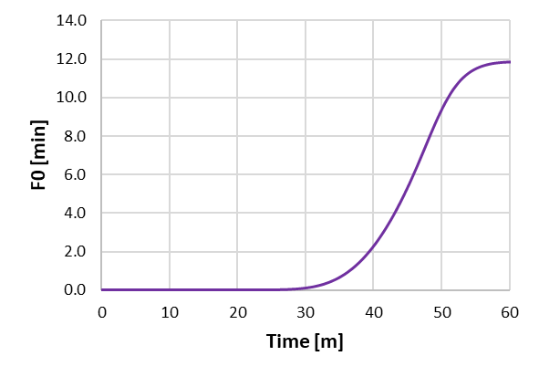



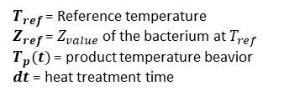
Methods
Letality factor
By integrating the heating curve of the product, we can obtain the lethality factor $F_{value}$, define as the time to neutralize all bacteria for a given temperature.
Heating
Sterilization
Cooling
$$F_{value}=\int_{0}^{t}{{10}^{(\frac{T_{p}(t)−T_{ref}}{Z_{ref}})}dt}$$
$$F_{0}=F_{value}$$
$$@ T_{ref}=121°C$$
$T_{ref}$= Reference temperature
$Z_{ref}$ = $Z_{value}$ of the bacterium at $T_{ref}$
$T_{p}(t)$= product temperature beavior
$dt$ = heat treatment time
T_{p}
$F_{value}$= equivalent time to neutralize the same number of bacteria of an ideal thermal cycle at temperature $T_{ref}$
Notes:
By integrating the coldest point temperature curve, we can obtain the lethality factor 𝑭_𝒗𝒂𝒍𝒖𝒆, define as the equivalent time to neutralize the same number of bacteria of an ideal thermal cycle at a reference temperature.
Its formulation consider four elements:
Reference temperature;
$Z_{value}$ of the bacterium
Product temperature profile
Heat treatment time.
If the reference temperature is equal to 121 degrees Celsius (the nominal sterilization temperature), the F value is called F0.

Slide 8
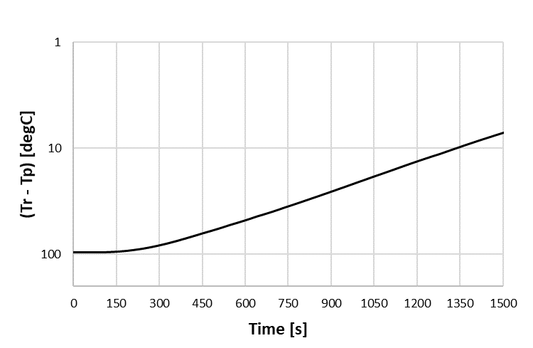
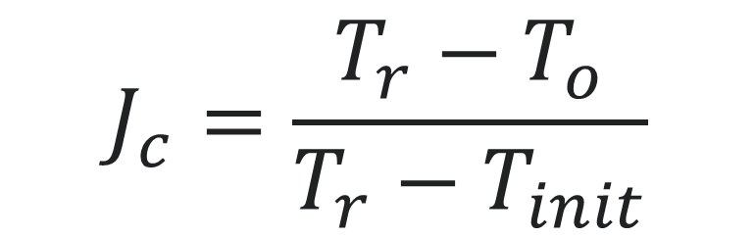
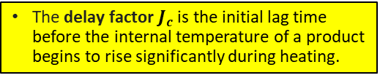
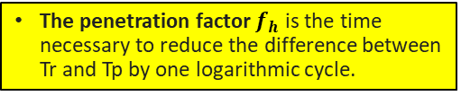


Methods
Other process parameters
Furthermore, considering the function (𝑻r−𝑻p) in logarithmic scale, we obtain the plot in the right part.
Heating
Sterilization
Cooling
$$f_{h}$$
T_{r}
$$T_{o}$$
T_{p}
The penetration factor $f_{h}$ is the time necessary to reduce the difference between Tr and Tp by one logarithmic cycle.
The delay factor $J_{c}$ is the initial lag time before the internal temperature of a product begins to rise significantly during heating.
Notes:
Furthermore, if we plot in a semi-logarithmic diagram the difference between retort and coldest point temperature, we obtain other 2 parameters.
The penetration factor $f_{h}$, that is the time necessary to reduce the difference between Tr and Tp by one logarithmic cycle.
The delay factor $J_{c}$, that represents the initial lag time before the internal temperature of a product begins to rise significantly during heating.

Slide 9
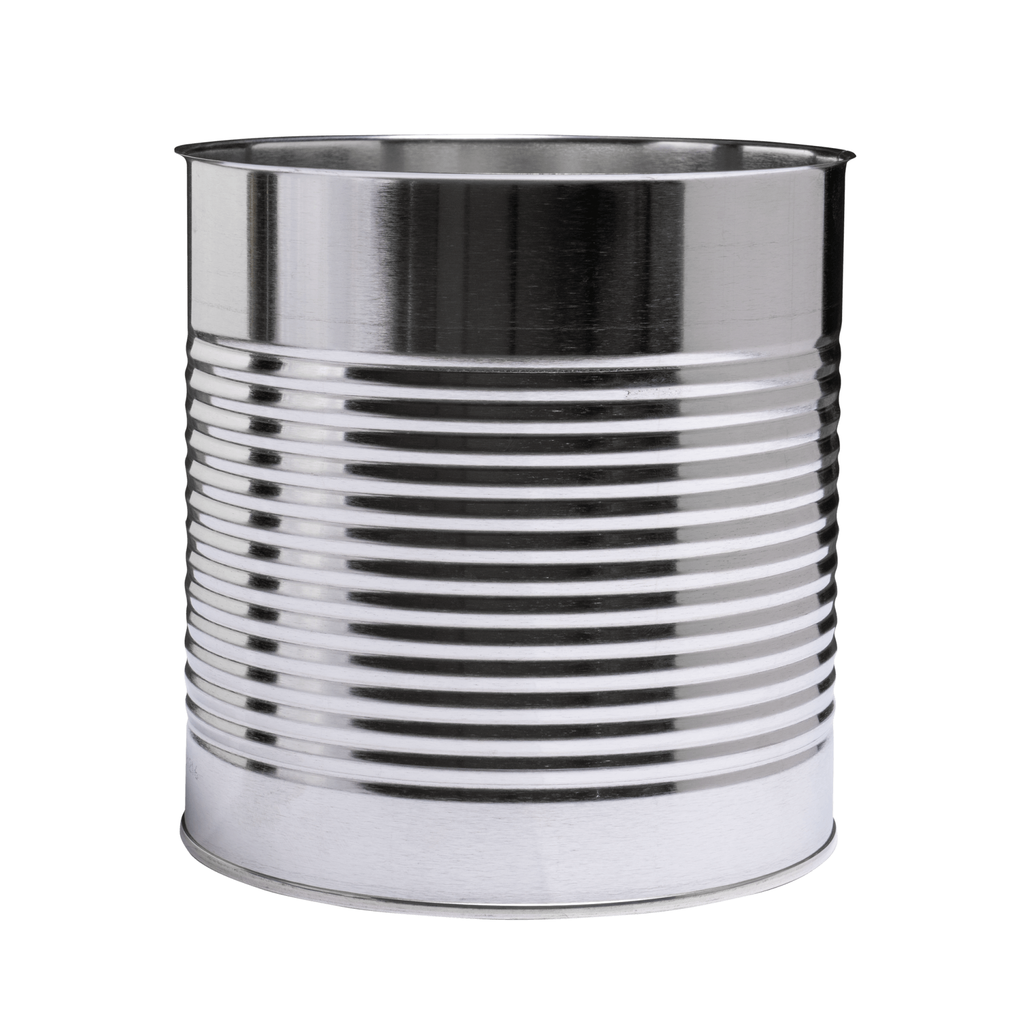
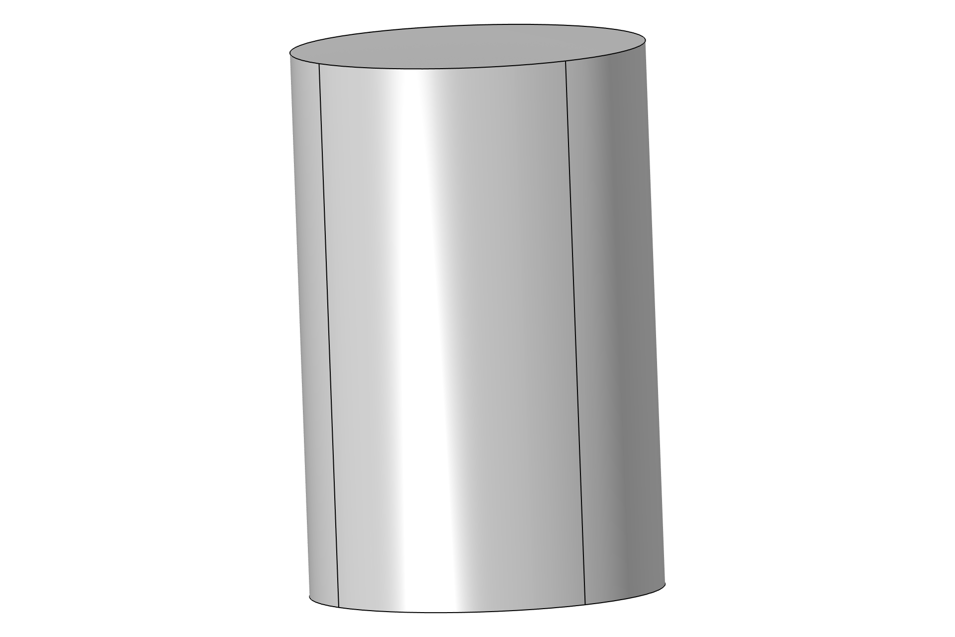
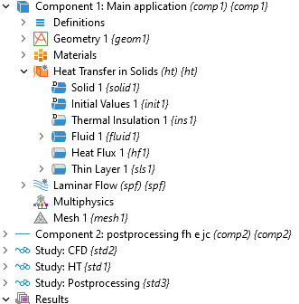
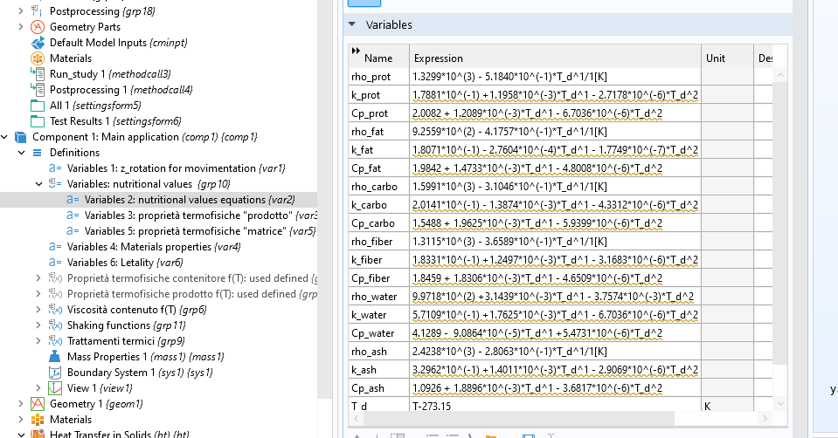
Modelling
Model implementation
A thermo-fluid dynamic model in COMSOL environment was built to analyze the heat penetration inside the box.
Thermal properties of product are made of analytical equation refers to the nutritional values.
Notes:
A thermo-fluid dynamic model in COMSOL environment was build to analyze the heat penetration inside the box.
Thermal properties of product are made of analytical equation refers to the nutritional values.

Slide 10
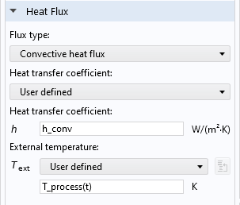
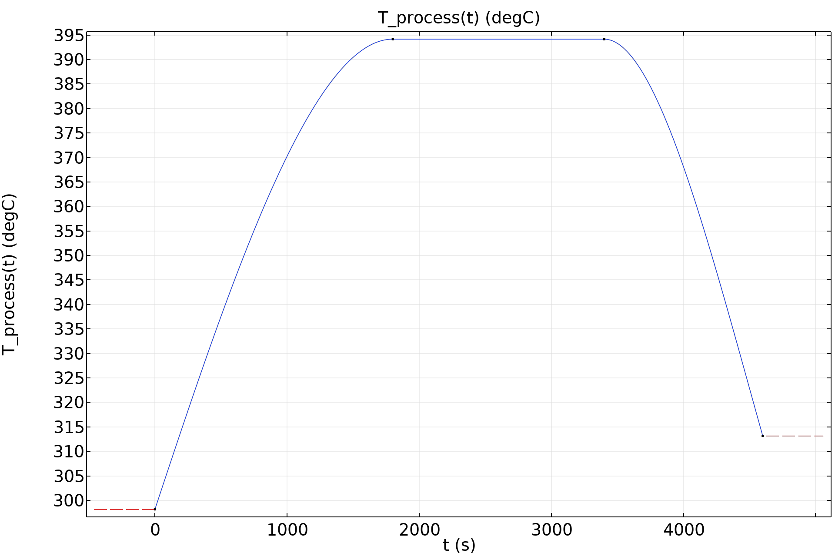
Modelling
Model implementation
Conductive heat exchange was solved inside the can (but also natural or forced heat exchange can be simulated, according to the physical states of the product and the specific treatment).
Convective heat flux was imposed along the wall of the can, according to process temperature
Notes:
Conductive heat exchange was solved inside the can
Convective heat flux was imposed along the wall of the can, according to the process temperature

Slide 11
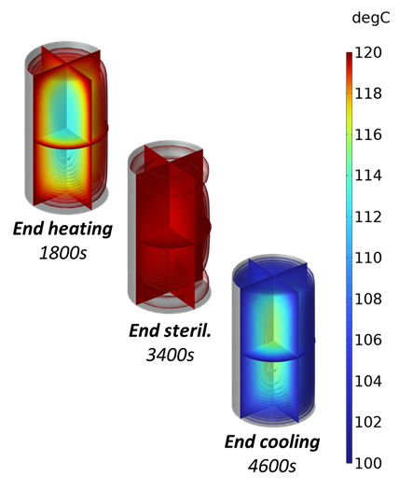
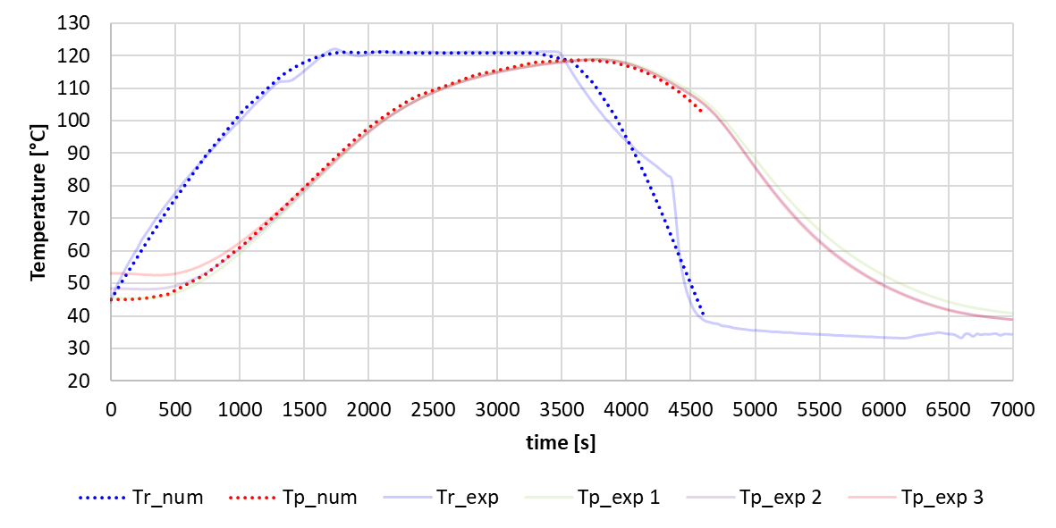
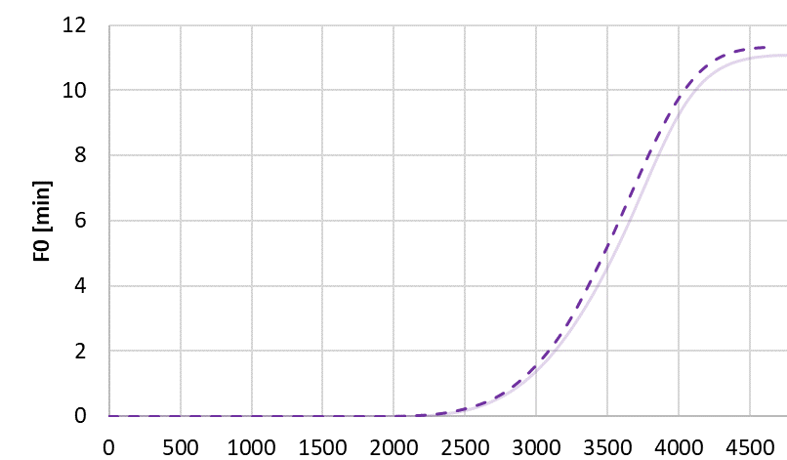
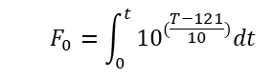
Modelling
NUM-EXP Validation
Heating
Sterilization
Cooling
T_{r}
Container = Tinplate
Content = Meat sauce
Thermal cycle = Standard
(heating/sterilization/cooling).
T_{p}
Heating
Sterilization
Cooling
T_ref=121°C
Z_value=10
F_{o}
Checking out our numerical temperature profile with some experimental curves, we achieve a very good agreement also in the lethality factor behavior.
Notes:
Checking out our numerical temperature profile with some experimental curves, we archive a very good agreement also in the lethality factor behavior.

Slide 12
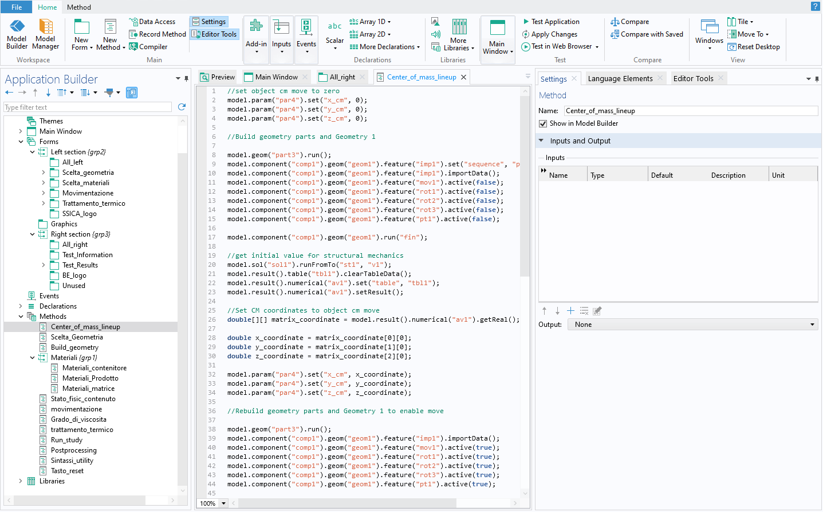
API interface
Forms and methods: to make the model user-friendly
Application builder interface was used to design a simplified graphics interface for all customers, from data entry to the result.
Several methods and form have been implemented to manage the various features of the application.
Let's take a closer look at how the app works in the next slides.
Notes:
Then, application builder was used to design a simplified interface, in order to make simple the use FOR each user.
Several methods and form have been implemented to manage the various features of the application.

Slide 13
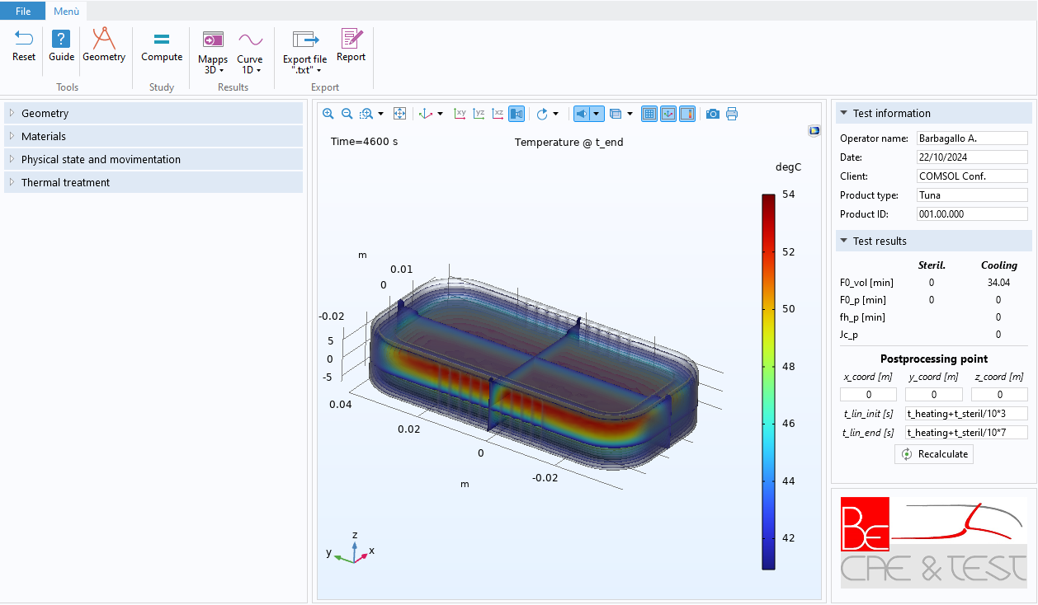
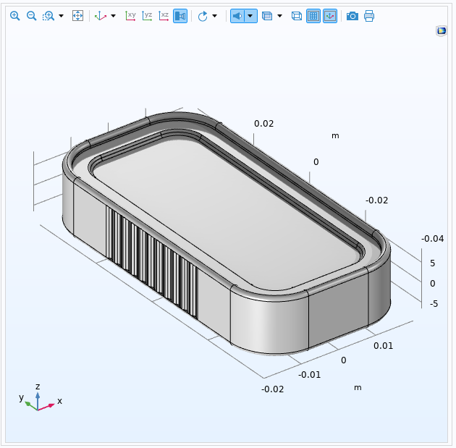

API interface
App UI
Ribbon / Utility buttons
Setting
Post-processing and test information
Notes:
And here we have the main window of the application.
It’s very simple and intuitive. We have:
In the center, the graphics windows.
In the left part, the setting tabs ;
In the right part, the result tabs;
In the top part a ribbon with some utility button
Let’s now take a look at the setting tabs.

Slide 14
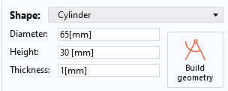
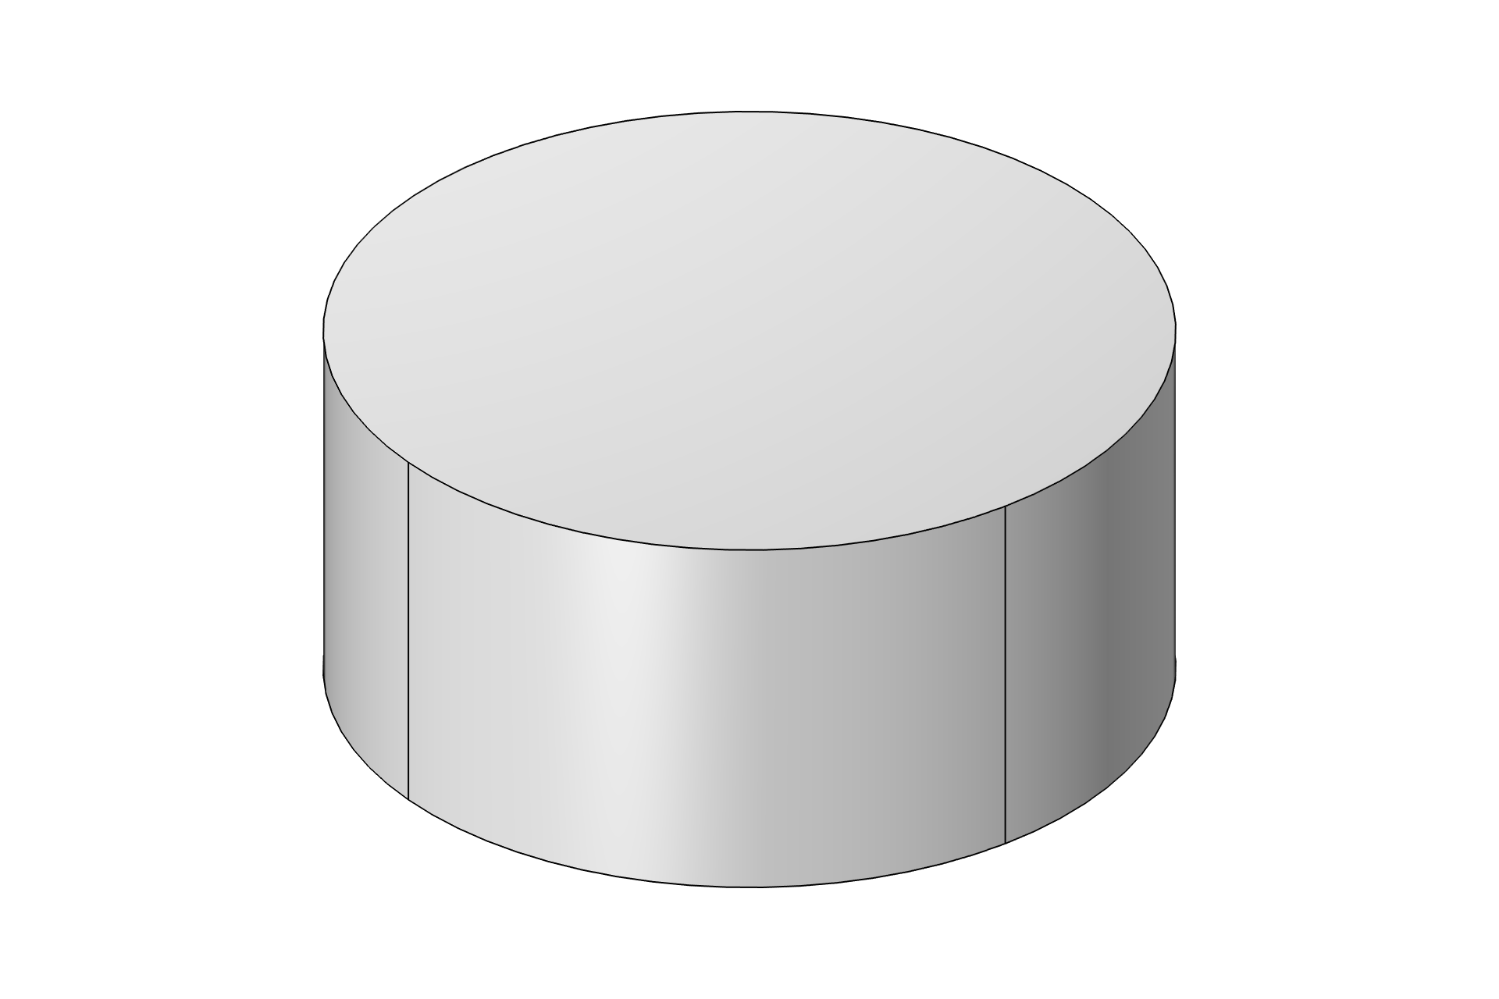







API interface
App UI: Geometry
Choose the shape of the container and the main dimensions.
Notes:
The first step is the geometry. We need to choose the shape of the container

Slide 15
API interface
App UI: Geometry
Choose the shape of the container and the main dimensions.
1) Select a shape for the geometry
2) Positioning and orientation
Rotate the container if is necessary
Notes:
We can set cylindrical or rectangular shapes, according to the real form we want to simulate,
or we can import a custom-made one.

Slide 16








API interface
App UI: Materials
Insert thermal properties throw a pre-implemented materials library or a “user defined” settings.
Pre-implemented materials library
“Constant parameters” and “f(T)” settings are like the previous slide.
“Nutritional values” setting estimate thermal properties of products starting from their nutritional values.
4) Choose the material of the content
If product is packed in a fluid matrix (such as oil or Brine), it is necessary to specify the total weight and the net weight of the can; the app will calculate averages thermal properties between matrix and product as a function of the specified weights.
5) Specify if the content has biphasic states
Notes:
The second step is the Material section.
We need to select the type of the container and the type of the content, in order to define the thermal properties of the domain.

Slide 17


API interface
App UI: Materials / Container
Allocate thermal properties throw a pre-implemented materials library or a “user defined” settings.
Pre-implemented materials library
In the “costant parameters” setting, user must import thermal properties value as a single value.
3) Choose the material of the container
In the “f(T)” parameters setting, user must import thermal properties as curves functions of temperature.
Notes:
About the container we can:
select a material from the library pre-implemented (such as aluminum, glass, tinplate ecc);
Or, in alternative , we can insert user defined values as a constant parameters or as a function of the Temperature.

Slide 18
API interface
App UI: Materials / Content
Insert thermal properties throw a pre-implemented materials library or a “user defined” settings.
Pre-implemented materials library
“Constant parameters” and “f(T)” settings are like the previous slide.
“Nutritional values” setting estimate thermal properties of products starting from their nutritional values.
4) Choose the material of the content
If product is packed in a fluid matrix (such as oil or Brine), it is necessary to specify the total weight and the net weight of the can; the app will calculate averages thermal properties between matrix and product as a function of the specified weights.
5) Specify if the content has biphasic states
Notes:
Even for the product content, we can choose a material from the implemented library (onions, tuna, salmon, meat, tomato sauce ecc) or a user defined settings.
If we don’t have any idea about the thermal properties, we can extimate them by inserting the nutritional values. There are implemented thermal properties correlation for each nutritional value (carbs, proteins, fat, ecc).

Slide 19
API interface
App UI: Materials / Content
Insert thermal properties throw a pre-implemented materials library or a “user defined” settings.
Pre-implemented materials library
“Constant parameters” and “f(T)” settings are like the previous slide.
“Nutritional values” setting estimate thermal properties of products starting from their nutritional values.
4) Choose the material of the content
If product is packed in a fluid matrix (such as oil or Brine), it is necessary to specify the total weight and the net weight of the can; the app will calculate averages thermal properties between matrix and product as a function of the specified weights.
5) Specify if the content has biphasic states
Notes:
If product is packed in a fluid matrix (such as oil or Brine), it is necessary to specify the total and the net weight of the can; the app will calculate averages thermal properties between matrix and product as a function of the specified weights.

Slide 20








API interface
App UI: Physical state
Specify the physical state of the content. This will identify the numerical model for the heat penetration.
“Solid” state simulate only a conductive heat exchange inside the can.
Physical state and handling
Physical state and handling
6) Choose an appropriate numerical approach
“Liquid” state simulate both convective and conductive heat exchange inside the can.
Physical state and handling
Since we are solving fluid dynamics, we must specify the degree of viscosity of the product
Specify the type of handling to change the convection model:
  Static=natural convection flow;
  Rotation=forced rotated flow;
Notes:
Here, we need to specify the physical state of the content to identify the numerical model for the heat penetration inside the can. We can choose between “solid” and “liquid”.

Slide 21
API interface
App UI: Physical state
Specify the physical state of the content. This will identify the numerical model for the heat penetration.
“Solid” state simulate conductive heat exchange inside the can.
Physical state and handling
Physical state and handling
6) Choose an appropriate numerical approach
“Liquid” state simulate both convective and conductive heat exchange inside the can.
Physical state and handling
Since we are solving fluid dynamics, we must specify the degree of viscosity of the product
Specify the type of handling to change the convection model:
  Static=natural convection flow;
  Rotation=forced rotated flow;
Notes:
Choose “Solid” to simulate a conductive heat penetration inside the can, as we can see in the picture in the bottom right part.
According to the literature, coldest point is located in the centre of the can.

Slide 22

API interface
App UI: Physical state
Natural convection heating
Specify the physical state of the content. This will identify the numerical model for the heat exchange.
“Liquid” state simulate convective heat exchange inside the can.
“Solid” state simulate only a conductive heat exchange inside the can.
Physical state and handling
Physical state and handling
6) Choose an appropriate numerical approach
Forced convection heating
Since we are solving fluid dynamics, we must specify the degree of viscosity of the product
Specify the type of handling to change the convection model:
Static=natural convection fluid flow;
Rotation=forced rotated fluid flow;
Notes:
Choose “Liquid” to simulate a convective heat exchange. In this case, we will solve a fluid-dynamical model inside the can, and so we need to specify the grade of viscosity and the type of handling:
Select “static” handling if the can is not moved:
By doing so, we will solve a Natural convection heating simulating buoyancy force (figure in the top-right part).
According to the literature, coldest point is located somewhere in the bottom part of the can. App allow us to know the coordinates of this point.
Select “rotation” handling if the can rotate around one axis:
This allow us to solve a Forced convection heating simulating rotating moving wall (figure in the bottom-right part)

Slide 23





API interface
App UI: Thermal treatment
Specify the thermal cycle. Choose between “standard” or “user defined” mode.
* Standard thermal treatment graph
In the “standard” treatment setting, we need to set the limit values of the thermal profile, and the app will create the curve as in the plot above.
7) Choose a thermal treatment.
Heating
Sterilization
Cooling
* imported thermal treatment graph
8) Specify the characteristics of the bacterium we want to neutralize.
Use the “user defined” setting to import a particular thermal curve. In this case, we need only specify the duration time of the three step of the treatment.
Notes:
In the last section, we must specify the thermal cycle.
We can choose between “standard” or “user defined” mode:
“standard” mode is used to build typical thermal treatment (heating/sterilization/cooling).
“User defined” mode allow us to load atypical thermal cycle,

Slide 24
API interface
App UI: start simulation
10) Run simulation
9) Fill the test information section and enter the coordinates of the point you want to analyse (by default the origin).
Notes:
At this point we are ready to launch the simulation.
We can fill the right section with test information and enter the coordinate of the point we want to analyze.
Then, click the “compute” button.

Slide 25


API interface
App UI: Results
The main Plots of the simulation are available here
The main results of the simulation are shown here
Notes:
The main Plots of the simulation are available in the relative ribbon section, while the main results of the simulation are shown in the right part

Slide 26




API interface
App UI: 3D Results
End heating thermal
plot [°C]
End cooling thermal
plot [°C]
Lethality F0
End heating Lethality F0
plot [min]
Notes:
We can consult 3D thermal or lethality plots in post-processing by clicking the relative ribbon section.

Slide 27




API interface
App UI: 1D results
Notes:
Or, in alternative, some 1D plots, such as temperature, lethality, and the semy-logarithmic plot of T_retort-T_point

Slide 28
API interface
App UI: Export
And you can also export data from simulation as “.txt” file or print a report in “.docx” format.
Notes:
It is also possible to export data from simulation as “.txt” file or to print a report in “.docx” format.

Slide 29



Remarks
To summarize…
Several protocols and industrial treatment are made up to guarantee food safety and preserve its quality.
With this app, users can easily predict:
  the bacteria reduction following a heat treatment;
  the efficiency of the process;
  the heat distribution inside the can during the cycle.
Notes:
So, to summarize the topic…
Several protocols are made up to guarantee food safety.
And with this app, users can easily simulate food heat treatment, having a prediction about bacteria reduction and heat distribution inside the can, in order to preserve food quality over time.

Slide 30















Thank you all for your attention!
Viale Africa, 170 A - 95129 Catania (CT)
Via Toscana, 104 - 41053 Maranello (MO)
Calle Impresores, 20 - 28660 Boadilla del Monte (Madrid)
BE CAE & Test s.r.l.
www.be-caetest.it
info@be-caetest.it
+39 095 216 64 26
Notes:
Thank you all for the attention!

