Slide 1









A comprehensive COMSOL Modeling for the solar-driven CO₂ electroreduction to CO
Matteo Agliuzza¹, Candido Fabrizio Pirri^{1,2}, Adriano Sacco²
¹Applied Science and Technology Department, Polytechnic University of Turin, Corso Duca degli Abruzzi 24, 10129 Torino, Italy
²Center for Sustainable Future Technologies @Polito, Italian Institute of Technology, Corso Trento 21, 10129 Torino, Italy
matteo.agliuzza@polito.it
Matteo Agliuzza
Ph.D. Candidate
Supervisors: Prof. Candido Fabrizio PIRRI and Adriano SACCO

Slide 2





Outline
Introduction
Artificial Leaf
COMSOL Model
Conclusions
Circular economy and CO₂RR
Introduction on the existing device and results
Mathematical model for the physical study of the electrochemical reactor.
Conclusions and brief hint about the perspectives of the future works
1

Slide 3



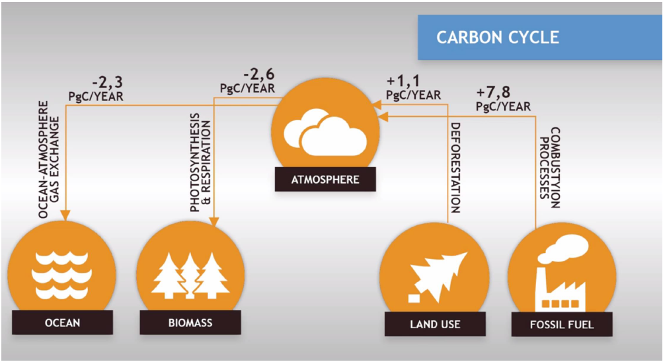
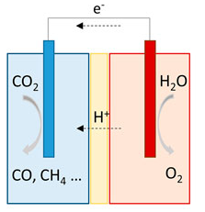
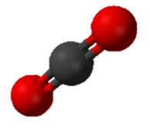



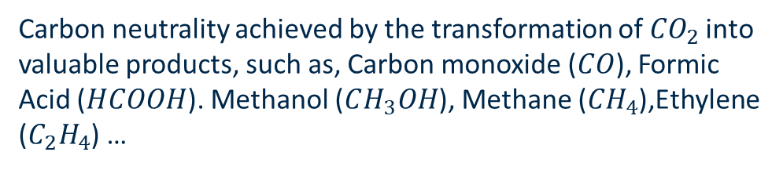
Introduction
Chemicals
Fuels
Carbon Neutral cycle
CO₂
Emissions from
combustion
Renewable
Energy Sources
CO₂ reactor
Positive net balance of carbon in atmosphere
Carbon neutrality achieved by the transformation of${CO}_{2}$ into valuable products, such as, Carbon monoxide ($CO$), Formic Acid ($HCOOH$). Methanol ($CH_{3}OH$), Methane (${CH}_{4}$),Ethylene ($C_{2}H_{4}$) …
2

Slide 4
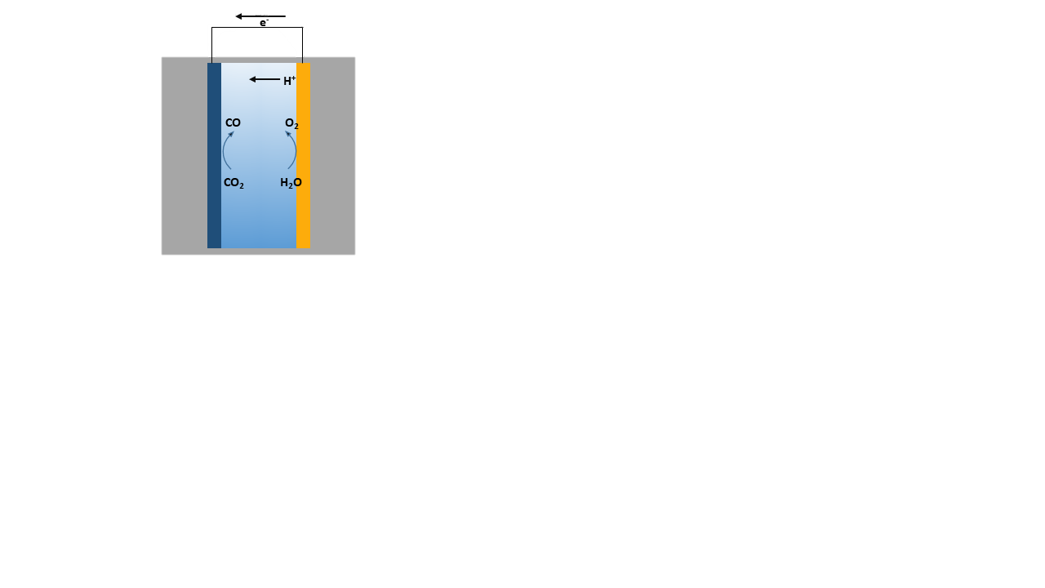
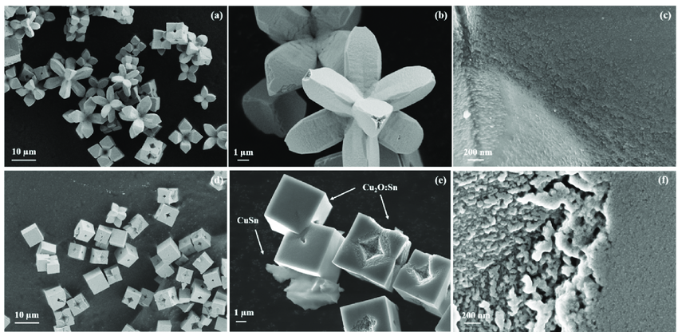
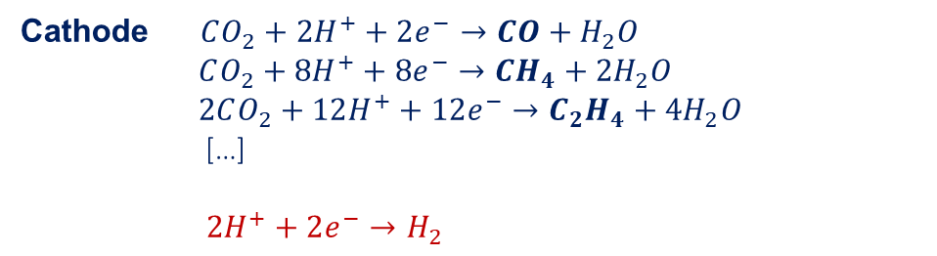

Introduction
Ag
Zeng et al, Catalysts 2021
Cu
Sn-Cu
Cathode $CO_{2}+2H^{+}+2e^{−}→CO+H_{2}O$
$$CO_{2}+8H^{+}+8e^{−}→CH_{4}+{2H}_{2}O$$
$$2CO_{2}+12H^{+}+12e^{−}→C_{2}H_{4}+{4H}_{2}O$$
[…]
$$2H^{+}+2e^{−}→H_{2}$$
Anode $2H_{2}O→2H^{+}+\frac{1}{2}O_{2}+2e^{−}$
OER
CO₂RR
HER
3

Slide 5

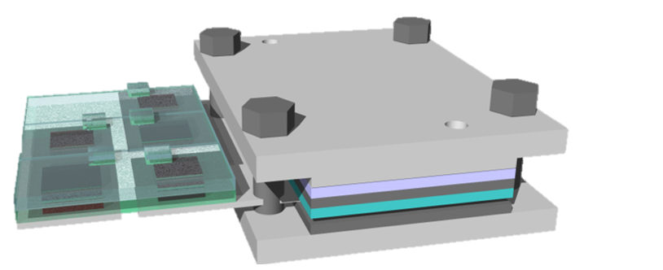



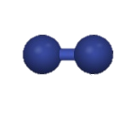

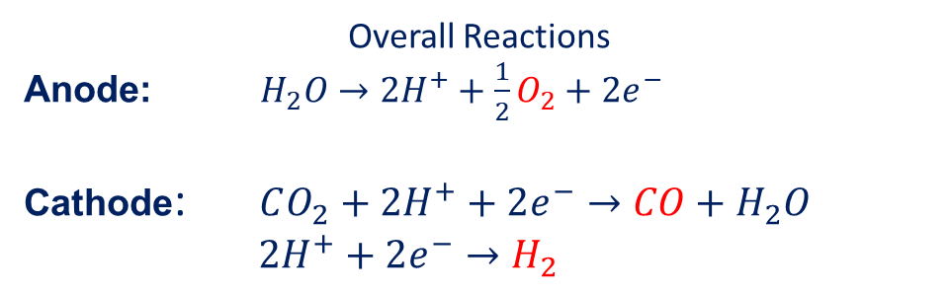

Artificial Leaf project
$$CO_{2}$$
Solar cell
(DSSC)
Electrolytic cell
Shared electrode
$$CO+H_{2}$$
Sacco et al, Sust. Chem. Eng. 2020
Dye-sensitized solar cells
Pt cathode
TiO₂ photo-anode
Electrolytic batch cell
Ag NPs cathode
Pt anode
Overall Reactions
Anode: $H_{2}O→2H^{+}+\frac{1}{2}O_{2}+2e^{−}$
Cathode: $CO_{2}+2H^{+}+2e^{−}→CO+H_{2}O$
$2H^{+}+2e^{−}→H_{2}$
4

Slide 6




COMSOL Simulation: WHY?
Predict chemical conditions in:
- boundary layers at interfaces
- bulk
Lead the scaling-up process of the electrochemical reactor
Predict performance of the device
Before prediction, the model is validated through experimental results
5

Slide 7
EC Model: highlights
Assumptions
y
2D model
All products and species remain in liquid phase
Catalysts are simulated through their kinetic parameters
System is isothermal @ ambient T°
BL
Membrane
BL
Outlet
Outlet
H
Ф_{m} = Ф_{e} - ΔФ_{d}
Ф_{m} = Ф_{e} - ΔФ_{d}
x=x_{a}
x=x_{a}
x=x_{a}
x=x_{m}
x=x_{m}
x=x_{a}
O₂
CO
Recirculation through inlets/outlets
Membrane is implemented as fixed space charge
Stationary conditions are investigated
H⁺
H⁺
H⁺
Anode (Pt)
H₂O
CO₂
Cathode (Ag)
CO₂
CO₂
K⁺
K⁺
OH⁻
OH⁻
-
-
HCO₃
HCO₃
2-
2-
CO₃
CO₃
O₂
CO
Ф = 0
H₂
Ф = -V_{c}
0
Inlet (CO₂ - saturated 0.1M KHCO₃)
Inlet (CO₂ - saturated 0.1M KHCO₃)
x_{a}
x
0
x_{m}
x_{c}
L
L_{m}
L
Agliuzza et al, J. Phys. Energy (2024)
6

Slide 8
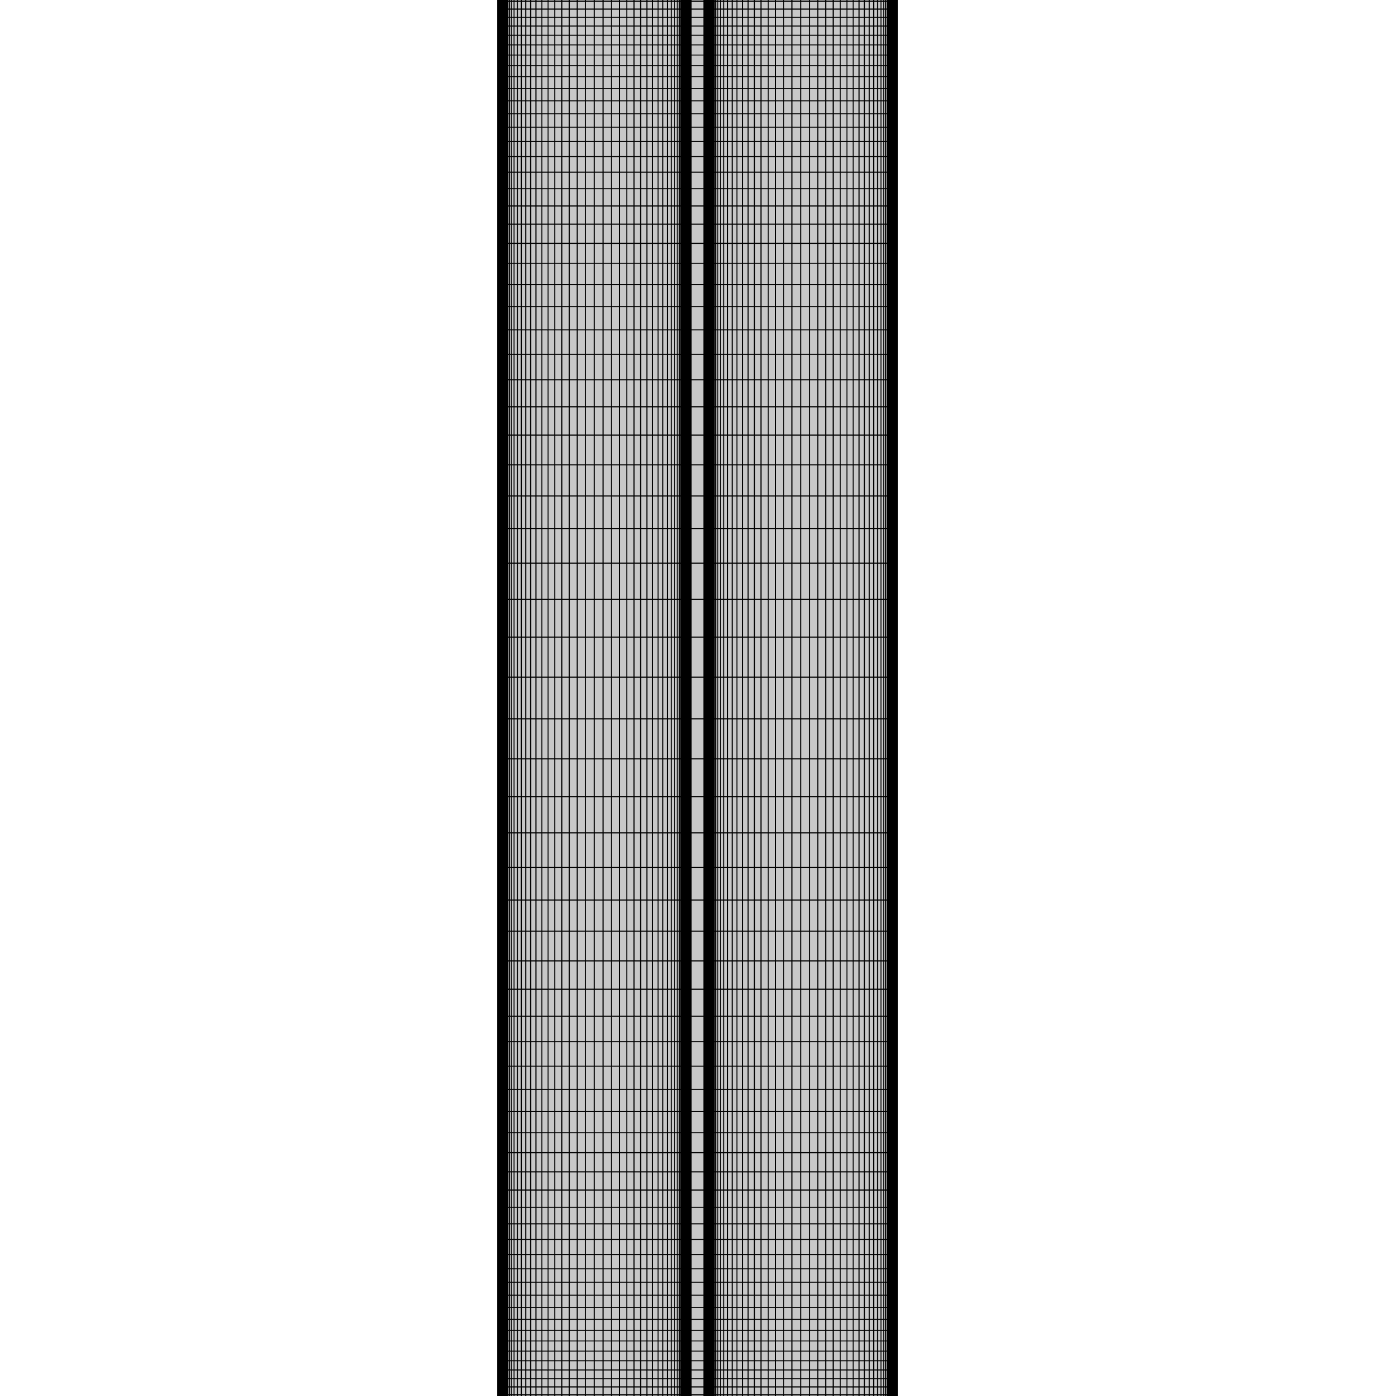
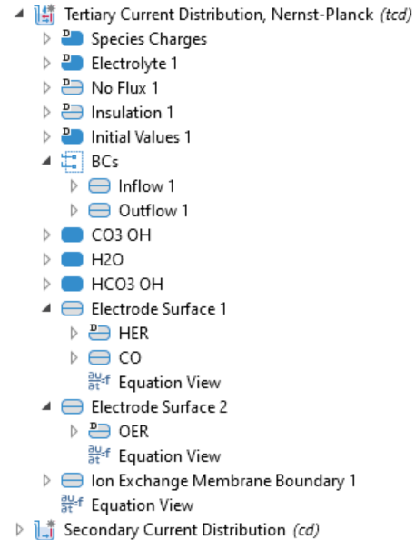
Model: main equations
7

Slide 9



Anode – Cathode domains
Tertiary Current Distribution (TCD) – Electrochemistry module
Current distribution
Nernst-Planck Equation: ${ N}_{i}=−D_{i}∇c_{i}−{ z}_{i}u_{m,i}Fc_{i}∇φ_{l} + c_{i}u$
diffusion
migration
convection
Equilibrium reactions
$$CO_{2}+OH^{−}↔HCO_{3}^{−}$$
$$HCO_{3}^{−}+OH^{−}↔CO_{3}^{2−}+H_{2}O$$
$H_{2}O↔OH^{−}$+ $H^{+}$
Inflows/Outflows
8

Slide 10


Anode – Cathode boundaries
Tertiary Current Distribution (TCD) – Electrochemistry module
Kinetics
Butler-Volmer Equation: $j_{partial}=j_{0}\left[C_{R}exp\left(\frac{α_{a}F}{RT}η\right)−C_{OX}exp\left(−\frac{α_{c}F}{RT}η\right)\right]$
Electrochemical reactions
$$\left(∎\right) CO_{2}+H_{2}O+2e^{−}→CO+2OH^{−}$$
CO₂RR
$$\left(∎\right) 2H^{+}+2e^{−}→H_{2}$$
HER
$$\left(∎\right) 4H_{2}O→4H^{+}+O_{2}+4e^{−}$$
OER
9

Slide 11



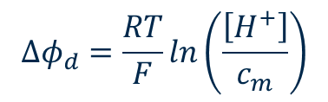
Membrane Domain
Secondary Current Distribution (CD) – Electrochemistry module
Ohm’s Law
No significant concentration gradients are expected in the membrane
$$i_{m}=−σ_{m}∆φ_{m}$$
$$N_{H^{+}}=\frac{i_{m}}{F}$$
Donnan potential
Required to let TCD and CD interfaces interact
$$φ_{m}=φ_{e}−φ_{d}$$
$$∆φ_{d}=\frac{RT}{F}ln\left(\frac{\left[H^{+}\right]}{c_{m}}\right)$$
10

Slide 12
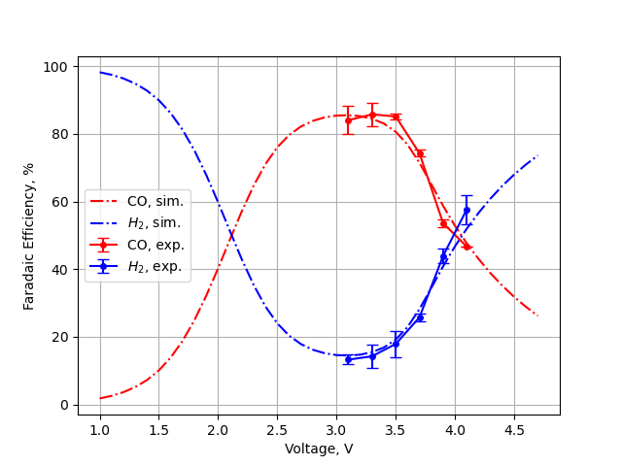
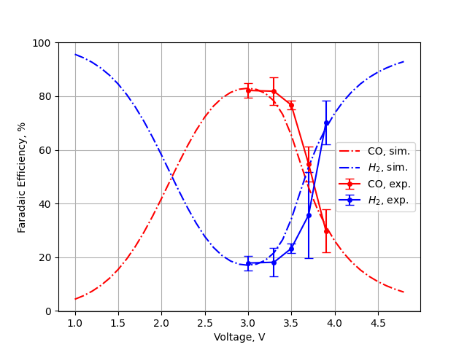
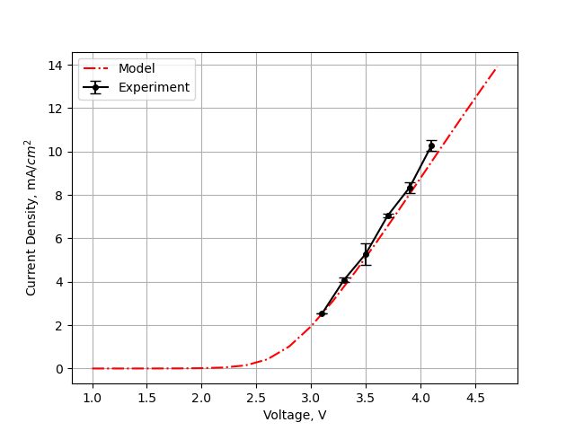
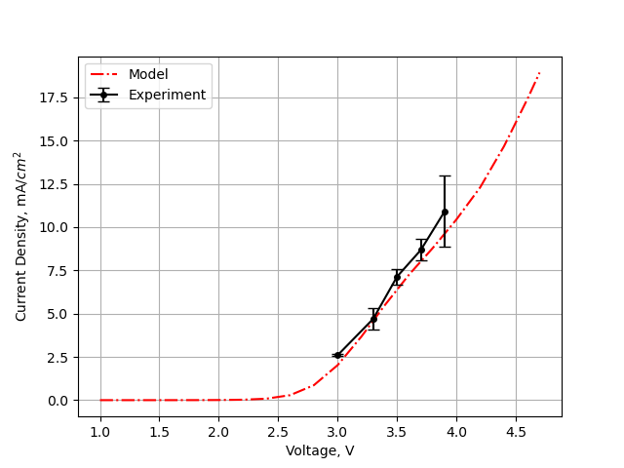
Results #1: Cell length L
L=0.6 cm
L=0.25 cm
11
Notes:
J0=exchange current density, current density at zero overpotential. Mass transport limitation is given by a limit in the maximum current density j
Diffusion-migration-convectoin: um = mobility, u=velocity, phi=electrolyte potential
Nernst eq modifies Eeq away from standard conditions (c=1M)

Slide 13
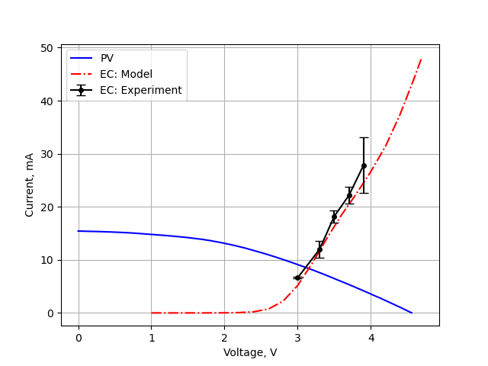
Solar-driven CO₂ reduction: Experiment
Power matching requires a suitable match between the voltage-current points of both PV and EC modules.
The PV is made of a module of 6 Dye-Sensitized Solar Cells
I_{op}=8.6 mA (approx. 3.4 mA/cm2)
V_{op}=3.1 V
FE_{co} = 82% , FE_{H2} = 18%
Operational Point
op
op
12
Notes:
J0=exchange current density, current density at zero overpotential. Mass transport limitation is given by a limit in the maximum current density j
Diffusion-migration-convectoin: um = mobility, u=velocity, phi=electrolyte potential
Nernst eq modifies Eeq away from standard conditions (c=1M)

Slide 14
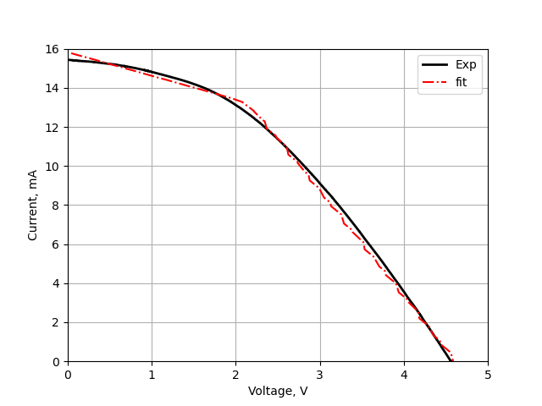
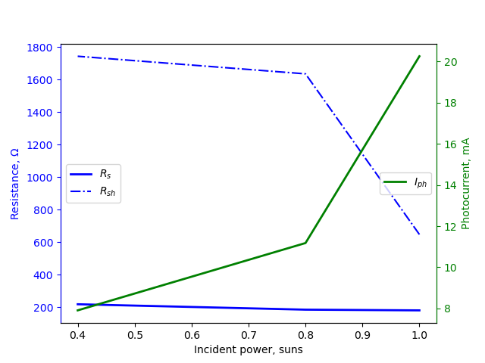
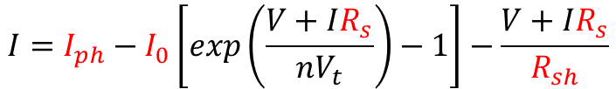
Solar-driven CO₂ reduction: Model
Step 1: Define the mathematical model for the solar cell
$$I=I_{ph}−I_{0}\left[exp\left(\frac{V+IR_{s}}{nV_{t}}\right)−1\right]−\frac{V+IR_{s}}{R_{sh}}$$
Step 2: Fit the experimental data and retrieve the parameters
13
Notes:
J0=exchange current density, current density at zero overpotential. Mass transport limitation is given by a limit in the maximum current density j
Diffusion-migration-convectoin: um = mobility, u=velocity, phi=electrolyte potential
Nernst eq modifies Eeq away from standard conditions (c=1M)

Slide 15
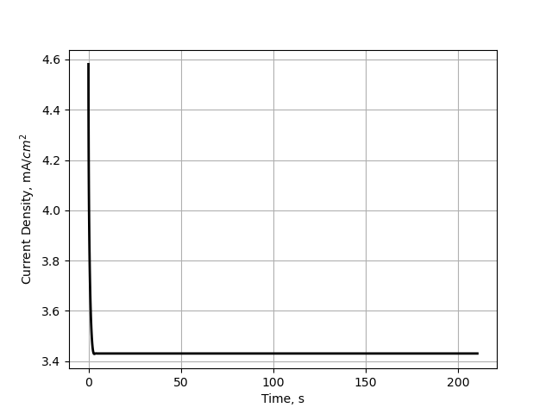
Solar-driven CO₂ reduction: Model
Step 3: implement the mathematical equation in COMSOL and perform the time-dependent simulation
Model results
Operational Point
14
Notes:
J0=exchange current density, current density at zero overpotential. Mass transport limitation is given by a limit in the maximum current density j
Diffusion-migration-convectoin: um = mobility, u=velocity, phi=electrolyte potential
Nernst eq modifies Eeq away from standard conditions (c=1M)

Slide 16
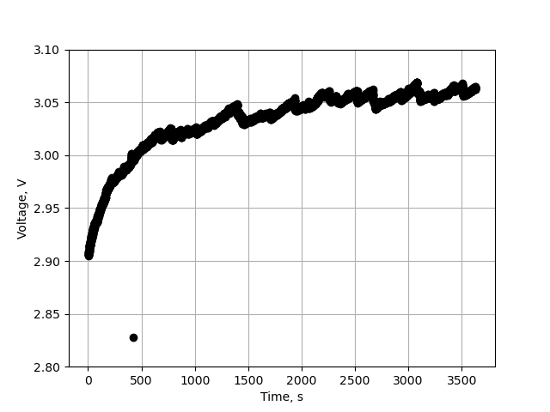
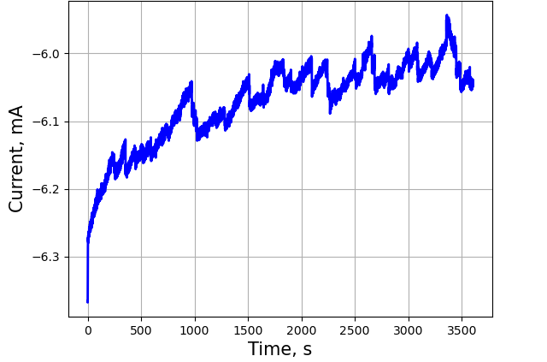
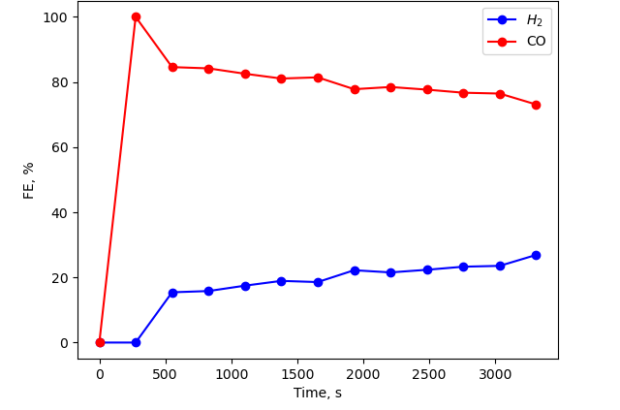
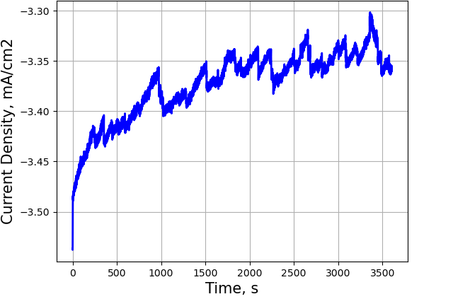
Solar-driven CO₂ reduction: first results
Approx. J=3.35 mA/cm2
(J_{model}=3.4 mA/cm2)
15
Notes:
J0=exchange current density, current density at zero overpotential. Mass transport limitation is given by a limit in the maximum current density j
Diffusion-migration-convectoin: um = mobility, u=velocity, phi=electrolyte potential
Nernst eq modifies Eeq away from standard conditions (c=1M)

Slide 17
Conclusions and Future Perspectives
A comprehensive model for the CO₂ electro-reduction is proposed, validated through experimental results
The photovoltaics module is implemented through its governing equation
More complex electrochemical cells will be implemented (e.g. Flow Cells)
Optimize the model to be predictive for PV-EC performance under different incident light conditions (e.g. cloudy weather)
16
Notes:
J0=exchange current density, current density at zero overpotential. Mass transport limitation is given by a limit in the maximum current density j
Diffusion-migration-convectoin: um = mobility, u=velocity, phi=electrolyte potential
Nernst eq modifies Eeq away from standard conditions (c=1M)

Slide 18
Thank you for your attention!
Notes:
J0=exchange current density, current density at zero overpotential. Mass transport limitation is given by a limit in the maximum current density j
Diffusion-migration-convectoin: um = mobility, u=velocity, phi=electrolyte potential
Nernst eq modifies Eeq away from standard conditions (c=1M)

Slide 19
Notes:
J0=exchange current density, current density at zero overpotential. Mass transport limitation is given by a limit in the maximum current density j
Diffusion-migration-convectoin: um = mobility, u=velocity, phi=electrolyte potential
Nernst eq modifies Eeq away from standard conditions (c=1M)

Slide 20
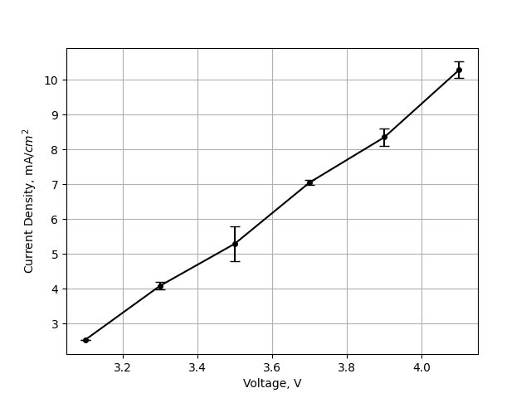
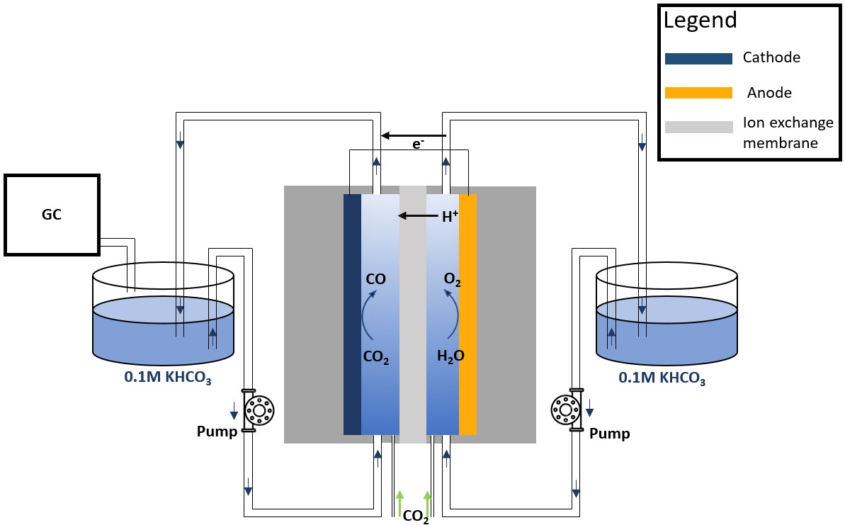
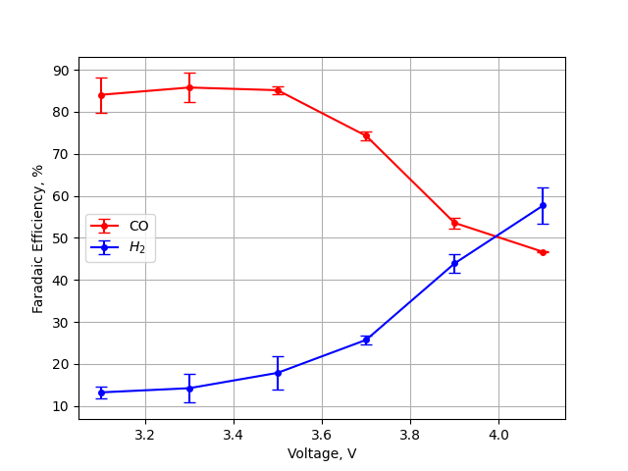

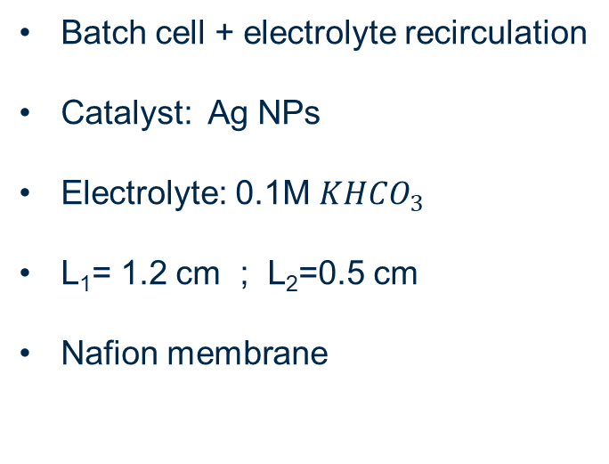

Experimental set-up
J: Current recorded for each Voltage applied and normalized on the catalyst surface area
Batch cell + electrolyte recirculation
Catalyst: Ag NPs
Electrolyte: 0.1M $KHCO_{3}$
L₁= 1.2 cm ; L₂=0.5 cm
Nafion membrane
FE: Figure of merit to determine the selectivity towards the production of the product of interest
$$KHCO_{3}$$
$$KHCO_{3}$$
Agliuzza et al, J. Phys. Energy (2024)

Slide 21
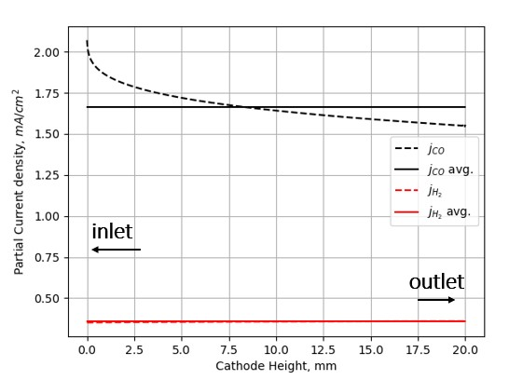
Results #0: Cathode-Height dependancy
The y-dependancy can be safely ignored.
All the data are reported as the average across the cathode height.
Notes:
J0=exchange current density, current density at zero overpotential. Mass transport limitation is given by a limit in the maximum current density j
Diffusion-migration-convectoin: um = mobility, u=velocity, phi=electrolyte potential
Nernst eq modifies Eeq away from standard conditions (c=1M)

Slide 22
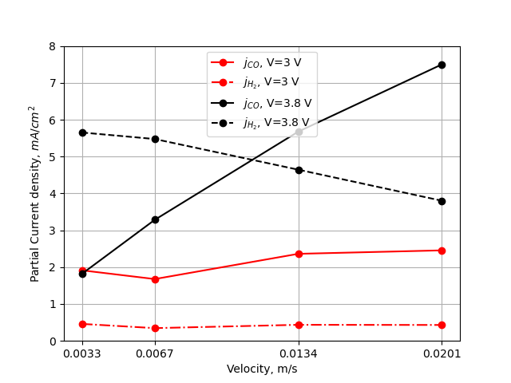

Results #2: inflow velocity u₀ @ L=0.25 cm
Dependancy on flow velocity is more pronounced on higher voltages. The reason is related to the fact that higher CO₂ feed rates is more impactful when there are higher rates of carbon dioxide comsuption.
Notes:
J0=exchange current density, current density at zero overpotential. Mass transport limitation is given by a limit in the maximum current density j
Diffusion-migration-convectoin: um = mobility, u=velocity, phi=electrolyte potential
Nernst eq modifies Eeq away from standard conditions (c=1M)

Slide 23
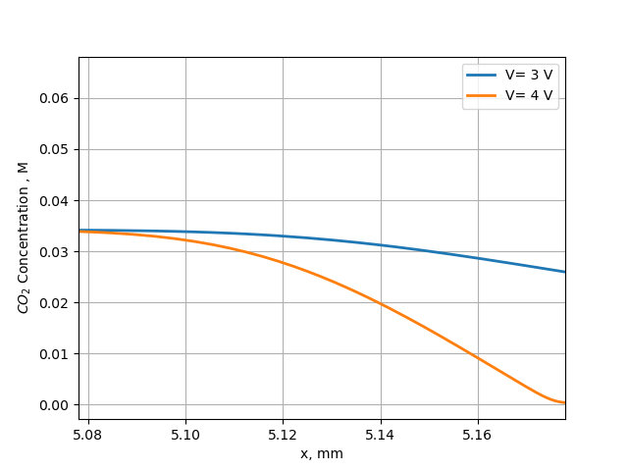
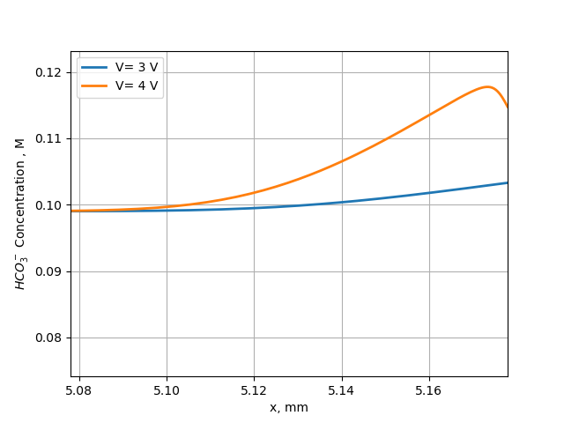
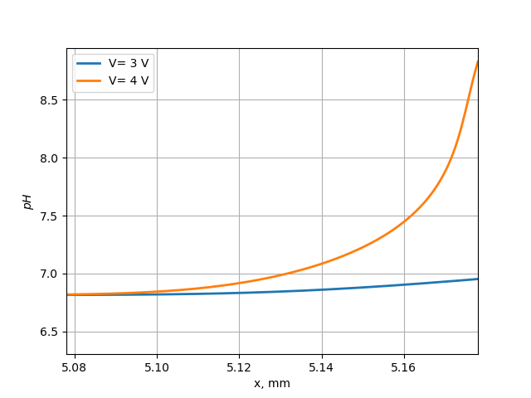
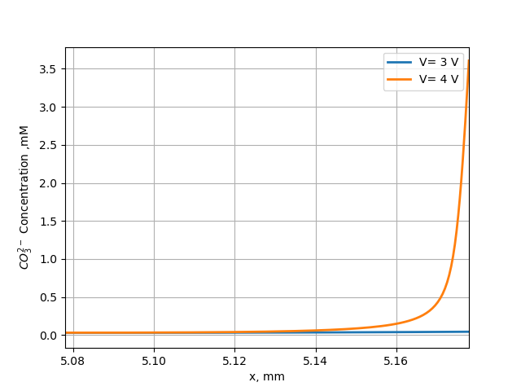
Results #3: L=0.25 cm , u₀=0.067 m/s @ V= 3 V , 4 V
cathode
cathode
bulk
bulk
cathode
cathode
bulk
bulk
Notes:
J0=exchange current density, current density at zero overpotential. Mass transport limitation is given by a limit in the maximum current density j
Diffusion-migration-convectoin: um = mobility, u=velocity, phi=electrolyte potential
Nernst eq modifies Eeq away from standard conditions (c=1M)

Slide 24
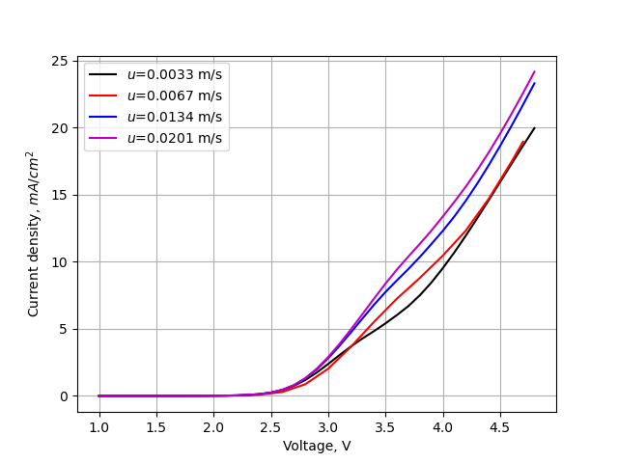
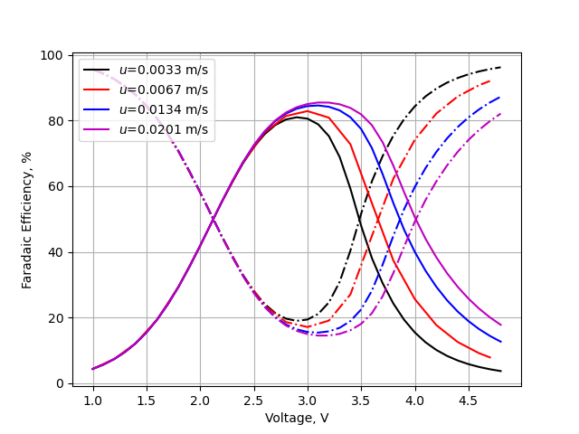

Results #2: inflow velocity u₀ @ L=0.25 cm
$$dashed line:H2$$
Notes:
J0=exchange current density, current density at zero overpotential. Mass transport limitation is given by a limit in the maximum current density j
Diffusion-migration-convectoin: um = mobility, u=velocity, phi=electrolyte potential
Nernst eq modifies Eeq away from standard conditions (c=1M)

Slide 25
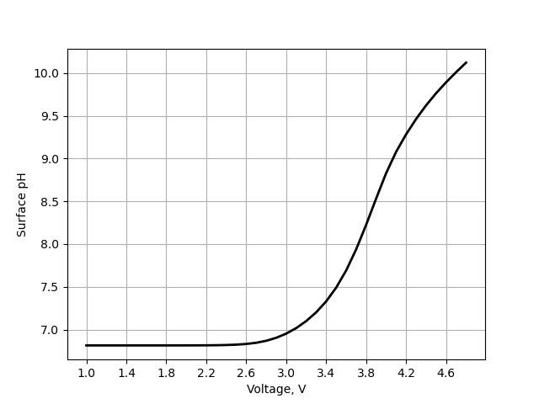
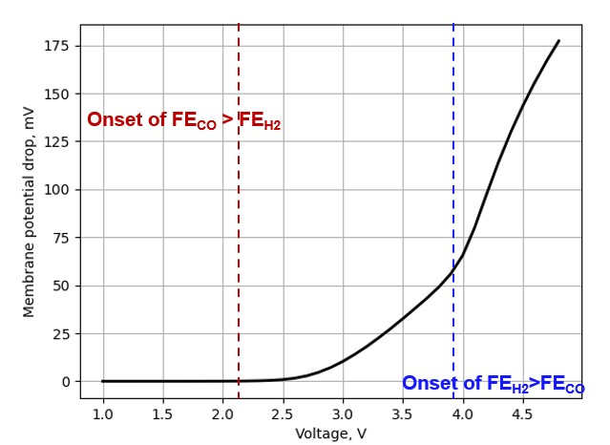
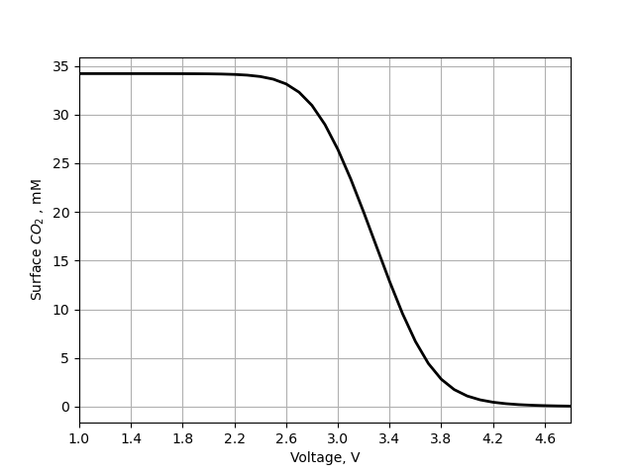
Results #4: L=0.25 cm , u₀=0.067 m/s
@ x= x_{cathode}
@ membrane surface
Onset of FE_{CO} > FE_{H2}
Onset of FE_{H2}>FE_{CO}
Notes:
J0=exchange current density, current density at zero overpotential. Mass transport limitation is given by a limit in the maximum current density j
Diffusion-migration-convectoin: um = mobility, u=velocity, phi=electrolyte potential
Nernst eq modifies Eeq away from standard conditions (c=1M)

