Slide 1


Modeling an Open-Cell Foam Heat Exchanger
B. Chinè¹, F. Rodriguez-Mendez¹, M. Meneses-Guzman²
¹ School of Materials Science and Engineering, Costa Rica Institute of Technology, Cartago, Costa Rica
² School of Industrial Production Engineering, Costa Rica Institute of Technology, Cartago, Costa Rica
bchine@itcr.ac.cr

Slide 2
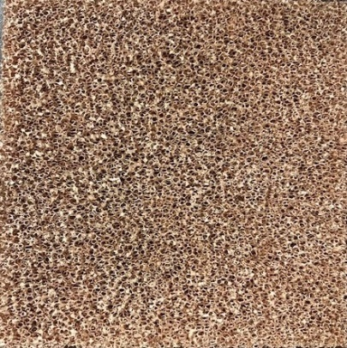
Presentation overview
Open-cell metal foam, heat exchanger
Geometry and governing equations
Numerical results
Conclusions

Slide 3
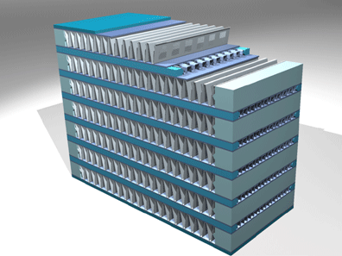
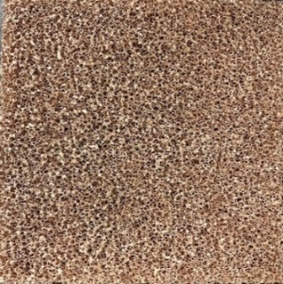
Open-cell metal foam, compact heat exchanger
Open-cell metal foams (or metal sponge) can be used to enhance heat transfer in many applications, such as cryogenic heat exchanger, compact heat sinks and heat exchanger.
They are characterized by a cellular structure represented by a metal (or a metal alloy) and connected gas voids inside.
Due to their intrinsic high porosity and large specific surface area, these materials are considered to have very promising properties to improve efficiency and minimize the required weight and volume of novel industrial heat exchangers.
In this work, we use COMSOL Multiphysics® 6.2 to study fluid flow and heat transfer processes through a open-cell foam heat exchanger prototype.
cooling air flow
hot water flow

Slide 4
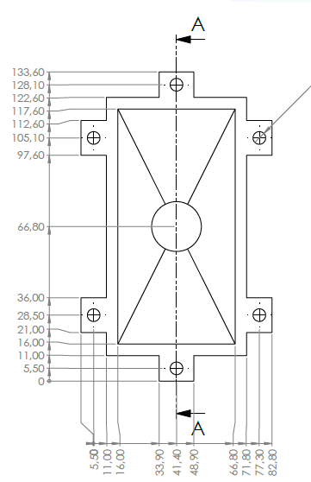
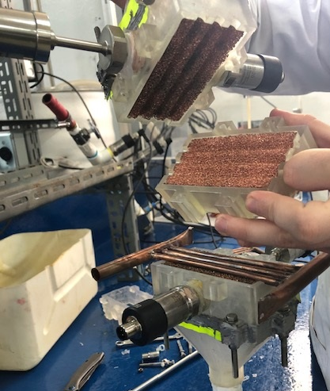
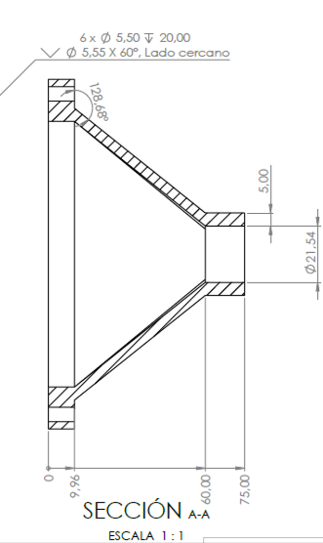
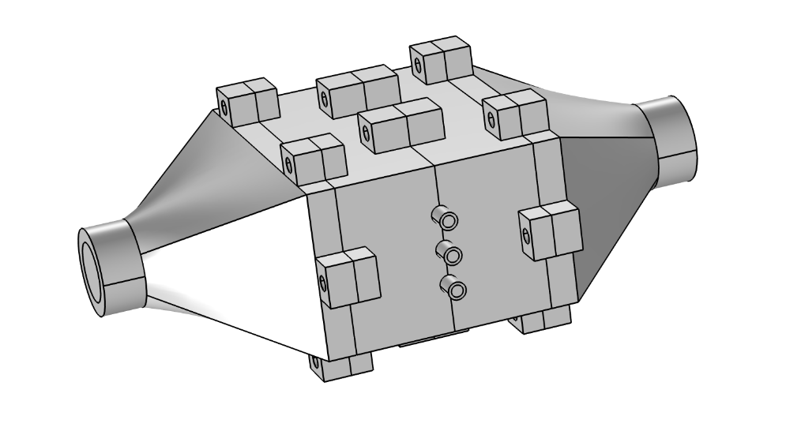
Geometry of the open-cell foam heat exchanger
end sections of the heat exchanger
Magnitude | Value
Length L | 230 mm
Width W | 101.6 mm
Height H | 50.8 mm
Wall thickness t | 5 mm
Inner diameter D_{a} of air inlet and outlet | 21.54 mm
Inner diameter of the copper tubes for the water crossflow | 4.35 mm
Copper sponge width w | 101.6 mm
Copper sponge height h | 50.8 mm
Copper sponge thickness s | 12.7 mm
copper tubes for the water flow
dimensions in mm
cooling air flow
hot water flow

Slide 5
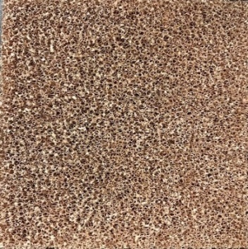
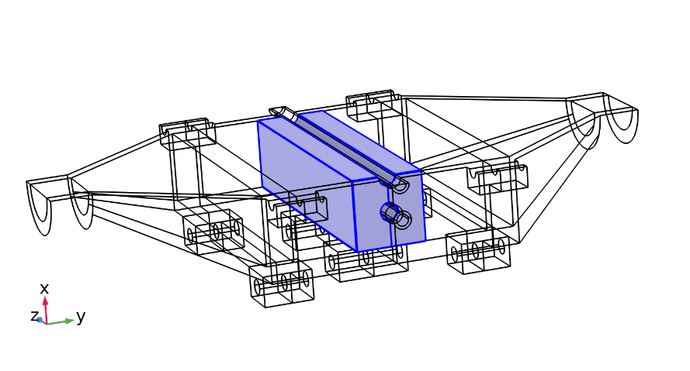
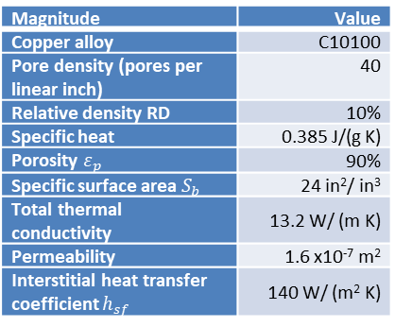
Open-cell metal foam sandwiched to three copper tubes
Magnitude | Value
Copper alloy | C10100
Pore density (pores per linear inch) | 40
Relative density RD | 10%
Specific heat | 0.385 J/(g K)
Porosity $ε_{p}$ | 90%
Specific surface area $S_{b}$ | 24 in²/ in³
Total thermal conductivity | 13.2 W/ (m K)
Permeability | 1.6 x10⁻⁷ m²
Interstitial heat transfer coefficient $h_{sf}$ | 140 W/ (m² K)
copper foam
copper tubes for the water flow
cooling air flow
hot water flow
compact heat exchanger reduced by symmetry

Slide 6




Governing equations of the model
Heat transferred from a laminar, incompressible stream of hot water to a laminar, compressible flow of cold air.
Steady state compressible fluid flow and heat transfer through the 3D heat exchanger section (Mass and Linear Momentum Conservation; Thermal Energy Conservation).
$∇·\left(ρu\right)=0$
{∇u}^{T}] –$\frac{2}{3} μ\left[∇ ·u\right]I$+ F
$ρ\left(u·∇\right)u$= ∇$·[−$p I $+$ μ [∇u +
$$ρc_{p} u·∇T+∇·q=Q$$
Copper foam modelled as a porous medium with non-Darcian flow and in LTNE conditions.
$\frac{ρ}{ε_{p}}\left(u•∇\right) \frac{u}{ε_{p}}=−∇p+∇•[\frac{1}{ε_{p}}\left\{μ(∇u+ (∇u)^{T}−\frac{2μ}{3}(∇•u)I\right\}]$ $−\left[{ κ}^{−1}μ+ρβ\left|u\right|+\frac{Q_{m}}{{ε_{p}}^{2}}\right]u+F$
Brinkman equations
additional source term (LTNE)
$q_{sf} \left(T_{s}− T_{f}\right)$
for fluid thermal energy conservation
$q_{sf} \left(T_{f}− T_{s}\right)$
for solid thermal energy conservation
COMSOL Multiphysics® 6.2: Heat Transfer and CFD modules
Conjugate Heat Transfer physics interface

Slide 7
at the outlets,
b) at the outlets,
Boundary conditions
Boundary conditions for the fluid flow:
a total flow rate of 1.893 L/min for water (inlet velocity U_{in,w} = 0.708 m/s in each tube)
a flow rate of 23.408 L/min for the cooling air (inlet velocity U_{in,a}= 1.071 m/s)
at the outlets, a null gauge pressure
boundary condition of no slip on the solid walls
conditions of symmetry on the central longitudinal y-z plane of the device
Boundary conditions for the heat transfer:
at the inlet, temperature Tin,a of 300 K for the air inflow and temperature Tin,w of 312 K for the water inflow
at the outlets for both fluids (q is the heat flux and n is the normal direction)
local thermal non-equilibrium boundary condition is used for the walls adjacent to the porous foam domain
conditions of symmetry on the central longitudinal y-z plane of the device
no thermal resistance is considered between the copper tubes and the porous medium
conditions of thermal insulation on the rest of the surfaces

Slide 8
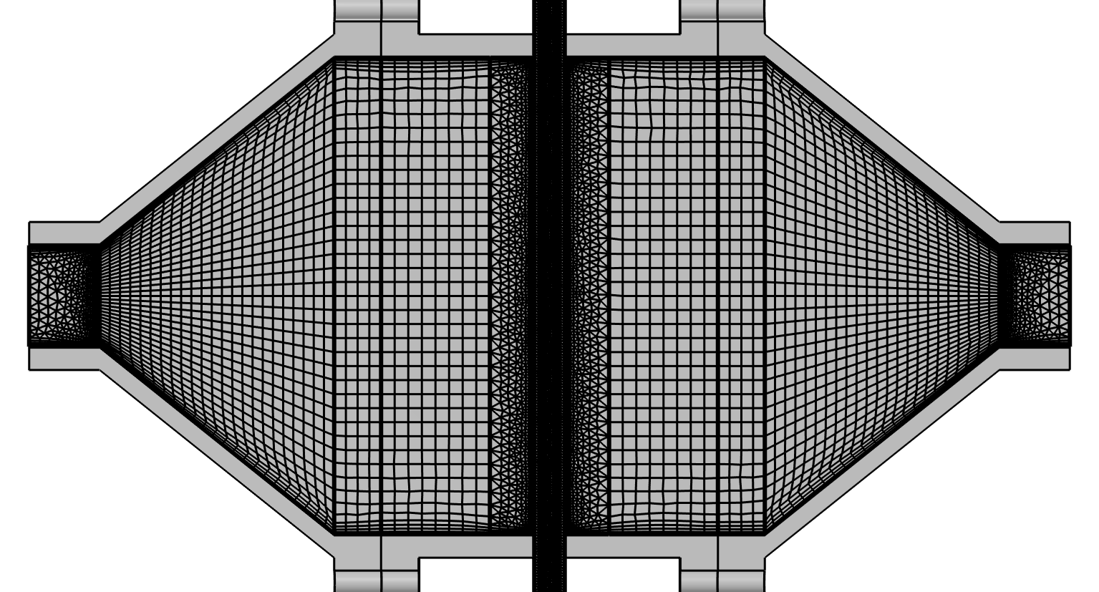
Solution with COMSOL Multiphysics 6.2
free tetrahedral mesh in the air inlet and outlet sections, porous medium, and in the cylindrical tubes
rest of the device is divided in structured quadrilateral elements
boundary layers on the solid walls, using default values of the software
Parameter | Size
maximum element size | 3.94 mm 2.75 mm (tubes)
minimum element size | 0.744 mm 0.298 mm (tubes)
the number of degrees of freedom is approximately 6.7x10⁵ plus 6x10⁴ internal DOFs

Slide 9
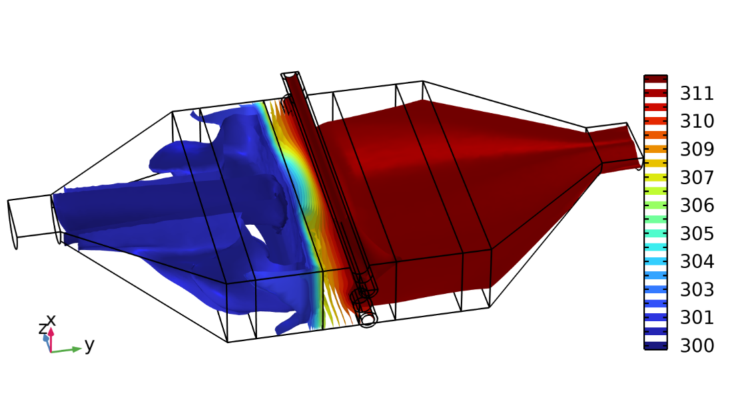
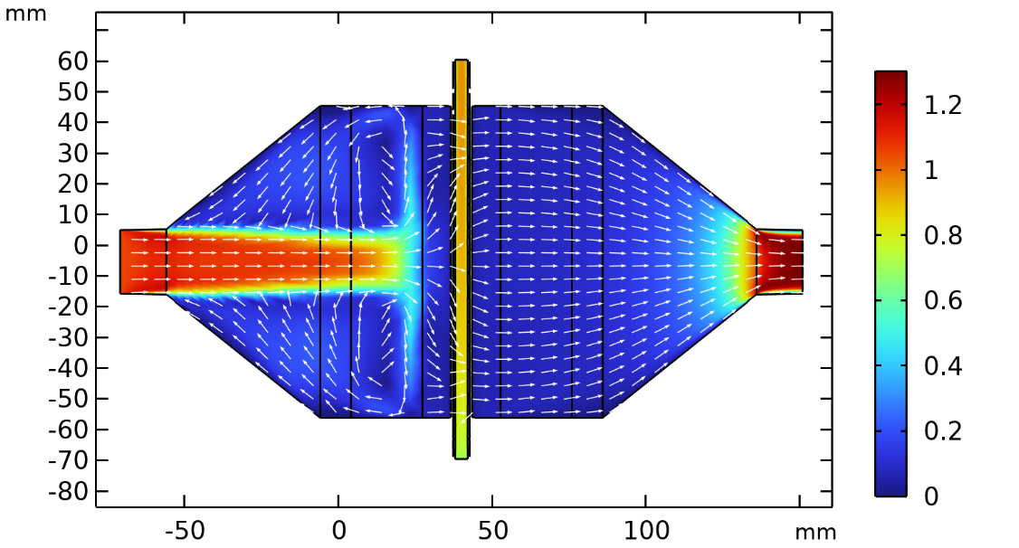
Numerical results: temperature and velocity
water temperature doesn’t show a significant variation
air temperature increases through the open-cell foams up to a value close to 312 K
two main recirculating streams between the central air jet and the solid walls
temperature iso-surfaces (K) in the heat exchanger
velocity magnitude (m/s) and velocity arrows on the longitudinal central y-z plane

Slide 10
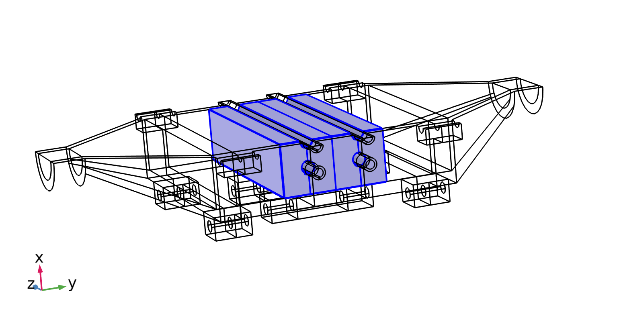
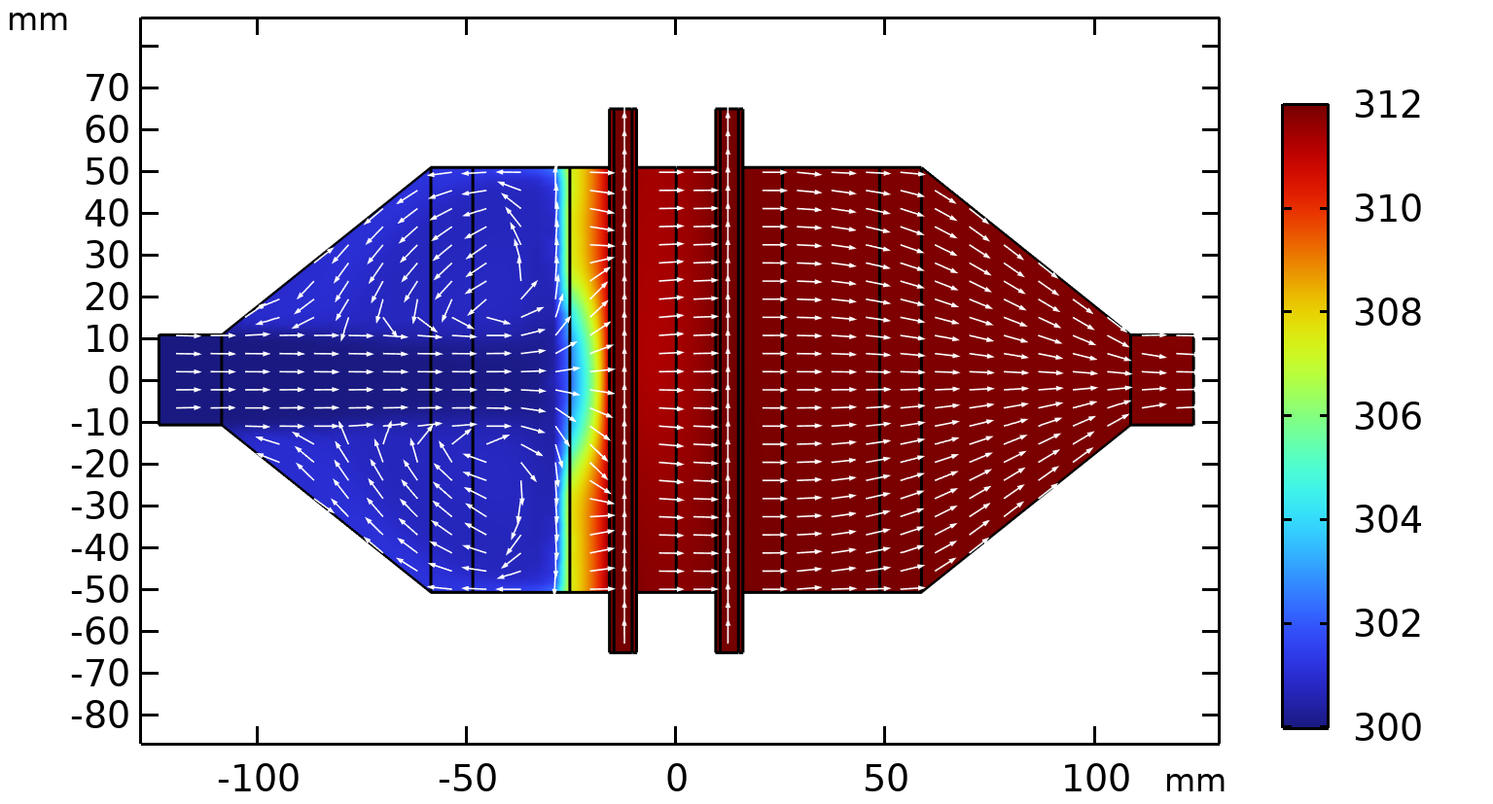
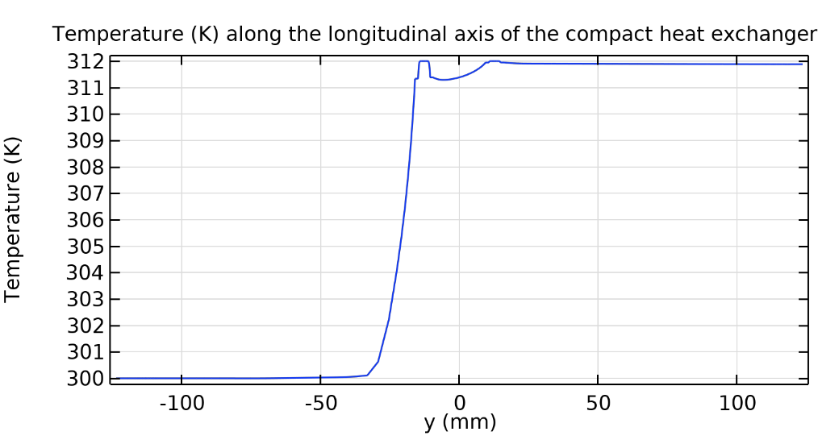
Numerical results: temperature and velocity arrows
a second series of three cylindrical tubes for the water flow added, but maintaining the same flow rate
again, water temperature doesn’t show a significant variation
air temperature increases through the open-cell foams up to a value close to 312 K
cooling air flow
hot water flow
temperature (K) and velocity arrows on the longitudinal central y-z plane (heat exchanger with 6 tubes for the water flow)
temperature (K) along the longitudinal y axis of the heat exchanger, with 6 tubes for the water flow

Slide 11
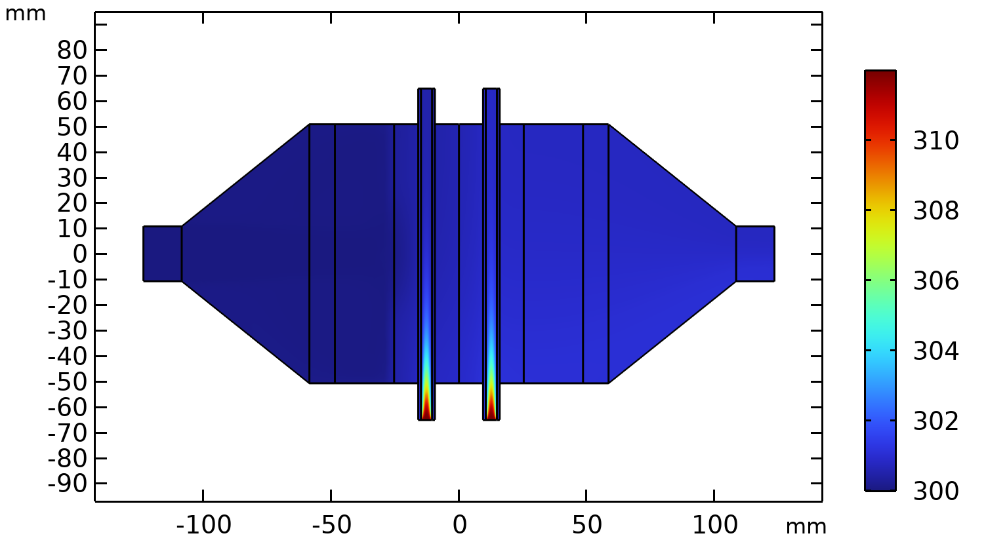
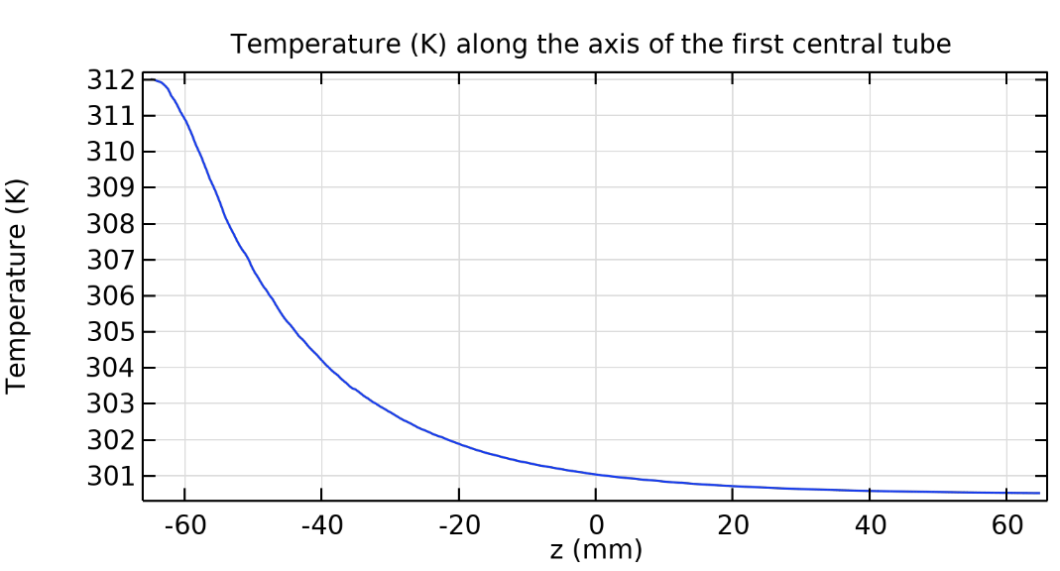
Numerical results of temperature
replacing water with air at the same inlet temperature of 312 K
cooling air flow
hot air flow
air temperature along the axis of the first central tube decreases until the asymptotic value of 300 K
temperature (K) on the longitudinal central z-y plane (heat exchanger with 6 tubes for air-air heat transfer)
temperature (K) along the z axis of the first central tube (heat exchanger with 6 tubes for air-air heat transfer)

Slide 12
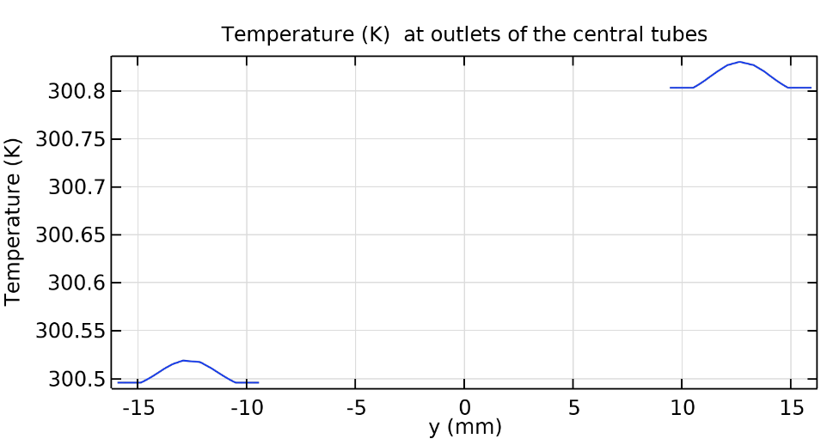
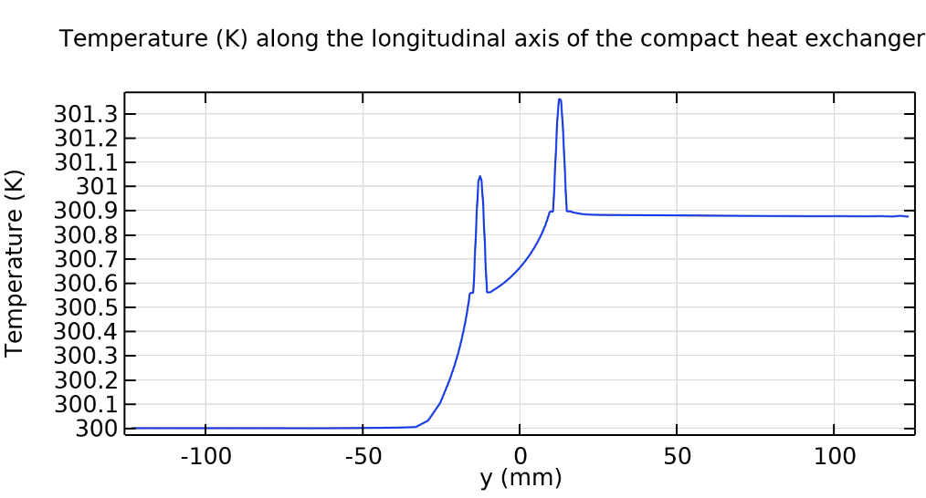
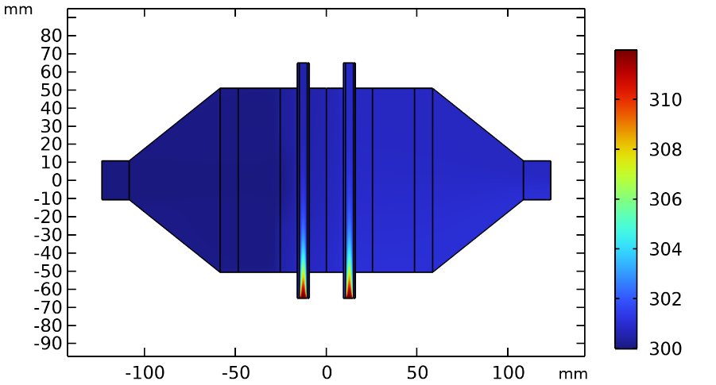
Numerical results of temperature
replacing water with air at the same inlet temperature of 312 K
along the two central tubes, the hot air temperature decreases at outlets until
300 K, approximately
cooling air flow
hot air flow
cold air temperature increase of 1 ℃ approximately, a much lesser value than 11 ℃ , as computed before for the heat exchanger with water as hot fluid

Slide 13
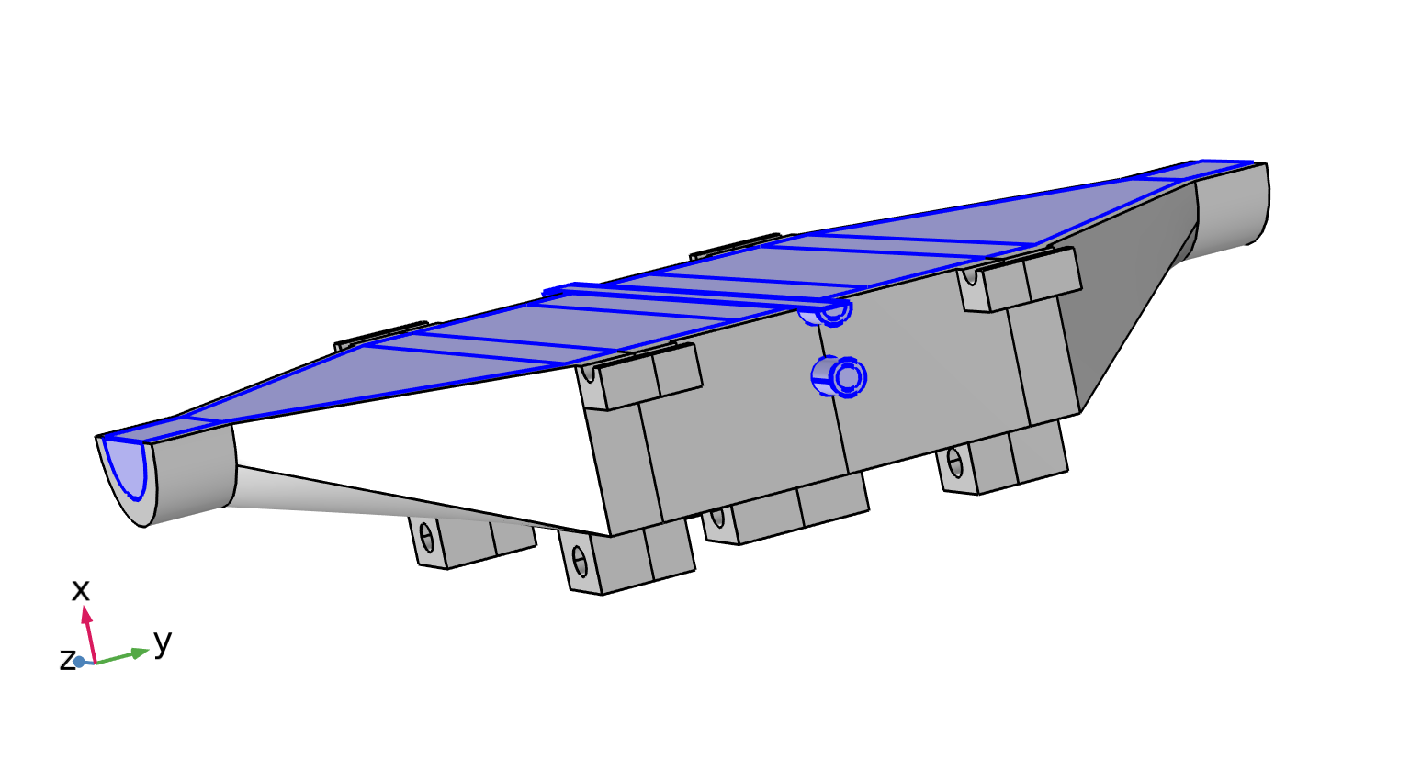

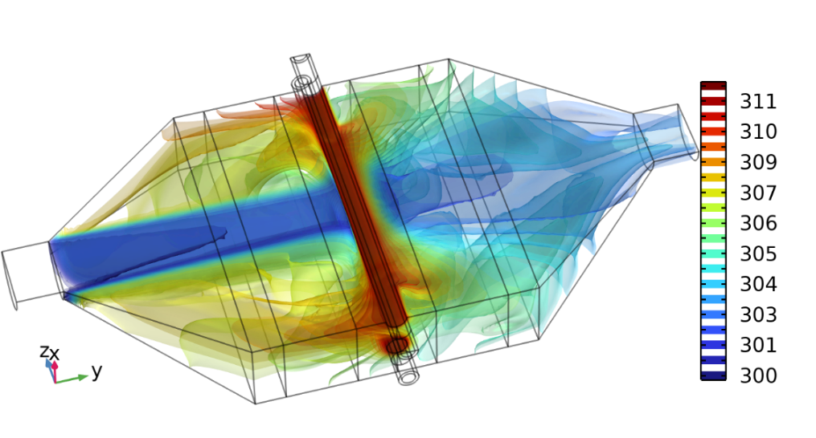
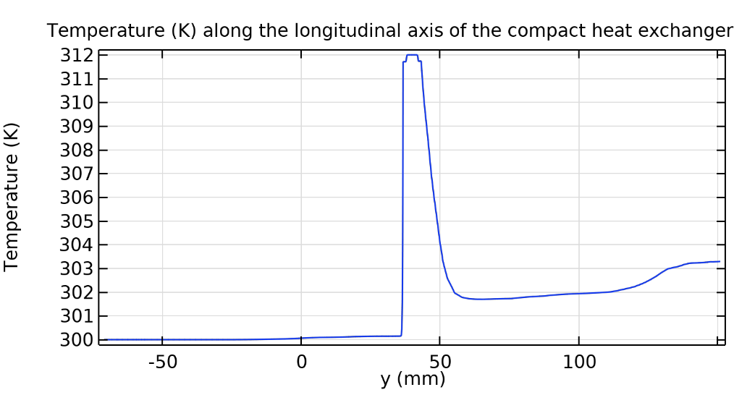
Numerical results of temperature
with three nude copper tubes for the water flow, without the open-cell foam
cooling air flow
hot water flow
nude copper tubes for the water flow, without foam
air temperature difference between the inlet and the outlet is approximately 3 ℃
According to the computational results, the energy transfer of the exchanger was enhanced using a copper sponge (high porosity and large specific surface area)

Slide 14
Conclusions
It has been developed a computational model of the fluid flow and heat transfer in a 3D prototype of an open-cell foam heat exchanger.
The numerical findings of the simulations show that the energy transfer of the exchanger is enhanced owing to the copper sponge's high porosity and large specific surface area.
Despite of the improved heat transfer experimented by the cooling air, the reduction of the hot water temperature is low, also constrained by the short tube length, therefore requiring some improvements of the device (introduction of coils, narrow channels, etc.).
The results, also confirmed by experimental work, show that the computational model developed with COMSOL Multiphysics® is effective for modelling the conjugate heat transfer process of this compact device.

Slide 15
References
[1] F. Garcia-Moreno, "Commercial Applications of Metal Foams: Their Properties and Production", Materials, 9, 85; doi:10.3390/ma9020085, 2016.
[2] T.J. Lu, H.A. Stone and M.F. Ashby, "Heat transfer in open-cell metal foams", Acta Materialia, 46(10), 3619-3635, 1998.
[3] K. Boomsma, D. Poulikakos and F. Zwick, "Metal foams as compact high performance heat exchangers", Mechanics of Materials, 35, 1161-1176, 2003.
[4] A. Kopanidis, A. Theodorakakos, E. Gavaises and D. Bouris, "3D Numerical simulation of flow and conjugate heat transfer through a pore scale model of high porosity open cell foam", Int. Journ. of Heat and Mass Transfer, 53, 2539-2550, 2010.
[5] H. Wang, L.J. Guo and K. Chen, "Theoretical and experimental advances on heat transfer and flow characteristics of metal foams", Sci. China Tech. Sci, 63, 705-718, 2020.
[6] S. Meinicke, T. Wetzel and B. Dietrich, "CFD Modeling of single-phase hydrodynamics and heat transfer in solid sponges", 11th Int. Confer. on CFD in the Minerals and Process Industry-CSIRO, Melbourne, Australia, 7-9 December 2015.
[7] T. Dixit and I. Ghosh, "Simulation intricacies of open-cell metal foam fin subjected to convective flow", App. Thermal Engin.,137, 532-544, 2018
[8] A. Jafarizade, M. Panjepour, M. Meratian and M.D. Emami, "Numerical simulation of gas/solid heat transfer in metallic foams: A general correlation for different porosities and pore sizes", Transport in porous media, 122(3), DOI 10.1007/s11242-018-1208-x, 2018.
[9] A.M Bayomy. and M.Z. Saghir, "Experimental and numerical study of aluminium metal foam (with/without channels) subjected to steady water flow", Pertanika Journal of Science and Technology, 25(1), 221-246, 2017.
[10] B. Bidar, F. Shahraki and D. M. Kalhori, "3D Numerical modelling of convective heat transfer through two-sided vertical channel symmetrically filled with metal foams", Periodica Polytechnica Mech. Engineer., 60(4), 193-2012, 2016.
[11] M. Odabaee and K. Hooman, "Metal foam heat exchangers for heat transfer augmentation from a tube bank", App. Thermal Engin., 36, 456-463, 2012.
[12] S. Mancin, C. Zilio, A. Cavallini and L. Rossetto, "Heat transfer during air flow in aluminum foams", Int. Journ. of Heat and Mass Transfer, 53, 4976-4984, 2010.
[13] A.M. Hassan, A.A. Alwan and H.K. Hamzah, "Numerical study of fan coil heat exchanger with copper-foam", Int. Journ. of Fluid Machinery and Systems, 16 (1), January-March, 2023.
[14] K. Yang, K. Liu and J. Wang, "Pore-scale numerical simulation of convection heat transfer in high porosity open-cell metal foam under rotating conditions", Applied Thermal Engineering, 195, 117168, 2021.
[15] B. Pulvirenti, M. Celli and A. Barletta, "Flow and convection in metal foams: A survey and new CFD results", Fluids, 5, 155; doi:10.3390/ fluids5030155, 2020.
[16] K. Kumar, B. Kotresha and K. Naik, "Flow and heat transfer irreversibility in partial filled metal foams", Int. Journ. of Thermal Sciences, 184, 107968, 2023.
[17] N. H. Roge, K. Yogi, A. Singh, H. Shrigondekar, S. Krishnan and S.V. Prabhu, "Local heat transfer distribution of thermally developing region in a rectangular open-cell metal foamed channel", Int. Journ. of Thermal Sciences, 203, 109138, 2024.
[18] Comsol AB, Comsol Multiphysics-CFD Module, User’s Guide, Version 6.2, 2023.
[19] Comsol AB, Comsol Multiphysics-Heat Transfer Module, User’s Guide, Version 6.2, 2023.
[20] T.L. Bergman, A.S. Lavine, F.P. Incropera and D.P. Dewitt, Fundamentals of heat and mass transfer, 7 ed., John Wiley and Sons, Hoboken (NJ), USA, 2011.

Slide 16
Acknowledgements
Many thanks for your attention !
We would like to also acknowledge:
Vicerrectoría de Investigación y Extensión

