Slide 1
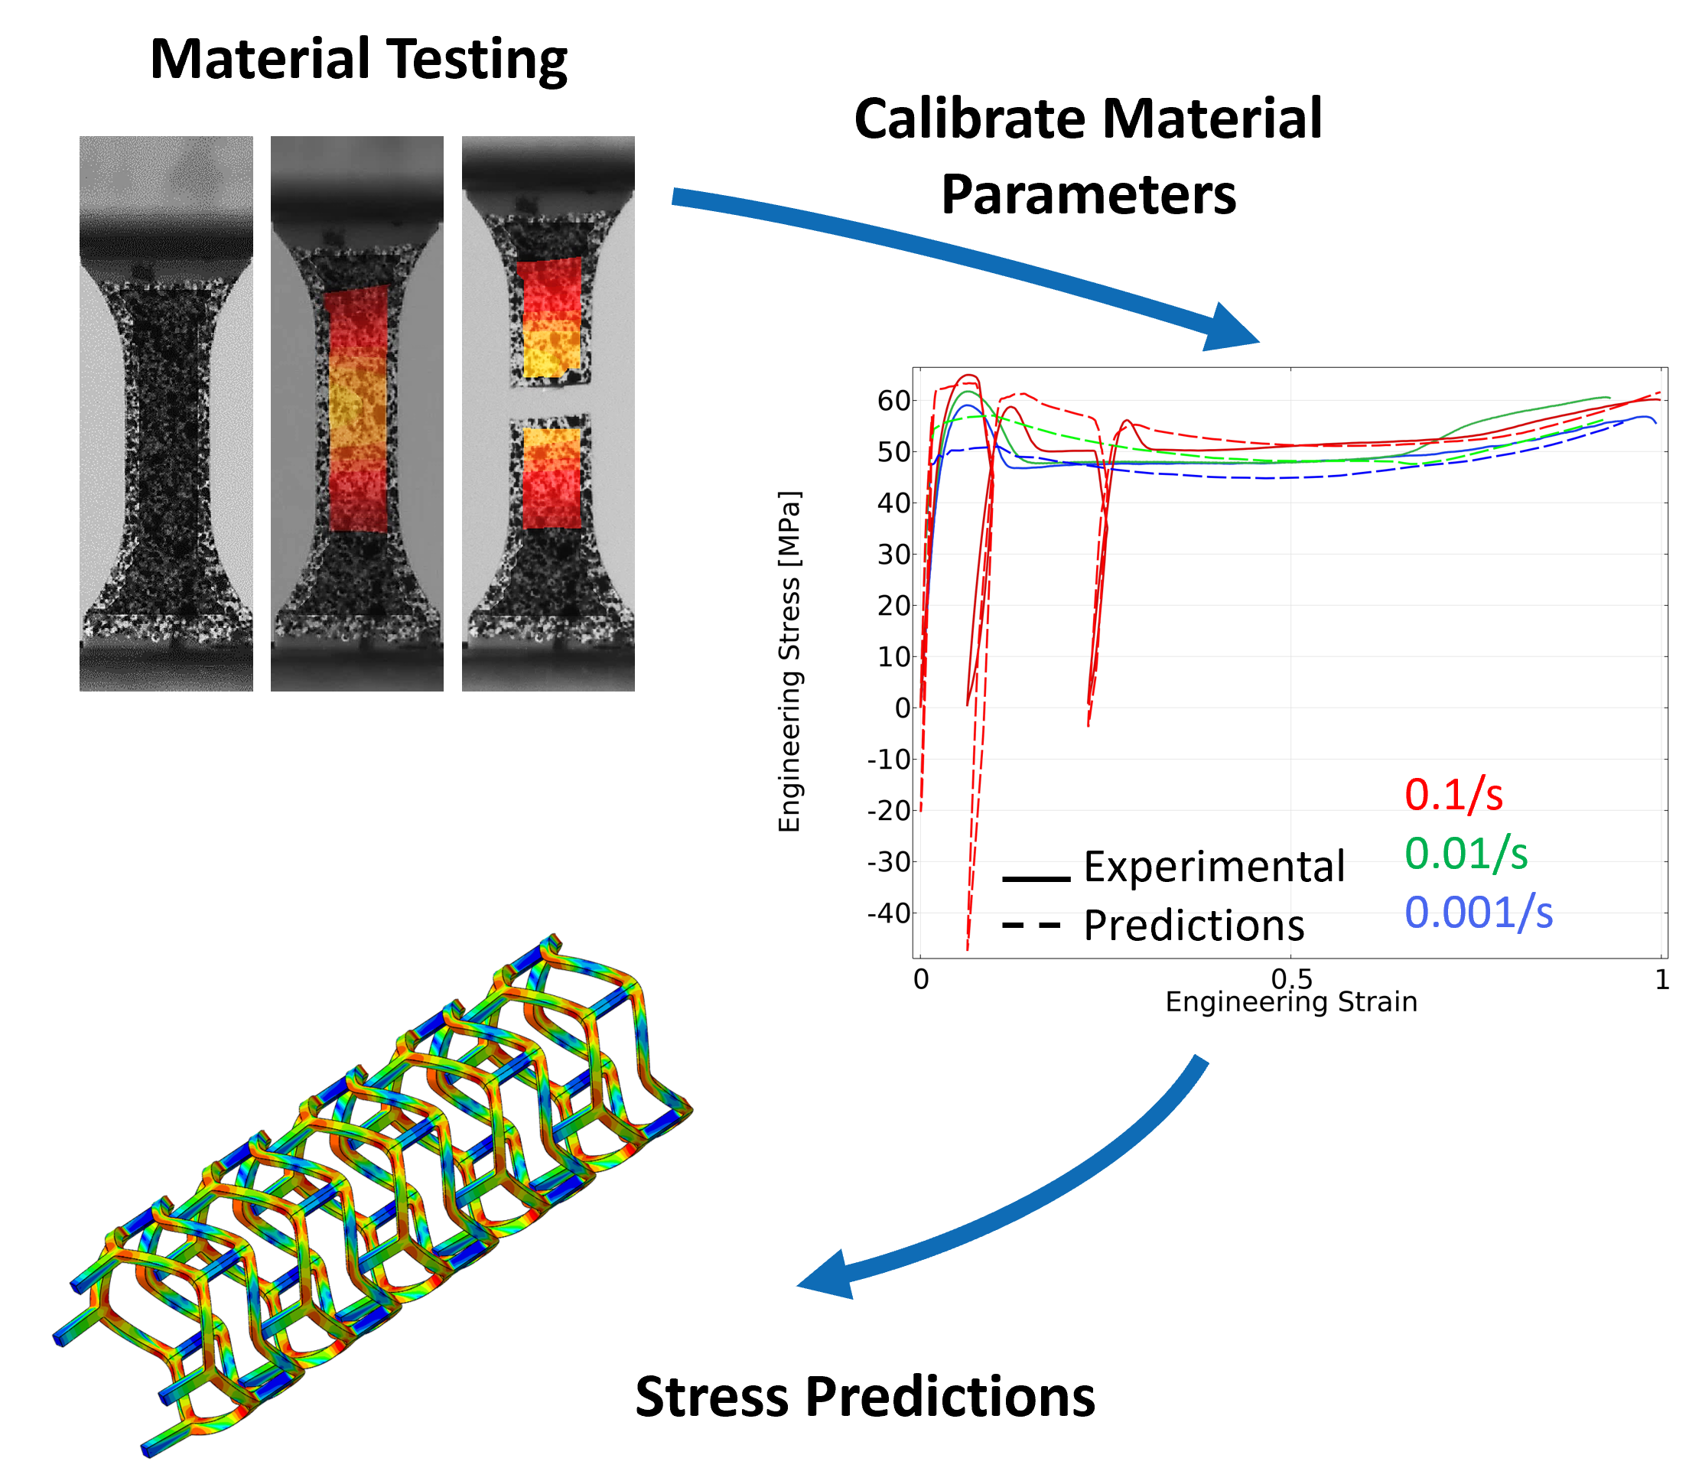
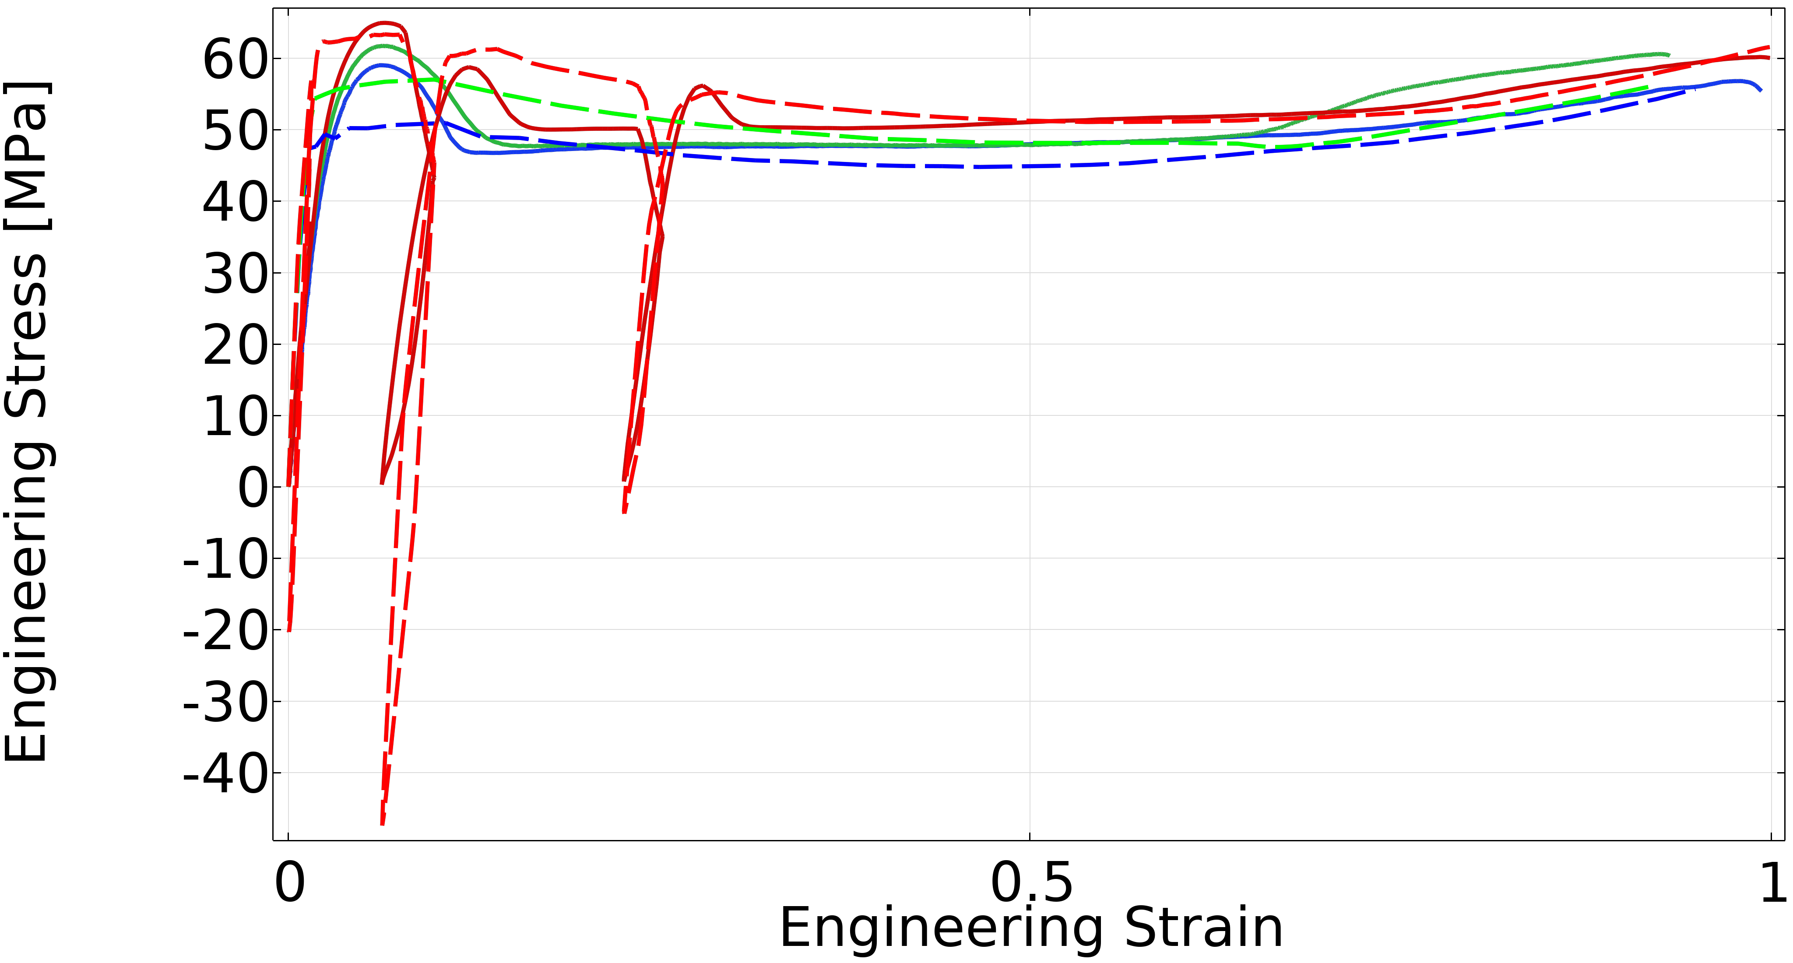
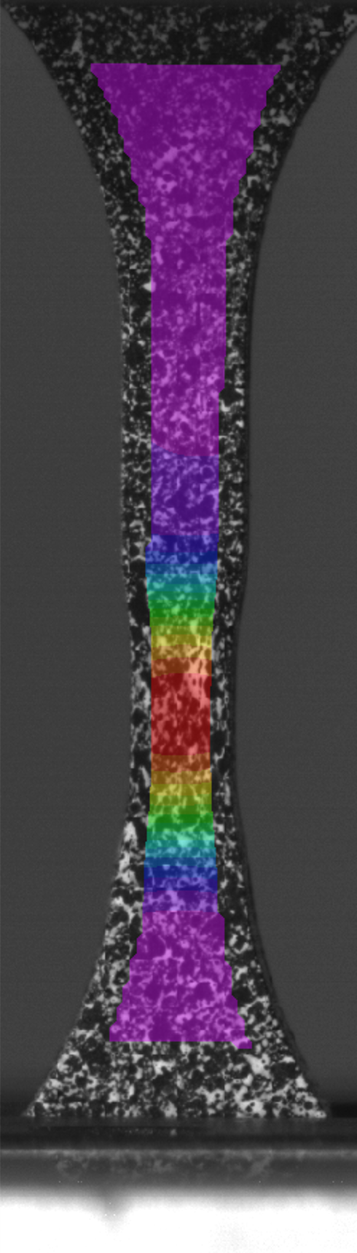
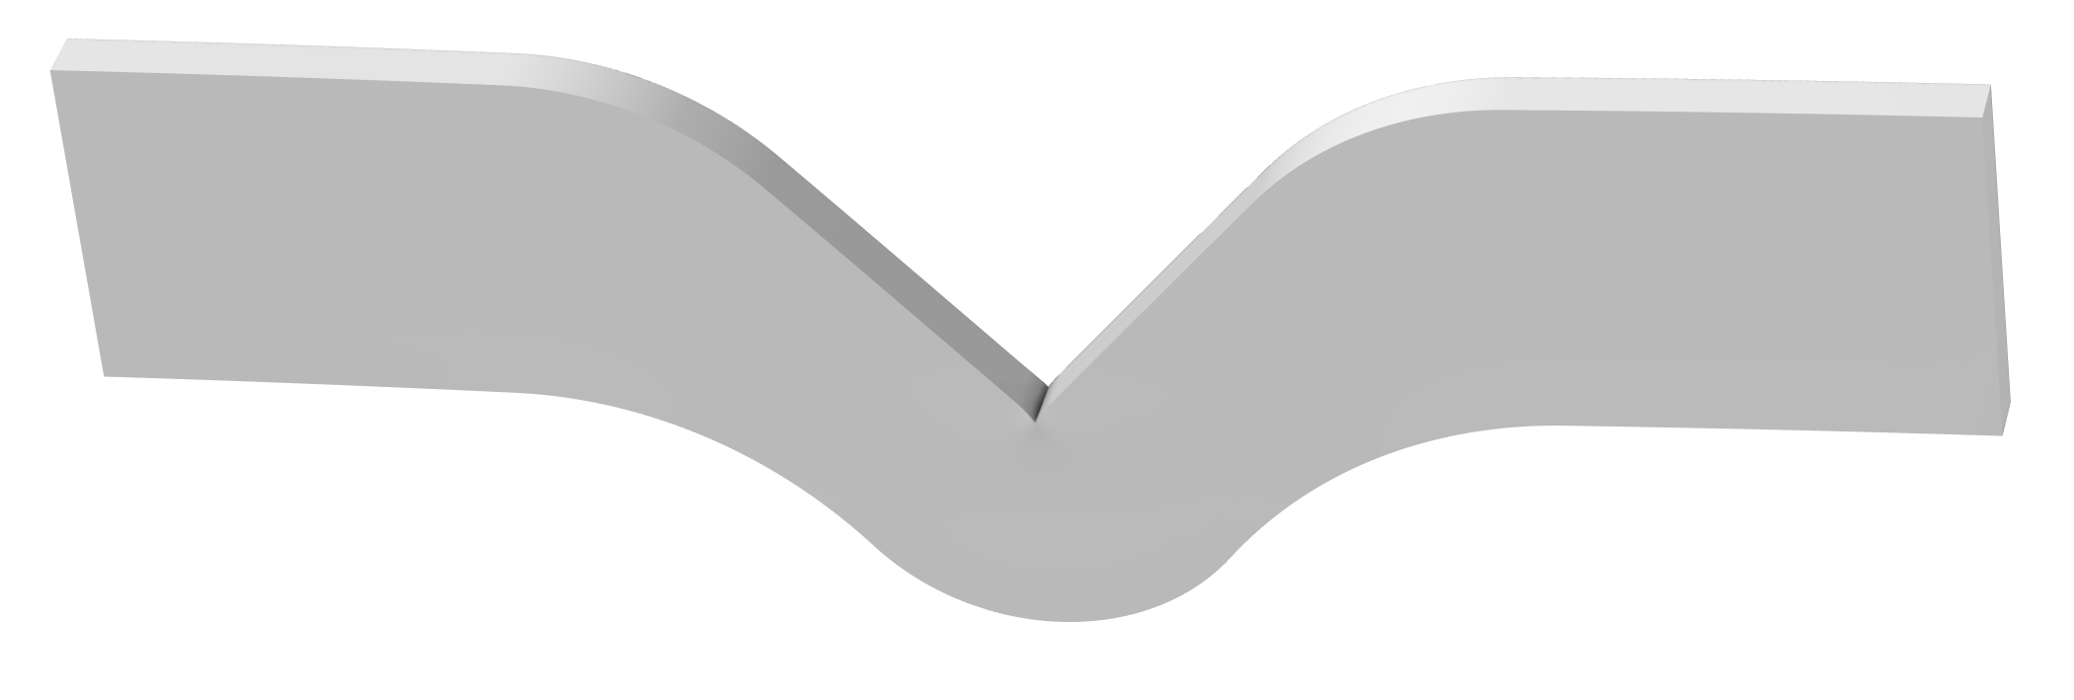
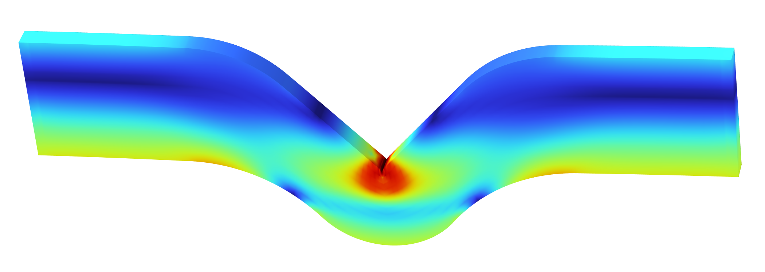
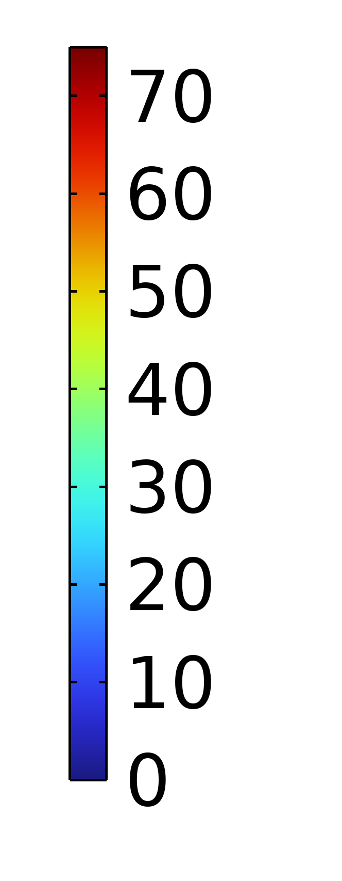


Non-Linear Solid Material Modeling in COMSOL®
Polymers’ time-dependent behavior is critical to capture for advanced Multiphysics simulations. Advanced material testing and material modeling in COMSOL® enable high accuracy models.
Sean Teller, Ph.D.
Nick Vasios, Ph.D.
Adriel Gonzalez, M.S.
steller@veryst.com
nvasios@veryst.com
agonzalez@veryst.com
Veryst Engineering
Needham, MA, USA
Introduction
Polymers are increasingly used in many sectors that use multiphysics simulation to predict product performance, optimize design, and prevent failure during service. Advanced simulations require correctly modeling the non-linear and time-dependent response of polymers, and COMSOL Multiphysics® has advanced solid mechanics constitutive models to capture these effects. Well-calibrated material models based on high-quality test data increase predictive capabilities of models in COMSOL®.
Polymers exhibit:
Strain-rate dependence
Temperature dependence
Creep and relaxation
Material anisotropy
Rate-, temperature-, and loading-dependent failure
All of these behaviors can be captured with COMSOL® using the Parameter Estimation toolbox.
Methodology
We performed material testing on a Polycarbonate (PC) material to capture the time-dependent behavior of this common engineering polymer. We performed monotonic and cyclic tension tests (Figure 1) to capture the large-strain viscoplastic behavior. We also performed compression tests (not shown) to capture yield stress pressure-dependence.
We then selected the Bergstrom-Bischoff material model (a Polymer Viscoplasticity model) available in COMSOL® and calibrated its 12 parameters with the Parameter Estimation workflow. The dashed lines in Figure 1 show the calibrated model predictions.
Experimental
Predictions
0.1/s
0.01/s
0.001/s
Figure 1. Uniaxial tension data and model predictions for a PC material at multiple strain rates, including cyclic loading. The inset image shows experimental strain contours from DIC.
Results
The calibrated material model predictions shown in Figure 1 agree well with experimental data. We performed a validation test using an ASTM D624 tear test specimen and loaded the sample to large strain. We then created a finite element model of the simulation, with von Mises stress contours shown in Figure 2.
The measured force vs. displacement results correlate well with the simulation results, with minimal error. The model captures the advanced, rate-dependent response of the polymer well, and can be used to perform time-dependent multiphysics simulations with COMSOL®.
von Mises Stress (MPa)
Figure 2. Model validation sample (top) and simulation stress result based on ASTM D624 sample for a tear test. The simulated force vs. displacement matches the experimental results well (not shown).
COMSOL Documentation, version 6.2, 2023.
Bergstrom and Bischoff. "An Advanced Thermomechanical Constitutive Model for UHMWPE." The International Journal of Structural Changes in Solids 2.1: 31-39.

