Slide 1
Modifying the bonding character of coupled states of thin-plate elastic resonators via prestress modulation
Pragalv Karki¹ and Jayson Paulose²
1. Department of Radiology, Mayo Clinic, Rochester, MN, USA
2. Department of Physics, University of Oregon, OR, USA

Slide 2
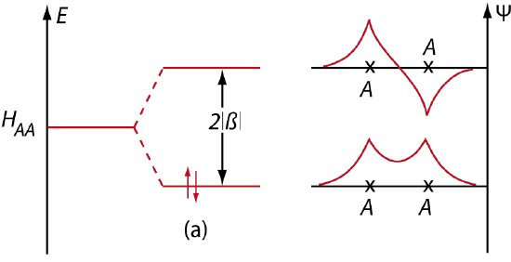
Bonding character
Diatomic molecule with expected bonding character
D. G. Pettifor, arXiv:1112.4638

Slide 3
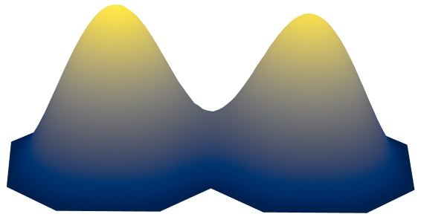
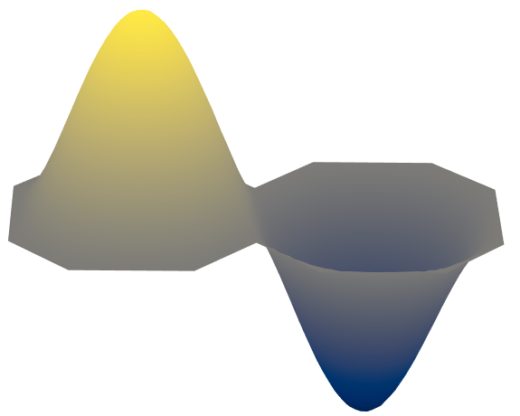
Bonding character
Reversing the bonding character
in thin elastic plates
Diatomic molecule with expected bonding character
Bonding
Anti-bonding
D. G. Pettifor, arXiv:1112.4638

Slide 4
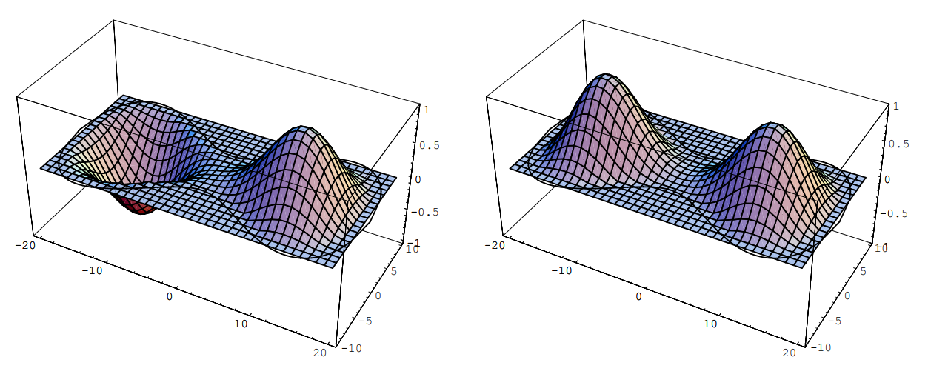
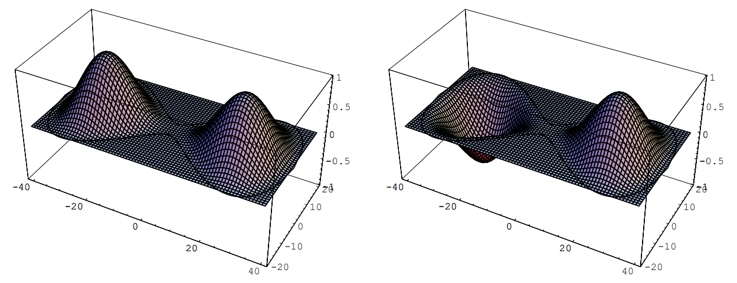
Fourth order plate to thin elastic plate
Fourth order plate
$$∇^{4}u=0 on domain$$
$$u=∇u=0 clamped on boundary$$
1st mode
2nd mode
1st mode
2nd mode
G. Sweers, Electronic Journal of Differential Equations (EJDE) , 2001

Slide 5
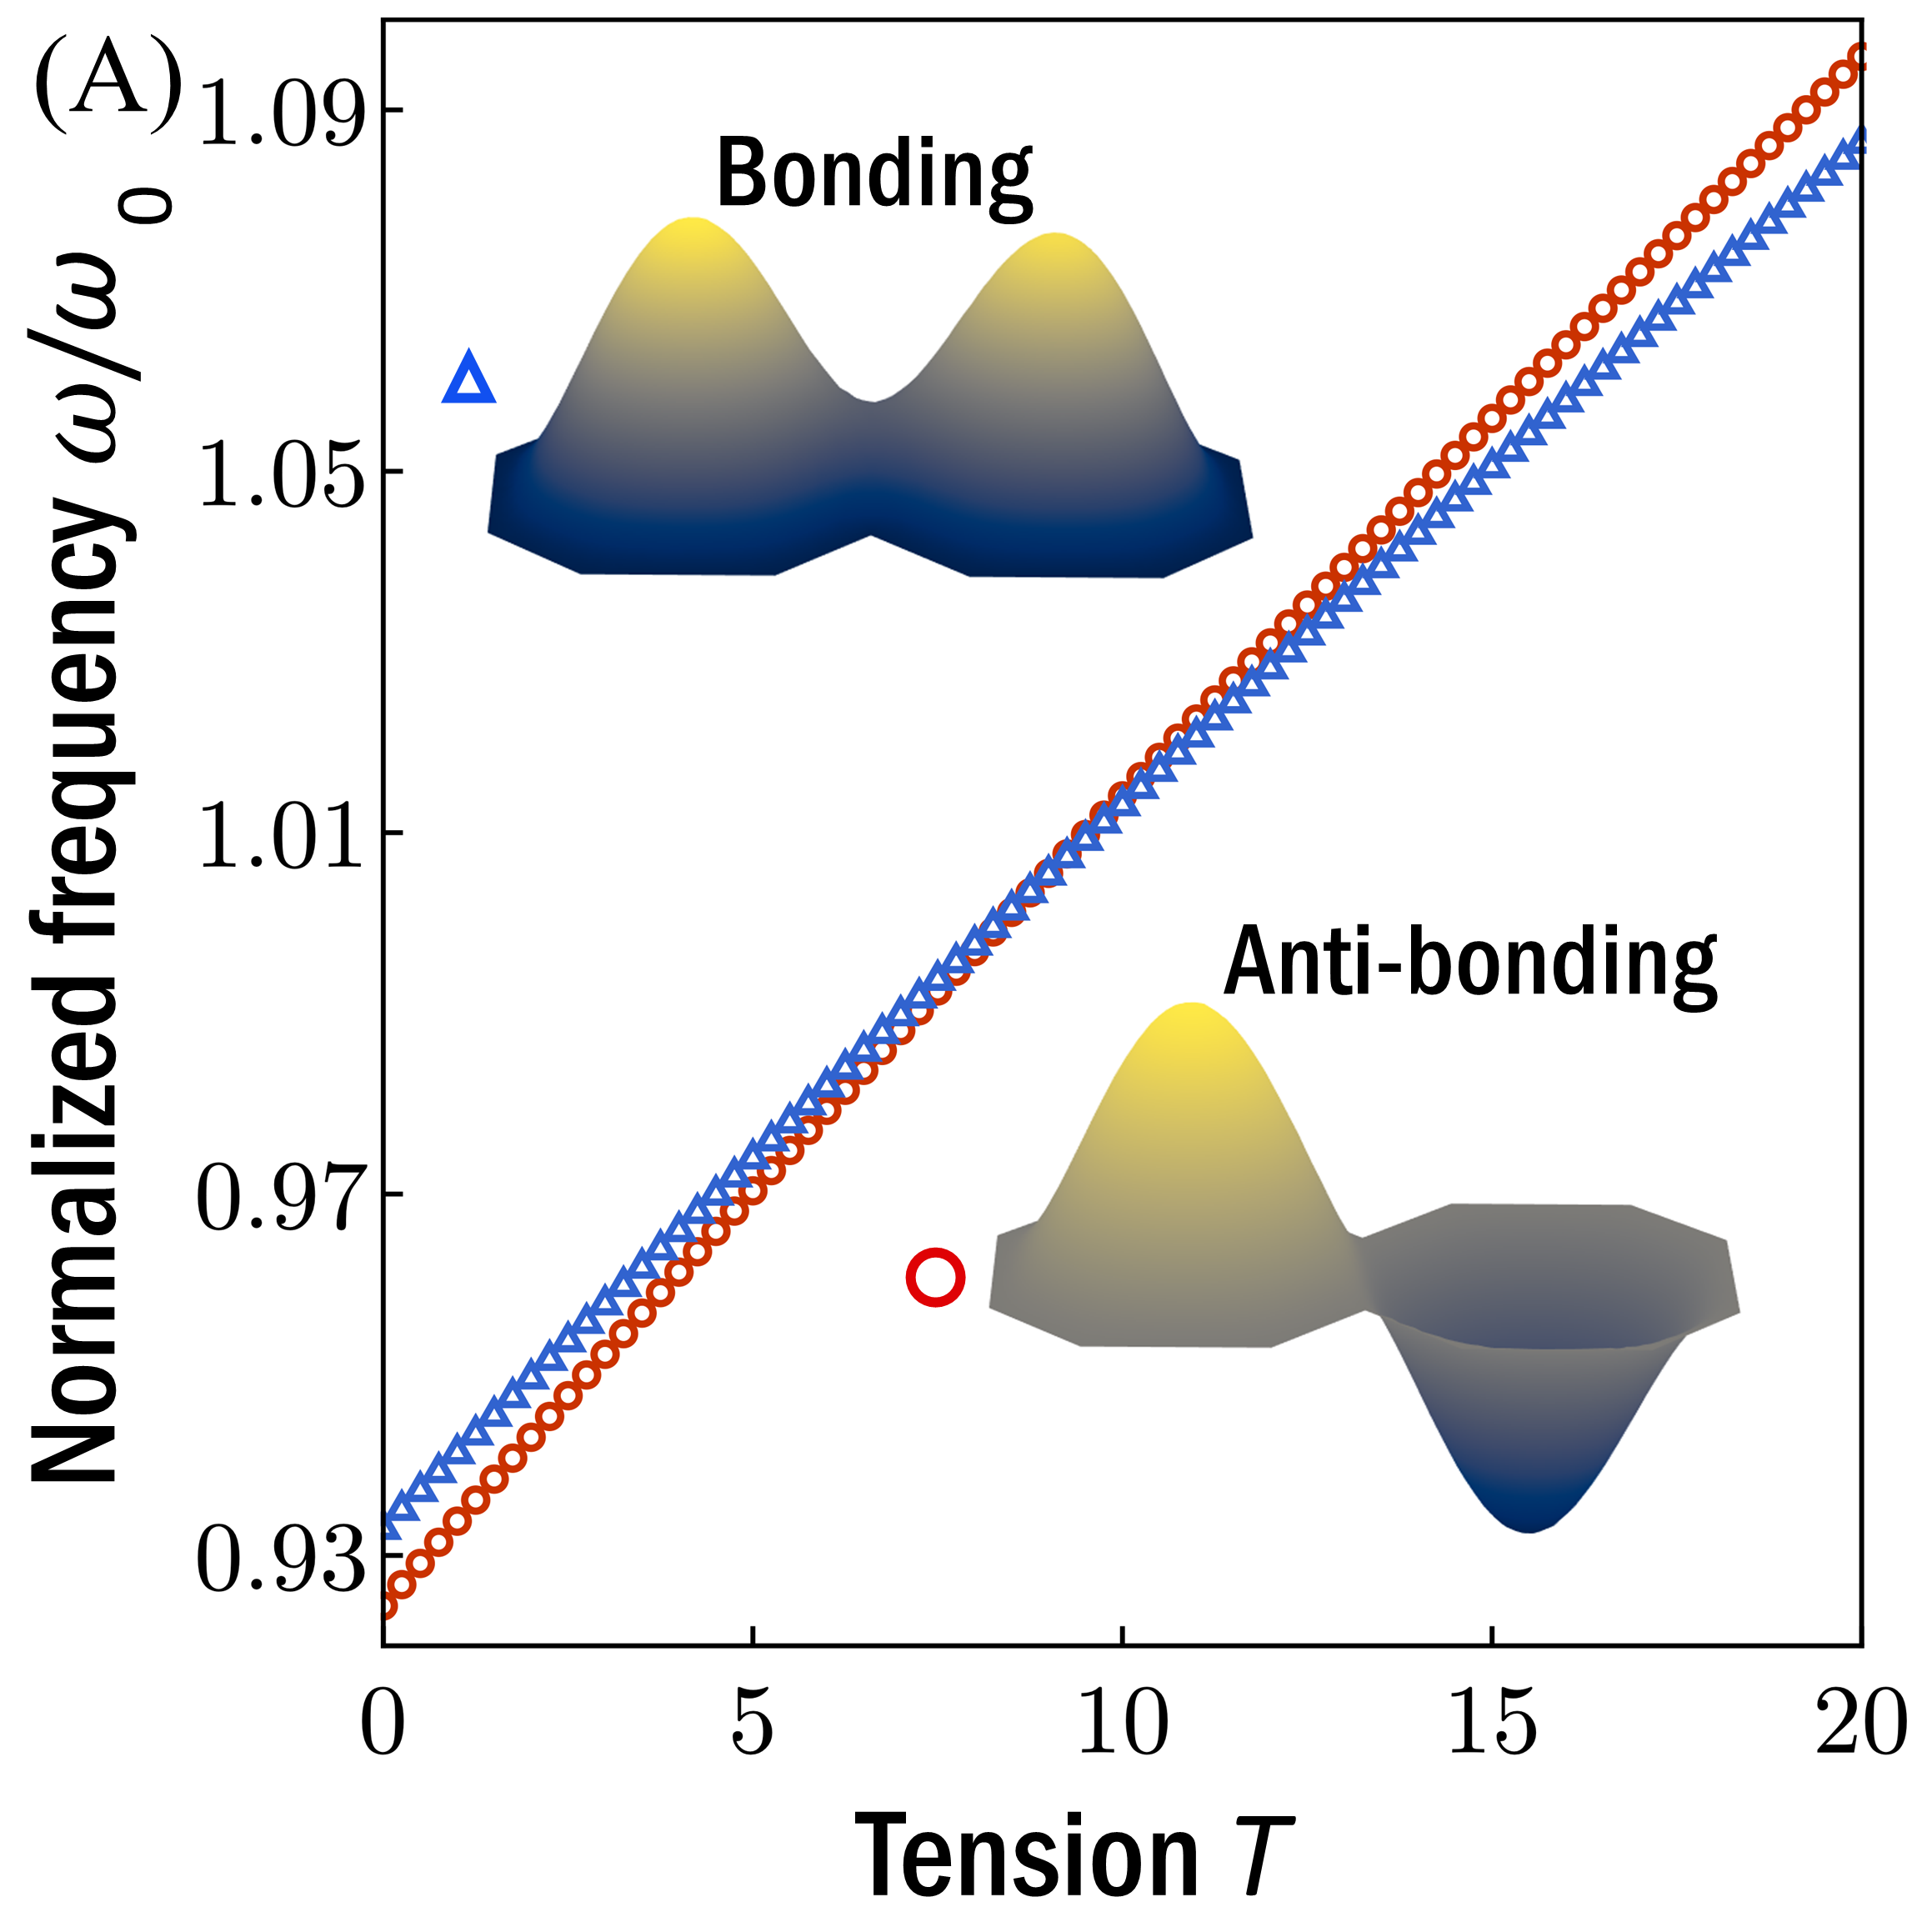
Fourth order plate to thin elastic plate
Fourth order plate
Thin elastic plate (Föppl–von Kármán)
$$∇^{4}u=0 on domain$$
$$∇^{4}u−T∇^{2}u=0 on domain$$
$$u=∇u=0 clamped on boundary$$
$$u=∇u=0 clamped on boundary$$
1st mode
2nd mode
1st mode
2nd mode
G. Sweers, Electronic Journal of Differential Equations (EJDE) , 2001

Slide 6

Thin elastic plate (Föppl–von Kármán)
Full dynamical equation
$$ρ\frac{∂^{2}u}{∂t^{2}}+c\frac{∂u}{∂t}+D∇^{4}u−T^{′}∇^{2}=0$$

Slide 7
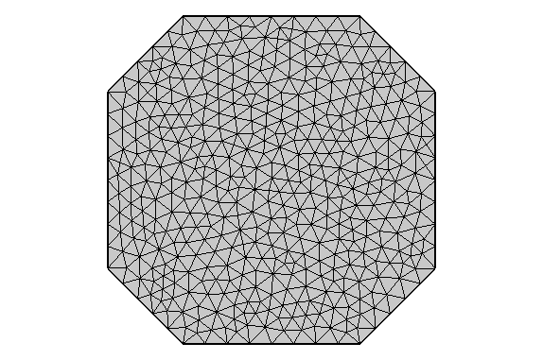



Thin elastic plate (Föppl–von Kármán)
Full dynamical equation
$$ρ\frac{∂^{2}u}{∂t^{2}}+c\frac{∂u}{∂t}+D∇^{4}u−T^{′}∇^{2}=0$$
Rescale
$\overline{x}=x/L$, $\overline{y}=y/L,$ $\overline{t}=t\sqrt{D/(ρL^{4})}$
$$L$$
Non-dimensional form
$$\frac{∂^{2}u}{∂{\overline{t}}^{2}}+ζ\frac{∂u}{∂\overline{t}}+{\overline{∇}}^{4}u−T{\overline{∇}}^{2}u=0$$

Slide 8
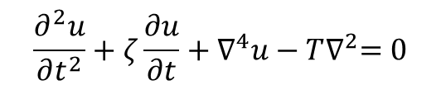
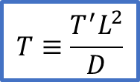
Thin elastic plate (Föppl–von Kármán)
Full dynamical equation
$$ρ\frac{∂^{2}u}{∂t^{2}}+c\frac{∂u}{∂t}+D∇^{4}u−T^{′}∇^{2}=0$$
Rescale
$\overline{x}=x/L$, $\overline{y}=y/L,$ $\overline{t}=t\sqrt{D/(ρL^{4})}$
$$L$$
Non-dimensional form
$$\frac{∂^{2}u}{∂{\overline{t}}^{2}}+ζ\frac{∂u}{∂\overline{t}}+{\overline{∇}}^{4}u−T{\overline{∇}}^{2}u=0$$
Drop the bars
$$\frac{∂^{2}u}{∂t^{2}}+ζ\frac{∂u}{∂t}+∇^{4}u−T∇^{2}=0$$
$$T≡\frac{T^{′}L^{2}}{D}$$

Slide 9
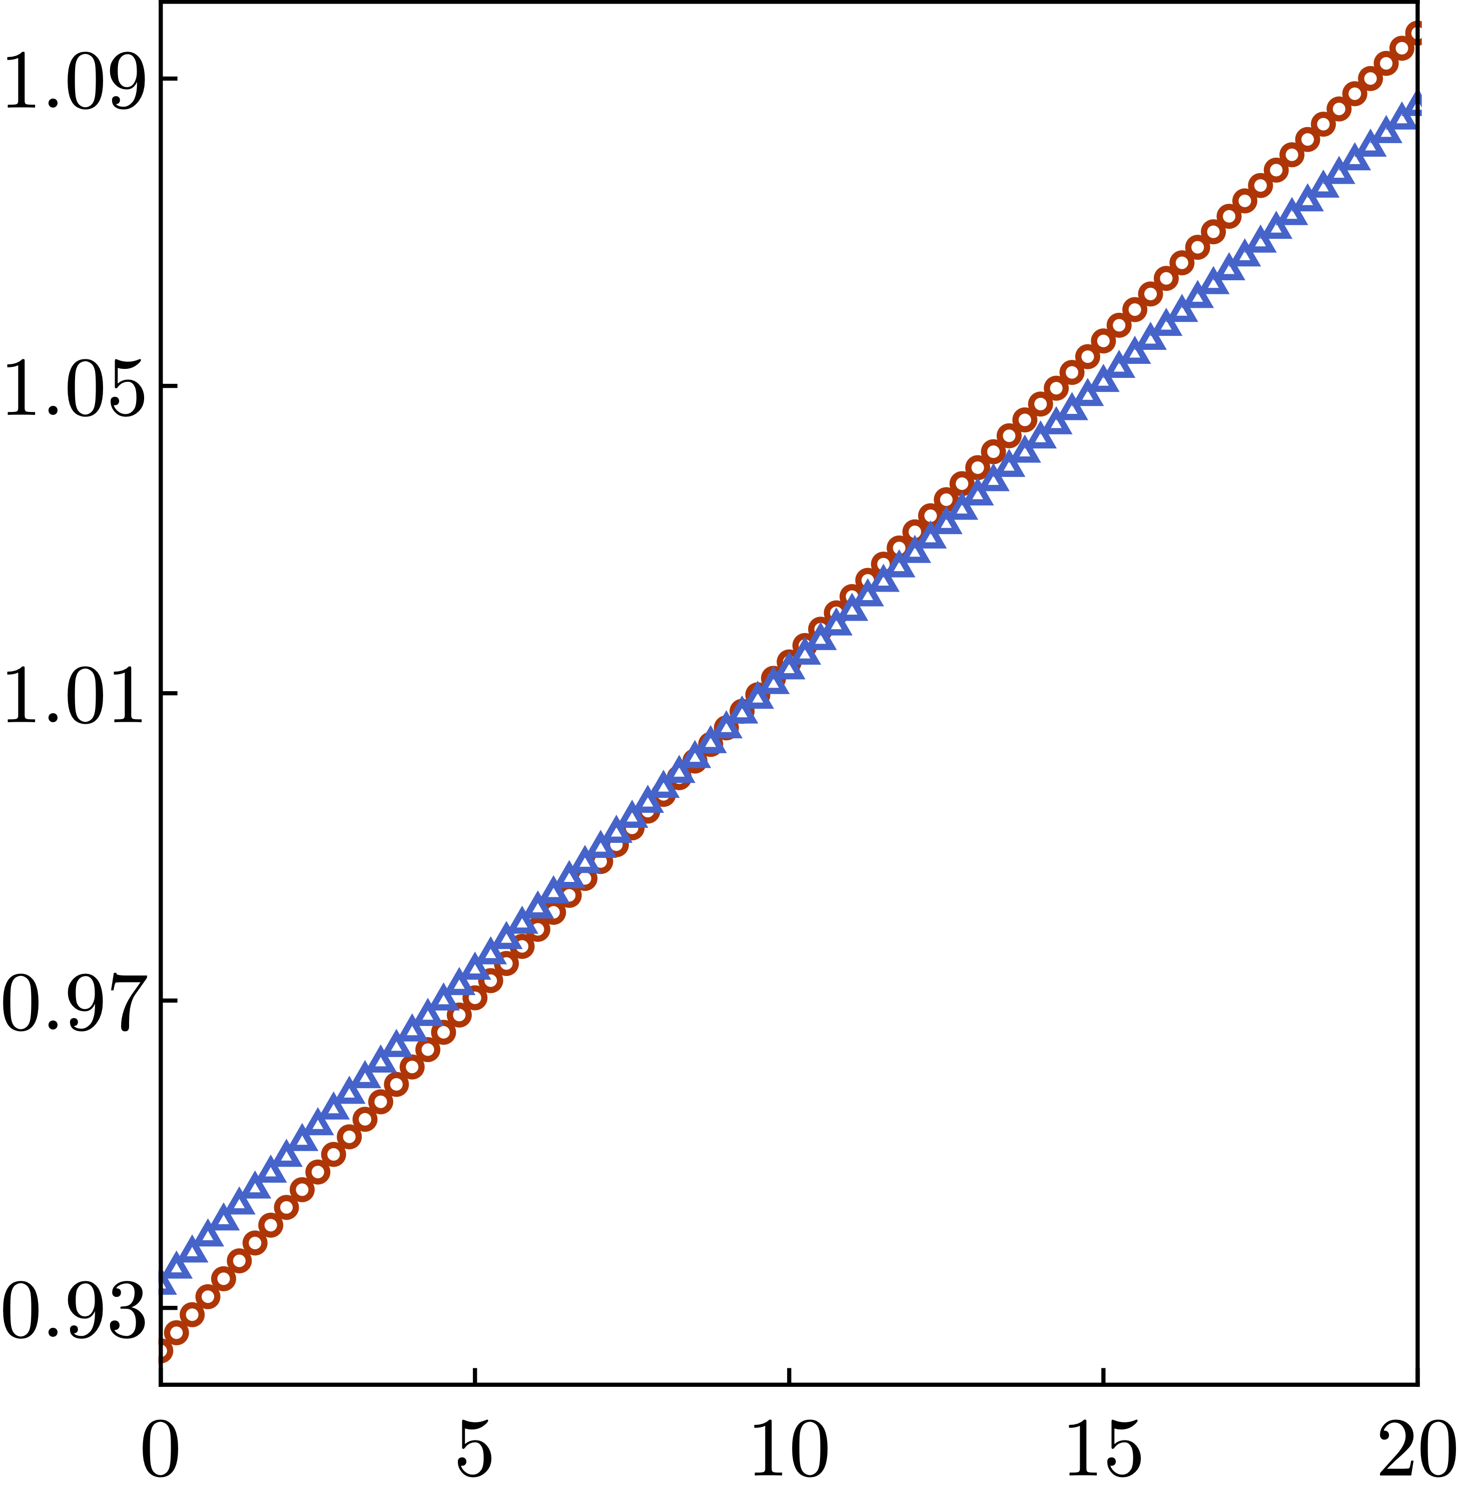



Thin elastic plate (Föppl–von Kármán)
Full dynamical equation
Eigenvalue problem
$$ρ\frac{∂^{2}u}{∂t^{2}}+c\frac{∂u}{∂t}+D∇^{4}u−T^{′}∇^{2}=0$$
$${ ∇}^{4}u−T∇^{2}u=ω^{2}u$$
Rescale
1D coupling
$\overline{x}=x/L$, $\overline{y}=y/L,$ $\overline{t}=t\sqrt{D/(ρL^{4})}$
Bonding
$$L$$
Non-dimensional form
Normalizing mode
$$T \text{= }0$$
$$\frac{∂^{2}u}{∂{\overline{t}}^{2}}+ζ\frac{∂u}{∂\overline{t}}+{\overline{∇}}^{4}u−T{\overline{∇}}^{2}u=0$$
Normalized frequency $ω/{\text{ω}}_{\text{0}}$
$$ω0$$
Anti-bonding
Drop the bars
$$\frac{∂^{2}u}{∂t^{2}}+ζ\frac{∂u}{∂t}+∇^{4}u−T∇^{2}=0$$
$$T≡\frac{T^{′}L^{2}}{D}$$
Tension T

Slide 10
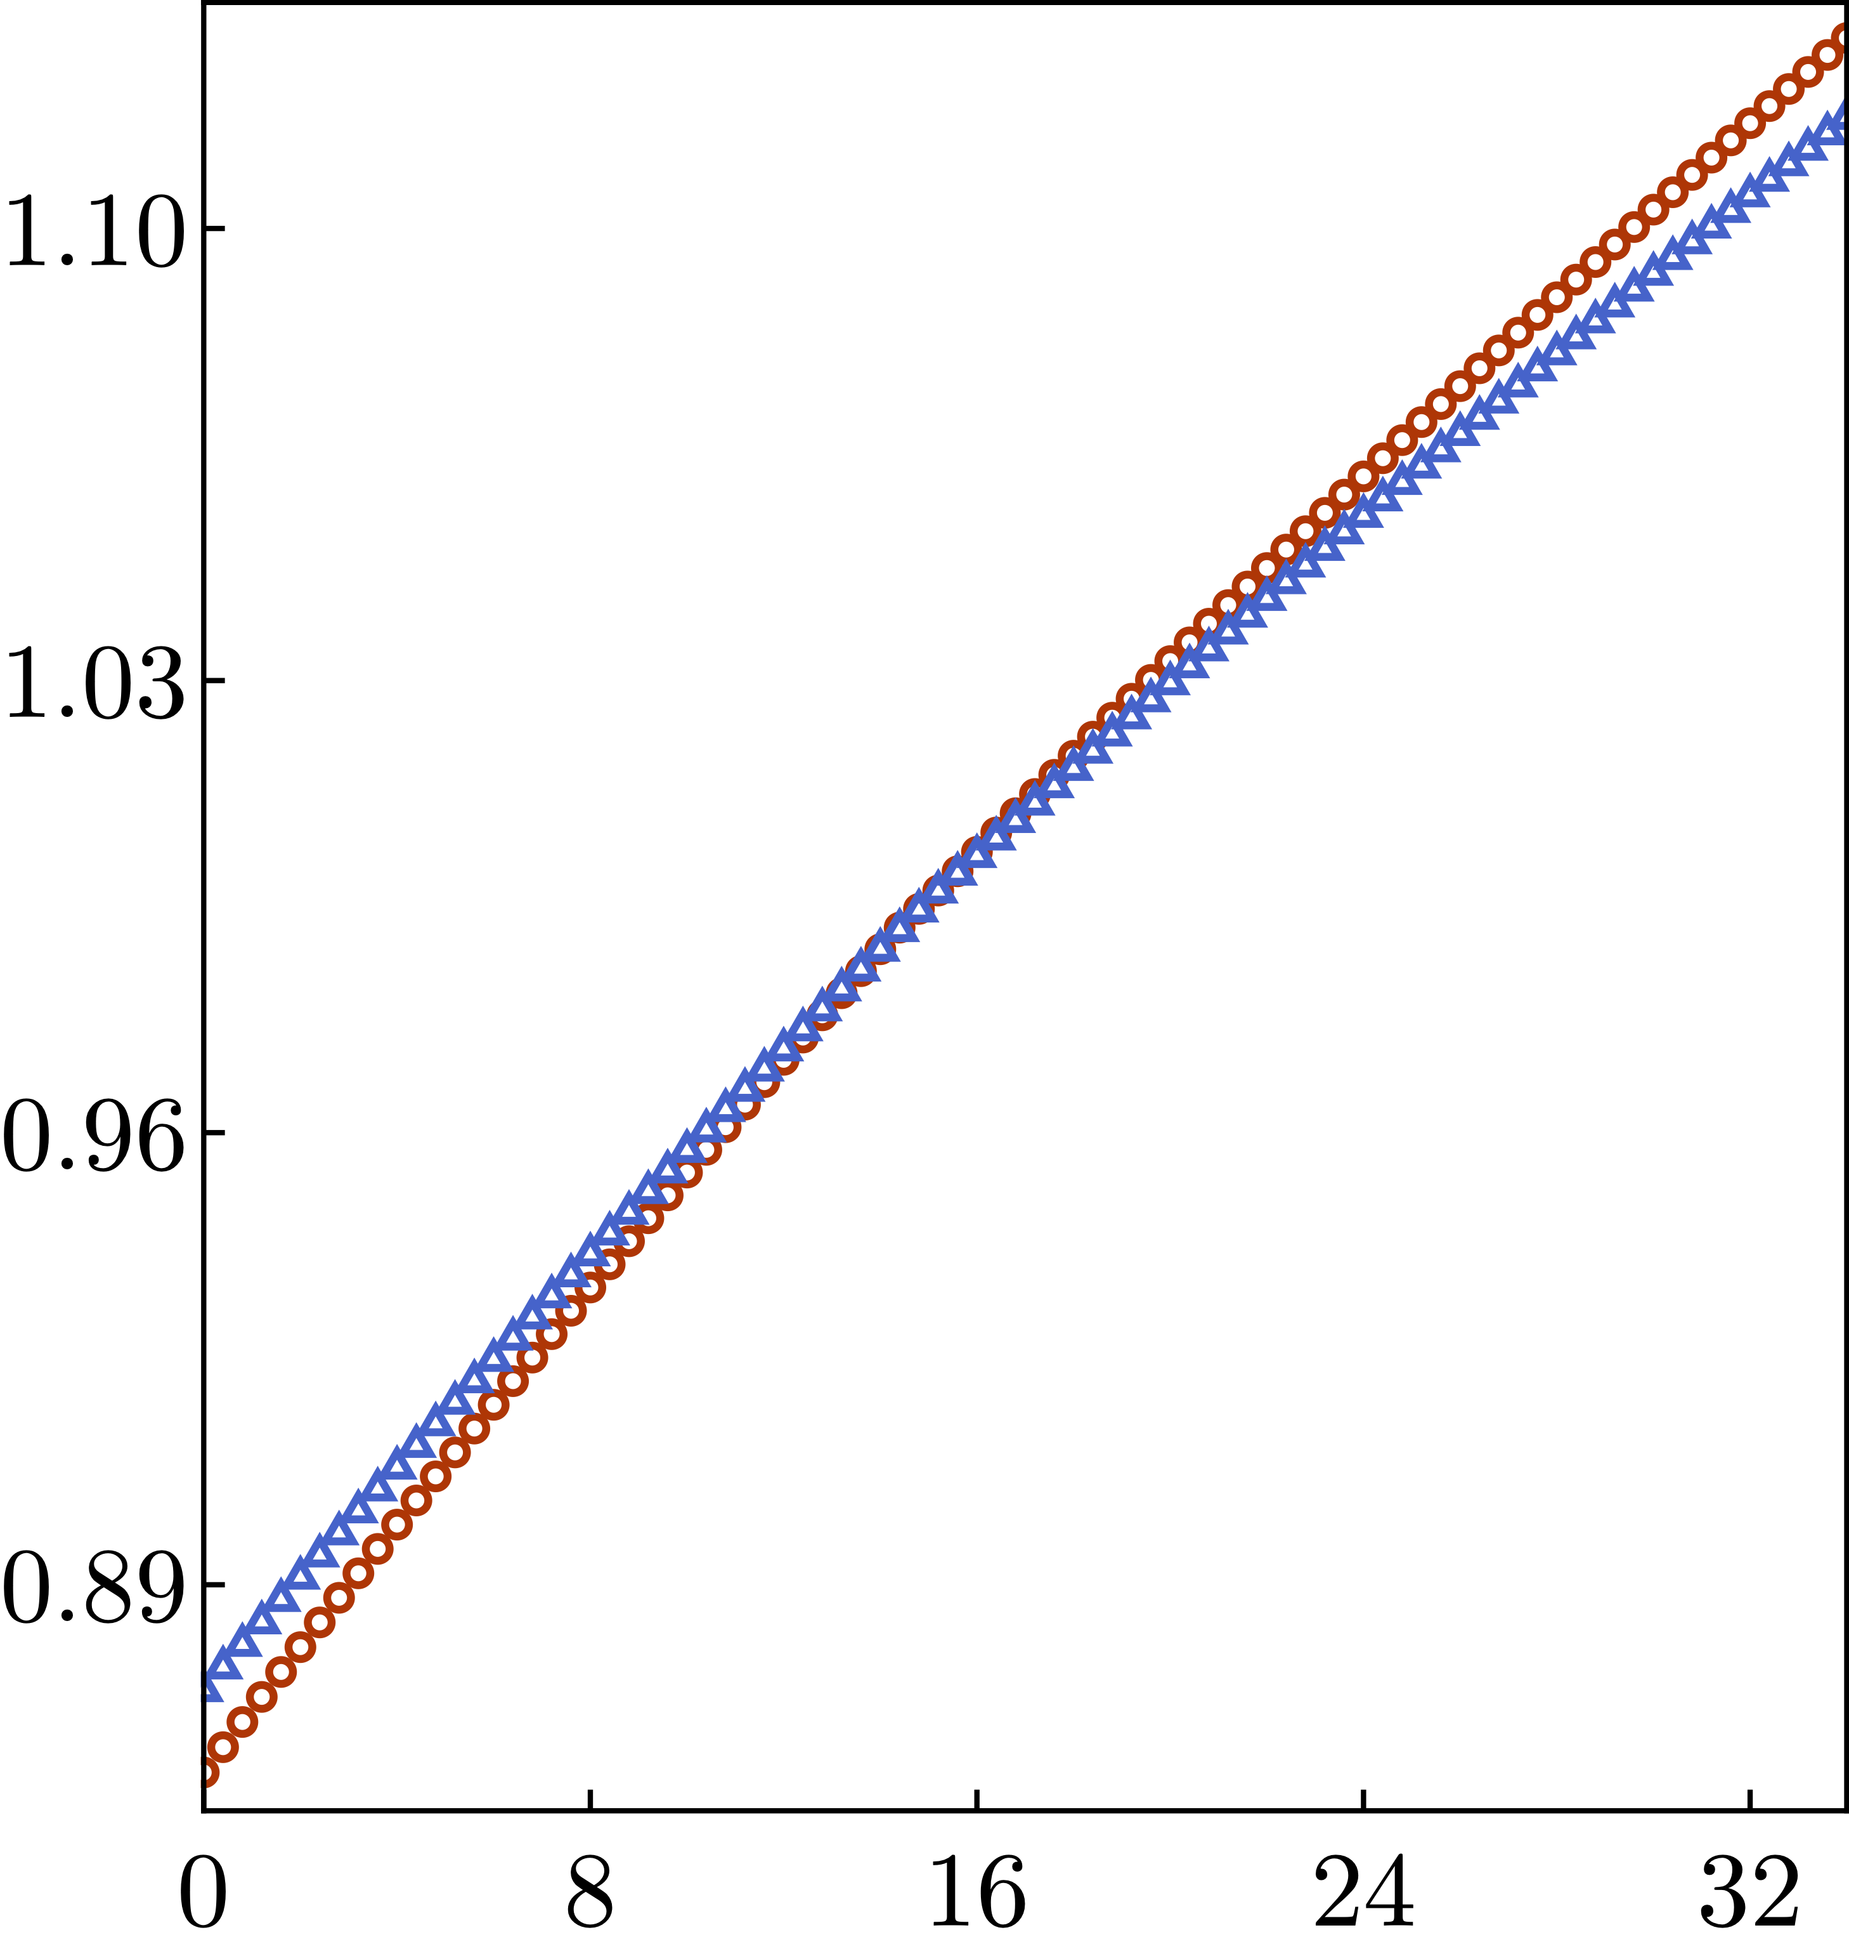
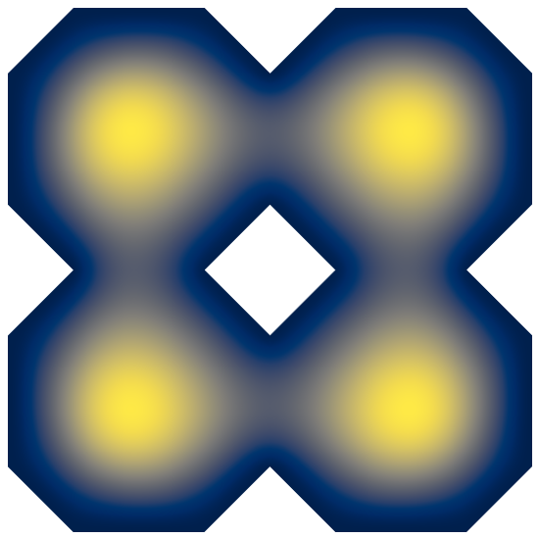
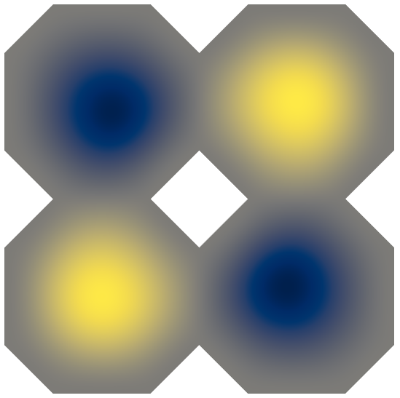
Thin elastic plate (Föppl–von Kármán)
Full dynamical equation
Eigenvalue problem
$$ρ\frac{∂^{2}u}{∂t^{2}}+c\frac{∂u}{∂t}+D∇^{4}u−T^{′}∇^{2}=0$$
$${ ∇}^{4}u−T∇^{2}u=ω^{2}u$$
Rescale
2D coupling
$\overline{x}=x/L$, $\overline{y}=y/L,$ $\overline{t}=t\sqrt{D/(ρL^{4})}$
Bonding
$$L$$
Non-dimensional form
Normalizing mode
$$T \text{= }0$$
$$\frac{∂^{2}u}{∂{\overline{t}}^{2}}+ζ\frac{∂u}{∂\overline{t}}+{\overline{∇}}^{4}u−T{\overline{∇}}^{2}u=0$$
Normalized frequency $ω/{\text{ω}}_{\text{0}}$
$$ω0$$
Drop the bars
$$\frac{∂^{2}u}{∂t^{2}}+ζ\frac{∂u}{∂t}+∇^{4}u−T∇^{2}=0$$
$$T≡\frac{T^{′}L^{2}}{D}$$
Tension T

Slide 11
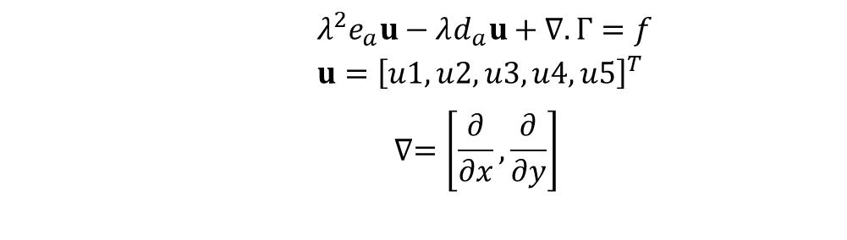
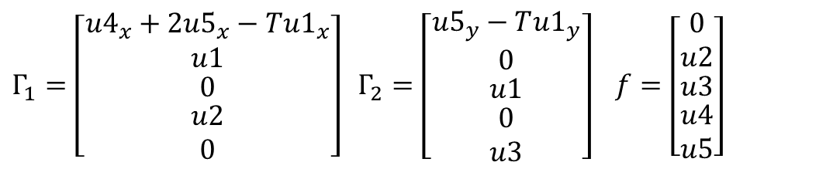
COMSOL implementation
Eigenvalue problem
$${ ∇}^{4}u−T∇^{2}u=ω^{2}u$$
Eigenvalue Study in General Form PDE
$${ λ}^{2}e_{a}u−λd_{a}u+∇.Γ=f \\ u={\left[u1,u2,u3,u4,u5\right]}^{T} \\ ∇=\left[\frac{∂}{∂x},\frac{∂}{∂y}\right]$$
$Γ_{1}=\left[\begin{matrix}{u4}_{x}+{2u5}_{x}−{Tu1}_{x} \\ u1 \\ \begin{matrix}0 \\ \begin{matrix}u2 \\ 0\end{matrix}\end{matrix}\end{matrix}\right] Γ_{2}=\left[\begin{matrix}{u5}_{y}−T{u1}_{y} \\ 0 \\ \begin{matrix}u1 \\ \begin{matrix}0 \\ u3\end{matrix}\end{matrix}\end{matrix}\right]$ $f=\left[\begin{matrix}0 \\ u2 \\ \begin{matrix}u3 \\ \begin{matrix}u4 \\ u5\end{matrix}\end{matrix}\end{matrix}\right]$

Slide 12




COMSOL implementation
Eigenvalue problem
$${ ∇}^{4}u−T∇^{2}u=ω^{2}u$$
We get 5 sets of equations
$$\left.\left.\left.I\right) {\left(u4\right.}_{xx}+{2u5}_{xx}+{u5}_{yy}\right)−{T\left(u1\right.}_{xx}+{u1}_{yy}\right)=λu1$$
Eigenvalue Study in General Form PDE
$$\left.III\right) u3={u1}_{y}$$
$$\left.II\right) u2={u1}_{x}$$
$${ λ}^{2}e_{a}u−λd_{a}u+∇.Γ=f \\ u={\left[u1,u2,u3,u4,u5\right]}^{T} \\ ∇=\left[\frac{∂}{∂x},\frac{∂}{∂y}\right]$$
$$\left.V\right) u5={u3}_{y}$$
$$\left.IV\right) u4={u2}_{x}$$
$Γ_{1}=\left[\begin{matrix}{u4}_{x}+{2u5}_{x}−{Tu1}_{x} \\ u1 \\ \begin{matrix}0 \\ \begin{matrix}u2 \\ 0\end{matrix}\end{matrix}\end{matrix}\right] Γ_{2}=\left[\begin{matrix}{u5}_{y}−T{u1}_{y} \\ 0 \\ \begin{matrix}u1 \\ \begin{matrix}0 \\ u3\end{matrix}\end{matrix}\end{matrix}\right]$ $f=\left[\begin{matrix}0 \\ u2 \\ \begin{matrix}u3 \\ \begin{matrix}u4 \\ u5\end{matrix}\end{matrix}\end{matrix}\right]$

Slide 13

COMSOL implementation
Eigenvalue problem
$${ ∇}^{4}u−T∇^{2}u=ω^{2}u$$
We get 5 sets of equations
$$\left.\left.\left.I\right) {\left(u4\right.}_{xx}+{2u5}_{xx}+{u5}_{yy}\right)−{T\left(u1\right.}_{xx}+{u1}_{yy}\right)=λu1$$
Eigenvalue Study in General Form PDE
$$\left.III\right) u3={u1}_{y}$$
$$\left.II\right) u2={u1}_{x}$$
$${ λ}^{2}e_{a}u−λd_{a}u+∇.Γ=f \\ u={\left[u1,u2,u3,u4,u5\right]}^{T} \\ ∇=\left[\frac{∂}{∂x},\frac{∂}{∂y}\right]$$
$$\left.V\right) u5={u3}_{y}$$
$$\left.IV\right) u4={u2}_{x}$$
Which simplifies to
$Γ_{1}=\left[\begin{matrix}{u4}_{x}+{2u5}_{x}−{Tu1}_{x} \\ u1 \\ \begin{matrix}0 \\ \begin{matrix}u2 \\ 0\end{matrix}\end{matrix}\end{matrix}\right] Γ_{2}=\left[\begin{matrix}{u5}_{y}−T{u1}_{y} \\ 0 \\ \begin{matrix}u1 \\ \begin{matrix}0 \\ u3\end{matrix}\end{matrix}\end{matrix}\right]$ $f=\left[\begin{matrix}0 \\ u2 \\ \begin{matrix}u3 \\ \begin{matrix}u4 \\ u5\end{matrix}\end{matrix}\end{matrix}\right]$
$$\left(\frac{∂^{4}u1}{∂x^{4}}+2\frac{∂^{4}u1}{∂x^{2}∂y^{2}}+\frac{∂^{4}u1}{∂y^{4}}\right)−T\left(\frac{∂^{2}u1}{∂x^{2}}+\frac{∂^{2}u1}{∂y^{2}}\right)=λu1,$$
$${ ∇}^{4}u1−T∇^{2}u1=λu1$$

Slide 14
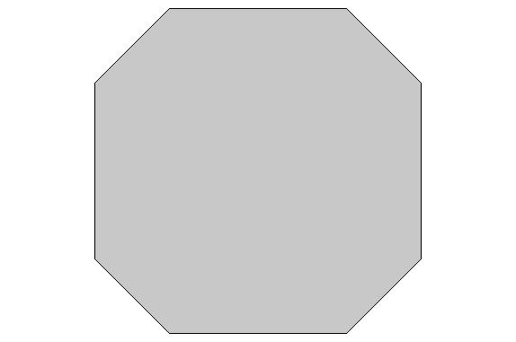

Band structure calculation
Bloch periodicity:
$$u_{k_{x}}\left(x,y\right)=e^{ik_{x}x}φ_{k_{x}}\left(x,y\right)$$
1D lattice

Slide 15




Band structure calculation
Bloch periodicity:
Bloch periodicity:
$$u_{k_{x}}\left(x,y\right)=e^{ik_{x}x}φ_{k}\left(x,y\right)$$
$$u_{k_{x}}\left(x,y\right)=e^{ik_{x}x}φ_{k_{x}}\left(x,y\right)$$
$$u_{k_{y}}\left(x,y\right)=e^{ik_{y}x}φ_{k}\left(x,y\right)$$
1D lattice
1st Brillouin zone
2D square lattice
$$k_{y}$$
$$k_{x}$$

Slide 16

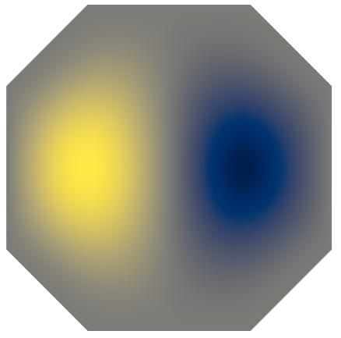
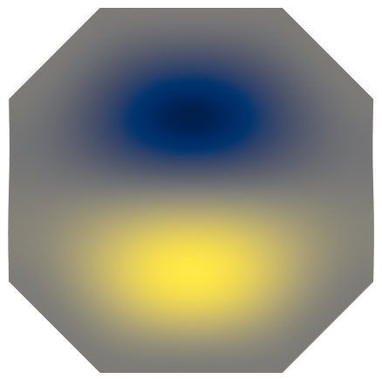
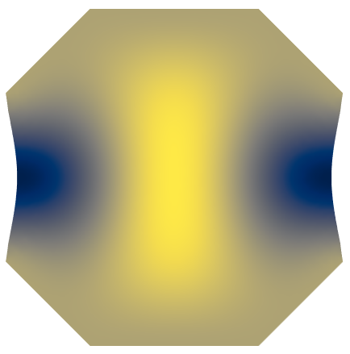
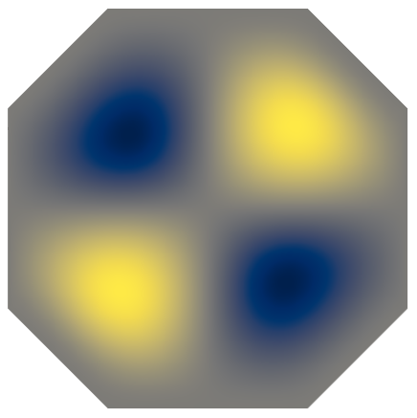
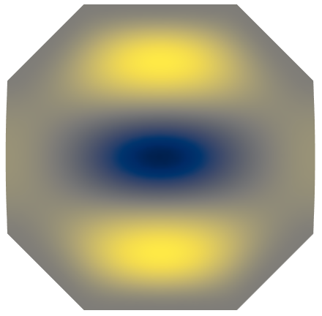
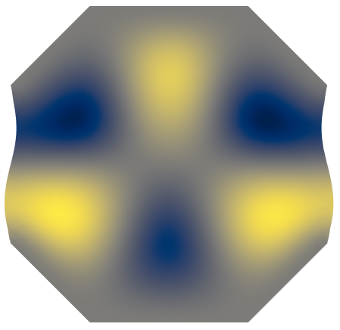
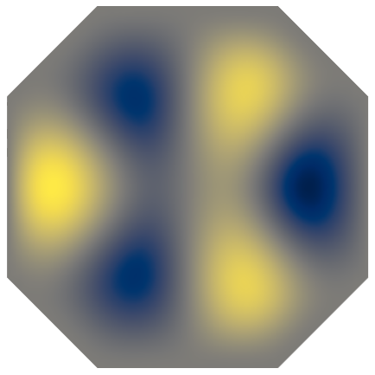
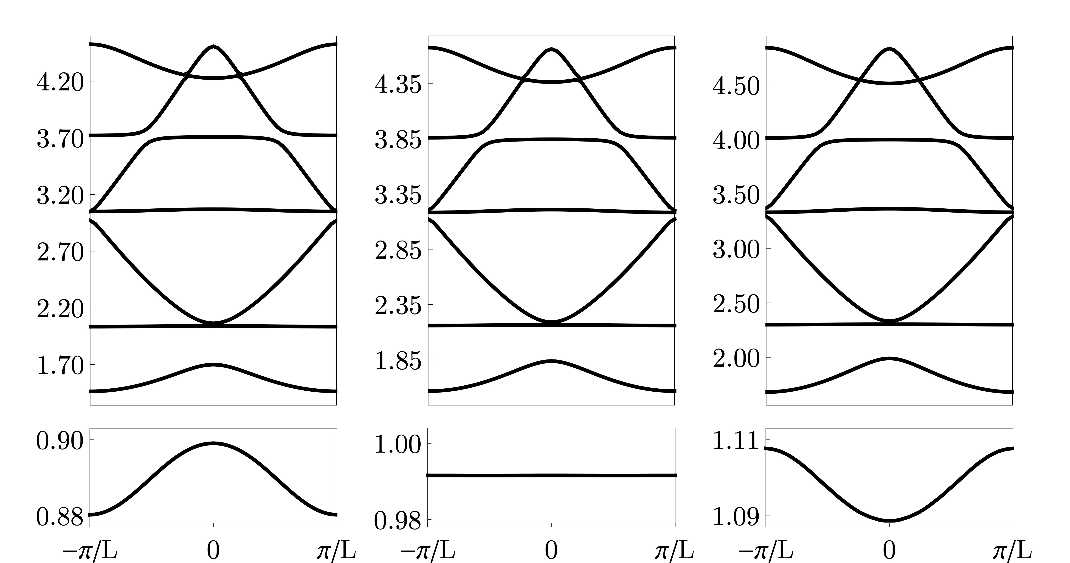





Band structure calculation – 1D
1
2
3
4
Modes
5
6
7
8
Bloch periodicity:
$$u_{k_{x}}\left(x,y\right)=e^{ik_{x}x}φ_{k_{x}}\left(x,y\right)$$
$$T=1$$
$$T=13.4$$
$$T=28$$
8
1D lattice
7
6
5
4
Normalized frequency
3
2
1
Crystal momentum$k_{x}$

Slide 17
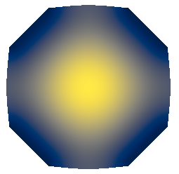
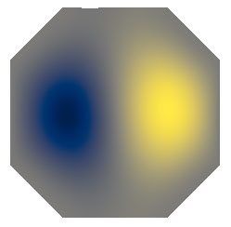
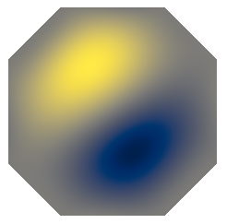
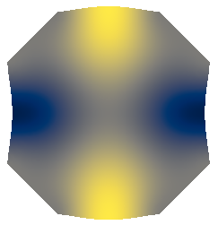
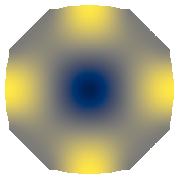
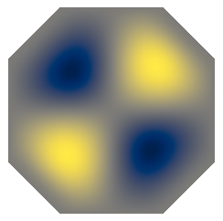
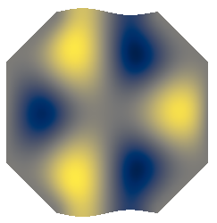
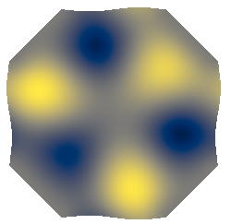
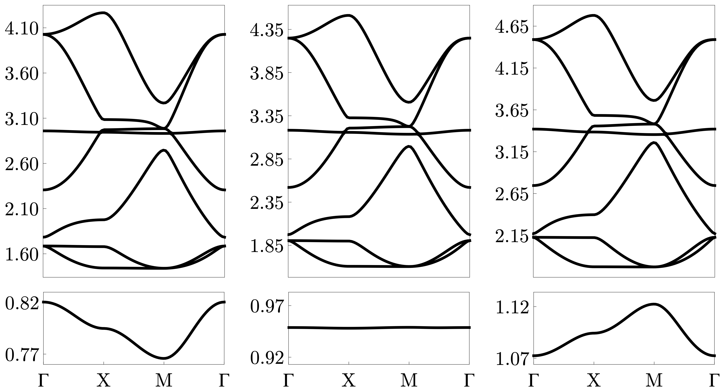





Band structure calculation – 2D
1
2
3
4
Modes
5
6
7
8
1st Brillouin zone
$$T=1$$
$$T=21$$
$$T=44$$
$$k_{y}$$
8
7
6
$$k_{x}$$
5
Normalized frequency
4
3
2
1
Symmetry points

Slide 18
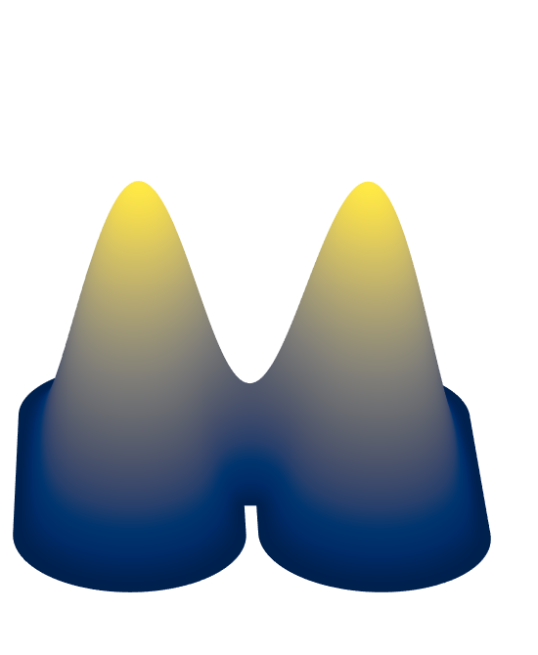

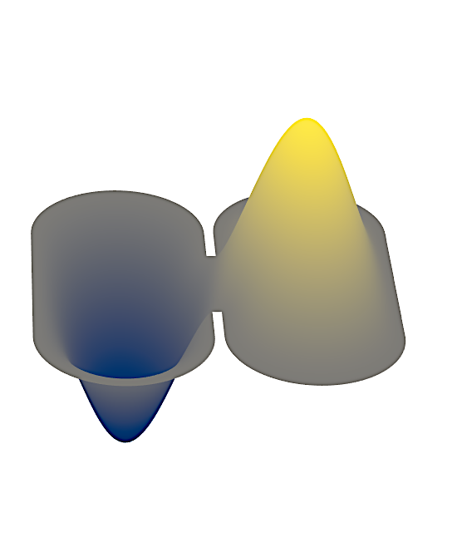





Mapping to a discrete spring mass model
P. Karki and J. Paulose, Physical Review Applied, 2021.
Bonding
$$∆y_{1}$$
$$τ$$
$$∆y_{2}$$
$$k_{1}$$
$$k_{2}$$
Anti-bonding

Slide 19
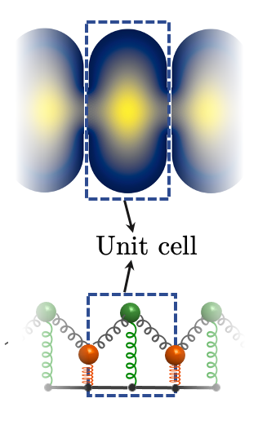

Band structure of 1D chain
Periodic boundary condition
COMSOL
Theory
Unit cell
Normalized frequency $ω/{\text{ω}}_{\text{0}}$
T=1
n=-1
n=0
n=+1
Quasi-momentum q

Slide 20

Band structure of 1D chain
Periodic boundary condition
Mode-crossing
$ω$ vs T
COMSOL
Theory
Unit cell
Normalized frequency $ω/{\text{ω}}_{\text{0}}$
T_{fb}=46.55
T=1
n=-1
n=0
n=+1
Tension T
Quasi-momentum q

Slide 21
Band structure of 1D chain
Periodic boundary condition
Mode-crossing
$ω$ vs T
T=120
COMSOL
Theory
Unit cell
Normalized frequency $ω/{\text{ω}}_{\text{0}}$
T_{fb}=46.55
T=1
n=-1
n=0
n=+1
Tension T
Quasi-momentum q

Slide 22
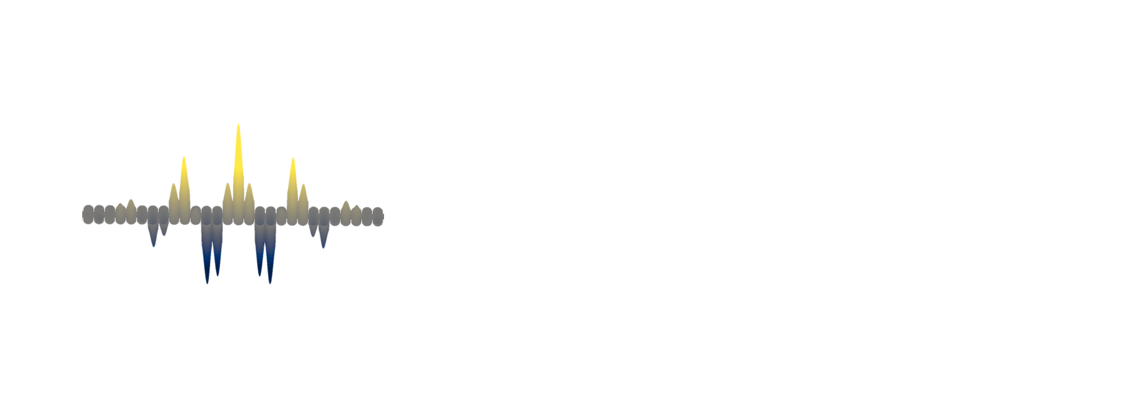
Stopping and reversing sound
Gaussian wave-packet
T=120
COMSOL

Slide 23


Stopping and reversing sound
Gaussian wave-packet
T=120
COMSOL
T_{fb}$≈$45
Normalized frequency $ω/{\text{ω}}_{\text{0}}$
Theory

Slide 24
Stopping and reversing sound
Gaussian wave-packet
T=120
COMSOL
T_{fb}$≈$45
Normalized frequency $ω/{\text{ω}}_{\text{0}}$
Theory
T=1
Quasi-momentum q_{x}

Slide 25
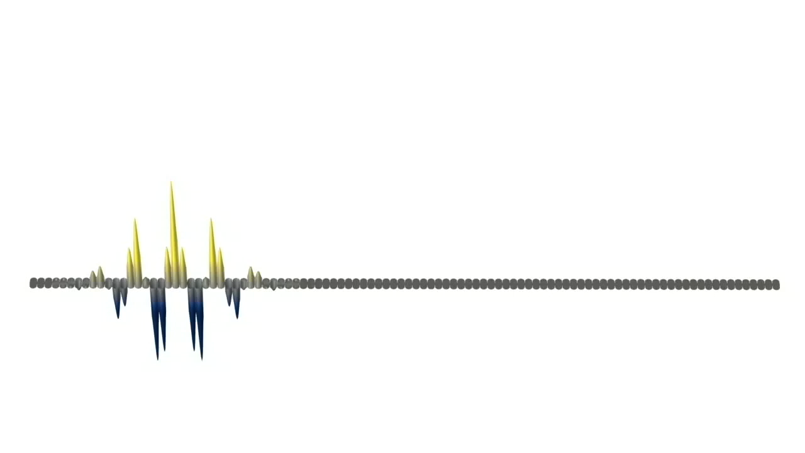
Stopping and reversing sound

Slide 26

Stopping and reversing sound
Discrete model
COMSOL
Rescaled time $ω0t$
Position (lattice units)

Slide 27
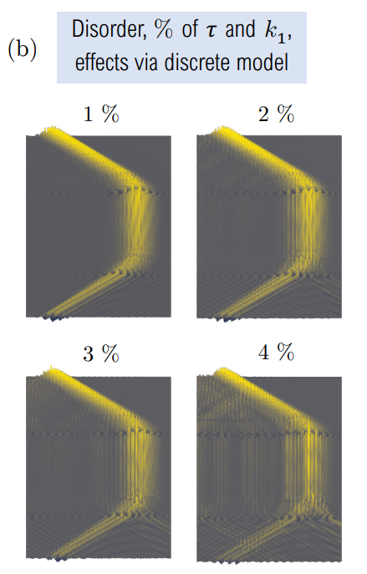
Stopping and reversing sound
Discrete model
COMSOL
Rescaled time $ω0t$
Position (lattice units)

Slide 28
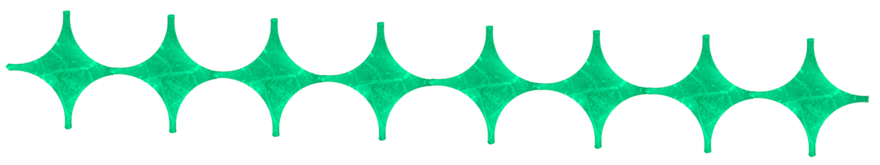
Potential experimental system
Graphene
Benjamín Alemán group, University of Oregon

Slide 29



Summary in 1D
Vibrational modes crossing
Changing dispersion character
Stopping and reversing sound
$ω \text{vs}$q_{x}
wave-packet modes
Rescaled time $ω0t$
Position (lattice units)

Slide 30
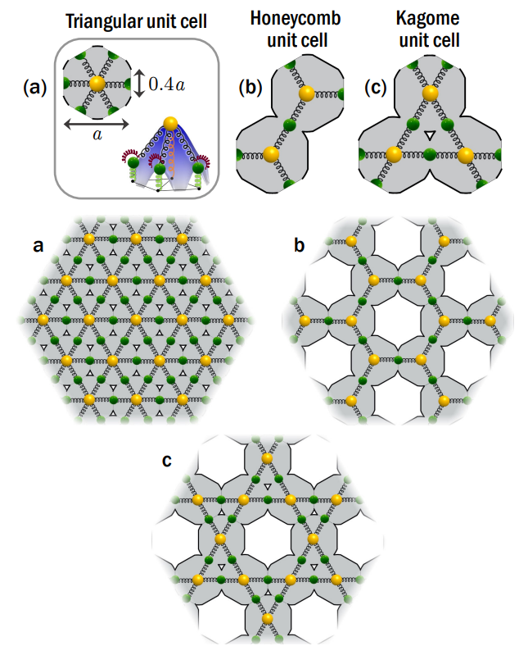
Singular flat band in 2D

Slide 31
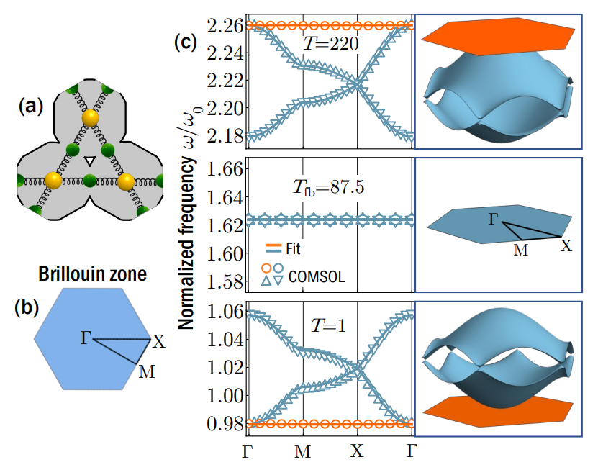
Singular flat band in 2D
P. Karki and J. Paulose, Physical Review Research, 2023

Slide 32
Conclusions
We created a custom model for coupled thin-plate elastic resonators
We modified the bonding character of the ground state of a fourth order coupled thin-plate elastic resonator system via prestress modulation
We imported solutions from eigenvalue problem to time-dependent studies to perform dynamical simulations

