Slide 1
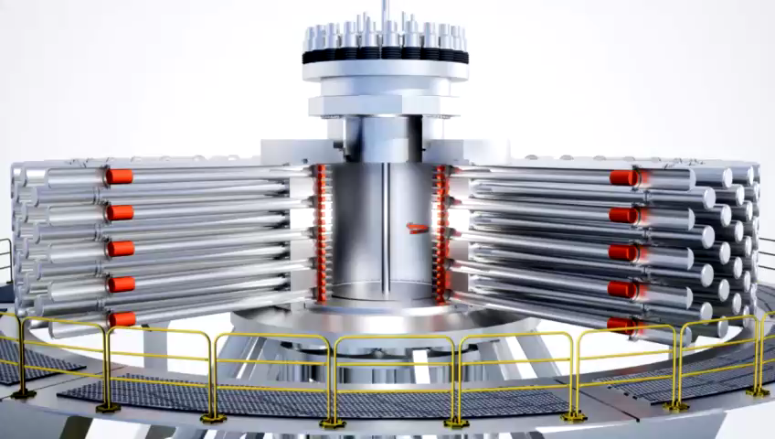


Magnetomechanical Compression of a Solid Lithium Liner for Magnetized Target Fusion
Jean-Sebastien Dick, Ph.D., General Fusion Inc.​, js.dick@generalfusion.com
Sean Teller, Ph.D., Veryst Engineering, steller@veryst.com
Magnetized Target Fusion (MTF) powerplant concept

Slide 2
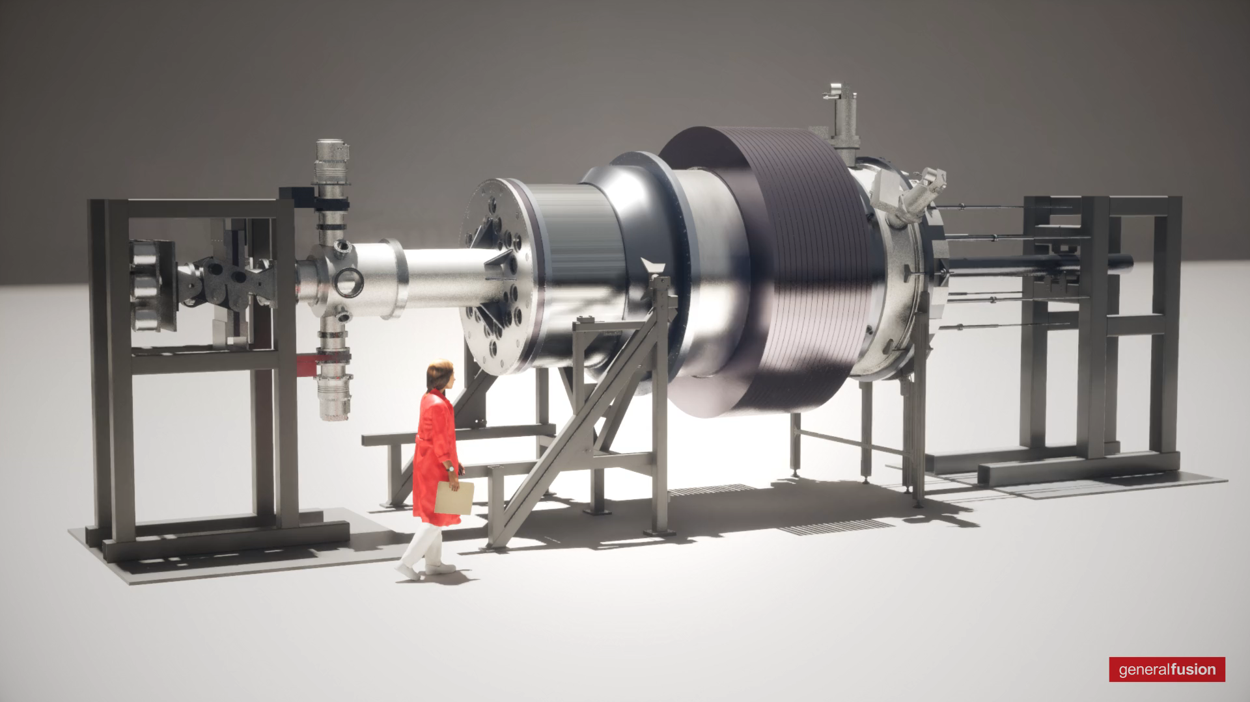

Plasma Compression Science for MTF
Objective:
  Reach fusion conditions in LM26 machine
How:
  Form a plasma using plasma injector
  Compress plasma using a solid lithium magnetic flux conserver
Lithium Ring Compressor (2023)
Lithium Cylinder Compressor (2024)
Large Magnetized Plasma Compressor (2025)
LM26 Machine $→\text{Lawson} \text{criterion}\text{, }\text{scientific} \text{equivalent} \text{breakeven}$

Slide 3

Simulation Challenges
3 electromagnetic compressors to build in 2 years
  Quick iterations (simplification to 2D-axi)
  Flexible data extraction for post-processing
Multiphysics
  Non-linear plastic hardening material (lithium)
    Large deformation
  Low-Frequency Electromagnetics
    Ohmic heating
    Lorentz Force
  Fully Coupled Solver

Slide 4
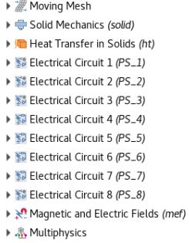
Modeling Methodology Highlights
Physics:
  Moving Mesh
  Solid Mechanics (linear)
    Plasticity (JC)
    Contact Mechanics (Penalty)
  Magnetic & Electric Field (quadratic)
    Lorentz Force
  Coil excitation from electrical circuits
  Heat Transfer (quadratic)
    Ohmic heating
Solver:
  Time dependent
    BDF 2nd order scheme
  Fully Coupled
  Automatic Remeshing
COMSOL Modeling Tree

Slide 5
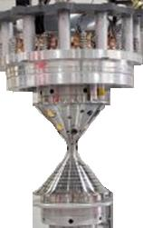

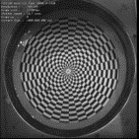
Modeling Validation Strategy
Material Characterization
Tension/Compression
Strain & strain-rate hardening
Lithium Ring Compressor
Azimuthal symmetry
Ring trajectory validation with COMSOL
Lithium Cylinder Compressor
Lithium / cone high speed impact
Cylinder shape validation with COMSOL
Temperature range (20– 120$°C$)
Temperature range (20– 120°C)

Slide 6


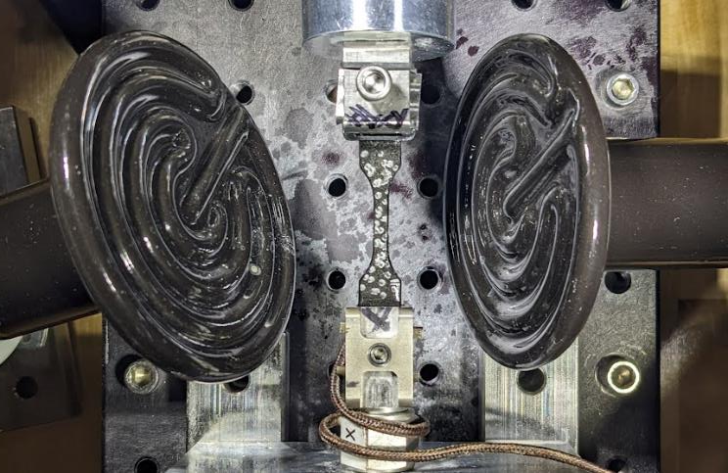
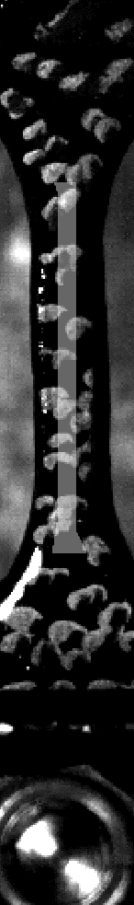
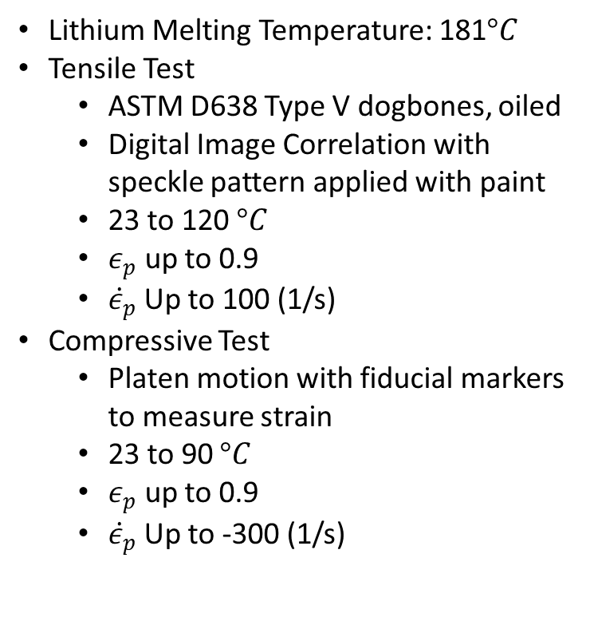
Material Characterization
Experimental Setup
Lithium Melting Temperature: 181$°C$
Tensile Test
  ASTM D638 Type V dogbones, oiled
  Digital Image Correlation with speckle pattern applied with paint
  23 to 120 $°C$
  $ε_{p}$ up to 0.9
  ${\dot{ε}}_{p}$Up to 100 (1/s)
Compressive Test
  Platen motion with fiducial markers to measure strain
  23 to 90 $°C$
  $ε_{p}$ up to 0.9
  ${\dot{ε}}_{p}$Up to -300 (1/s)
Ceramic Heater
Sample
Sample and Load Cell Section
Thermocouple (backside)
LoadCell
Test Video
50 ms

Slide 7
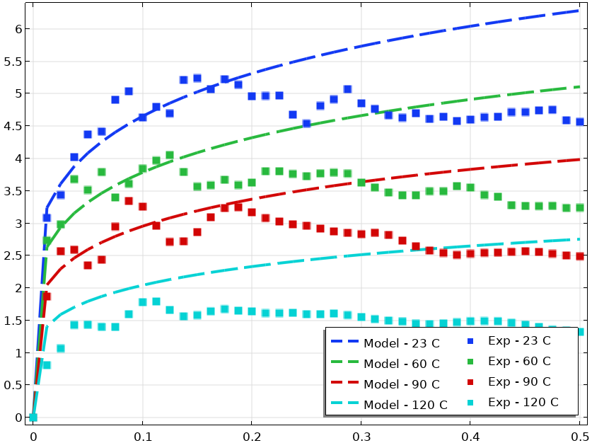

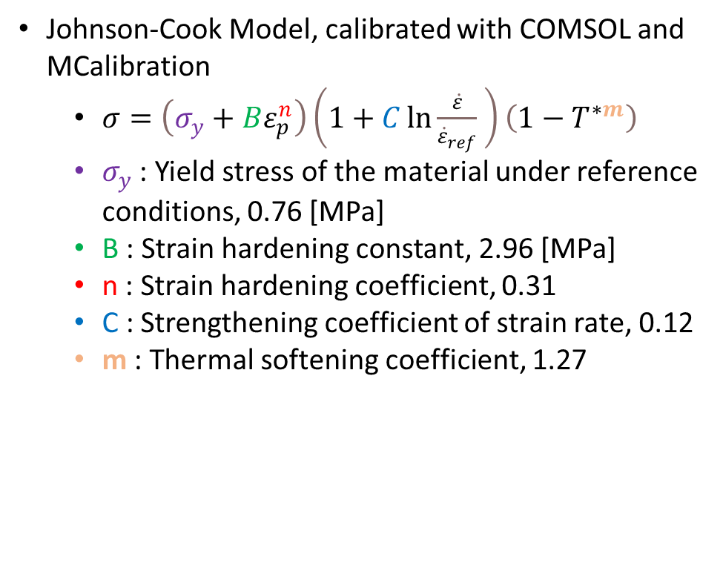
Material Characterization
Numerical Setup
Johnson-Cook Model, calibrated with COMSOL and MCalibration
  $σ=\left(σ_{y}+Bε_{p}^{n}\right)\left(1+C\ln{\frac{\dot{ε}}{{\dot{ε}}_{ref}}} \right)\left(1−T^{∗m}\right)$
  $σ_{y}$ : Yield stress of the material under reference conditions, 0.76 [MPa]
  B : Strain hardening constant, 2.96 [MPa]
  n : Strain hardening coefficient, 0.31
  C : Strengthening coefficient of strain rate, 0.12
  m : Thermal softening coefficient, 1.27
Engineering Stress (MPa)
Engineering Strain ()
Comparison of Material Model and Experimental Tensile Measurements for at 100 [1/s]

Slide 8
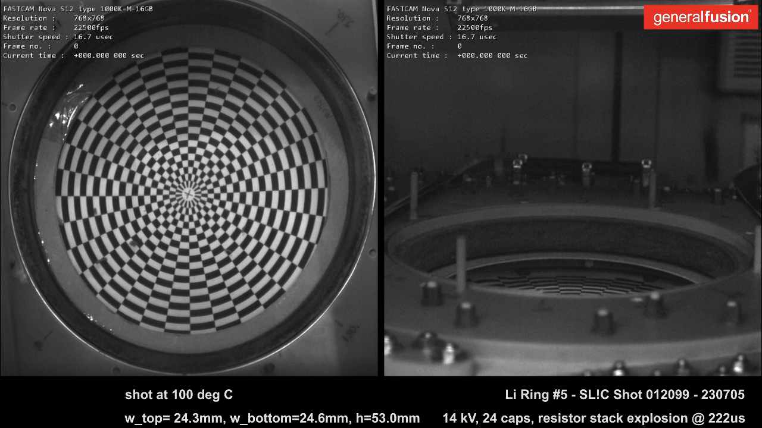
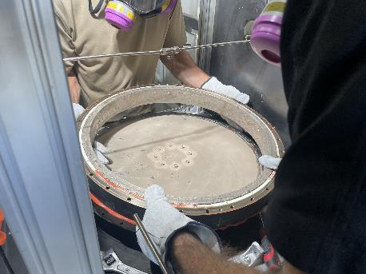
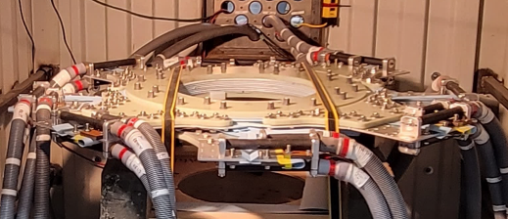
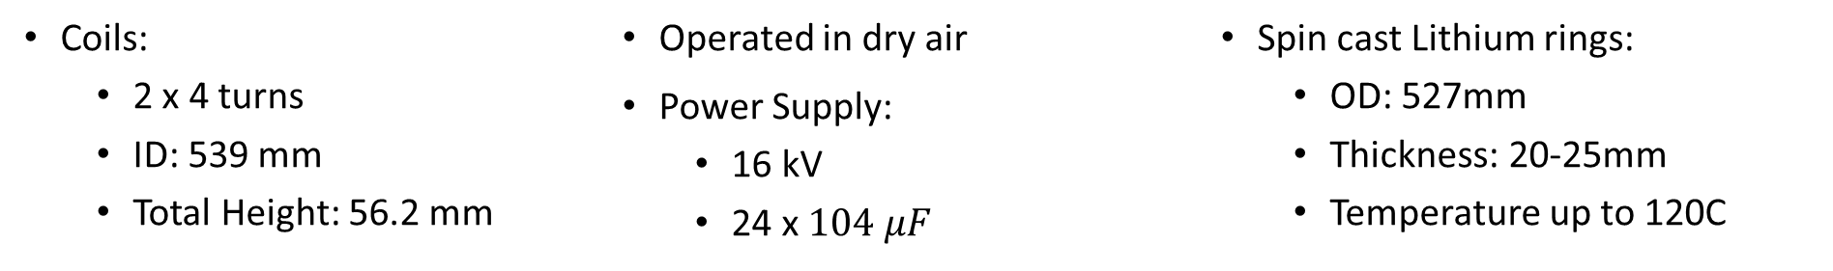
Lithium Ring Compressor
Experimental Setup
Electromagnetic Ring Compression Video
Spin cast lithium ring
Electromagnetic Compressor Test Section
Coils:
  2 x 4 turns
  ID: 539 mm
  Total Height: 56.2 mm
Operated in dry air
Power Supply:
  16 kV
  24 x $104 μF$
Spin cast Lithium rings:
  OD: 527mm
  Thickness: 20-25mm
  Temperature up to 120C
Notes:
Lithium ring compressor
Only interaction between coils and rings
From this experiment, we want to evaluate if our bigger machine will be able to reach fusion conditions
Symmetry
Compression time scale
Energy transfer from the capacitors to the ring (kinetic energy)

Slide 9
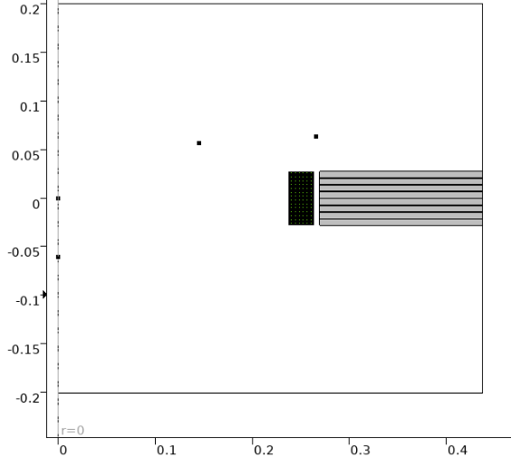
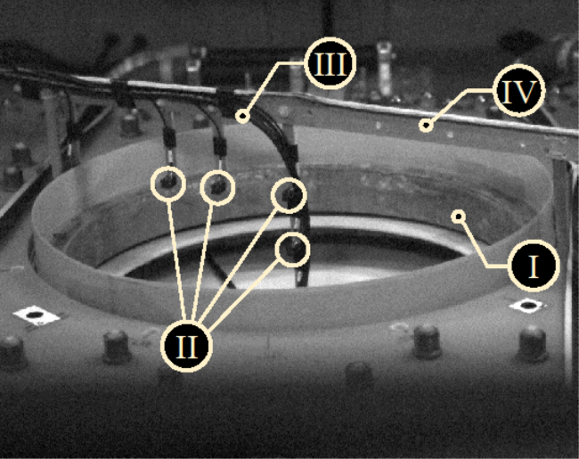
Lithium Ring Compressor
Numerical Setup
Lithium Ring
Magnetic Field Probes (B-probes)
Rogowski loop(current measurement)
Support structure
Coils
II
I
V
COMSOL 2D-axisymmetric Model with location of B-probes
Ring compressor with location of B-probes

Slide 10
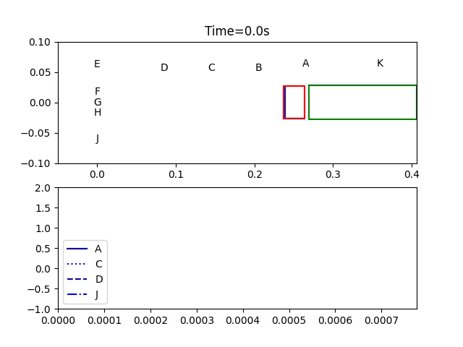
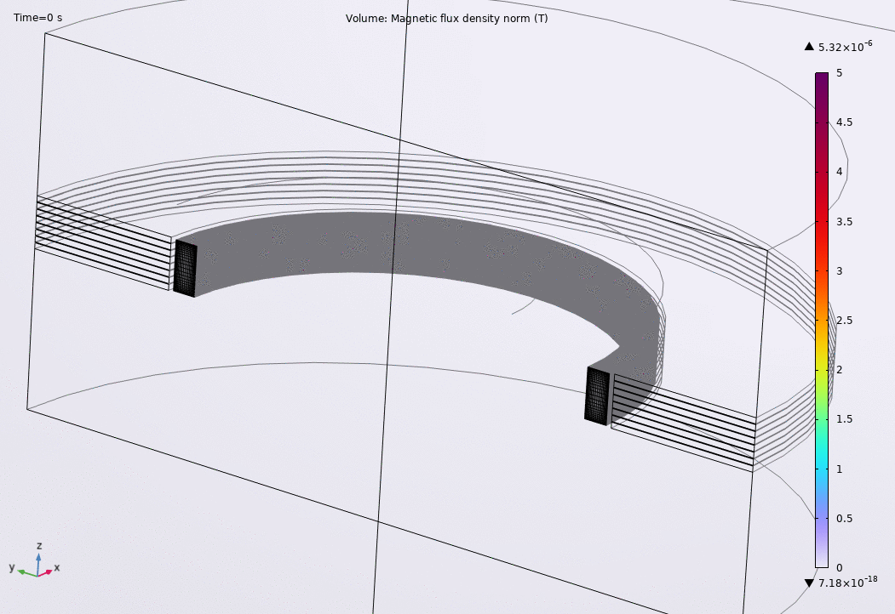




Lithium Ring Compressor
Results
COMSOL:
EXP:
$$z$$
coils
$$r$$
$$\left|B\right|$$
$$t (s)$$
Norm of the magnetic flux density
2D rotated dataset
Animation comparing experimental trajectory and b-probe measurements with numerical simulation

Slide 11

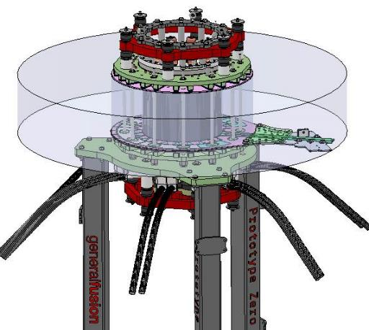
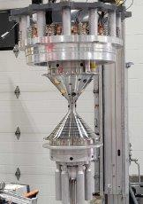
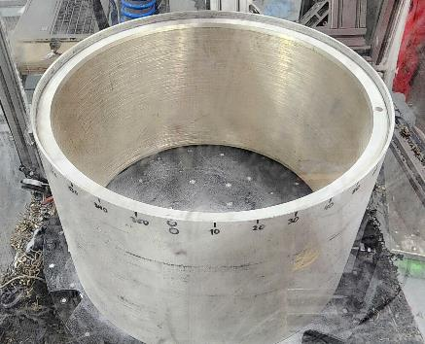
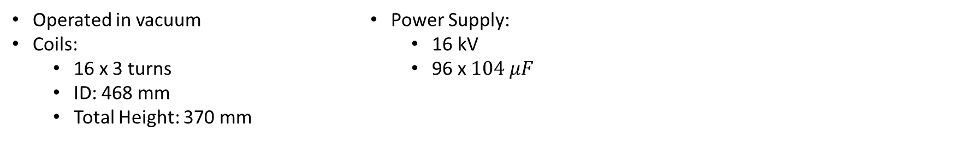
Lithium Cylinder Compressor
Experimental Setup
CAD Model of the Cylindrical Compressor
Lithium cylinder machined in argon vessel
Coils
Center Shaft
  435 mm
Cones
370 mm
13-18 mm
Center shaft and cones prior to installation in the compressor
Operated in vacuum
Coils:
  16 x 3 turns
  ID: 468 mm
  Total Height: 370 mm
  Power Supply:
    16 kV
    96 x $104 μF$

Slide 12
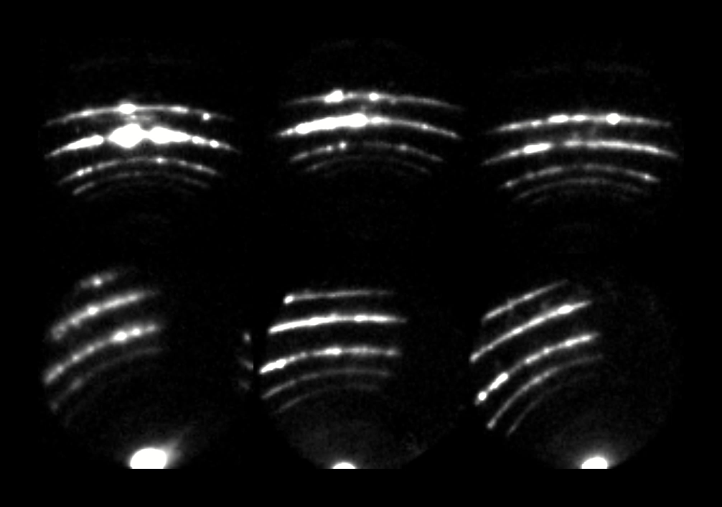
Lithium Cylinder Compressor
Experimental Setup
Structured Light Reconstruction (SLR)
  Technique developed at General Fusion to measure deformation of liners
  Pattern reconstruction of the reflections from laser sheets
Photo Doppler velocimetry (PDV)
  Located in the shaft
  Extract velocity of the liner at a point near equator
Laser light reflected by liner during compression as seen by fisheye lenses

Slide 13
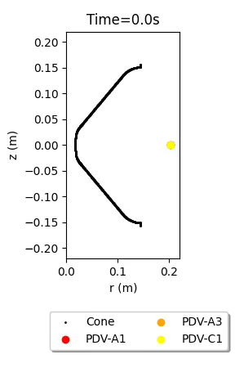
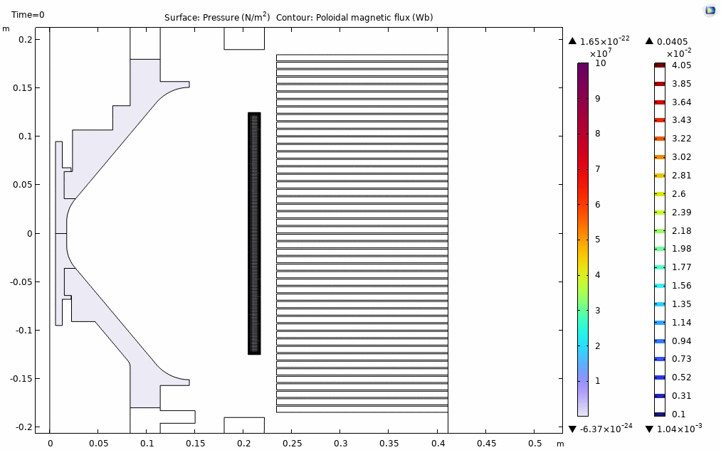
Lithium Cylinder Compressor
Numerical Setup and Results
Conical Structure
Coils connected to power supply
Hydrostatic pressure and poloidal magnetic flux contour
Comparison sample between COMSOL, SLR and PDV channels

Slide 14
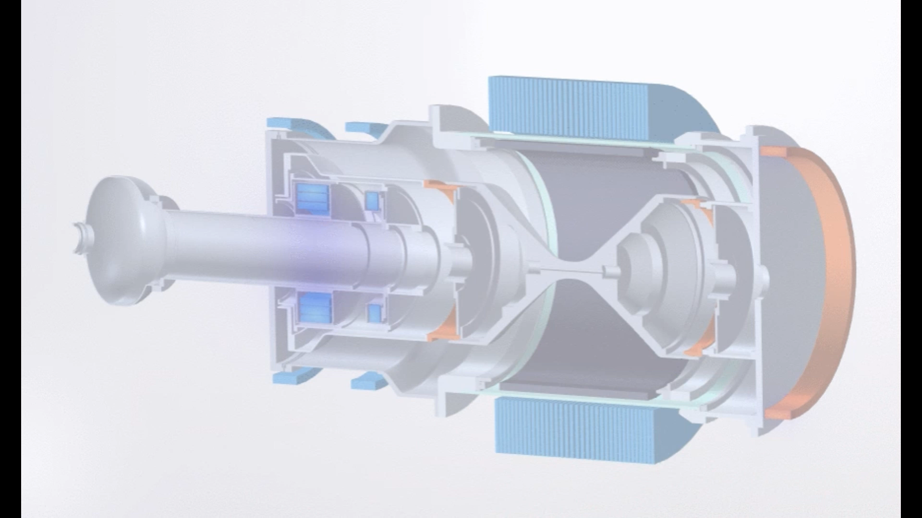
Conclusion
Plasma compression cavity
Plasma formation injector
Summary:
  We use COMSOL Multiphysics to rapidly iterate electromagnetic compressor designs
  A rate-dependent Johnson-Cook Material model of lithium was calibrated using high-strain rate data
  Simulation models aligned closely with measured trajectories and magnetic probe data
Outcomes:
  The design and operating conditions of the LM26 plasma compressor were driven by COMSOL Multiphysics simulations
  Fusion conditions should be achieved on schedule in 2025
LM26 Plasma compressor COMSOL Multiphysics model, colored by norm of magnetic flux density

