Slide 1
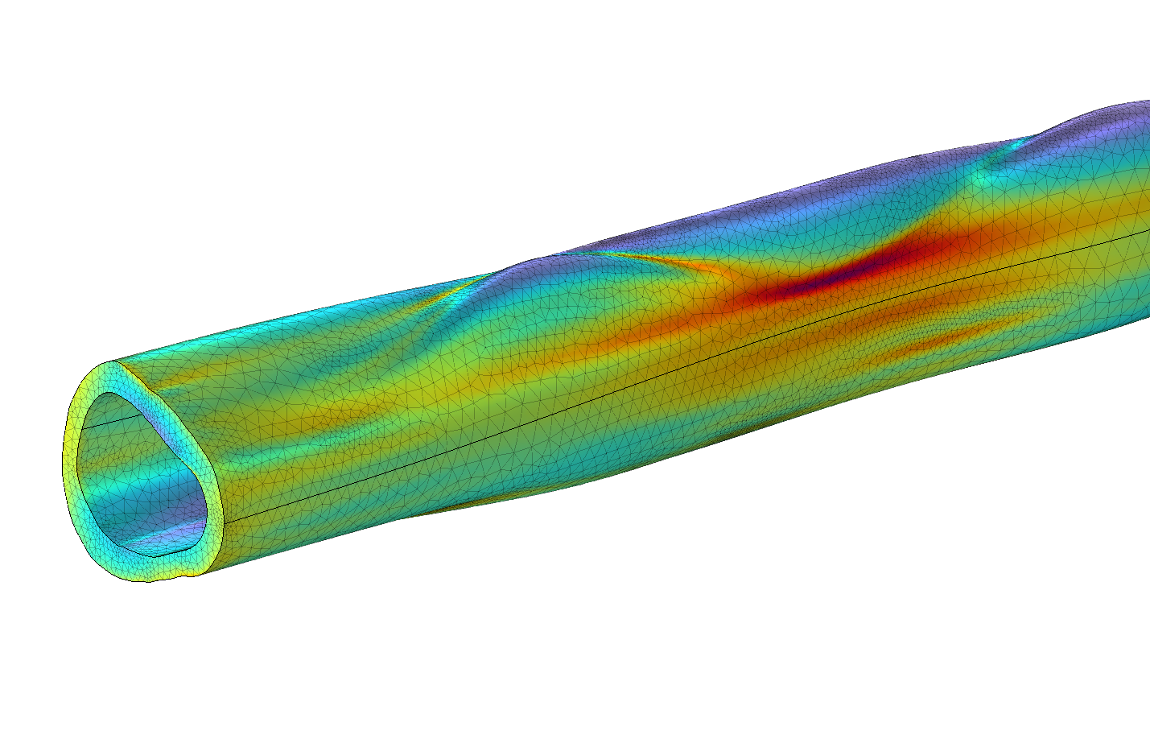
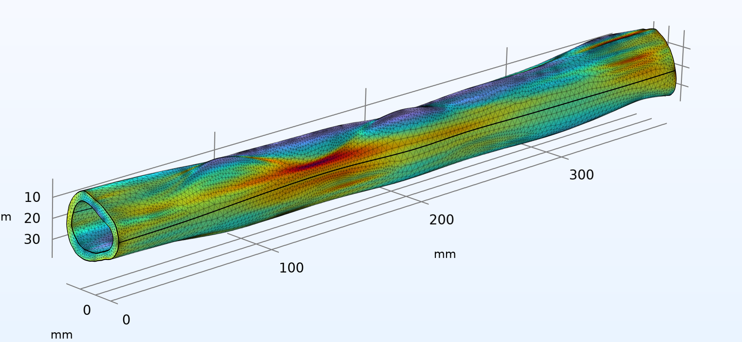
Finite Element Modeling of Human Femur Diaphysis
This study developed COMSOL finite element models of the human femur diaphysis (shaft), subjected to anatomical loading. Results demonstrate the importance of anatomical geometry in FEA models.
G.E. Henderson, E.H. Conard and J.L. Palladino
Department of Engineering, Trinity College, Hartford, CT, USA
Abstract
Modeling biological structures is challenging due to their often complex anatomical geometries and material properties. Finite element studies of the femur, the largest and strongest bone in the human body, have focused on the femoral neck, since this is where fractures often occur. This study developed COMSOL finite element models of the human femur diaphysis (shaft), subjected to anatomical loading. Models were developed from a simple, hollow cylinder; to an anatomical, but uniform, cross section; to an anatomically correct model with eleven cross sections. Models were subjected to physiologically relevant axial, torsional, and bending loads. The calculated stresses and deformations were used to quantitatively compare the models. The asymmetry of the anatomical cross section is especially important for torsion and bending loads, with the femur more resistant to bending in the anterior/posterior direction than the medial/lateral directions. Results show the importance of anatomical geometry in development of biomechanical models.
Methodology
The anatomical femur cross section was built using medical CT scan data from the literature [1]. Data points defining the outer perimeter (periosteum) and inner perimeter (endosteum) were digitized from these scans. Work planes were defined for the outer and inner perimeters for each of the 11 cross sections. Perimeter profiles were contoured by vertex projection and then lofted into a 3D solid. The interior lofted solid was subtracted from the exterior lofted solid, giving the final geometry. The models were constrained at one end and loaded at the other for the three cases of axial compression, torsion, and bending. A physics-controlled mesh and a stationary analysis were performed. The model used isotropic material properties of cortical bone with elastic modulus of 17.4 GPa, Poisson’s ratio of 0.39, and density of 1908 kg/m³.
Three of the 11 femur cross section profiles, demonstrating the degree to which the femur’s cross section changes along the shaft long axis. The resulting model is not prismatic, leading to high stress regions.
Results
For each loading case studied, model results were validated by developing increasingly detailed femur models, starting from a solid cylinder, and a hollow cylinder, which permitted comparison of finite-element analysis (FEA) results with hand calculations. These symmetric cross section, prismatic models were followed by one with an anatomical cross section that was extruded, giving a prismatic model. Finally, the full anatomical model with eleven cross sections was developed. The latter is non prismatic and therefore depends upon FEA analysis for its solution. The resulting anatomical geometry leads to unanticipated high stress regions. Results demonstrate the importance of anatomical geometry in development of FEA models.
Figure 2: Von Mises stress calculated for a 200 Nm torsion load applied to the full 11 section anatomical femur model. The high stress regions exceed the ultimate shear stress of 69 MPa for cortical bone.
[1] A. Proficio, et al., morphomap: An R package for long bone landmarking, cortical thickness, and cross-sectional geometry mapping, Am. J. Phys. Anthro. 174(1):129—139, 2021.
[2] Z. Yang, Finite Element Analysis for Biomedical Engineering Applications, CRC Press, FL, 2019.
[3] R. B. Martin, et al., Mechanical Properties of Bone, chapter. 7 in: Skeletal Tissue Mechanics (2ed), Springer, NY, 2015.
[4] Fung, Y.C., A First Course in Continuum Mechanics (2ed), Prentice-Hall, NJ, 1977.

