Slide 1
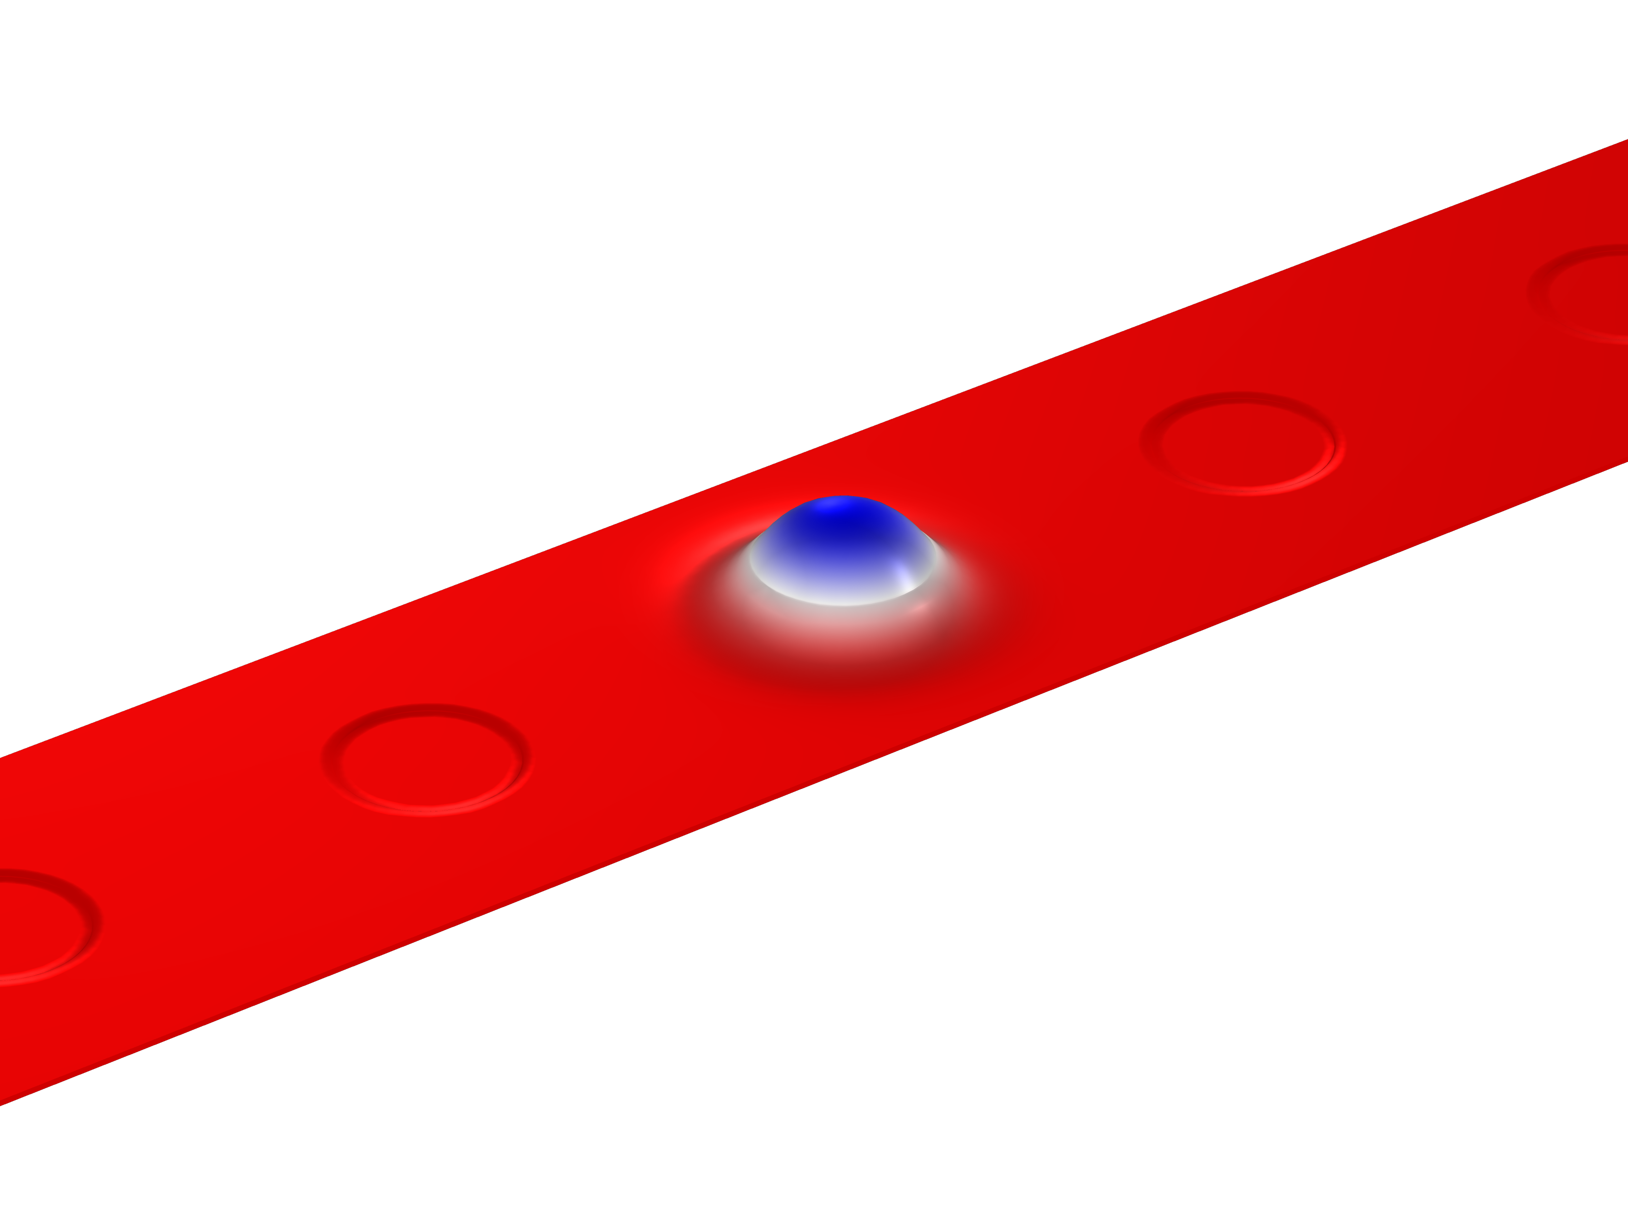
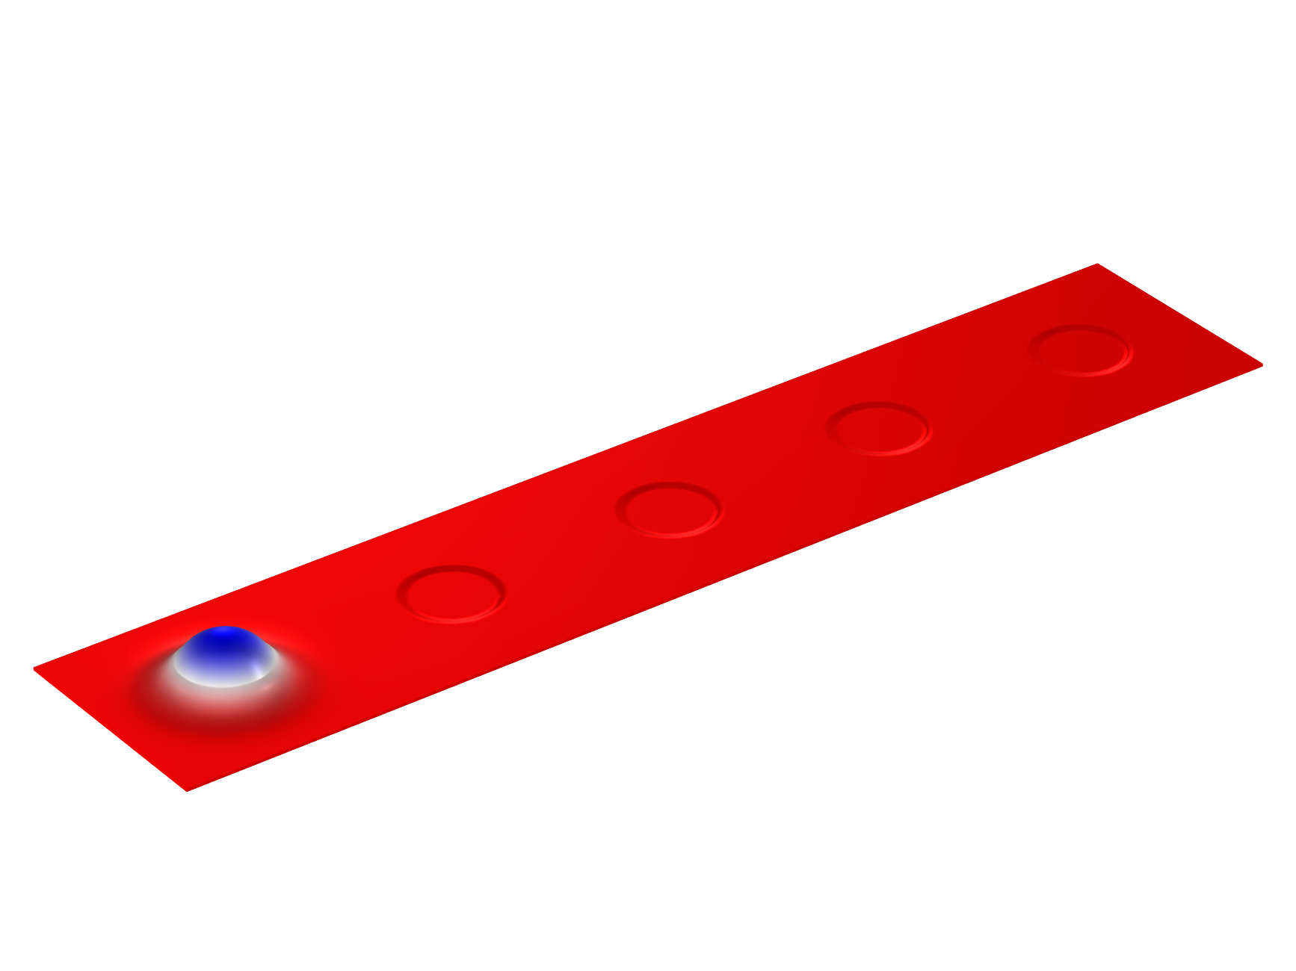
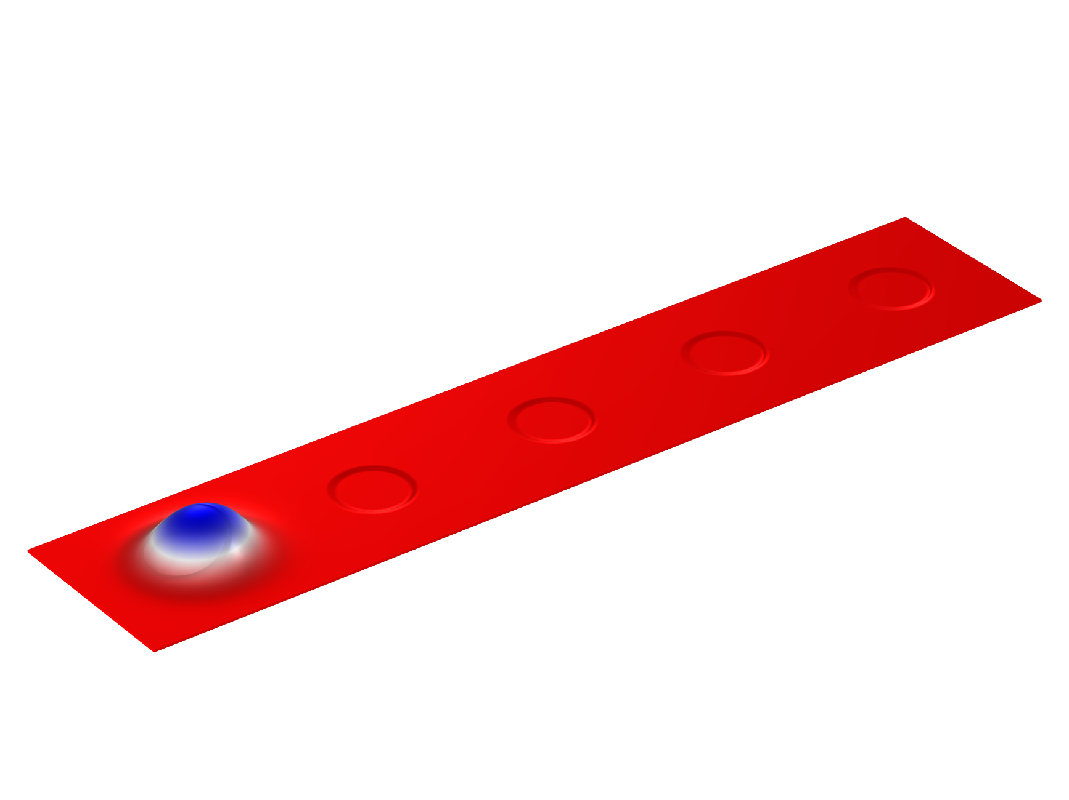
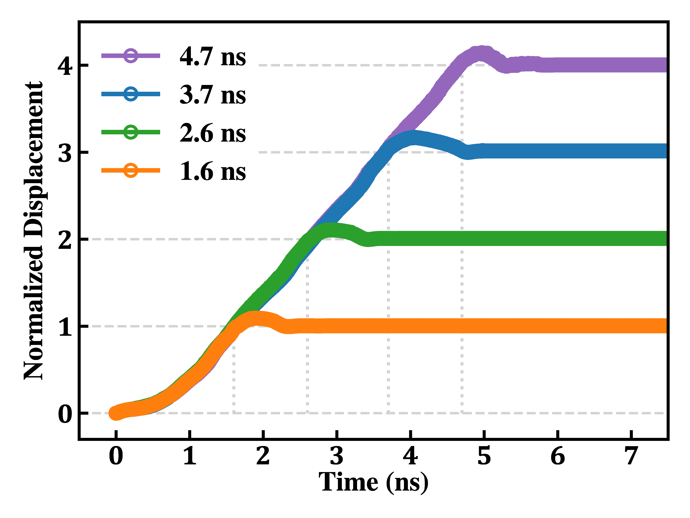
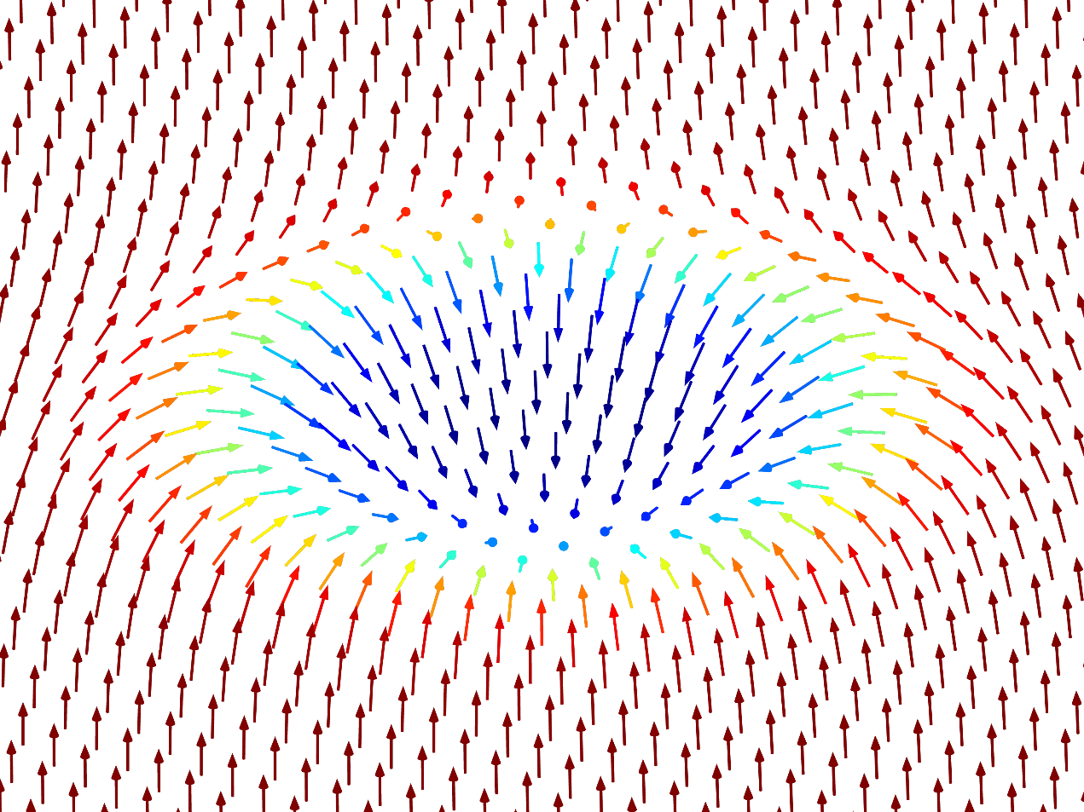
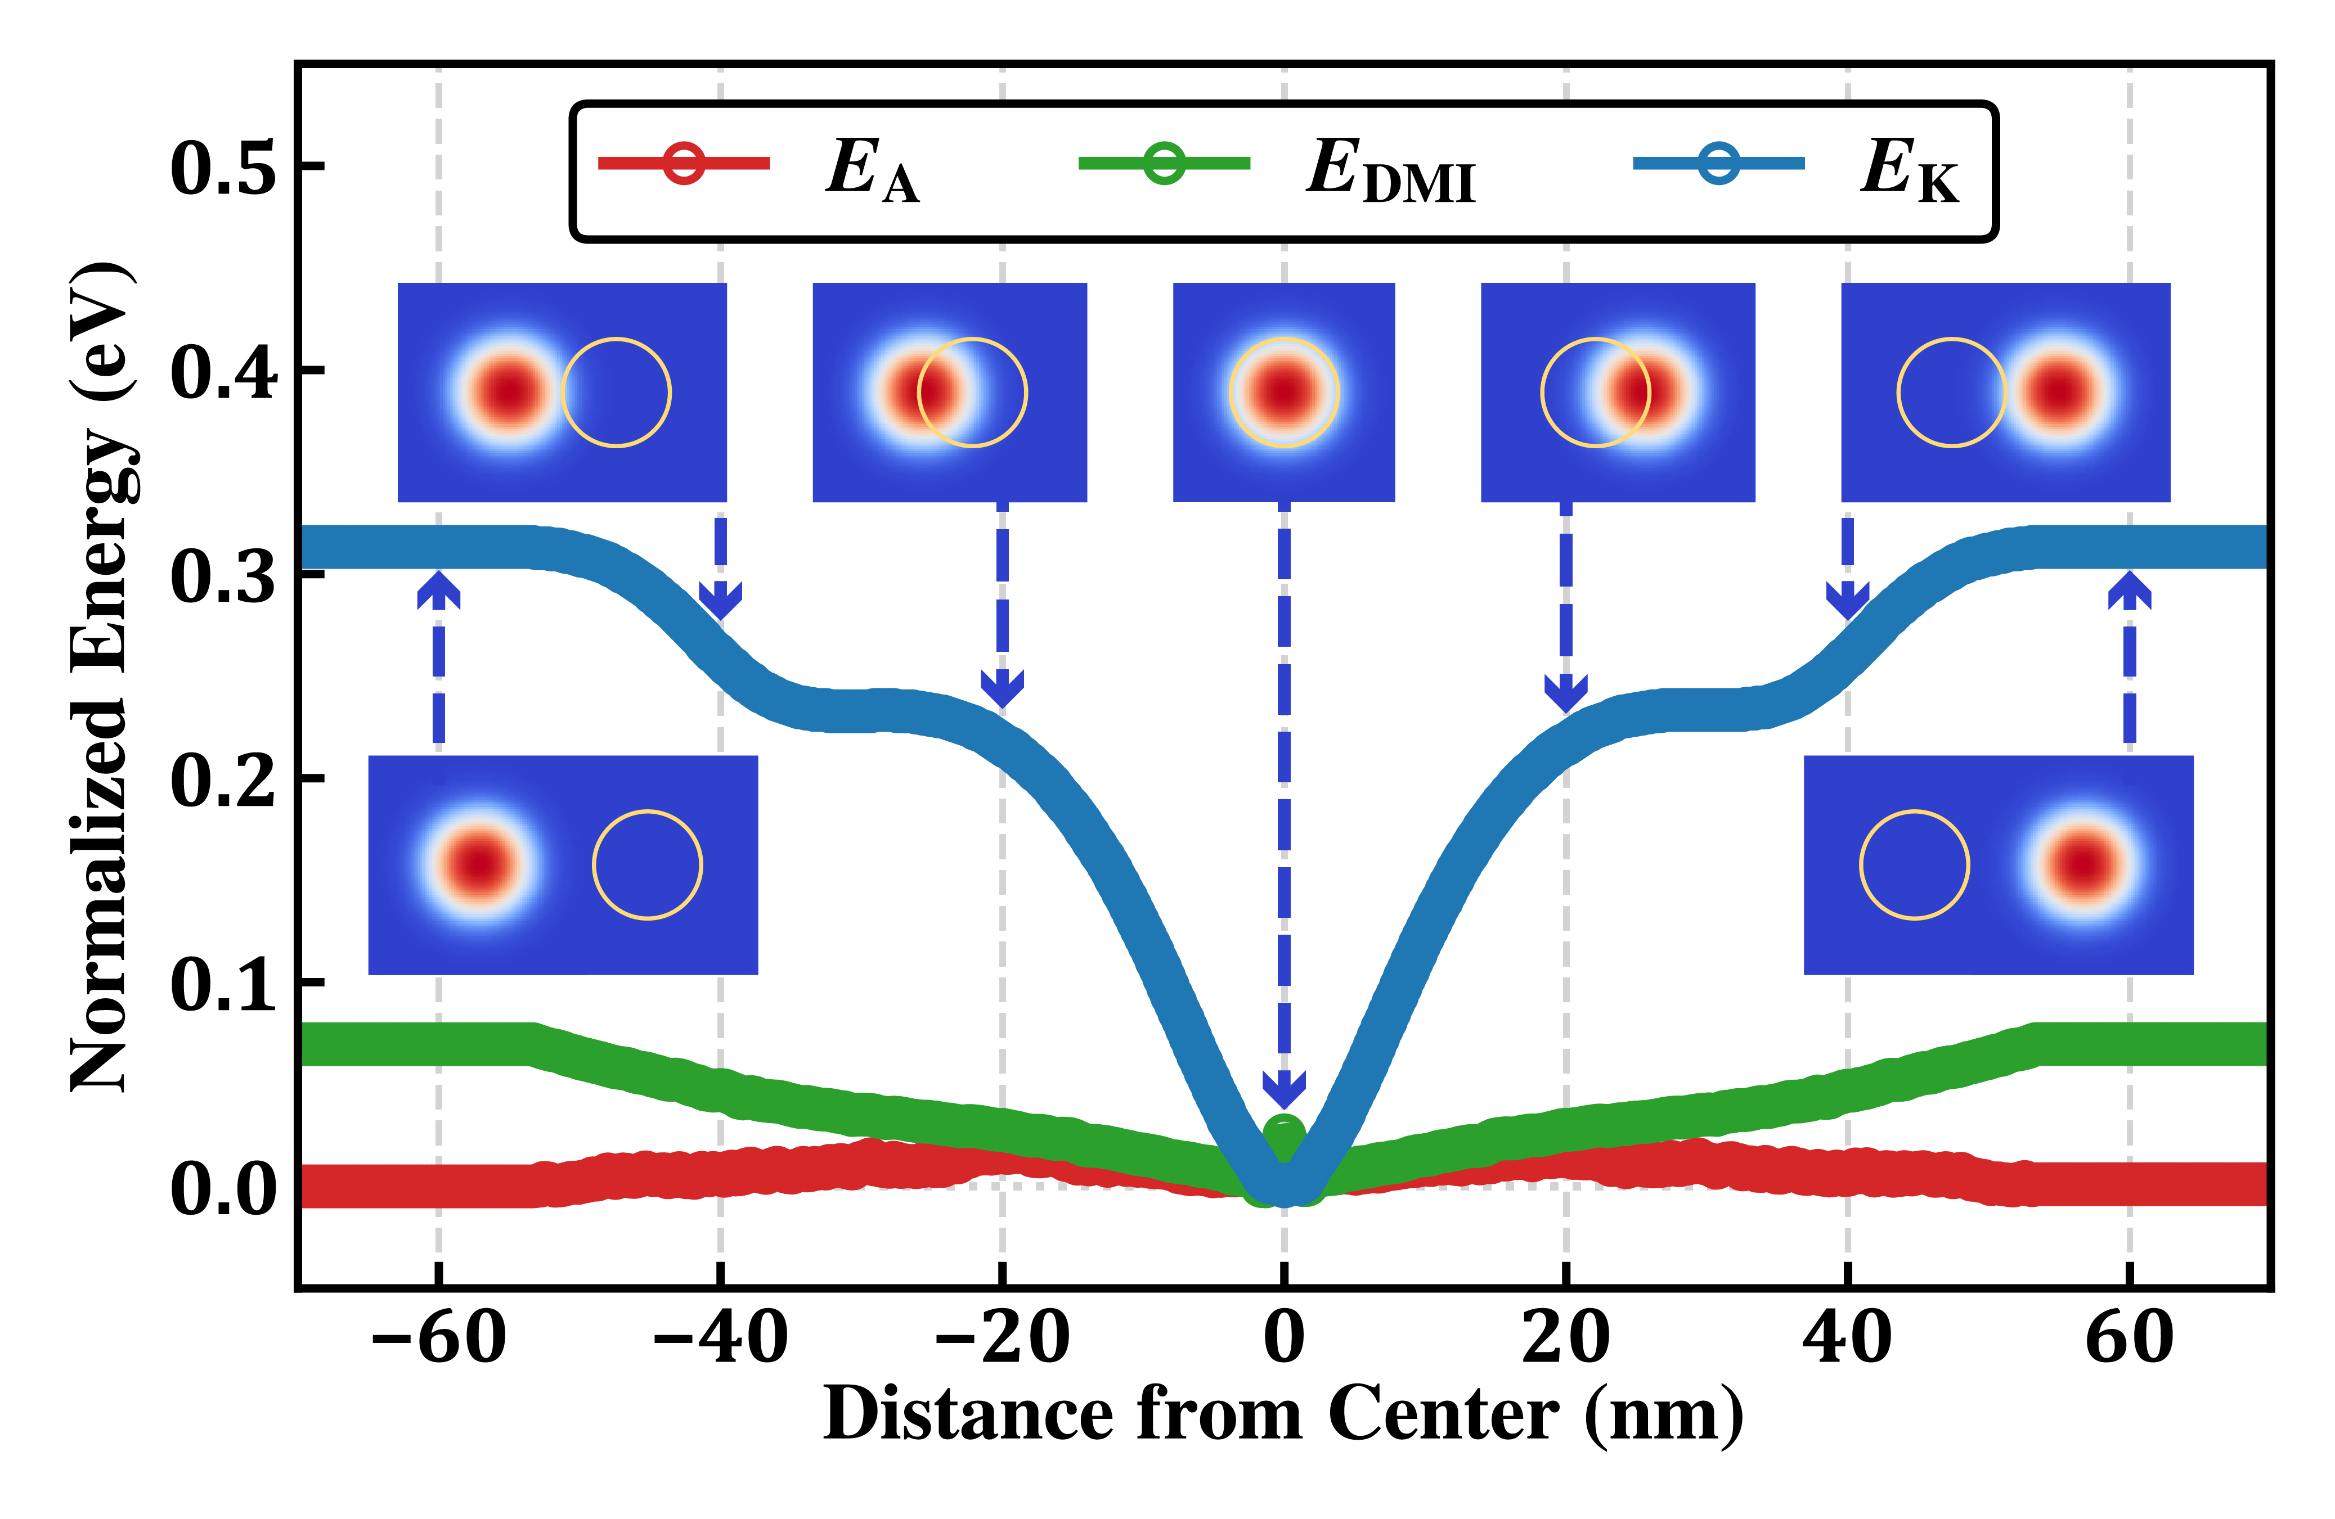
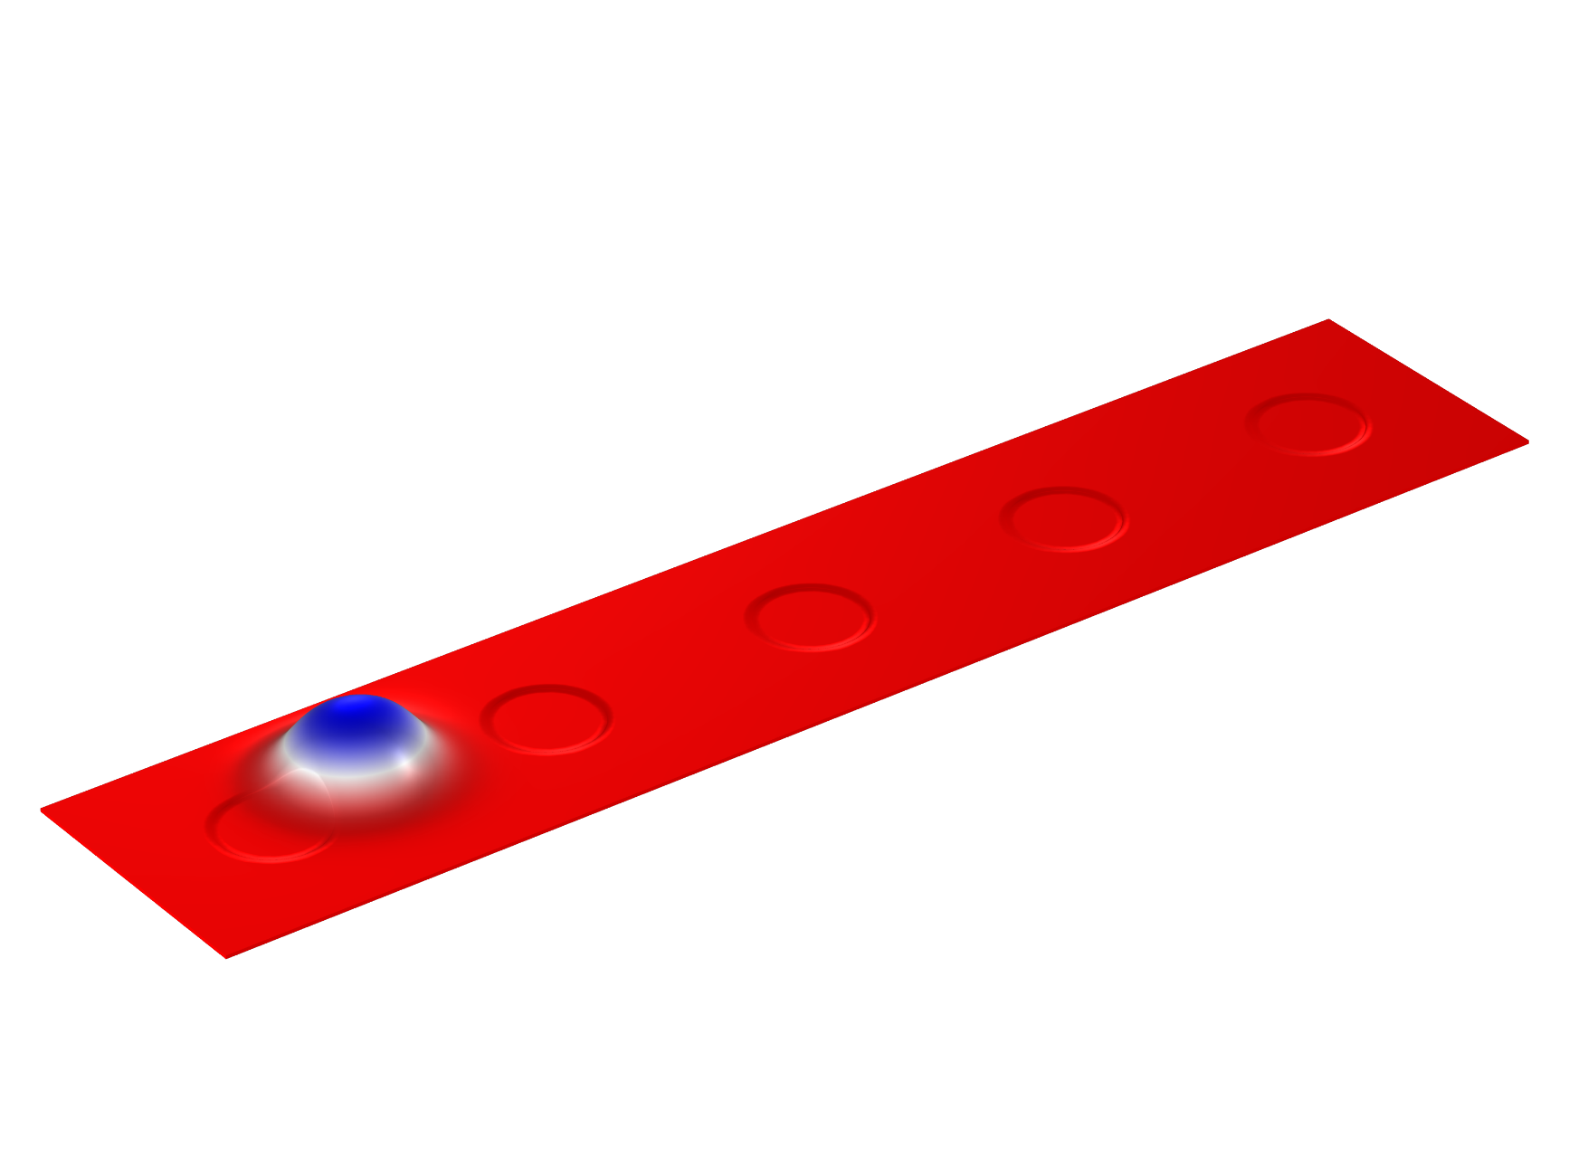
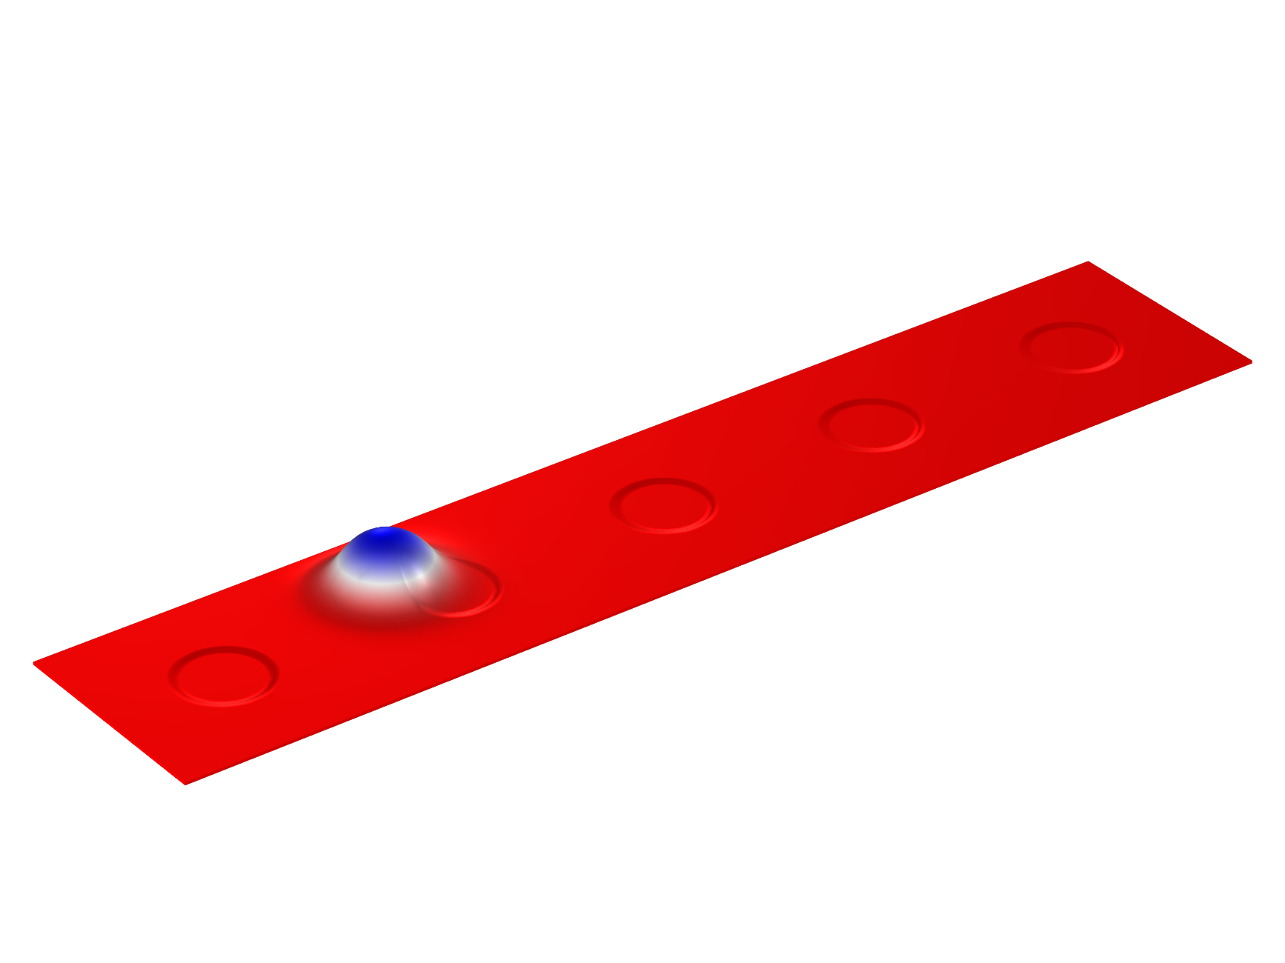
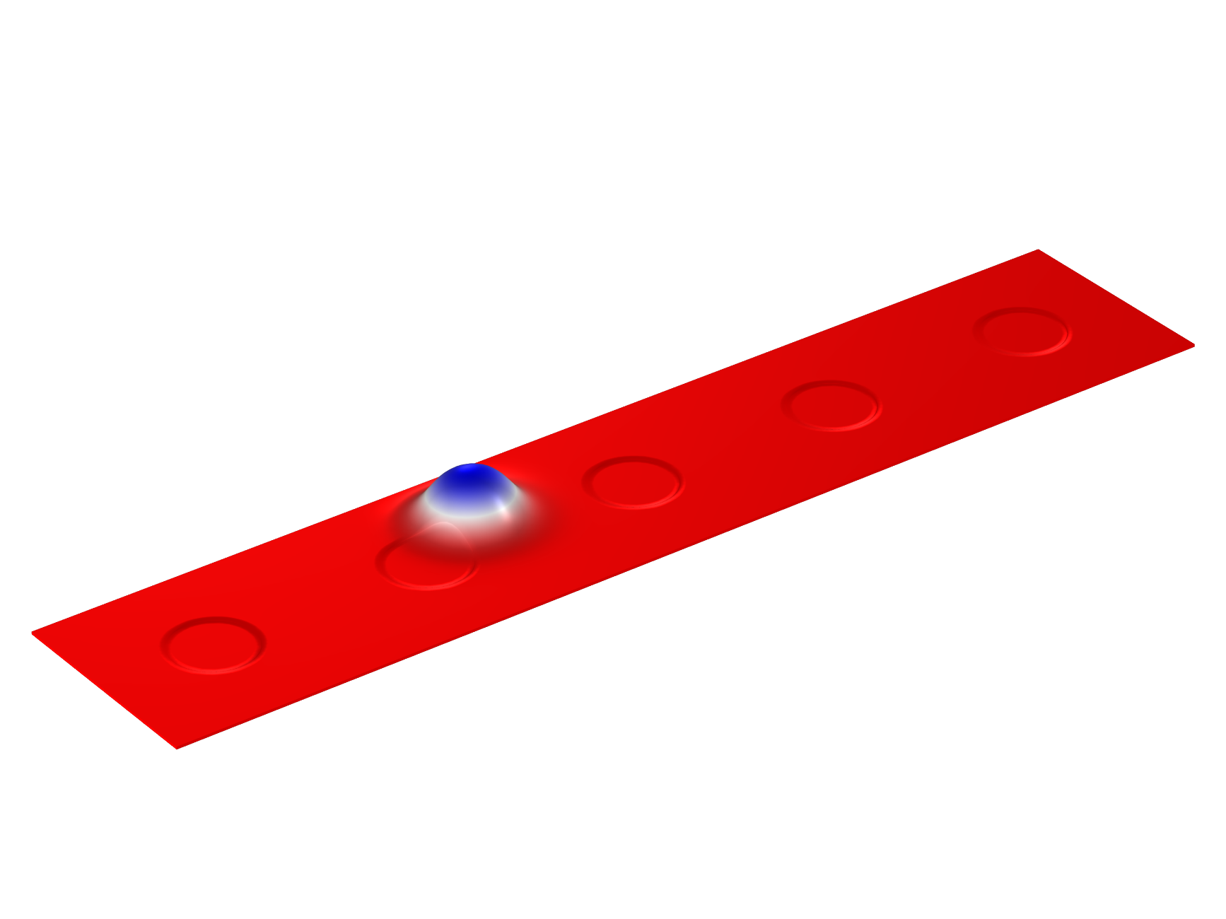
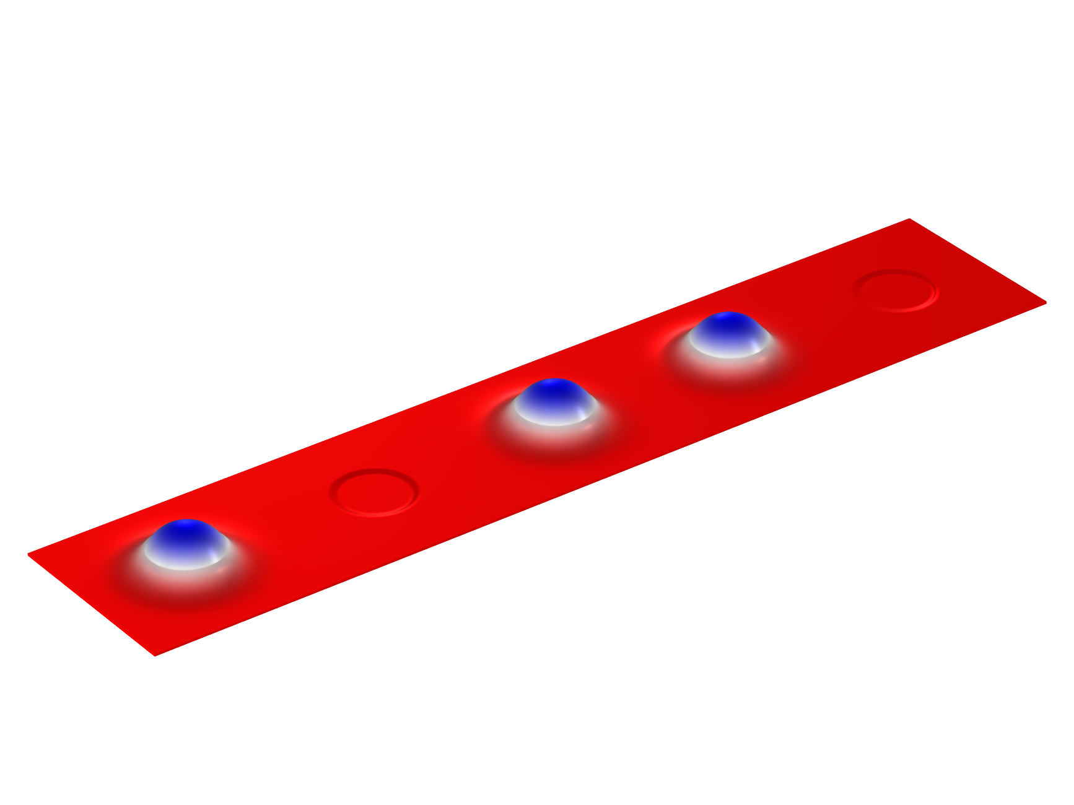
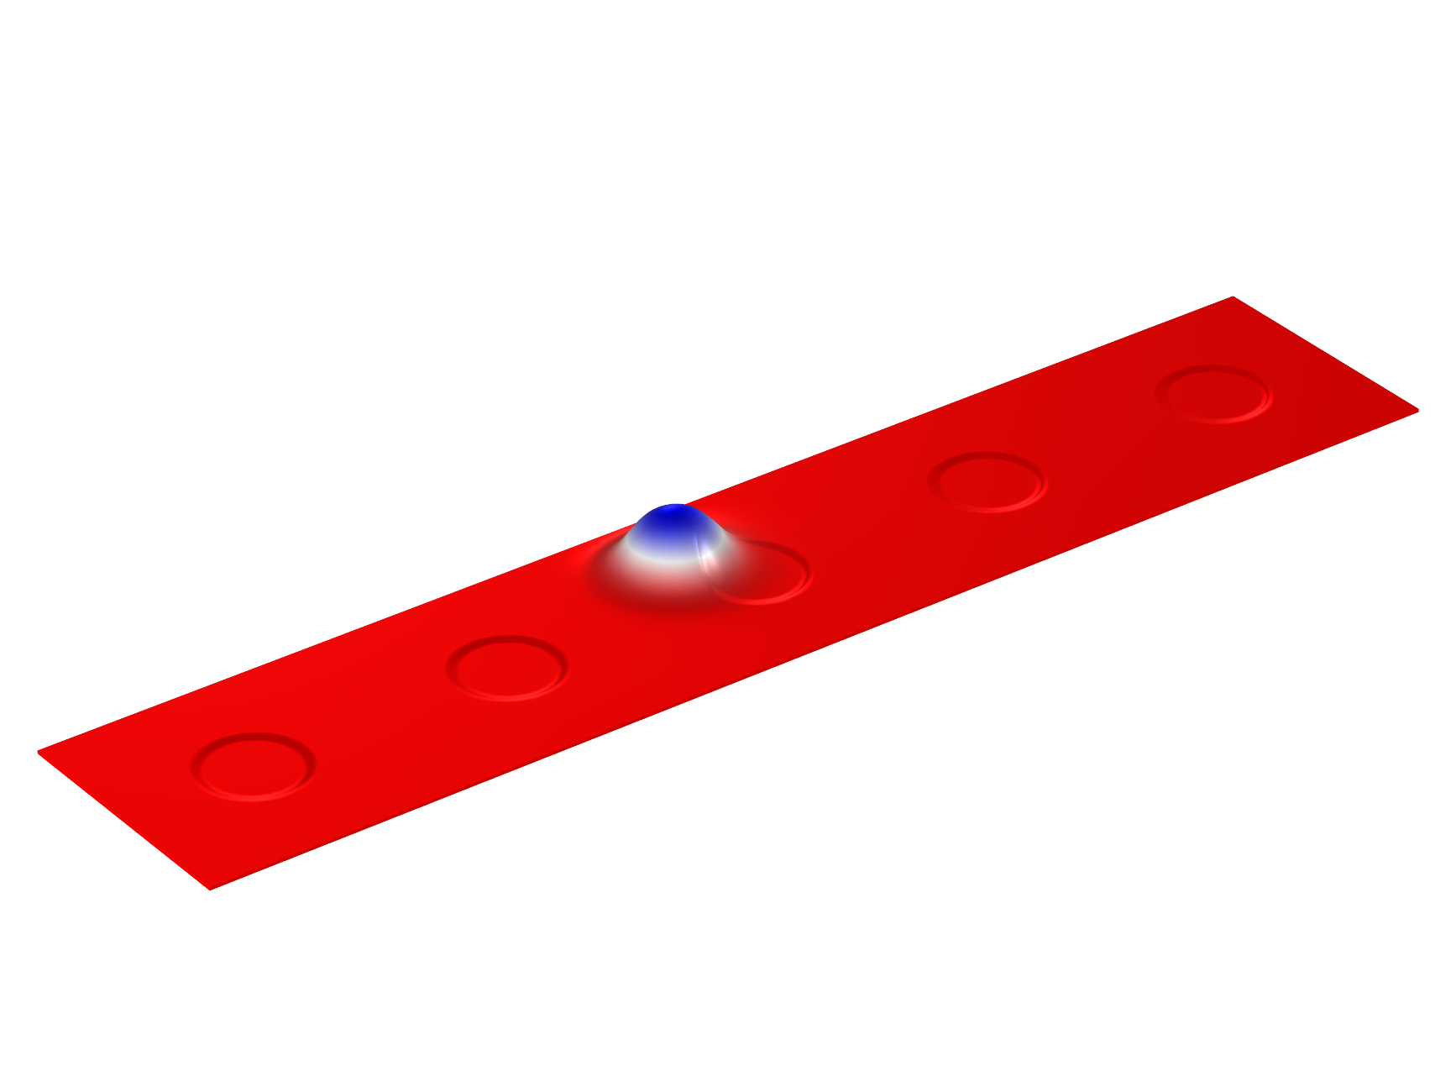
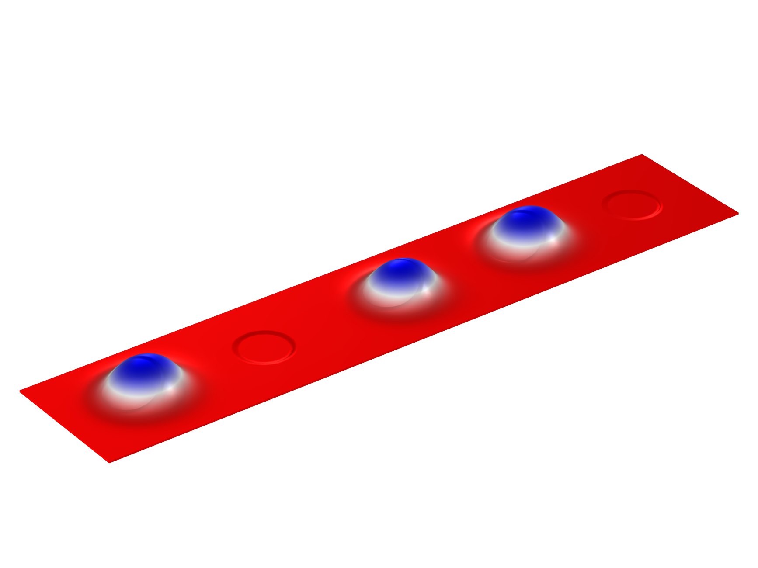
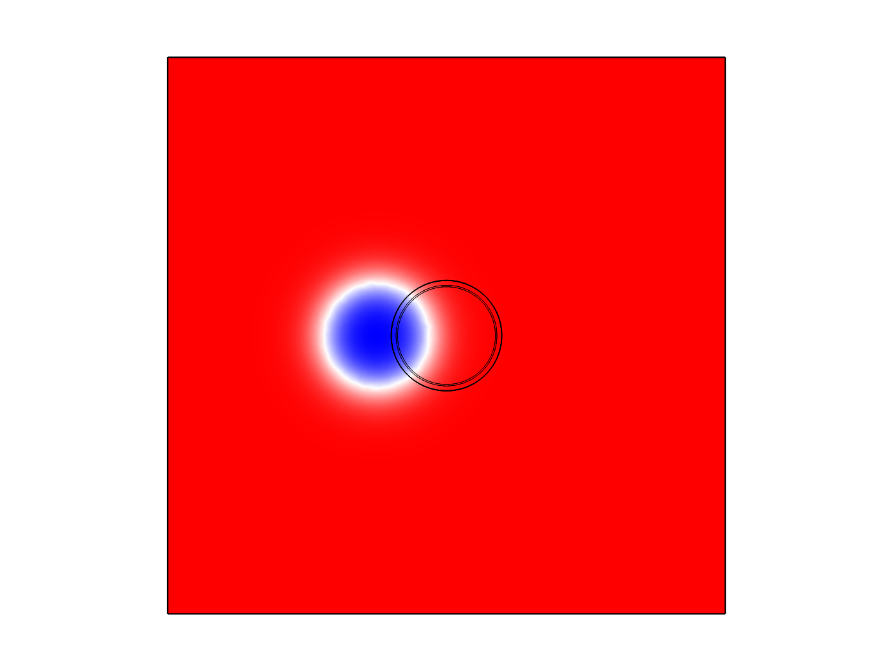
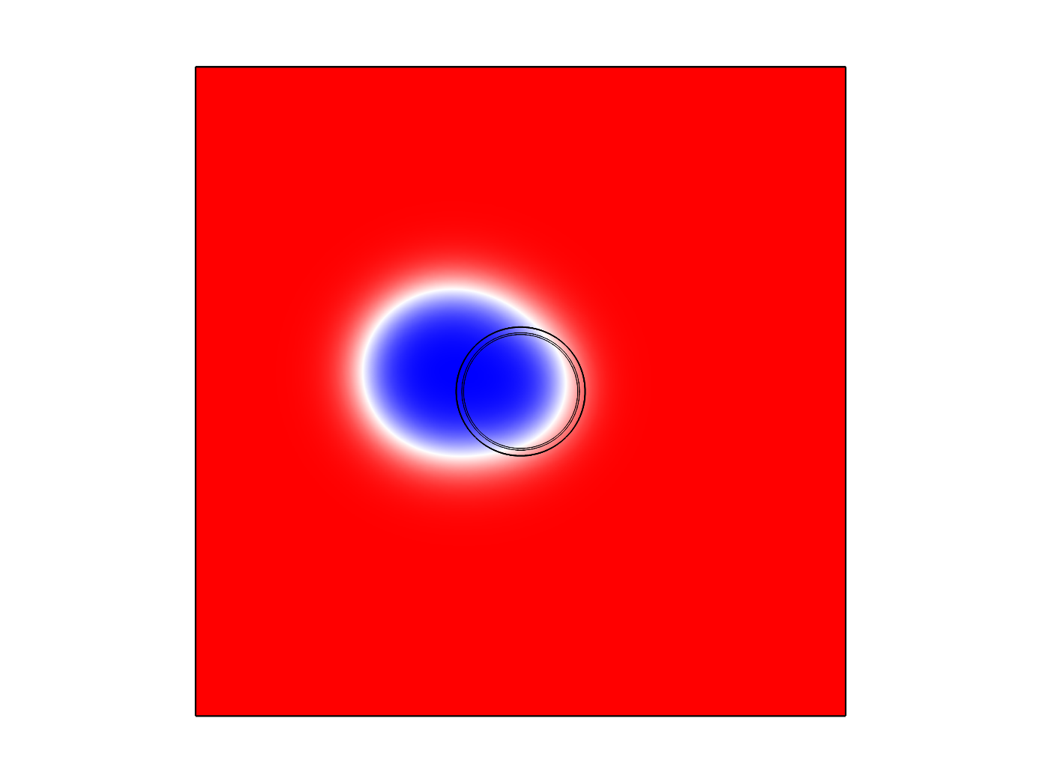
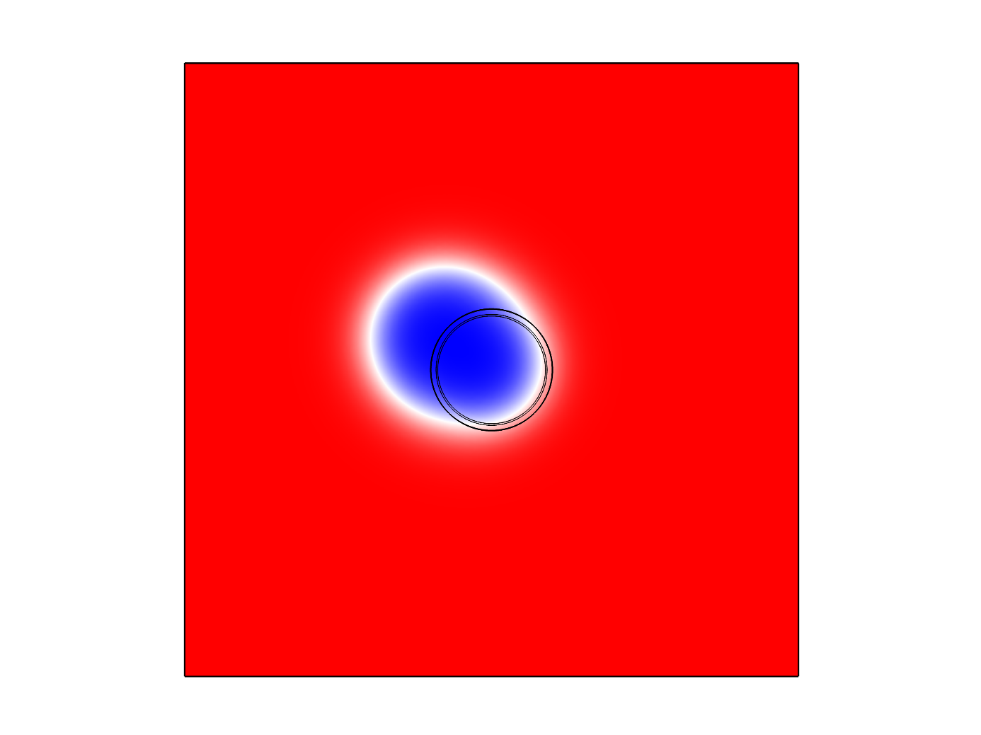
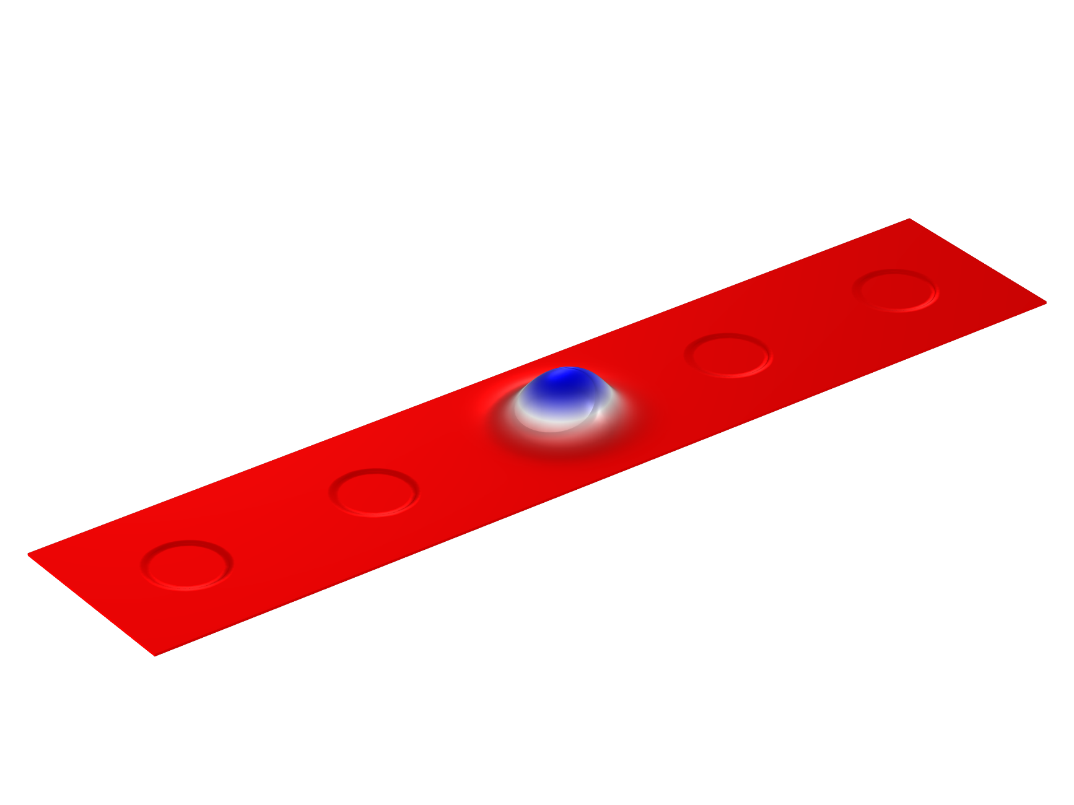
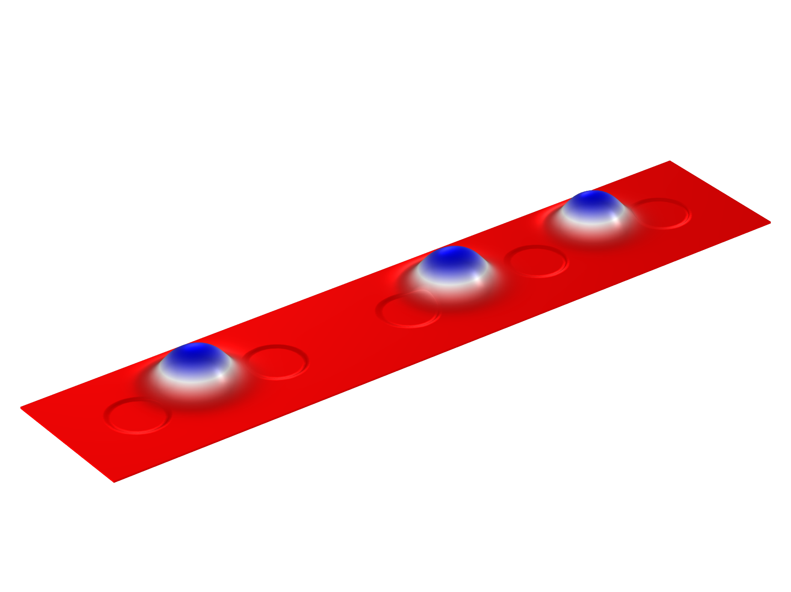

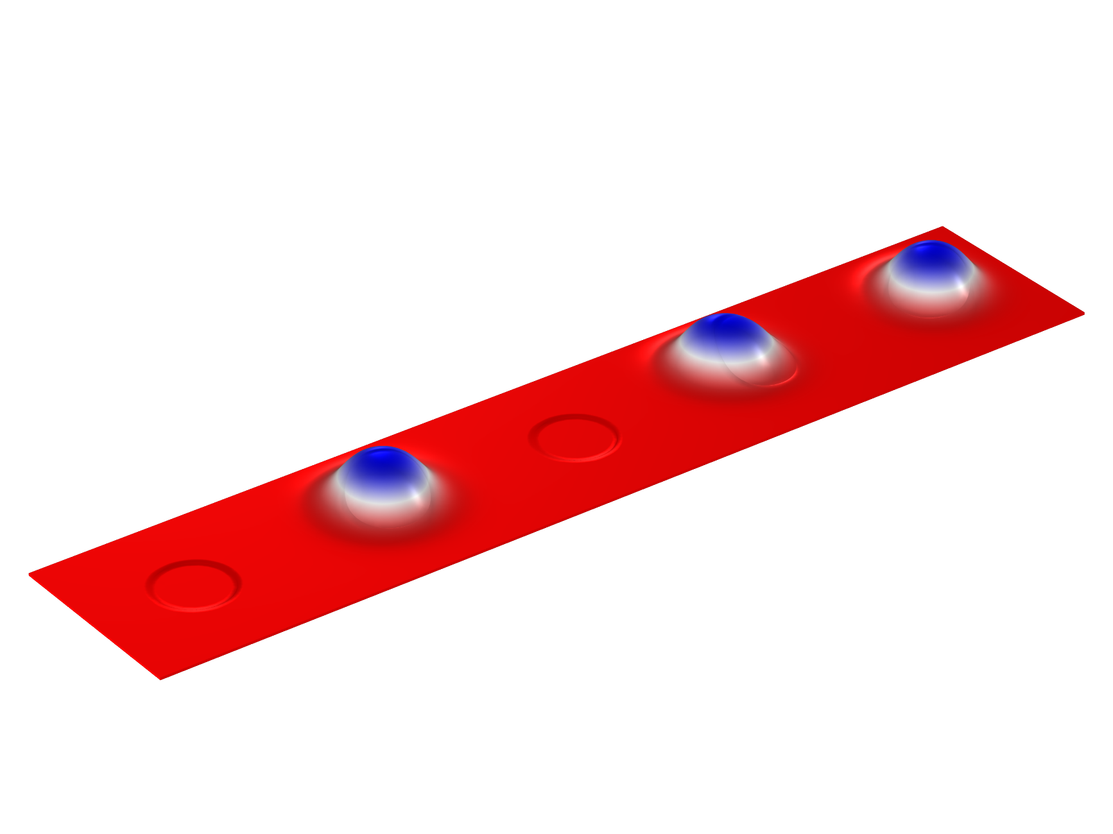
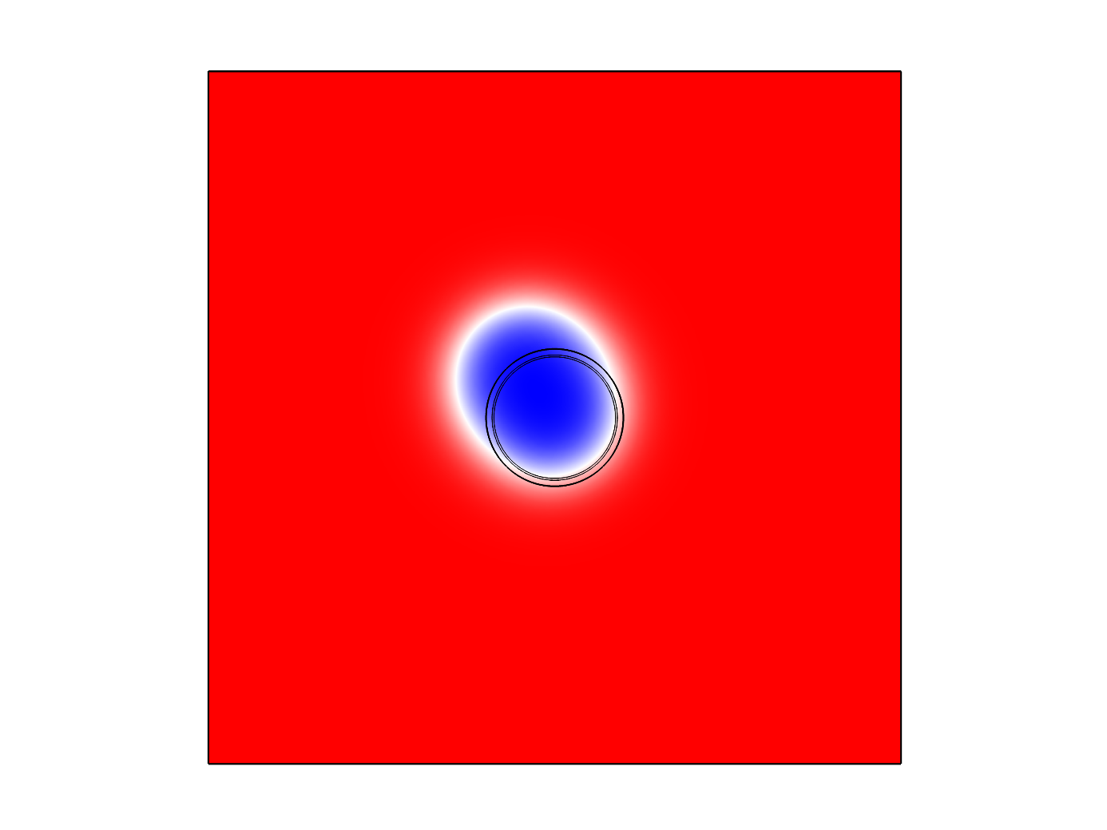
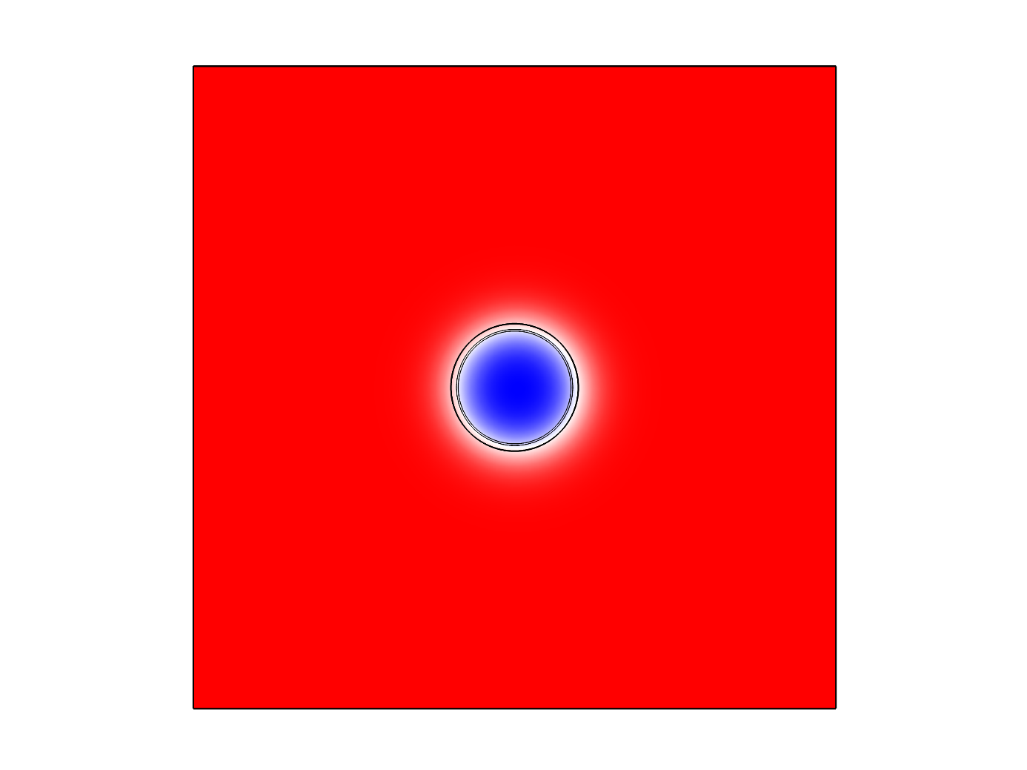
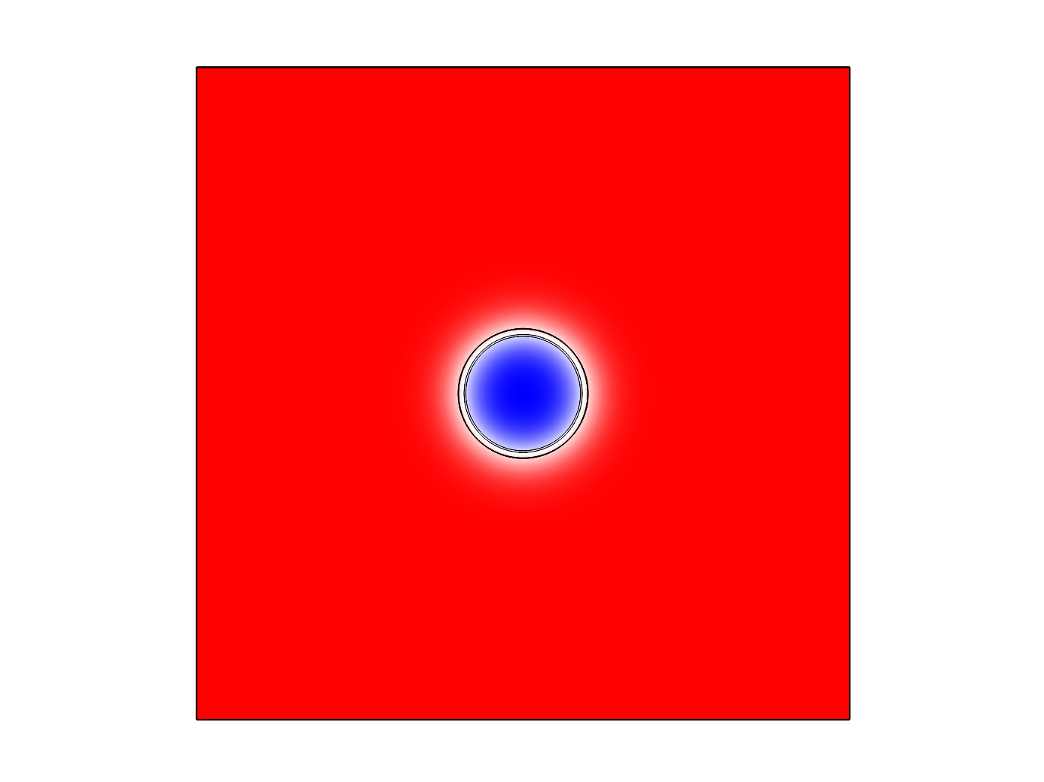

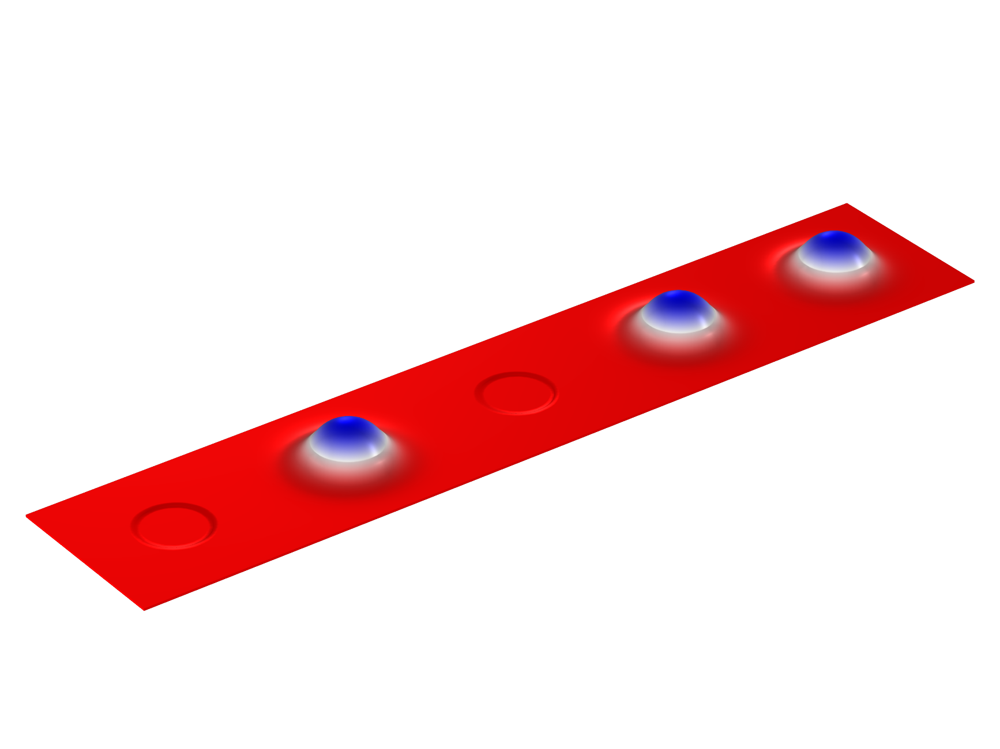

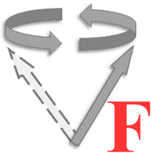


Magnetic Skyrmion Shift Register
Skyrmion data storage by inhomogeneous perpendicular magnetic anisotropy and data shift by spin-orbit torque of current pulses
Chensong Hua (华辰松) and Weichao Yu (余伟超)
22110190020@m.fudan.edu.cn
Institute for Nanoelectronic devices and Quantum computing, Fudan University, Shanghai, 200433, China
Method
The dynamics of spins can be illustrated by the Landau-Lifshitz-Gilbert (LLG) equation, in which the effective field includes Heisenberg exchange interaction, anisotropy, external magnetic field, Dzyaloshinskii-Moriya interaction (DMI) and the magnetic dipolar field. Most of the interactions are built in the Micromagnetics Module, while the magnetic dipolar field should be solved along with the AD/DC module. The spin-orbit torque (SOT) generated by spin-polarized currents is an additional torque term on the right hand side.
LLG equation:
Maxwell equation:
Effective magnetic field:
Skyrmion Data Storage
Skyrmion Data Shift
Skyrmion is a kind of topologically protected spin texture which can be dynamically driven by spin torques. Here the inhomogeneity of perpendicular magnetic anisotropy in the indentations is applied to generate a strong pinning effect on the skyrmions for storage as data bits.
Different spin-polarized current pulses can be applied to the racetrack to generate the spin-orbit torque for data shifts. Skyrmion sequences can be created as the initial states for further manipulations on the whole data string.
Topological charge:
Spin-orbit torque :
FIGURE 4. Skyrmion displacement under different pulse durations.
FIGURE 1. Left: Profile of a Néel-type skyrmion. Right: Skyrmion energy at different distances from the center of the indentation.
FIGURE 2. A skyrmion captured by an indentation spontaneously. Screenshots for every 0.3ns.
FIGURE 3. A single data bit shifts two sites. Screenshots for every 0.5ns.
FIGURE 5. The overall shift of a “1011” data string. Screenshots for every 0.6ns.
References
[1] L. Zhao, C. Hua, et. al., Sci. Bull. 69, 2370 (2024).
https://cn.comsol.com/blogs/micromagnetic-simulation-with-comsol-multiphysics
Excerpt from the Proceedings of the COMSOL Conference 2024 Shanghai

