Slide 1
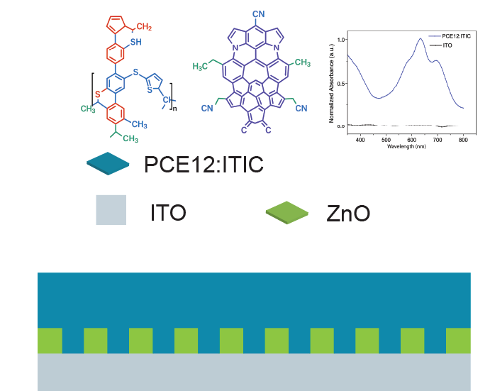
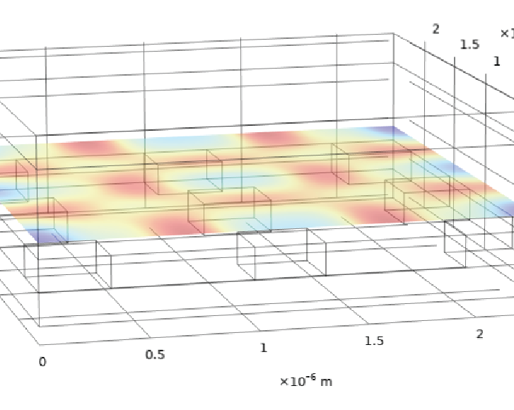
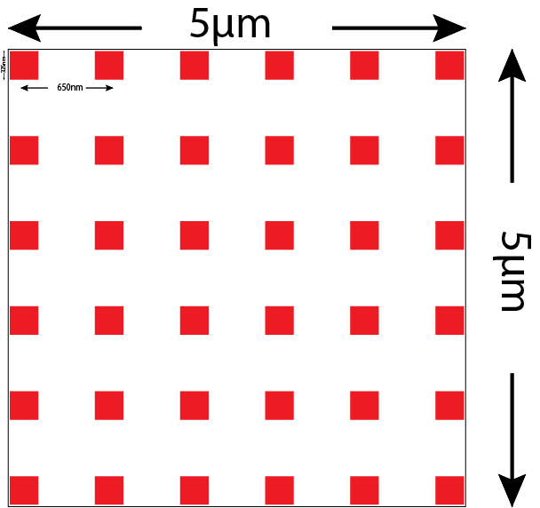
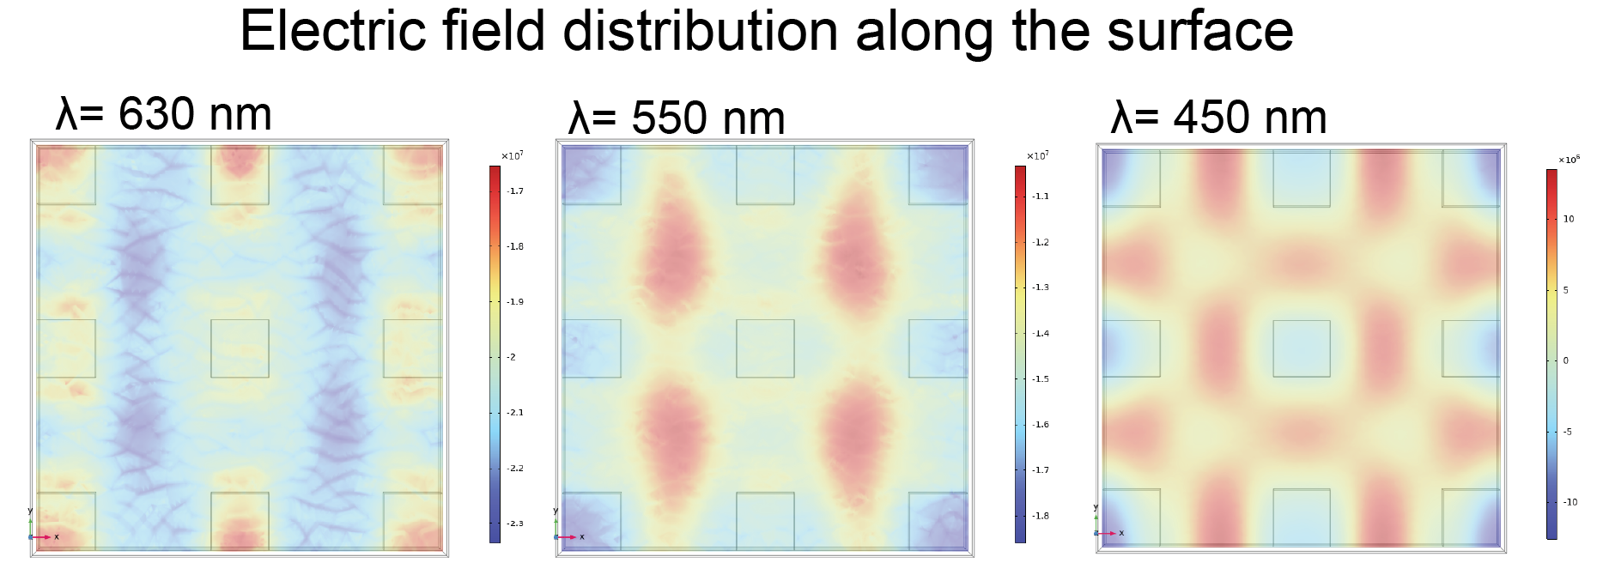
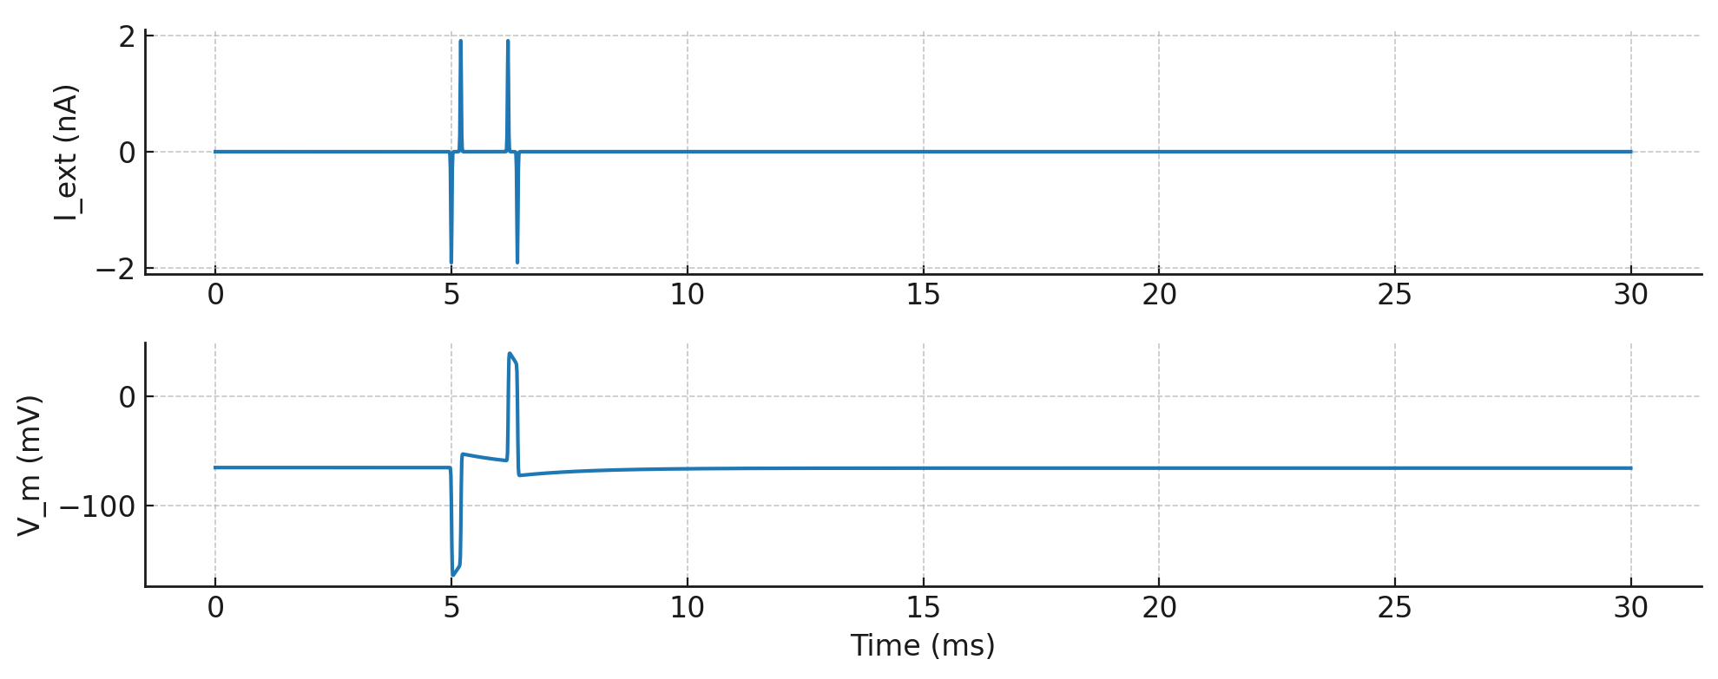

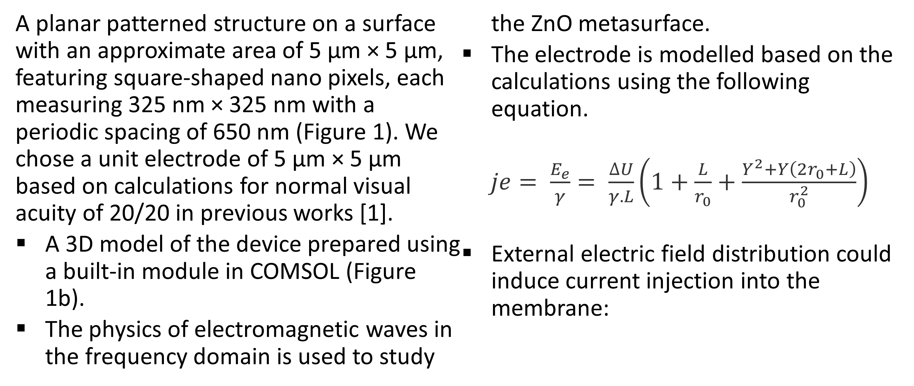

Zinc oxide Metasurfaces Design to Increase Spatial Resolution in Retinal Prostheses Device
Metasurfaces in subretinal implants enable precise light shaping and enhanced absorption for photostimulation of retinal neurons. They support wireless, polarization-sensitive control to restore vision with high spatial resolution.
Shashi Bhushan Srivastava^{1,2*}, Mohammad Mohammadiaria³, Daniel Rathbun^{1,2}
1. Department of Ophthalmology, Henry Ford Health, 1 Ford Place, Detroit, Michigan, USA
2. Department of Physiology, College of Human Medicine, Michigan State University, Lansing, Michigan, USA
2. Independent Researcher, Pavia, Italy.
Introduction & Goals
The key challenge in retinal stimulation is the unresolved inability to independently activate retinal neurons across a large area of the visual field. Recent retina implants have been shown to form monochromatic vision with prosthetic visual acuity of 20/438, dependent on the individual pixel size of 100 microns. It is still far from meaningful image formation.
Organic photovoltaic (OPV) devices in a bulk heterojunction (BHJ) architecture show significant potential for overcoming the limitations of silicon photovoltaic systems in wireless applications. However, their functionality is constrained by the necessary potential for safe capacitive stimulation.
We propose and introduce an innovative approach by incorporating an intrinsic metasurface into an OPV device with an architecture of indium-doped tin oxide (ITO)/zinc oxide (ZnO)/ polymer: non-fullerene BHJ. The ZnO thin film can be utilized as a metasurface to generate spatially selective electric field distributions, resulting in high visual acuity without the need for physical separation.
Methodology
A planar patterned structure on a surface with an approximate area of 5 µm × 5 µm, featuring square-shaped nano pixels, each measuring 325 nm × 325 nm with a periodic spacing of 650 nm (Figure 1). We chose a unit electrode of 5 µm × 5 µm based on calculations for normal visual acuity of 20/20 in previous works [1].
A 3D model of the device prepared using a built-in module in COMSOL (Figure 1b).
The physics of electromagnetic waves in the frequency domain is used to study the ZnO metasurface.
The electrode is modelled based on the calculations using the following equation.
$je= \frac{E_{e}}{γ}= \frac{∆U}{γ.L}\left(1+\frac{L}{r_{0}}+\frac{Y^{2}+Y\left(2r_{0}+L\right)}{r_{0}^{2}}\right)$
External electric field distribution could induce current injection into the membrane:
FIGURE 1. Nanopatterned metasurface design corresponding to maximum plasmonic effect for red incident light.
$$I_{ext} (t)=−C_{eff}​\frac{dφ_{e} }{dt}$$
Results
(a)
Enhanced electric field confinement and field intensity led by plasmonic and dielectric hybrid modes.
ZnO exhibits a strong change in its dielectric permittivity (tunable) upon photoexcitation.
Topological photonic effects of metasurfaces – topological properties in momentum space can be tuned by tuning optical pumping and wavelength, enabling controlled polarization states and wavefronts.
The electric field confinement changed its position away from the ZnO surface by tuning the incident light with wavelength (λ = 450 nm, and λ = 530 nm (Figure 2a))
It reveals a significant opportunity to utilize metasurfaces for the selective stimulation of retinal cells.
The reduced size of a unit electrode allows for the possibility of approaching practical visual acuity.
FIGURE 2. (a) Electric field confinement onto ZnO surface at 630 nm wavelength, at 550 nm wavelength, and at 450 nm wavelength. (b) ZnO metasurface-driven capacitive photocurrent, when injected in a Hodgkin-Huxley neuron model, results in membrane potential.
(b)
Palanker, D., et al., Design of a high-resolution optoelectronic retinal prosthesis. J Neural Eng, 2005. 2(1): p. S105-20.
Mierisch, A.M., S.R. Taylor, and V. Celli, Understanding the Degradation of Organic Coatings Through Local Electrochemical Impedance Methods: II. Modeling and Experimental Results of Normal Field Variations above Disk Electrodes. Journal of The Electrochemical Society, 2003. 150(7): p. B309.

